Slide 1
Project: IEEE P802.15 Working Group for Wireless Personal Area Networks (WPANs)
Submission Title: [802.15.4ad Narrowband Proposal Simulations]
Date Submitted: [11 March, 2025]
Source: [Joerg ROBERT] Company [FAU Erlangen-Nuernberg/ Fraunhofer IIS]
Address []
Voice:[], FAX: [], E-Mail:[Joerg.Robert@ieee.org]
Re: []
Abstract: [Simulation results for 802.15.4ad proposal]
Purpose: [Presentation in TG 802.15.4ad]
Notice: This document has been prepared to assist the IEEE P802.15. It is offered as a basis for discussion and is not binding on the contributing individual(s) or organization(s). The material in this document is subject to change in form and content after further study. The contributor(s) reserve(s) the right to add, amend or withdraw material contained herein.
Release: The contributor acknowledges and accepts that this contribution becomes the property of IEEE and may be made publicly available by P802.15.

Slide 2
802.15.4ad Proposal Simulations for Narrowband Proposal
Joerg Robert (FAU/Fraunhofer IIS)

Slide 3
Background
Our proposal for Narrowband [3] bases on the TI proposal [4] with specific extension for improved performance
The current setup only analyses the communication performance
Synchronization performance will be shown in one of the next telephone conferences

Slide 4
Simulation Assumptions
Simulation of TDL-B/D and interference according to Technical Guidance Document [5]
Realistic channel and noise estimation
Perfect timing synchronization assumed → preambles are currently not part of the signal
1000 packets or 20 erroneous packets
Packet length of 20 payload bytes
Raised-Cosine Shaped OFDM Reception Window [2]
Noise figure F=0dB
OFDM parameters are 120µs symbol duration with 108 active carriers, DSSS = 2

Slide 5
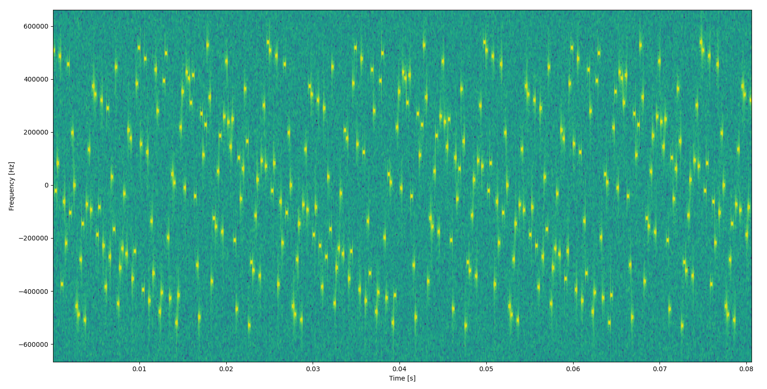
Spectrum of the Signal
Preamble is missing

Slide 6
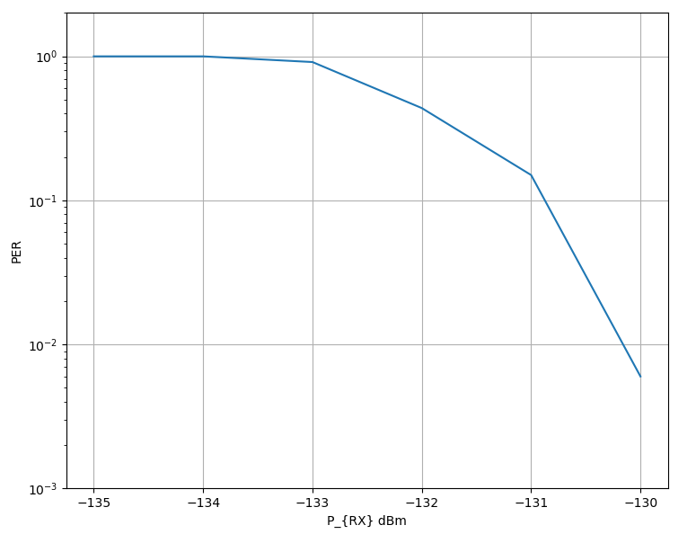
AWGN Performance of TI Proposal
TI Proposal with DSSS = 2, CR ½
Similar results as TI
Decoding without channel knowledge
Theoretical limit is around -140dBm [1]
Gap is approx. 9dB

Slide 7
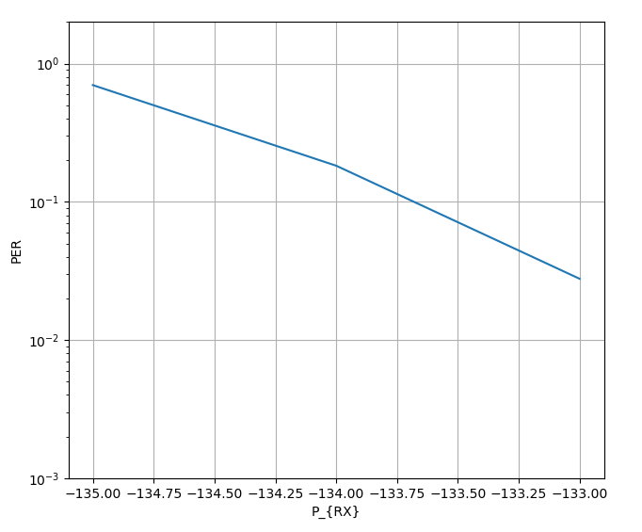
For Comparison: Performance of Coherent Receiver
Gain of 3dB available for coherent receivers
Keep backdoor for allowing coherent decoding
Further 3dB available for sophisticated decoders → -137dBm and much closer to theoretical limit of -140dBm
Details will be shown in one of the next Telcos

Slide 8
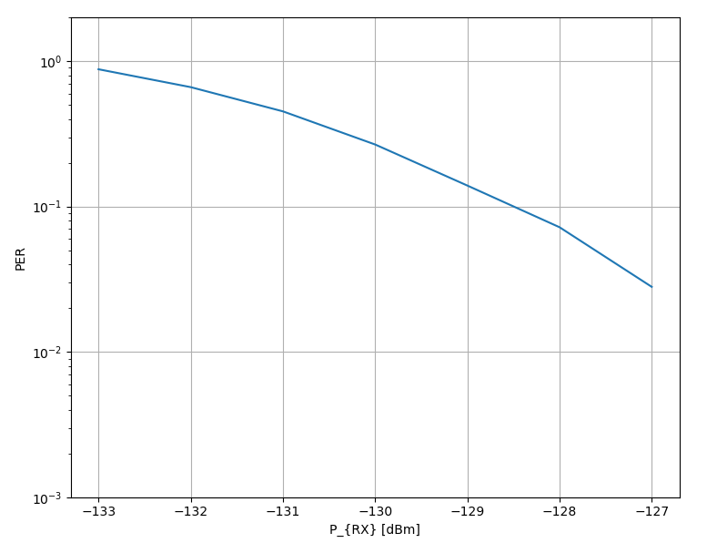
TDL-D – LOS Channel
Performance loss of approx. 2dB compared to AWGN channel
Similar results as TI
Interleaver may not be optimal and requires optimization

Slide 9
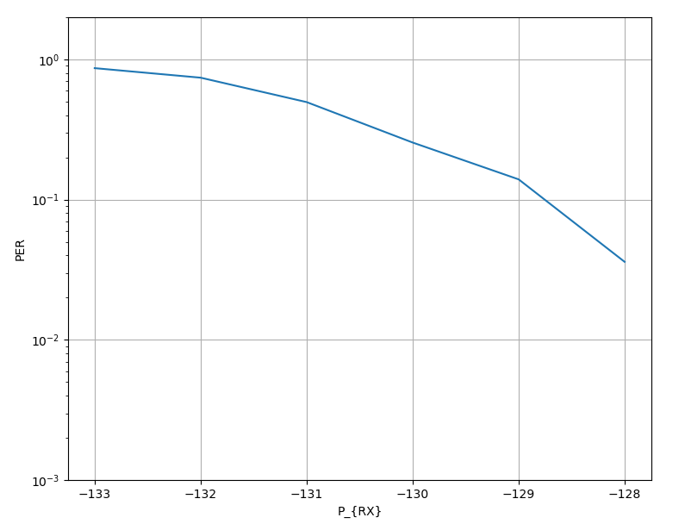
TDL-D – LOS Channel with Alternative Interleaver
Same simulation as on previous slide with alternative interleaver
Gain of approx. 0.5dB
Optimized hopping pattern may provide further gain

Slide 10
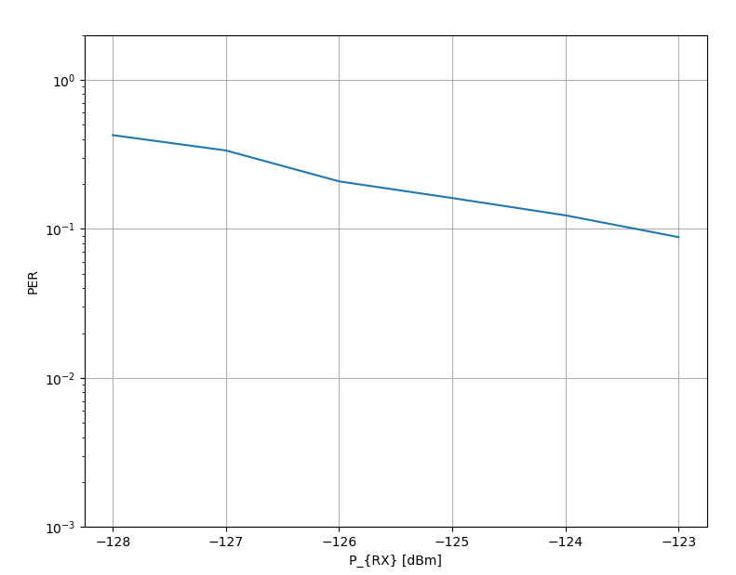
TDL-B – Non-LOS Channel
Performance loss of approx. 2dB compared to LOS channel
Similar results as TI
Interleaver may not be optimal and requires optimization

Slide 11
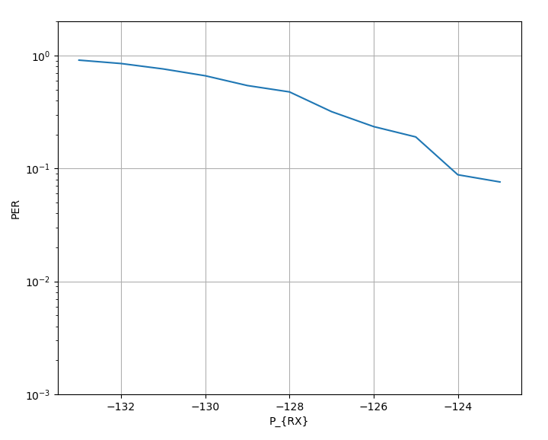
TDL-B – Non-LOS Channel with Alternative Interleaver
Same simulation as on previous slide with alternative interleaver
Gain of approx. 1dB
Optimized hopping pattern may provide further gain
Will continue to work on this

Slide 12
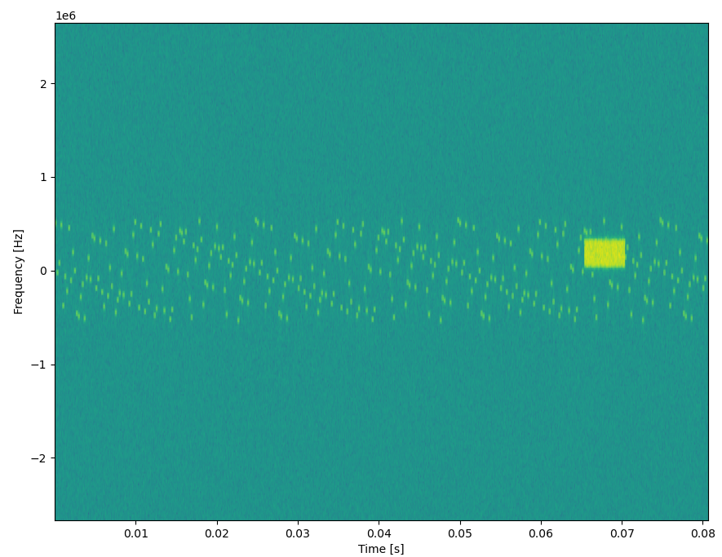
Wide-Band Interference
Example of wide-band interference with -70dBm and 250kHz bandwidth
Interferer duration 5ms
Also other parameters simulated
Use of realistic interferer-detection

Slide 13
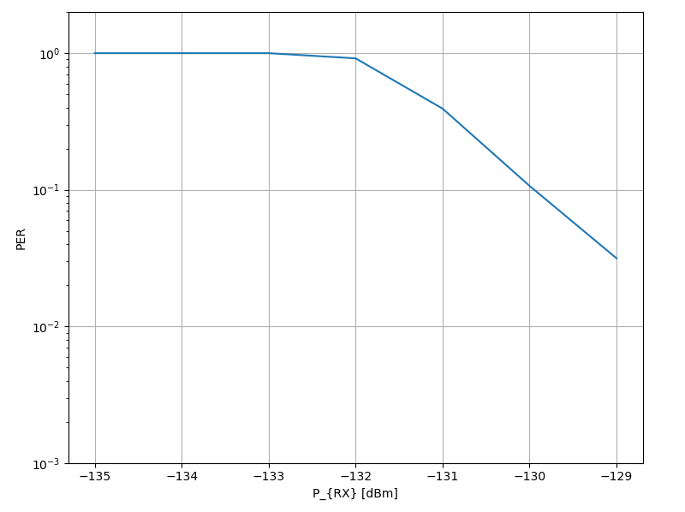
Interferer 250kHz, -70dBm
Only 2dB loss compared to AWGN channel
No error floor
→ Very robust

Slide 14
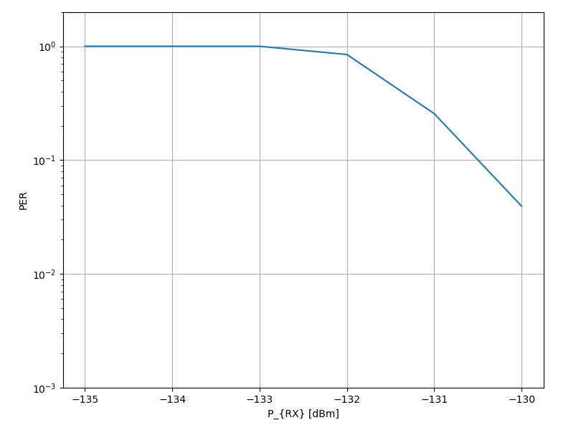
Interferer 250kHz, -70dBm – Alternative Interleaver
Same assumptions as on previous slide
Gain of approx. 0.5dB due to alternative interleaver

Slide 15
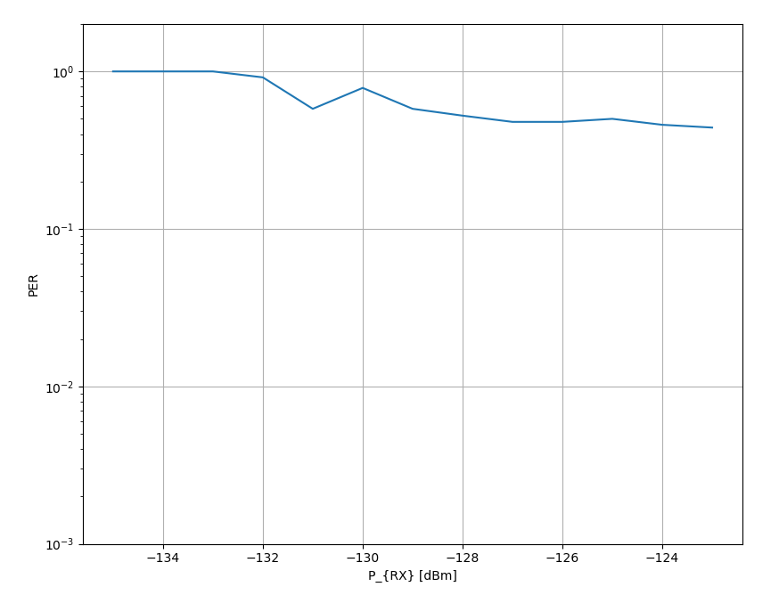
Interferer 2 MHz, -70dBm
No packet error rate below 50%
Interleaver is too short recover data
Fluctuations due to early stop of simulation after 20 packet errors

Slide 16
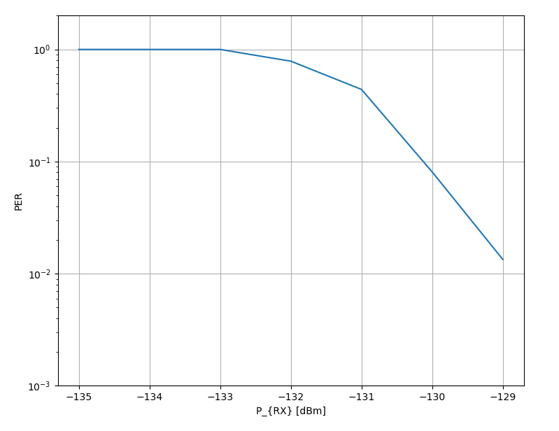
Interferer 2 MHz, -70dBm – Alternative Interleaver
Same simulation assumptions as on previous slide, but with alternative interleaver
Error-free decoding possible with loss of only 2dB compared to AWGN channel

Slide 17
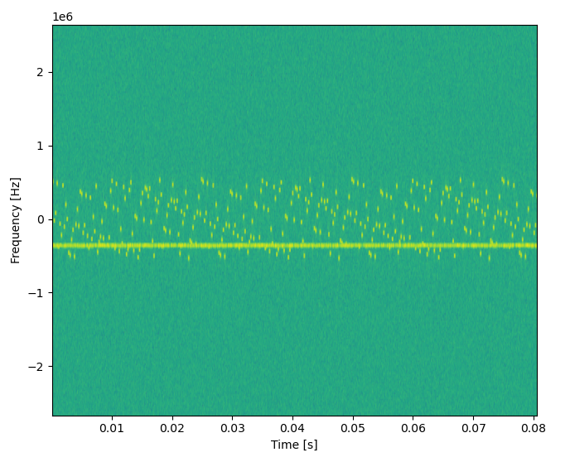
Narrow-Band Interferer
Interferer bandwidth of 10kHz
Interferer lasts the complete packet duration
Interferer Level of -100dBm

Slide 18
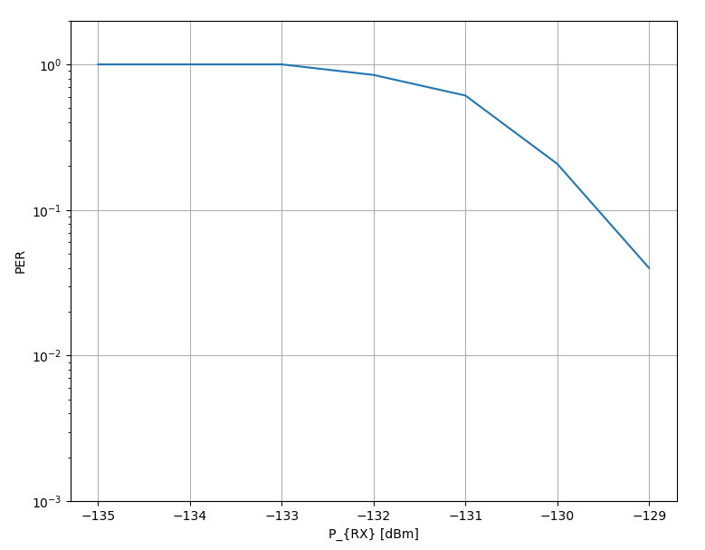
Narrow-Band Interferer, -100dBm
Error free decoding is possible with only 1.5dB loss compared to AWGN channel
Decoding with good performance requires Raised-Cosine Shaped OFDM Reception Window [2]

Slide 19
Conclusions of the Simulation Results
The narrow-band OFDM approach offers excellent robustness in real-world channels
Simple receivers are possible, hooks allow for decoding close to the theoretical limits in (future) sophisticated receivers
Some optimizations can further improve the performance

Slide 20
Next Planned Simulations
Effect of replacing CRC with Reed Solomon Code
Performance of sophisticated coherent receiver
Optimization of interleaving and hopping
Realistic synchronization

Slide 21
Spectrum of the Signal
There are clusters visible → no optimum interleaving

Slide 22
Literature
[1] J. Robert and A. Heuberger, "LPWAN downlink using broadcast transmitters," 2017 IEEE International Symposium on Broadband Multimedia Systems and Broadcasting (BMSB), Cagliari, Italy, 2017
[2] J. Robert, J. Zoellner and M. Slimani, "Adaptive Windowing for OFDM with Dense Subcarrier Spacing in Mobile Channels," OFDM 2012; 17th International OFDM Workshop 2012 (InOWo'12), Essen, Germany, 2012
[3] FAU/Fraunhofer IIS Proposal, DCN 15-25/0049r00
[4] TI Proposal, DCN 15-24/0651r01
[5] Technical Guidance Document, DCN 15-24/0061r16

