Slide 1
Project: IEEE P802.15 Working Group for Wireless Personal Area Networks (WPANs)
Submission Title Update to Singapore frequency plan for unlicensed spectrum operation
Date Submitted : March 10, 2025
Source : Thomas Almholt (Texas Instruments, Inc)
Re : TG4ad Next Generation SUN PHYs
Abstract : This contribution describes an update to the Singapore frequency band
Purpose: Singapore frequency band update
Notice: This document has been prepared to assist the IEEE P802.15.4ad It is offered as a basis for discussion and is not binding on the contributing individual(s) or organization(s). The material in this document is subject to change in form and content after further study. The contributor(s) reserve(s) the right to add, amend or withdraw material contained herein.
Release: The contributor acknowledges and accepts that this contribution becomes the property of IEEE and may be made publicly available by P802.15.
Slide 1
Notes:
Jul 12, 2010
Page 1

Slide 2
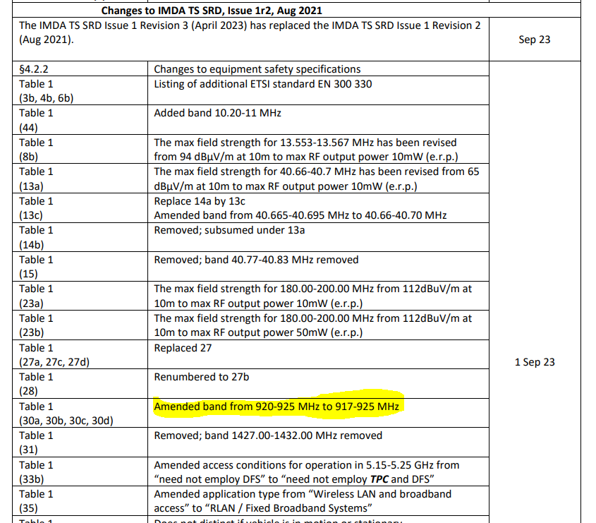
The Singapore regulations have extended the un-licensed band from 920-925 to 917-925 MHz in September 2023.
https://www.imda.gov.sg/-/media/imda/files/regulation-licensing-and-consultations/ict-standards/telecommunication-standards/radio-comms/imdatssrd.pdf
Proposal to put this change on the list of items for a future update to a PHY TPS
Slide 2
Notes:
Jul 12, 2010
Page 2

