Slide 1
Project: IEEE P802.15 Working Group for Wireless Specialty Networks (WSNs)
Submission Title: Future direction of NG-OWC Network Technologies
Date Submitted: March 11, 2025
Source: Lai Yi Aung, Yeong Min Jang (Kookmin University)
Address: Room #603 Mirae Building, Kookmin University, 77 Jeongneung-Ro, Seongbuk-Gu, Seoul, 136702, Republic of Korea
Voice: +82-2-910-5068 E-Mail: yjang@kookmin.ac.kr
Re:
Abstract: Present Future direction of NG-OWC Network Technologies
Purpose: Presentation for contribution on IG NG-OWC
Notice: This document has been prepared to assist the IG NG-OWC. It is offered as a basis for discussion and is not binding on the contributing individual(s) or organization(s). The material in this document is subject to change in form and content after further study. The contributor(s) reserve(s) the right to add, amend or withdraw material contained herein.
Release: The contributor acknowledges and accepts that this contribution becomes the property of IEEE and may be made publicly available by IG NG-OWC.

Slide 2
Future direction of NG-OWC Network Technologies
Contribution Mar 11, 2025

Slide 3
Contents
Background
Fundamentals of Optical Wireless Communication (OWC)
GEO – OGS (Geostationary Earth Orbit-Optical Ground Station)
LEO – OGS (Low Earth Orbit-Optical Ground Station)
Current Issues
Possible Solutions for NG-OWC Network
Challenges
Conclusion
References

Slide 4
Background
Optical Wireless Communication (OWC) offers high bandwidth, low latency, and electromagnetic interference immunity in the infrared (IR), visible light communication (VLC), and ultraviolet (UV) spectrums as an alternative to traditional radio frequency (RF) systems.
However, as global connectivity demands increase, terrestrial networks are insufficient.
Non-Terrestrial Networks (NTNs) are crucial for extending coverage to remote, rural, and oceanic regions.
OWC is increasingly considered a key enabler for NTN-based communication systems due to its high data rate capability and reduced spectrum congestion.
Future advancements in hybrid networking, AI-driven optimization, and quantum security will shape 6G and beyond.

Slide 5
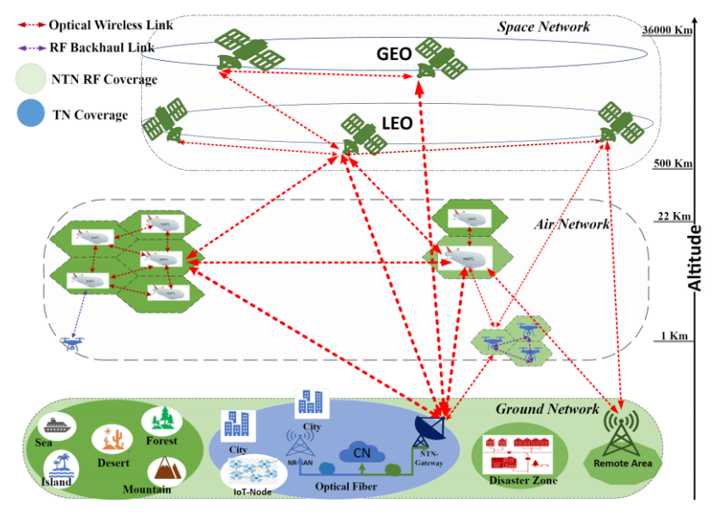
Fundamentals of Optical Wireless Communication (OWC)
The figure showcases the integration of Optical Wireless Communication (OWC) within Non-Terrestrial Networks(NTNs), highlighting communication layers including space, air, and ground networks, enabling high-speed data transmission[1].
GEO (Geostationary Earth Orbit) Satellites : (~36,000 km altitude)
LEO (Low Earth Orbit) Satellites : (~500 km altitude)
CCB-NTN(Cluster constellation-based non-terrestrial network)
Fig. 1. CCB-NTN architecture with balanced mix of RF and OWC links.

Slide 6
Current Issues
Fig. 2. Issues involved in the link budget estimation of the NTN-OWC systems.
The figure highlights major optical wireless communication impairments in NTN-based OWC systems, emphasizing the need for advanced beam-tracking techniques, adaptive optics, and signal processing for successful deployment[1].

Slide 7
Possible Solutions for NG-OWC
Transmitter Loss:
Increases optical output power.
Implement adaptive beam shaping and collimation techniques to reduce divergence.
OFDM (Orthogonal Frequency-Division Multiplexing) and PPM (Pulse Position Modulation) enhance signal transmission.
Free Space Propagation Loss:
Use near-infrared (IR) or mid-IR wavelengths for better penetration through atmospheric conditions.
Dynamically adjust power levels based on weather conditions.
Switch to RF communication in severe weather conditions.
Reduces bit errors caused by signal fluctuations.
AI can predict turbulence effects and adjust transmission accordingly.
Receiver Loss:
Avalanche photodiodes (APDs) or single-photon detectors improve signal detection.
Use optical amplifiers with low-noise designs.
Use low-noise electronic amplifiers and cooling mechanisms.
Controlling Loss:
Implement dynamic beam tracking using gimbal systems.
Adaptive tracking algorithms ensure continuous alignment.
RF signals can help assist optical link alignment.

Slide 8
Challenges
Atmospheric Interference :
Rain, Fog, and Dust
Line-of-Sight Issues
Limited Range :
Propagation Distance
Urban Environments
Integration with Existing Infrastructure :
Compatibility Issues
Hybrid Solutions
Complexity of System Design
Security Concerns

Slide 9
Conclusion
The optical wireless communication (OWC) revolution offers high-speed, secure, and efficient data transmission, but faces challenges like atmospheric interference, limited range, system complexity, and security concerns.
Advancements in technology and research into hybrid solutions are overcoming these limitations.
And then, OWC could become a vital component in future networks.
Collaboration across industries is essential for its full realization.
The efficient operation of OWC networks requires a combination of hardware advancements, adaptive control techniques, AI-driven optimizations, and hybrid networking approaches.

Slide 10
References
S. Basu, L. Oliviero, G. Cossu, C. Cantore, A. D’Orazio and E. Ciaramella, "Prospects of Optical Wireless Communications in Non-Terrestrial Networks," 2024 24th International Conference on Transparent Optical Networks (ICTON), Bari, Italy, 2024, pp. 1-4, doi: 10.1109/ICTON62926.2024.10647761.
M. Kumari, N. Sharma, R. Chauhan, K. Joshi, V. Madaan and G. Sunil, "Investigation of OWC System Incorporating Different Filters," 2024 4th International Conference on Innovative Practices in Technology and Management (ICIPTM), Noida, India, 2024, pp. 1-4, doi: 10.1109/ICIPTM59628.2024.10563970.
S. Aboagye et al., "Multi-Band Wireless Communication Networks: Fundamentals, Challenges, and Resource Allocation," in IEEE Transactions on Communications, vol. 72, no. 7, pp. 4333-4383, July 2024, doi: 10.1109/TCOMM.2024.3366816.
M. Petkovic, A. M. Vegni, E. H. Orallo, P. Manzoni and D. Vukobratovic, "Novel Design of Two-Tier Slotted-ALOHA OWC/RF IoT Networks with Adaptive Control," 2024 14th International Symposium on Communication Systems, Networks and Digital Signal Processing (CSNDSP), Rome, Italy, 2024, pp. 400-405, doi: 10.1109/CSNDSP60683.2024.10636674.
A. N. Hamad, W. Z. Ncube, A. A. Qidan, T. E. H. El-Gorashi and J. M. H. Elmirghani, "Intelligent Reflecting Surfaces assisted Laser-based Optical Wireless Communication Networks," 2024 24th International Conference on Transparent Optical Networks (ICTON), Bari, Italy, 2024, pp. 1-5, doi: 10.1109/ICTON62926.2024.10647466.

