Slide 1
Project: IEEE P802.15 Working Group for Wireless Personal Area Networks (WPANs)
Submission Title: Wireless Next Generation Meeting Slides March 2025
Date Submitted: 14 January 2025
Source: Benjamin A. Rolfe (Blind Creek Associates)
Contact:
E-Mail: ben.rolfe @ ieee.org
Re: Wireless Next Generation
Abstract: Meeting Slides for the March 2025 Plenary Session.
Purpose: Support the illusion of organization.
Notice: This document has been prepared to assist the IEEE P802.15. It is offered as a basis for discussion and is not binding on the contributing individual(s) or organization(s). The material in this document is subject to change in form and content after further study. The contributor(s) reserve(s) the right to add, amend or withdraw material contained herein.
Release: The contributor acknowledges and accepts that this contribution becomes the property of IEEE and may be made publicly available by P802.15.
Notes:
Jul 12, 2010
Page 1

Slide 2

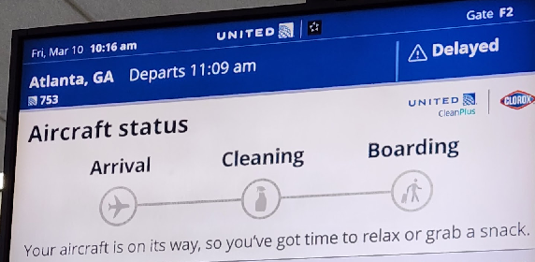
March 2025
802 Plenary
Atlanta, GA, USA

Slide 3
Mixed Mode Meeting
Registration is required
Please remember to enter your attendance in IMAT
Reminder:
This is a non-PAR activity
All the rules of conduct apply https://grouper.ieee.org/groups/802/sapolicies.shtml

Slide 4
802.15 WNG Agenda
Topic | Presenter | Time
WNG Open | Ben Rolfe | 0:05
Group Association for IEEE 802.15.4 | Jianlin Guo | 0:25
Waveform compression and its role in Low Power Network security and efficiency | Micah Givens | 0:30
WNG Close | Ben Rolfe | 0:05

Slide 5
References

Slide 6

Any Other Business

Slide 7

Adjourned

