Slide 1
Project: IEEE P802.15 Working Group for Wireless Personal Area Networks (WPANs)
Submission Title: PSD observations for KDB 987594
Source: Carlos Aldana (Meta), Bin Tian (Qualcomm), Menzo Wentink (Qualcomm), Pooria Pakrooh (Qualcomm)
Address : [1 Hacker Way, Menlo Park, CA 94025]
E-Mail: [caldana (at) meta.com]
Re: Study Group 4ab: UWB Next Generation
Abstract: [This provides a closer look at AWGN PSDs that are compliant with KDB 987594]
Purpose: [For information]
Notice: This document has been prepared to assist the IEEE P802.15. It is offered as a basis for discussion and is not binding on the contributing individual(s) or organization(s). The material in this document is subject to change in form and content after further study. The contributor(s) reserve(s) the right to add, amend or withdraw material contained herein.
Release: The contributor acknowledges and accepts that this contribution becomes the property of IEEE and may be made publicly available by P802.15.
Notes:
Jul 12, 2010
Page 1

Slide 2
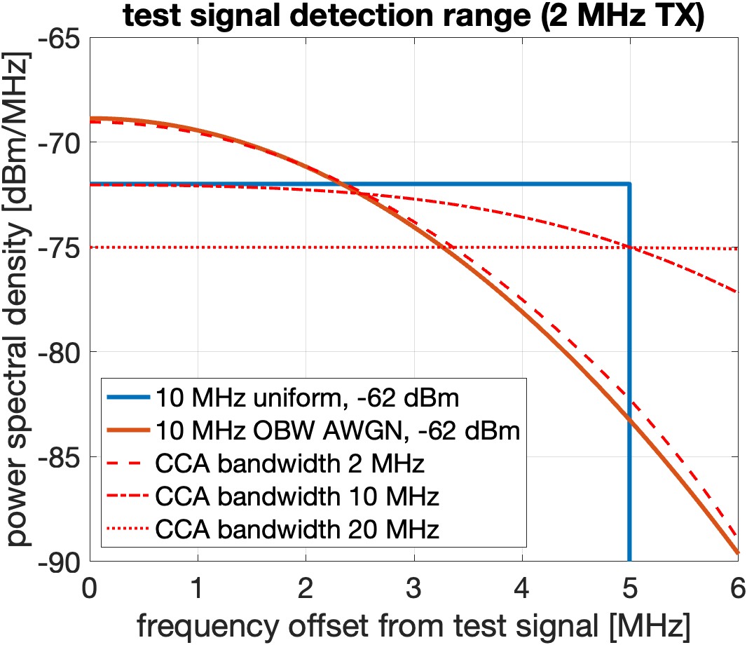
Background
15-25-103-00 contained this PSD plot
  ~3dB drop after 2.5 MHz and ~9dB after 5 MHz

Slide 3
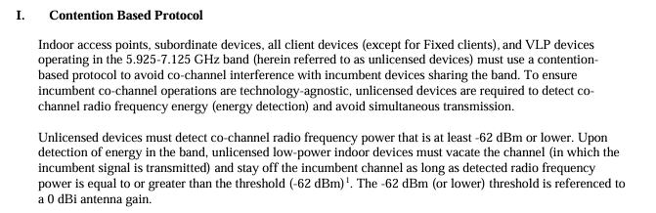

KDB 987594 details

Slide 4
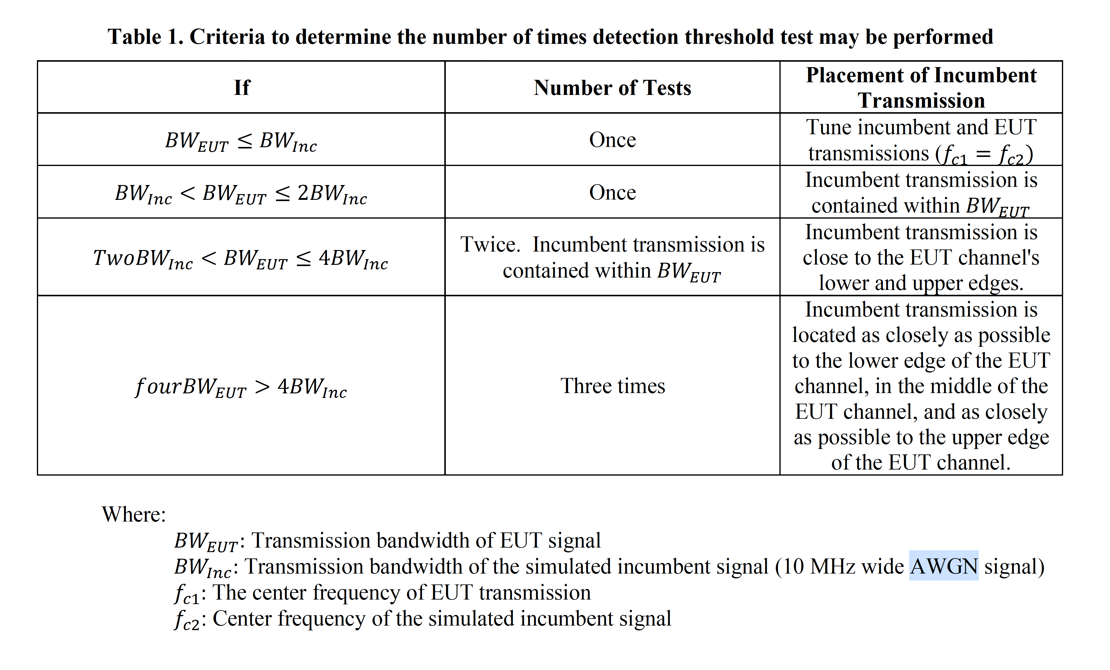
KDB 987594 details
The NB device is centered at the same frequency as incumbent

Slide 5
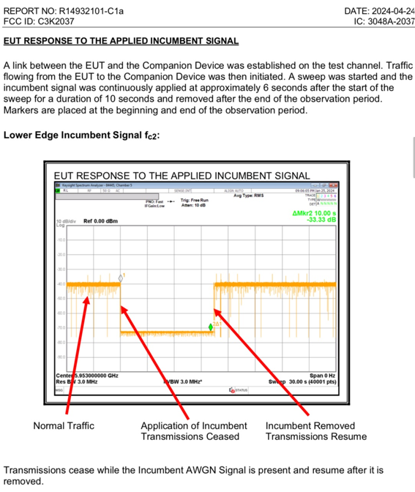
CBP FCC Test Example

Slide 6
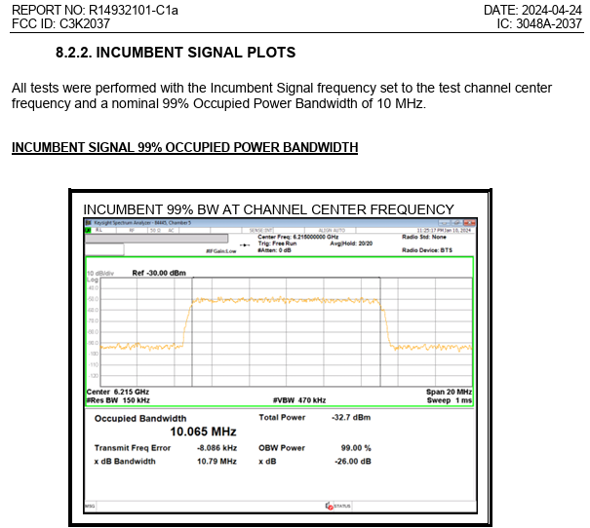
Incumbent Signal
Flat spectrum for ~ 10 MHz
~5 MHz from fc

Slide 7
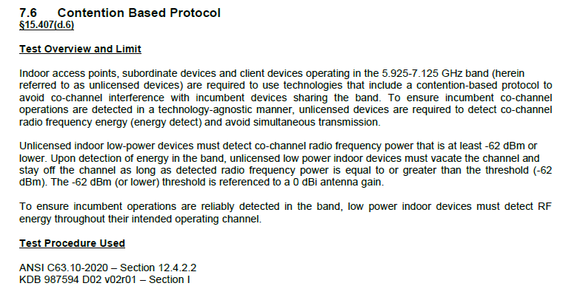
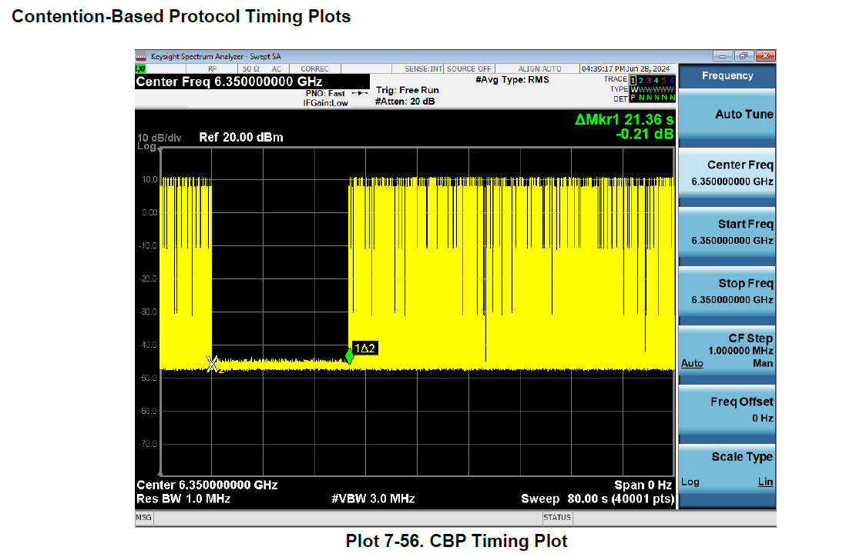
Another CBP FCC Test Example
NB device with FCC ID BCG-A3048 [link]

Slide 8
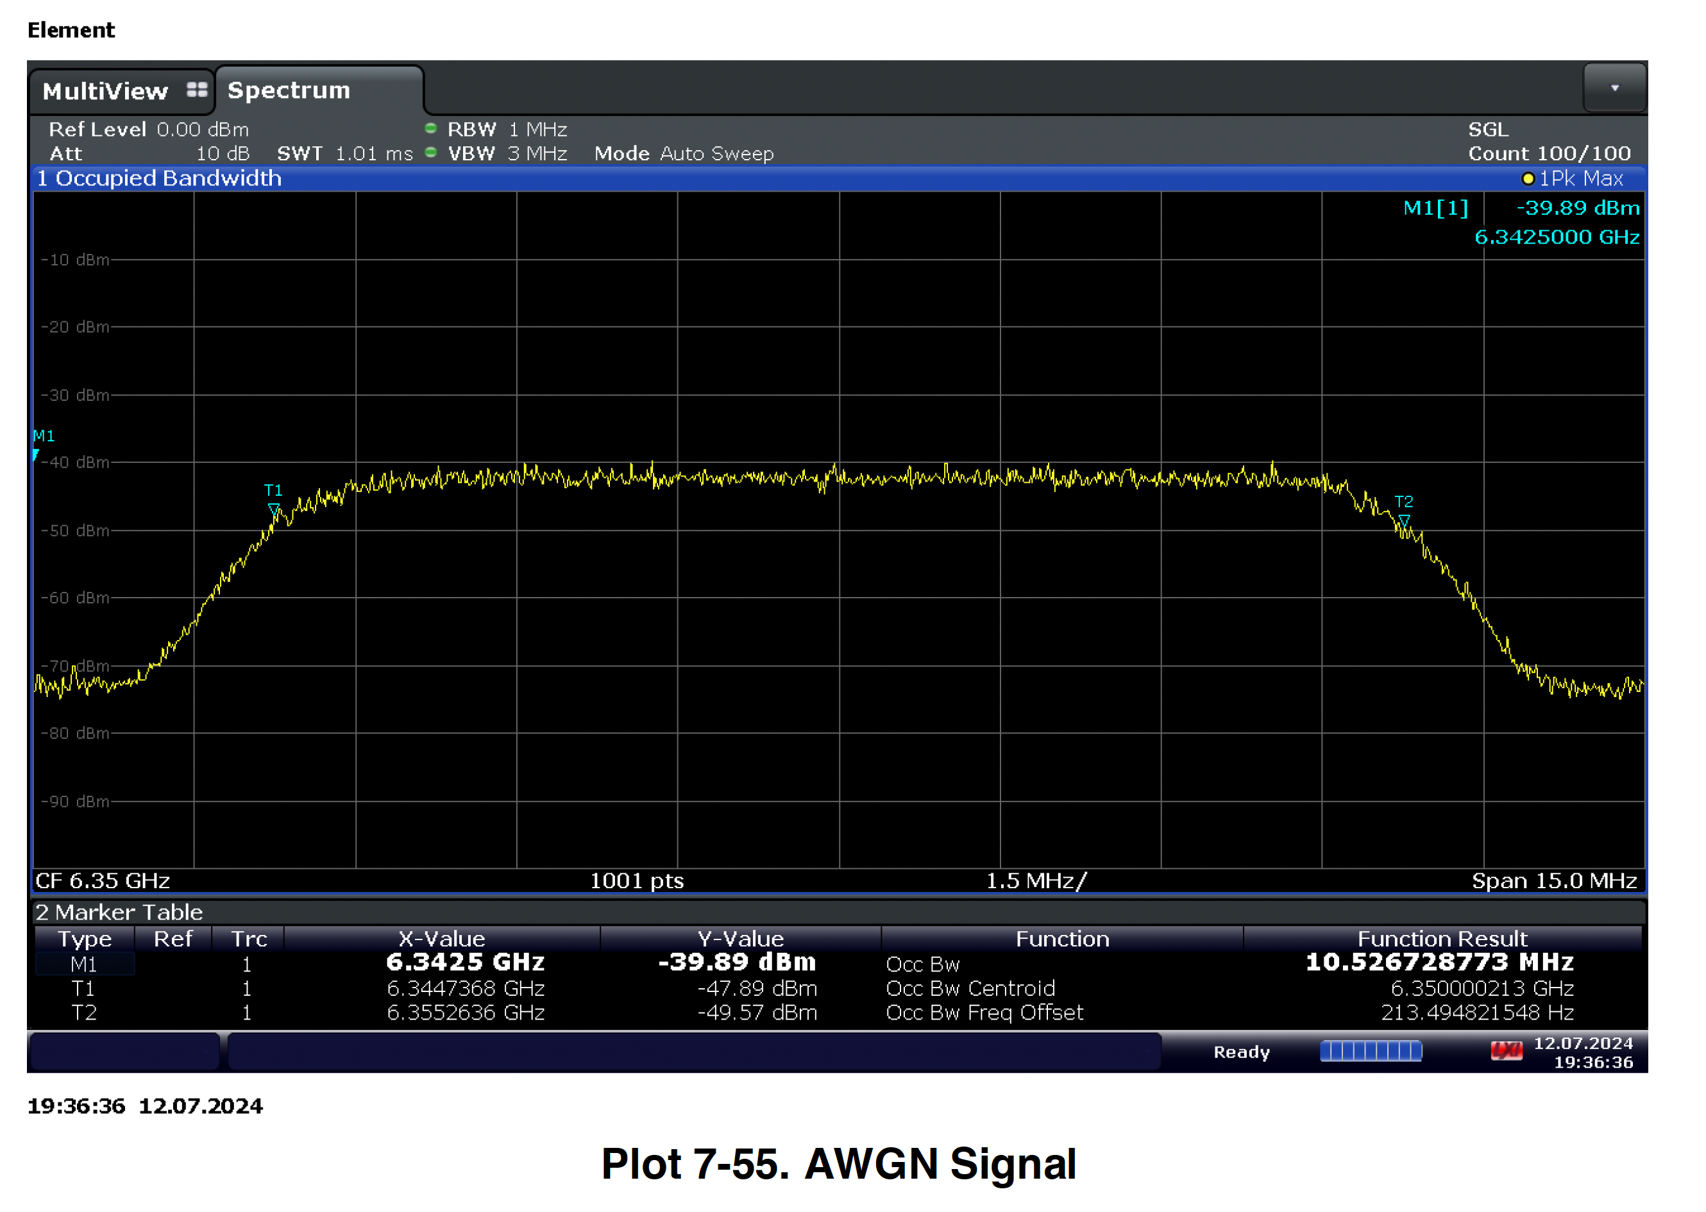
Incumbent Signal
It has flat spectrum for ~ 9 MHz
~5 MHz from fc
Same plot
exists in BCGA2117
Test report

Slide 9
Observations
We have shown 2 PSD plots that are relatively flat for >= 9 MHz and show little degradation at 5 MHz offset from fc.
  9 dB drop at 5 MHz offset that is claimed by 15-25-103-00 is not seen.
In addition, per KDB, our understanding is the center frequency of NB aligns with that of incumbent (i.e., 0 Hz frequency offset)
Question: Is narrowband LBT device operation in 6-8GHz UNII bands still “non-permissible” in FCC regulatory domain, as per 15-25-103-00?

