Slide 1
Project: IEEE P802.15 Working Group for Wireless Personal Area Networks (WPANs)
Submission Title: Possible Next Steps on NB Channel Access (CID 988)
Source: Carlos Aldana (Meta)
Address : [1 Hacker Way, Menlo Park, CA 94025]
E-Mail: [caldana (at) meta.com]
Re: Study Group 4ab: UWB Next Generation
Abstract: [This provides slides to aid discussion towards convergence on CID 988 resolution]
Purpose: [For information]
Notice: This document has been prepared to assist the IEEE P802.15. It is offered as a basis for discussion and is not binding on the contributing individual(s) or organization(s). The material in this document is subject to change in form and content after further study. The contributor(s) reserve(s) the right to add, amend or withdraw material contained herein.
Release: The contributor acknowledges and accepts that this contribution becomes the property of IEEE and may be made publicly available by P802.15.
Notes:
Jul 12, 2010
Page 1

Slide 2
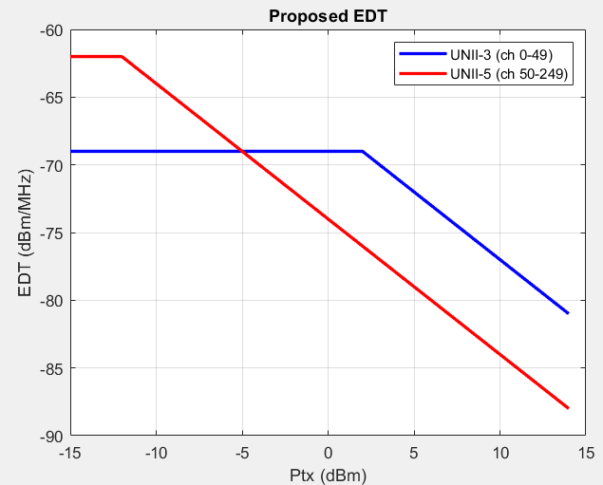
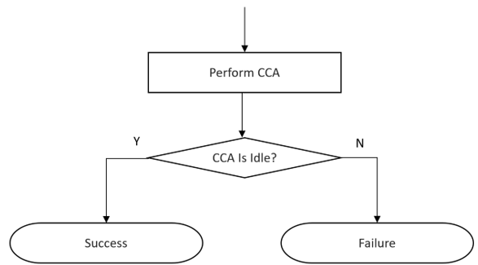
Summary of 15-24-407-07-4ab
Propose to use single CCA before every NB transmission

Slide 3
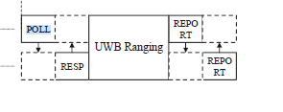
Background
There were concerns with the 15-24-407-07-4ab document that included:
Alex (Apple)
  EDT is too low for 14 dBm in 6 GHz
Riku (NXP)
  Can we use Short Control Signaling (SCS) clause in ETSI that allows no-LBT for management and control frames?
    The Report frames are clearly data frames and would not be allowed under SCS
    There have been no decisions made in ETSI regarding SCS in 6 GHz
      The SCS allowance for no-LBT could be removed in future ETSI BRAN meetings.

Slide 4
Latest in ETSI BRAN
5% duty cycle no-LBT (BRAN(24)125012) is not accepted
2. eDAA proposed by Apple (BRAN(25)128007) is not accepted
3. Low Duty Cycle no-LBT proposed by NXP (BRAN(25)128008r1) is not accepted
4. Accepted Minutes (BRAN(25)128016r1) of ETSI BRAN #127 show that LBT-based channel access proposal in BRAN(24)124017r3 is accepted
  It is the only NB channel access mechanism that has been accepted at ETSI.

Slide 5
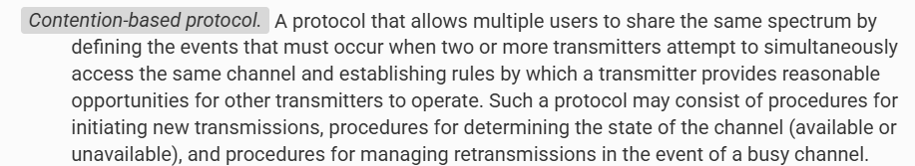
FCC CBP Definition
Section 90.7 of Part 90, Subpart A

Slide 6
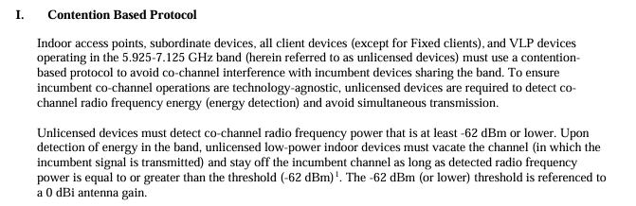

FCC
FCC mandates Contention Based Protocol (CBP) in FCC 15.407(d.6) (see Appendix)
FCC website points to guides for obtaining certification
  only KDB 987594 is listed

Slide 7
Summary of Previous Discussion
6 Options discussed at the last meeting:
Accept 15-24-407-07-4ab as is to resolve CID 988 and other coex related CIDs: 204, 275, 276, 967, 996, 977, 978, 979, 1356, 1358, 1359, 150, 94, 12, 13
  Consistent with both FCC and ETSI.
2 . Consider a second LBT within 50us (on another NB channel) if CCA is busy (Menzo)
  Consistent with FCC & ETSI and an improvement on 1. above
3. If Tx duty cycle < Y%, EDT is fixed at -75 dBm/MHz (regardless of Tx Power) else follow EDT in Slide 2
LBT as specified in 15-24-407-07-4ab doc is mandatory for NB operation in Section 10.38.7.3 (NBA UWB MMS) and 10.43.2 (UWB data offload to NB) except for device with Tx duty cycle less than X%.
If DC> 1/15%, then NB use frequency hopping over more than 15 channels to spread the interference over the full spectrum (Mickael)
  Similar to NXP proposal at ETSI, which allows for 6% duty cycle over 480 MHz, which was not accepted.
LBT mandatory for NB operation in Section 10.38.7.3 (NBA UWB MMS) and 10.43.2 (UWB data offload to NB) except for device with Tx duty cycle less than X% (Bin Tian)

Slide 8
Discussion
802.15.4ab needs to define a mandatory LBT mechanism with additional considerations:
Energy detection threshold (one value or dynamic) (15-24-407-07)
Single CCA or allow for second CCA on another channel within 50us
Other
  Duty-cycle based?

Slide 9
Appendix

Slide 10
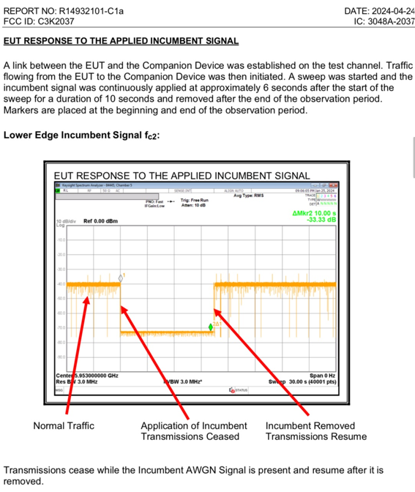
CBP FCC Test Example

Slide 11
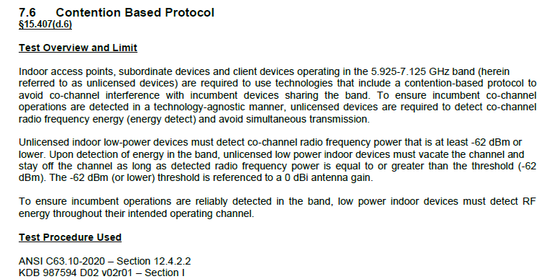
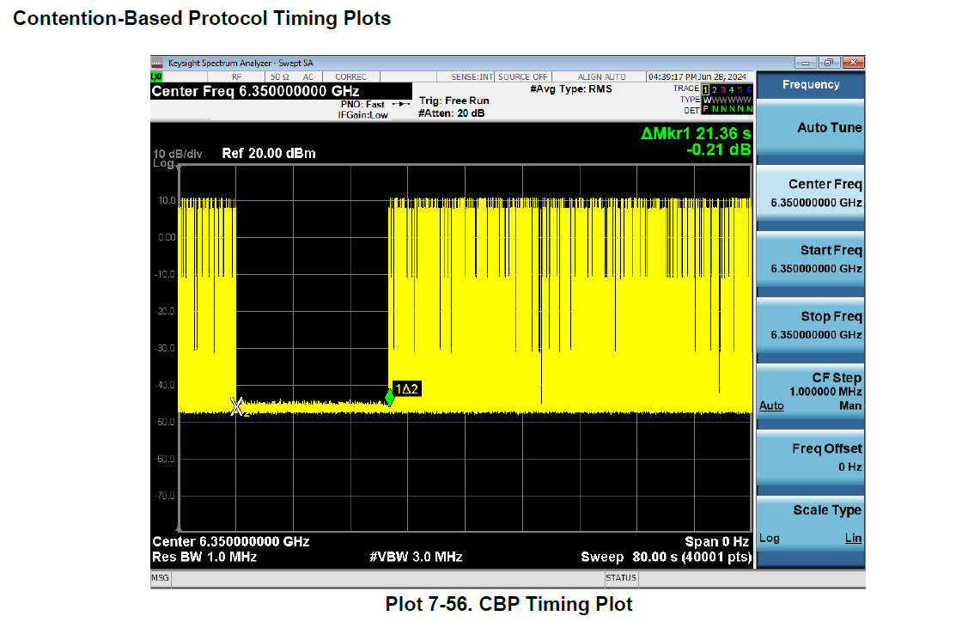
Another CBP FCC Test Example
NB device with FCC ID BCG-A3048 [link]

Slide 12
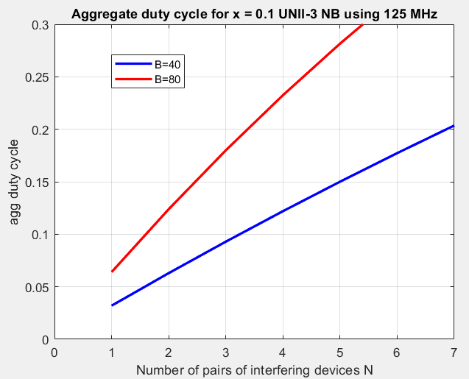
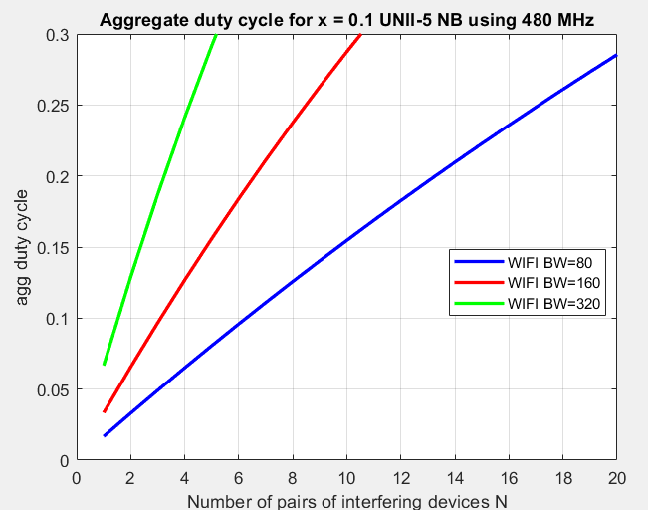
Aggregate Duty cycle for no-LBT
The plot below shows the aggregate duty cycle when N NB pairs are near a 802.11 link.
We see that 2 / 3 NB nearby pairs using 125 MHz causes ~10% aggregate NB duty cycle on 80/40 MHz 802.11
We see that 2 / 3 / 6 NB nearby pairs using 480 MHz causes ~10% aggregate NB duty cycle on 320/160/80 MHz 802.11

