Slide 1
Project: IEEE P802.15 Working Group for Wireless Personal Area Networks (WPANs)
Submission Title: Possible Next Steps on NB Channel Access (CID 988)
Source: Carlos Aldana (Meta)
Address : [1 Hacker Way, Menlo Park, CA 94025]
E-Mail: [caldana (at) meta.com]
Re: Study Group 4ab: UWB Next Generation
Abstract: [This provides slides to aid discussion towards convergence on CID 988 resolution]
Purpose: [For information]
Notice: This document has been prepared to assist the IEEE P802.15. It is offered as a basis for discussion and is not binding on the contributing individual(s) or organization(s). The material in this document is subject to change in form and content after further study. The contributor(s) reserve(s) the right to add, amend or withdraw material contained herein.
Release: The contributor acknowledges and accepts that this contribution becomes the property of IEEE and may be made publicly available by P802.15.
Notes:
Jul 12, 2010
Page 1

Slide 2
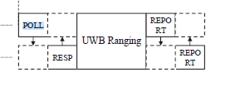
Background
There were concerns with the 15-24-407-07-4ab document that included:
Alex (Apple)
EDT is too low for 14 dBm in 6 GHz
Riku (NXP)
Can we use Short Control Signaling (SCS) clause in ETSI that allows no-LBT for management and control frames?
The Report frames are clearly data frames and would not be allowed under SCS
There have been no decisions made in ETSI regarding SCS in 6 GHz
The SCS allowance for no-LBT could be removed in future ETSI BRAN meetings.
FCC mandates Contention Based Protocol (CBP) in FCC 15.407(d.6) (see Appendix)

Slide 3
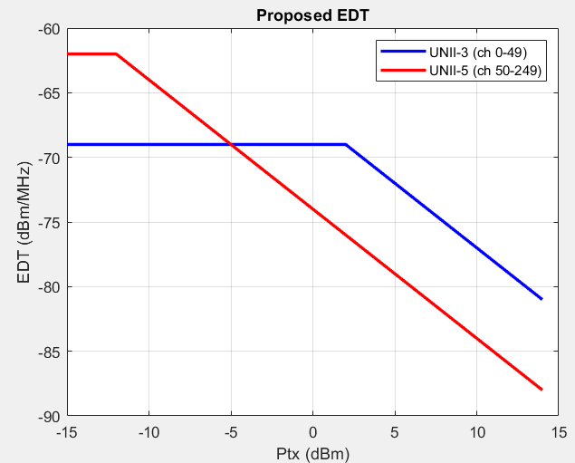
Latest EDT in 15-24-407-07-4ab
EDT Proposal
min(-69 dBm/MHz, -67 dBm/MHz – Ptx) in channels 0 to 49 and to min(-62 dBm/MHz,-74 dBm/MHz – Ptx) in channels 50 to 249

Slide 4
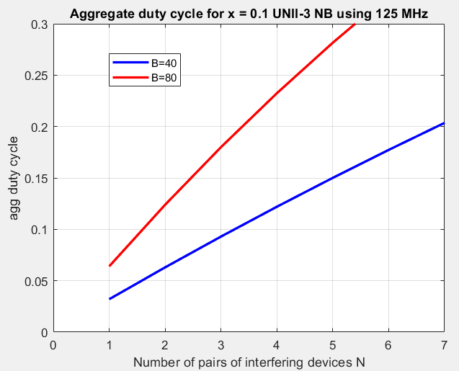
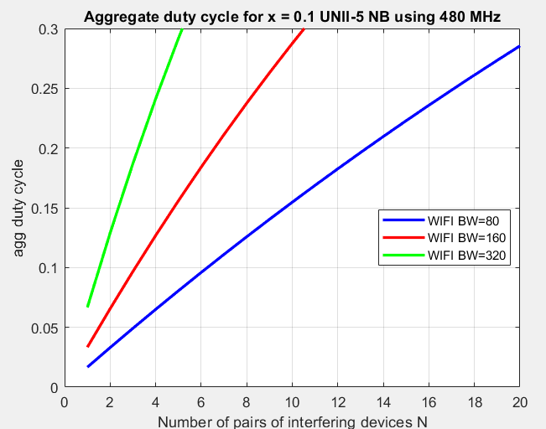
Aggregate Duty cycle for no-LBT
The plot below shows the aggregate duty cycle when N NB pairs are near a 802.11 link.
We see that 2 / 3 NB nearby pairs using 125 MHz causes ~10% aggregate NB duty cycle on 80/40 MHz 802.11
We see that 2 / 3 / 6 NB nearby pairs using 480 MHz causes ~10% aggregate NB duty cycle on 320/160/80 MHz 802.11

Slide 5
Potential Ways Forward
4 Options :
If Tx duty cycle < Y%, EDT is fixed at -75 dBm/MHz (regardless of Tx Power) else follow EDT in Slide 3 (preferred, with increasing EDT for decreasing TX Power).
LBT as specified in 15-24-407-07-4ab doc is mandatory for NB operation in Section 10.38.7.3 (NBA UWB MMS) and 10.43.2 (UWB data offload to NB) except for device with Tx duty cycle less than X%.
Not preferred as it likely needs both FCC and ETSI changes
Consider a second LBT within 50us (on another NB channel) if CCA is busy (Menzo)
4. If DC> 1/15%, then NB use frequency hopping over more than 15 channels to spread the interference over the full spectrum (Mickael)

Slide 6
Bin’s suggestion
LBT mandatory for NB operation in Section 10.38.7.3 (NBA UWB MMS) and 10.43.2 (UWB data offload to NB) except for device with Tx duty cycle less than X%.

Slide 7
Appendix

Slide 8
CBP Testing FCC
AFAIK, KDB 987594 is the only testing procedure adopted for CBP testing [link]

Slide 9
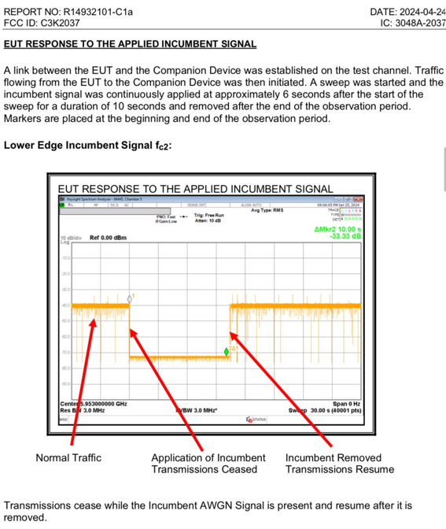
CBP FCC Test Example

Slide 10
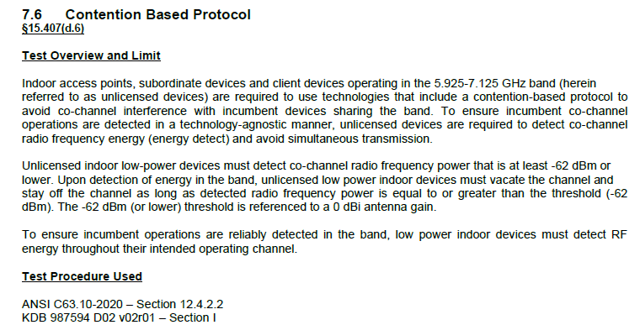
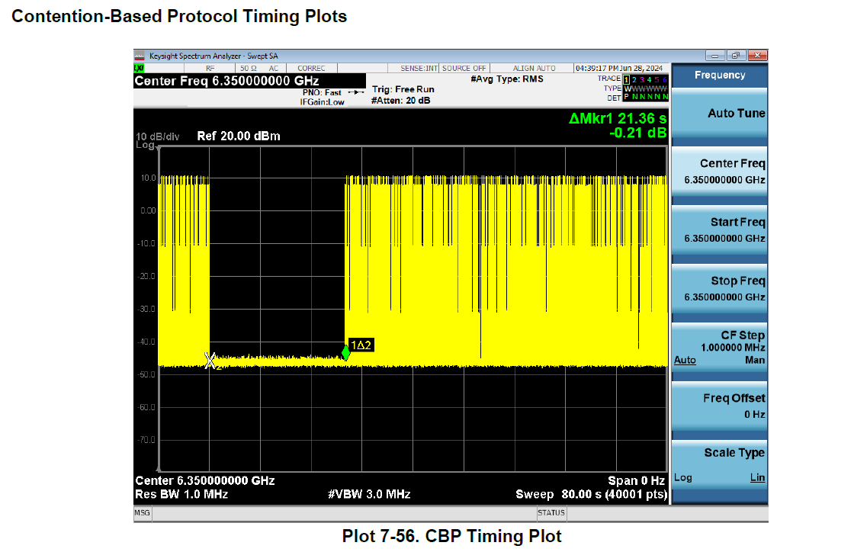
Another CBP FCC Test Example
NB device with FCC ID BCG-A3048 [link]

