Slide 1
Project: IEEE P802.15 Working Group for Wireless Specialty Networks (WSN)
Submission Title: TG4ab Closing Report 2025
Date Submitted: 15 January 2025
Source: Benjamin A. Rolfe (Blind Creek Associates)
Contact:
Voice: [deprecated],
E-Mail: ben.rolfe @ ieee.org
Re: Task Group 4ab: 802.15.4 UWB Next Generation
Abstract: Closing report for the 802 Wireless Interim January 2025
Purpose: Continue project progress and continue the illusion of organization
Notice: This document has been prepared to assist the IEEE P802.15. It is offered as a basis for discussion and is not binding on the contributing individual(s) or organization(s). The material in this document is subject to change in form and content after further study. The contributor(s) reserve(s) the right to add, amend or withdraw material contained herein.
Release: The contributor acknowledges and accepts that this contribution becomes the property of IEEE and may be made publicly available by P802.15.

Slide 2
Task Group 15.4ab Next Generation UWB Amendment
January 2025 802
\Wireless Interim Session
Mixed Mode
Live from
Kobe, Japan

Slide 3
Agenda
https://mentor.ieee.org/802.15/dcn/24/15-24-0678-10-04ab-detailed-agenda-january-2025.xlsx

Slide 4
Project Information

Slide 5
5.2.b Scope of the project (As approved):
This amendment enhances the Ultra Wideband (UWB) physical layers (PHYs) medium access control (MAC), and associated ranging techniques while retaining backward compatibility with enhanced ranging capable devices (ERDEVs). Areas of enhancement include:
additional coding, additional coding, preamble and modulation schemes to support improved link budget and/or reduced air-time relative to IEEE Std 802.15.4 UWB;
additional channels and operating frequencies;
interference mitigation techniques to support greater device density and higher traffic use cases relative to the IEEE Std 802.15.4 UWB;
improvements to accuracy, precision and reliability and interoperability for high-integrity ranging; schemes to reduce complexity and power consumption;
definitions for tightly coupled hybrid operation with narrowband signaling to assist UWB;
enhanced native discovery and connection setup mechanisms;
sensing capabilities to support presence detection and environment mapping;
and mechanisms supporting low-power low-latency streaming as well as high data-rate streaming allowing at least 50 Mb/s of throughput.
Support for peer-to-peer, peer-to-multi-peer, and station-to-infrastructure protocols are in scope, as are infrastructure synchronization mechanisms. This amendment includes safeguards so that the high throughput data use cases do not cause significant disruption to low duty-cycle ranging use cases.
https://development.standards.ieee.org/myproject-web/app#viewpar/9081

Slide 6
Near Term Working Milestones
 | Current Schedule
First letter ballot | June 2024
Initial LB comment resolution | Start: July 2024
First recirculation | Feb 2025
Recirculation comment resolution | March 2025
Second recirculation | May 2025
Recirculation comment resolution | June-July 2025
First SA-Ballot | July 2025
SA-Ballot comment resolution | Sept 2025
We are here
Recirc start by 20-Feb can close before the March Plenary

Slide 7
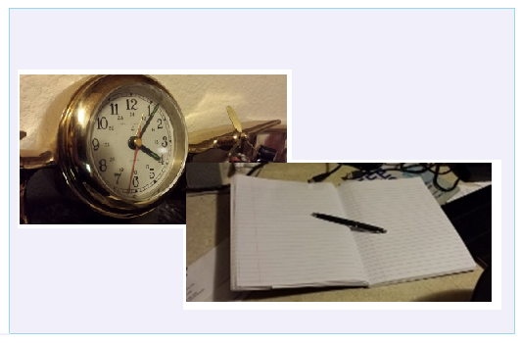
Editor’s Corner

Slide 8
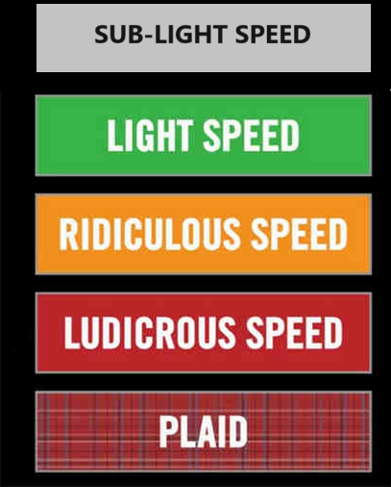
Comment resolution

Slide 9
Consolidated Comments
15-24-0371
https://mentor.ieee.org/802.15/dcn/24/15-24-0371-35-04ab-consolidated-comments-draft-1-0.xlsm
Resolved approximately 130 technical comments
Approximately 190 technical comments to go
Will continue via interim Webex

Slide 10
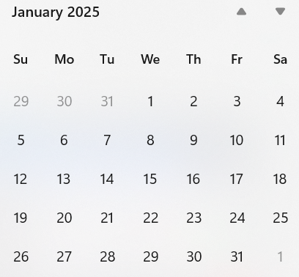
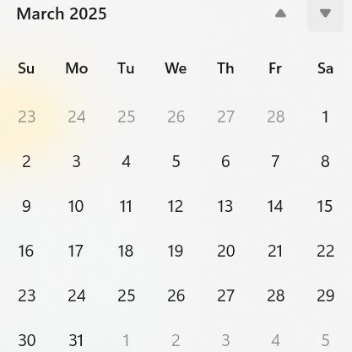
Call schedule, January thru March
Now
Plenary
Wireless Interim
Open Recirc
Commence on 30-January-2025, through 05-March-2025
Tuesdays 06:00 PT (2 hour)
Wednesday 5-Feb 06:00 PT (1 hour)
Thursdays 14:00 PT (1 hour)
Except: ??

