Slide 1
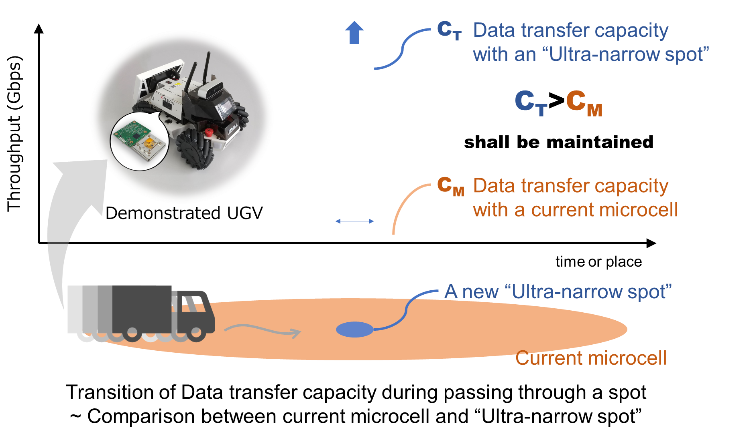
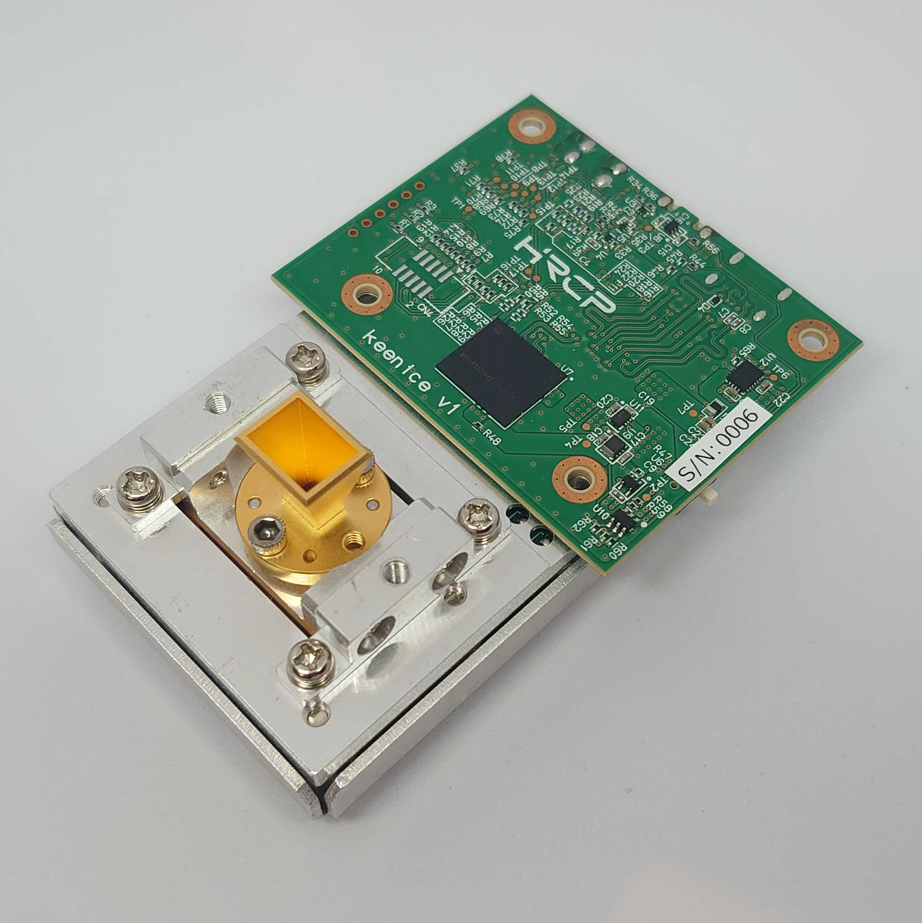
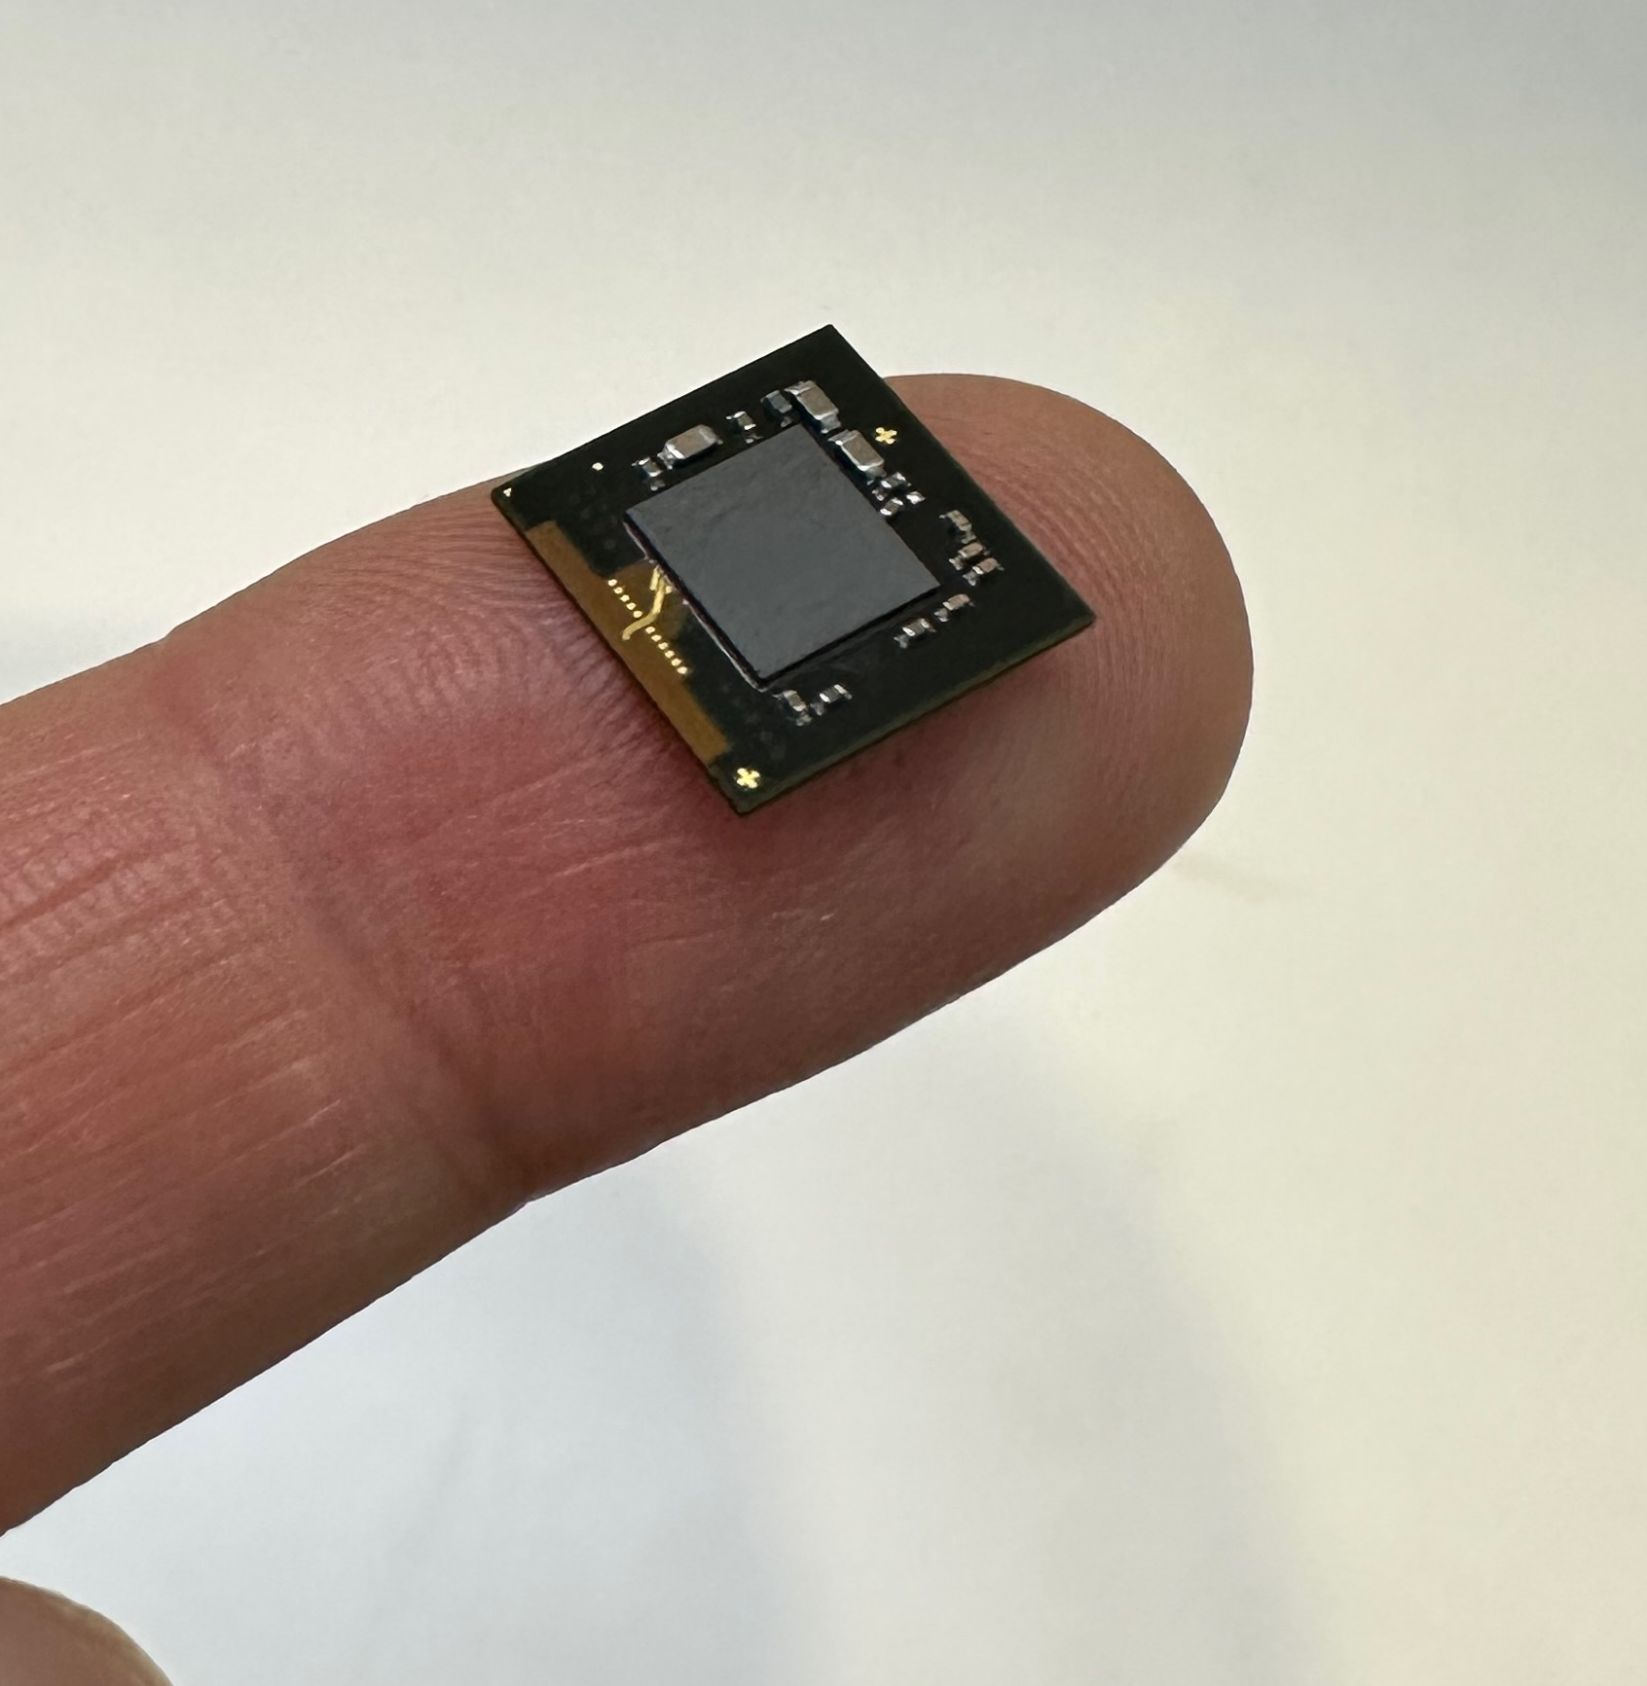
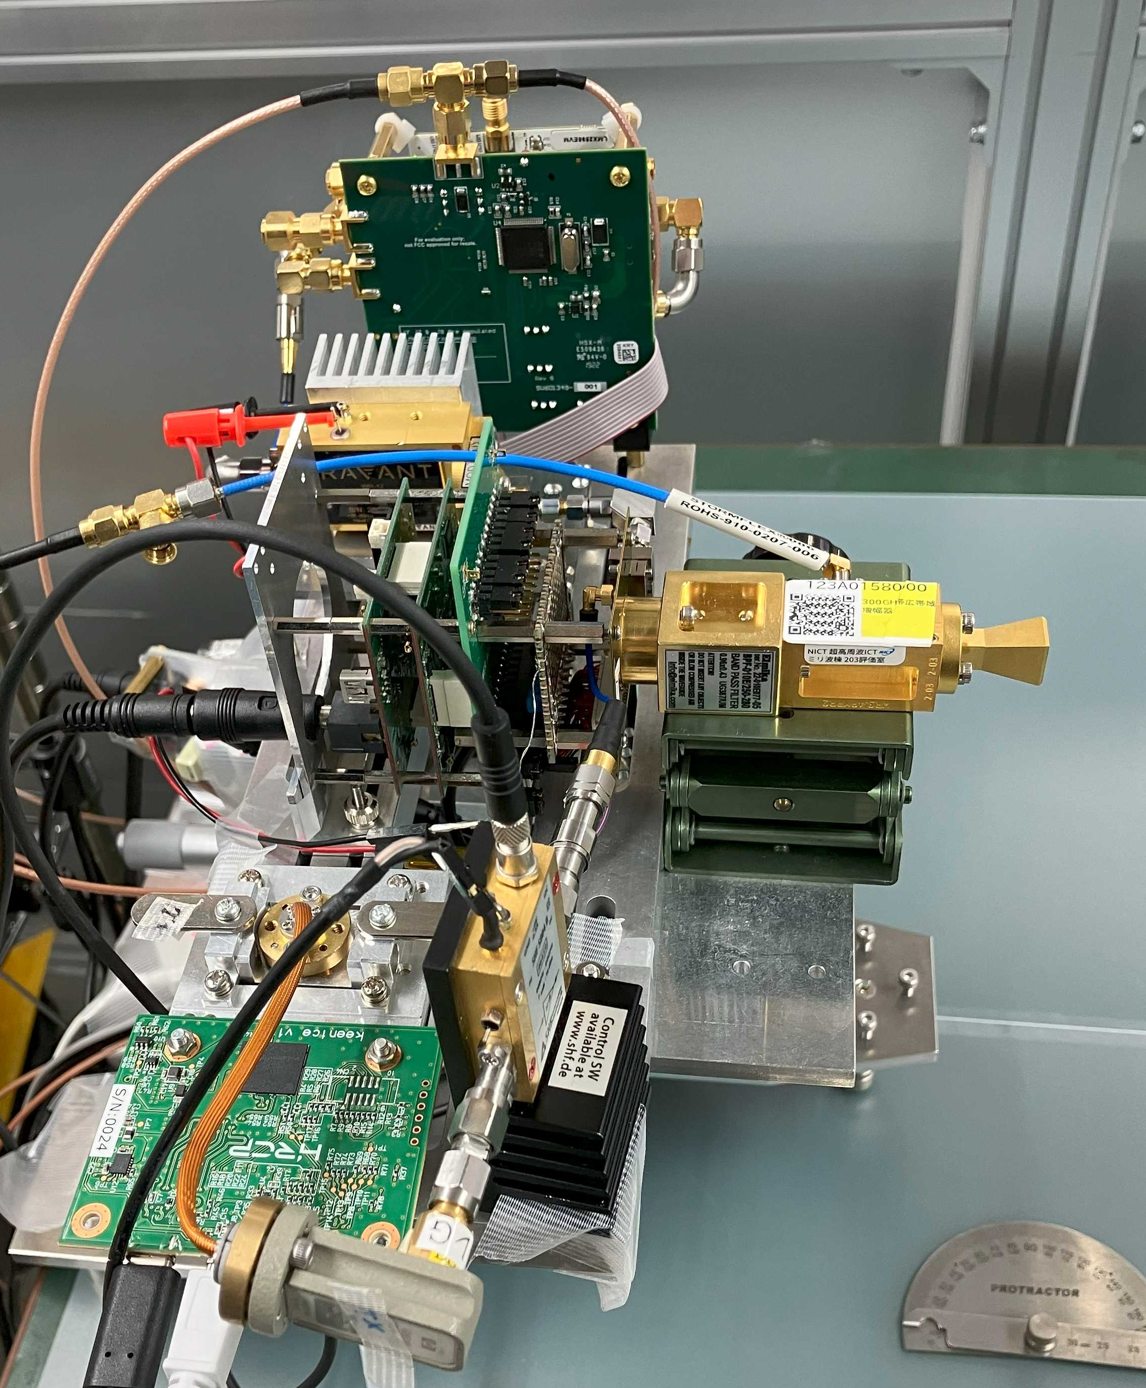
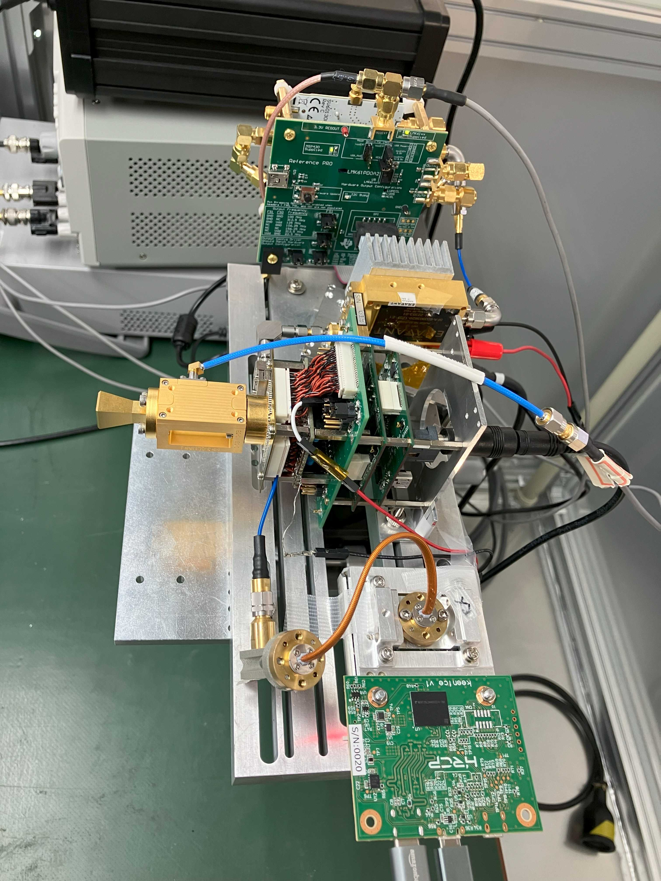
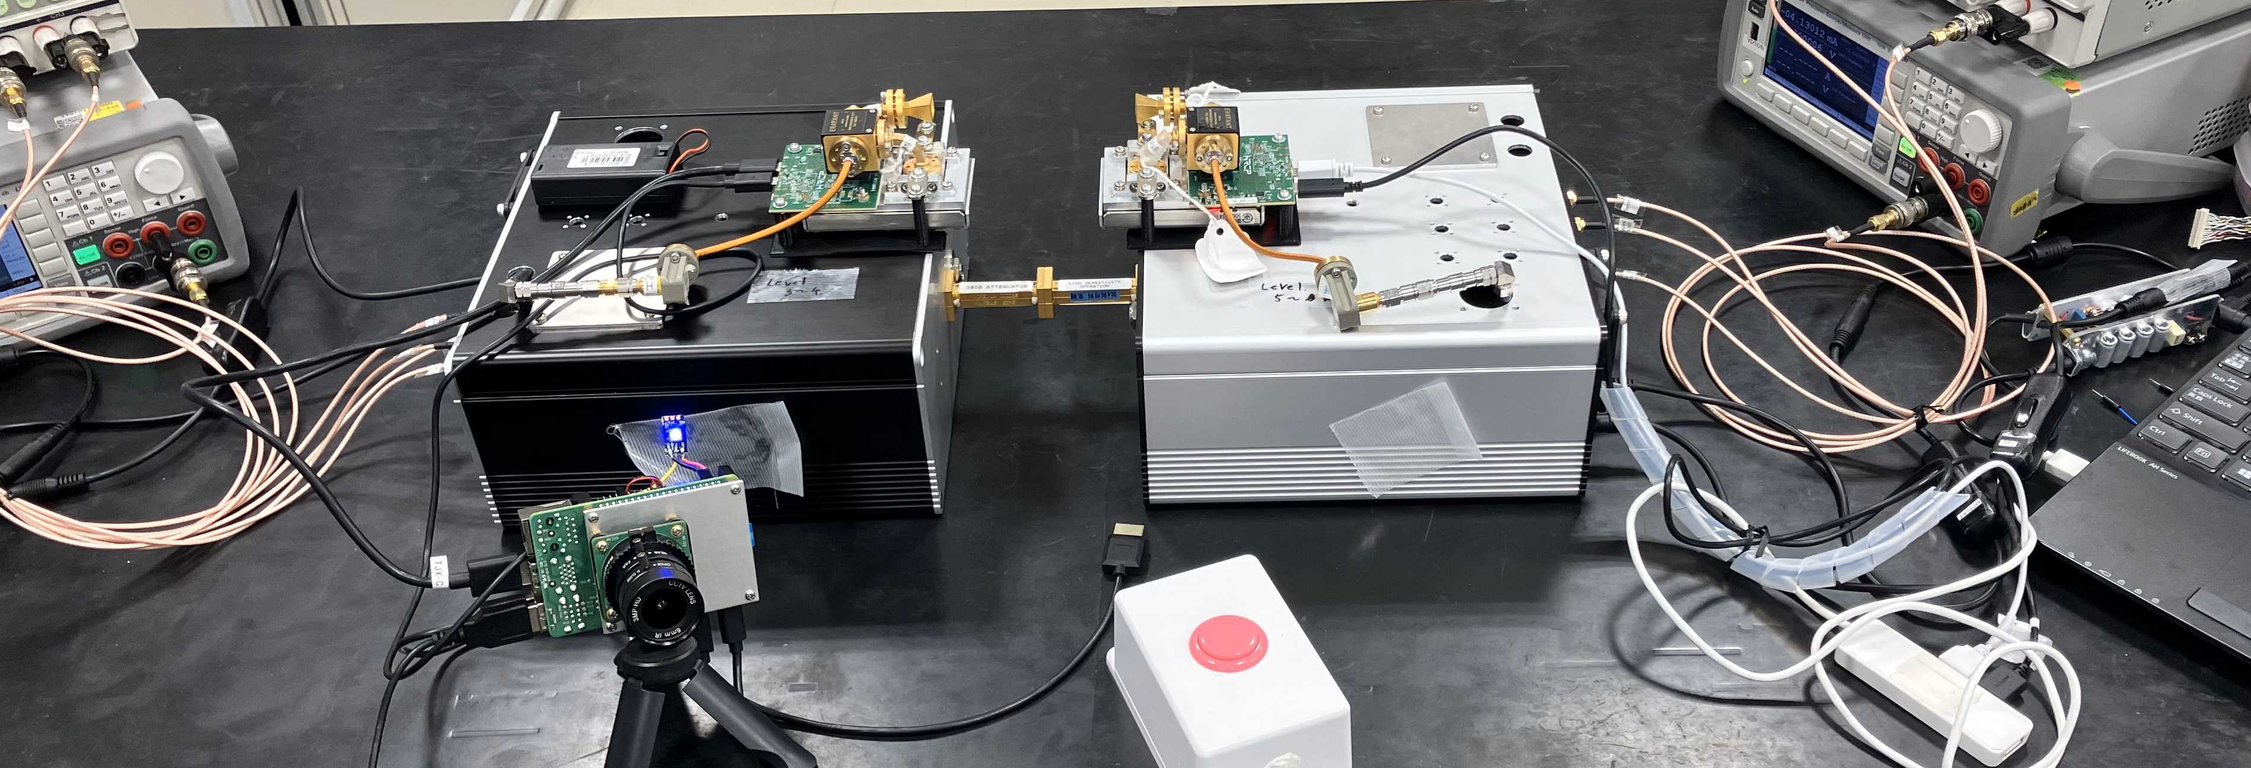
Terahertz Wireless Technology for Beyond 5G ~Ultra narrow spot wireless service & IEEE802.15.3d/e Hybrid Test Environment ~
DISCLAIMER
The use of any particular/specific brands of components, equipment, or instruments as a part of the demonstration and presentation does not constitute an endorsement of those brands by IEEE, IEEE SA, or the IEEE LMSC.
Background
THz wireless technology, whose frequency bands are from 100GHz to 300GHz, will open a new huge market with its extreme throughput. However, users need to adapt to the “Ultra-narrow-spot” caused by its propagation characteristics.
Manufacturing the SoC for the THz wireless standard, IEEE 802.15.3d, is key to addressing the issue. This allows for (1) ultra-instantaneous link establishment, enabling data transmission to begin immediately as the device enters the coverage area, and (2) ultra-high-speed wireless data transmission over 100 Gbps. These capabilities enable the exchange of a huge amount of data in much less than a second.
Features
Terahertz Wireless Technology for Beyond 5G ~Ultra narrow spot wireless service & IEEE802.15.3d Test Environment ~
Utilizing the 30 GHz to 100 GHz millimeter-wave band,
achieving effective data rates of several tens of Gbps
(IEEE 802.15.3e compliant systems).
Utilizing the 100 GHz to terahertz range,
achieving effective data rates from several tens of Gbps to over 100 Gbps
(IEEE 802.15.3d compliant systems).
(1) Development of IEEE802.15.3e system (60GHz band) implementing ultra-short time link establishment protocol technology and promotion of experiments on mobile equipment
(2) Ultra-high-speed data transfer technology using ultra-wideband frequenciesPlans to construct an IEEE802.15.3d evaluation environment in which the IEEE802.15.3e system (60 GHz band) is frequency-converted to the 300 GHz band
63 mm
Parameter | Value
Carrier Frequency Center | 60.48 GHz or 62.64 GHz
Bandwidth | 2.16 GHz
Data Rate | Up to 6 Gbps
Transmission Distance | cm to hundreds of meters
Link Establishment Time | < 2 ms
Supported Standards | IEEE 802.15.3e, TransferJet X
RF Connection Interface | WG-15 UG-385/U
Supported Interfaces | USB, 10 Gigabit Ethernet
Local Storage | > 256 GB (Module-mounted using UFS)
95 mm
Main specifications of IEEE802.15.3e compliant ultra-short time link established wireless module
(Cooperation: HRCP)
Demonstration of THz wave (3d) + MMW (3e) Hybrid Wireless Communication System
THz-wave transmitter
In an anechoic chamber
Overview of the system
Synthesizer
Overview of the system
x6
ANT
Playback!!
THz-wave receiver
The recorded data was converted by the mmw transceiver into a modulated signal in the mmW band of the IEEE802.15.3e standard (CH2).
The modulated signals was up-converted to the THz-wave band of the IEEE802.15.3d standard (CH9) by THz CMOS TX.
The received signal was down-converted to a IEEE802.15.3e standard signal by THz CMOS RX, demodulated by the mmW transceiver, and output as a video data.
Control signals for sending and receiving video signals are performed between mmW transceivers.
Since the radio license is not yet obtained, THz propagation will be demonstrated using waveguide attenuators with 60 dB insertion loss.
THz CMOS TX
BPF
AMP
THz-wave transmitter
THz-wave receiver
Synthesizer
AMP
Down link (271.08GHz)
ANT
x6
mmW transceiver
Up link (60.48GHz)
mmW transceiver
LNA
THz CMOS TX
mmW transceiver
~2.0m
Recording!
Ch9
IEEE 803.15.3d
mmW transceiver
BW(GHz)
2.16
Ch1~32
THz-wave transmitter
8.64
Ch49~56
THz-wave receiver
11.7GHz
Synthesizer
S. Beppu, et al., EuMIC2024
12.96
Ch57~61
Synthesizer
11.7GHz
multiplier
x6
BPF
LO
LO
BPF
multiplier
x6
THz CMOS TX
70.2GHz
17.28
Ch62~63
f _{GHz}
70.2GHz
THz CMOS RX
250
260
270
280
290
300
310
320
IC
x2
252.72
321.84
WG
x2
IC
60.48GHz
WG
BPF
AMP
ANT
RF
ANT
LNA
BPF
60.48GHz
IF
AMP
271.08GHz
Down link (271.08GHz)
271.08GHz
IF
mmW
transceiver
(Transfer Jet X)
ANT
Up link (60.48GHz)
RF
ANT
mmW
transceiver
(Transfer Jet X)
THz + mmW
Hybrid !!
CIR
BW(GHz)
Ch2
IEEE 803.15.3e
CIR
Specifications
2.16
57
58
59
60
61
62
63
64
65
f _{GHz}
57.24
66
mmW transceivers
65.88
The center frequency of THz and mmW communications were 271.08 GHz (3d, ch9) GHz and 60.48 GHz (3e, ch2), respectively.
The symbol rate and data rate were 1.76 GHz and 3.52 Gbps, respectively.
THz-wave transmitter
(in case)
60dB ATT
THz-wave receiver
(in case)
Demonstration setup (@IEEE 802 Wireless Interim, Jan 15, 2025)
This work was supported in part by the Ministry of Internal Affairs and Communications of Japan (JPJ000254, Research and Development for Expansion of Radio Wave Resources)
January 2025
doc.: IEEE 802.15-25-0057-00-wng0

