Slide 1
Project: IEEE P802.15 Working Group for Wireless Speciality Networks (WSN)
Submission Title: SC THz November 2024 Closing Plenary Slides
Date Submitted: 14 November 2024
Source: Thomas Kürner TU Braunschweig
Address: Schleinitzstr. 22, D-38092 Braunschweig, Germany
Voice:+495313912416, FAX: +495313915192, E-Mail: t.kuerner@tu-bs.de
Re: n/a
Abstract: SC THz November 2024 Closing Plenary Slides
Purpose: Closing report to WG 15 closing plenary
Notice: This document has been prepared to assist the IEEE P802.15. It is offered as a basis for discussion and is not binding on the contributing individual(s) or organization(s). The material in this document is subject to change in form and content after further study. The contributor(s) reserve(s) the right to add, amend or withdraw material contained herein.
Release: The contributor acknowledges and accepts that this contribution becomes the property of IEEE and may be made publicly available by P802.15.

Slide 2
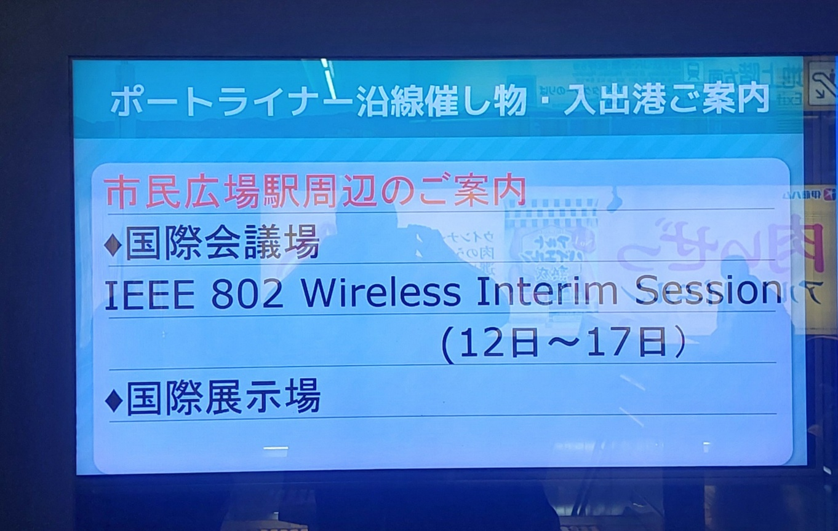
SC THz January 2025
Closing Report

Slide 3
Meetings/Contributions
3 meetings on Tue AM1 and We PM1 and PM2 AM2
Contributions
  Liaison statement from ITU-R Working Party 5C (25/0025) by Thomas Kürner (TU Braunschweig/Germany)
  Proposal of a liaison statement to ITU-R Working Party 5C (24/0688r3) by Hiroyo Ogawa (NICT)
  Proposal of a liaison statement to ITU-R Working Party 5A and 5C (24/0689r1) by Hiroyo Ogawa (NICT)
  Contribution Simple Wireless System Simulation with Characteristics of 3D-Printed THz Metasurfaces (25/0019r1) by Akifumi Kasamatsu (NICT/Japan)
  Contribution Development of THz metrology standards for licensing system of radio stations in Japan (25/0020r4)by Katsumi Fuji (NICT/Japan)
  x

Slide 4
Contributions contd.
Contributions
  LS_from_ETSI_ISG_THz_on_the_publication_of_GR_THz_003_and_GR_THz_004 (25/0024) by Thomas Kürner (TU Braunschweig/Germany)
  Path Loss Measurements and Models at 300 GHz in an Industrial Environment (25/0023) by Thomas Kürner (TU Braunschweig/Germany)
  Street Canyon Channel Characteristics at 154 GHz and 300 GHz (25/0013) by Shigenobu Sasaki (Niigata University/Japan)

Slide 5
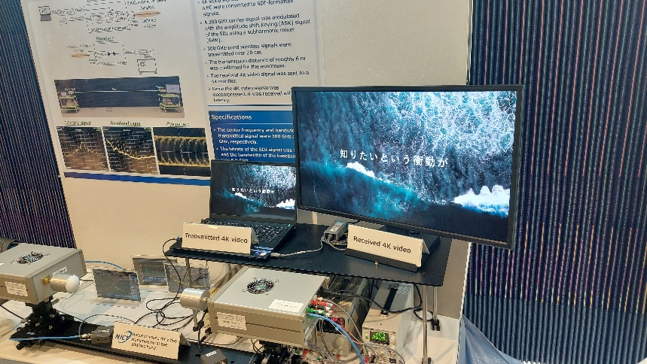
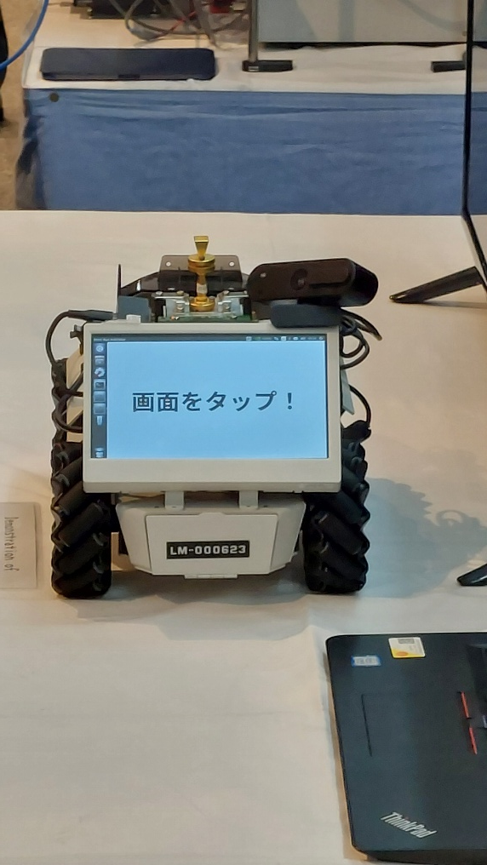
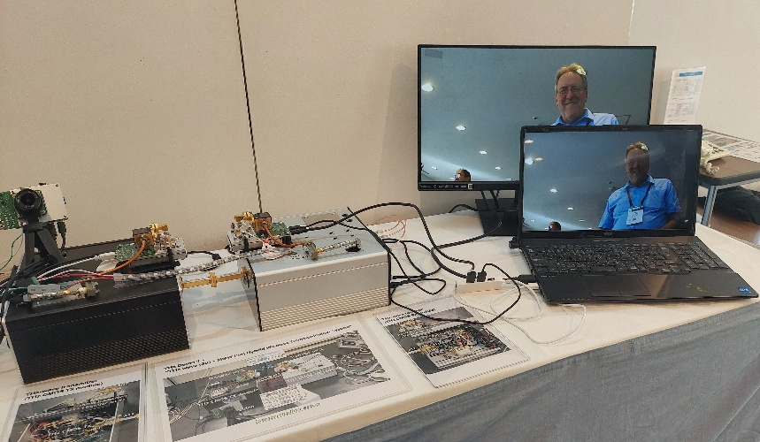
We had a very successful SC THz Tech Focus Meeting + Demonstrations!

Slide 6
SC Motion
Move that SC THz formally request that the 802.15 WG reviews and approve the response to the liaison from ITU-R WP5C in doc. IEEE 802.15-25-0688-05 and forward it to 802.18 TAG for submission to 802 LMSC.
Mover: Iwao Hosako
Seconder: Shigenobu Sasaki
4Y/0 N/0 Abstain

Slide 7
WG Motion
Move that 802.15 WG reviews and approves the response to the liaison from ITU-R WP5C in doc. IEEE 802.15-25-0688-05 and forward it to 802.18 TAG for submission to 802 LMSC.
Mover: Thomas Kürner
Seconder: Ann Krieger

Slide 8
SC Motion
Move that SC THz formally request that the 802.15 WG reviews and approve the liaison to ITU-R WP5A and WP5C in doc. IEEE 802.15-25-0689-03 and forward it to 802.18 TAG for submission to 802 LMSC.
Mover: Iwao Hosako
Seconder: Shigenobu Sasaki
4Y/0 N/0 Abstain

Slide 9
WG Motion
Move that 802.15 WG reviews and approves the to ITU-R WP5A and WP5C in doc. IEEE 802.15-25-0689-03 and forward it to 802.18 TAG for submission to 802 LMSC.
Mover: Thomas Kürner
Seconder: Ann Krieger

Slide 10
Next Meetings
  Requested March meetings slots for SC THz: None
    Next SC THz meetings planned are
      July Plenary at Madrid
      November Plenary at Bangkok

