Slide 1
Project: IEEE P802.15 Working Group for Wireless Personal Area Networks (WPANs)
Submission Title: [Development of THz metrology standards for licensing system of radio stations in Japan]
Date Submitted: [ 10 January 2025]
Source: [Katsumi Fujii, Jerdvisanop Chakarothai, Maya Mizuno, Norihiko Sekine] Company [NICT]
Address [4-2-1, Nukuikitamachi, Koganei, Tokyo, 184-8795, Japan]
Voice:[+81-42-327-7042], FAX: [+81-42-327-7537], E-Mail:[katsumi@nict.go.jp]
Re: [N/A]
Abstract: [This presentation described the status of development of THz metrology standards for licensing system of radio station in Japan.]
Purpose: [Provide the current status of THz metrology standards in Japan.]
Notice: This document has been prepared to assist the IEEE P802.15. It is offered as a basis for discussion and is not binding on the contributing individual(s) or organization(s). The material in this document is subject to change in form and content after further study. The contributor(s) reserve(s) the right to add, amend or withdraw material contained herein.
Release: The contributor acknowledges and accepts that this contribution becomes the property of IEEE and may be made publicly available by P802.15.

Slide 2
Development of THz metrology standards for licensing system of radio stations in JAPAN
Katsumi Fujii, Chakarothai Jerdvisanop,
Maya Mizuno, Norihiko Sekine
NICT (Japan)

Slide 3
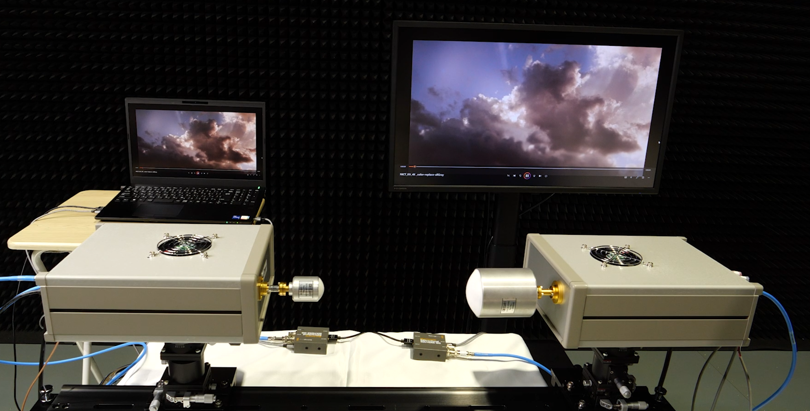
Introduction
To conduct research on THz (over 110 GHz) wireless communication, the management of THz band are required by government.
We must have not only high-precision measurement technologies for Frequency, RF Power, and other parameters, but also their metrological standards are required.
This presentation would like to explain Japan’s licensing system for radio stations as defined by the Radio Law and the current status of metrological standards development for THz band.
Display
Original
Real-time Video Transmitting System using 300 GHz
You can see it at SC WNG - Special 802.15 Technology Focus
w/Technology Demos (Virtual Rm 1) on 14th January.
Transmitter
300 GHz
Receiver

Slide 4
Primary Standard and Its Traceability for THz band
Meter Convention
International System of Units (SI)
International Comparisons
Country A
Country B
NMIJ is in charge of maintaining SI basic units such as length and mass, as well as units relevant to electromagnetic waves such as RF power, RF attenuation, RF impedance, and field strength (antennas) as primary standards in Japan.
NICT is in charge of calibrating the measurement instruments, which are required for test/inspecting radio stations, using the reference instrument calibrated by NMIJ.
Radio Law requires a traceability system for measuring instruments, with NICT at the top.
It is applied to frequencies up to 3 THz.
JAPAN
NMIJ/AIST
NICT
All units including Frequency, RF Power, etc.
Calibration
Only Frequency
as a designated institute
Radio Law
NICT
Frequency Standard
RF Power Meter
RF Attenuator
Spectrum analyzer
Antenna
Calibration
Test houses
Test / Inspection of radio stations
Radio Stations ( over 300 million )

Slide 5
Licensing System for THz Radio Stations
Special licensing system for THz band
For THz (over 110 GHz), there is no primary standard of RF power in Japan. The Ministry of Internal Affairs and Communications (MIC) cannot license any radio stations using THz band.
Therefore, a special licensing system for THz band was introduced by the MIC in May 2022.
It amended the regulations that licenses of radio station can issue if the tests of radio station for THz band are performed by the measuring instrument certificated using the provisional reference values provided by NICT. The measuring instrument are not required traceability to SI units.
As a result,
NICT maintains the provisional reference values of RF power for THz and starts a certification service to the power meters.
NICT and NMIJ begin to develop the primary standards of RF power up to 1.1 THz.
Below 110 GHz
Over 110 GHz
( up to 1.1 THz )
NMIJ/AIST
Calibration
[Not required]
NICT
Calibration
Certification
Test houses
Test / Inspection
Test / Inspection
Radio Stations
The following pages will report on the current status of the development of primary standards.

Slide 6
Frequency Standard (Generator)
The frequency generator is calibrated by comparing with primary standards maintained by NICT or AIST.
The calibrating frequency is 10 MHz.
The calibrated frequency standard is used to compare with the frequency of the reference signal source of the spectrum analyzer, or to connected directly to a spectrum analyzer as a reference signal. The spectrum analyzers are used the measurement for the characteristics of radio stations under test such as Frequency deviation, Occupied bandwidth, and Spurious emissions.
Spectrum analyzers are also calibrated by the remote calibration system using GNSS. Although the accuracy is lower compared to using a calibrated frequency generator, it is sufficiently accurate for licensing the stations operated in THz band.
NMIJ
NICT
Calibration
(10 MHz)
Primary
Standard
Freq.
Standard
Time Interval Counter
(Comparator)
Test
Transmitter
under test
Spectrum
Analyzer
Freq.
Standard
Ref. IN
In 2021, NICT has developed a frequency counter that directly measures THz frequencies.
Calibrated Freq.
(10 MHz)
Press release
A Highly-Accurate and Broadband Terahertz Counter Eyes “Beyond 5G / 6G” https://www.nict.go.jp/en/press/2021/07/29-1.html

Slide 7
RF Power Meter
Japan's primary standard
110
GHz
170
220
330
500
750
1100
GHz
The RF power meter is calibrated by comparing the RF power values indicated by the primary standard (calorimeter) maintained by AIST with those indicated by the RF power meter.
Using the RF power meter maintained by NICT, the output power from a transmitter is tested, and the reference levels for spectrum analyzers used in tests are calibrated.
Currently, the primary standard for RF power in Japan covers up to 110 GHz. However, in fact, several calorimeters have been developed for the frequency ranges of 110-170 GHz, 140-220 GHz, and 220-330 GHz. These are awaiting approval as Japan's primary standards within NMIJ. Additionally, development is ongoing for a calorimeter for the 330-500 GHz range.
Calibration
NMIJ
Primary
Standard
Signal Generator
Power meter
Test
Transmitter
under test
References
Precise Power Measurement With a Single-Mode Waveguide Calorimeter in the 220–330 GHz Frequency Range DOI: 10.1109/TIM.2018.2795878
Calibrating Power Meters in the 140–220-GHz Frequency Range Using an Absolute-Power Reference Calorimeter DOI: 10.1109/TIM.2020.3036083
Uncertainty calculation of the D-band power meter calibration factor DOI: 10.1109/IRMMW-THz.2014.6956137
Power meter

Slide 8
RF Attenuator
110
170
220
330
500
750
1100
GHz
Japan's primary standard
50
GHz
75
110
170
220
330
500
750
1100
GHz
The RF attenuator is calibrated by comparing the RF power values indicated by the primary standard (induction voltage divider) maintained by AIST with those indicated by the RF attenuator.
Using the calibrated RF attenuator with the RF power meter, the output power of transmitters under test are measured. In addition, the RF attenuator is used to evaluate the linearity of a spectrum analyzers with respect to the input signal level.
Currently, the primary standard for RF attenuation in Japan is covered up to 50 GHz. However, the development of primary standards up to 110 GHz has already been completed. These are awaiting approval within NMIJ as Japan's official primary standards.
Calibration
Attenuator
Signal
Generator
RF
Local source
LO
NMIJ
IF
Primary Standard
(IVD)
1 kHz
Estimation of linearity of Spectrum Analyzer
Signal
Generator
Spectrum Analyzer
References
Attenuation Standard in the Frequency Range of 50–75 GHz DOI: 10.1109/TIM.2010.2045944
Evaluation Method of Display Linearity of Spectrum Analyzer (in Japanese) DOI: 10.14923/transcomj.2022PEP0002
Attenuator

Slide 9
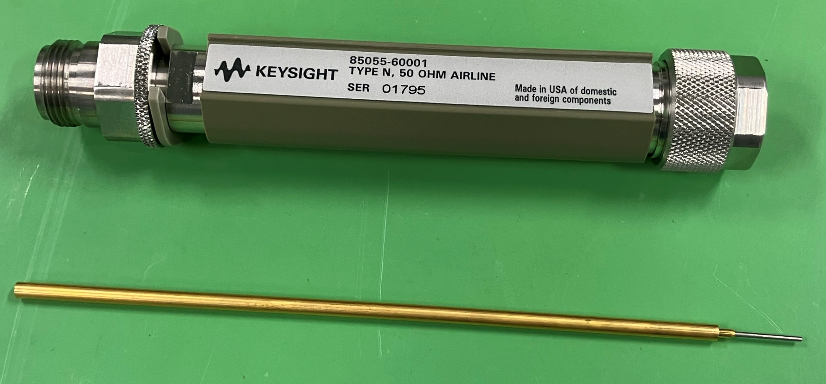
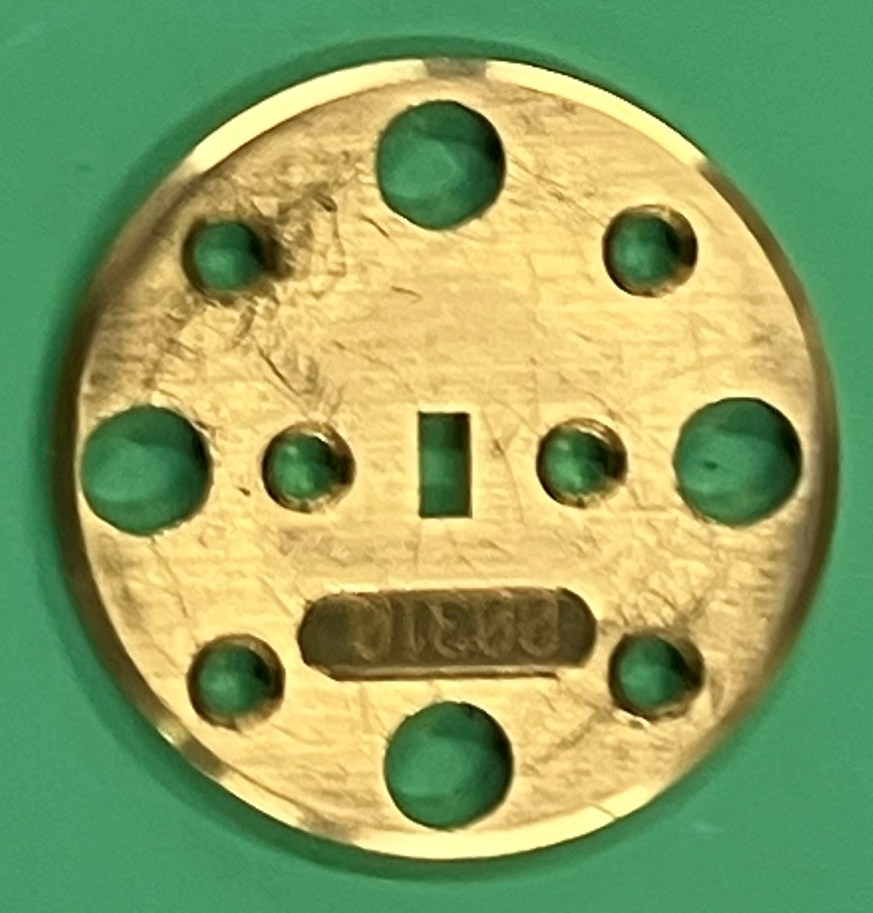
RF Impedance
Japan’s primary standard
33
GHz
50
75
110
170
220
330
500
750
1100
GHz
The primary standard of RF impedance is transmission lines, which is traceable to SI unit (length). The traceability of RF impedance is ensured by measuring impedances of calibration kits for VNA.
At NICT, the calibration kits are used to measure the reflection coefficient of RF power meters, antennas etc.. However, NICT is not supply the calibration results of RF impedance itself.
Currently, the primary standard for RF impedance in Japan is up to 33 GHz, whose standard uses PC3.5 connector. For mm-waves, waveguides (λ/4-sim) are used as the primary standard. Since ensuring the traceability of VNAs is essential to develop devices, it is hoped to support higher frequency range.
Calibration
NMIJ
Primary Standard
(Transmission line)
Vector Network Analyzer (VNA)
Calibration kit for VNA
Open
Short
Load
References
Standards Research in Japan: Latest Development of Millimeter-Wave and Submillimeter-Wave Measurements DOI: 10.1109/MMM.2013.2280242
Comparison Between Two National Metrology Institutes of Diameters and Characteristic Impedance of Coaxial Air Lines DOI: 10.1109/TIM.2008.2008465
Measurement of reflection coefficient
NICT
VNA
Power meter
$$Γ$$

Slide 10
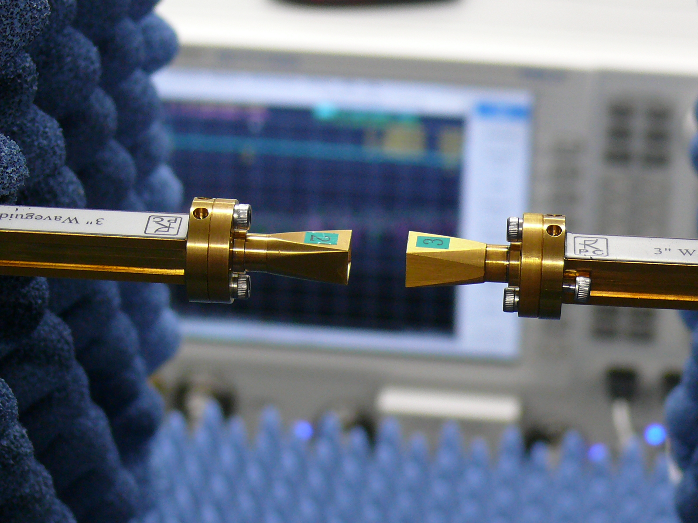
Antenna
Japan’s primary standard
1
GHz
50
75
110
170
220
330
500
750
1100
GHz
The calibration of antennas is conducted by comparing the gain of the primary standard (standard antenna) maintained by NMIJ with the gain of the antennas under calibration.
Since the primary standard provided by NMIJ is valid up to 1 GHz, for antennas above 1 GHz, the antenna gain is determined using the primary standards (RF Attenuation, RF Impedance, Length, Frequency).
Currently, NICT offers calibration services up to 40 GHz, and research has been completed up to 500 GHz. NICT is also considering calibration for the 500-750 GHz range. Additionally, research is being conducted on calibration methods for circularly polarized antennas, which may be required for collision-avoidance radars and similar applications.
NMIJ
Primary Standard
(RF attenuation, RF impedance, Length, Frequency)
Vector Network Analyzer (VNA)
NICT
References
Antenna Gain Self-calibration Method with Moving Flat Reflector for Millimeter-wave Frequency Band DOI: 10.1109/CAMA.2018.8530657
Calibration of a circularly polarized horn antenna in the frequency range from 220 to 330 GHz DOI: 10.1109/IRMMW-THz.2016.7758486
Standard Gain Horn (220 – 330 GHz)

Slide 11
Roadmap for Metrology Standards and Calibrations
NICT, which is at the top of the organization responsible for calibrating measurement instruments required for wireless licenses and NMIJ, which maintains Japan's primary standards, have jointly created a roadmap for metrology standards and calibration in the millimeter wave and THz band in May 2024.
Moving forward, research and development will be conducted in accordance with this roadmap.
Download
NICT https://rri.nict.go.jp/_assets/pdf/panf_B5g6gRoadMap.pdf
NMIJ https://unit.aist.go.jp/nmij/news/2024/pdf/20240520.pdf

Slide 12
Summary
This presentation introduced
Japan’s licensing system for radio stations as defined by the Radio Law.
The current status of metrological standards development.
NMIJ maintains the Japan’s primary standards and it provides the reference values.
NICT calibrates measurement instruments, which are required for radio licensing in Japan.
For the primary standards,
in order to be recognized as a national primary standards, both technical completion and administrative recognition must be fulfilled.
Therefore, not only technical development but also procedures for obtaining approval must be diligently pursued. After that, the THz band will be officially licensed and made available for use.

