Slide 1
Project: IEEE P802.15 Working Group for Wireless Specialty Networks (WSN)
Submission Title: Interim Call Slides Nov2024-Jan2025
Date Submitted: 25 November 2024
Source: Benjamin A. Rolfe (Blind Creek Associates)
Contact:
Voice: [deprecated],
E-Mail: ben.rolfe @ ieee.org
Re: Task Group 4ab: 802.15.4 UWB Next Generation
Abstract: Meeting Slides for the interim Webex November 2024 through January 2025
Purpose: Continue project progress and continue the illusion of organization
Notice: This document has been prepared to assist the IEEE P802.15. It is offered as a basis for discussion and is not binding on the contributing individual(s) or organization(s). The material in this document is subject to change in form and content after further study. The contributor(s) reserve(s) the right to add, amend or withdraw material contained herein.
Release: The contributor acknowledges and accepts that this contribution becomes the property of IEEE and may be made publicly available by P802.15.

Slide 2
Task Group 15.4ab Next Generation UWB Amendment
Meeting Slides for the Interim meeting
November 26th, 2024
through
January 7th 2025

Slide 3
Meeting Preamble
Stuff you need to know before we get to the meeting content

Slide 4
Task Group Rules
Discussion: Everyone present is welcome
Straw polls: Everyone present may vote
Formal motions: WG voters
To make, second and vote
Patent policy for PAR activities applies
All the usual rules of conduct
Please identify yourself on first contact with name and affiliation

Slide 5
IEEE-SA Patent, Copyright, and Participation Policies
See: https://grouper.ieee.org/groups/802/sapolicies.shtml
IEEE-SA Patent Slides for Standards Development Meetings (.pdf)
https://development.standards.ieee.org/myproject/Public/mytools/mob/slideset.pdf
IEEE-SA Standards Board Patent Committee (PatCom) home page
https://standards.ieee.org/content/ieee-standards/en/about/sasb/patcom/index.html
IEEE-SA Participation Policy meeting slide set - individual method (.pdf)
https://standards.ieee.org/content/dam/ieee-standards/standards/web/documents/other/Participant-Behavior-Individual-Method.pdf
Working Group Copyright Materials
https://standards.ieee.org/ipr/copyright-materials.html
https://standards.ieee.org/content/dam/ieee-standards/standards/web/documents/other/ieee-sa-copyright-policy-2019.pdf

Slide 6
Participants have a duty to inform the IEEE
Participants shall inform the IEEE (or cause the IEEE to be informed) of the identity of each holder of any potential Essential Patent Claims of which they are personally aware if the claims are owned or controlled by the participant or the entity the participant is from, employed by, or otherwise represents
Participants should inform the IEEE (or cause the IEEE to be informed) of the identity of any other holders of potential Essential Patent Claims
Early identification of holders of potential Essential Patent Claims is encouraged

Slide 7
Participants have a duty to inform the IEEE
Ways to inform IEEE
Cause an LOA to be submitted to the IEEE SA (patcom@ieee.org); or
Provide the chair of this group with the identity of the holder(s) of any and all such claims as soon as possible; or
Speak up now and respond to this Call for Potentially Essential Patents
If anyone in this meeting is personally aware of the holder of any patent claims that are potentially essential to implementation of the proposed standard(s) under consideration by this group and that are not already the subject of an Accepted Letter of Assurance, please respond at this time by providing relevant information to the WG Chair
Participants shall inform the IEEE (or cause the IEEE to be informed) of the identity of each holder of any potential Essential Patent Claims of which they are personally aware if the claims are owned or controlled by the participant or the entity the participant is from, employed by, or otherwise represents
Participants should inform the IEEE (or cause the IEEE to be informed) of the identity of any other holders of potential Essential Patent Claims
Early identification of holders of potential Essential Patent Claims is encouraged

Slide 8
IEEE 802 Ground Rules
Respect … give it, get it
NO product pitches
NO corporate pitches
NO prices
NO restrictive notices – (no confidentially notices in email)
Presentations must be openly available

Slide 9
Agenda
https://mentor.ieee.org/802.15/dcn/24/15-24-0668-07-04ab-tgab-agenda-november-2024-through-january-2025.xlsx

Slide 10
5.2.b Scope of the project (As approved):
This amendment enhances the Ultra Wideband (UWB) physical layers (PHYs) medium access control (MAC), and associated ranging techniques while retaining backward compatibility with enhanced ranging capable devices (ERDEVs). Areas of enhancement include:
additional coding, additional coding, preamble and modulation schemes to support improved link budget and/or reduced air-time relative to IEEE Std 802.15.4 UWB;
additional channels and operating frequencies;
interference mitigation techniques to support greater device density and higher traffic use cases relative to the IEEE Std 802.15.4 UWB;
improvements to accuracy, precision and reliability and interoperability for high-integrity ranging; schemes to reduce complexity and power consumption;
definitions for tightly coupled hybrid operation with narrowband signaling to assist UWB;
enhanced native discovery and connection setup mechanisms;
sensing capabilities to support presence detection and environment mapping;
and mechanisms supporting low-power low-latency streaming as well as high data-rate streaming allowing at least 50 Mb/s of throughput.
Support for peer-to-peer, peer-to-multi-peer, and station-to-infrastructure protocols are in scope, as are infrastructure synchronization mechanisms. This amendment includes safeguards so that the high throughput data use cases do not cause significant disruption to low duty-cycle ranging use cases.
https://development.standards.ieee.org/myproject-web/app#viewpar/9081

Slide 11
Near Term Working Milestones
 | Current Schedule
First letter ballot | June 2024
Initial LB comment resolution | Start: July 2024
First recirculation | Feb 2025
Recirculation comment resolution | March 2025
Second recirculation | May 2025
Recirculation comment resolution | June-July 2025
First SA-Ballot | July 2025
SA-Ballot comment resolution | Sept 2025
We are here
Recirc start by 20-Feb can close before the March Plenary

Slide 12
CRG
Name | Affiliation
Ben Rolfe (Chair) | BCA
Billy Verso | Qorvo
Clint Chaplin | Samsung
Riku Pirhonen | NXP
Mickael Maman | ST Microelectronics
Rojan Chitrakar | Huawei
Alex Krebs | Apple
Pooria Pakrooh | Qualcomm
Carlos Aldana | Meta
Li-Hsiang Sun | MediaTek
Quorum: 50% of CRG present

Slide 13
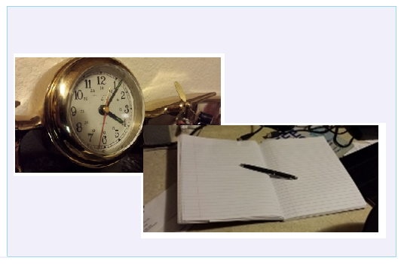
Editor’s Corner

Slide 14
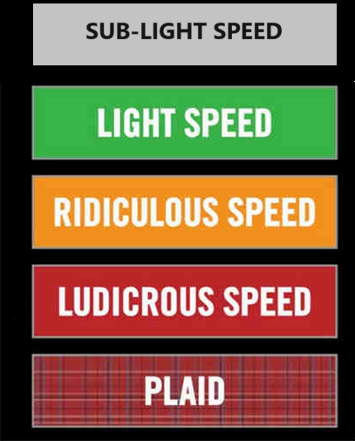
Comment resolution

Slide 15
Consolidated Comments
15-24-0371
https://mentor.ieee.org/802.15/dcn/24/15-24-0371-32-04ab-consolidated-comments-draft-1-0.xlsm

Slide 16
Any Other Business

Slide 17
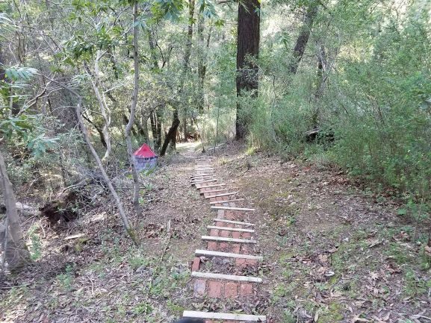
Next Steps

Slide 18
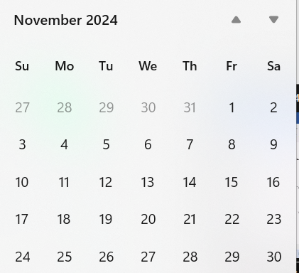
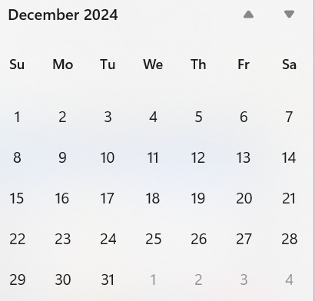
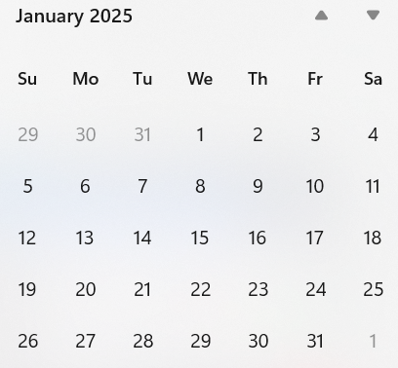
Call schedule, November thru January
Now
Next
Plenary
Wireless Interim
Commence on 26-November-2024 through January 7th
Weekly Tuesdays 06:00 PT (1 hour)
Thursdays 14:00 PT (1 hour)
Excludes November 28, December 24, 26, 31, January 2

Slide 19
Recess
November 2024 – January 2025

Slide 20
Resume from Recess Happy New Year!
Task Group 15.4ab Next Generation UWB Amendment
November 2024 – January 2025

Slide 21
Participants have a duty to inform the IEEE
Ways to inform IEEE
Cause an LOA to be submitted to the IEEE SA (patcom@ieee.org); or
Provide the chair of this group with the identity of the holder(s) of any and all such claims as soon as possible; or
Speak up now and respond to this Call for Potentially Essential Patents
If anyone in this meeting is personally aware of the holder of any patent claims that are potentially essential to implementation of the proposed standard(s) under consideration by this group and that are not already the subject of an Accepted Letter of Assurance, please respond at this time by providing relevant information to the WG Chair
Participants shall inform the IEEE (or cause the IEEE to be informed) of the identity of each holder of any potential Essential Patent Claims of which they are personally aware if the claims are owned or controlled by the participant or the entity the participant is from, employed by, or otherwise represents
Participants should inform the IEEE (or cause the IEEE to be informed) of the identity of any other holders of potential Essential Patent Claims
Early identification of holders of potential Essential Patent Claims is encouraged

Slide 22
Any Other Business

Slide 23
Adjourned

