Slide 1
802.18 to 802.15 Liaison Report January 2025
Date: 15 January 2025
Author:

Slide 2
RR-TAG at a glance
Membership as of 15 November 2024
68 voters (including 10 on LMSC)
2 nearly voters
10 aspirants
Officers
Chair: Edward Au (Huawei Technologies)
Co-Vice Chair: Gaurav Patwardhan (Hewlett Packard Enterprise)
Co-Vice Chair: Al Petrick (Jones-Petrick Associates)
IEEE SA Program Manager: Jodi Haasz (IEEE SA)

Slide 3
Progress since the 2024 November plenary
Reviewed the latest ongoing consultations
Approved the following IEEE 802 LMSC submissions:
Japan MIC: Call for opinions on the proposed ministerial ordinance to amend part of the Radio Law Enforcement Regulations: Addition of systems and bands to the special exemption system for non-technical equipment
Saudi Arabia CST: Light Licensing Regulations Annex for the 6 GHz Frequency Band
Vietnam MIC: Draft Circular amending and supplementing a number of articles of Circular No. 08/2021/TT-BTTTT dated October 14, 2021 of the Minister of Information and Communications stipulating the List of radio equipment exempted from radio frequency use licenses, technical conditions and accompanying exploitation
Discussed the latest topics related to spectrum and regulation in Europe, North America, and Asia Pacific.

Slide 4
Objectives this week (1)
Review and approve draft responses to the following consultations:
France ARCEP: Draft decision repealing decision no. 2007-0683 of 24 July 2007 as amended and setting the conditions for use of radio frequencies for equipment operating using ultra-wideband technology
UK Ofcom: Ofcom’s Plan of Work 2025/26
Review draft responses to the following external liaisons:
ITU-R Working Party 5C liaison re 450 GHz to 1000 GHz
ITU-R Working Party 5A and 5C re IEEE Std 802.15.3-2023
Discuss the latest topics related to spectrum and regulation in Europe, North America, and Asia Pacific, including ETSI BRAN update and ETSI ISG THZ liaison

Slide 5
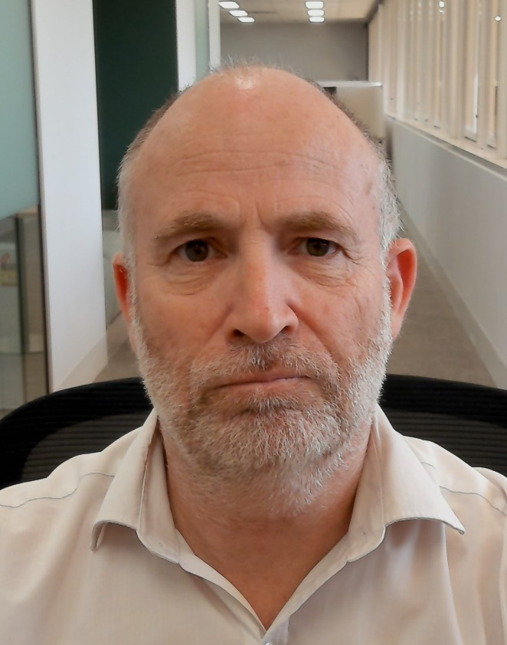
Objectives this week (2)
Invited presentation from Australia ACMA
Title: ACMA Spectrum planning for Wi-Fi
Author: Andrew Stewart (Senior Manager, Spectrum Planning Section, Australian Communications and Media Authority)
Document: 18-25/0001

