Slide 1

153rd Session of meetings of the
IEEE 802.15 Working Group for Wireless Specialty Networks (WSN)
Closing Report
Nov 10-14, 2024
Held in Vancouver & Hybrid via Webex

Slide 2
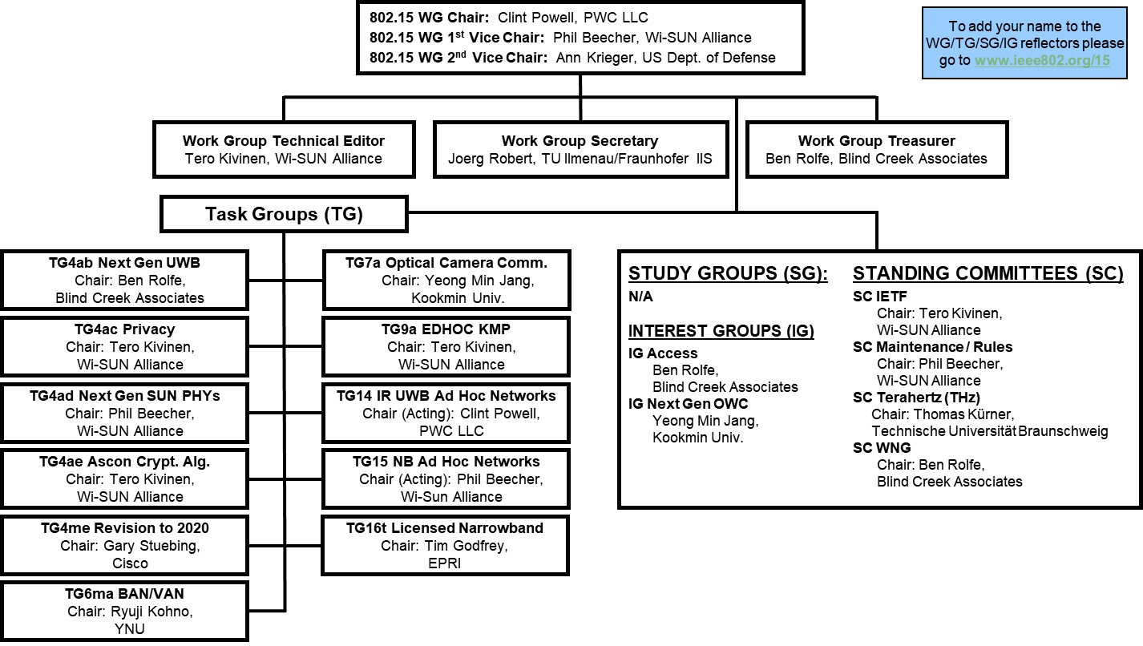
802.15 WG Org. Chart

Slide 3
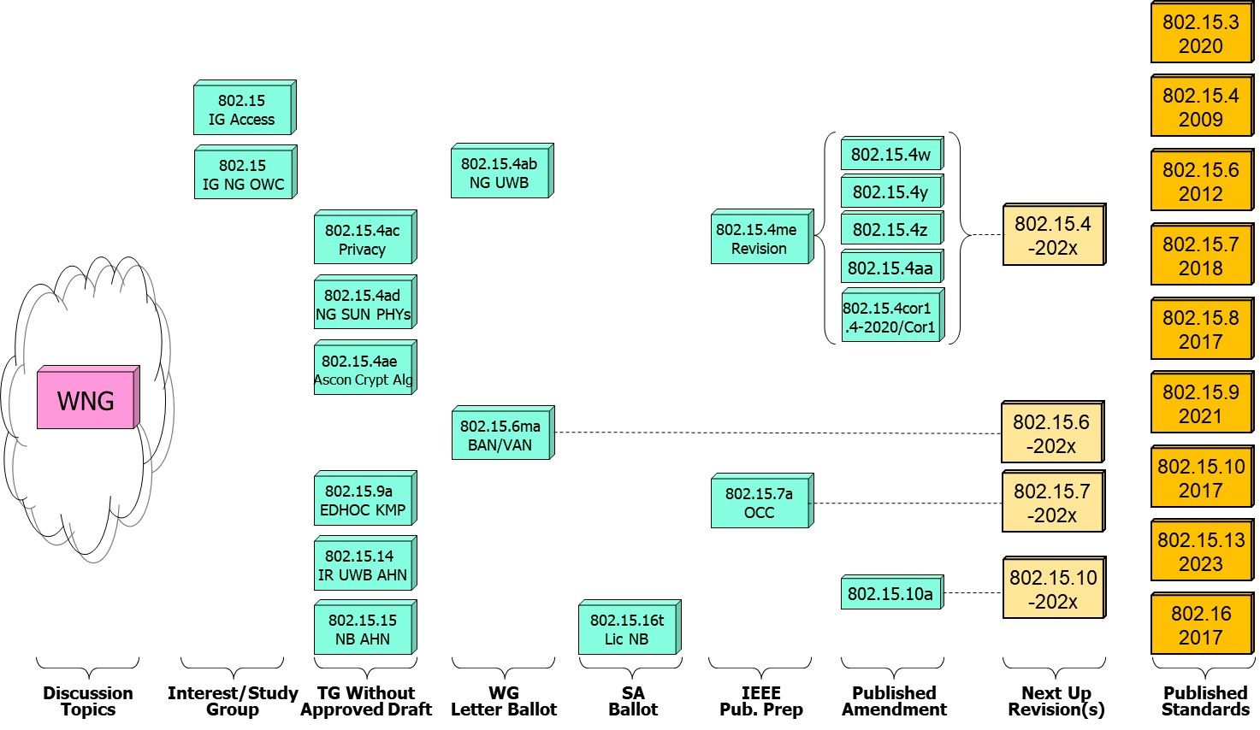
802.15 WG Standards Pipeline

Slide 4
WG15 LB Closings Update
WG15 Letter Ballots closing since the start of the previous session
  Project P802.15.6ma
  Draft / LB # D3 / LB210
  VOTERS 122
  VOTED 96
  YES 88
  ABSTAIN 8
  NO 0
  % VOTERS 78.69%
  % YES 100.00%
  % ABSTAIN 8.33%
  Did Not Vote 26
  Did Not Vote % 21.3%
  Open Date 9/20/24
  Close Date 10/20/24

Slide 5
802.15 WG Administrative
Voting members: 122
Nearly voting members: 3
Aspirant voting member: 25
Membership roster: 802.15 WG Membership Status
802.15 WG Officers - Elected March 2024
Clint Powell - Chair
Phil Beecher - 1st Vice-Chair
Ann Krieger - 2nd Vice-Chair
Joerg Robert - Secretary (appointed)
Tero Kivinen - Tech. Editor (appointed)
Ben Rolfe - Treasurer (appointed)

Slide 6
802.15 WG Operations
802.15 Operations Manual - covering Membership rules, Voting in the subgroup, Parliamentary procedures for approval to move any deliverables to the Standards Committee for action, officer scope of duties and much more…
WG15 Op's Manual
802 Operations Links
802 LMSC Op’s Manual
802 LMSC P&P
802 LMSC Chairs Guidelines
802 WCSC Op’s Manual

Slide 7
802 LMSC Annual Review of 802.15
Scope
  The 802.15 Working Group (WG) on Wireless Specialty Networks (WSN) focuses on the development of open consensus standards addressing wireless networking for the emerging Internet of Things (IoT), allowing these devices to communicate and interoperate with one another, mobile devices, wearables, etc.
    The goal of 802.15 is to publish standards, recommended practices, or guides that have broad market applicability and deal effectively with the issues of coexistence and interoperability with other wired and wireless networking solutions.
Duties
  Maintain and revise the 802.15 standards, amendments, and recommended practices
  Develop new standards when a PAR is approved by IEEE SASB and is assigned to the 802.15 WG by the IEEE 802 LMSC
  Maintain liaisons with other groups within IEEE 802 LMSC, and other relevant standards setting bodies and radio spectrum regulatory bodies
Membership
See slide 4

Slide 8
Example 802.15 WG Session
(see specific mtg. agenda for actual graphic)

Slide 9
2.6a: Designation of Individual Experts for this Session
Individual experts who attend electronically for a specific purpose/presentation can be designated as such by the WG Chair and receive a registration fee waiver and limited attendance rights.
See section 5 in https://mentor.ieee.org/802-ec/dcn/17/ec-17-0090-25-0PNP-ieee-802-lmsc-operations-manual.pdf ,
  The Working Group Chair may designate specific individual experts who are allowed to participate in Working Group discussions via electronic means during an in-person meeting for the benefit of the group. These individuals are not considered to be attending the meeting and so they are not required to pay meeting fees and they do not get participation credit. The participation of these individuals should be limited to specific technical topics. Such participation shall be documented in the minutes of the Working Group meeting.
The individuals listed below are hereby designated as specific individual experts on their respective topics and subject to the restrictions and benefits described in the 802 OM.
  n/a
  n/a
  n/a
  n/a
  n/a
For WNG, attendance for each is limited to the WNG timeslot in which the respective presentation is scheduled.

Slide 10

















IEEE 802.15 Standards & their Applications
802.15.16
802.15.4
Locating and Tracking
Ultra-low Power Sensors
Automotive
FAN/MAN/RAN
802.15.4
Multi-media networks
&
High Speed
Interconnect
802.15.3
Industrial Networks
802.15.7
802.15.13
Medical
802.15.6
Critical Infrastructure Networks
Consumer Devices
Optical
Communications
Agricultural Sensing
Structural Monitoring
10

Slide 11
IEEE 802.15
Subgroups Objectives

Slide 12
TG4ab (NG UWB) -
Next Gen. Ultra WideBand Amendment
Chair: Ben Rolfe
Objective:
Enhancements to 802.15.4 Ultra Wideband (UWB) physical layers (PHYs) media access control (MAC), and associated ranging techniques while retaining backward compatibility with enhanced ranging capable devices (ERDEVs).
TG4ab Webpage
Areas being worked on include:
Ranging
Link budget improvements
Improvements to accuracy, precision and reliability
Sensing
Pulse shape improvements
Channel impulse response reporting to support multistatic sensing
To better support presence detection, environment mapping and other uses
Data
Higher data rates for shorter transmission duration and power savings
Channel coding and packet format improvements for robustness
Additional options for even greater power savings
Protocol enhancements to support very low latency, low energy communications
Interference mitigation techniques to support:
Greater device density
Coexistence in the presence of other users
This amendment builds on top of the existing 802.15.4 standard and the 802.15.4z amendment.

Slide 13
TG4ac (Privacy) - Privacy Amendment
Chair: Tero Kivinen
Objective:
This amendment specifies modifications to the IEEE Std 802.15.4 MAC specification to specify mechanisms that address and improve user privacy. These mechanisms include randomized addresses, and exchanges that support session continuity. This amendment maintains backward compatibility with the base standard.
TG4ac Webpage
This amendment builds on top of the existing 802.15.4 standard.

Slide 14
TG4ad (NG SUN PHYs) -
Next Gen. SUN PHYs
Chair: Phil Beecher
Objective:
The amendment specifies modifications for the development of a second-generation physical layer (PHY) for Smart Utility Networks (SUN). The primary focus is the improvement of the OFDM (Orthogonal Frequency Division Multiplexing) modes for higher data rates and longer-range communication, particularly in congested license-exempt frequency bands.
TG4ad Webpage
Areas being worked on include:
Definition of use-cases
Number of devices in given area
Max. payload bit-rate
Latency requirements
Definition of frequency bands
…
Channel Models
Channel models for indoor and outdoor use
Interference models for license-exempt band operation
…
This amendment builds on top of the existing 802.15.4 standard.

Slide 15
TG4ae (Ascon Crypt. Alg.) - Amendment
Chair: Tero Kivinen
Objective:
This amendment adds the use of Ascon-128 and Ascon-128a cryptographic algorithms to the IEEE Std 802.15.4.
Ascon-128 and Ascon-128a: Ascon is a family of lightweight authenticated ciphers that has been selected by US National Institute of Standards and Technology (NIST) for future standardization of the lightweight cryptography. Ascon provides the same Authenticated Encryption with Associated Data (AEAD) functionality as Advanced Encryption Standard (AES), allowing an Ascon algorithm to be a drop-in.
TG4ae Webpage
This amendment builds on top of the existing 802.15.4 standard.

Slide 16
TG4me (Revision) - Revision to IEEE Std 802.15.4-2020
Chair: Gary Stuebing
Objective:
This project is needed to incorporate accumulated maintenance changes and corrigenda (editorial and technical corrections) into the standard and to include approved amendments.
TG4me Webpage
This is a roll up revision incorporating the following amendments:
IEEE Std 802.15.4w
IEEE Std 802.15.4y
IEEE Std 802.15.4z,
IEEE Std 802.15.4aa which are approved.
One additional amendment, P802.15.4ab, is currently under development.
This revision will replace the existing 802.15.4 standard.

Slide 17
TG6ma (BAN/VAN) - BAN with Enhanced Dependability Revision
Chair: Ryuji Kohno
Objective:
Enhancements to the Body Area Networks (BAN) Ultra Wideband (UWB) physical layer (PHY) and media access control (MAC) to support enhanced dependability to a human BAN (HBAN), adding support for vehicle BAN (VBAN.
TG6ma Webpage
Areas being worked on include:
Channel Modeling
Precise modeling of radio propagation of implant and wearable human BANs and around vehicle BANs for dependable data transmission
Classified modeling of multiple BANs and coexistence with other radios for resolution in PHY and MAC
Data transmission
Cognition of channel environment and coexistence
Initial acquisition and synchronization in coexisting BANs
FEC and hybrid ARQ according to QoS levels of data packets for various channel models and coexistence classes
Packet contention
Control and data channels, superframe formant, and MAC function to avoid packet contention in various classes of coexistence
Hybrid protocol of contention-free and contention access according to required QoS levels of data packets
Inter coordinators or hubs negotiation among coexisting BANs
Interference mitigation in coexistence
Interference surprising and canceling technologies for theoretical and feasible implementation in coexistence
Result in simpler classes of coexistence by mitigation of interference from non-BAN
Ranging
Optional ranging for cognition of dynamism of coexisting BANs
This revision builds on the existing 802.15.6 standard with enhanced dependability for human BAN and additional vehicle BAN.

Slide 18
TG7a (OCC) - Higher Rate, Longer Range Optical Camera Comms.
Chair: Yeong Min Jang
Objective:
This standard offers a global, secure, high-speed optical communication solution up to 100 Mbps and 200 m, with advantages like access to unlicensed spectrum, inherent security, and AI-enhanced features, promising for commercial and business markets.
TG7a Webpage
Areas being worked on include:
Wavelength range: 10000 nm to 190 nm in optically transparent media.
Data rate: Capable of delivering up to 100 Mbit/s.
Communication types: Designed for point-to-point and point-to-multipoint communication.
Adaptation features:
Adaptation to varying channel conditions.
Maintaining connectivity during high mobility (up to 350 km/h).
Flicker mitigation.
Radio Frequency (RF) co-existence.
Communication range: Up to 200 m.
Technology utilized:
Multiple-Input-Multiple-Output (MIMO).
MIMO-Orthogonal frequency-division multiplexing (MIMO-OFDM) for dealing with high levels of optical interference while maintaining high-rate data transmission.
Additional mechanisms:
Relaying mechanisms for enabling heterogeneous operation with existing RF wireless data communications standards.
Safety and regulation: Adheres to applicable eye safety regulations.
This amendment builds on top of the existing 802.15.7 standard.

Slide 19
TG9a (EDHOC KMP) - Amendment
Chair: Tero Kivinen
Objective:
This amendment specifies the use of EDHOC (RFC 9528) KMP for the IEEE Std 802.15.9. This standard describes support for transporting KMP datagrams to support the security functionality present in IEEE Std 802.15.4.
TG9a Webpage
This amendment builds on top of the existing 802.15.4 standard.

Slide 20
TG14 (IR UWB AHN) - Impulse Radio UWB Wireless Ad Hoc Networks
Chair: Clint Powell
Objective:
Focused on impulse radio (IR) Ultra Wideband (UWB) PHY and MAC providing precision ranging capability that is accurate to the centimeter level by including (via. referencing) the 802.15.4 IR UWB functionality into a simple focused specification.
TG14 Webpage
Objective
This TG is currently in hibernation awaiting the outcome/conclusion of the TG4me revision, to see if has satisfied the objective of this project.
This project is for a new standard that references the 802.15.4 standard.

Slide 21
TG15 (NB AHN) - Narrow Band Wireless Ad Hoc Networks
Chair: Phil Beecher
Objective:
Focused on narrow band ad hoc network PHY and MAC by including (via referencing) functionality and features of 802.15.4 into a simple focused specification.
TG15 Webpage
Objective
This TG is currently in hibernation awaiting the outcome/conclusion of the TG4me revision, to see if has satisfied the objective of this project.
This project is for a new standard that references the 802.15.4 standard.

Slide 22
TG16t (Lic NB) - Licensed Narrowband Amendment
Chair: Tim Godfrey
Objective:
Enhancements to IEEE 802.16-2017 physical layer (PHYs) and media access control (MAC) to enable operation in licensed spectrum with channel bandwidths greater than or equal to 5 kHz and less than 100 kHz. The amendment is frequency independent but focuses on spectrum less than 2 GHz. The range and data rate supported by the narrower channels are commensurate with those of the base standard, as scaled by the reduced channel bandwidth. The project also amends IEEE Std 802.16 as required to support aggregated operation in adjacent and non-adjacent channels.
TG16t Webpage
Areas being worked on include:
Definition of the Wireless MAN-NB PHY to enable operation in narrow channels
Aggregation of non-contiguous narrow channels to provide higher capacity
Enhancements to MAC to improve efficiency and reduce control overhead
Definition of a Direct Peer-to-Peer (DPP) mode to support operation without fixed infrastructure
Updates to security protocols
This amendment builds on top of the existing 802.16 standard.

Slide 23
IG Access -
WG15 Access Techniques
Chair: Ben Rolfe
Objective:
Determine interest in starting efforts for development of projects on 802.15 Access Techniques.

Slide 24
IG (NG-OWC) - Next Gen. Optical Wireless Communication
Chair: Yeong Min Jang
Objective:
Determine interest in next-generation optical wireless communication (NG-OWC) characteristics and its future applications.
Areas being worked on include:
Artificial Intelligence (AI) for NG-OWC
Integration of various AI technologies into the OWC system
Lightweight AI utilization for each developed AI technology
Channel modelling for NG-OWC
Integration of machine-learning for channel estimation
Utilization of machine learning for channel estimation for dynamic and complex channel conditions
Future applications of NG-OWC
NG-OWC encompasses fields such as IoT, underwater communication, joint communication, sensing, and localization (V2V, M2M, Drone/UAV, etc.)
NG-OWC for OWC based drone Networks
NG-OWC for Indoor/Outdoor Positioning through OWC and LiDAR integration
Deep learning-based OWC to support high mobility vehicle
Preferred camera types for OWC
Resolution: Minimum 720x540 (single-link), maximum 3840 x 2160 (multi-link)
Frame rate: Minimum 30 FPS, preferred more than 120 FPS
Spectrum: Mono, color
Light sources: IR, VL, and UV
This group will evaluate the interest in developing Next Gen OWC capabilities

Slide 25
SC IETF -
Internet Engineering Task Force
Chair: Tero Kivinen
Objective:
This standing committee brings in the information from the Internet Engineering Task Force (IETF) to the 802.15 working group. It concentrates on the IETF working groups that might be of interest to the 802.15 working group members.
SC IETF Webpage
IETF working groups followed include:
6lo, lake, suit

Slide 26
SC MAINT -
802.15 Maintenance Activities
Chair: Phil Beecher
Objective:
The Standing Committee Maintenance (SCM) has the following roles:
Reviewing comments related to possible errata on 802.15 standards and making recommendations to 802.15 Working Group
Managing and maintaining the 802.15 Operations Manual
Managing and maintaining the 802.15 Motion templates and project checklist template
Reviewing 802 PARs and ICAIDs on behalf of 802.15 Working Group
SC MAINT Webpage
SCM meets at least once during every 802 plenary and 802 wireless interim session

Slide 27
SC THz -
THz Standing Committee
Chair: Thomas Kürner
Objective:
The IEEE 802.15 Standing Committee Terahertz is chartered to explore the feasibility of Terahertz for wireless communications. The Terahertz frequency band runs roughly from 300 GHz to 3 THz, a staggering 2700 GHz of bandwidth.
SC THz Webpage
Areas being worked on include:
The IEEE 802.15 Standing Committee Terahertz is soliciting, and hearing, contributions that address numerous THz issues.
There are no immediate plans to transition the group to a study group or a task group; rather, we want to fully understand the technology status in regards to a further amendment of IEEE Std. 805.15.3-2023 or a completely new standard.
Apart from the implementation aspects of THz Communications there are important regulatory aspects to be considered. For example the allocation and identification of THz spectrum especially in conjunction with the agenda items at WRC-27 and WRC-31 are topics of the THz standing committee.

Slide 28
SC WNG -
Wireless Next Generation
Chair: Ben Rolfe
Objective:
The IEEE 802.15 Standing Committee Wireless Next Generation is chartered to facilitate discussions on new Wireless related Technologies that may be of interest to the 802.15 community, and that may lead to new 802.15 standardization projects. The WNG also provides the opportunity to address the whole 802.15 work group with issues or concerns with current techniques or technologies.
SC WNG Webpage
Areas being worked on include:
WNG topics are not limited to only the PHY layer and/or the MAC sublayer since information on the layers above the MAC including the application is very important to making sure that the PHY and MAC are appropriate, especially in the WSN environment.
Presenters in WNG are usually asked to relate the material presented and/or discussed to the work of the WG via the “usual question”:
  What do you propose the Working Group do next?
The answer usually falls into one of these categories:
Information for the group
Form an interest group to pursue
Consider in the future a new project

Slide 29
Subgroups Objectives this Session
TG 4ab (NG UWB)
  Conduct comment resolution for the Initial Letter Ballot
  Determine whether or not to start a Letter Ballot Recirc.
  Update timeline for TG
TG 4ac (Privacy)
  Continue hearing presentations on technical areas and preparing draft
  Update timeline for TG
TG 4ad (NG SUN PHYs)
  Continue hearing presentations on technical areas and channel modeling
  Update timeline for TG
TG 4ae (Ascon Crypt. Alg.)
  Continue hearing presentations on technical areas to include in the draft
  Update timeline for TG

Slide 30
Subgroups Objectives this Session
TG 4me (Revision)
  Review any feedback from IEEE Tech Editors
  Respond to comments from ISO
TG 6ma (Revision + BAN/VAN)
  Conduct comment resolution for the Initial Letter Ballot
  Determine whether or not to start a Letter Ballot Recirc.
TG 7a (OCC)
  Review any feedback from IEEE Tech Editors
  Respond to comments from ISO
TG 9a (EDHOC KMP)
  Continue hearing presentations on technical areas to include in the draft
  Update timeline for TG

Slide 31
Subgroups Objectives this Session
TG 14 (IR UWB AHN) – in hibernation, no meetings
TG 15 (NB AHN) – in hibernation, no meetings
TG 16t (Lic NB)
  Conduct comment resolution for the Initial SA Ballot
  Determine whether or not to start a SA Ballot Recirc.
  Update timeline for TG

Slide 32
Subgroups Objectives this Session
Joint 802.1/802.15
  Meeting w/802.1 on Tues. eve.
Joint 802.11/802.15
  Meeting w/802.11 on Tues. eve.
IG Access
  Continue discussing interest in potential projects
IG NG OWC
  Continue hearing presentations
  Determine next steps

Slide 33
Subgroups Objectives this Session
SC MAINTENANCE
  Review PARs submitted for LMSC approval
  Review draft of detailed development process steps checklist
  Review list of all templates for WG15 Subpage for completeness
  Review WG15 P&P for any updates
SC IETF
  Discuss IETF activities related to 802/802.15 at WG15 mid-week
SC THz
  Hearing several presentations
SC WNG
  Hearing presentations on WSN related topics

Slide 34
TG4ab (NG-UWB)
November 2024
Closing Report

Slide 35


Task Group 15.4ab
Next Generation UWB Amendment
November 2024 802 Plenary Session
Mixed Mode
Live from
Vancouver, BC, Canada

Slide 36
Session Objectives
Resolve comments
Resolve some more comments

Slide 37
Progres
864 technical comments total
Addressed 516 technical comments
  140 technical during this session
348 technical comments left to address
  89 we have proposed resolutions
  259 awaiting proposed resolutions

Slide 38

Next Steps

Slide 39
Near Term Working Milestones
 | Current Schedule
First letter ballot | June 2024
Initial LB comment resolution | Start: July 2024
First recirculation | Jan 2025
Recirculation comment resolution | Feb/March 2025
Second recirculation | March 2025
Recirculation comment resolution | March/April 2025
First SA-Ballot | May 2025
SA-Ballot comment resolution | Start July 2025
We are here

Slide 40
Forming a CRG: Volunteers
  CRG Motion: move to request the working group form a comment resolution group with the following members:
Name | Affiliation
Ben Rolfe (Chair) | BCA
Billy Verso | Qorvo
Clint Chaplin | Samsung
Riku Pirhonen | NXP
Mickael Maman | ST Microelectronics
Rojan Chitrakar | Huawei
Alex Krebs | Apple
Pooria Pakrooh | Qualcomm
Carlos Aldana | Meta
Li-Hsiang Sun | MediaTek
  Moved by: Clint Chaplin Second: Billy Verso
  Passed by unanimous consent

Slide 41
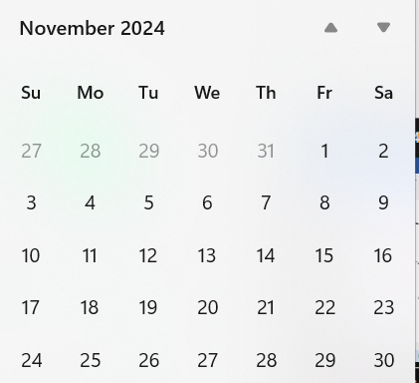
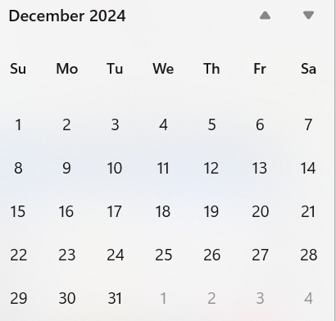
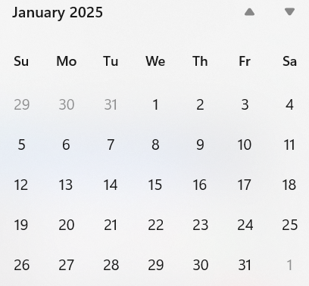
Call schedule, November thru January
Plenary
Interim
Commence on 26-November-2024 through January 7th
Weekly Tuesdays 06:00 PT (1 hour)
Thursdays 14:00 PT (1 hour)
  Excludes November 28, December 24, 26, 31, January 2
Slide 41

Slide 42
Plan for January: Resolve comments!

Slide 43
TG4ac (Privacy)
November 2024
Closing Report

Slide 44
Agenda for November
Work on the actual draft text
Issue list: 15-23-0422-05
Privacy primitives: 15-24-0166-05
Privacy MLME-primatives 15-24-0315-06
Privacy frame formats 15-24-0314-05
Slide 44

Slide 45
Detailed Agenda for November
Tuesday 12th of November 10:30-12:30
  Opening slides
  Approve agenda (this document) 15-24-0599
  Approve minutes 15-24-0495-00
  Work on the draft sharing agreement with IETF
  Go through the primitives, frame formats and MLME-primitives
Thursday 14th of November 10:30-12:30
  Check out the draft
  Closing report
Slide 45

Slide 46
More information
List of issues can be found in the document 15-23-0422.
Project task list: 15-23-0397-02
Old WNG presentation 15-22-0477
Slide 46

Slide 47
Timeline
Finalize the list of issues to be solved | Jan 2024
First version of the draft for WG pre-ballot commenting | Nov 2024
Draft ready for letter ballot | Jan 2025
Draft ready for SA ballot | Mar 2025
SA ballot start | Apr 2025
SA ballot done | Jul 2025
Submit to RevCom | Sep 2025
Standard published | Jan 2026
Slide 47

Slide 48
Meeting achievements
Updated frame formats, MLME primitives and privacy primitives documents
  MLME primitives 15-24-0315-07
  Privacy primitives: 15-24-0166-07
  Frame formats: 15-24-0314-06
Slide 48

Slide 49
Agenda for TG4ac for January
Two sessions
    No overlap with TG9a, or TG4ae.
Process pre-LB comments
Start working group LB
Slide 49

Slide 50
TG4ad (NG-SUN PHY)
November 2024
Closing Report

Slide 51
Agenda
Monday PM2:
Policies and guidelines
Call for Patents
Approval of the agenda
Approval of September meeting minutes
Presentations and Contributions
Recess
Tuesday AM2:
Presentations and Contributions
Review PAR and decide if modifications are required
Technical Guidance Document
Recess
Wednesday PM2:
Technical Guidance Document
Presentations and Contributions
Recess
Thursday AM2:
Call for Proposals
Next Steps and Timeline
AoB
Adjourn

Slide 52
Achievements
Approval of September meeting minutes
Presentations:
    https://mentor.ieee.org/802.15/dcn/24/15-24-0611-03-04ad-c-i-calculation-for-evaluation-of-transmission-characteristics-of-ieee-802-15-4ad-phy-under-interference-noise.pptx
    https://mentor.ieee.org/802.15/dcn/24/15-24-0614-01-04ad-channel-model-for-evaluation-of-transmission-characteristics-of-ieee-802-15-4ad-phy.pptx
    https://mentor.ieee.org/802.15/dcn/24/15-24-0654-00-04ad-text-proposal-for-interfer-frequency.pptx
    https://mentor.ieee.org/802.15/dcn/24/15-24-0647-02-04ad-modification-in-current-technical-guidance-document-r11-regarding-interference-scenario.pptx
    https://mentor.ieee.org/802.15/dcn/24/15-24-0645-00-04ad-dr-iot-and-tg4ad-gap-analysis.pptx
    https://mentor.ieee.org/802.15/dcn/24/15-24-0643-02-04ad-remarks-on-models-and-evaluation-of-solutions-for-tg4ad-phy-proposals.ppt
    https://mentor.ieee.org/802.15/dcn/24/15-24-0630-01-04ad-items-that-should-be-evaluated-by-the-proposers-of-the-802-15-4ad-phy.pptx
    https://mentor.ieee.org/802.15/dcn/24/15-24-0061-16-04ad-draft-802-15-4-next-generation-sun-phy-technical-guidance-document.docx
    https://mentor.ieee.org/802.15/dcn/24/15-24-0643-02-04ad-remarks-on-models-and-evaluation-of-solutions-for-tg4ad-phy-proposals.ppt
    https://mentor.ieee.org/802.15/dcn/24/15-24-0061-16-04ad-draft-802-15-4-next-generation-sun-phy-technical-guidance-document.docx
    https://mentor.ieee.org/802.15/dcn/24/15-24-0488-00-04ad-call-for-proposals.docx
Finalized and approved Technical Guidance Document
Finalized Call for Proposals

Slide 53
Proposed Timeline
2024
November: Approve Technical Guidance Document
Issue call for proposals (next week)
2025
January: Hear initial proposals
March: Hear final proposals
March and beyond: Start drafting the standard

Slide 54
Provisional Conference call schedule
No calls between November and January session

Slide 55
TG4ae (ASCON)
November 2024
Closing Report

Slide 56
Detailed Agenda for November
Monday 11th of November 16:00-18:00
  Opening slides
  Approve agenda (this document) 15-24-0600-02
  Approve minutes 15-24-0483-01
  Update and send out call for participation and call for proposals.
  Update document listing changes needed.
Wednesday 13th of November 09:00-10:00
  Update document listing changes needed.
  Closing report
Slide 56

Slide 57
TG motion to approve comments to be sent
Motion to approve document #15-24-0617-02 to be sent to NIST to provide public comments to their NIST SP 800-232 IPD.
  The comments need to be sent before February 7th, 2025.
Moved: Ann Krieger
Seconded: Don Sturek
Motion passes.
Slide 57

Slide 58
WG motion to approve comments to be sent
IEEE 802.15 WG has reviewed and approved document #15-24-0617-02 containing comments to NIST SP 800-232 Initial Public Draft, and request approval from the LMSC to send the comments to NIST.
Moved:
Seconded:
Slide 58

Slide 59
Timeline
Finalize the list of issues to be solved | Nov 2024
First version of the draft for WG pre-ballot commenting | Mar 2025
Draft ready for letter ballot | Jul 2025
Draft ready for SA ballot | Sep 2025
SA ballot start | Nov 2025
SA ballot done | Jan 2026
Submit to RevCom | Mar 2026
Standard published | Jul 2026
Slide 59

Slide 60
Meeting achievements
Sent out call for participation and call for proposals document 15-24-0482-02.
Updated document 15-24-0484-00 listing changes needed for IEEE Std 802.15.4.
Created document 15-24-0617-02 containing comments to be sent to NIST in response to their public initial draft of Ascon.
Slide 60

Slide 61
Agenda for TG4ae for January
Two meetings
    No overlap with TG9a, or TG4ac.
Review status of comments to NIST SP 800-232 IPD from TG4ae/WG15/802?
Start working on the draft.
Slide 61

Slide 62
TG6ma (BAN/VAN)
November 2024
Closing Report

Slide 63
Objectives of TG 6ma – Enhanced Dependability Body Area Network (ED-BAN)
Objective: Enhancements to the BAN Ultra Wideband (UWB) physical layer (PHY) and media access control (MAC) to support enhanced dependability to a human BAN (HBAN) and adds support for vehicle body area networks (VBAN), a coordinator in a vehicle with devices around the vehicular cabin.
Action:
•Review of Letter Ballot 210
•Comment resolution for LB 210 of draft D03
•Necessary documentation for Letter Ballot such as Coexistence Assurance Document, Progess Report, Project Task List
•Performance Evaluation of Technologies in PHY; Channel Coding According to 8 QoS Levels of Packets and Coexistence Levels, Interference Mitigation, etc.
•Performance Evaluation of Technologies in MAC; Channel Management, CCA, Hybrid Contention Free/Access Protocol According to 8 QoSs and Coexistences.
•Harmonization or Commonality with 4ab in Coexistence and Feasible Implementation of 6ma and 4ab
•Feasibility of TSN of 802.1 in MAC
•WG Motion to Recirculation
Next Things to Do： Recirculation of draft D04 for Recirculation of Letter Ballot
Slide 63

Slide 64
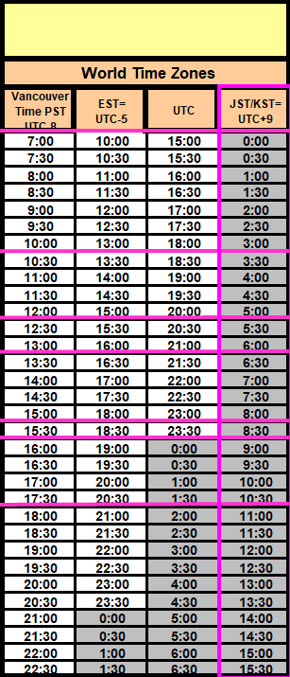
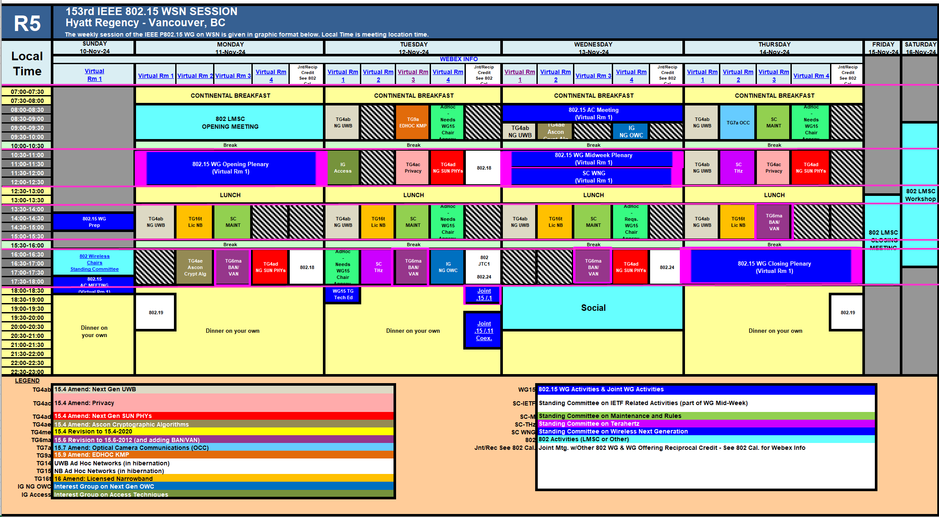
TG15.6ma Interim Session Schedule for 10th-15th, November 2024
TG15.6ma has three own sessions such as
Session1(Virtual RM#3) PM2 16:00-18:00 Nov.11(MON) in Vancouver time, 9:00-11:00 Nov.12(TUE) in JST/KST
Session2(Virtual RM#3) PM2 16:00-18:00 Nov.12(TUE) in Vancouver time, 9:00-11:00 Nov.13(WED)in JST/KST
Session3(Virtual RM#3) PM2 16:00-18:00 Nov.13(WED) in Vancouver time, 9:00-11:00 Nov.14(THU) in JST/KST
Session4(Virtual RM#3) PM1 13:30-15:30 Nov.14(THU) in Vancouver time, 6:30- 8:30 Nov,15(FRI) in JST/KST
Slide 64

Slide 65
Agenda items for the week
TG15.6ma meeting call to order
Call for essential patents and policies & procedures reminder doc.#15-24-0566-01-06ma
Approve last meeting minutes: TG 15.6ma Meeting Minutes for September 2024 doc.#15-24-0534-00-06ma
Agenda of TG15.6ma November Meeting doc.#15-24-0565-10-06ma
Review and Summary
  Overview of IG, SG, TG15.6ma doe Dependable BAN Revision of IEEE802.15.6-2012 doc.#15-23-0455-05-06ma
  Basic Consensus in MAC and PHY of Revision of IEEE802.15.6-2012(IEEE802.15.6ma) doc.#15-23-0557-05-06ma
  Review of Letter Ballot(LB)210 for draft D03 doc.#15-24-0xxx-00-06ma
  Consolidated comments & resolutions LB210 doc.#15-24-0575-03-06ma
  Rescheduling Timeline doc.#15-23-0361-08-06ma
  Presentation
  1.. Performance Improvement by Proper Sets of Preamble Codes in UWB Wireless Communications in a Presence of Multiple Coexisting VBANs doc.#15-24-0567-00-06ma
  2. Hybrid ARQ Scheme for High QoS Packets in High Class of Coexistence of IEEE 802.15.6ma #15-23-0576-06-06ma 3. Evaluation of IEEE 802.15.6 Ultra-wideband Physical Layer Utilizing Super Orthogonal Convolutional 22-0562-12-06ma
  4. Ranging Accuracy Evaluation under TG6ma Communication Senarios doc.#15-24-0248-03-06ma
  5. Simulation results of performance evaluation for MAC of UWB-BAN draft of IEEE802.15,6ma in cases of random geographical distribution of multiple coexisting BANs doc.#15-24-0yyy-00-06ma
  6 MAC Performance Evaluation of Multiple BAN Coexistence Under TG6ma Channel doc.#15-24-0246-03-06ma
  7 MAC superframe structure and frames doc.#15-24-0573-00-06ma
  8 Update of simulation results of MAC of UWB-BAN IEEE802.15.6ma in multiple BANs doc.#15-24-0602-01-06ma
  9. TG Motion to Recirculation doc.#15-24-0zzz-00-06ma
  10. Interference Mittigation Schemes in Class 3, 5, 6, and 7 of Coexisitence in TG6ma doc.#15-24-0074-05-06ma
  11. Coordinator-to-Coordinator(C2C) Ranging and Communication for Multiple BAN Coexistence 15-24-0406-00-06ma
  12. TG15.6ma Coexistence Assessment Document doc.#15-24-0348-03-06ma
  13 MAC services support for IEEE P802.1ACea doc.#15-24-0594-00-6a
  14..TG6ma Channel Model Document for Enhanced Dependability doc.#15-22-0519-07-06ma
  15. Comments to channel-model-document doc.#15-24-0073-02-06ma
  16. Progress Report of TG6ma doc.#15-23-0056-07-06ma
  17. Timeline of TG6ma doc.#15.23-0056-08-06ma
  18. TG15.6ma Closing Report for November 2024 doc.#15-24-0563-00-06ma
  19. TG15.6ma Meeting Minutes for September 2024 doc.#15-24-0565-00-06ma
Slide 65

Slide 66
TG6ma: Motion to approve the formation of CRG
Move that 802.15 WG approves the formation of a Comment Resolution Group (CRG) for the WG balloting of P802.15.6ma with the following membership: Ryuji Kohno (YNU/YRP-IAI), Huan-Bang Li(NICT), Takumi Kobayashi (Nitech), Seong-Soon Joo (KPST),. The 802.15.6ma CRG is authorized to approve comment resolutions, edit the draft according to the comment resolutions, and to approve the start of recirculation ballots of the revised draft on behalf of the 802.15 WG. Comment resolution on recirculation ballots between sessions will be conducted via reflector email and via teleconferences announced to the reflector as per the LMSC 802 WG P&P.
Moved By: Ryuji Kohno
Seconded By: Phil Beecher
Motion; Approved
Yes 29 87.9%
Abstain 3 9.1%
No 1 3.0%
Valid 33
Unexercised 0 Total 33 Voters 33
View-only Attendees 0 Non-Voters 16 Total 49
Slide 66

Slide 67
TG 6ma Timeline(expected)
Tech Req Doc July 2022
Presentation of proposals
May 2023
Comment Resolutionfor LB
Nov. 2024
Comment Resolutionfor LB2
Jan. 2025
EC approval to SB, SB submission
March 2025
SB recirculation
May 2025
WG PreBallot submission for Draft2.5 August 2024
SB recirculation if required
July 2025
Revcom Approve
Sept 2025
^{Draft V1,18 Com}
May. 2024
Recirculation (LB2)
Dec. 2024
RevcomSubmission
August 2025
Comment Resolution fo Draft v2.3 on WG for PreBallot July 2024
1st Letter Ballot(LB)
Sept. 2024
Conditional approval for Sponsor Ballot (SB)
February 2025
TRD,CMD
Call Proposals Sept 2022
Std. Draf V1.9 Proposals
Nov. 2023
Notes: SASB/RevCom scheduled for 2024 a guess
Slide 67

Slide 68
Expecting Timeline detail
Topic item | Deadline | Action items | Notes
Std Draft D2_3 WG pre-ballot recirculation. | July/2024 |  | Editorial comments from 802.15 technical editor were addressed. Still missing cross-references.
Towards the July 2024 meeting | July/2024 | Adding MAC text. Revise PHY text. Editorial revisions.
Target WG letter ballot (LB) submission: submit draft to TEG | August/2024 | Disposition of comments. | 1. Based on pre-ballot resolutions, prepare Draft D2_4 2. Request LB submission before the September meeting. Consequently, the July meeting is used to resolve comments.
TG and WG Motion to letter ballot (LB) submission: submit draft to EC | Sep/2024 | TG and WG Motion to LB | Prepare all necessary documents: Project Task List, Progress Repor, Coexistence Assurance(CA) document, TG Motion to LB, WG Motion to LB
1st LB circulation | Sep/2024 |  | Comment-resolutions to LB recirculation.
Comment Resolution for LB | Nov/2024 |  | Comment-resolutions to LB recirculation.
2nd LB recirculation | Nov/2024 |  | Comment-resolutions to LB recirculation.
Conditional approval for Sponsor Ballot (SB) | Nov/2024 |  | Seek conditional approval for SB by the Executive Committee.
Final LB recirculation. | Jan/2025 |  | WG approval to request SB submission.
Request EC approval for SB | Jan/2025 |  | Request SB approval by the EC (conditional or not)
IEEE SA Sponsor Ballot submission | March/2025 |  | One month for IEEE SA editorial review.
1st SB recirculation | May/2025 |  | Comment-resolutions to SB and recirculation.
2nd SB recirculation | Jun/2025 |  | Comment-resolutions to SB and recirculation.
Request conditional/unconditional approval to RevCom | Jun/2025 |  | Submission to SASB agenda
Final SB recirculation, if required. Submission to RevCom | July/2025 |  | Submission to SASB
RevCom submission | July/2025 |  | RevCom approval
Note: the deadlines are subject to change.
Reference: doc.#15-23-0369-09-06ma
Slide 68

Slide 69
Contributions
・TG15.6ma opening report for November 2024 meeting 15-24-0566-01-06ma
・TG15.6ma Agenda of September Meeting in 2024 15-24-0565-10-06ma
・Progress report of 802.15.6ma 15-23-0056-08-06ma
・TG6ma Necessary Documents for Letter Ballot(LB) 15-24-0489-01-06ma
・Rescheduling Timeline 15-23-0361-07-06ma
・Overview of IG-DEP, SG6a, TG6a ＆ TG15.6ma BAN with Enhanced Dependability15-23-0455-05-06ma
・Basic Consensus in MAC and PHY of Revision of IEEE802.15.6-2012 15-23-0557-05-06ma
・Review of Letter Ballot(LB)210 for draft D03 15-24-0xxx-00-06ma
・Consolidated comments & resolutions LB210 15-24-0575-03-06ma
・Propagation Channel Parameters of UWB for Human BAN (HBAN) Use Cases 15-24-0145-03-06ma
・MAC Performance Evaluation of Multiple BAN Coexistence Under TG6ma Channel Model 24-246-03
・Performance Evaluation of Channel Coding with Interleaver for Some Classes of Coexistence 24-247-02
・Ranging Accuracy Evaluation under TG6ma Communication Senarios 15-24-0248-02-06ma
・Hybrid ARQ Scheme for High QoS Packets in High Class of Coexistence of IEEE 802.15.6ma 23-0576-05
・Evaluation of IEEE 802.15.6 UWB PHY Utilizing Super Orthogonal Convolutional Code 15-22-0562-10
・MAC superframe structure and frames 15-24-0573-00-06ma
・Update of simulation results of MAC of UWB-BAN IEEE802.15.6ma in multiple BANs 15-24-0602-01-06ma
・ Coordinator-to-Coordinator(C2C) Ranging and Communication for Multiple BAN Coexistence24-0406-00・
・Proposed text for 6ma - MAC Service Features 15-24-0356-00-06ma
・Theoretical Analysis of System Performance in a Multi-BAN Coexistence Environment (Class 1)24-0357-0
・TG15.6ma Coexistence Assessment Document 15-24-0348-03-06ma
・Comments to channel-model-document 15-24-0073-02-06ma
・Overview of Interference Mittigation Schemes for Coexisitence in TG6ma 15-24-0536-00-06ma
  ・MAC services support for IEEE P802.1ACea 15-24-0594-00-6a
・Project Task List of TG6ma 15-23-0536-01-06ma
・Progress Report of TG6ma 15-23-0056-09-06ma
・Timeline of TG6ma 15.23-0361-08-06ma
・TG15.6ma Closing Report for November 2024 15-24-0563-00-06ma
・TG15.6ma Meeting Minutes for November 2024 15-24-0566-00-06ma
Slide 69

Slide 70
TG7a (OCC)
November 2024
Closing Report

Slide 71
TG Motion #1
Motion:
TG7a approves the following resolution for comment received from ISO/IEC JTC 1/SC 6 N 18278 Summary of Voting on Submission of IEEE 802.15.7-2018
“IEEE Std 802.15.7 specifies CCM* as a mandatory cipher suite. There is nothing to prevent additional, optional cipher suites being implemented to meet specific national interests”
Moved: Phil Beecher
Second: Volker Jungnickel
Approved by unanimous consent
Slide 71

Slide 72
TG Motion #2
    TG Motion to approve the formation of CRG for TG7a
Move that 802.15.7a TG approve the formation of a Comment Resolution Group (CRG) for the SA balloting of the P802.15.7a with the following membership: Yeong Min Jang(Chair), Sangsung Choi, Sang-Kyu Lim, Ryuji Kohno, and Seongsoon Joo. The 802.15.7a CRG is authorized to approve comment resolutions, edit the draft according to the comment resolutions, and to approve the start of recirculation ballots of the revised draft on behalf of the 802.15 WG. Comment resolution on recirculation ballots between sessions will be conducted via reflector email and via teleconferences announced to the reflector as per the LMSC 802 WG P&P.
Moved: Phil Beecher
Second: Volker Jungnickel
Approved by unanimous consent
Slide 72

Slide 73
WG Motion #1
TG7a: Motion to approve comment response to IEC/ISO JTC1/SC6
802.15 WG approves the comment response in document https://mentor.ieee.org/802.15/dcn/24/15-24-0652-00-0mag-response-to-iso-802-15-7-comment.docx and requests 802 LMSC to forward the response to IEC/ISO JTC1 under the PSDO agreement. 802.15 WG authorizes the 802.15 WG Chair and Technical Editor to make edits as agreed by 802 LMSC.
Moved: Phil Beecher
Second: Ann Krieger
Approved by
Slide 73

Slide 74
WG Motion #2
    WG Motion to approve the formation of CRG for TG7a
Move that 802.15 WG approve the formation of a Comment Resolution Group (CRG) for the SA balloting of the P802.15.7a with the following membership: Yeong Min Jang (Chair), Sangsung Choi, Sang-Kyu Lim, Ryuji Kohno, and Seongsoon Joo. The 802.15.7a CRG is authorized to approve comment resolutions, edit the draft according to the comment resolutions, and to approve the start of recirculation ballots of the revised draft on behalf of the 802.15 WG. Comment resolution on recirculation ballots between sessions will be conducted via reflector email and via teleconferences announced to the reflector as per the LMSC 802 WG P&P.
Moved:
Seconded:
Approved by
Slide 74

Slide 75
Plan for January Meeting
1 slot (PM1 or PM2 on Mon)
Slide 75

Slide 76
TG9a (EDHOC)
November 2024
Closing Report

Slide 77
Detailed Agenda for November
Tuesday 12th of November 08:00-10:00
  Opening slides
  Approve agenda (this document) 15-24-0601-01
  Approve minutes 15-24-0501-01
  Update and send out call for participation and call for proposals.
  Update document listing changes needed.
Thursday 14th of November 13:30-15:30
  Update document listing changes needed.
  Closing report
Slide 77

Slide 78
More information
Project task list: 15-24-0468-00
Slide 78

Slide 79
Timeline
Finalize the list of issues to be solved | Nov 2024
First version of the draft for WG pre-ballot commenting | Jan 2025
Draft ready for letter ballot | Mar 2025
Draft ready for SA ballot | Jul 2025
SA ballot start | Sep 2025
SA ballot done | Nov 2025
Submit to RevCom | Dec 2025
Standard published | Jan 2026
Slide 79

Slide 80
Meeting achievements
Updated call for participation and call for proposal document and sent it out.
Updated list of changes needed to the IEEE Std 802.15.9.
Slide 80

Slide 81
Agenda for TG9a for January
Two sessions
No overlap with TG4ac, or TG4ae.
  Finalize the draft
Slide 81

Slide 82
TG16t (LIC-NB)
November 2024
Closing Report

Slide 83
Plan for week
Monday PM1 1:30pm PST
Tuesday PM1 1:30pm PST
Wednesday PM1 1:30pm PST
Thursday PM1 1:30pm PST

Slide 84
November Meeting Start Status
SA Ballot on P802.16t D4.0 closed October 19th
Comment Resolution Spreadsheet in 802.15-24-0561r0

Slide 85
Plan for SA Recirculation
Start with D4.1 that has MEC comments resolved.
All comments resolved during meeting – resolutions in 802.15-24-0561r4
Draft D5.0 developed during week of November Plenary
Next Steps
  Complete 1st 10 day SA recirculation on D5.0 (close in early December )
  Complete 2nd 10 day SA recirculation on D6.0
  WG Motion (WG Motion in January or could be LB on Monday right after meeting) to forward 16t to RevCom
    Needs to be approved 10 days before EC meeting.
    Re-charter CRG in January
  LMSC EC Approval Feb 5th or 12th. EC Call
  RevCom Approval 14th February deadline for March SASB

Slide 86
Formation of Comment Resolution Group
Move that 802.15 WG approve the formation of a Comment Resolution Group (CRG) for the SA balloting of the P802.15.16t_D05 with the following membership: Tim Godfrey (Chair), Vishal Kalkundrikar, Harry Bims, Tero Kivinen, and Joerg Robert. The 802.15.16 CRG is authorized to approve comment resolutions, edit the draft according to the comment resolutions, and to approve the start of recirculation ballots of the revised draft on behalf of the 802.15 WG. Comment resolution on recirculation ballots between sessions will be conducted via reflector email and via teleconferences announced to the reflector as per the LMSC 802 WG P&P.
TG Vote
  Unanimous Approval

Slide 87
Teleconference / CRG Meeting
Tuesday November 26^{th --} 7am Pacific, 10am Eastern, 8:30pm India
Tuesday December 17^{th --} 7am Pacific, 10am Eastern, 8:30pm India

Slide 88
TG Motion for SA Recirculation
Move that TG16t formally requests that 802.15 WG start a Standards Association Recirculation Ballot of document P802.15.16t-D5.0.
Moved by: Tim Godfrey
Seconded by: Vishal
Result: Unanimous Consent

Slide 89
WG Motion for SA Recirculation
Move that 802.15 WG start a Standards Association Recirculation Ballot of document P802.15.16t-D5.0.
Moved by: Tim Godfrey
Seconded by: Phil Beecher
Result:

Slide 90
Revision Plans
Revision PAR to be submitted in November. On LMSC Consent Agenda, no Coexistence Assessment Document.
Harmonization – contact AAR, AREMA with a liaison letter and see if they are interested in harmonization once revision PAR starts.
Draft Revision PAR Uploaded to Mentor as “15-24-0519-02-Draft Revision PAR for 802.16-2017.pdf”
NesCom meeting January 29, Submit deadline 20 December.
Task Group will be TG16me
Draft will be P802.16

Slide 91
WG Motion for Revision PAR
Move that the Revision PAR contained in document 802.15-24-0519-02, be approved by the IEEE 802.15 WG and that the LMSC be requested to forward the PAR to NesCom. The 802.15 working group chair and technical editor are authorized to make additional modifications to the PAR as needed to reflect LMSC discussion at its closing meeting.
Moved by: Tim Godfrey
Second by: Phil Beecher

Slide 92
Project Timeline
Milestone | Date
Task Group Start | Jan 2020
SRD Approval | April 2021
SDD Approval | Jan 2022
Draft Development
Informal TG review of draft | Mar 2023
Working Group Letter Ballot | Nov 2023
Working Group Recirculation Letter Ballot | March 2024
SA Ballot | Sept 2024
SA Recirc | Nov 2024
Forward to RevCom | Feb 2025
PAR Extension NesCom Approved Sept 25 2024

Slide 93
Future Meetings
January 2025 Interim (TG16t Not Meeting In Person in January)
March 2025 Plenary
  Atlanta, GA, USA

Slide 94
IG Access
November 2024
Closing Report

Slide 95
Agenda
Opening and Meeting Reminders for non-PAR activity
Any other business
Adjourn

Slide 96
Meeting Summary
Meeting opening
  Called to order at 10:30 local time (Vancouver, BC)
  Attendance requirements reminder
  Review IEEE Policy slides for pre-PAR activity
  Review agenda:
    Noted that no agenda items were received prior to opening the plenary
    Discussion topic suggested by attendee (other business)
Discussion
  Suggestion to consider a high-level view of the variations in regulatory requirements in different regions and bands that are covered by 802 wireless standards
  Not intended to over every region, a few to start with
Next Steps:
Any other business: non heard
Adjourn at 12:10 local time

Slide 97
Recorded Attendance:
Name
Guo, Jianlin
HOSAKO, IWAO
Huang, Lei
Jones, Vincent Knowles IV
Kabbinale, Aniruddh
KOBAYASHI, Takumi
kristem, vinod
Lee, Jaegook
Luo, Xiliang
Pakrooh, Pooria
Rolfe, Benjamin
Schmidt, Reinhold
Sekine, Norihiko
So, Youngwan
Suzuki, Takafumi
Wisland, Dag
Zakaib, Larry

Slide 98
IG NG-OCC
November 2024
Closing Report

Slide 99
Session Objectives
Present seven contributions related to the future of next generation OWC(OCC, FSO, and LiFi) technology

Slide 100
Session Schedule
IG NG-OWC scheduled 2 time slots in this week meeting
- Tue. PM2 and Wed. AM1

Slide 101
Accomplishment for the meeting
1st Slot: Tue. PM2
  Meeting Objectives and Agenda Approval (604-00)
  Discussion and Approval of IG NG-OWC September 2024 Meeting Minutes(598-00)
  Present and accept the presentation from Kookmin University titled "Future Direction of MAC Protocols for NG-OWC in 3D Drone Networks" (622-00)
  Present and accept the presentation from Kookmin University titled "Edge Computing Platform for NG-OWC in Smart Factory Environment" (623-00)
  Present and accept the presentation from Kookmin University titled "Towards High-Speed, Secure Communication for Drones: The Role of FSO Networks" (624-00)
  Present and accept the presentation from Kookmin University titled "Advancing FSO Networks for Next-Generation Drone Communication System" (625-00)
  Present and accept the presentation from Kookmin University titled "Deep-learning based Invisible Light Object Detection for OWC Network in Drone Systems" (627-00)
  Recess

Slide 102
Accomplishment for the meeting
2nd Slot: Thurs. AM2
  Meeting Objectives and Agenda Approval (604-00)
  Present and accept the presentation from Kookmin University titled "Lightweight AI for NG-OWC in Constrained Environment" (626-00)
  Present and accept the presentation from Kookmin University titled "Deep Learning-based Real-time Tracking for Drone Systems" (628-00)
  Plan for January meeting: January meeting will be skipped
  Plan for IG NG-OWC
  Adjourn

Slide 103
Plan for January Meeting
January meeting will be skipped

Slide 104
  Plan for IG NG-OWC
Invite experts from other countries.
Invite contributors from research institute and companies

Slide 105
SC IETF
November 2024
Closing Report

Slide 106
Agenda for November
Discuss what will be happening in IETF 121 Dublin (November 2 – 8, 2024)
Slide 106

Slide 107
IETF 121
IETF 121 was held in Dublin between 2nd of November and 8th of November, 2024.
The proceedings are being collected:
  https://datatracker.ietf.org/meeting/121/proceedings
Slide 107

Slide 108
IETF 122
IETF 122 will be held in Bangkok, between 15th of March and 21th of March, 2025.
Registration is open:
  Registration
  There is registration fee waivers program
    Almost all remote participation requests are accepted.
    https://www.ietf.org/meeting/registration-fee-waivers/
Slide 108

Slide 109
Working groups to cover
6lo – IPv6 over Networks of Resource-constrained Nodes
Lake – Lightweight Authenticated Key Exchange
Suit – Software Updates for Internet of Things
Slide 109

Slide 110
6lo – IPv6 over Networks of Resource-constrained Nodes
Did meet in 121
  Agenda
  Video
  No minutes yet.
Slide 110

Slide 111
6lo Work in progress
  RFC Editor queue
    IPv6 ND Multicast Address Listener Registration
      https://datatracker.ietf.org/doc/draft-ietf-6lo-multicast-registration/
  Work in progress
    Transmission of SCHC-compressed Packets over IEEE 802.15.4
      https://datatracker.ietf.org/doc/draft-gomez-6lo-schc-15dot4/
    Path-Aware Semantic Addressing (PASA) for Low power and Lossy Networks
      https://datatracker.ietf.org/doc/draft-ietf-6lo-path-aware-semantic-addressing/
    IPv6 Neighbor Discovery Prefix Registration
      https://datatracker.ietf.org/doc/draft-ietf-6lo-prefix-registration/
    Transmission of IPv6 Packets over Short-Range OWC
      https://datatracker.ietf.org/doc/draft-choi-6lo-owc/
Slide 111

Slide 112
Lake – Lightweight Authenticated Key Exchange
Did meet in 121
  Agenda
  Video
  Minutes
Slide 112

Slide 113
Lake – Work in progress
Document status
  Working documents
    Lightweight Authorization using EDHOC draft-ietf-lake-authz
    Implementation Considerations for EDHOC draft-ietf-lake-edhoc-impl-cons
Slide 113

Slide 114
Suit – Software Updates for Internet of Things
Did meet in 121
  Agenda
  Video
  Minutes
Slide 114

Slide 115
Suit – Work in progress
Document status
  Publication requested
        https://datatracker.ietf.org/doc/draft-ietf-suit-manifest/
        https://datatracker.ietf.org/doc/draft-ietf-suit-mud/
        https://datatracker.ietf.org/doc/draft-ietf-suit-trust-domains/
        https://datatracker.ietf.org/doc/draft-ietf-suit-firmware-encryption/
Work in Progress (most of then almost done in WG)
  https://datatracker.ietf.org/doc/draft-ietf-suit-report/
  https://datatracker.ietf.org/doc/draft-ietf-suit-update-management/
  https://datatracker.ietf.org/doc/draft-moran-suit-mti/
Slide 115

Slide 116
BoFs in IETF 121
List of requested BoFs can be found from https://datatracker.ietf.org/doc/bof-requests
List of approved BoFs can be found from https://datatracker.ietf.org/wg/bofs/
alldispatch – IETF-Wide "Dispatch" Session BOF
diem – Digital Emblems BOF
hpwan – High Performance Wide Area Network BOF
rpp – RESTful Provisioning Protocol BOF
Deepspace – Deepspace BOF
Slide 116

Slide 117
IETF-Wide "Dispatch" Session (alldispatch)
Combination of the different dispatch groups in the IETF.
Experiment to see whether we can combine all of them.
This is meant to solve five problems:
  Proponents often have trouble figuring out where to dispatch something that spans multiple areas.
  Each Dispatch session aggravates scheduling because they have large target audiences, and consolidating them in a single time slot will simplify that problem.
  Participants with cross-area expertise, who provide valuable input for dispatching, find it difficult to attend multiple Dispatch sessions.
  Currently, Dispatch meetings sometimes result in routing to a different Dispatch, which wastes months.
  There is a common practice of "Dispatch Shopping" in which proponents attempt to discover the least rigorous venue. This consumes agenda time and can result in lower-quality work being admitted into the IETF.
Slide 117

Slide 118
Digital Emblems (diem)
International law defines a number of emblems, such as the blue helmets of United Nations peacekeeping forces, as indicative of special protections.
Such physical emblems do not translate to the digital realm and also suffer from a number of weaknesses in the physical world.
This BoF is to explore the problem space, discuss technical requirements raised by a variety of stakeholders, and help determine if there is useful work to be done in the IETF around digital emblems.
Not working group forming.
Slide 118

Slide 119
High Performance Wide Area Network (hpwan)
“High-Performance Wide Area Networks (HP-WANs) are WANs that are engineered to meet the stringent demands of high-speed, low-latency, and ultra-high-volume applications in environments such as research, academia, and large-scale data processing.
These networks must efficiently handle high-throughput transmissions (particularly for large transactions), optimize available bandwidth, and ensure resilience, often where minimizing latency is critical.
Slide 119

Slide 120
RESTful Provisioning Protocol (rpp)
The Extensible Provisioning Protocol (EPP) was standardized over 20 years ago to address the needs of domain name management between domain name registries and registrars.
Though EPP is still serving the domain name industry well, the progress in available development, integration and operational patterns, tools and technologies create a desire to have a provisioning protocol using the REST architectural style and the JSON data-interchange format.
This evolution already started in the ccTLD space and first production deployments of this approach have already seen adoption by both existing clients and a preferred way of integration for new registrars.
A REST architecture may allow easier integration between registries and registrars, thus lowering the costs for domain registration and new market entrants.
Slide 120

Slide 121
Deepspace (deepspace)
Deep space communications involve long delays (e.g., Earth to Mars is 4-20 minutes) and intermittent communications, because of orbital dynamics. The combination of long delays and intermittent communications makes the round-trip time very large and very variable. Space agencies and private sector are planning to deploy IP networks on celestial bodies, such as Moon or Mars, ground, orbits and vicinity. While deep space is defined by ITU as 2M km away from Earth, therefore excluding Moon, this work does include Moon deployment.
WG forming
Slide 121

Slide 122
SC MAINT
November 2024
Closing Report

Slide 123
SC Meeting Objectives – Agenda
    Meetings 1&2 (Monday and Tuesday)
    Policy and Procedure
    Approve Agenda
    PAR reviews
    Recess
    Meeting 3 Wednesday
    Review comment received from IEC/ISO/JTC1/SC6 for IEEE Std 802.15.9
    Review any comments or questions on existing or new standards
      Corrigendum for 802.15.4: 15-24-0635 contains the comment responses. Write PAR in January 2025
    Review any change requests for Operations Manual – none
    Motion templates (JTC1 motions, Draft Sharing motions)
    Review Project Checklist – n/a
    Recess until 9:00am Thursday
    Meeting 4 Thursday
    Joint meeting with TG7a for IEC/ISO JTC1 question(s) 8:00 to 9:00am
    SCM AoB
    Adjourn
Slide 123
Notes:
November 24
Page 123

Slide 124
802 PARs for Review
Information at https://www.ieee802.org/PARs.shtml
Nov 10-15, 2024 Vancouver, BC, CA
P802.1CB - Standard - Frame Replication and Elimination for Reliability - Revision to IEEE Standard 802.1CB-2017, PAR
P802.1CBec - Amendment - Guidance ffor Sequence Recovery Function Parameter Configuration, PAR and CSD
P802.11bq - Amendment - Enhancements for Integrated mmWave (IMMW) WLAN, PAR and CSD
P802.16 - Standard for Air Interface for Broadband Wireless Access Systems - Revision to IEEE Standard 802.16-2017, PAR
Slide 124
Notes:
November 24
Page 124

Slide 125
802 PARs for Review
Information at https://www.ieee802.org/PARs.shtml
P802.11bq - Amendment - Enhancements for Integrated mmWave (IMMW) WLAN, PAR and CSD
Comments on 802.11bq PAR:
5.2.b Scope of the project: This amendment defines standardized modifications to both the IEEE Std 802.11 physical layer (PHY) and the IEEE Std 802.11 Medium Access Control (MAC) that allows Wireless Local Area Network (WLAN) non-standalone operation in unlicensed bands between 42 GHz and 71 GHz using single-user (SU) OFDM based transmissions. The amendment requires that an 802.11 device supporting this amendment also supports at least one of the 2.4 GHz to 7.25 GHz (sub-7 GHz) unlicensed bands. The amendment expands the multi-link operation defined in the sub-7 GHz band specifications to support non-standalone operation in the unlicensed bands between 42 GHz and 71 GHz. This amendment on PHY and MAC operation in unlicensed bands between 42 GHz and 71 GHz leverages or reuses existing PHY and MAC specifications defined for the operation in sub-7 GHz bands, e.g. SU transmission PPDU format and MAC frames, and defines bandwidth modes operating in non-overlapping channels. This amendment provides coexistence mechanisms with legacy IEEE 802.11 and other IEEE 802 wireless devices (including 802.15.3 devices) operating in the unlicensed bands between 42 GHz and 71 GHz.
Slide 125
Notes:
November 24
Page 125

Slide 126
Achievements
    Reviewed PARs / CSDs
    Reviewed comments and questions on existing or new standards – in January we’ll work on Corrigendum PAR for 802.15.4 .
    Prepared motions for ISO/IEC JTC1/SC6 comment resolution submissions
    Updated example motions 15-23-0506-04-0mag
Slide 126
Notes:
November 24
Page 126

Slide 127
SC THz
November 2024
Closing Report

Slide 128
Meetings/Contributions
2 meetings on Tue PM2 and Thu AM2
18 participants (9 onsite, 9 online)
Contributions
  Contribution Power delay profile measurement for THz communications link (24/0616r2) by Hirokazu Sawada (NICT/Japan)
  Contribution Sub-Terahertz Band Wireless Fronthaul with Commercially Available Fronthaul Equipment and Optical Transceiver (24/0574) by Seung-Hyun Cho (ETRI)
  Contribution Characterization of Indoor Sub-THz Channels at 154 and 300 GHz (24/0586) by Shigenobu Sasaki (Niigata University/Japan)
  Contribution A Concept for an Agile and Flexible Spectrum Management for THz Communications (24/0580) by Thomas Kürner (TU Braunschweig)
  Contribution Initial Assessment of THz Indoor Channel with Passive Reflective Intelligent Surfaces (24/0581) ) by Thomas Kürner (TU Braunschweig)
  Contribution Preparation for WNG in KOBE (24/0657r1) by Iwao Hosako (NICT)
  x

Slide 129
Next Meetings
  Requested January meetings slots for SC THz: Three
  Future SC THz meetings planned are
    January Wireless Interim at Kobe
      A one hour special presentation will be organized during the 802.15 SC WNG meeting, (see doc. 24/0567r1)
    March – will not meet
    May Wireless Interim at Warsaw
    July – will not meet
    Sept – will not meet
    November Plenary at Bangkok

