Slide 1
Project: IEEE P802.15 Working Group for Wireless Personal Area Networks (WPANs)
Submission Title: [TG15.6ma Closing Report for November 2024]
Date Submitted: [14th November 2024]
Source: [Ryuji Kohno1,2,] [1;Yokohama National University, 2;YRP International Alliance Institute(YRP-IAI)]
Address [1; 79-5 Tokiwadai, Hodogaya-ku, Yokohama, 240-8501 Japan
2; YRP1 Blg., 3-4 HikarinoOka, Yokosuka-City, Kanagawa, 239-0847 Japan]
Voice:[1; +81-90-5408-0611], FAX: [+81-45-383-5528],
Email:[1: kohno@ynu.ac.jp, 2: kohno@yrp-iai.jp] Re: []
Abstract: [This document contains closing report for TG15.6ma for Revision of P802.15.6-2012 with Enhanced Dependability November 2024.]
Purpose: [information]
Notice: This document has been prepared to assist the IEEE P802.15. It is offered as a basis for discussion and is not binding on the contributing individual(s) or organization(s). The material in this document is subject to change in form and content after further study. The contributor(s) reserve(s) the right to add, amend or withdraw material contained herein.
Release: The contributor acknowledges and accepts that this contribution becomes the property of IEEE and may be made publicly available by P802.15.

Slide 2
IEEE 802.15 TG6ma (Revision of IEEE802.15.6-2012) Closing Report In Personal and Virtual Hybrid Interim Session Vancouver, BC, Canada November 14th, 2024 Ryuji Kohno Yokohama National University(YNU), YRP International Alliance Institute(YRP-IAI)

Slide 3
Objectives of TG 6ma – Enhanced Dependability Body Area Network (ED-BAN)
Objective: Enhancements to the BAN Ultra Wideband (UWB) physical layer (PHY) and media access control (MAC) to support enhanced dependability to a human BAN (HBAN) and adds support for vehicle body area networks (VBAN), a coordinator in a vehicle with devices around the vehicular cabin.
Action:
•Review of Letter Ballot 210
•Comment resolution for LB 210 of draft D03
•Necessary documentation for Letter Ballot such as Coexistence Assurance Document, Progess Report, Project Task List
•Performance Evaluation of Technologies in PHY; Channel Coding According to 8 QoS Levels of Packets and Coexistence Levels, Interference Mitigation, etc.
•Performance Evaluation of Technologies in MAC; Channel Management, CCA, Hybrid Contention Free/Access Protocol According to 8 QoSs and Coexistences.
•Harmonization or Commonality with 4ab in Coexistence and Feasible Implementation of 6ma and 4ab
•Feasibility of TSN of 802.1 in MAC
•WG Motion to Recirculation
Next Things to Do： Recirculation of draft D04 for Recirculation of Letter Ballot

Slide 4
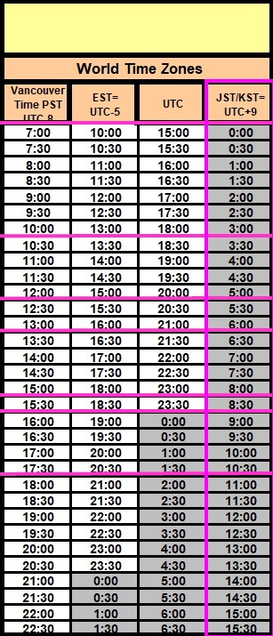
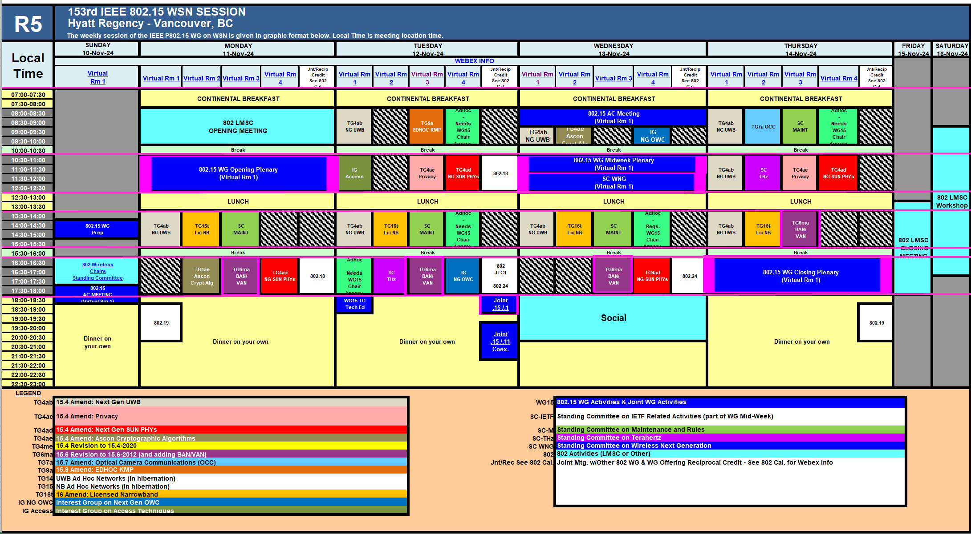
TG15.6ma Interim Session Schedule for 10th-15th, November 2024
TG15.6ma has three own sessions such as
Session1(Virtual RM#3) PM2 16:00-18:00 Nov.11(MON) in Vancouver time, 9:00-11:00 Nov.12(TUE) in JST/KST
Session2(Virtual RM#3) PM2 16:00-18:00 Nov.12(TUE) in Vancouver time, 9:00-11:00 Nov.13(WED)in JST/KST
Session3(Virtual RM#3) PM2 16:00-18:00 Nov.13(WED) in Vancouver time, 9:00-11:00 Nov.14(THU) in JST/KST
Session4(Virtual RM#3) PM1 13:30-15:30 Nov.14(THU) in Vancouver time, 6:30- 8:30 Nov,15(FRI) in JST/KST

Slide 5
Agenda items for the week
TG15.6ma meeting call to order
Call for essential patents and policies & procedures reminder doc.#15-24-0566-01-06ma
Approve last meeting minutes: TG 15.6ma Meeting Minutes for September 2024 doc.#15-24-0534-00-06ma
Agenda of TG15.6ma November Meeting doc.#15-24-0565-10-06ma
Review and Summary
Overview of IG, SG, TG15.6ma doe Dependable BAN Revision of IEEE802.15.6-2012 doc.#15-23-0455-05-06ma
Basic Consensus in MAC and PHY of Revision of IEEE802.15.6-2012(IEEE802.15.6ma) doc.#15-23-0557-05-06ma
Review of Letter Ballot(LB)210 for draft D03 doc.#15-24-0xxx-00-06ma
Consolidated comments & resolutions LB210 doc.#15-24-0575-03-06ma
Rescheduling Timeline doc.#15-23-0361-08-06ma
Presentation
1.. Performance Improvement by Proper Sets of Preamble Codes in UWB Wireless Communications in a Presence of Multiple Coexisting VBANs doc.#15-24-0567-00-06ma
2. Hybrid ARQ Scheme for High QoS Packets in High Class of Coexistence of IEEE 802.15.6ma #15-23-0576-06-06ma 3. Evaluation of IEEE 802.15.6 Ultra-wideband Physical Layer Utilizing Super Orthogonal Convolutional 22-0562-12-06ma
4. Ranging Accuracy Evaluation under TG6ma Communication Senarios doc.#15-24-0248-03-06ma
5. Simulation results of performance evaluation for MAC of UWB-BAN draft of IEEE802.15,6ma in cases of random geographical distribution of multiple coexisting BANs doc.#15-24-0yyy-00-06ma
6 MAC Performance Evaluation of Multiple BAN Coexistence Under TG6ma Channel doc.#15-24-0246-03-06ma
7 MAC superframe structure and frames doc.#15-24-0573-00-06ma
8 Update of simulation results of MAC of UWB-BAN IEEE802.15.6ma in multiple BANs doc.#15-24-0602-01-06ma
9. TG Motion to Recirculation doc.#15-24-0zzz-00-06ma
10. Interference Mittigation Schemes in Class 3, 5, 6, and 7 of Coexisitence in TG6ma doc.#15-24-0074-05-06ma
11. Coordinator-to-Coordinator(C2C) Ranging and Communication for Multiple BAN Coexistence 15-24-0406-00-06ma
12. TG15.6ma Coexistence Assessment Document doc.#15-24-0348-03-06ma
13 MAC services support for IEEE P802.1ACea doc.#15-24-0594-00-6a
14..TG6ma Channel Model Document for Enhanced Dependability doc.#15-22-0519-07-06ma
15. Comments to channel-model-document doc.#15-24-0073-02-06ma
16. Progress Report of TG6ma doc.#15-23-0056-07-06ma
17. Timeline of TG6ma doc.#15.23-0056-08-06ma
18. TG15.6ma Closing Report for November 2024 doc.#15-24-0563-00-06ma
19. TG15.6ma Meeting Minutes for September 2024 doc.#15-24-0565-00-06ma

Slide 6
TG6ma: Motion to approve the formation of CRG
Move that 802.15 WG approves the formation of a Comment Resolution Group (CRG) for the WG balloting of P802.15.6ma with the following membership: Ryuji Kohno (YNU/YRP-IAI), Huan-Bang Li(NICT), Takumi Kobayashi (Nitech), Seong-Soon Joo (KPST),. The 802.15.6ma CRG is authorized to approve comment resolutions, edit the draft according to the comment resolutions, and to approve the start of recirculation ballots of the revised draft on behalf of the 802.15 WG. Comment resolution on recirculation ballots between sessions will be conducted via reflector email and via teleconferences announced to the reflector as per the LMSC 802 WG P&P.
Moved By: Ryuji Kohno
Seconded By: Phil Beecher
Motion; Approved
Yes 29 87.9%
Abstain 3 9.1%
No 1 3.0%
Valid 33
Unexercised 0 Total 33 Voters 33
View-only Attendees 0 Non-Voters 16 Total 49

Slide 7
TG 6ma Timeline(expected)
Tech Req Doc July 2022
Presentation of proposals
May 2023
Comment Resolutionfor LB
Nov. 2024
Comment Resolutionfor LB2
Jan. 2025
EC approval to SB, SB submission
March 2025
SB recirculation
May 2025
WG PreBallot submission for Draft2.5 August 2024
SB recirculation if required
July 2025
Revcom Approve
Sept 2025
^{Draft V1,18 Com}
May. 2024
Recirculation (LB2)
Dec. 2024
RevcomSubmission
August 2025
Comment Resolution fo Draft v2.3 on WG for PreBallot July 2024
1st Letter Ballot(LB)
Sept. 2024
Conditional approval for Sponsor Ballot (SB)
February 2025
TRD,CMD
Call Proposals Sept 2022
Std. Draf V1.9 Proposals
Nov. 2023
Notes: SASB/RevCom scheduled for 2024 a guess

Slide 8
Expecting Timeline detail
Topic item | Deadline | Action items | Notes
Std Draft D2_3 WG pre-ballot recirculation. | July/2024 |  | Editorial comments from 802.15 technical editor were addressed. Still missing cross-references.
Towards the July 2024 meeting | July/2024 | Adding MAC text. Revise PHY text. Editorial revisions.
Target WG letter ballot (LB) submission: submit draft to TEG | August/2024 | Disposition of comments. | 1. Based on pre-ballot resolutions, prepare Draft D2_4 2. Request LB submission before the September meeting. Consequently, the July meeting is used to resolve comments.
TG and WG Motion to letter ballot (LB) submission: submit draft to EC | Sep/2024 | TG and WG Motion to LB | Prepare all necessary documents: Project Task List, Progress Repor, Coexistence Assurance(CA) document, TG Motion to LB, WG Motion to LB
1st LB circulation | Sep/2024 |  | Comment-resolutions to LB recirculation.
Comment Resolution for LB | Nov/2024 |  | Comment-resolutions to LB recirculation.
2nd LB recirculation | Nov/2024 |  | Comment-resolutions to LB recirculation.
Conditional approval for Sponsor Ballot (SB) | Nov/2024 |  | Seek conditional approval for SB by the Executive Committee.
Final LB recirculation. | Jan/2025 |  | WG approval to request SB submission.
Request EC approval for SB | Jan/2025 |  | Request SB approval by the EC (conditional or not)
IEEE SA Sponsor Ballot submission | March/2025 |  | One month for IEEE SA editorial review.
1st SB recirculation | May/2025 |  | Comment-resolutions to SB and recirculation.
2nd SB recirculation | Jun/2025 |  | Comment-resolutions to SB and recirculation.
Request conditional/unconditional approval to RevCom | Jun/2025 |  | Submission to SASB agenda
Final SB recirculation, if required. Submission to RevCom | July/2025 |  | Submission to SASB
RevCom submission | July/2025 |  | RevCom approval
Note: the deadlines are subject to change.
Reference: doc.#15-23-0369-09-06ma

Slide 9
Contributions
・TG15.6ma opening report for November 2024 meeting 15-24-0566-01-06ma
・TG15.6ma Agenda of September Meeting in 2024 15-24-0565-10-06ma
・Progress report of 802.15.6ma 15-23-0056-08-06ma
・TG6ma Necessary Documents for Letter Ballot(LB) 15-24-0489-01-06ma
・Rescheduling Timeline 15-23-0361-07-06ma
・Overview of IG-DEP, SG6a, TG6a ＆ TG15.6ma BAN with Enhanced Dependability15-23-0455-05-06ma
・Basic Consensus in MAC and PHY of Revision of IEEE802.15.6-2012 15-23-0557-05-06ma
・Review of Letter Ballot(LB)210 for draft D03 15-24-0xxx-00-06ma
・Consolidated comments & resolutions LB210 15-24-0575-03-06ma
・Propagation Channel Parameters of UWB for Human BAN (HBAN) Use Cases 15-24-0145-03-06ma
・MAC Performance Evaluation of Multiple BAN Coexistence Under TG6ma Channel Model 24-246-03
・Performance Evaluation of Channel Coding with Interleaver for Some Classes of Coexistence 24-247-02
・Ranging Accuracy Evaluation under TG6ma Communication Senarios 15-24-0248-02-06ma
・Hybrid ARQ Scheme for High QoS Packets in High Class of Coexistence of IEEE 802.15.6ma 23-0576-05
・Evaluation of IEEE 802.15.6 UWB PHY Utilizing Super Orthogonal Convolutional Code 15-22-0562-10
・MAC superframe structure and frames 15-24-0573-00-06ma
・Update of simulation results of MAC of UWB-BAN IEEE802.15.6ma in multiple BANs 15-24-0602-01-06ma
・ Coordinator-to-Coordinator(C2C) Ranging and Communication for Multiple BAN Coexistence24-0406-00・
・Proposed text for 6ma - MAC Service Features 15-24-0356-00-06ma
・Theoretical Analysis of System Performance in a Multi-BAN Coexistence Environment (Class 1)24-0357-0
・TG15.6ma Coexistence Assessment Document 15-24-0348-03-06ma
・Comments to channel-model-document 15-24-0073-02-06ma
・Overview of Interference Mittigation Schemes for Coexisitence in TG6ma 15-24-0536-00-06ma
・MAC services support for IEEE P802.1ACea 15-24-0594-00-6a
・Project Task List of TG6ma 15-23-0536-01-06ma
・Progress Report of TG6ma 15-23-0056-09-06ma
・Timeline of TG6ma 15.23-0361-08-06ma
・TG15.6ma Closing Report for November 2024 15-24-0563-00-06ma
・TG15.6ma Meeting Minutes for November 2024 15-24-0566-00-06ma

Slide 10
Contacts and Conference call
Chair; Ryuji Kohno, YNU/YRP-IAI
kohno@ynu.ac.jp, kohno@yrp-iai.jp
1st Vice-Chair; Marco Hernandez, CWC
marco.hernandez@ieee.org
2nd Vice-Chair; Daisuke Anzai, Nitech
anzai@nitech.ac.jp
3. Secretary; Takumi Kobayashi, Nitech/YRP-IAI
kobayashi-takumi@yrp-iai.jp, kobayashi@nitech.ac.jp
Technical Editors;
Minsoo Kim, YRP-IAI minsoo@minsookim.com
Seong-Soon Joo, KPST wowbk@kpst.co.kr
Kento Takabayashi, Toyo U. takabayashi@toyo.jp
Marco Hernandez, CWC marco.hernandez@ieee.org

Slide 11
Thank You !
Any Questions ?

