Slide 1
Project: IEEE P802.15 Working Group for Wireless Personal Area Networks (WPANs)
Submission Title : Long Range extension of the 802.15.4-2020 OFDM PHY
Date Submitted : November 14, 2024
Source : Thomas Almholt (Texas Instruments, Inc), Tomas Motos (Texas Instruments, Inc)
Re : TG4ad Next Generation SUN PHYs
Abstract : This contribution describes a new long range extension of the SUN 802.15.4 OFDM PHY with high degree of re-use of existing OFDM PHY.
Purpose: Long Range technology proposal
Notice: This document has been prepared to assist the IEEE P802.15.4ad It is offered as a basis for discussion and is not binding on the contributing individual(s) or organization(s). The material in this document is subject to change in form and content after further study. The contributor(s) reserve(s) the right to add, amend or withdraw material contained herein.
Release: The contributor acknowledges and accepts that this contribution becomes the property of IEEE and may be made publicly available by P802.15.
Slide 1
Notes:
Jul 12, 2010
Page 1

Slide 2
Agenda 1/2
Introduction
PPDU format for SUN OFDM LR
Preamble and data fields
Long Training Field
PHR
PSDU field
Data rates for SUN OFDM LR
Modulation and coding for SUN OFDM LR
Scrambler, FEC, Interleaver, DSSS
Bit-to-symbol mapping
Single subcarrier mapping
Linear Congruential Generated (LCG) subcarrier mapping
PPDU Tail field
Pad field

Slide 3
Agenda 2/2
Performance requirements
Operating Frequency Range
Transmit power spectral density (PSD) mask
Receiver sensitivity
Adjacent channel rejection, Alternate channel rejection

Slide 4
Introduction 1/5
Proposed solution provides:
This solution provide high link budget, while still being FCC 15.247 digital spread spectrum compliant (500kHz OCBW)
SC-OFDM technology provides high channel efficiency, co-channel interference tolerance / channel re-use
0dB PAPR for high efficiency analog design and low power

Slide 5
Introduction 2/5
The SUN OFDM LR PHY supports data rates ranging from 694 b/s to 16.6 kb/s. The subcarrier spacing is selectable between four values: 10.416-2/3 kHz, 20.83-1/3 kHz, 41.6-2/3 kHz and 83.3-1/3 kHz.
The symbol rate is selectable between 15 us, 30 us, 60 us or 120 us. A double symbol period is defined as twice the duration of a single symbol period, which corresponds to 30 us, 60 us, 120 us or 240 us.
This PHY includes four options, four symbol durations (SymDur, units in us) and three rate (DSSS) values. Not all combinations of options, symbol durations and rates are valid, as explained in tables 4, 5, 6 and 7. The total signal bandwidth for each option ranges from 1.2 MHz down to less than 200 kHz.

Slide 6
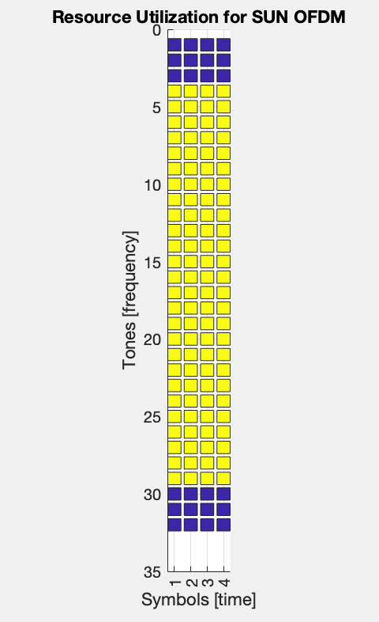
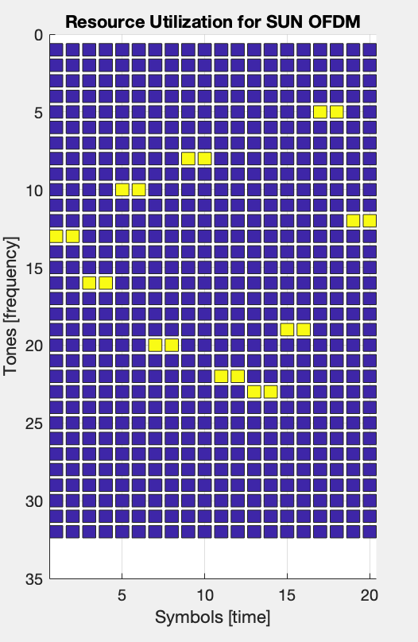
Introduction 3/5
SUN OFDM
SUN OFDM Long Range Extension
High Density / High Data Rate
Full Spectrum utilization
8-9 dB PAPR
Sparse in time / frequency domain
0 PAPR
Long Range

Slide 7
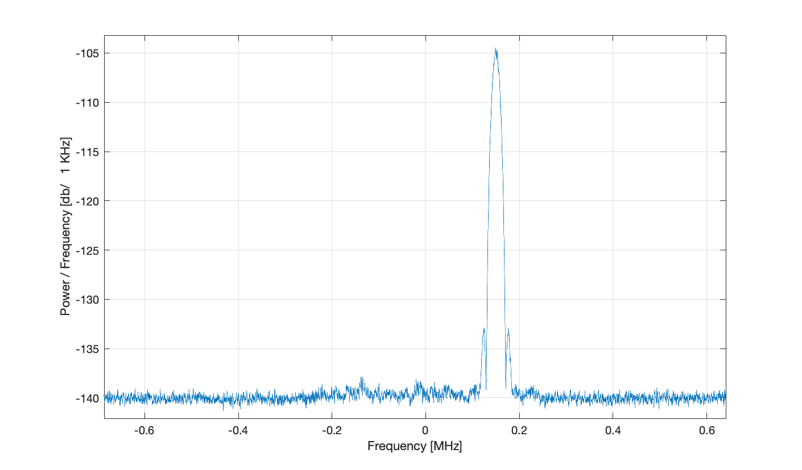
Introduction 4/5
Technique is resilient to co-channel interference.
Simulations show ~ 30 dB of in-band Interferer to wanted
Wanted Signal 3 dB over sensitivity
Unwanted Signal
Wanted Signal
Notes:
Take a look at LeCM PHY’s and see what (FSK fast hopper), original LiCM (CDMA)
Add the blocker graph from Motos
Add FCC compliance plot

Slide 8
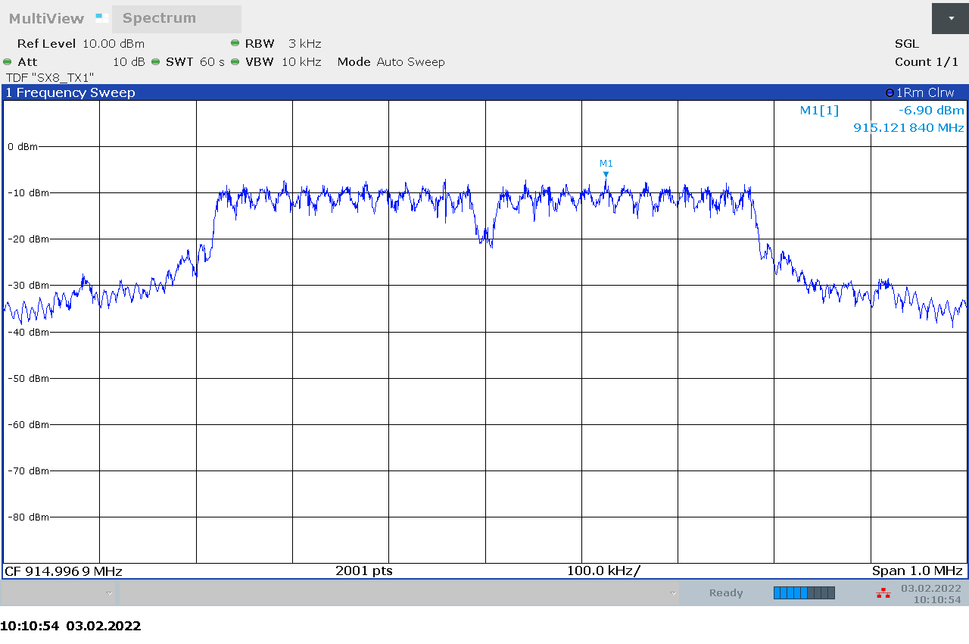
Introduction 5/5
Existing Options (1-4) from SUN-OFDM to enable world wide compliance.
Option 3 and 4 would target Europe and Japan regulations
Option 2 would target FCC
Specifically for FCC compliance with 8dBm/3kHz at maximum TX power of 30dBm a symbol rate of 120us or faster must be selected.
Notes:
Take a look at LeCM PHY’s and see what (FSK fast hopper), original LiCM (CDMA)
Add the blocker graph from Motos
Add FCC compliance plot

Slide 9
PPDU format for SUN OFDM LR
General:
The SUN OFDM LR PPDU shall be formatted as illustrated in Figure 1.
STF LTF PHR PHY Payload
The PHY Payload field shall be formatted as illustrated in Figure 2.
PSDU PPDU Tail Pad
STF | LTF | PHR | PHY Payload
Figure 1 : Format of the SUN OFDM LR PPDU
PSDU | PPDU Tail | Pad
Figure 2 – Format of the SUN OFDM LR PPDU

Slide 10
Preamble and data fields
The STF shall be a sequence of 160 symbols transmitted in one single subcarrier. The subcarrier selected for the STF shall be specified in the STF subcarrier parameter. The symbols in the STF correspond to the encoding of the STF bit pattern, first spread with DSSS=2 and then modulated using BPSK. The sequence of bits employed in the STF is represented in the table.
Index | Value | Index | Value | Index | Value | Index | Value
0 | 0 | 20 | 0 | 40 | 0 | 60 | 0
1 | 0 | 21 | 1 | 41 | 0 | 61 | 0
2 | 0 | 22 | 1 | 42 | 1 | 62 | 0
3 | 0 | 23 | 0 | 43 | 1 | 63 | 1
4 | 0 | 24 | 1 | 44 | 0 | 64 | 1
5 | 0 | 25 | 1 | 45 | 0 | 65 | 1
6 | 0 | 26 | 1 | 46 | 0 | 66 | 0
7 | 0 | 27 | 0 | 47 | 0 | 67 | 0
8 | 0 | 28 | 0 | 48 | 0 | 68 | 1
9 | 0 | 29 | 1 | 49 | 0 | 69 | 0
10 | 0 | 30 | 0 | 50 | 1 | 70 | 1
11 | 0 | 31 | 0 | 51 | 1 | 71 | 0
12 | 0 | 32 | 0 | 52 | 1 | 72 | 0
13 | 0 | 33 | 1 | 53 | 1 | 73 | 0
14 | 0 | 34 | 0 | 54 | 1 | 74 | 1
15 | 0 | 35 | 1 | 55 | 0 | 75 | 0
16 | 1 | 36 | 1 | 56 | 0 | 76 | 1
17 | 0 | 37 | 0 | 57 | 1 | 77 | 0
18 | 0 | 38 | 1 | 58 | 1 | 78 | 1
19 | 1 | 39 | 1 | 59 | 1 | 79 | 0
Table 1

Slide 11
Preamble and data fields
The LTF is a sequence of 26 bits listed below , spread using a DSSS=2 and then modulated employing the sub-channel index selection scheme as described later.
Index | Value | Index | Value | Index | Value
0 | 0 | 12 | 0 | 24 | 0
1 | 0 | 13 | 0 | 25 | 1
2 | 0 | 14 | 0
3 | 0 | 15 | 0
4 | 1 | 16 | 1
5 | 1 | 17 | 0
6 | 1 | 18 | 1
7 | 1 | 19 | 1
8 | 0 | 20 | 0
9 | 1 | 21 | 0
10 | 1 | 22 | 1
11 | 1 | 23 | 1
Table 2

Slide 12
Preamble and data fields
The PHR for SUN OFDM LR is a bit field of 24 bits, formatted as illustrated in Table 3. All multibit fields are unsigned integers and shall be processed MSB first
The PHR shall be modulated with DSSS=6, as described later (Modulation and Coding). The Rate field shall contain the DSSS used for encoding of the PHY Payload
The Frame Length field is an unsigned integer that shall be set to the total number of octets contained in the PSDU (prior to FEC encoding). The Frame Length field shall be transmitted MSB first
Bits 0-1 | 2-9 | 10-17 | 18-23
Rate | Frame Length | HCS | Tail
Table 3
DSSS value | Rate
2 | 0
4 | 1
6 | 2

Slide 13
Data rates for SUN OFDM LR
SUN OFDM LR supports four options, four spreading rates and four different symbol durations. The selected option determines the overall signal BW. The selected symbol duration translates into the bandwidth of each of the sub-carriers. The spreading rate provides an additional coding mechanism to increase redundancy and improve link budget.
Parameter | Option 1 | Option 2 | Option 3 | Option 4
Nominal bandwidth (kHz) | 1100 | 550 | 280 | 156
Channel Spacing (kHz) | 1200 | 800 | 400 | 200
DFT size | 128 | 64 | 32 | 16
Active tones | 104 | 52 | 26 | 12
Pilot tones | 0 | 0 | 0 | 0
Data tones | 104 | 52 | 26 | 12
DSSS=2 (kb/s) | 2.083 | 2.083 | 2.083 | 2.083
DSSS=4 (kb/s) | 1.041 | 1.041 | 1.041 | 1.041
DSSS=6 (kb/s) | 0.694 | 0.694 | 0.694 | 0.694
Data rates for SUN OFDM LR with SymDur = 120 us
Table 4
Parameter | Option 1 | Option 2 | Option 3
Nominal bandwidth (kHz) | 1100 | 550 | 280
Channel Spacing (kHz) | 1200 | 800 | 400
DFT size | 64 | 32 | 16
Active tones | 52 | 26 | 12
Pilot tones | 0 | 0 | 0
Data tones | 52 | 26 | 12
DSSS=2 (kb/s) | 4.167 | 4.167 | 4.167
DSSS=4 (kb/s) | 2.083 | 2.083 | 2.083
DSSS=6 (kb/s) | 1.389 | 1.389 | 1.389
Data rates for SUN OFDM LR with SymDur = 60 us
Table 5

Slide 14
Data rates for SUN OFDM LR
SUN OFDM LR supports four options, four spreading rates and four different symbol durations. The selected option determines the overall signal BW. The selected symbol duration translates into the bandwidth of each of the sub-carriers. The spreading rate provides an additional coding mechanism to increase redundancy and improve link budget.
Parameter | Option 1 | Option 2
Nominal bandwidth (kHz) | 1100 | 550
Channel Spacing (kHz) | 1200 | 800
DFT size | 32 | 16
Active tones | 26 | 12
Pilot tones | 0 | 0
Data tones | 26 | 12
DSSS=2 (kb/s) | 8.333 | 8.333
DSSS=4 (kb/s) | 4.167 | 4.167
DSSS=6 (kb/s) | 2.778 | 2.778
Data rates for SUN OFDM LR with SymDur = 30 us
Table 6
Parameter | Option 1
Nominal bandwidth (kHz) | 1100
Channel Spacing (kHz) | 1200
DFT size | 16
Active tones | 12
Pilot tones | 0
Data tones | 12
DSSS=2 (kb/s) | 16.667
DSSS=4 (kb/s) | 8.333
DSSS=6 (kb/s) | 5.556
Data rates for SUN OFDM LR with SymDur = 15 us
Table 7

Slide 15
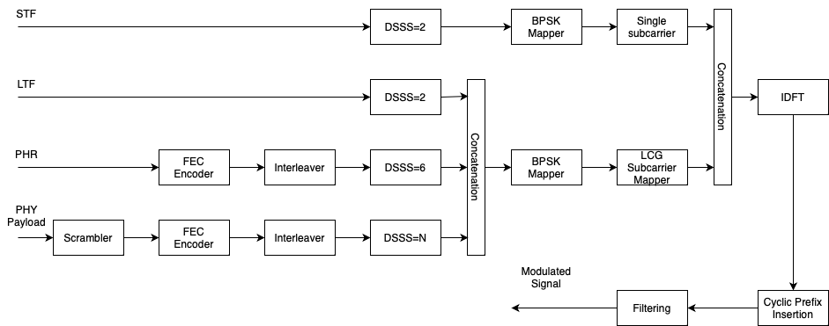
Modulation and coding for SUN OFDM LR
Reference modulator diagram

Slide 16
Modulation and coding for SUN OFDM LR
Scrambler
The inputs to the scrambler are the data octets of the PSDU. The scrambler uses a PN0 sequence that is shown in Figure 16-2. The PN9 scrambler is initialized by all ones (111111111) seed.
The scrambled bits are found using XOR operation of each of the input bits with the PN9 sequence:
$bit_{n}=\left(input bit_{n}\right) \text{XOR} (PN9_{n})$

Slide 17
Modulation and coding for SUN OFDM LR
FEC
The PHY Payload shall be coded with a convolutional encoder of coding rate R = ½. The convolutional encoder shall use the generator polynomials expressed in octal representation g0 = 133₈ and g1 = 171₈. The convolutional encoder shall be initialized to the all zeros state before encoding the PHR and then reset to the all zeros states before encoding the PHY Payload.

Slide 18
Modulation and coding for SUN OFDM LR
Interleaver
The interleaving process takes as input the sequence of 16 coded bits and produces a sequence of 16 interleaved bits. The complete sequence of coded bits of length N is defined as C={c(i)},0 ≤ I ≤ N-1. N is a multiple of 16 as the input sequence to the FEC stage is always a multiple of 8.
Let A^((p)) be a collection of consecutive NBLOCK subsequences of 16 bits each, where 0 ≤ p ≤ N_BLOCK-1 and NBLOCK = N/16. The subsequence A^((0)) shall be passed to the interleaver first in time and the subsequence A^((N_BLOCK-1)) shall be passed to the interleaver last in time.

Slide 19
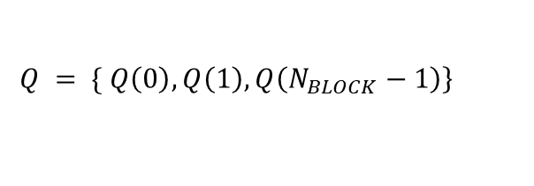
Modulation and coding for SUN OFDM LR
Each subsequence contains exactly 16 bits. The interleaving process consists of one permutation. The index of the coded bit before the first permutation shall be denoted as k; i shall be the index after the permutation.
Let be the interleaved subsequence. The complete sequence of interleaved coded bits is then expressed as:
The Interleaver shall be applied to the PHR and the PSDU.
$A^{(p)}=\{a\left(p\right)\left(k\right)\}$
$i=4×\left[k \text{mod} 4\right]+\text{floor}\left(k/4\right)$
$$Q^{\left(p\right)}=\left\{q\left(p\right)\left(i\right)\right\}$$
$$\left.Q = \{ Q\left(0\right), Q\left(1\right), Q\left(N_{BLOCK}−1\right)\right\}$$

Slide 20
Modulation and coding for SUN OFDM LR
DSSS
The N-bit input sequence to the DSSS block is converted to a sequence of N x DSSS binary valued chips.
Table 8 to 10 describe the three possible DSSS used in SUN OFDM LR. There are two tables per input bit, corresponding to the even bits in the sequence or odd bits in the sequence. k represents the index of the incoming N-input sequence, 0 < k< N-1.
K | Input bit | Chip Values (c0 c1)
K=even | 0 | 0 0
 | 1 | 0 1
K=odd | 0 | 1 1
 | 1 | 1 0
2 bit-to-chip mapping
Table 8
K | Input bit | Chip Values (c0 c1 c2 c3)
K=even | 0 | 0 0 1 1
 | 1 | 0 1 1 0
K=odd | 0 | 1 1 0 0
 | 1 | 1 0 0 1
4 bit-to-chip mapping
Table 9
K | Input bit | Chip Values (c0 c1 c2 c3 c4 c5)
K=even | 0 | 0 0 1 1 0 0
 | 1 | 0 1 1 0 1 0
K=odd | 0 | 1 1 0 0 1 1
 | 1 | 1 0 0 1 0 1
6 bit-to-chip mapping
Table 10

Slide 21
Performance requirements
Receiver sensitivity
Adjacent channel rejection
SymDur [us] | DSSS=2 | DSSS=4 | DSSS=6
120 | -118 dBm | -120 dBm | -122 dBm
60 | -115 dBm | -117 dBm | -119 dBm
30 | -112 dBm | -114 dBm | -116 dBm
15 | -109 dBm | -111 dBm | -113 dBm
 | DSSS=2 |  | DSSS=4 |  | DSSS=6
SymDur [us] | Adj (dB) | Alt (dB) | Adj (dB) | Alt (dB) | Adj (dB) | Alt (dB)
120 | 35 | 45 | 37 | 47 | 39 | 49
60 | 32 | 42 | 34 | 44 | 36 | 46
30 | 29 | 39 | 31 | 41 | 33 | 43
15 | 26 | 36 | 28 | 38 | 30 | 40

