Slide 1
Project: IEEE P802.15 Working Group for Wireless Specialty Networks
Submission Title: Coordinator-to-Coordinator(C2C) Ranging and Communication for Multiple BAN Coexistence
Date Submitted: November 10th, 2024
Source: Ryuji Kohno1,2, Minsoo Kim¹, Takumi Kobayashi^{1,2}, Marco Hernandez¹,
Company: ¹Yokosuka Research Park International Alliance Institute (YRP-IAI), Japan; ²Yokohama National University (YNU), Japan, ³Centre for Wireless Communications(CWC), University of Oulu, Finland
Address: ¹YRP 1, 3-4 Hikarino-oka, Yokosuka, 239-0847 Japan; ²79-5 Tokiwadai, Hodogaya-ku, Yokohama, 240-8501 Japan
Voice: ²+81-90-5408-0611, Fax: ²+81-45-383-5528, E-Mail:[minsoo@minsookim.com; kobayashi-takumi-ch@ynu.ac.jp, Marco.Hernandez@ieee.org; kohno@ynu.ac.jp]
Re: In response to call for technical contributions
Abstract: This document contains a discussion of coordinator-to-coordinator ranging and communication to realize the enhanced reliability of P802.15.6a.
Purpose: Material for discussion in P802.15.6a TG
Notice: This document has been prepared to assist the IEEE P802.15.6a. It is offered as a basis for discussion and is not binding on the contributing individual(s) or organization(s). The material in this document is subject to change in form and content after further study. The contributor(s) reserve(s) the right to add, amend or withdraw material contained herein.
Release: The contributor acknowledges and accepts that this contribution becomes the property of IEEE and may be made publicly available by P802.15.6a.

Slide 2
Coordinator-to-Coordinator(C2C) Ranging and Communication for Multiple BAN Coexistence
Ryuji Kohno^{1,2} , Minsoo Kim¹, Takumi Kobayashi^{1,2}, Marco Hernandez^{1,3}
¹Yokosuka Research Park International Alliance Institute (YRP-IAI)
²Yokohama National University (YNU)
³Centre for Wireless Communications(CWC), University of Oulu

Slide 3
Coordinator-to-Coordinator(C2C)
Ranging and Communications
Coordinator-to-coordinator (C2C) ranging and communication is performed through a link between BAN Coordinators, separate from links between a BAN Coordinator and BAN Nodes in each BAN in case of coexisting multiple BANs, i.e. Classes 1 and 2 of coexisting classes.
To avoid complexity, it would be preferable to use the same PHY as the link between a BAN Coordinator and BAN Nodes.
BAN
Node
BAN
Node
BAN
Node
BAN
Coordinator
BAN
Coordinator
BAN
Node
Link between Coordinators
to talk to each other
BAN
Node
BAN
Node

Slide 4
Need for C2C Ranging and Communications
Interference and collisions in dense situations
  Links between coordinators can be utilized to control channel access between 2 or more BANs to reduce collisions and interference, especially in situations where BANs are densely located.
  C2C ranging can be performed to identify situation of geographically distribution of possible coexisting multiple BANs in dynamic motion.
Support for various use cases
BAN
Node
BAN
Node
desired signal
BAN
Node
desired signal
BAN
Coordinator
BAN
Node
BAN
Coordinator
interference
collision
BAN
Node
BAN
Node

Slide 5

Possible Scenarios of C2C
Vehicle BAN and Human BANs inside the vehicle (n <= 5)
  As passengers are in the confined space, the probability of collision and the need for interference management increase.
  If a star topology is applied, Vehicle BAN can be a super-coordinator and perform central management.
  A Vehicle BAN coordinator may support up to 5 Human BAN coordinators for a passenger vehicle, such as sedan, pickup, SUV, utility vehicle.
Vehicle BAN
Coordinator
Human BAN
Coordinator
Human BAN
Coordinator

Slide 6
Possible Scenarios of C2C
Vehicle BAN and Human BANs around the vehicle
  A link between a VBAN coordinator and a HBAN coordinator outside the vehicle can also be useful in various situations.
    When approaching a pedestrian who is a family member
    When authenticating the owner of a car
Vehicle BAN
Coordinator
Human BAN Coordinator
Human BAN
Coordinator
Human BAN
Coordinator

Slide 7
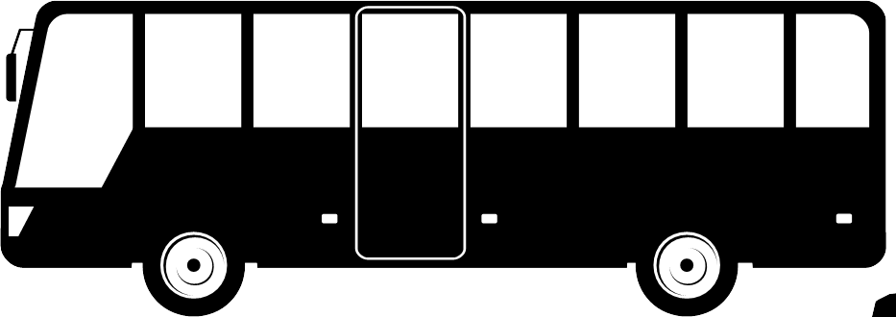
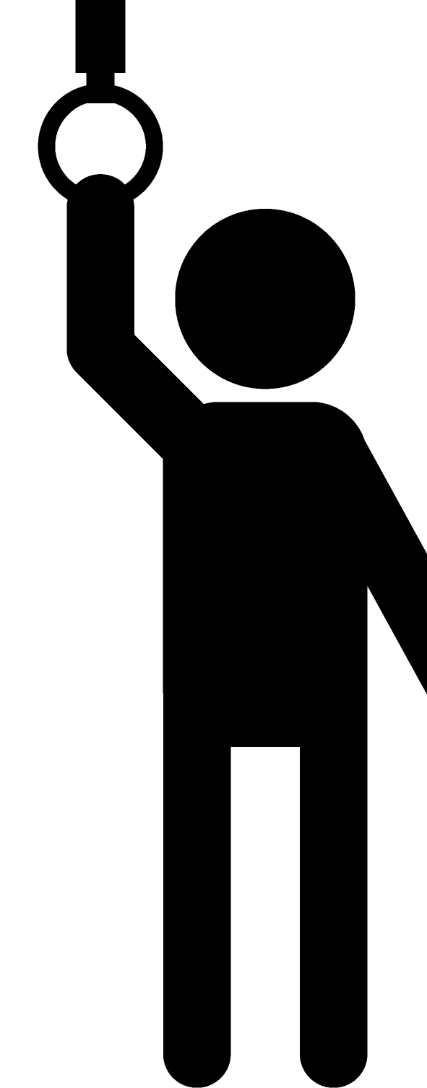
Possible Scenarios of C2C
Vehicle BAN and Human BANs inside the vehicle (n > 5)
  For a van or a bus that can accommodate more than 5 people, its Vehicle BAN should be able to accommodate more Human BANs. (for instance, up to 15 Human BAN coordinators)
  The coverage area of the Vehicle BAN should also be considered along with the size of the vehicle.
Vehicle BAN Coordinator
HC
HC
HC
HC
HC
HC
HC
HC
HC: Human BAN Coordinator

Slide 8
Possible Scenarios of C2C
Vehicle BAN and Human BANs inside the vehicle (n > 5)
  Larger vehicles can be covered by grouping Human BANs.
  Handover may be introduced, considering the similarity with the cellular network.
Vehicle BAN Coordinator #1
Vehicle BAN Coordinator #2
HC
HC
HC
HC
HC
HC
HC
HC
HC: Human BAN Coordinator

Slide 9
Possible Scenarios of C2C
Multiple Human BANs
  A star topology may be undesirable.
    Unlike the case of Vehicle BAN, it is difficult to determine a super-coordinator, because there is no superiority or inferiority between Human BANs.
    Even if a super-coordinator is selected, it cannot cover the wider area of multiple Human BANs.
Human BAN
Coordinator
Human BAN
Coordinator
Human BAN
Coordinator
Human BAN
Coordinator
Human BAN
Coordinator

Slide 10
Possible Scenarios of C2C
Multiple Human BANs
  If there is no Vehicle BAN, peer-to-peer (P2P) communication is the only option.
    However, distributed control increases complexity and communication overhead.
    If peer-to-peer communication should be employed, it should be limited to BAN Coordinators, excluding links between BAN Coordinator and BAN Nodes, to reduce overheads.
    Careful considerations are required.

Slide 11
Possible Scenarios of Handovers
Handover of Human BAN nodes
  Human BAN nodes may be handed over from its Human BAN Coordinator to a Vehicle BAN Coordinator, when its user approaches or boards the vehicle.
VBAN Coordinator
HBAN Node
HBAN Node
HBAN Node
HBAN Coordinator
HBAN Coordinator
HBAN Coordinator
Before: HBAN Node ↔ HBAN Coordinator
After: HBAN Node ↔ VBAN Coordinator

Slide 12
Possible Scenarios of Handovers
Handover of Human BAN coordinators
  Human BAN coordinators may be handed over from a Vehicle BAN Coordinator to another Vehicle BAN Coordinator, when its user moves on a bus.
Vehicle BAN Coordinator #1
Vehicle BAN Coordinator #2
HC
HC
HC
HC: Human BAN Coordinator
Before: HBAN Coordinator ↔ VBAN Coordinator #1
After: HBAN Coordinator ↔ VBAN Coordinator #2

Slide 13
Topologies of the Described Scenarios
A dependable network can be built through flexible configuration according to the use cases and QoS control with priority order.
Inside of a vehicle
Inside of a vehicle
P2P
P2P
VBAN
Coordinator
VBAN
Coordinator
P2P
1
0..1
0..1
1
0..1
0..1
Around a user
0..*
0..*
0..*
0..*
HBAN
Coordinator
HBAN
Coordinator
HBAN
Coordinator
HBAN
Coordinator
HBAN
Coordinator
1
1
1
0
1
1..*
1..*
1..*
1..*
1..*
0..*
1..*
HBAN
Node
VBAN
Node
HBAN
Node
HBAN
Node
VBAN
Node
HBAN
Node
HBAN
Node
Standalone HBANs
HBANs inside/around of a vehicle in coordination with a VBAN
HBANs inside/around of a vehicle in deep coordination with a VBAN
(HBAN nodes inside a vehicle are handed over to a VBAN coordinator)

Slide 14
Detecting other BANs
C2CP (C2C Period) that is a special time periods reserved for coordinator-to-coordinator communication may be required during management control channel in a superframe.
It should be also noted that Vehicle BAN and Human BAN have different mobility characteristics.
  Vehicle BAN coordinators and nodes are fixed on the vehicle, while Human BAN coordinators and nodes are mobile around a vehicle.

Slide 15
Summary(1/2)
Coordinator-to-coordinator (C2C) ranging and communication is presented, especially to reduce collisions and interference in situations where BANs are densely located, for instance in a hospital and a passenger bus.
Both Human BAN and Vehicle BAN are based on the same BAN standard, while Human BAN is mainly for healthcare purpose and in/on/around the human body and Vehicle BAN is for a feedback control loop and in/on/around the vehicle body. Being the same standard also allows interactive sensing and control between the human body and the vehicle.
Scenarios representing several use cases in which multiple Human BANs and/or Vehicle BAN are densely located are presented.
A 2-layer star topology was suggested for a scenario where a Vehicle BAN and Human BANs coexist, and a peer-to-peer topology where only same types of BANs coexist.
We need careful consideration of the mentioned topologies, and how to detect other BANs.

Slide 16
Summary(2/2)
C2C ranging and communications should be periodically performed in every superframe to detect and recognize a geographical and dymnamic statues of possible coexisting multiple BANs.
In particular, C2C ranging can be performed by two way ranginig (TWR) with CWC communications.
Although C2C ranging should be described in detail in standard document, it is assumed to use the same procedure as in IEEE802.15.4z.

Slide 17
Thank you for your attention!

