Slide 1
Project: IEEE P802.15 Working Group for Wireless Personal Area Networks (WPANs)
Submission Title: Regarding Timing Offset Between NB and MMS
Date Submitted: November 12, 2024
Source: Ehsan Hosseini, Koorosh Akhavan, Pooria Pakrooh, and Bin Tian (Qualcomm)
E-Mail: {ehsanh, kakhavan, ppakrooh, btian}@qti.qualcomm.com
Abstract: TBD
Notice: This document has been prepared to assist the IEEE P802.15. It is offered as a basis for discussion and is not binding on the authoring individual(s) or organization(s). The material in this document is subject to change in form and content after further study. The authors(s) reserve(s) the right to add, amend or withdraw material contained herein.

Slide 2
Introduction
According to 15.ab standard, O-QPSK PHY is expected to share a common clock source with the UWB PHY to determine the clock offset (A) to assist the MMS accumulation

Slide 3
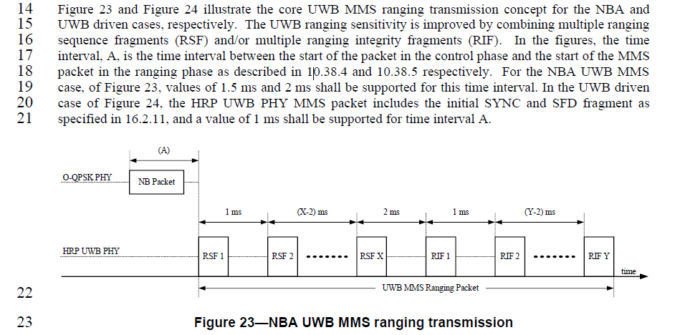
Introduction
While there is specification on the values of $A$ in the 15.4ab, there is no specification on the ‘tolerance’ of $A$

Slide 4
Tx Calibration
At the Tx, the NB signal and UWB signal go through two different Tx paths, e.g., two different Radios.
Even with timing calibration between NB and UWB at the Tx antenna, the timing offset $A$ is subject to error, $δA$.
CIR estimation is the primary operation that enables ToA estimation.
Due to Rx NB timing error $δτ$ caused by channel delay spread, noise and other impairments, the UWB receiver needs to estimate the CIR over a uncertainty window $T_{w}$, to ensure first path and strong path falls in the window.
CIR Window

Slide 5
CIR Window
$$A$$
$$δ_{A}$$
Tx
NB packet
UWB
RSF1
$$ToF$$
$$ToF$$
$$ToF$$
$$ToF$$
Rx
NB Packet
UWB
RSF1
$$A$$
$$δ_{A}+δ_{τ}$$
$$C$$
$C$: Parameter specifies the minimum CIR span to capture
$$T_{w}/2$$
$$T_{w}/2$$
$$δ_{τ}$$
physical channel
physical channel
$$T_{w}/2>max\left(\left|δ_{τ}\right|\right)+max\left(\left|δ_{A}\right|\right)+C$$

Slide 6
Discussion
The total timing error between the transmitted UWB fragment and its expected arrival time at Rx should fit in the CIR window $T_{w}$.
At Rx, we must have
$$\frac{T_{w}}{2}>max\left(\left|δA\right|\right)+max\left(\left|δτ\right|\right)+C$$
Although $T_{w}$ is a design parameter, it cannot arbitrarily grow.
We recommend defining a constraint on $δA$ to limit design complexity of the NBA-MMS UWB receivers and guarantee interoperability between devices

Slide 7
Numerical examples
Here we have computed limits on $δA$ for some examples based on some design choices for $T_{w}$ as well as assumptions on $δτ$
$$\max\left(\left|δA\right|\right)=$$ |  | $$\max\left(\left|δτ\right|\right)+C=$$
 |  | $$0$$ | $$25 chips$$ | $$50 chips$$ | $$75 chips$$ | $$100 chips$$ | $$125 chips$$ | $$150 chips$$
$$T_{w}=$$ | $$125 chips$$ | $$62 chips$$ | $$37 chips$$ | $$12 chips$$ | $$NA$$ | $$NA$$ | $$NA$$ | $$NA$$
 | $$250 chips$$ | $$125 chips$$ | $$100 chips$$ | $$75 chips$$ | $$50 chips$$ | $$25 chips$$ | $$0 chips$$ | $$NA$$
 | $$500 chips$$ | $$250 chips$$ | $$225 chips$$ | $$200 chips$$ | $$175 chips$$ | $$150 chips$$ | $$125 chips$$ | $$100 chips$$
 | $$1000 chips$$ | $$500 chips$$ | $$475 chips$$ | $$450 chips$$ | $$425 chips$$ | $$400 chips$$ | $$375 chips$$ | $$350 chips$$

Slide 8
Start-of-signal definition
We need a clear definition of Tx Start-of-Signal (SoS) for OQPSK and UWB.
The SoS for UWB fragments can be defined to be the peak of the first chip.
The SoS for OQPSK can be defined based on the baseband I/Q signal such as the red arrow shown below.
SoS

