Slide 1
Project: IEEE P802.15 Working Group for Wireless Specialty Networks (WSNs)
Submission Title: Towards High-Speed, Secure Communication for Drones: The Role of FSO Networks
Date Submitted: November 12, 2024
Source: Lai Yi Aung, Nguyen Ngoc Huy, Yeong Min Jang (Kookmin University)
Address: Room #603 Mirae Building, Kookmin University, 77 Jeongneung-Ro, Seongbuk-Gu, Seoul, 136702, Republic of Korea
Voice: +82-2-910-5068 E-Mail: yjang@kookmin.ac.kr
Re:
Abstract: Towards High-Speed, Secure Communication for Drones: The Role of FSO Networks
Purpose: Presentation for contribution on IG NG-OWC
Notice: This document has been prepared to assist the IG NG-OWC. It is offered as a basis for discussion and is not binding on the contributing individual(s) or organization(s). The material in this document is subject to change in form and content after further study. The contributor(s) reserve(s) the right to add, amend or withdraw material contained herein.
Release: The contributor acknowledges and accepts that this contribution becomes the property of IEEE and may be made publicly available by IG NG-OWC.

Slide 2
Towards High-Speed, Secure Communication for Drones: The Role of FSO Networks
November 12, 2024

Slide 3
Contents
Background
UAV platform
Requirements for System Design
Challenges
Conclusion
References

Slide 4
Background
The increasing use of drones (UAVs) is driving a surge in the demand for high-speed, secure communication in next-generation networks.
Next-generation mobile communications networks can be enhanced by vertically deployed Unmanned Aerial Vehicle (UAV) platforms integrated with Free Space Optical communications (FSO).
In dynamic situations, these systems can be tuned for secure, scalable, and real-time communications.

Slide 5
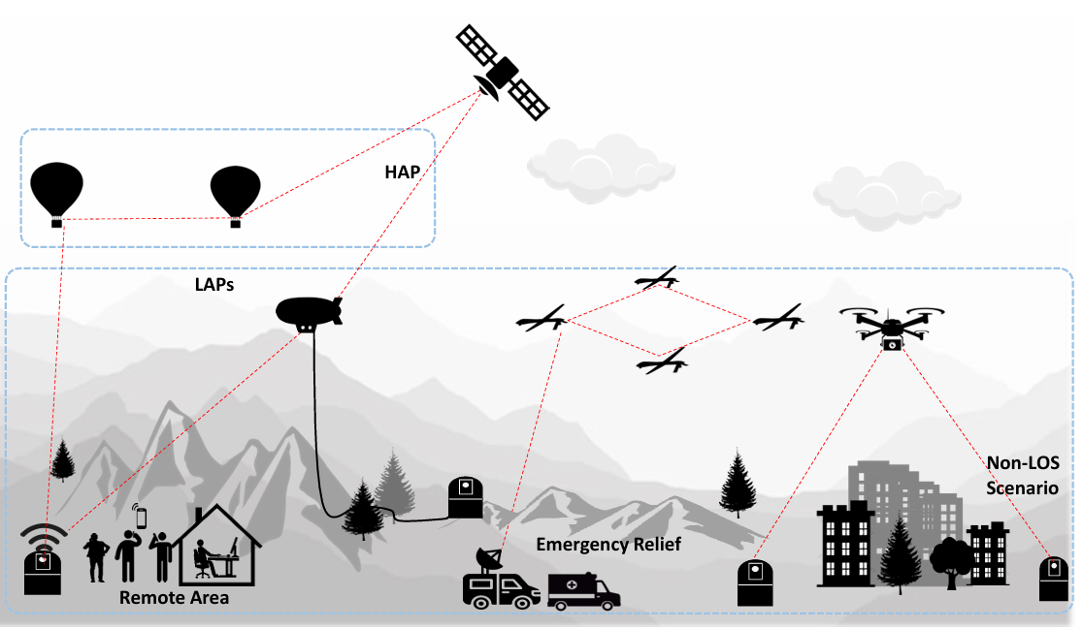
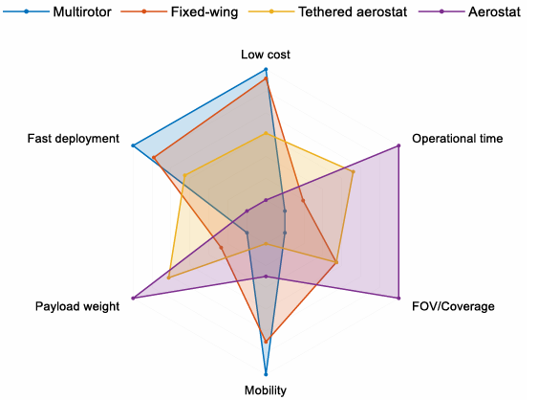
UAV platform
Fig. 1. Application of UAV-enabled 3D relay across several scenarios.
Fig. 2. Qualitative comparison of key performance indicators of different UAV platforms.
The system aims to enhance reliability and adaptability for real-time, high-data-rate applications, serving as a valuable reference for FSO-based UAV communication systems.

Slide 6
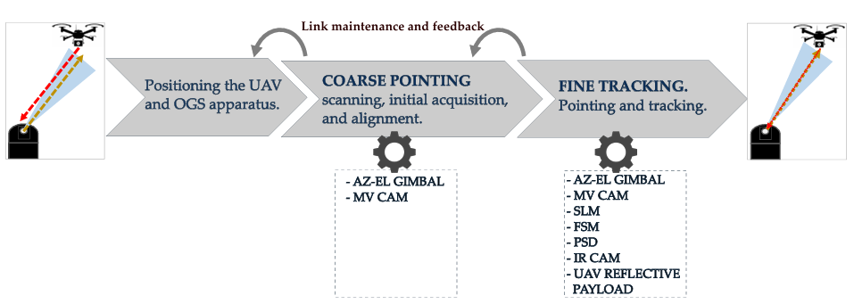
Requirements for System Design
Azimuth/Elevation - (AZ-EL) gimbals
Machine Vision Camera - (MV CAM)
Spatial Light Modulators - (SLMs)
Fast Steering Mirrors - (FSMs)
Position Sensing Detectors - (PSDs)
Fig. 3. Coarse and fine-pointing sequence summary with key OGS and UAV components utilized.

Slide 7
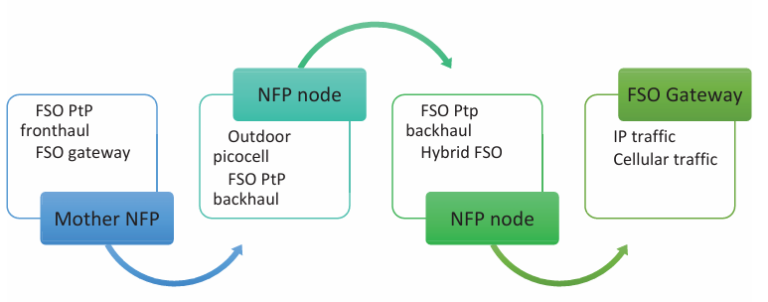
Requirements for System Design
Fig. 4. Proposed framework
This figure visually represents the innovative approach of using network forwarding points(NFPs) in a vertical architecture to enhance wireless communication, particularly in the context of 5G+ networks, addressing challenges related to coverage, capacity, and cost-effectiveness.

Slide 8
Challenges
The paper highlights challenges in UAV-FSO communication, including stable line-of-sight(LOS), handling atmospheric disturbances like rain and fog, and managing UAV payload capacity.
The challenge lies in ensuring system reliability in diverse environmental conditions and optimizing the UAV's flight parameters for optimal performance.
The widespread deployment of UAV-assisted FSO systems faces challenges due to various factors, necessitating the need to overcome these obstacles for secure, high-speed communication network advancements.

Slide 9
Conclusion
Free Space Optical (FSO) networks are essential for allowing drones to communicate securely and quickly.
It calls for more research to maximize design parameters and reliability while highlighting the significance of tackling technical issues like stability and weather effects.
UAV-FSO systems could greatly enhance aerial communication capabilities, making them suitable for future mobile and emergency networks.

Slide 10
References
NwanzeJ. Nzekwu, MarcoA.Fernandes, Gil M. Fernandes, Paulo P. Monteiro and Fernando P.Guiomar, “ AComprehensive Review of UAV-Assisted FSO Relay Systems”, Photonics 2024, 11, 274. https://doi.org/10.3390/photonics11030274
Z. Gu, J. Jiang, T. Dong, Z. Liu and Y. Ji, "Cross-Layer Topology Control Mechanism for FSO-Based UAV Relay Networks," 2024 IEEE International Conference on Communications Workshops (ICC Workshops), Denver, CO, USA, 2024, pp. 1274-1279, doi: 10.1109/ICCWorkshops59551.2024.10615902.
A. C. Campos, M. A. Fernandes, G. M. Fernandes, P. P. Monteiro and F. P. Guiomar, "Flexible and Cost-Efficient Auto-Alignment for Bidirectional Optical Wireless Communications," 2024 24th International Conference on Transparent Optical Networks (ICTON), Bari, Italy, 2024, pp. 1-4, doi: 10.1109/ICTON62926.2024.10647241.
H. Khalid et al., "HOOPOE: High Performance and Efficient Anonymous Handover Authentication Protocol for Flying Out of Zone UAVs," in IEEE Transactions on Vehicular Technology, vol. 72, no. 8, pp. 10906-10920, Aug. 2023, doi: 10.1109/TVT.2023.3262173.

