Slide 1
Project: IEEE P802.15 Working Group for Wireless Personal Area Networks (WPANs)
Submission Title: [C/I calculation for Evaluation of Transmission Characteristics of IEEE 802.15.4ad PHY under Interference Noise]
Date Submitted: 11 November 2024
Source: Hiroshi Harada Jaeseok Lim (Kyoto University)
Address Yoshidahonmachi. Sakyo, Kyoto, 606-8501, Japan
Voice: +81-75-753-5317 , E-Mail: hiroshi.harada@i.kyoto-u.ac.jp
Re: [Wireless Next Generation, Long Range extension enhancements to 802.15.4-2020]
Abstract: Discuss C/I calculation for Evaluation of Transmission Characteristics of IEEE 802.15.4ad PHY under Interference Noise. A part of this contribution was supported from the commissioned research (No. JPJ012368C05101) by National Institute of Information and Communications Technology (NICT) , Japan.
Purpose: Propose C/I calculation scheme to evaluate proposed systems for IEEE 802.15.4ad.
Notice: This document has been prepared to assist the IEEE P802.15. It is offered as a basis for discussion and is not binding on the contributing individual(s) or organization(s). The material in this document is subject to change in form and content after further study. The contributor(s) reserve(s) the right to add, amend or withdraw material contained herein.
Release: The contributor acknowledges and accepts that this contribution becomes the property of IEEE and may be made publicly available by P802.15.

Slide 2
C/I calculation for Evaluation of Transmission Characteristics of IEEE 802.15.4ad PHY under Interference Noise
September 2024
Nov. 11, 2024
Hiroshi Harada Jaeseok Lim

Slide 3
Background
September 2024
Doc#512 provided a proposal for a method to evaluate 802.15.4ad PHY under interference.
Based on #512, the group has been agreed that interference should be generated in restricted time and frequency ranges per packet for the purpose of evaluating the physical layer.
The group has been agreed that the relationship between C/I and PER will be evaluated using the above interference generated.
However, because the calculation method for C/I is not defined in the group, there is a possibility that the evaluation results will vary between different proposers.
In this contribution, we propose a method for defining C/I.

Slide 4
Interference generation (modified from #512)
Starting time
(randomly decided per packet)
Center frequency
(randomly decided per packet)
Interference bandwidth
Interference time duration
Interference
Generator
Interference
(Frequency, Time domain)
Carrier bandwidth
Carrier time duration
Interference is generated as band-limited white noise;
Starting time is randomly generated within the carrier time duration
Center frequency is randomly generated within the carrier bandwidth
Carrier Power
C/I

Slide 5
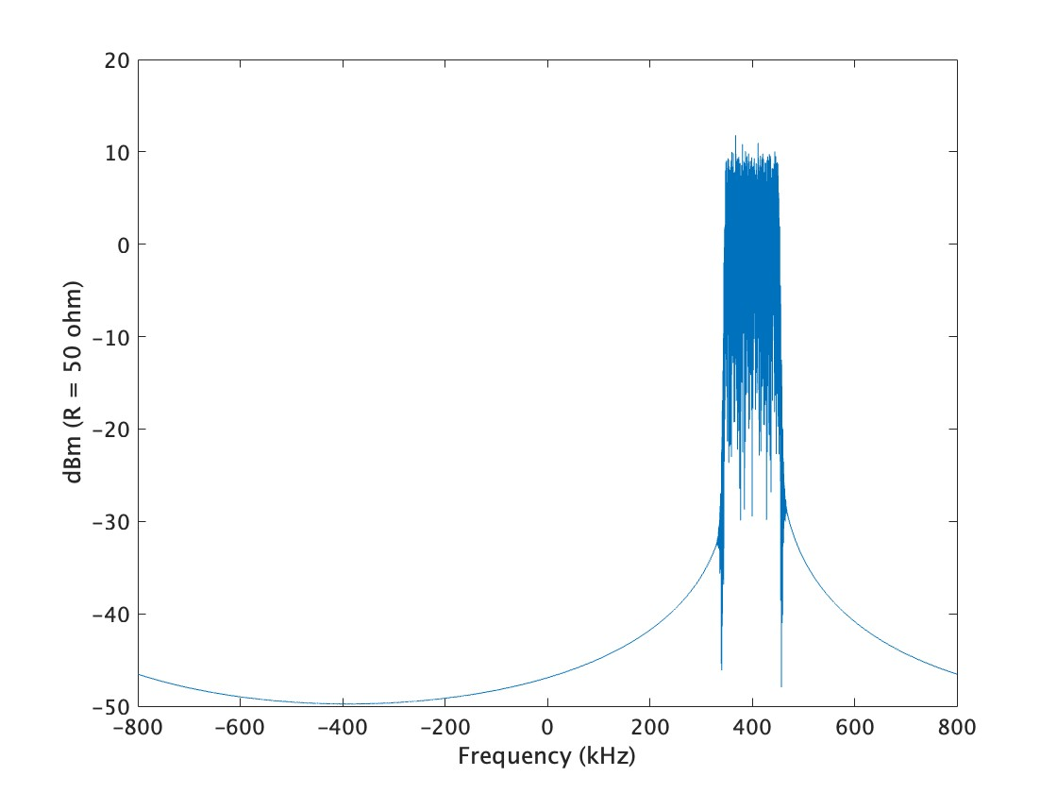
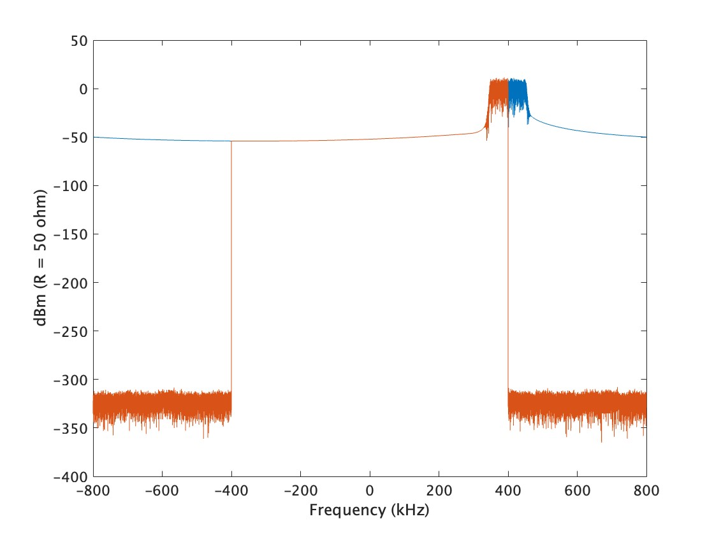
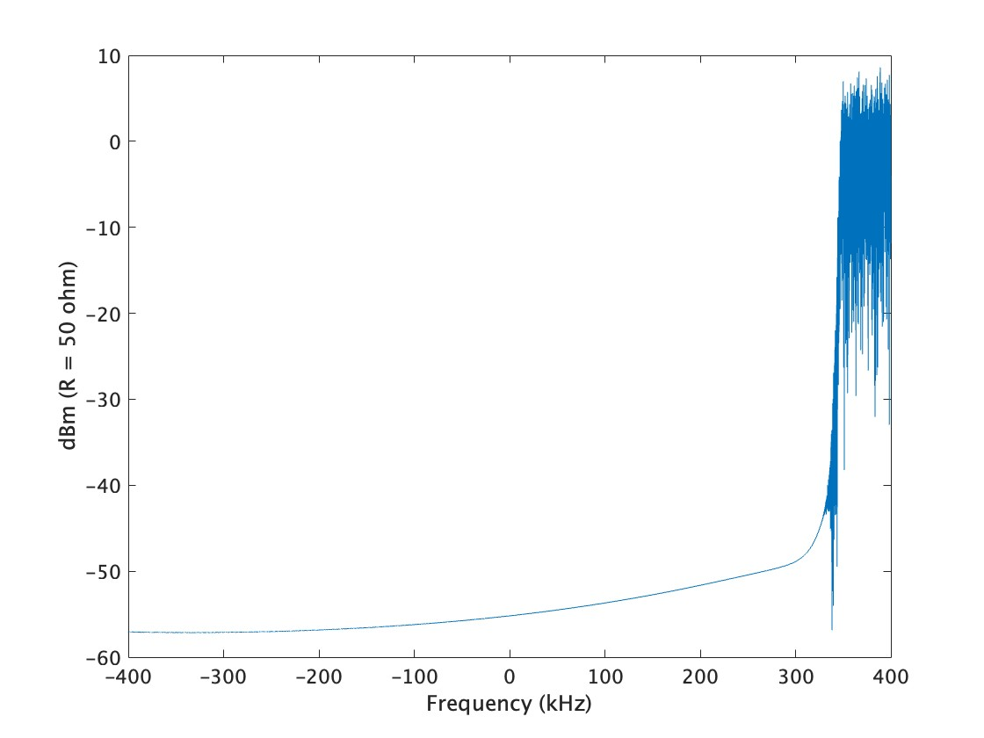
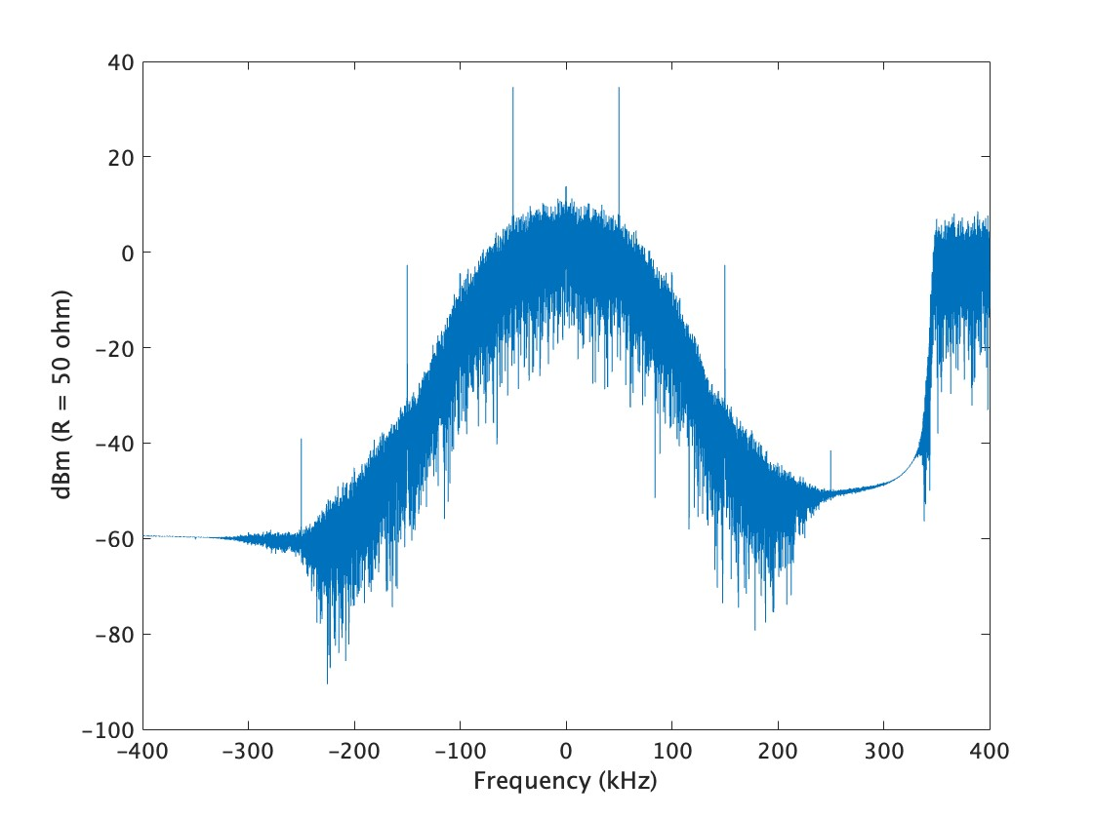
Incorporation of the generated interference signals into a transmission evaluation simulator (Example of SUN FSK signal with 400 kHz bandwidth)
Interference
generator
BPF
Down-
sampling
SUN FSK signal
SUN FSK
Receiver
800 kHz

Slide 6
Generation Examples (from #512)
Packet
BW < iBW or BW=iBW
Interferer
BW
Time
BW > iBW
nBW
BW
iBW: Bandwidth of interference signal
Time

Slide 7
Assumed C/I
Frequency
Frequency
iBW
(Sample rate)/2
Center frequency of interferer
Shift frequency
of interferer
Center frequency of carrier
Observation
frequency
range
Center frequency of carrier = 0 Hz
Time
BW
–(Sample rate)/2
Time
Analog RF signal
Digital BB signal
iBW: Bandwidth of interference signal

Slide 8
Assumed C/I in the baseband
Frequency
C/I(Pattern A)
Calculated interference power applied by RF and calculated the C/I
:
(Sample rate)/2
Shift frequency
of interferer
Observation
frequency range
Center frequency of carrier = 0 Hz
Time
–(Sample rate)/2
C/I(Pattern B)
Calculated the interference power within the range of the observation time duration and observation frequency range and calculated the C/I
Observation
time
: Packet
:
Digital BB signal
: Interferer
: Net interferer
: Actual signal
in time domain
zero-padding

Slide 9
C/I(Pattern A)
Frequency
(Sample rate)/2
Shift frequency
of interferer
iBW
:
:
Center frequency of carrier = 0 Hz
Time
–(Sample rate)/2
BW
: Packet
C/I(Pattern A1)
Calculated by the ratio using the packet and interference powers generated as is
C_{PSD}/I_{PSD}(Pattern A2)
Calculated by the ratio of the generated packet and interference power spectrum densities
: Interferer
: Net time interferer
: Actual signal
in time domain

Slide 10
C/I(Pattern B)
: Packet
: Interferer
Frequency
: Net interferer
: Actual signal
in time domain
C/I
(Sample rate)/2
Shift frequency
of interferer
Observation
frequency range
:
Center frequency of carrier = 0 Hz
Time
zero-padding
–(Sample rate)/2
Observation
time
Calculated by the ratio using the packet and interference powers within the range of Observation time and Observation frequency range, respectively

Slide 11
Recommendation
C/I should be Pattern B, and should be calculated as the ratio of the signal and interference powers at the receiver.
The simulation performed in 15.4ad changes the center frequency and reception time of the interference randomly. So even though the interference wave is propagated with a constant transmission power and channel from the transmitter the power of the interference component at the receiver fluctuates.
Even though interference waves with “power determined by transmission power and channel characteristics” should appear randomly and interfere, C/I cannot express “power determined by transmission power and channel characteristics”, and can only observe the power of the interference component within the bandwidth at the receiver.
Apart from the received interference power, which varies depending on the frequency and time of reception, the interference power that does not vary depending on the frequency and time of reception is required for 15.4ad.
As a result, our recommendation is that the proposer of the physical layer should perform computer simulations to calculate the setting C/I on the horizontal axis and the packet error rate on the vertical axis.

Slide 12
PER Calculation
Bandwidth of Interferer [kHz] | Frame length [ms]
125 | 5
200 | 5
2000 | 5
Same as packet | Same as packet
PER
Setting C/I

