Slide 1
Project: IEEE P802.15 Working Group for Wireless Personal Area Networks (WPANs)
Submission Title : Link Budget Analysis of NG-SUN PHY for IEEE 802.15.4ad Preliminary Proposal
Date Submitted : November 11, 2024
Source : Sangsung Choi, Seonghyeon Chung (A2UICT), Tae-Joon Park, Seung-Sik Lee(ETRI)
Re : TG4ad Next Generation SUN PHYs
Abstract : This contribution describes the link budget requirements of NG-SUN PHY in ship area network and container network environments.
Purpose: Discussion
Notice: This document has been prepared to assist the IEEE P802.15.4ad It is offered as a basis for discussion and is not binding on the contributing individual(s) or organization(s). The material in this document is subject to change in form and content after further study. The contributor(s) reserve(s) the right to add, amend or withdraw material contained herein.
Release: The contributor acknowledges and accepts that this contribution becomes the property of IEEE and may be made publicly available by P802.15.
Notes:
Jul 12, 2010
Page 1

Slide 2
Introduction(1)
Real-time monitoring and tracking of shipping containers is one of the key technologies required for global logistics.
Efficient container monitoring and tracking requires the deployment of a reliable IoT wireless network in container storage environments such as ships, ports, terminals, container yards (CYs), inland container warehouses (ICDs), etc.
In these container storage environments, wireless communication is more difficult than in traditional outdoor environments due to the presence of specific metal structures.

Slide 3
Introduction(2)
In container storage environments, signal attenuation induced by steel structures and the presence of multi-path interference result in reduced signal coverage and degraded signal quality compared to more open areas
Several propagation measurements were conducted to verify the feasibility of wireless communications between ship parts and to analyze the performance of WSN on board.
The propagation measurement at a frequency 923MHz and 2.4GHz were conducted on board ‘Segero’[1]
An empirical path loss model for a stacked shipping container environment with rows and blocks was investigated at IEEE 802.15.4 frequencies of 433, 868 and 2400 MHz[2].

Slide 4
Introduction(3)
Existing IEEE 802.15.4 compatible devices have somewhat insufficient communication performance, such as received sensitivity, for deployment of IoT wireless networks in container storage environments.
IEEE 802.15.4ad NG-SUN PHY may be one of the new low-power wireless communication candidates to deploy IoT networks in container storage environments.
The main focus of this contribution is to review the propagation characteristics in container storage environments featuring steel structures and signal attenuation, and to analyze the link budget of NG-SUN PHY for IEEE 802.15.4ad Preliminary Proposal.

Slide 5
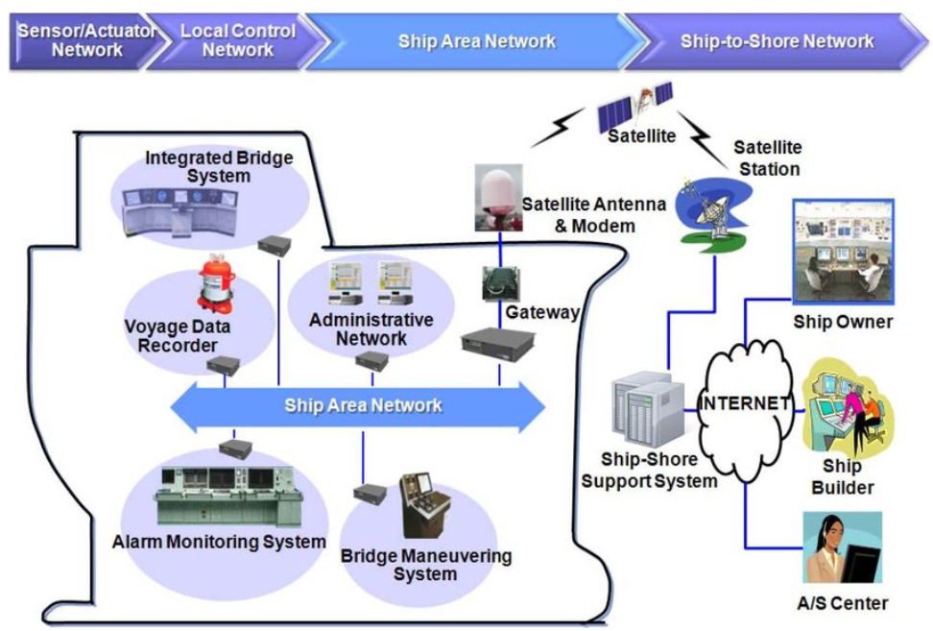
Ship Area Network(SAN)
SAN provides unified interface to local control networks in a merchant marine while enabling remote maintenance services.
Latest SANs have been configured as Ethernet-based Control Area Network(CAN) that applied the National Marine Electronic Association (NMEA) 2000 standard protocol.
Source: ETRI

Slide 6
Wireless environment in SAN
Low-power wireless communications for new IoT networks connecting to SANs on large ships are known to face challenges such as severe signal attenuation due to the complex steel bulkhead structures inside the ship.
Integrating new sensors inside a ship presents several challenges due to the sophisticated wiring systems used during shipbuilding.
In this situation, wireless communication seems like a viable option and a cost-effective alternative, especially if the target is in a difficult location to access.
A hierarchical zone-based network was proposed as a solution for large shipboard wireless sensor networks (WSN) using IEEE 802.15.4 compliant hardware[3].
Requires reliable PHYs to support multi-hop network
Requires robust PHYs to multipath interference

Slide 7
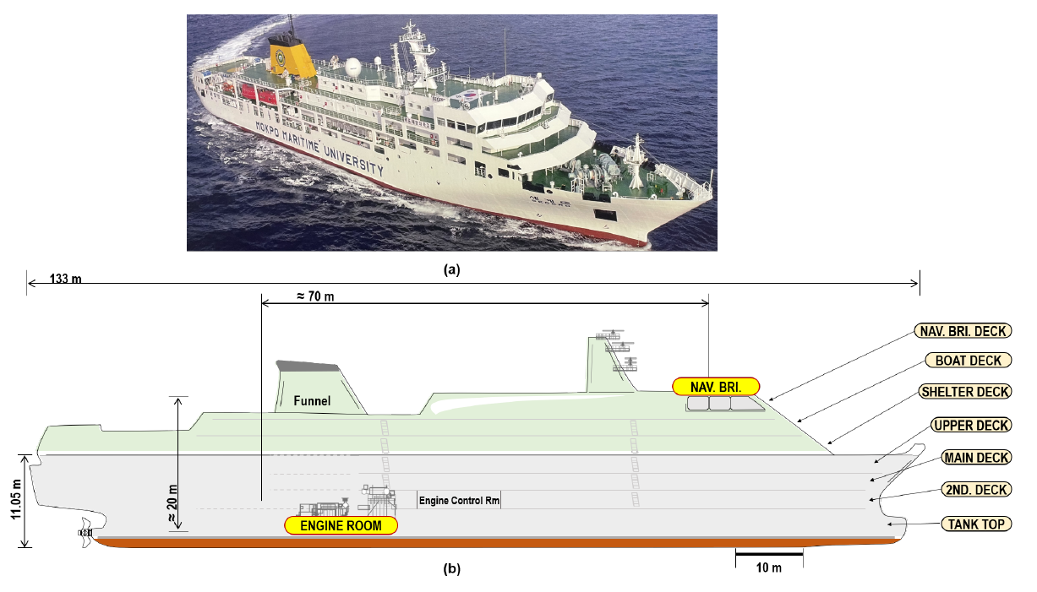
Measurement of Signal Strength on Ship(1)
Reference [1] presents an experiment to measure signal strength in a ship using 923 MHz and 2.4 GHz devices
It was conducted on the "Segero," a training vessel from Mokpo National Maritime University in Korea,
It was specifically designed for student practical sessions and maritime safety training.
Source: Evaluation of a Multi-Hop Wireless Internet-of-Things Network on Large Ships. Jabeom Gu, Miryong Park, Seungsik Lee, Hoyong Kang, and Buki Kim
Journal of Marine Science and Engineering 2023, 11, 2243

Slide 8
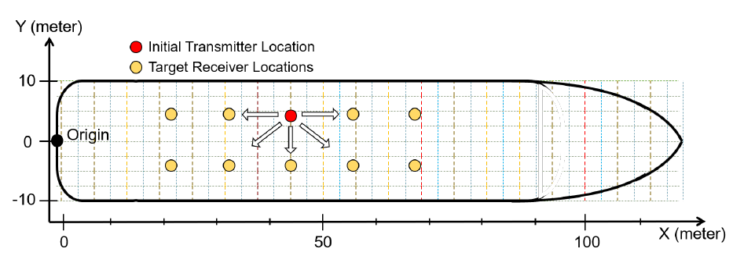
Measurement of Signal Strength on Ship(2)
The experiment focused on measuring signal propagation characteristics and identifying factors affecting signal strength.
RSSI was measured by sequentially changing the receiver location starting from a nearby point at initial transmitter location and moving outward, and then the measurements moved to the next receiver location after completing the measurements at one transmitter location
Marked locations for RSSI measurements from the Engine Room to the Navigation Bridge, to identify areas with reliable signal strength.
This information was important in selecting optimal router locations and determining the feasibility of building a multi-hop network
< Measurement steps and coordination system >

Slide 9
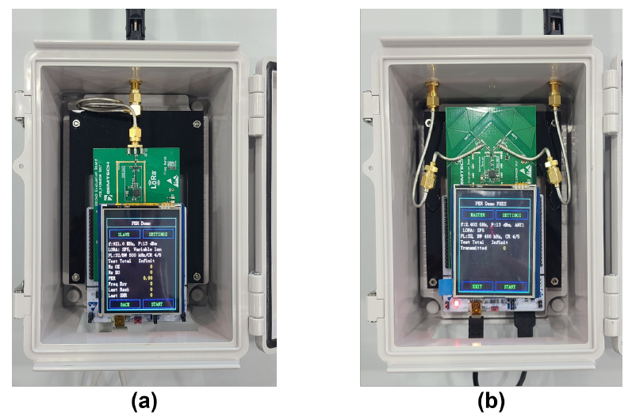
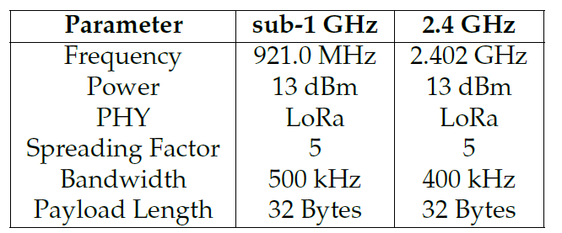
Measurement of Signal Strength on Ship(3)
The RSSI measurements were performed using two transmitter-receiver pairs for each of the 923MHz and 2.4 GHz bands.
SX1262DVK1CAS for 923MHz transmission and reception tests
SX1280RF1ZHP for 2.4GHz transmission and reception tests
< Wireless parameters for measurement >
< Measurement devices for (a) sub-1 GHz and (b) 2.4 GHz >.

Slide 10
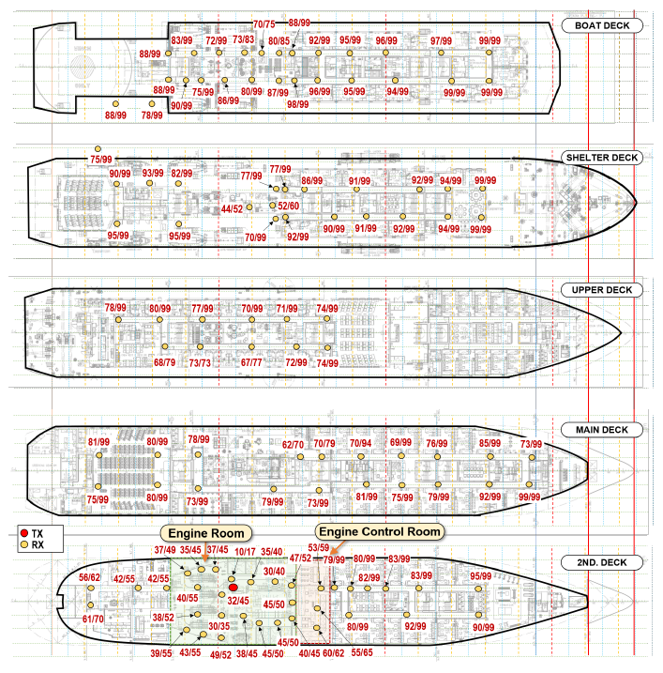
Measurement Results(1)
Transmission from Engine Room(1)
This shows measurements taken from all areas of the ship when the transmitter is located in the engine room.
The transmitter is positioned at coordinates X = 56, Y = 5 within the Second Deck, specifically inside the Engine Room (Tx_{EngineRoom})

Slide 11
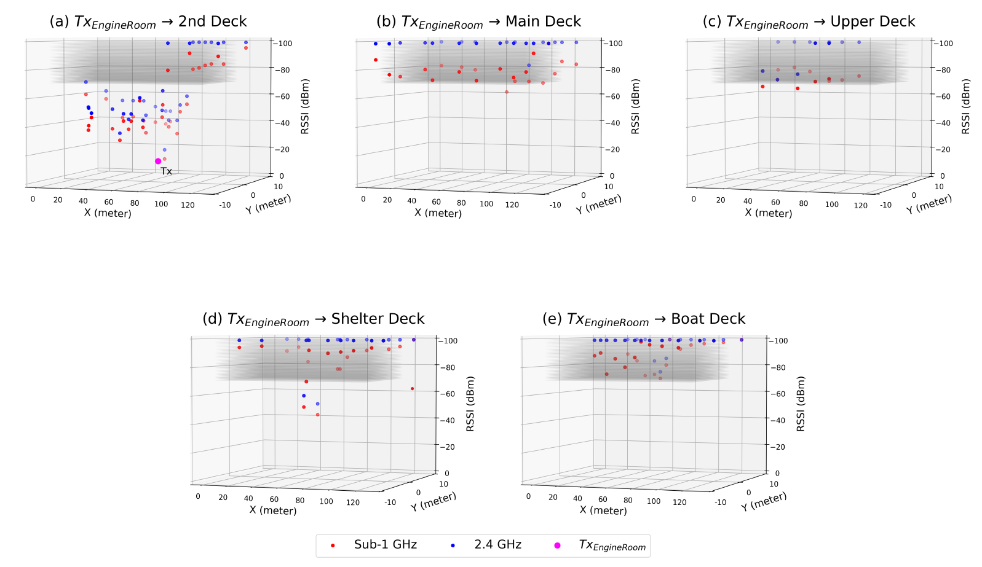
Measurement Results(2)
Transmission from Engine Room(2)
The RSSI values around the Engine Room are good enough above -70 dBm across the Engine Room for both 923MHz and 2.4 GHz frequency
However, the RSSI value drops significantly outside the Engine Control Room because the signal has to penetrate two heavy iron doors.

Slide 12
Measurement Results(3)
Transmission from Machinery Space in Shelter Deck(1)
The measured RSSI values when the transmitter is positioned inside the Machinery Space(Tx_{MachinerySpace}) at coordinates X=68 and Y=3 on the Shelter Deck
There are still several places where the RSSI values are reasonably high in the exterior part of the Shelter Deck
However, inside the crew quarters through the hallway, the values are getting lower, almost below -80 dBm.

Slide 13
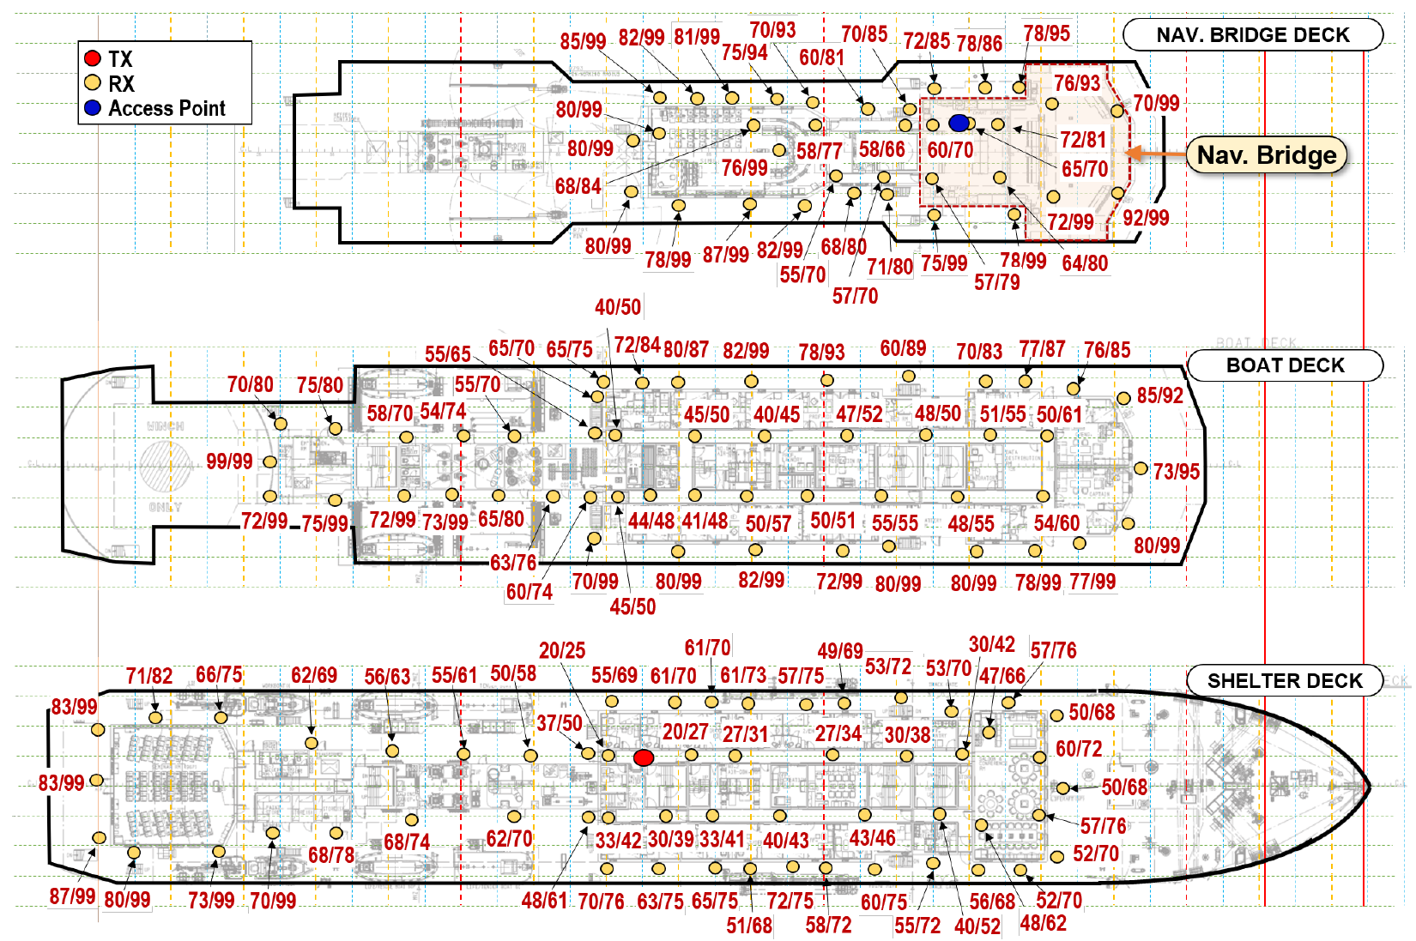
Measurement Results(4)
Transmission from the hallway of Shelter Deck(1)
RSSI values ​​measured at various levels, shelters, boats, and the navigation lide bridge deck when the transmitter is located inside the crew quarters hallway close to the Machinery Space.

Slide 14
Measurement Results(5)
Transmission from the hallway of Shelter Deck(2)
The RSSI values around the Shelter Deck(Fig. a) are good enough above -75 dBm across the interior part for both the 923MHz and 2.4 GHz frequency
In the Boat Deck(Fig. b ), there are still many places where the signal strength is reasonable.
But it becomes weaker at two levels above it, so one-hop transmission could not reach the access point located inside the Navigation Bridge.

Slide 15
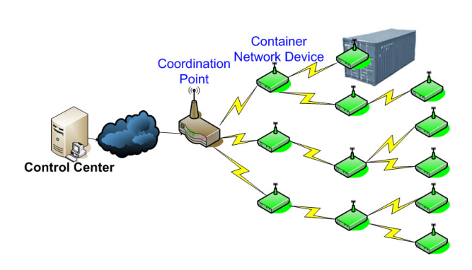
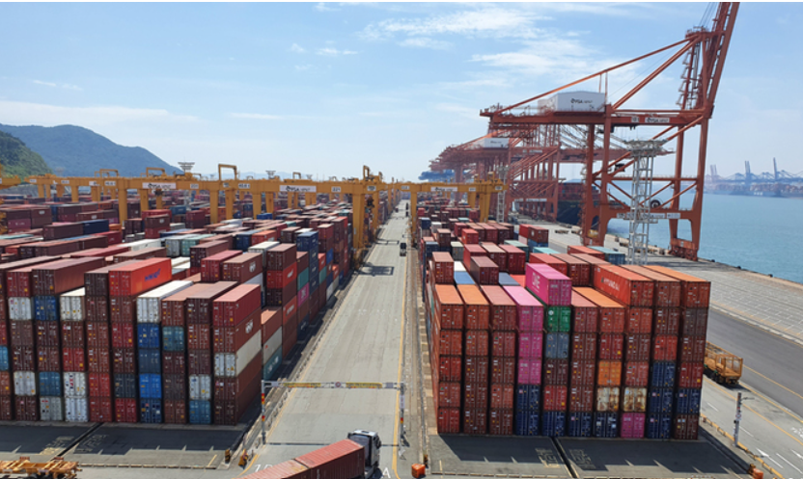
Container Network
Container networking refers to the ability for containers to connect to and communicate with each other, or to non-Docker workloads.
In container loading environments such as ships, ports, terminals, container yards (CYs), inland container warehouses (ICDs), etc. where metal containers are stacked, communication shadow areas are occurred where wireless links are lost.
Ad-hoc networks are required to deployed container network in these container loading environment

Slide 16
Wireless Environment of Container Network(1)
Container cargoes are transferred to multiple agencies from loading point to transportation and unloading point, requiring low-power communication that can withstand long periods of time.
Each container must be reliably and safely transmitted to the necessary locations without falling under the management scope of the participating network administrator.
Traditional sensor networks cause serious problems when information from some sensors cannot be transmitted,
Due to the characteristics of the ship, ports, terminals, container yards (CYs) and inland container depots (ICDs), it is difficult to deploy many sink nodes where information from container nodes is collected.
The number of nodes participating in the container network is much larger than the number of nodes in other general sensor networks.

Slide 17
Wireless Environment of Container Network(2)
Since it is a high-level stacking environment of containers made entirely of metal (iron), the RF transmission characteristics are different from those of a network of sensors that are likely to be in a relatively open environment.
Metal basically has the characteristic of blocking and reflecting RF.
This causes relatively many shadow areas when containers are stacked high.
However, the RF characteristics actually improve in the alleys between stacking blocks.

Slide 18
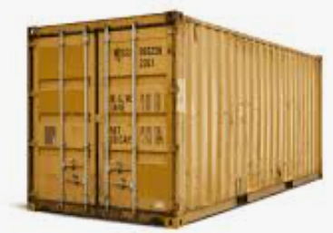
Wireless Links for Shipping Container Monitoring
According to Reference [2], there are three types of wireless links for shipping container monitoring.
Intra-container link: A sensor inside the container transmits sensory data to the IEEE802.15.4 device’s antenna, which is attached inside or outside to that container
Inter-container link: Relaying of data occurs between IEEE802.15.4 device antennas attached to different containers
Extra-container link: A IEEE802.15.4 device’s antenna sends data to the private or cloud server
Extra container link
TX
TX
RX
TX
TX
RX
TX
TX
TX
RX
Intra-container link
TX
Inter-container link
RX

Slide 19
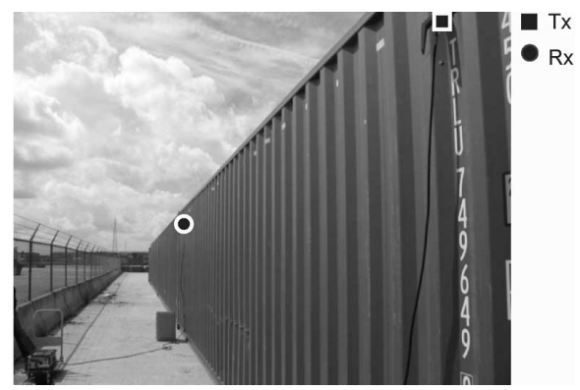
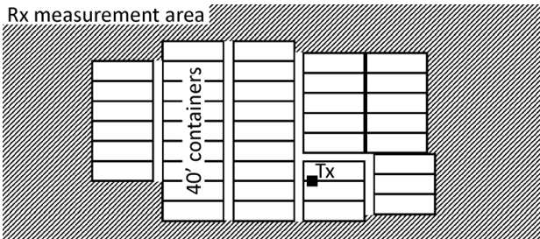
Pass Loss for the Inter-Container Link
Because of the particularity of the container environment, well-known path loss models for outdoor environments (e.g., COST 231 Walfisch-Ikegami) are an unsatisfactory fit for empirical path loss around containers.
Reference [2] presents empirical path loss models for an environment of stacked shipping containers.
Source: Intra-, Inter, and Extra-Container Path Loss for Shipping Container Monitoring System. Emmeric Tanghe, Wut Joseph Peter Ruckebusch, Luc Martens Ingrid Moerman
IEEE Antenna and Wireless Propagation Letters Vol. 11, 2012

Slide 20
Pass Loss in Container Row Stacking(1)
The measurements are carried out along the row of four containers (total length of 42.7 m)
The Tx is mounted on the ventilation holes near the top of the first container and the Rx is then moved in steps of 0.5 m along the top of the container row at the same height above ground level as the Tx.
At each Rx location, the median of 200 samples of received power is recorded. In total, 83 Rx locations are measured per frequency
Measured path loss in dB is found to correlate well with logarithmic distance (average correlation of 0.78 over the three frequencies)
Path loss PL (in dB) is fitted to the following model as function of distance (in meters) between Tx and Rx:
PL(d) = b₀ + b₁ ∙10log10(d) + χ_{s}
b₀ and b₁ are regression parameters,
χ_{s} assumes a normal distribution with standard deviation

Slide 21
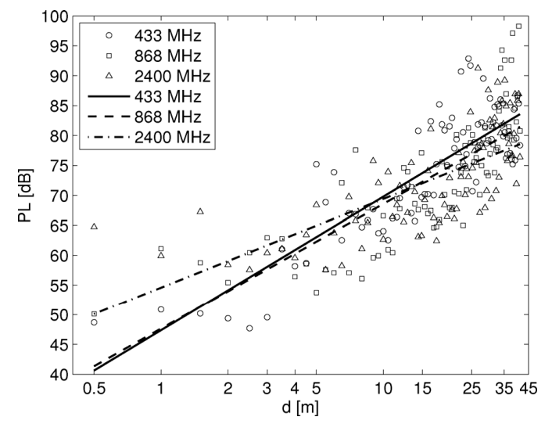
Pass Loss in Container Row Stacking(2)
Pass Loss versus distance for inter-container link
Inter-container Path Loss Model Parameters

Slide 22
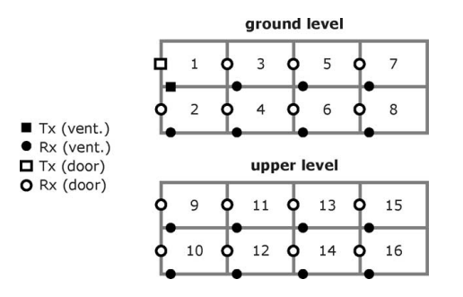
Pass Loss in Container Block Stacking(1)
The measurements were carried out on a three-dimensional stack of 16 20’ containers (4 long, 2 wide, and 2 high)
The antennas of the IEEE802.15 devices are mounted outside on the containers’ ventilation holes (black symbols) and doors (white symbols), respectively.
For both scenarios, path loss is measured between the Tx on container 1 (squares) and the Rx’s on the other containers (circles).
For each Tx–Rx link,
the median of 300 samples of received power is recorded

Slide 23
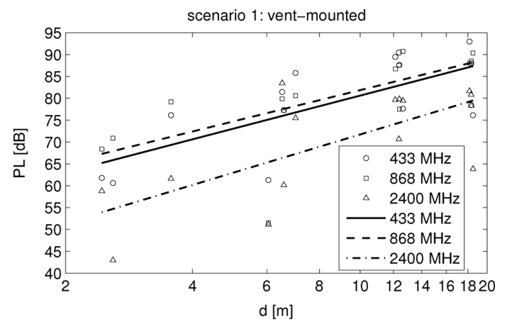
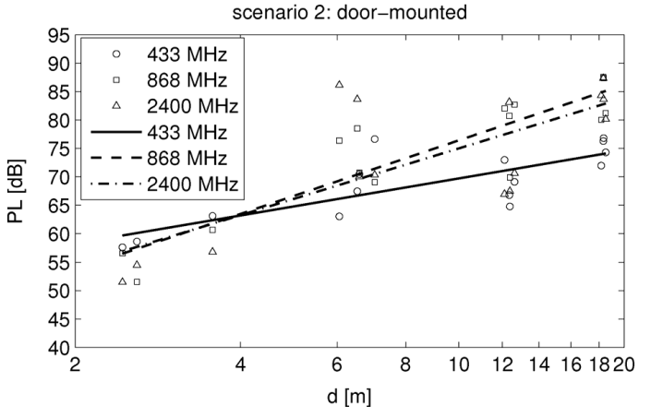
Pass Loss in Container Block Stacking(2)
Pass Loss versus distance for inter-container link
Inter-container Path Loss Model Parameters
 | Vent-mounted |  |  | Door-mounted
Frequency (MHz) | b₀ (dB) | b₁ (-) | σ_{s} (dB) | B₀ (dB) | B₁ (-) | σ_{s} (dB)
433 | 55.46 | 2.52 | 7.76 | 53.36 | 1.64 | 3.98
869 | 58.10 | 2.38 | 7.98 | 43.93 | 3.25 | 4.94
2400 | 42.69 | 2.90 | 9.30 | 45.50 | 2.95 | 8.33

Slide 24
Link Budget of NG-SUN PHY(1)
Assume container row stacking
PL(d) = b₀ + b₁ 10log10(d) + χ_{s}
@868MHz : b₀ = 47.64, b₁ = 2.09, χ_{s} = 6.56
PL@50m = 89.7dB,
PL@1000m = 116.9dB
Assume TX Power 10dBm@868MHz
Noise Figure of 10 dB and 5 dB Implementation Margins 5 dB
Expected received signal level @50m = -94.7dB
@1000m = -121.9dB
Assume sensitivity at receiver -120dB,
Link margin @50m = 25.3dB
@1000m = -1.9dB

Slide 25
Link Budget of NG-SUN PHY(2)
Assume container block stacking
PL(d) = b₀ + b₁ 10log10(d) + χ_{s}
@868MHz : b₁ = 58.10, b₀ = 2.38, χ_{s} = 7.98
PL@ 50m = 106.5dB
Assume TX Power 10dB @868MHz,
Noise Figure of 10 dB and 5 dB Implementation Margins 5 dB
Expected received signal level @50m = -111.5dB
Assume sensitivity at receiver -120dB,
Link margin = 8.5dB

Slide 26
Conclusion (1)
Well-known path loss models for outdoor environments (e.g. COST 231 Walfisch-Ikegami) are not suitable for empirical path loss around containers and inside a ship due to the specific characteristics of the steel structure environment.
In this contribution, path loss is experimentally investigated for two types of use cases: ship area network and container network environments.
Using IEEE 802.15.4 compatible devices, the ship-wide signal strength coverage was measured in the 900 MHz and 2.4 GHz bands.
A pass loss modeling in container environments was investigated according to inter-container links, frequencies, and container stacking configurations.

Slide 27
Conclusion (2)
The results of signal strength measurements on board ship
RSSI values around the Engine Room (and the Engine Control Room) are good enough above -70 dBm over the engine room for both the 900MHz and 2.4 GHz bands.
Thus, it appears that the heavy metal components, intricate piping networks, and a variety of machinery and equipment in the Engine Room do not attenuate too much.
Therefore, only one router is needed to cover the entire Engine Room.
Radio signals could not penetrate two adjacent heavy iron doors, as seen from the measurement outside of the Engine Control Room.
A router node will be needed in such configuration.

Slide 28
Conclusion (3)
The transmission in a large ship using the sub-1 GHz band devices can successfully reach more than two levels, while the 2.4 GHz can reach only one level when both the transmitter and receiver are placed in the interior part or the hallway of the ship.
On the other hand, any receiver in the exterior part will have to penetrate at least one heavy iron door, which will have a negative effect of more than 20 dBm on the signal strength.
It is worth noting that the presence of Machinery Spaces, located above the Engine Room, has a significant impact on signal strength.
In this measurements taken inside these spaces at the Shelter Deck revealed considerably stronger signals, reaching approximately -50 dBm for both the sub-1 GHz and 2.4 GHz frequencies.
This finding suggests that the Machinery Spaces can be utilized in establishing multi-hop networks in large ships, taking advantage of their signal propagation characteristics

Slide 29
Conclusion (4)
The results path loss measurements in container storage environments
TX Power 10mW@868MHz@50m :
Receiver Sensitivity for container row stacking : < -94.7dB
TX Power 10mW@868MHz@50m :
Receiver Sensitivity for container block stacking < -111.5dB
To implement effective wireless IoT communication networks in ships, ports, terminals, container yards (CYs), inland container depots (ICDs), etc. NG-SUN PHY requires at least -120dB sensitivity because of metallic characteristic of containers.
In container storage environments, container networks can be deployed through multi-hop networking within 50m.

Slide 30
References
[1] Jabeom Gu; Miryong Park; Seungsik Lee; Hoyong Kang; Buki Kim; Evaluation of a Multi-Hop Wireless Internet-of-Things Network on Large Ships; Journal of Marine Science and Engineering 2023
[2] Emmeric Tanghe; Wut Joseph Peter Ruckebusch; Luc Martens; Ingrid Moerman; Intra-, Inter, and Extra-Container Path Loss for Shipping Container Monitoring System; IEEE Antenna and Wireless Propagation Letters Vol. 11, 2012
[3] Kdouh, H.; Zaharia, G.; Brousseau, C.; Farhat, H.; Grunfelder, G.; El, G. Application of Wireless Sensor Network for the Monitoring Systems of Vessels. In Wireless Sensor Networks - Technology and Applications; Matin, M., Ed.; InTech, 2012.

Slide 31
Thanks for Listening !
Q&A

