Slide 1
Project: IEEE P802.15 Working Group for Wireless Personal Area Networks (WPANs)
Submission Title: ETSI 303687 Update on NB Channel Access
Source: Carlos Aldana (Meta), Guoqing Li (Meta), Davide Magrin (Meta), Kumail Haider (Meta)
Address : [1 Hacker Way, Menlo Park, CA 94025]
E-Mail: [caldana, guoqingli, davidmagrin, haiderkumail (at) meta.com]
Re: Study Group 4ab: UWB Next Generation
Abstract: [This provides review of ETSI progress related to NB Coex]
Purpose: [For information]
Notice: This document has been prepared to assist the IEEE P802.15. It is offered as a basis for discussion and is not binding on the contributing individual(s) or organization(s). The material in this document is subject to change in form and content after further study. The contributor(s) reserve(s) the right to add, amend or withdraw material contained herein.
Release: The contributor acknowledges and accepts that this contribution becomes the property of IEEE and may be made publicly available by P802.15.
Notes:
Jul 12, 2010
Page 1

Slide 2
Latest BT-SIG Proposal in BRAN(24)126018
NOTE: This was submitted for “Discussion”

Slide 3
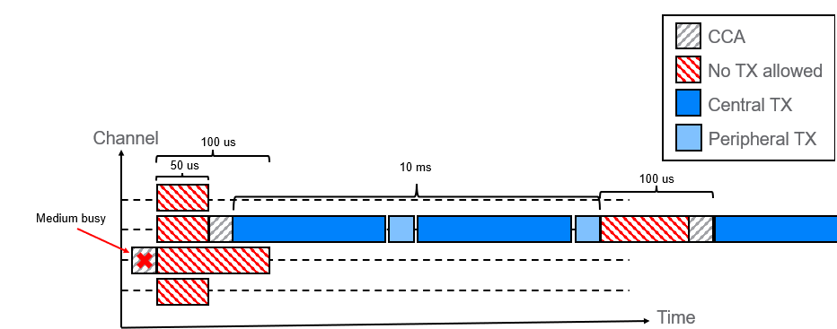
Informative Block Diagram

Slide 4
Informative State Diagram
Perform CCA
Is CCA Idle?
Y
N
Success
Y
Switch Channel?
N
Delay
50us
Delay
100us

Slide 5
Pending Items in ETSI
EDT
High duty cycle NB preventing WB channel access
11-24-1150-01 from Menzo (QC)
11-24-1138-00 from Sebastian (Ericsson)

Slide 6
Potential ways forward
2 options
Accept Document 15-24-407 as is
Document 15-24-407 (coauthored by individuals from Qualcomm, Mediatek, Calterah, Cisco, Intel, HPE, Amazon, and Meta) that addresses CID 988 is revised at the January 2025 meeting to reflect ETSI BRAN #127 (December 2024) agreements.

