Slide 1
        doc.: 15-24-0558-00-04ab
Project: IEEE P802.15 Working Group for Wireless Personal Area Networks (WPANs)
Submission Title: HCS generation for Dynamic PHR
Date Submitted: October, 2024
Source: Vinod Kristem, Xiliang Luo, Moche Cohen (Apple)
Address: One Apple Park Way, Cupertino, CA 95104, USA
E-Mails: vkristem@apple.com
Abstract: Clarify the text on HCS generation for Dynamic PHR
Purpose: To provide clarity in the spec text on HCS generation for dynamic PHR
Notice: This document has been prepared to assist the IEEE P802.15. It is offered as a basis for discussion and is not binding on the contributing individual(s) or organization(s). The material in this document is subject to change in form and content after further study. The contributor(s) reserve(s) the right to add, amend or withdraw material contained herein.
Release: The contributor acknowledges and accepts that this contribution becomes the property of IEEE and may be made publicly available by P802.15.

Slide 2
        doc.: 15-24-0558-00-04ab
PAR Objective | Proposed Solution (how addressed)
Safeguards so that the high throughput data use cases will not cause significant disruption to low duty-cycle ranging use cases
Interference mitigation techniques to support higher density and higher traffic use cases
Other coexistence improvement
Backward compatibility with enhanced ranging capable devices (ERDEVs)
Improved link budget and/or reduced air-time
Additional channels and operating frequencies
Improvements to accuracy / precision / reliability and interoperability for high-integrity ranging
Reduced complexity and power consumption
Hybrid operation with narrowband signaling to assist UWB
Enhanced native discovery and connection setup mechanisms
Sensing capabilities to support presence detection and environment mapping
Low-power low-latency streaming
Higher data-rate streaming allowing at least 50 Mbit/s of throughput | Clarifies the text on HCS generation for Dynamic PHR
Support for peer-to-peer, peer-to-multi-peer, and station-to-infrastructure protocols
Infrastructure synchronization mechanisms

Slide 3
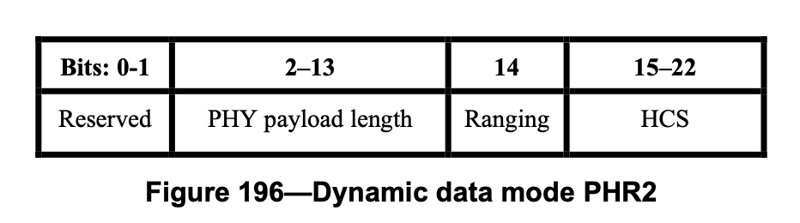
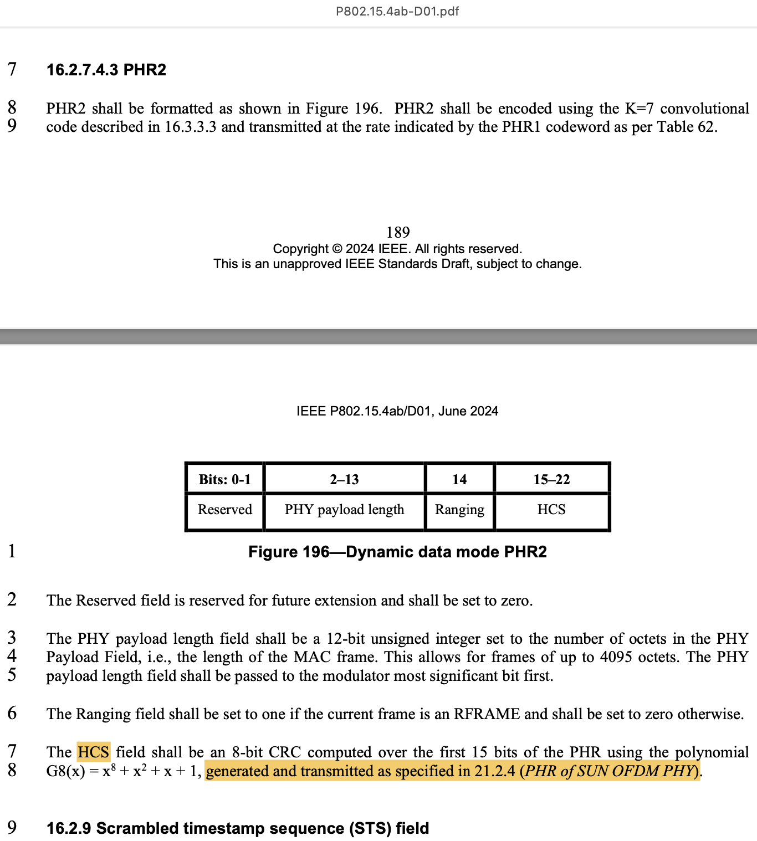

Introduction
        doc.: 15-24-0558-00-04ab
Dynamic data mode is one of the features added in IEEE 802.15.4ab
HCS for Dynamic data mode is generated using the CRC polynomial
HCS generation and transmission refers to SUN OFDM PHY (Clause 21.2.4 of TG4me)
  Some inconsistencies and gaps in description
TG4ab Draft 1.0
$$G_{8}\left(x\right)=x^{8}+x^{2}+x+1$$

Slide 4
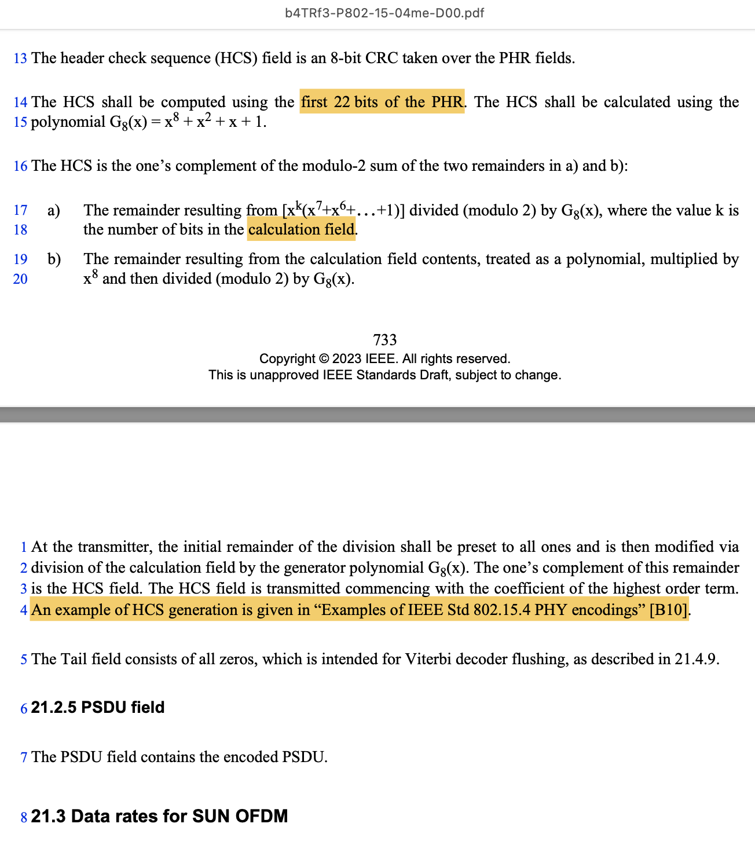
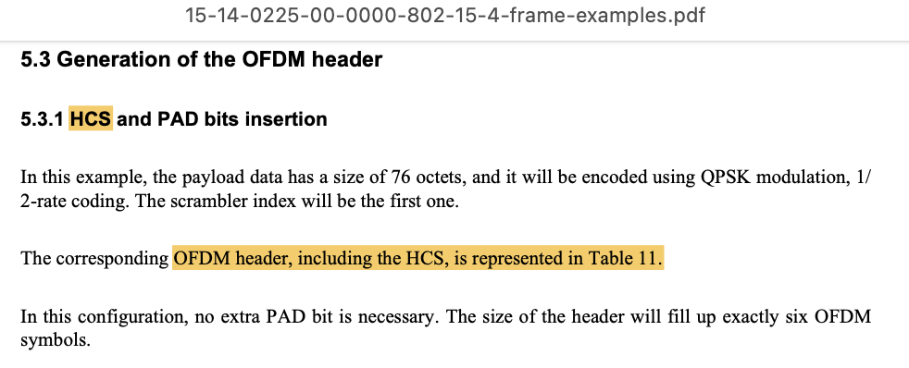
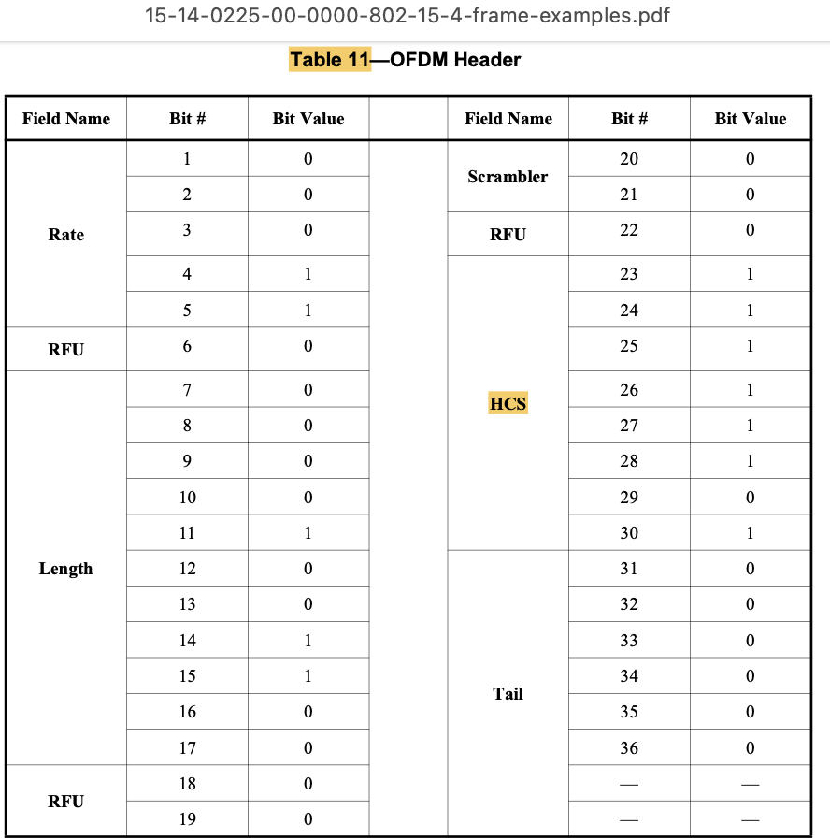


Gaps in description of HCS generation
        doc.: 15-24-0558-00-04ab
HCS generation using SUN OFDM PHY (Clause 21.2.4 of TG4me)
  Uses 22-bits of PHR, while 4ab uses 15-bits of PHR2
  Reference to ‘calculation field’, which is neither defined in 4ab Draft 1.0 nor TG4me clause 21.2.4
  Reference to DCN 15-14-0225-00-0000 for example generation
    HCS generation details are missing. Example sequence provided
  Key detail on remainder polynomial is missing
    Generates a unique non-zero remainder polynomial of , when 23-bit PHR2 is used (assuming no transmission errors)
TG4me Clause 21.2.4
$$x^{3}+x^{2}$$
$$x^{3}+x^{2}$$
15-14-0225r0 [B10]

Slide 5
Proposed changes to address gaps
        doc.: 15-24-0558-00-04ab
DCN 15-24-0559-00-04ab-Proposed-text-to-clarify-HCS-generation
No design change. Add text/figures to clarify generation and transmission, with example
  Improves 4ab spec. quality and to avoid potential interop issues
Replace the reference to Clause 21.2.4 with the corresponding text
  Clarify the calculation field and PHR bits used for HCS generation
Add an example HCS generation structure, showing a typical implementation
  Provide an example PHR2 sequence with HCS
Add missing details on the expected remainder polynomial at the receiver

Slide 6
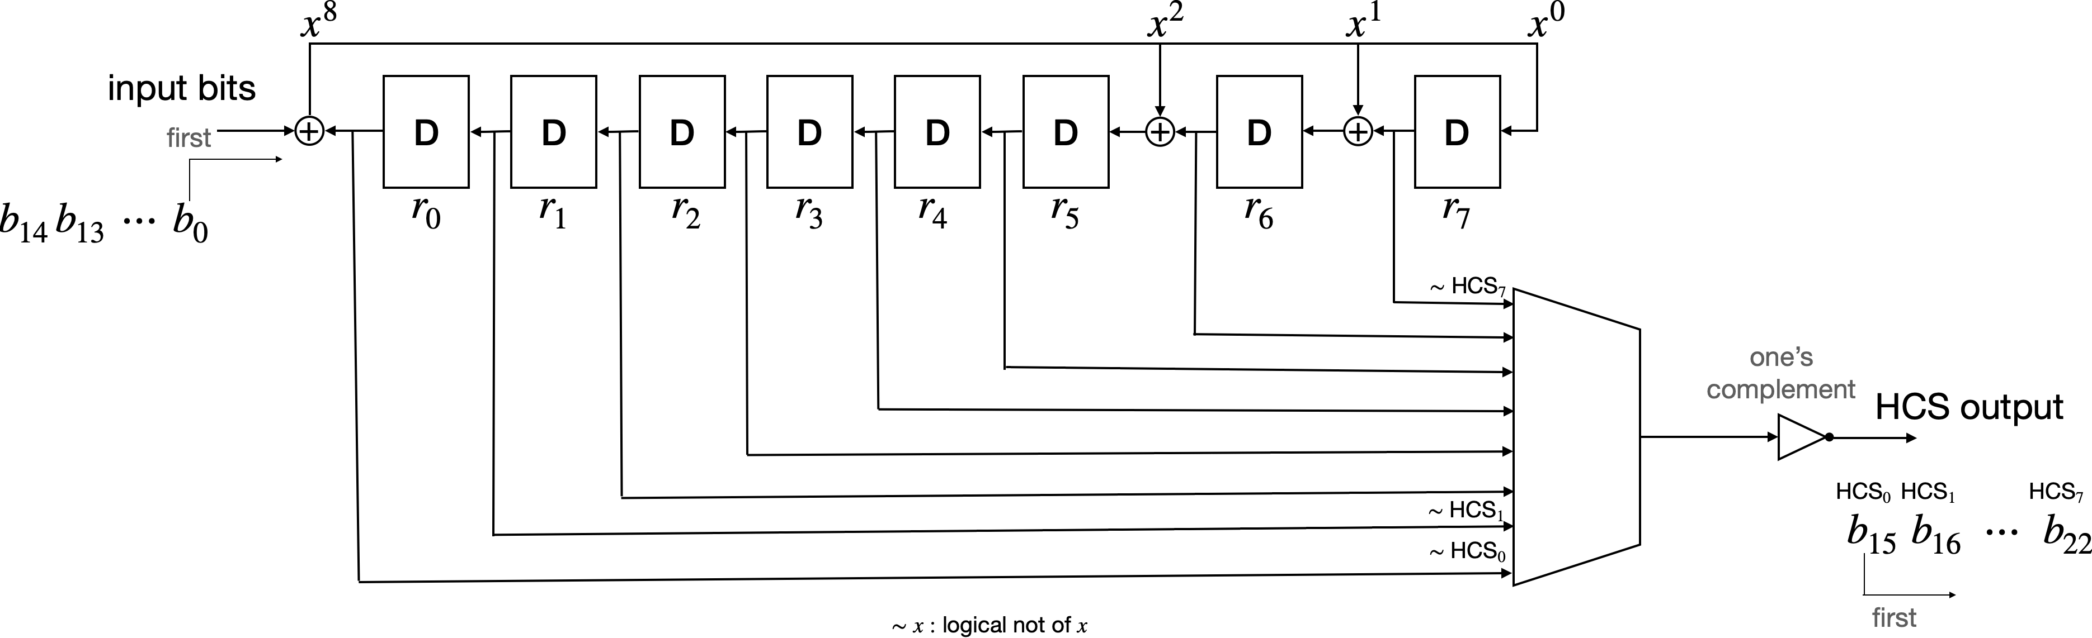
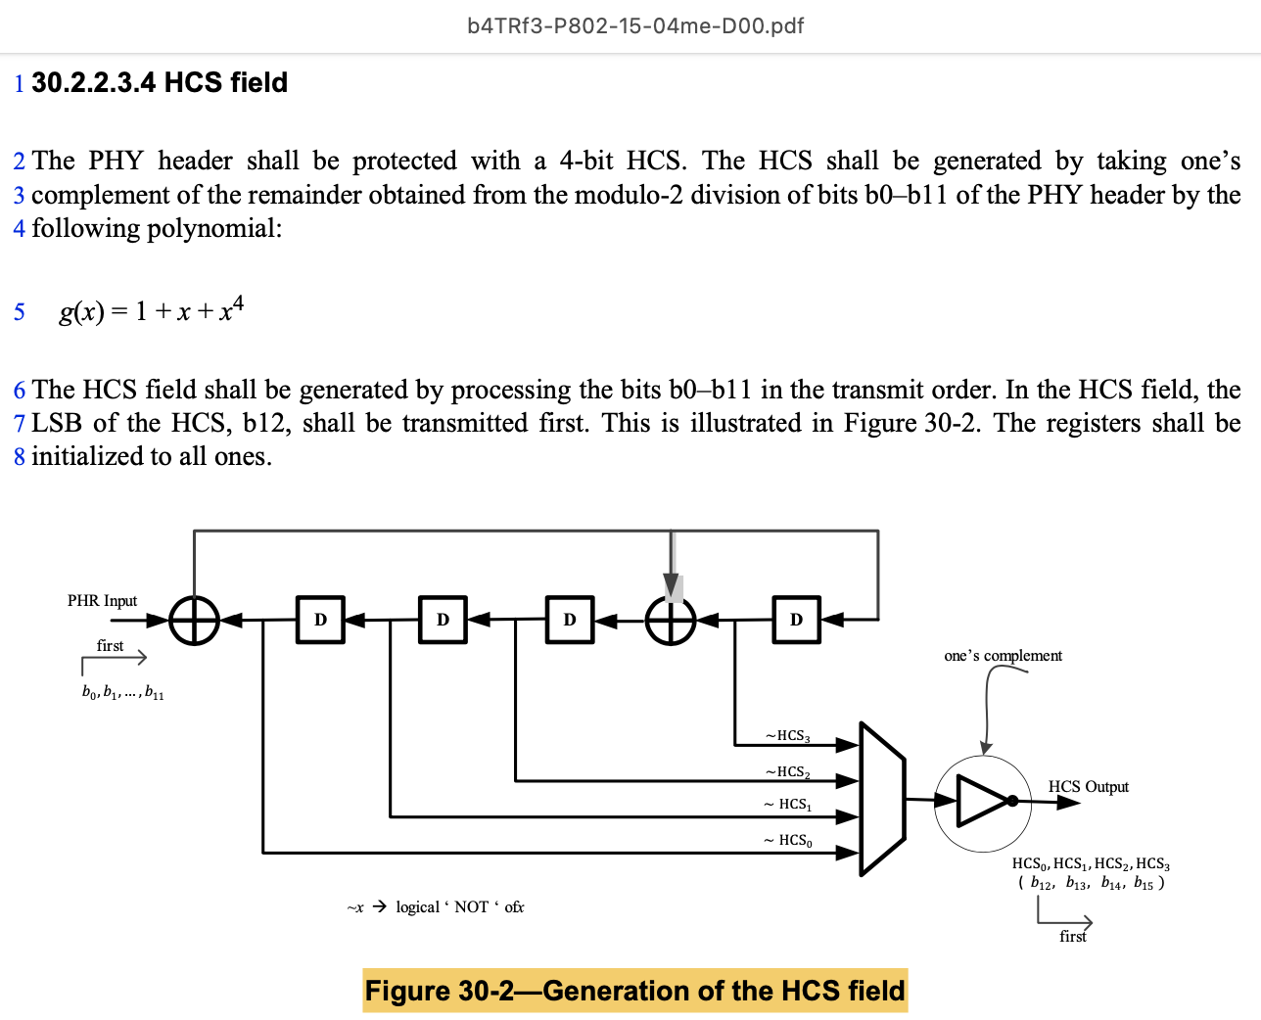

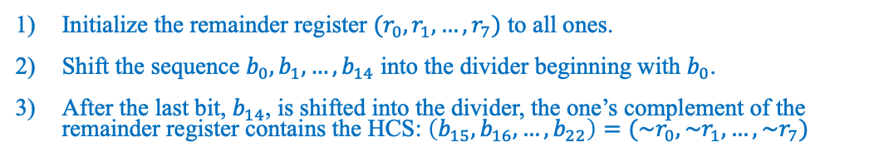
Typical Implementation
        doc.: 15-24-0558-00-04ab
Example HCS generation (Extension of Fig. 30-2 in TG4me Clause 30.2.2.3.4)
TG4me Clause 30.2.2.3.4
Initialize the remainder register $(r_{0},r_{1},…, r_{7})$ to all ones.
Shift the sequence $b_{0},b_{1},…, b_{14}$ into the divider beginning with $b_{0}$.
After the last bit, $b_{14}$, is shifted into the divider, the one’s complement of the remainder register contains the HCS: $\left(b_{15},b_{16},…, b_{22}\right)=(\sim r_{0},\sim r_{1},…, \sim r_{7})$
Example PHR2 with HCS (Similar to Fig. 22-5 in TG4me Clause 22.2.3)
Bits: 0 | 1 | 2-13 |  |  |  |  |  |  |  |  |  |  |  | 14 | 15-22
0 | 0 | 0 | 0 | 0 | 0 | 0 | 0 | 1 | 0 | 1 | 0 | 1 | 0 | 0 | 1 | 0 | 1 | 1 | 1 | 1 | 0 | 0
Unique remainder polynomial of (0x0C) with 23-bit PHR2 (no transmission errors)
$$x^{3}+x^{2}$$

