Slide 1
Project: IEEE P802.15 Working Group for Wireless Specialty Networks (WSN)
Submission Title: TG4ab September 2024 Closing Report
Date Submitted: 12 Sept 2024
Source: Benjamin A. Rolfe (Blind Creek Associates)
Contact:
Voice: [deprecated],
E-Mail: ben.rolfe @ ieee.org
Re: Task Group 4ab: 802.15.4 UWB Next Generation
Abstract: Closing report for the Wireless Interim Session, September 2024
Purpose: Continue project progress and continue the illusion of organization
Notice: This document has been prepared to assist the IEEE P802.15. It is offered as a basis for discussion and is not binding on the contributing individual(s) or organization(s). The material in this document is subject to change in form and content after further study. The contributor(s) reserve(s) the right to add, amend or withdraw material contained herein.
Release: The contributor acknowledges and accepts that this contribution becomes the property of IEEE and may be made publicly available by P802.15.

Slide 2
Task Group 15.4ab Next Generation UWB Amendment
September 2024 802 Wireless Interim Session
Mixed Mode
Live from
Waikoloa Beach, Hawaii

Slide 3
Agenda
(check mentor for latest version)
https://mentor.ieee.org/802.15/dcn/24/15-24-0453-10-04ab-tg4ab-september-2024-agenda.xlsx

Slide 4
Session Objectives
Review and Resolve ballot comments
Resolve some more comments
Resolve the rest of the comments

Slide 5
5.2.b Scope of the project (As approved):
This amendment enhances the Ultra Wideband (UWB) physical layers (PHYs) medium access control (MAC), and associated ranging techniques while retaining backward compatibility with enhanced ranging capable devices (ERDEVs). Areas of enhancement include:
additional coding, preamble and modulation schemes to additional coding, preamble and modulation schemes to support improved link budget and/or reduced air-time relative to IEEE Std 802.15.4 UWB;
additional channels and operating frequencies;
interference mitigation techniques to support greater device density and higher traffic use cases relative to the IEEE Std 802.15.4 UWB;
improvements to accuracy, precision and reliability and interoperability for high-integrity ranging; schemes to reduce complexity and power consumption;
definitions for tightly coupled hybrid operation with narrowband signaling to assist UWB;
enhanced native discovery and connection setup mechanisms;
sensing capabilities to support presence detection and environment mapping;
and mechanisms supporting low-power low-latency streaming as well as high data-rate streaming allowing at least 50 Mb/s of throughput.
Support for peer-to-peer, peer-to-multi-peer, and station-to-infrastructure protocols are in scope, as are infrastructure synchronization mechanisms. This amendment includes safeguards so that the high throughput data use cases do not cause significant disruption to low duty-cycle ranging use cases.
https://development.standards.ieee.org/myproject-web/app#viewpar/9081

Slide 6
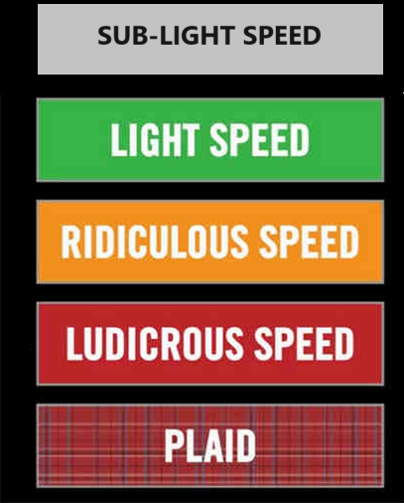
Comment Resolution

Slide 7
Comment Summary
Consolidated comments: 15-24-0371-14 (pending)

Slide 8
Next Steps

Slide 9
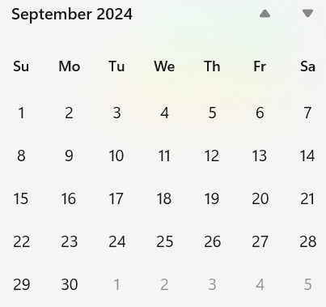
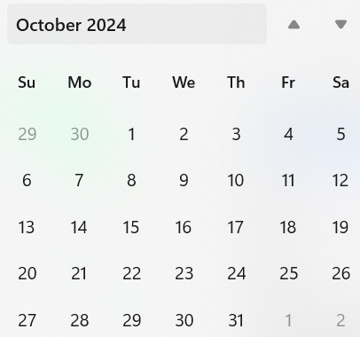
Call schedule, September thru November
Now
Wireless Interim
Plenary
Next
Commence on 24-Sept-2024
Weekly Tuesdays 06:00 PT (1 hour)
Thursdays 15:00 PT (1 hour)
September 24 through November 5th.

Slide 10
Adjourned

