Slide 1
IG NG-OWC
Submission Title: Priority based data aggregation and scheduling to improve the QoS in FSO enabled VANET
Date Submitted: September 10, 2024
Source: Muhammad Ayaz, Nguyen Ngoc Huy, Yeong Min Jang, Kookmin University
Address: Room #603 Mirae Building, Kookmin University, 77 Jeongneung-Ro, Seongbuk-Gu, Seoul, 136702, Republic of Korea
Voice: +82-2-910-5068 E-Mail: yjang@kookmin.ac.kr
Re:
Abstract: Present the Priority based data aggregation and scheduling to improve the QoS in FSO enabled VANET
Purpose: Presentation for contribution on IG NG-OCC
Notice: This document has been prepared to assist the IG NG-OCC. It is offered as a basis for discussion and is not binding on the contributing individual(s) or organization(s). The material in this document is subject to change in form and content after further study. The contributor(s) reserve(s) the right to add, amend or withdraw material contained herein.
Release: The contributor acknowledges and accepts that this contribution becomes the property of IEEE and may be made publicly available by IG NG-OCC.

Slide 2
Priority based data aggregation and scheduling to improve the QoS in FSO enabled VANET
September 12, 2024

Slide 3
Contents
Background
  FSO
  VANET
  FSO enabled VANET
  QoS
Proposed Priority based data aggregation and scheduling to improve the QoS in FSO enabled VANET
Conclusion

Slide 4
Background
Free-Space Optics (FSO)
Free-Space Optics (FSO) sends data across the atmosphere using light, usually infrared laser beams.
It provides point-to-point, high-speed communication without requiring physical infrastructure like wires.
FSO can support very high data transfer rates, making it suitable for applications that require large amounts of data transmission.
FSO can be more secure than RF communications due to the limited range and difficulty of intercepting the signal

Slide 5
Continue...
Vehicular Ad-Hoc Networks (VANETs)
VANETs are a type of mobile ad-hoc network (MANET) specifically designed for communication between vehicles.
These networks allow vehicles to exchange information with each other and with roadside infrastructure, enabling a wide range of applications.
VANETs are self-organizing networks that do not require a fixed infrastructure. Vehicles can form a network on and communicate with each other directly.

Slide 6
Continue...
FSO enabled VANET
Integrating FSO technology into VANETs involves using optical communication to enhance the traditional communication methods like DSRC (Dedicated Short Range Communications) or cellular networks.
High Data Rates
Low Latency
Security
QoS
Free-Space Optics (FSO) can significantly enhance the capabilities of Vehicular Ad-Hoc Networks (VANETs)
But optimizing Quality of Service (QoS) remains a crucial challenge

Slide 7
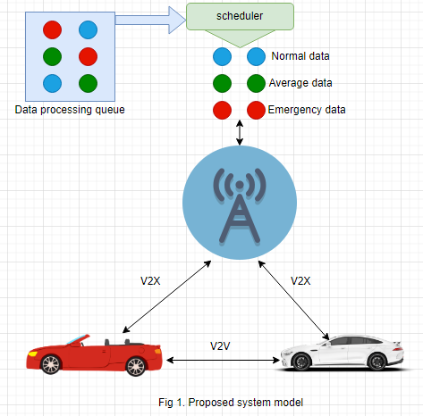
Priority based data aggregation and scheduling to improve the QoS in FSO enabled VANET
Architecture Components:
Data processing queue store the data
Schedular is responsible to assign priority to data on the basis of their importence
Infrastructure communicate with vehicles and cloud
Vehicle to vehicle communication
Emergency data : high priority
Average data: medium priority
Normal data : low priority
FSO components:
  Transmiter
  Reciever
  Optics
  Modulation
  Demodulation

Slide 8
Conclusion
To improve the quality of service, data prioritization in FSO enabled VANETs is essential for ensuring the safe, efficient, and reliable operation of these networks.
Prioritizing critical messages, VANETs can improve road safety, enhance traffic management, and provide a better user experience.

Slide 9
Reference
P. K. Sahoo, Siksha O Anusandhan University, A. K. Yadav, and Tribhuvan University, “A comprehensive road map of modern communication through free-space optics,” Journal of Optical Communications, Dec. 2020, doi: 10.1515/joc-2020-0238.

