Slide 1
Project: IEEE P802.15 Working Group for Wireless Specialty Networks
Submission Title: Overview of 6ma MAC Specification
Date Submitted: September 11th , 2024
Source: Ryuji Kohno^{1,2}, Minsoo Kim¹, Takumi Kobayashi^{1,4}, Marco Hernandez^{1,3}, Seong-Soon Joo⁶, Daisuke Anzai⁴, Kento Takebayashi⁵, Jussi Happola³
Company: ¹Yokosuka Research Park International Alliance Institute (YRP-IAI), ²Yokohama National University (YNU), Japan, ³Centre for Wireless Communications(CWC), University of Oulu, Finland, ⁴Nagoya Institute of Technology, ⁵Toyo University, ⁶Korea Platform Service Technology (KPST), Korea
Address: ¹YRP 1, 3-4 Hikarino-oka, Yokosuka, 239-0847 Japan; ²79-5 Tokiwadai, Hodogaya-ku, Yokohama, 240-8501 Japan, ³PO Box 4500, FI-90014 University of Oulu, Finland
Voice: ²+81-90-5408-0611, Fax: ²+81-45-383-5528, E-Mail:[kohno@yrp-iai.jp, minsoo@minsookim.com; kobayashi-takumi@yrp-iai.jp, anzai@nitech.ac.jp, Marco.Hernandez@ieee.org, petrucciniyng@gmail.com, wowbk@kpst.co.kr, jussi.haapola@oulu.fi]
Re: In response to call for technical contributions
Abstract: This document contains an overview of MAC of IEEE802.15.6ma to realize the enhanced reliability of P802.15.6ma.
Purpose: Material for discussion in P802.15.6ma TG
Notice: This document has been prepared to assist the IEEE P802.15.6ma. It is offered as a basis for discussion and is not binding on the contributing individual(s) or organization(s). The material in this document is subject to change in form and content after further study. The contributor(s) reserve(s) the right to add, amend or withdraw material contained herein.
Release: The contributor acknowledges and accepts that this contribution becomes the property of IEEE and may be made publicly available by P802.15.6ma.

Slide 2
Overview of 6ma MAC Specification of IEEE802.15.6ma (Revision of IEEE802.15.6-2012)
Ryuji Kohno^{1,2} ,Minsoo Kim¹, Takumi Kobayashi^{1,4},
Marco Hernandez^{1,3}, Seong-Soon Joo⁶, Daisuke Anzai⁴, Kento Takebayashi⁵, Jussi Haapola³
¹Yokosuka Research Park International Alliance Institute (YRP-IAI)
²Yokohama National University (YNU), Japan
³Centre for Wireless Communications(CWC), University of Oulu, Finland,
⁴Nagoya Institute of Technology(NIT) Japan,
⁵Toyo University(TU), Japan,
⁶Korea Platform Service Technology (KPST), Korea

Slide 3
Overview of 6ma MAC Specification
Concept of Depedable BAN in 6ma
15.6ma PHY and MAC New Features
15.6ma Channel Models, QoS Levels, Coexistence Classes
15.6ma Error-Control; FEC and HARQ
MAC Frame Formats
MAC Service Features (MAC Function)
BAN Creation
C2C Communications and Ranging
Summary

Slide 4
1. Concept of Depedable BAN in 6ma(1/2)
IEEE802.15.6ma; revision of IEEE802.15.6-2012 focuses on enhanced dependability in classified environments of coexistence with the same and other frequency shared wireless networks by PHY and MAC.
15.6ma covers new and conventional channel models of major use cases of 802.15.6ma Body Area Networks (BAN) are for human and vehicle bodies in medical and automotive applications for enhanced dependability.
15.6ma supports some backward compatibility with 15.6-2012 as much as possible but not all of them in PHY and MAC. 15.6ma aims to replace 15.6-2012 for enhanced dependability. For instance, 15.6ma focuses on only UWB in PHY and only time structure mode in MAC.

Slide 5
1. Concept of Depedable BAN in 6ma(2/2)
In order to perform enhaced dependability in revision of IEEE802.15.6-2012(IEEE802.15.6ma), coexistence environments have been classified. Some classes of multiple new and legacy BANs coexistence are focused to manage packet contention in MAC layer while other classes are taken care by mitigation of interference in Physical layer(PHY) and manage contention in MAC.
Ranging in 802.15.6ma is optional but ranging between coordinators of neibouring or coverage overlaid BANs is helpful to identify geographical overlay and mobility of incoming and outgoing to determine coexistence class stataes. Ranging between BAN coordinator and its nodes in star topology in 802.15.6ma is the same as 802.15.4z and its amendment.

Slide 6
2. 15.6ma PHY and MAC New Features(1/2)
Since IEEE802.15.6-2012 has too many modes in PHY and MAC, 15.6ma chooses a few modes to simplify specification of PHY and MAC while introduces new error-controlling schemes of FEC and HARQ, and management and data channels for enhanced dependability in various channel models and 8 classes of coexistence models for 8 levels of QoS priority order packets such as
  PHY
    Various channel coding and decoding matched with QoS priority levels of packets and coexistence classes
    Interference mitigation schemes according to various environment of coexistence classes
  MAC
    Two channels using two UWB band channels are applied for management channel to control frames of coexisting networks and data transmission channel. Its alternative mode is two channels for management and data transmission using a single UWB band channel.
    Coordinator-to-coordinator(C2C) negotiation of existing networks
  Cross Layer of PHY and MAC
    Hybrid ARQ for higher priority of packets in high class of coexistence

Slide 7
2. 15.6ma PHY and MAC New Features(2/2)
  3. Cross Layer of PHY and MAC
    Hybrid ARQ for higher priority of packets in high class of coexistence
    For the sake of easy implementation, hybrid ARQ is optional in limited high classes of coexistene.
    Ranging between coexisting BANs’ coordinators could be proceeded by C2C(coordinator-to-coordinator) functionality.
    Ranging information in PHY is applied for identifying coexistence class states in which appropriate MAC is selected.

Slide 8
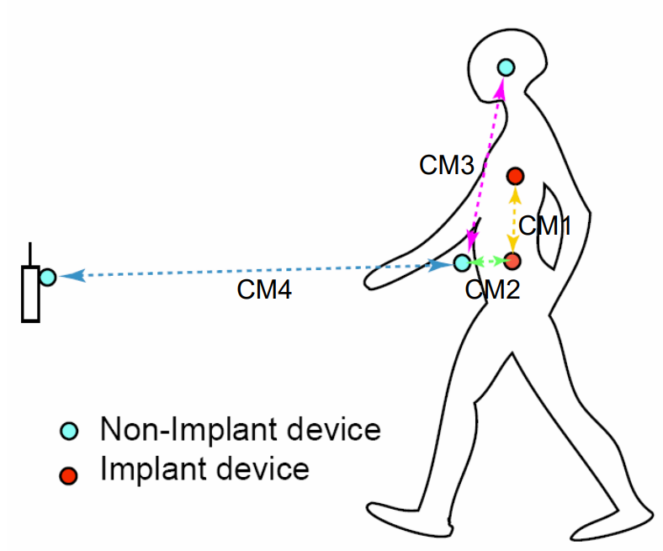
3. Channel models and scenarios in IEEE802.15.6ma
Scenario | Description | Frequency Band | Channel Model
S2 | Implant to Body Surface | 402-405 MHz, | CM2
S2.1 | Implant (upper body) to Body Surface | 3.1-10.6 GHz UWB | CM2.1
S2.2 | Implant (head) to Body Surface | 3.1-10.6 GHz UWB | CM2.2
S3 | Implant to External | 402-405 MHz, 3.1-10.6 GHz UWB | CM2
S4 | Body Surface to Body Surface (LOS) | 400, 600, 900 MHz 2.4, 3.1-10.6 GHz | CM3
S4.1 | Body Surface to Body Surface (LOS) | 3.1-10.6 GHz CM4.1 | CM4.1
S5 | Body Surface to Body Surface (NLOS) | 400, 600, 900 MHz 2.4, 3.1-10.6 GHz | CM3
S6 | Body Surface to External (LOS) | 900 MHz 2.4, 3.1-10.6 GHz | CM4
S6.1 | Body Surface (head) to External (LOS) | 3.1-10.6 GHz | CM6.1
S7 | Body Surface to External (NLOS) | 900 MHz 2.4, 3.1-10.6 GHz | CM4
Path loss (Mandatory)
Optional;
  Fading ( Small scale/ large scale)
  Shadowing
  Power delay profile
Specific use cases
Implant to Body Surface for BCI
Implant to External for BCI
Body surface to body surface for BCI
Body Surface to External for BCI
Implant to body surface for capsule endoscopy

Slide 9
3.1 Classification of Channel and Environment Models for Human and Vehicle Body Area Networks (HBAN&VBAN)
Channel model
※Covered by
IEEE 802.15.6-2012
HBAN model
In-body (Implant)
※
On-body
※
Channel model
With environment
Around body
Outdoor
※Around means;
Desk, WiFi AP in the room etc.
Indoor
※
Home
Implanted BCI model
Office
※
On skull BCI model
Medical (e.g. Hospital)
※
capsule endoscopy
※not covered in 2012
VBAN model
In-vehicle
Engine compartment
Note:
HBAN-model:
-Environment with co-existing systems is not considered.
VBAN model:
Key-less entry system
Localization in-body, on-body
Most dominant model should be defined and separatory defined as Mandatory and Optional.
Cabin
Through Engine compartment and cabin
On-vehicle
Roof
Around vehicle
Side Right/Left/Front/back
Bottom
Static vehicle
Moving vehicle

Slide 10
3.2 8 Levels of Packets corresponding to User Priority of QoS in IEEE802.15.6 and 6ma
In Std.15.6 WBAN systems, a various data such as vital signs, skin temperature, blood pressure, ECG, EEG, ECoG, and vehicle controlling commons have different QoS levels corresponding to user priority.
In 15.6ma for dependable WBAN for human and vehicles, data packet transmission should be dependable according to QoS levels even in various classes of coexistence environment.
Therefore, appropriate sets of error controlling scheme with FEC and hybrid ARQ corresponding to QoS levels have been standardized in 15.6ma,
User priority | Traffic designation | Frame type
0 | Background (BK) | Data
1 | Best effort (BE) | Data
2 | Excellent effort (EE) | Data
3 | Video (VI) | Data
4 | Voice (VO) | Data
5 | Medical data or network control | Data or management
6 | High-priority medical data or network control | Data or management
7 | Emergency or medical implant event report | Data

Slide 11
3.3 8 Classes of Coexistence Environment Models
Coexistence Class | Coexisting system(s) |  |  |  |  | Category
Level | 802.15.6ma | 802.15.6-2012 | Non-UWB (ex. Wi-Fi / Unlicensed / 3GPP) | 802.15 UWB (ex. 802.15.4) | Non-802.15 UWB (ex. ETSI SmartBAN) | Category
Class 0 | - | - | - | - | - | Single BAN
Class 1 (1a) | ✓ | - | - | - | - | Multiple 15.6 BANs
Class 2 (1b) | ✓ | ✓ | - | - | -
Class 3 | ✓ | - | ✓ | - | - | Non-UWB
Class 4 (2a) | ✓ | - | - | ✓ | - | Multiple UWB systems
Class 5 (2b) | ✓ | - | - | - | ✓
Class 6 (2c) | ✓ | - | - | ✓ | ✓
Class 7 | ✓ | ✓ | ✓ | ✓ | ✓ | Final Boss
The coexistence class has been redefied to 8 levels, which can be represented by 3 bits and would be suitable to include in PHY or MAC headers.

Slide 12
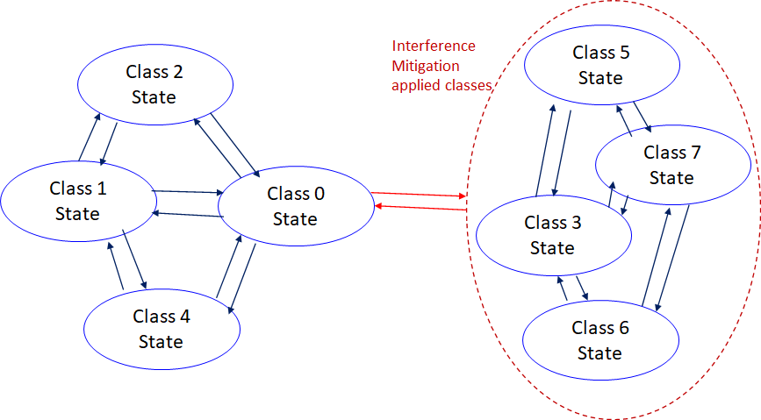
    3.4 Coexistence Class States Transition(1/2)
The standard's revision supports BANs operating with high reliability (coexistence class 0) and coexisting in dense environments with intra-interference and inter-interference (coexistence class 1 to 7). Figure 6 shows the state transition between several classes of coexistence environments defined in above –mentioned table.
Class 0: 6ma BAN alone
Class 1: Multiple 6ms BANs
Class 2: 6ma BAN with old 6 BAN
Class 4: 6ma BAN with other
802.15 UWB WSNs e.x. 4z, 4ab
Class 3: 6ma BAN with other
narrowband Nets WSNs
Class 5: 6ma BAN with other
UWB Nets e.x. ESTI SmartBAN
Class 6: 6ma with 802.15 other WSN
Class 7: 6ma with any frequency
shared networks
Figure 6 Diagram of state transitions for coexistence class environments.

Slide 13
    3.4 Coexistence Class States Transition(2/2)
The standard's revision focuses on the dependability mechanisms for a single HBAN or VBAN (Class 0) and the scenario with multiple HBANs or VBANS (Class 1).
Class 2 supports compatibility with legacy BANs (IEEE 802.15.6-2012 Std).
Class 4 supports coexistence with other IEEE 802.15 UWB Stds, and amendments such as 15.4, 15.8, 15.4z, and 4ab, via the PHY and MAC specification.
Classes 3, 5, 6, and 7 support coexistence with other wireless systems can result in Class 0, 1, and 2 by mitigation technology to cancel interference from other radios except regacy 15.6 at the receiver side (see clause 4.7.2 of draft#1.11.
During CCA, a BAN coordinator may analyze the type of synchronization preamble detected from a 15.6ma, 15.6, or 15.4 system.
In Figure 6, the state transition probabilities are approximated in consecutive superframes. Furthermore, the duration of the CAP and CFP are determined by statistics of various QoS level of packets in previous consecutive superframes for every coming superframe.
The draft revision #1.11 supports BANs operating with high reliability in dense environments coexisting with intra-interference and inter-interference due to other wireless systems in the same frequency band. Figure 6 shows state transition among several classes of coexistence environment defined in Table 1.

Slide 14
3.4 MAC Basic Consensus
Two channels using two UWB band channels are applied for control channel to control frames of coexisting networks and data transmission channel. Its alternative mode is two channels or time slots for control and data transmission using a single UWB band channel.
IEEE802.15.6ma; revision of IEEE802.15.6-2012 focuses on enhanced dependability in data transmission and ranging according to the class 0-7 of coexistence.
  Class 0&1: New 15.6ma MAC is defined primarily to support enhanced dependability of a new 15.6ma BAN (Class 0) and multiple 15.6ma BANs (Class 1).
  Class 2: 15,6ma MAC is defined secondarily to support backward compatibility with a legacy 15.6-2012 BAN as long as enhanced dependability of a new 15.6ma BAN can be performed in Class 2.
  Class 4: 15.6ma MAC is defined to support interoperability with coexisting 15.4ab WSN/PAN in secondary as long as enhanced dependability of 15.6ma BAN can be performed in primary in Class 4.
  Class 3,5,6,7: 15.6ma MAC is defined to support enhanced dependability of 15.6ma BAN while mitigating interference from coexisting other radios.
Hence, new 15.6ma MAC documentation must be good enough by describing mostly in Class 1 including Class 0, and Class 4 while describing a way to recognize class of coexistence and to mitigate interference in other classes.

Slide 15
4. 15.6ma Error-Control; FEC and HARQ
Corresponding Combination of 8 QoS Levels and 8 Coexistence Classes
Coexistence Class | 0 | 1 | 2 | 3 | 4 | 5 | 6 | 7
QoS Level
0 | LDPC or BCC | LDPC or BCC | LDPC or BCC | LDPC(in) & RS(out) | LDPC(in) & RS(out) | LDPC or BCC | LDPC(in) & RS(out) | LDPC(in) & RS(out)
1 | LDPC or BCC | LDPC or BCC | LDPC or BCC | LDPC(in) & RS(out) | LDPC(in) & RS(out) | LDPC or BCC | LDPC(in) & RS(out) | LDPC(in) & RS(out)
2 | LDPC or BCC | LDPC or BCC | LDPC or BCC | LDPC(in) & RS(out) | LDPC(in) & RS(out) | LDPC or BCC | LDPC(in) & RS(out) | LDPC(in) & RS(out)
3 | LDPC or BCC | LDPC or BCC | LDPC or BCC | LDPC(in) & RS(out) | LDPC(in) & RS(out) | LDPC or BCC | LDPC(in) & RS(out) | LDPC(in) & RS(out)
4 | LDPC(in) & RS(out) | LDPC(in) & RS(out) | CFP/HARQ | LDPC(in) & RS(out) | LDPC(in) & RS(out) | LDPC or BCC | LDPC(in) & RS(out) | LDPC(in) & RS(out)
5 | LDPC(in) & RS(out) | LDPC(in) & RS(out) | CFP/HARQ | CFP/HARQ | CFP/HARQ | LDPC(in) & RS(out) | CFP/HARQ | CFP/HARQ
6 | LDPC(in) & RS(out) | LDPC(in) & RS(out) | CFP/HARQ | CFP/HARQ | CFP/HARQ | LDPC(in) & RS(out) | CFP/HARQ | CFP/HARQ
7 | LDPC(in) & RS(out) | LDPC(in) & RS(out) | CFP/HARQ | CFP/HARQ | CFP/HARQ | LDPC(in) & RS(out) | CFP/HARQ | CFP/HARQ
Remark: LDPC(in) and RS(out) means concatenated code with LDPS as inner code and Reed-Solomon code as outer code.
Slide 15
Ryuji Kohno(YNU/YRP-IAI)

Slide 16
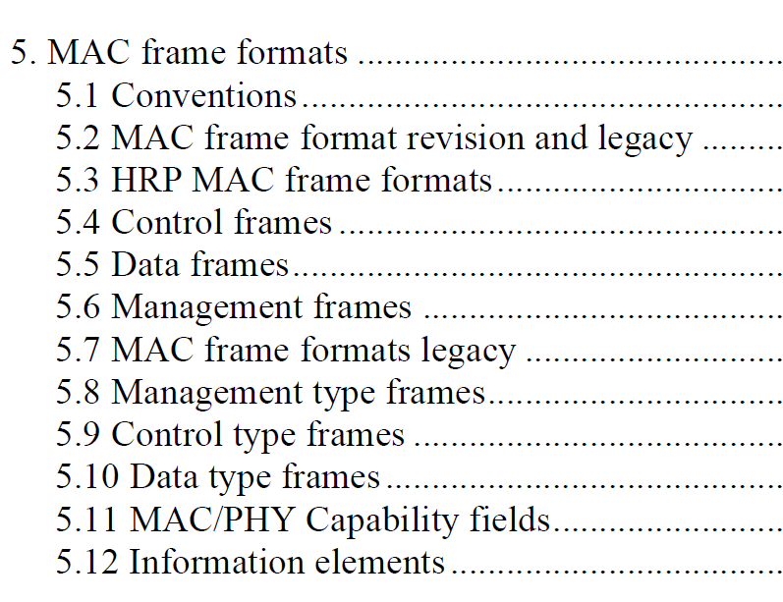
5. MAC Frame Formants

Slide 17
5.1.1. MSDU format in 15.6-2012
5.1 Conventional MAC Frame Structure
The usual: MAC header + MAC payload + MAC footer

Slide 18
5.1.2 15.6ma MAC
Due to the historic background of 15.6, the MSDU format supports several MAC mechanisms (polling, CSMA, slotted Aloha, LBT), and it is up to vendors what specifically to implement.
  However, the result was that the MAC spec is difficult to understand
The revision 15.6ma plans to simplify the MAC mechanism under a UWB PHY:
  LBT & slotted Aloha (CAP) and TDMA (CFP)
  (maybe the support of an Ethertype field)
  Hence, the MSDU Header will change.

Slide 19
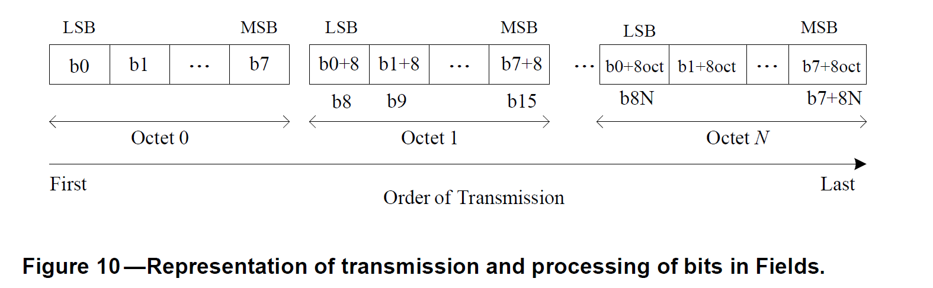
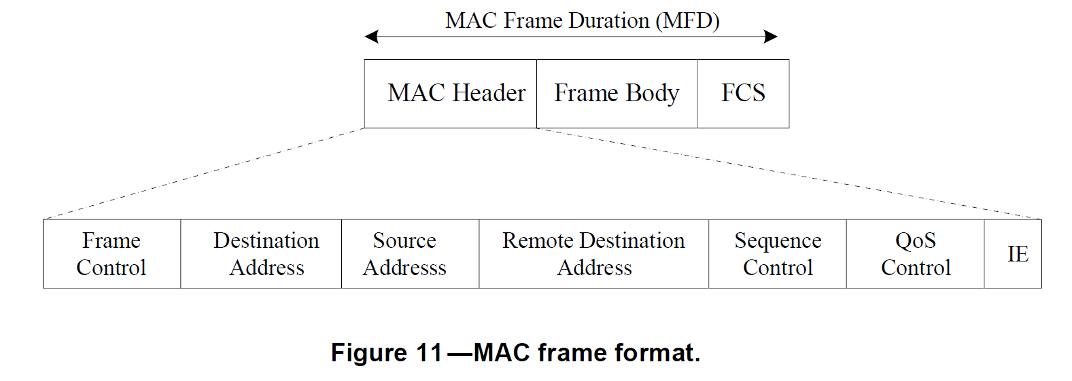

Slide 20
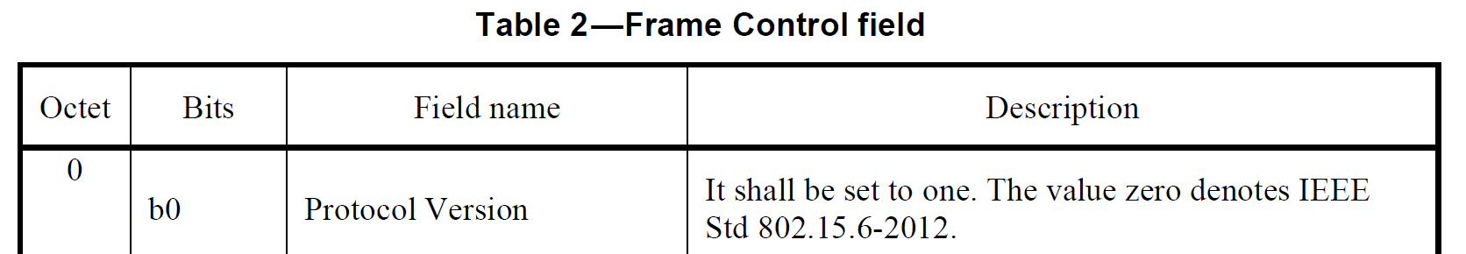
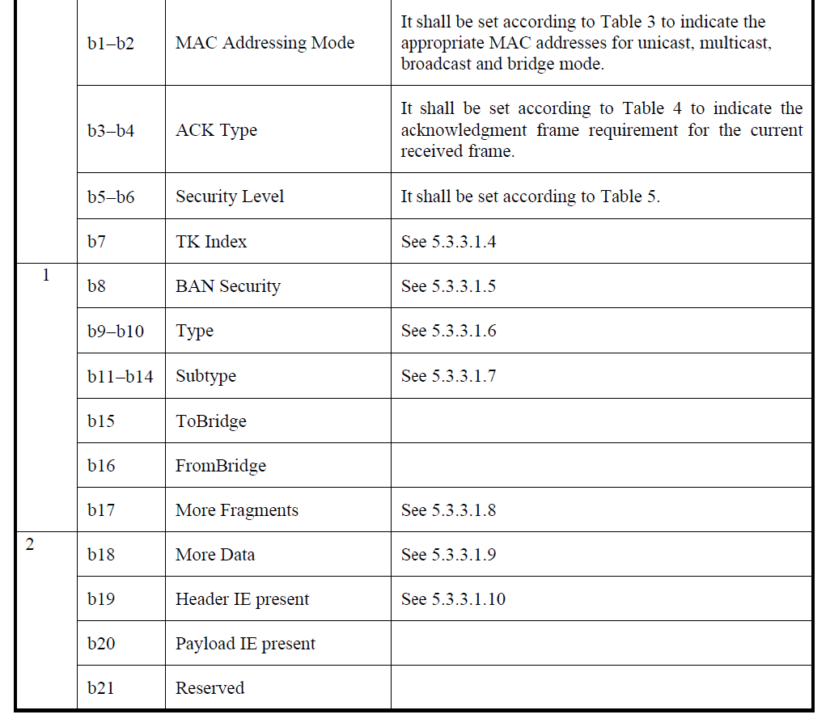

Slide 21
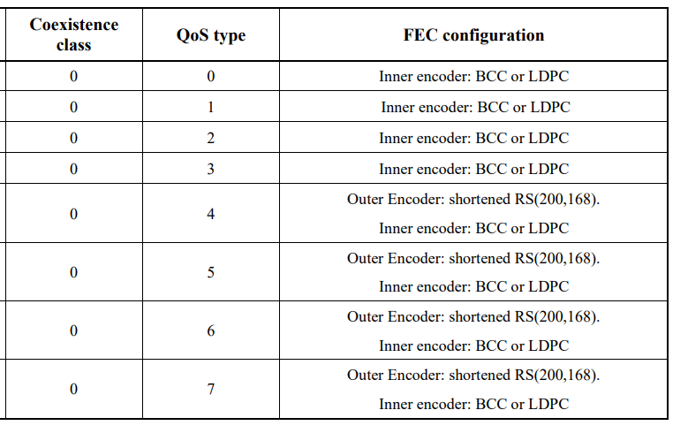
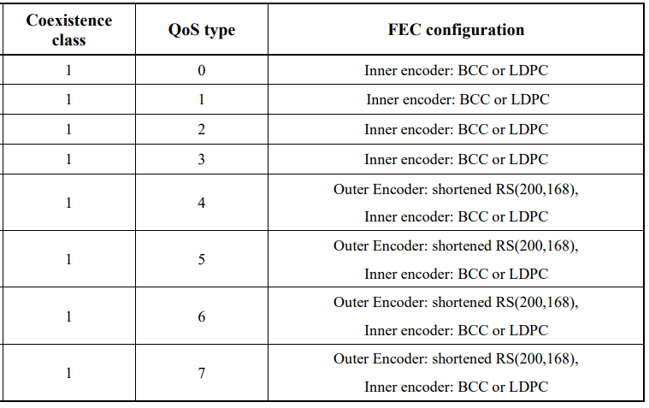
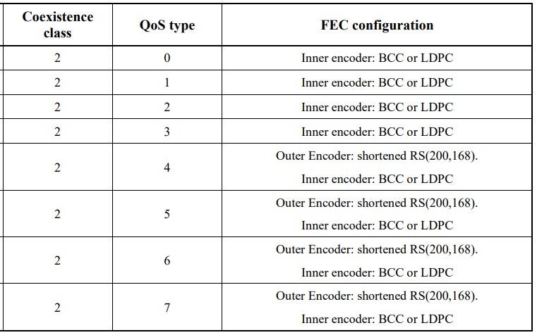
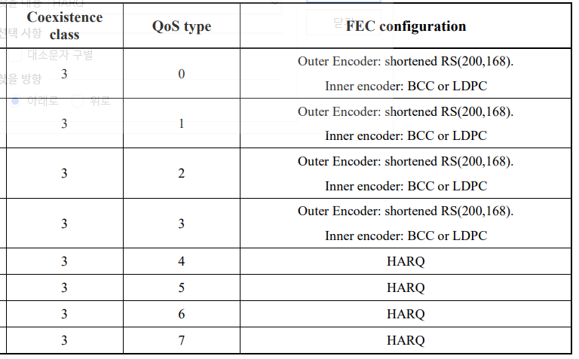
examples

Slide 22
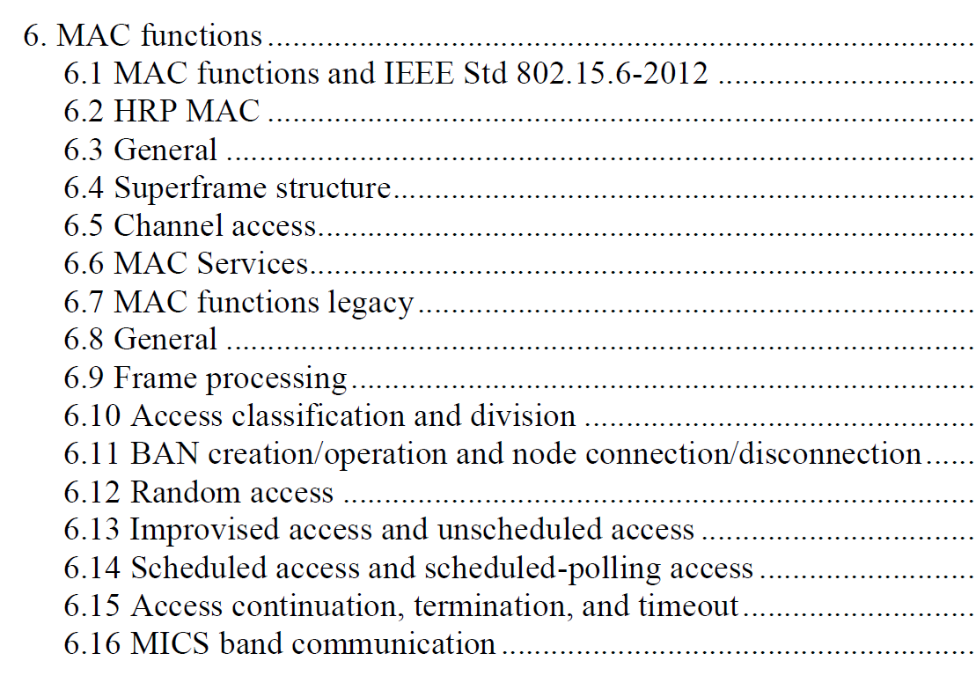
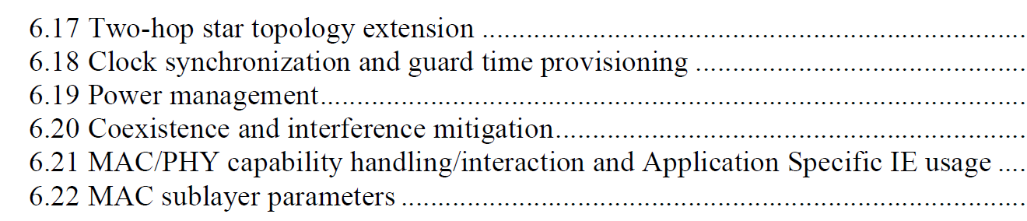
6. MAC Services Feature

Slide 23
6.1 Group MAC superframe structure (I)
group superframe structure
  Group Coordination Period (GCP)
    group beacon slot : group beacon frame from group coordinator
    group coordination slots : group coordination request & response frames from group member BAN coordinators
    group notification slot : group allocation map frame from group coordinator
  Group Allocation Period (GAP)
    group coordinator BAN active superframe (BAN #0 superframe) duration
    group member BAN active superframes (BAN #1 superframe ~ ) duration
      BAN #x beacon period slot, Contention Access Period (CAP) slots, Contention Free Period (CFP) slots
      BAN #x inactive period is Group Beacon Interval - BAN #x active superframe duration
BAN #1 Beacon Interval (BI)
BAN #1 Inactive Period
BAN#0(Coord BAN)
BAN #1 SD
BAN #n SD
BAN#0(Coord BAN)
BAN #1 SD
Group
Beacon
Coord.
Req.
Coord.
Resp.
Group
Alloc..
B
CAP
CFP
Group
Beacon
Group
Alloc..
B
CAP
CFP
GB TS
Group Mang. TS
GN TS
Group Coordination Period (GCP)
Group Allocation Period (GAP)
Group Beacon Interval (GBI)

Slide 24
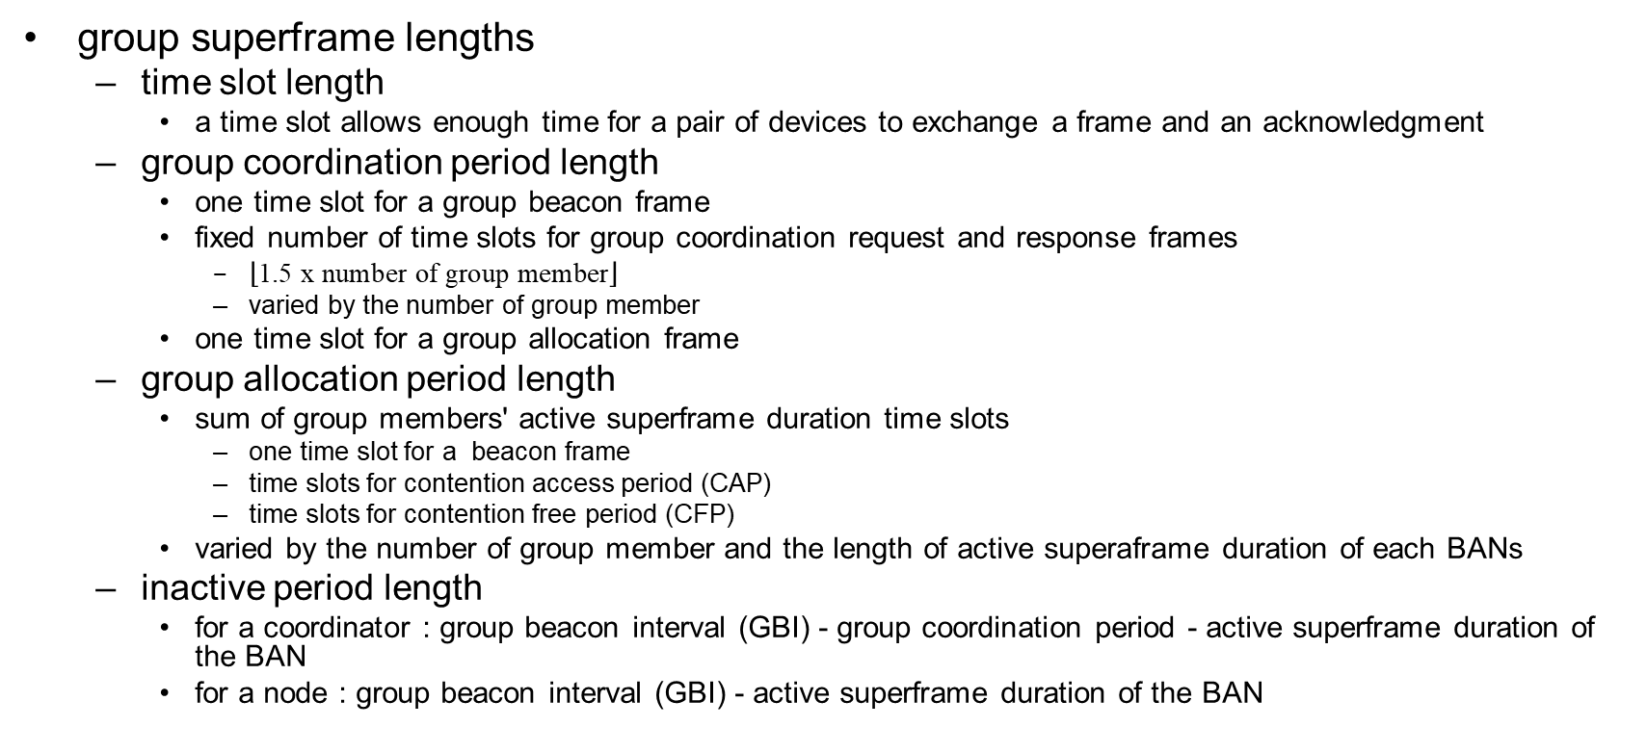
6.1 Group MAC superframe structure (II)

Slide 25
6.2 BAN Node Service Features
a BAN node
  is specified in MIB
    set as ‘coordinator disabled’
a BAN node services
  associate a BAN
    listen channels and resolve out HRP UWB beacons
      frame body : timestamp, BAN identifier, superframe structure (length of BI, length of CAP, length of CFP)
    search a BAN that can support service configuration specified in MIB
      ‘service configuration’ : user priority, service class
    send an association request frame to the searched coordinator during CAP of the BAN
      frame body : service configuration, number of CFP slot for up and down, (traffic flow infor.)
    receive an association response frame from the coordinator
      frame body : result code (if denied, reason code), timestamp, length of BI, offset of CAP start to beacon slot, assigned number of CFP slots, list of offset slots for assigned CFP
    listen beacon frame periodically
      reconfigure the access time slot (beacon slot, CAP slot, CFP slot) from the next beacon interval if receiving changed superframe structure
  transmit/receive data
    listen for CAP to receive, listen assigned down CFP slots
    transmit management or data frame on CAP with CSMA/CA, transmit data frame on assigned up CFP slots
  disassociate a BAN
    send a dissociation request frame to the coordinator
    receive a dissociation response frame from the coordinator
      frame body : result code
      if timed out to receive a disassociation response frame, stop to listen beacon

Slide 26
6.2 BAN Coordinator Service Features (I)
a BAN coordinator
  is specified in MIB
    set as ‘coordinator enabled’
a BAN coordinator services
  start a BAN
    configure superframe structure according to the BAN configuration specified in a MIB
      BAN configuration : max number of node, list of supported service configuration
    listen channels and resolve out HRP UWB, 15.6-2012, 15.4z/ab beacons
      figure out coexisting BAN
    if not found coexisting BAN, broadcasts a beacon periodically
      frame body : timestamp, BAN identifier, superframe structure (length of BI, length of CAP, length of CFP)
    if found coexisting BAN, select a group BAN and join a group BAN, and then broadcasts a beacon periodically
  join a group BAN
    requests to join a group BAN by sending a group coordination request frame during group coordination time slot of GCP
      GCReq management frame, join subtype, frame body : timestamp, BAN identifier, superframe structure (length of BI, length of CAP, length of CFP)
    listen group notification time slot of GCP for receiving group allocation frame
      GA management frame, frame body : timestamp, Group BAN identifier, group superframe structure (length of GBI, length of GCP), GAP map (number of group member, BAN#0 map(BAN ID, BAN coord addr, length of BI, length of CAP, length of CFP), BAN#1 map, … )
    reconfigures superframe structure from the next beacon interval
      change the access time to the beacon slot

Slide 27
6.2 BAN Coordinator Service Features (II)
a BAN coordinator services
  maintain a BAN
    broadcasts a beacon
    receives an association request frame from a node
    sends an association response frame to the node
    receives a disassociation request frame from a node
    sends a disassociation response frame to the node
    synchronize to group superframe, if join a group BAN
      wakeup on the start of group superframe, listen group beacon
        if fail to receive group beacon, start coexisting BAN listening procedure
      receive group allocation frame, check changes on group superframe structure
        if changed, notify changed beacon slot offset for BAN superframe to node in the BAN
        set next wakeup time by changed beacon slot offset
    realign the superframe to follow the group BAN
      when notifed that the group allocatin map is changed
      reconfigure superfraeme, send a beacon containinig new superfrmae structure
  leave a group BAN
    listens coexisting BAN periodically
      decide to leave, when fails to receive group beacons consequently 3 times,
      or when finds a coexisting group BAN which is superior to current group BAN
    requests to leave a group BAN
      send disassociation group BAB requesy frame
    reconfigures superframe structure

Slide 28
6.3 Group BAN Coordinator Service Features (I)
a BAN coordinator and possible group BAN coordinator
  is specified in MIB
    set as ‘group coordinator enabled’
a BAN coordinator services
  start a BAN and a Group BAN
    configure superframe structure according to the BAN configuration specified in a MIB
    listen channels and resolve out HRP UWB, 15.6-2012, 15.4z/ab beacons
    if not found a coexisting BAN, create a group BAN and start a BAN
    if found coexisting BAN, select a group BAN and join a group BAN, or challenge to become a group BAN coordinator
    after establishing or joining a group BAN, and start a BAN by broadcasting a beacon periodically
  maintain a BAN as a coordinator
    broadcasts a beacon
    receives an association request frame from a node
    sends an association response frame to the node
    receives a disassociation request frame from a node
    sends a disassociation response frame to the node
    synchronize to group superframe
    realign the superframe to follow the group BAN

Slide 29
6.3 Group BAN Coordinator Service Features (II)
a Group BAN coordinator services
  creation a Group BAN
    configures group superframe structure
    start to broadcast group beacon and group allocation map frame periodically
  maintain a Group BAN
    maintain group allocation map
    receives group association request from a BAN
      assign a location of active superframe duration of a newly joined BAN
      reconfigure group allocation map, send a group association response frame
    receives group disassociation request from a BAN
      remove active superframe duration of a BAN
      reconfigure group allocation map , send a group association response frame
    reconfigures group superframe structure
      reconfigure group beacon and group allocation map every group beacon interval

Slide 30
6.3 Group BAN Coordinator Service Features (III)
a Group BAN coordinator services
  resign a group coordinator or leave a group BAN
    when a group coordinator decides to resign, broadcasts group election request frame
    receive group coordinator challenge request frame from coordinator
      group coordinator selects new group coordinator from the candiataes
    if no coordinator intend to become a group coordinator
      group coordinator stars to disband group BAN
    when resign or disband procedure finish, reconfigures superframe structure
  disband a Group BAN
    group disbanding is occurred
      when a BAN group coordinator leave a a BAN group and not to role over
    broadcast group disbanding request from a group coordinator
      group coordination request frame (group disband command)
    as a response of disbanding request, coordinators of a BAN group maintain own BAN separately
      a coordinator broadcasts reconfiguration of a BAN
      BAN will cease transmission for 2 Beacon Intervals
      coordinator broadcasts reconfigured beacon

Slide 31
6.3 Group BAN Coordinator Service Features (IV)
BAN group coordinator superiority check
  BAN ID represent the capability of a BAN group coordinator
  lower BAN ID of BAN group coordinator is superior
Migration procedure
  group coordinator migration is occurred
    when group coordinator leaves from a BAN group or
    when new coexisting coordinator challenge to become a group coordinator
  broadcast group coordinator migration request from a group coordinator or newly joined coordinator
    group coordination request frame (group coordinator migration resign command)
    group coordination request frame (group coordinator migration challenge command)
  as a response of migration resign request, a coordinator that can take a group coordinator role broadcasts an intention which contains role-over
    group coordination response frame (group coordinator migration intend command)
  as a response of migration challenge request, a group coordinator role broadcasts an intention which contains deny or accept
    group coordination response frame (group coordinator migration intend command)
  newly selected group coordinator broadcasts group BAN realignment
    group coordination request frame (group BAN realignment command)
    BAN will cease transmission for 2 Group Beacon Intervals
    group coordinator broadcasts own group beacon and new group allocation map

Slide 32
6.3 Group BAN Coordinator Service Features (V)
BAN group coordinator superiority check
  make short to converge into a synchronized BAN group
  larger number of BANs in a BAN group is superior
Merging procedure
  group merging is occurred
    when newly coexisting BAN group coordinator challenge to merge
  broadcast group merging request from newly joined group coordinator
    group coordination request frame (group merging challenge command)
  as a response of merging challenge request, a group coordinator broadcasts an intention which contains role-over
    group coordination response frame (group merging agree command)
  newly selected group coordinator broadcasts group BAN realignment
    group coordination request frame (group BAN realignment command)
    BAN will cease transmission for 2 Group Beacon Intervals
    group coordinator broadcasts own group beacon and new group allocation map

Slide 33
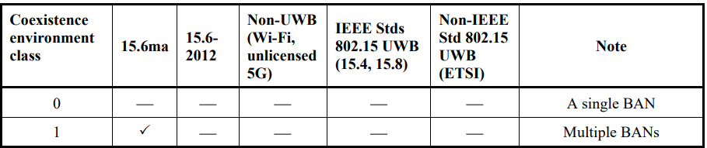
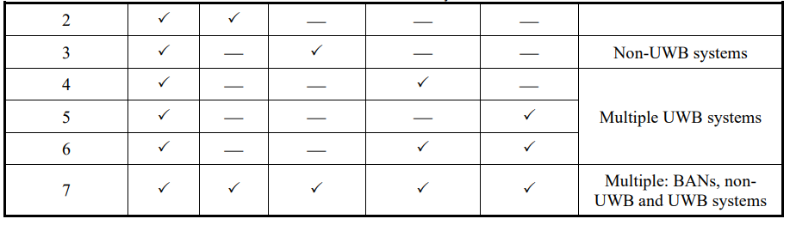
6.4 Interference Mitigation Service Features (I)
listen around continuously and mitigate interfering according to coexistence class
  coordinator listen channels and separate out coexisting UWB networks in interfering range
  for coexistence class 1, form a group BAN or merging group BANs
  for coexistence class 2, reconfigure group superframe not to interfere 15.6-2012 superframe
  for coexistence class 3, select FEC configuration : outer encoder (shortened BS)/inner encoder(BCC/LDPC) or HARQ according to QoS
  for coexistence class 4, reconfigure group superframe not to interfere 15.4 superframe
  for coexistence class 5, reconfigure group superframe not to interfere non-IEEE UWB network
  for coexistence class 6, reconfigure group superframe not to interfere 15.4 superframe and non-IEEE UWB network
  for coexistence class 7, select FEC configuration : outer encoder (shortened BS)/inner encoder(BCC/LDPC) or HARQ according to QoS

Slide 34
6.4 Interference Mitigation Service Features (II)
for coexistence class 1
form a group BAN
  a node set as group coordinator enabled start a group BAN
align active superframe duration of BANs in a group BAN
  whenever a BAN join or leave, reallocate active superframe durations on group allocation period
    keep the order of allocation with a BAN joined sequence
  a group coordinator may choose the mode of group allocation period that set the length of group allocation period fixed or varied
    in fixed mode, not served part of GAP becomes group inactive period
    in varied mode, GAP contains active superframe duration only, there is no group inactive period
  when GAP is not affordable to accept for newly joined BAN
    send group association response of fail with no available GAP
  reconfigure beacon and group allocation map every GBI
    length of GBI, number of BANs, location of active superframe durations of BANs

Slide 35
6.4 Interference Mitigation Service Features (III)
merging group BANs
  when two more group BANs are coexisting
    two more group coordinators can listen each other
    severe interference occurred
  a group coordinator request to merge group BANs
    broadcast elect group coordinator frame on group coordination period of neighbor group BAN
  reconfigure beacon and group allocation map every GBI
    length of GBI, number of BANs, location of active superframe durations of BANs

Slide 36
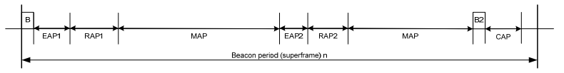
6.4 Interference Mitigation Service Features (IV)
for coexistence class 2
reconfigure group superframe of 15.6ma not to interfere 15.6-2012 superframe
  not to collide with group beacon, group allocation map, and beacon of a BAN in a group of 15.6ma to beacon of 15.6-2012 superframe
I inactive superframes
(beacon periods)
BAN#0(Coord BAN)
BAN #1 Superframe Duration
BAN #n SD
GB
GC
GN.
B
CAP
CFP
Group Coordination Period (GCP)
Group Allocation Period (GAP)
Group Beacon Interval (GBI)

Slide 37
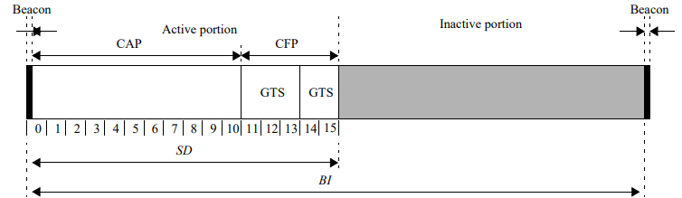
6.4 Interference Mitigation Service Features (V)
for coexistence class 4
reconfigure group superframe of 15.6ma not to interfere 15.4 superframe
  not to collide with group beacon, group allocation map, and beacon of a BAN in a group of 15.6ma to beacon of 15.4 superframe
BAN#0(Coord BAN)
BAN #1 Superframe Duration
BAN #n SD
GB
GC
GN.
B
CAP
CFP
Group Coordination Period (GCP)
Group Allocation Period (GAP)
Group Beacon Interval (GBI)

Slide 38
7. BAN Creation

Slide 39
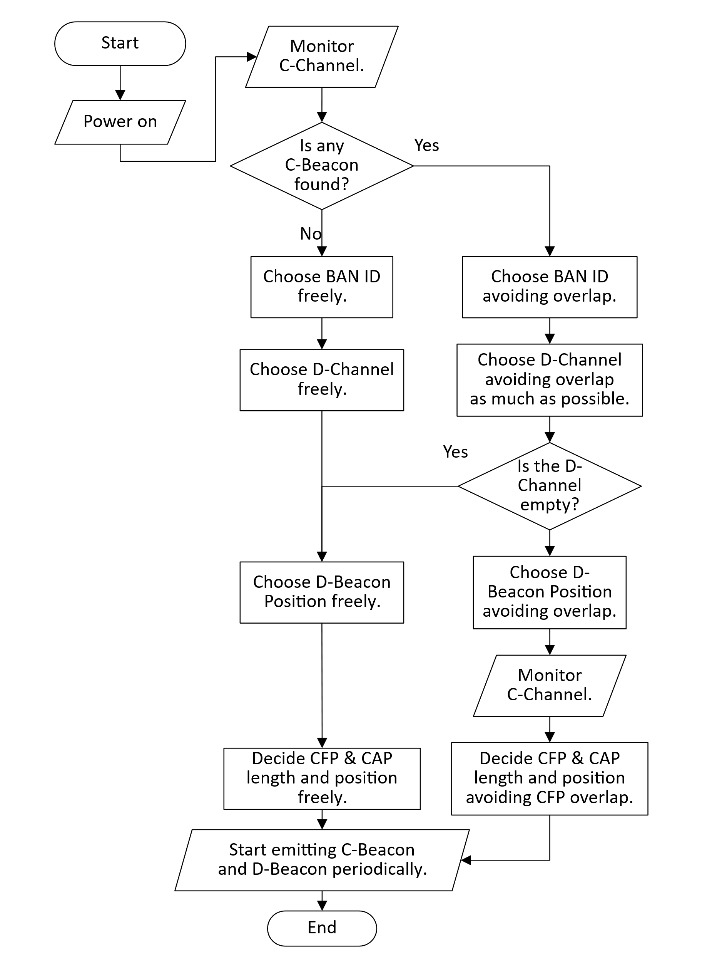
7.1 BAN Creation
Neighbor BAN Detection: The coordinator monitors the C-Channel to identify neighboring BANs and determine their presence.
BAN ID Selection: The coordinator selects an available BAN ID that is not currently in use by neighboring BANs to ensure uniqueness within the network.
Data Channel (D-Channel) Selection: The coordinator chooses a suitable D-Channel for communication. D-Channel Occupancy Indexes obtained from neighboring BAN’s C-Beacons can be used to determine which D-Channel to use.
D-Channel Synchronization: If other BANs are using the same D-Channel, the coordinator synchronizes to the superframe of the BAN(s) already using that D-Channel.

Slide 40
7.1 BAN Creation (cont.)
D-Beacon Position Selection: The coordinator selects a specific position for the D-Beacon transmission within the Network Management Period (NMP) of the superframe. It ensures that the chosen position does not overlap with neighboring BANs using the same D-Channel.
Periodic Control Beacon (C-Beacon) Transmission: The coordinator transmits Control Beacons periodically on the C-Channel. The C-Beacon includes essential information such as the BAN ID, D-Channel number, and D-Beacon Position in NMP.
Periodic Data Beacon (D-Beacon) Transmission: The coordinator transmits Data Beacons periodically on the D-Channel. The D-Beacon provides slot numbers indicating the start of the Contention Free Period (CFP) and the Contention Access Period (CAP) within each superframe.

Slide 41
7.2 Superframe transition due to proximity of BAN piconets
As BANs are mobile, it is possible for multiple BANs that have started independently to come into close proximity with each other.
Since these BANs are likely using different superframes, their frames will interfere each other, causing performance degradation.
To avoid this interference, BANs located in close proximity must transition to using common superframes.
After superframe transition

Slide 42
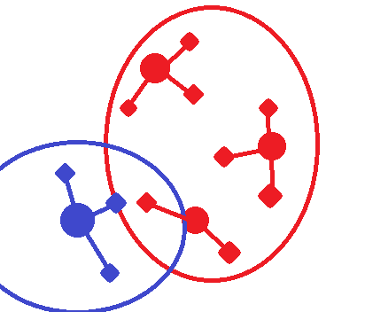
7.2 Superframe transition due to proximity of BAN piconets (cont.)
A coordinator continuosly monitors the C-Channel to detect neighboring BANs.
When a coordinator receives a Control Beacon (C-Beacon) with a different Superframe Reference BAN ID value and a Superframe Priority Index grater than its own, it indicates that a new BAN is nearby.
In such cases, the coordinator must transition to using the superframe of the newly met BAN to avoid interference and ensure efficient communication.
BAN ID = 1
Superframe Reference BAN ID = 1
BAN ID = 2
Superframe Reference BAN ID = 1
BAN ID = 4
Superframe Reference BAN ID = 4
BAN ID = 3
Superframe Reference BAN ID = 1

Slide 43
7.2 Superframe transition due to proximity of BAN piconets (cont.)
The Superframe Priority Index is used to determine which BAN should continue using its current superframe and which BAN should transition to the superframe of another BAN when multiple BANs come into close proximity.
  The index should be defined in a way that allows BANs with many nodes of high priority to maintain their superframes, while BANs with lower priority nodes can transition to other BAN’s superframe.
Fallback Mechanism: In scenarios where a BAN with a low Superframe Priority Index fails to receive the C-beacon of another BAN, interference cannot be avoided due to the inability to perform superframe transition.
  To address this situation, implementing a fallback mechanism allowing high-priority BANs to initiate superframe transition would be advantageous.

Slide 44
7.3 Node Connection/Disconnection
The node monitors the C-Channels to acquire a C-Beacon, which provides essential information.
By receiving the C-Beacon, the node can obtain the BAN ID, D-Channel number, and D-Beacon Position for further communication.
The node also monitors the D-Channels to acquire a D-Beacon, which provides details about the positions of Contention Free Period (CFP) and Contention Access Period (CAP).
During the CAP, the node initiates the Connection Request (C-Request) frame using the Contention Access procedure.
Upon successful reception of the C-Request frame, the coordinator responds by transmiting
  an Acknowledgement,
  and a Connection Assignment (C-Assignment) frame in the next available time slot.
The C-Assignment frame provides information of the allocated resources to the node, including the number of time slots allocated, and the node’s allocated Node ID.

Slide 45
7.4 Fields in Control Beacon
BAN ID
  This is a unique identifier assigned to each Body Area Network (BAN).
  It is used to distinguish between BANs operating in the vicinity and facilitate communication between them.
D-Channel number
  This refers to the specific channel utilized for data transmission within a BAN.
  Each BAN is assigned a particular D-Chanel number to avoid interference with other BANs and enable efficient communication.
D-Beacon Position in Network Management Period (NMP)
  This indicates the specific time slot within the NMP where the D-Beacon, which provides network management information, is transmitted.
D-Channel Occupancy Index
  This index is a measure used to inform neighboring BANs about the congestion level of the D-Channel.
  It provides an indication of how busy the channel is, helping BANs make informed decisions regarding D-Channel selection.

Slide 46
7.4 Fields in Control Beacon (cont.)
The Superframe Reference BAN ID
  This serves the purpose of informing neighboring BANs about the BAN with which they share the same superframe.
  BANs that share superframes should have the same Superframe Reference BAN ID, allowing synchronization and coordinated operation within the shared superframe.
The Superframe Priority Index
  This is an index used to determine the priority of a BAN in relation to other BANs when multiple BANs come into proximity.
  It enables the orderly transition of superframes, ensuring that BANs with higher priority can maintain their superframes while lower-priority BANs transition to other BAN’s superframes.

Slide 47
7.4 Fields in Data Beacon
Position of Contention Free Period (CFP)
  This refers to the specific time slots within the superframes where the Contention Free Period occurs.
  The CFP is a dedicated period during which scheduled frames are transmitted without contention.
  To ensure coexistence an minimize interference among coexisting BANs, the position of the CFP may vary between BANs.
  By assigning different CFP position, BANs can have non-overlapping CFPs, allowing for interference-free transmission of scheduled frames.

Slide 48
7.4 Fields in Data Beacon (cont.)
Position of Contention Access Period (CAP)
  This refers to the specific time slots within the superframes where the Contention Access Period occurs.
  The CAP is a period during which unscheduled frames are transmitted using the slotted aloha access mechanism, where nodes contend for access to the channel.
  The specific position of the CAP within the superframe allows nodes to know when to transmit unscheduled frames and participate in the contention process.
  The CAP provides a mechanism for nodes to access the channel when their transmissions are not pre-scheduled during the Contention Free Period (CFP).

Slide 49
7.5 List of Frame Type
Channels | Periods | Frames | Sender | Receiver
Control | n/a | Control Beacon | Coordinator | Other Coordinators and Nodes
 |  | Coordinator-to-Coordinator |  | Other Coordinators
Data | Network Management | Data Beacon | Coordinator | Other Coordinators and Nodes
 | Contention Free | Scheduled Downlink Data | Coordinator | Specific Node
 |  |  | Coordinator | Relay Node
 |  |  | Relay Node | Relay Node
 |  |  | Relay Node | Specific Node
 |  | Scheduled Uplink Data | Node | Own Coordinator
 |  |  | Node | Relay Node
 |  |  | Relay Node | Relay Node
 |  |  | Relay Node | Own Coordinator
 | Contention Access | Connection Request | Node | Own Coordinator
 |  | Connection Assignment | Coordinator | Specific Node
 |  | Disconnection Notification | Node | Own Coordinator
 |  | Unscheduled Uplink Data | Specific Node | Own Coordinator

Slide 50
7.6 Summary
The proposed solution emphasizes the allocation of time slots to each Body Area Network (BAN) to prevent frame collisions, even when multiple BANs are present.
It suggest utilizing a Control Channel for precise time slot allocation and improved clear channel assessment.
The operating procedures of essential MAC functions, including BAN creation, are presented through a flowchart, along with an explanation of the required fields to facilitate the procedure.

Slide 51
        Doc: IEEE P802.15-23-0557-03-6a
Doc.#802.15-22-0633-00-06a (November 2022)
MAC Protocol Using Negotiation among Coordinators in Coexistence of Multiple Wireless BANs
Shunya Ogawa*, Minsoo Kim†, Ryuji Kohno*†
＊Yokohama National University(YNU)
† YRP International Alliance Institute(YRP-IAI)

Slide 52
8. C2C Communications and Ranging
doc.: IEEE 802.15-22-0633-00-06ma
MAC Protocol Using Negotiation among Coordinators in Coexistence of Multiple Wireless BANs
Doc.#802.15-22-0633-00-06a (November 2022)

Slide 53
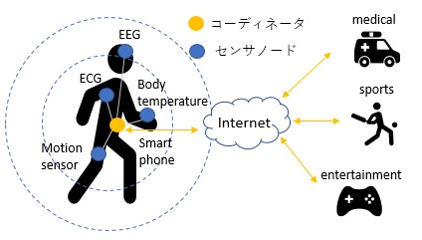
8.1 Introduction
doc.: IEEE 802.15-22-0633-00-06ma
From the development of an aging society and wireless communication technology, researches on medical information communication technology are thriving
One solution is a WBAN (Wireless Body Area Network)
IEEE802.15.6
WBAN
A network consisting of sensor nodes and coordinators installed around the human body
International standard of WBAN Defined for physical layer and MAC layer
Coordinator Sensor Node
This study changes the MAC layer
Hardware already sold
MAC layer can be changed by software
Fig1. Overall picture of WBAN network
WBAN can control priority according to importance of data packet
In this research, we focus on the MAC layer of IEEE 802.15.6 and propose a MAC protocol that reduces inter-BAN interference

Slide 54
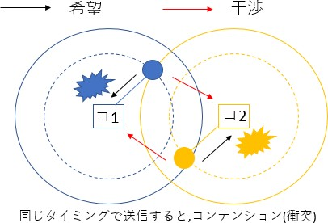
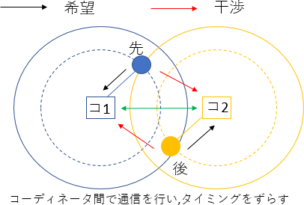
8.2 Issues in the standard
doc.: IEEE 802.15-22-0633-00-06ma
Issue
Interference problem in the case where multiple BANs overlap (specifically, situations where people with BAN approaching)
Because the schedule adjustment between the coordinators has not been done
Proposal
Negotiation between coordinators, scheduling between different BANs, to prevent deterioration due to inter-BAN interference
Desired Packet
Interfering Packet
Desired Packet
Interfering Packet
What is interference at the MAC layer
Sensor nodes within the communication range try to transmit packets at the same timing, causing collisions, making it impossible to communicate correctly
1st
C1
C2
C1
C2
2nd
In case of no negotiation of Coordinators of overlapped BANs, contention happens among packets of the BANs
In case of negotiation of Coordinators of overlapped BANs, contention can be resolved
Fig2. Issue and proposal

Slide 55
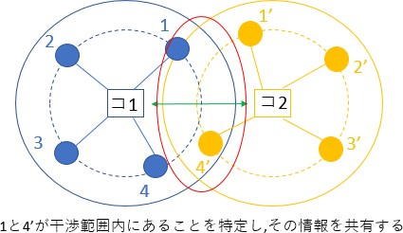
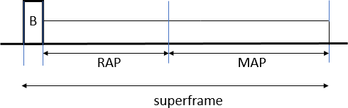
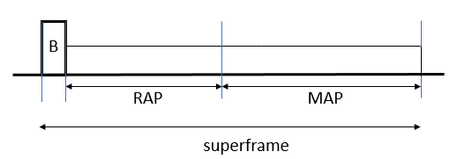
8.3 Outline of proposed method
Purpose
Increase the throughput of each BAN in case of interference
Communication should be guaranteed in descending order of User Priority
Proposal
Negotiate between coordinators, share the overlap situation of the sensor nodes, and identify the sensor nodes that will cause contention
Do not send them at the same time
1 and 4 'are not sent at the same time
コ1
C1
C1
C2
コC22
By detecting overlapped nodes, e.g. 1 and 4, coordinators e.g. C1 and C2 negotiate in order to minimize contentions
Fig3. Outline of proposed method

Slide 56
8.4 Time synchronization method between coordinators
The time difference between receiving the beacon frames of the two coordinators is used as the offset value.
𝑇𝑇_{𝑜𝑜𝑜𝑜𝑜𝑜𝑜𝑜𝑜𝑜𝑜𝑜} = 𝑇𝑇₁ − 𝑇𝑇₀ ⋯ (1)
𝑇𝑇₁:Overlap coordinator beacon time 𝑇𝑇₀:Reference coordinator beacon time
Calculate the amount of time adjustment (𝑇𝑇_{𝐶𝐶𝐶𝐶𝑜𝑜𝐶𝐶𝐶𝐶𝐶𝐶𝐶𝐶𝐶𝐶𝑜𝑜𝑜𝑜}) based on the offset value
^{𝑇𝑇}𝐶𝐶𝐶𝐶𝑜𝑜𝐶𝐶𝐶𝐶𝐶𝐶𝐶𝐶𝐶𝐶𝑜𝑜𝑜𝑜 ^{= 𝑇𝑇}𝑜𝑜𝑜𝑜𝑜𝑜𝑜𝑜𝑜𝑜𝑜𝑜,1 ^{− 𝑇𝑇}𝑜𝑜𝑜𝑜𝑜𝑜𝑜𝑜𝑜𝑜𝑜𝑜,0 ^{⋯ (2)}
𝑇𝑇_{𝑜𝑜𝑜𝑜𝑜𝑜𝑜𝑜𝑜𝑜𝑜𝑜,1} :Offset value obtained from the reception of previous beacon frame
𝑇𝑇_{𝑜𝑜𝑜𝑜𝑜𝑜𝑜𝑜𝑜𝑜𝑜𝑜,0} :Offset value obtained from the reception of the current beacon frame
If the value of 𝑇𝑇_{𝐶𝐶𝐶𝐶𝑜𝑜𝐶𝐶𝐶𝐶𝐶𝐶𝐶𝐶𝐶𝐶𝑜𝑜𝑜𝑜} is greater than 0, stop the time of the reference coordinator by the value of 𝑇𝑇_{𝐶𝐶𝐶𝐶𝑜𝑜𝐶𝐶𝐶𝐶𝐶𝐶𝐶𝐶𝐶𝐶𝑜𝑜𝑜𝑜} and vice versa
Slide 8

Slide 57
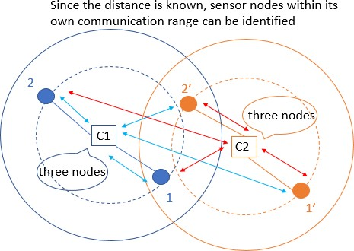
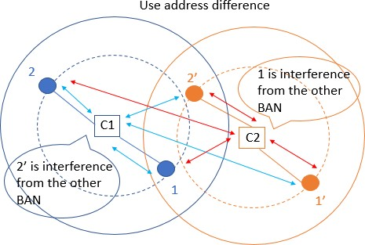
8.5 procedure of how to identify overlap situations
Since BAN uses UWB communication, it uses physical layer information that indicates the distance (between coordinators and sensor nodes)
  By knowing the distance between a sensor node and the coordinator, it is possible to identify whether or not the node is within its communication range
Use the address of the sensor node given for each BAN
  By sharing this address among the coordinators, it is possible to identify whether a sensor node within the trust range is under its own control or under the control of another BAN
Fig4. how to identify overlap situations
9

Slide 58
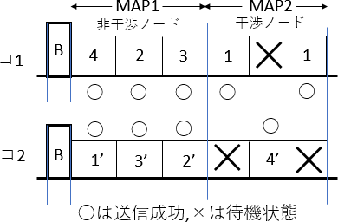
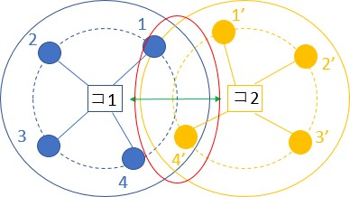
8.6 MAC protocol of MAP(Managed access period)
Proposal
(Adopt polling for MAP)
Divide Superframe's MAP structure into two parts, MAP 1 and MAP 2
In MAP 1, sensor nodes not related to interference are allocated
  Send at the same time
In MAP 2, sensor nodes related to interference are allocated
  When one BAN attempts to transmit at MAP 2, the other BAN is placed in a standby state
Non Overlapped Nodes
Overlapped Nodes
C1
C1
C2
C2
Fig4. MAC protocol of MAP
By separating by interference and non-interference, packet collision does not occur and efficient transmission can be done

Slide 59
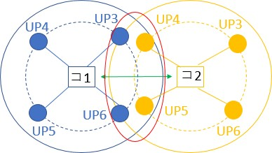
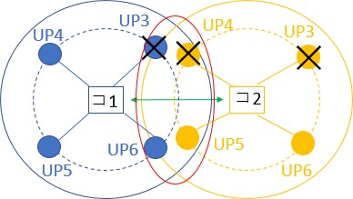
8.7 MAC protocol of RAP(Random Access Period)
Proposal
(Adopt CSMA / CA for RAP)
The Superframe's RAP protocol is as follows
If the interfering node is low UP (4 or less), do not conflict transmission rights (those with lower UP than competing nodes do not compete)
If the interference node is high UP (5 or more), compete transmission rights of normal CSMA/CA
Although contention will occur, it will guarantee in descending order of UP
C1
C2
C1
C2
Fig5. MAC protocol of RAP
It is possible to reduce the contention of packets while guaranteeing in descending order of UP

Slide 60
8.8 Drawback of proposed method
doc.: IEEE 802.15-22-0633-00-06ma
MAC protocol of MAP
  Depending on the number of interfering nodes, the characteristics are degraded
The number of slots of MAP 1 and MAP 2 of Superframe becomes extra
MAC protocol of RAP
  When offeredload is low, the delay characteristic deteriorates
When packet occurrence interval is large, deterioration due to not competing transmission right is large
Even if these two combinations are used, only the average UP as a whole improves, high UP is particularly guaranteed, and low UP is sacrificed can not be controlled for each purpose
We aim to respond by changing parameters according to design policy

Slide 61
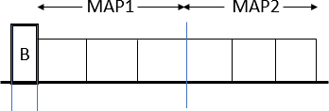
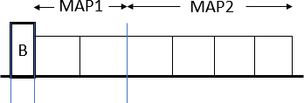
8.8.1 Measures to drawback MAP
Measures
Change the ratio of the number of slots of MAP 1 and MAP 2 of Superframe
MAP 1 : MAP 2 = number of non-interfering nodes ÷ 2 : to be the number of interference nodes
(It is known from the simulation that this is the optimal solution)
Ex) 4 non-interference nodes, 4 interference nodes and 6 slots
Non Overlapped Nodes
Interfering Nodes
Non Overlapped Nodes
Interfering Nodes
非干渉ノード
干渉ノード
非干渉ノード
干渉ノード
Fig6. Measures to draw back MAP
By changing the ratio of the number of slots of MAP 1 and MAP 2 according to the number of interfering nodes, there is no extra

Slide 62
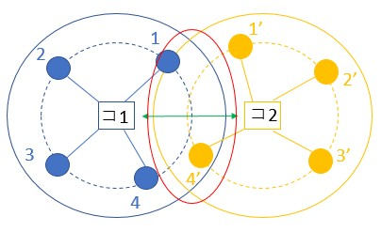
8.8.2 Measures to drawback MAP
Measures
Switch on whether to use the proposed method for each offeredload
When offeredload is low, competing transmission rights of normal CSMA
/ CA
When the offer load becomes such that packets conflict, countermeasures against interference are made using the proposed
method
Low offeredload High offeredload
switching
C1
C2
C1
C2
Fig7. Measures to drawback MAP
Due to the switching of the proposed scheme, the deterioration at the time of low offeredload decreases
15

Slide 63
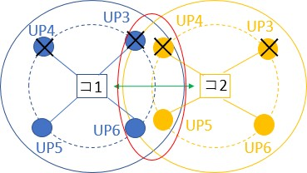
8.8.3 Control to make the priority higher
We propose a MAC protocol not only giving average performance as a whole, but also differentiating between high UP and low UP
 | RAP
If it is low UP (4 or less) irrespective of interference or non-interference, do not compete transmission right If it is high UP (5 or more) irrespective of interference or non- interference, compete transmission right C1 C2 Fig8. RAP
MAP
How to assign transmission rights
The one with the largest UP value × elapsed time
as usual
We changed the weighting value called UP value
Weighting to make the priority more dominant
By changing parameters, we can cope with each design policy (giving average performance , differentiating between high UP and low UP)

Slide 64

8.8.4.1 Simulation characteristics
Determining parameters based on the standard (IEEE 802.15.6)
The probability of occurrence for each UP is the same
One type of packet is generated from one node
RAP, MAP handle all packets
The condition for discarding the packet is the case where the number of retransmissions is 4 or more and the case where the number of packets to be crowded becomes 3 or more
There is no EAP for simplicity
Fig9. Superframe structure
Table1. simulation characteristics
Number of nodes | 4(UP高2,低2)
Data rate | 242.9 [kbps]
Payload length | 128 [octets]
Number of BANs | 2
Superframe length | 115 [ms]
Number of slots | RAP=5,MAP=12
Simulation time | 30 [s]
Number of trials | 100
 | Content of evaluation
Overall network throughput characteristics Throughput characteristics per UP Delay characteristics per UP Evaluation is made in two ways such as average performance, differentiating between high UP and low UP

Slide 65
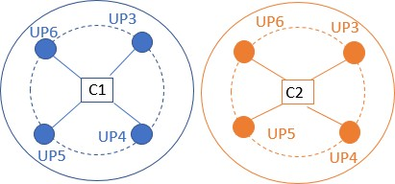
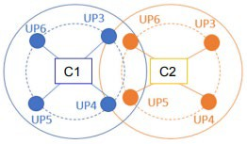
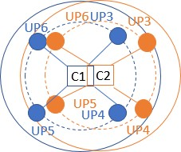
8.8.4.2 Simulation scenario
        Doc: IEEE P802.15-23-0557-03-6a
1, there are no interference node each
2, there are two interference nodes each
3, there are four(all) interference nodes each

Slide 66
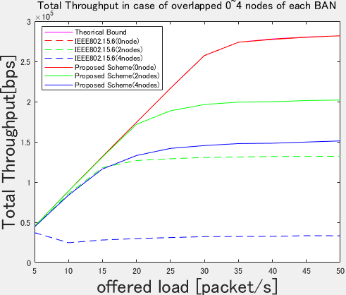
8.8.4.3 Simulation result(Total throughput)
Average performance
Differentiating between low UP and high UP
Fig11. Overall network throughput Fig12. Overall network throughput
The theorical bound is the throughput of the entire network in the absence of interference
Compared to the standard, the throughput of the whole network is improved in the proposed method in each case
Since there is no difference in overall throughput by design policy, both are valid

Slide 67
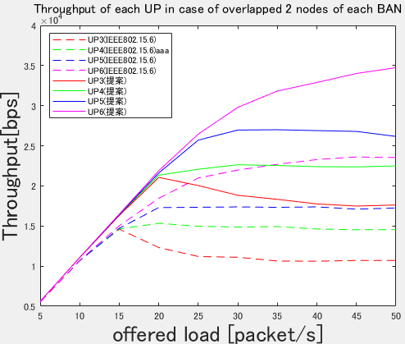
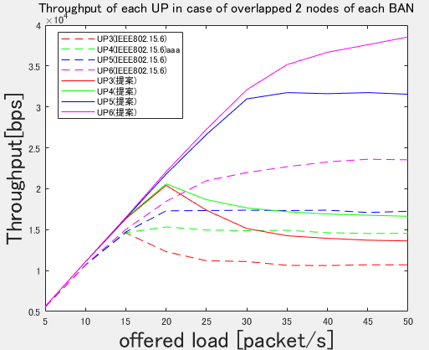
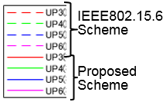
8.8.4.3 Simulation result(Throughput of each UP overlapped 2 nodes)
Average performance
Differentiating between low UP and high UP
Solid line: proposed method Dashed line: Standard
Solid line: proposed method Dashed line: Standard
Solid line: proposed method
Dashed line: Standard
Fig13. Throughput of each UP overlapped 2 nodes
Fig14. Throughput of each UP overlapped 2 nodes
Similarly, the proposed method is superior to the throughput for each UP
We can cope with the case where average performance is given and the case where difference is given for each UP

Slide 68
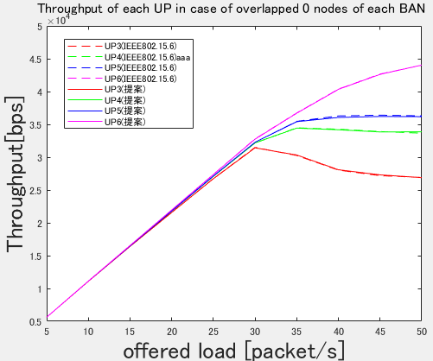
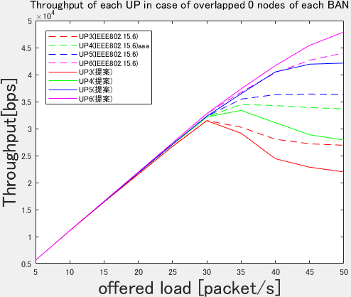
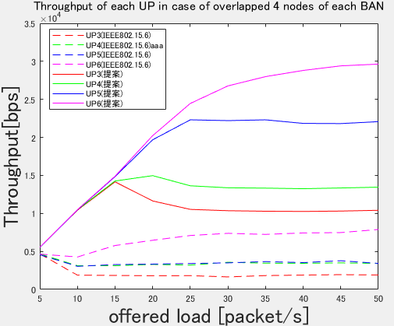
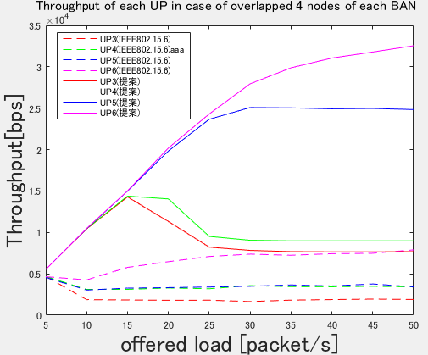
8.8.4.3 Simulation result(Throughput of each UP overlapped 0,4 nodes)
Average performance
Differentiating between low UP and high UP
Fig15. Throughput of each UP overlapped 0 node
Fig16. Throughput of each UP overlapped 0 node
Fig17. Throughput of each UP overlapped 4 nodes
Fig18. Throughput of each UP overlapped 4 nodes

Slide 69
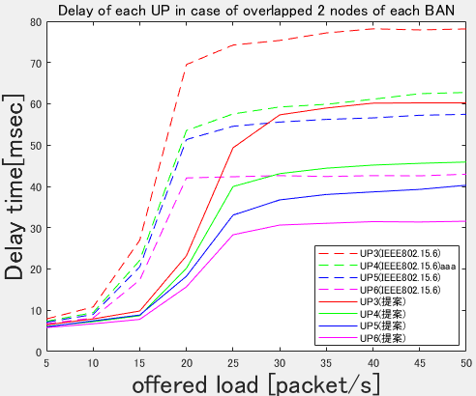
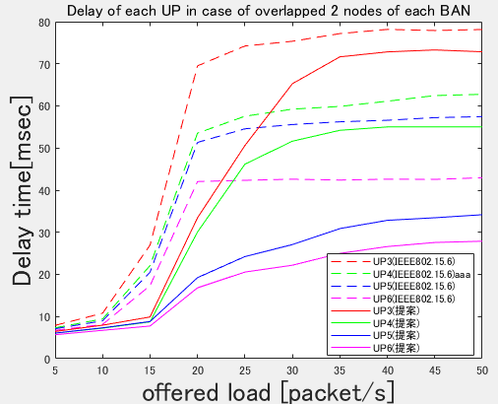
8.8.4.3 Simulation result(Delay of each UP overlapped 2 nodes)
Average performance
Differentiating between low UP and high UP
Solid line: proposed method Dashed line: Standard
Fig19. Delay of each UP overlapped 2 nodes
Fig20. Delay of each UP overlapped 2 nodes
Similarly, the proposed method is superior to the throughput for each UP
We can cope with the case where average performance is given and the case where difference is given for each UP

Slide 70
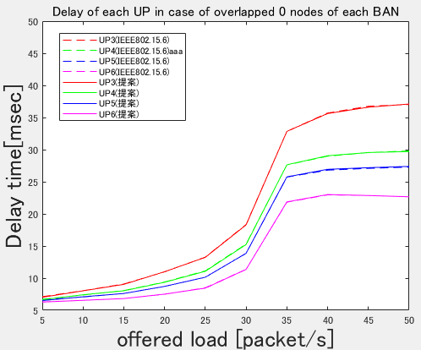




8.8.4.3 Simulation result(Throughput of each UP overlapped 0,4 nodes)
Average performance
Differentiating between low UP and high UP
Fig21. Delay of each UP overlapped 0 node
Fig22. Delay of each UP overlapped 0 node
Fig23. Delay of each UP overlapped 4 nodes
Fig24. Delay of each UP overlapped 4 nodes

Slide 71
8.8.5.1 Conclusion and Future works
Conclusion
We conducted research to mitigate interference against the international standard MAC protocol
In order to reduce interference in multiple BAN environments, we propose to communicate between coordinators to identify and share interfering nodes, and the proposed protocol has improved throughput and delay characteristics over international standards
We showed that we can deal with by changing parameters according to design policy
Future works
Consideration when the number of BAN becomes 3 or more
Consideration when packet occurrence probability changes for each UP
Theoretical analysis on optimum values of various parameters
MAP 1 and MAP 2 ratio, UP weighting etc.

Slide 72
9. MAC for Transition among Different Classes of Coexistence
In practical use cases, if mobility of BAN should be taken into account, then MAC function for transition among different classes of coexistence should be defined.
While periodical detection in CCA period, if a beacon is detected and a beacon packet preamble is decoded using pre-knowledge of possible coexisting systems, then it is possible to identify transition of classes of coexistence.
The transition of classes of coexistence can be described with finite state transition diagram such as Markov model.
In practical use cases, the finite state or class transition can be simplified and useful to predict transition using probabilistic approach.
The transition between class 0 and 1 could be covered by above-mentioned MAC. The transition among classes 0, 1, 2 and 4 may be described shortly only in case that legacy 15.6-2012 BAN and 15.4ab can be detectable by new 15,6ma BAN.
Transition to class 3, 5, 6, and 7 can be detectable in periodical CCA, so interference from coexisting systems different from 15.6ma, 15.6, and 15.4ab can be mitigated and then the same MAC could be proceeded by the same manner as in class 1,2 and 4.

Slide 73
Reference : MAC documents in MENTOR 802.15

