Slide 1
        DCN 15-24-0532-01-04ab
Project: IEEE P802.15 Working Group for Wireless Personal Area Networks (WPANs)
Submission Title: Non-interleaved MMS comment resolution
Date Submitted: October 15, 2024
Source: Riku Pirhonen (NXP)
Abstract: Current UWB Multi-millisecond (MMS) operation supports interleaved transmission of initiator and responder ranging packets. This proposals introduces minimal changes to allow also non-interleaved operation to support traditional SS-TWR and DS-TWR.
Purpose: Propose non-interleaved option for MMS by introducing ExtendedRpDuration.
Notice: This document has been prepared to assist the IEEE P802.15. It is offered as a basis for discussion and is not binding on the contributing individual(s) or organization(s). The material in this document is subject to change in form and content after further study. The contributor(s) reserve(s) the right to add, amend or withdraw material contained herein.
Release: The contributor acknowledges and accepts that this contribution becomes the property of IEEE and may be made publicly available by P802.15.

Slide 2
This presentation
Graphical presentation of
  Non-Interleaved SS- and DS-TWR for UWB Driven Mode
  Non-Interleaved SS- and DS-TWR for NBA-MMS
  Non-Interleaved SS- and DS-TWR for UWB Driven Mode with SP0 control packet
Recap of the key comments presented in DCN 15-24-0409-01-04ab
  ExtendedRpDuration in Draft 1 “Management MAC Configuration Field”
  macMmsExtendedRpDuration to MAC PIB attributes
  Stylized proposal how to edit the figures in 10.38.5
  Some minor text edits in 10.38.5

Slide 3
Non-Interleaved SS- and DS-TWR for UWB Driven Mode
3 x RpDuration
Reporting phase
2 x RpDuration
Report content:
Responder T_{reply1}
Initiator T_{reply2}
RpDuration
Initiator
1 ms slot
Responder
UWB SYNC+SFD
Note that RpDuration can be longer than, e.g., exact 5 ms
ExtendedRpDuration defines number of MMS packets
UWB RSF/RIF

Slide 4
Non-Interleaved SS- and DS-TWR for NBA-MMS
3 x RpDuration
Reporting phase
2 x RpDuration
Report content:
Responder T_{reply1}
Initiator T_{reply2}
RpDuration
macMms
RcpPoll
NSlots
macMms
RcpPoll
NSlots
Initiator
macMms
RcpResp
NSlots
1 ms slot
Responder
NB packet
Initiator NB slots length is defined by macMmsRcpPollNSlots
Responder NB slot length is defined be macMmsRcpRespNSlots
ExtendedRpDuration defines number of MMS packets
UWB RSF/RIF

Slide 5
Non-Interleaved SS- and DS-TWR for UWB Driven Mode with SP0 control packet
3 x RpDuration
Reporting phase
2 x RpDuration
macMms
RcpPoll
NSlots
RpDuration
macMms
RcpPoll
NSlots
Initiator
macMms
RcpResp
NSlots
1 ms slot
Responder
UWB SYNC+SFD
Initiator SP0 slots length is defined by macMmsRcpPollNSlots
Responder SP0 slot length is defined be macMmsRcpRespNSlots
ExtendedRpDuration defines number of MMS packets
UWB RSF/RIF
UWB SP0 CNTRL

Slide 6
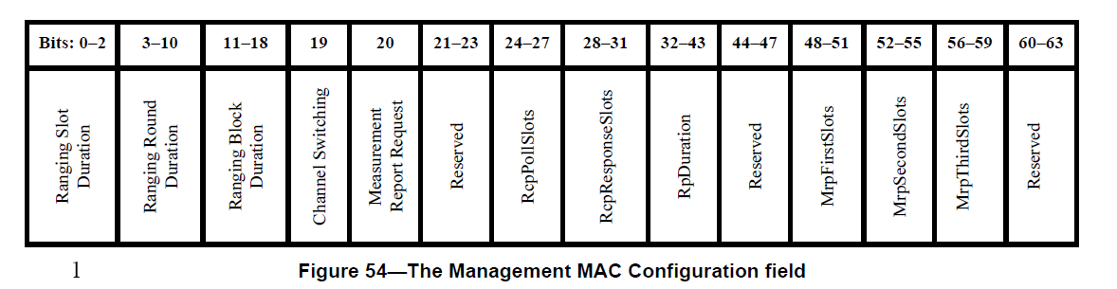
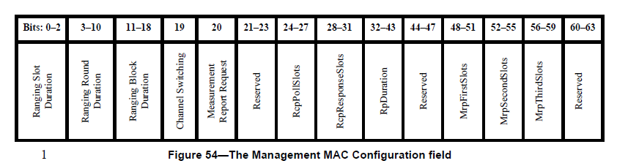
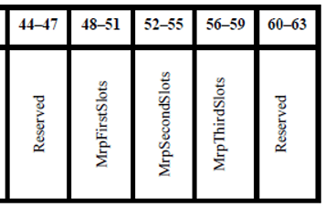
10.38.9.3.12 The Management MAC Configuration field
Add ExtendedRpDuration bits (955)
44-45
46-47
ExtendedRpDuration

Slide 7
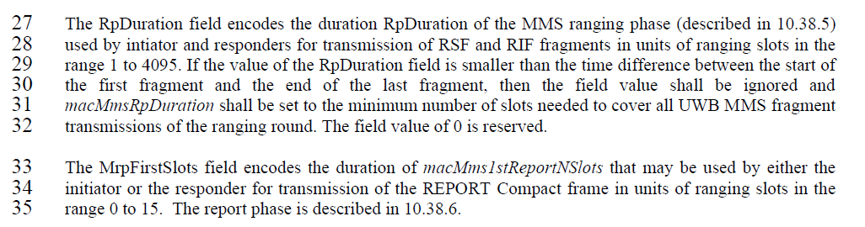
10.38.9.3.12 The Management MAC Configuration field
Add description below
the Figure (956)
Page 86, line 33
The ExtendedRpDuration field enables non-interleaved MMS packets by extending the ranging phase to double or triple of the RpDuration. By default, bits are 00,
which means interleaved initiator and responder transmissions. Bit values 01 mean double RpDuration and non-interleaved transmission by initiator and responder
as shown in Figure XX [in chapter 10.38.5], and bits set to 10 mean triple RpDuration and non-interleaved transmissions by initiator – responder – initiator, as shown
in figure XX [in chapter 10.38.5]. Bit combination 11 is reserved. If control phase is used, each ranging phase defined by RpDuration is preceded by a control phase.

Slide 8
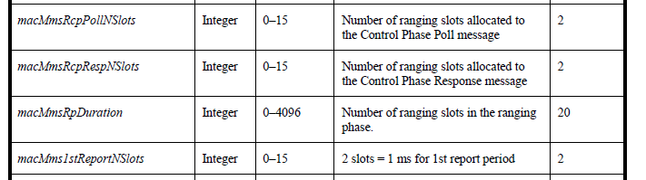
10.38.10.1 MMS specific MAC PIB attributes
Add MAC PIB attribute
macMmsExtendedRpDuration | Integer | 0 – 3 | 0 = Interleaved ranging phase 1 = Non-interleaved ranging phase of double RpDuration 2 = Non-interleaved ranging phase of triple RpDuration 3 = reserved | 0
Page 125, line 1, table 20 (959)

Slide 9
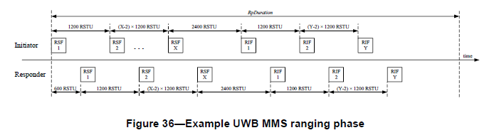
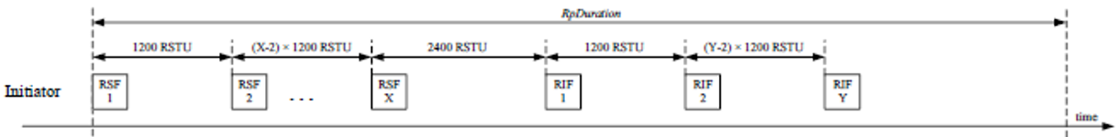
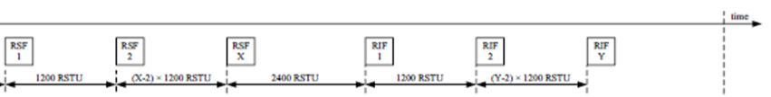
10.38.5 UWB MMS ranging phase (stylized pictures)
Add Figures to illustrate non-interleaved response possible with ExtendedRpDuration
(see pages 3-5 in this document)
Figure XX – Example non-interleaved UWB MMS ranging phase with 2xRpDuration (macMmsExtendedRpDuration = 1)
Figure XX – Example non-interleaved UWB MMS ranging phase with 3xRpDuration (macMmsExtendedRpDuration = 2)
Example with ExtendedRpDuration value 1 (2xRpDuration) and 2 (3xRpDuration) (97) and (954)

Slide 10
Other text edits throughout the document
10.38.5 UWB MMS ranging phase (952)
p 69, line 7. In non-interleaved mode responder shall start transmission of MMS packet after one RpDuration from the start of the ranging phase, and when DS-TWR is desired, initiator may transmit a second MMS packet after two RpDurations from the start of the ranging phase.
10.38.5 UWB MMS ranging phase (953)
p 69, line 12. After macMmsRpDuration, or in case of non-interleaved mode after double or triple macMmsRpDuration as defined by the ExtendedRpDuration, and transmission and reception of all the fragments…

Slide 11
Summary of comments 952, 953, 97, 954, 955, 956, 959
Riku Pirhonen | 952 | 69 | 10.38.5 | 7 | In order to support traditional SS-TWR and DS-TWR, non-interleaved mode is proposed. It would delay sending responder MMS packet by RpDuration and, for DS-TWR, initiator can send another MMS packet after two RpDurations. | In non-interleaved mode responder shall start transmission of MMS packet after one RpDuration from the start of the ranging phase, and when DS-TWR is desired, initiator may transmit a second MMS packet after two RpDurations from the start of the ranging phase.
Riku Pirhonen | 953 | 69 | 10.38.5 | 12 | Add behavior in case of the proposed non-interleaved mode. | After macMmsRpDuration, or in case of non-interleaved mode after double or triple macMmsRpDuration as defined by the ExtendedRpDuration, and transmission and reception of all the fragments…
Frank Leong | 97 | 69 | 10.38.5 | 15 | The example only represents interleaved MMS operation. A non-interleaved example should be added. | Add two similar figures, one showing non-interleaved SS-TWR MMS operation (2*RpDuration), and another showing non-interleaved DS-TWR MMS operation (3*RpDuration).
Riku Pirhonen | 954 | 69 | 10.38.5 | 16 | Add picture of the proposed non-interleaved mode | Add picture that shows non-interleaved mode with double and triple RpDuration.
Riku Pirhonen | 955 | 86 | 10.38.9.3.12 | 1 | Add ExtendedRpDuration field to the Managemetn MAC Configuration field figure | Add ExtendedRpDuration field between RpDuration and Reserved, and use bits 44 and 45 for this
Riku Pirhonen | 956 | 86 | 10.38.9.3.12 | 33 | Add description for ExtendedRpDuration field | The ExtendedRpDuration field enables non-interleaved MMS packets by extending the ranging phase to double or triple of the RpDuration. By default, bits are 00, which means interleaved initiator and responder transmissions. Bit values 01 meand double RpDuration and non-interleaved transmission by initiator and responder as shown in Figure XX [in chapter 10.38.5], and bits set to 10 mean triple RpDuration and non-interleaved transmissions by initiator – responder – initiator, as shown in figure XX [in chapter 10.38.5]. Bit combination 11 is reserved.
Riku Pirhonen | 959 | 125 | 10.38.10.1 | 1 | Add MAC PIB attribute macMmsExtendedRpDuration to Table 20 on the row after MacMmsRpDuration | macMmsExtendedRpDuration, Integer, 0 - 3, 0 = Interleaved ranging phase, 1 = Non-interleaved ranging phase of double RpDuration, 2 = Non-interleaved ranging phase of triple RpDuration, 3 = reserved, Default 0

Slide 12
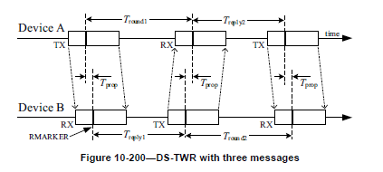
DS-TWR for MMS – reference from IEEE802.15.4

Slide 13
Comments 8, 9, 96, 98, 100, 962
Frank Leong | 96 | 69 | 10.38.5 | 3 | The example only represents interleaved MMS operation. A non-interleaved example should be added. | Add a paragraph stating "The responder may start transmitting a first RIF or RSF fragment at 1200 RSTU after the start of the last initiator RSF or RIF fragment." Add another similar paragraph for the DS-TWR case. | Frank -> Riku See 952, 953
Stefan Lemsitzer | 8 | 187 | 16.2.1 | 13 | PPDUs can also be transmitted sequentially, propose to make this a "may" statement | “In this MMS mode, the transmission and reception of the PPDU fragments are typically may be interleaved.” | Billy
Frank Leong | 98 | 187 | 16.2.1 | 14 | Suggesting interleaving is typical represents bias. | Change "are typically" to "may be". | Frank -> Billy, see 98
Stefan Lemsitzer | 9 | 192 | 16.2.11.1 | 31 | In some ranging protocols, it may be beneficial if no interleaving is used. Propose to make this a "may" statement | “For two-way ranging (TWR) with MMS packets, the fragment transmissions of the transmitted MMS packet aremay be interleaved with fragment receptions of the received MMS response packet.” | Billy
Frank Leong | 100 | 192 | 16.2.11.1 | 32 |  | Change "are interleaved" to "may be interleaved". | Frank –> Xiliang, see 962
Riku Pirhonen | 962 | 192 | 16.2.11.1 | 32 | Add word typically to reflect that also non-interleaved packets could be used in case of proposed non-interleaved mode. | … the fragment transmissions of the transmitted MMS packets are typically interleaved … | Xiliang

