Slide 1
Project: IEEE P802.15 Working Group for Wireless Specialty Networks
Submission Title: Overview of Interference Mitigation Schemes for Coexistence in TG6ma
Date Submitted: September 11th, 2024
Source: Takumi Kobayashi^{1,2}, Minsoo Kim², Marco Hernandez^{2,3}, Daisuke Anzai¹, Ryuji Kohno^{2,4},
Company: [¹Nagoya Institute of Technology, ²YRP International Alliance Institute, ³CWC, University of Oulu, ⁴Yokohama National University]
Address [1; Gokiso-cho, Showa-ku, Nagoya 466-8555 Japan, 2: YRP1 Blg., 3-4 HikarinoOka, Yokosuka-City, Kanagawa, 239-0847 Japan, 3: University of Oulu Pentti Kaiteran katu 1, 90570 Oulu, Finland, 4: 79-5 Tokiwadai, Hodogaya-ku, Yokohama, 240-8501 Japan]
Voice:[+81-90-5408-0611] E-Mail:[kobayashi@nitech.ac.jp, minsoo@minsookim.com, marco.hernandez@ieee.org, kohno@ynu.ac.jp, Kohno@yrp-iai.jp]
Re: In response to call for technical contributions
Abstract: This provides considerations of radio environment surrounding human body area network(HBAN) and vehicle body area network(VBAN) for enhanced dependability. As an example of PHY layer countermeasure technology of these co-existence and EMC/EMI issues, signal processing technology on space and time domains based on orthogonal matched filter is introduced.
Purpose: Material for discussion in P802.15 TG6ma
Notice: This document has been prepared to assist the IEEE P802.15. It is offered as a basis for discussion and is not binding on the contributing individual(s) or organization(s). The material in this document is subject to change in form and content after further study. The contributor(s) reserve(s) the right to add, amend or withdraw material contained herein.
Release: The contributor acknowledges and accepts that this contribution becomes the property of IEEE and may be made publicly available by P802.15.

Slide 2
Overview of Interference Mitigation Schemes for Coexistence in TG6ma
Takumi Kobayashi^{1,2}, Minsoo Kim², Marco Hernandez^{2,3}, Daisuke Anzai¹, Ryuji Kohno^{2,4}
¹ Nagoya Institute of Technology
² YRP International Alliance Institute
³ CWC, University of Oulu
⁴ Yokohama National University

Slide 3
In 4.7.1, 4.7.2 and 6.5 of standard document draft D03, coexistence environments are explaind and defined as class 0 to 7. It seems that the inteference in classes 1 and 2 can be reduced by MAC technologies and control schemes. On the other hand, interference in case of classes 3 to 7 (interference from NOT802.15.6 series wireless and/or the other electro-magnetic radiative systems) should be reduced and mitigated in the PHY layer and/or signal processing.
In Annex G, interference mitigation technologies on physical layer and signal processing are explained more focusing on the interference mitigation for coexistence level 3 to 7 that cannot be mitigated by only MAC technique.

Slide 4
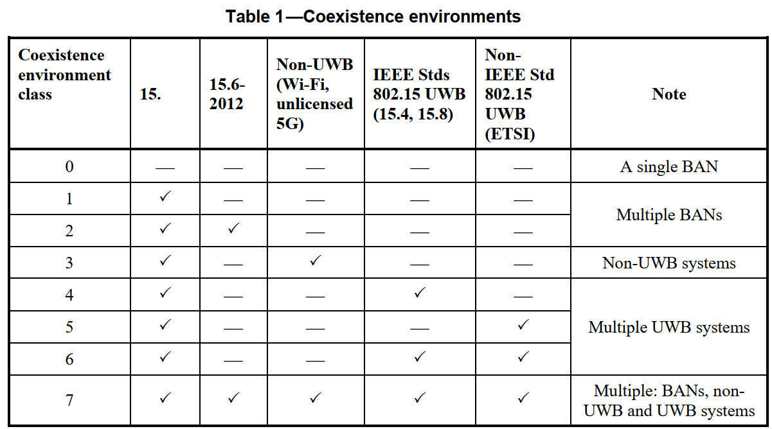
Coexistence environments in TG6ma
New Std of TG6ma

Slide 5
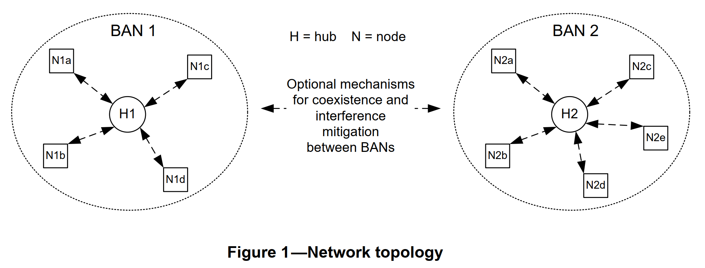
Network topology and coexistence environment assumed in TG6ma

Slide 6
Radio environment
15.6ma
15.6ma
EMI source
15.4z
15.6ma
15.6ma
15.6-2012
15.4ab
15.4

Slide 7
Various Interference in Coexistence
＊ IEEE 802.11a (wi-fi) （5GHz） overlaps
UWB-WBAN
IEEE 802.15.6ma
User “B”
Other BAN
Other UWB system.
e.g. IEEE 802.15.4-2020
IEEE 802.15.4z
Other UWB-BAN
user ？
interference
user ？
Other NB-BAN
interference
User “A”.
A wants to connect to “B”.
user ？
Inter-user interference
“IUI”
Inter-system interference
Inter-BAN interference
“IBI?”
“ISI”
Interference from a system using
the same standard.
Interference from a system using
overlapped frequency
VBAN ⬄ HBAN interference
Unknown signal.
EMI / EMC issues
Known signal.
Pre-knowledge can be used to mitigation

Slide 8
EMC (Electro-Magnetic Compatibility)
Thunder,
Electrostatic discharge; ESD
Pulse noise,
Colored noise etc..
BAN device
Other devices e.g. Medical devices
Other radio devices
e.g. cellular phone, cellular base station
Power electronics
motors
Microwave oven
Interference
Emission

Slide 9
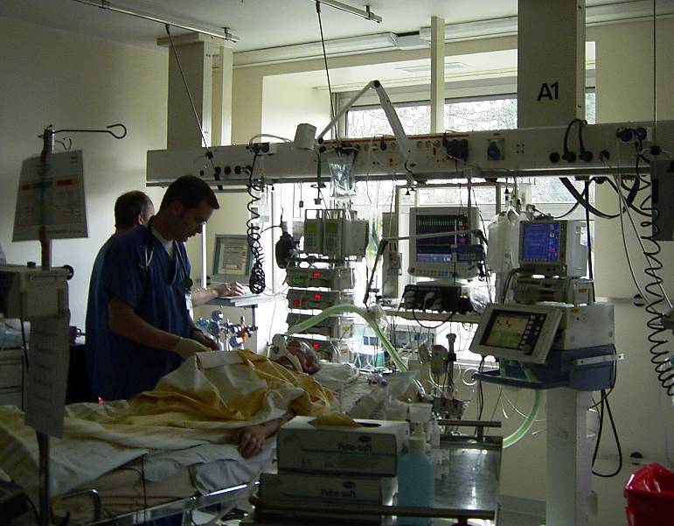
Medical room radio environment
Cardiac output monitor
Infusion pumps
Vital monitor
Artificial respirator

Slide 10
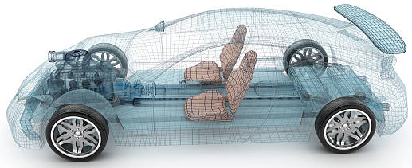
Environment Model in Vehicle
Engine/Motor room environment model
Engine/motor diagnostic sensor and controller
Air pressure sensor, wheel health sensor and controller
Transmission monitoring sensor and controller
Cabin environment sensor (temperature, brightness, humidity etc.)
Sheet sensor, health care sensors for driver
Sheet sensor, health care sensors for passenger
Cabin room environment model
Note:
Various type of car/vehicles
Bus, Bulldozer, Heavy construction equipment needed each different sensors.
4
2
5
1
3
6
https://media.istockphoto.com/photos/transparent-car-design-wire-model3d-illustration-my-own-car-design-picture-id594040008?k=6&m=594040008&s=612x612&w=0&h=XE8LiBjpM51aB4pH2CFt6-MT6IvALRPnlxPcac0RXhg=

Slide 11
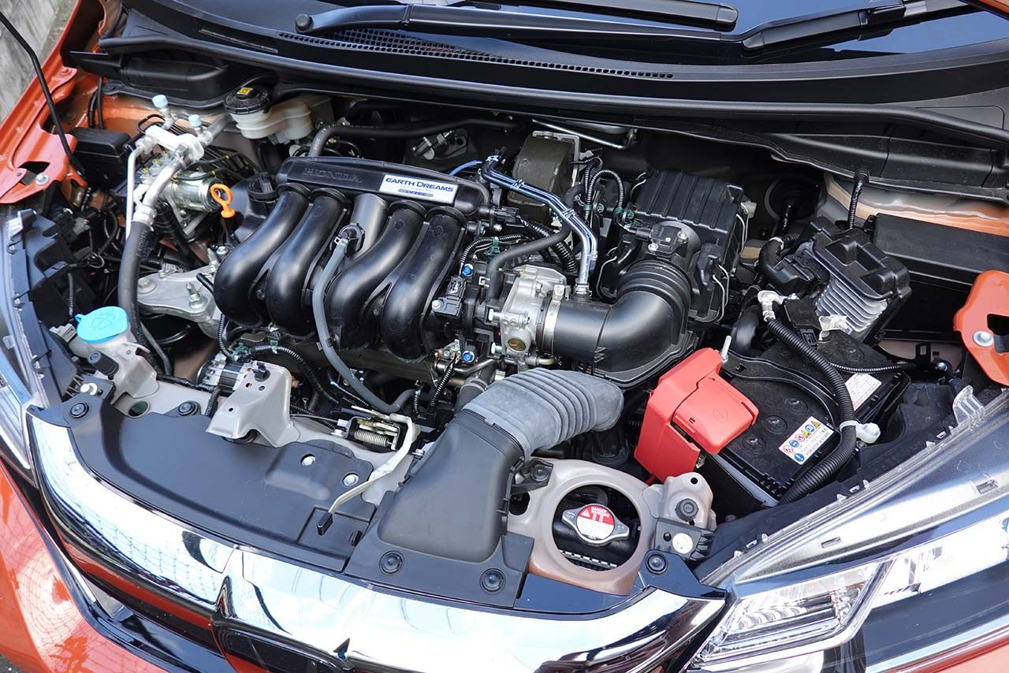
Engine/Motor Room Environment
Many metallic components
Components existing in densely
Ignition noise, motor noise
Larger path-loss than free propagation
A lot of reflection of RF signal
Electro-magnetic interference, EMI issues
Especially EV
https://www.as-web.jp/car/575374/attachment/03a_sub_dsc01273
Ignition coil
Spark plug
Electric generator
Electric motor
High current battery and cable

Slide 12
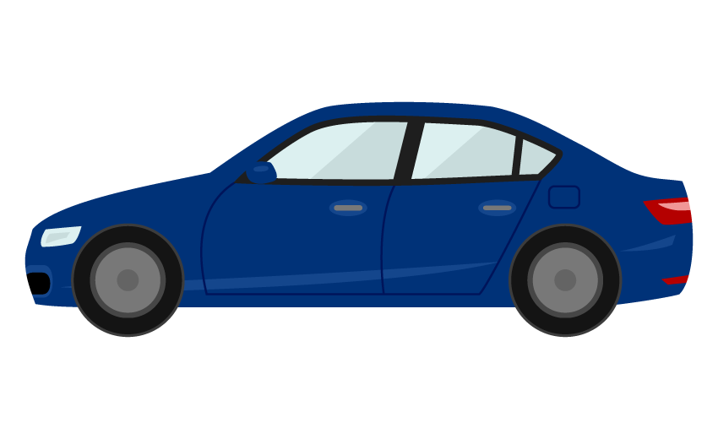
Electromagnetic Environment
Front object CCD camera
Rear object monitor CCD camera
Lane departure system
Night vision
Blind spot detection
Front airbag sensors
Nighttime pedestrian warning
Rear camera
Cross traffic alert
Drowsiness sensos
Rear object laser radar
Front object laser radar
Side airbag SRS
Tire pressure sensor
Tire pressure sensor
Automatic brake actuator
Steering angle sensor
Central computer
Wheel speed sensor
Wheel speed sensor
Active park assist
Adaptive cruise control
Nighttime pedestrian warning IR sensor
Sensors, monitors and vehicle controlling systems in modern vehicle

Slide 13
Interference sources example
Interference from the other 15.6ma devices (not controlled)
  From the other BAN networks, hidden devices etc.
Interference from the other UWB systems
  For example: 15.4, 15.4ab and 15.4z
Interference from the other wireless systems
  Such as 802.11 series, 802.15.x (narrowband) systems operating in the UWB band.
Interference from the other electric and electronic components
  Such as medical components, vehicle components, electric motor, spark plug etc.

Slide 14
Interference mitigation or rejection by…
MAC: Basically, interference mitigation on MAC needs communication. MAC technology cannot remove interference from the other system which cannot be detected in the receiver of new TG6ma nodes or coordinators.
PHY: Partially applicable by using PHY technology such as FEC, HARQ, etc…
Lower level signal processing such as “interference canceller” :can be effective to remove the effect of unknown interference from unknown various source.

Slide 15
Interference mitigation by
MAC

Slide 16
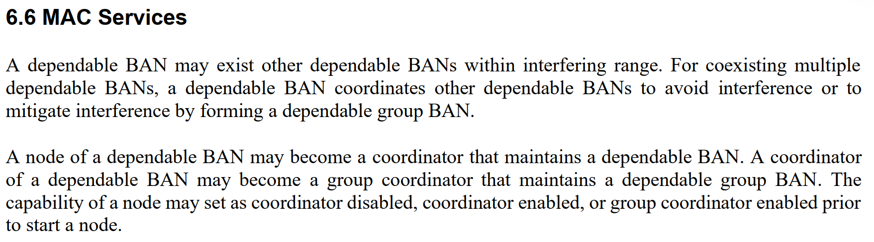

Slide 17
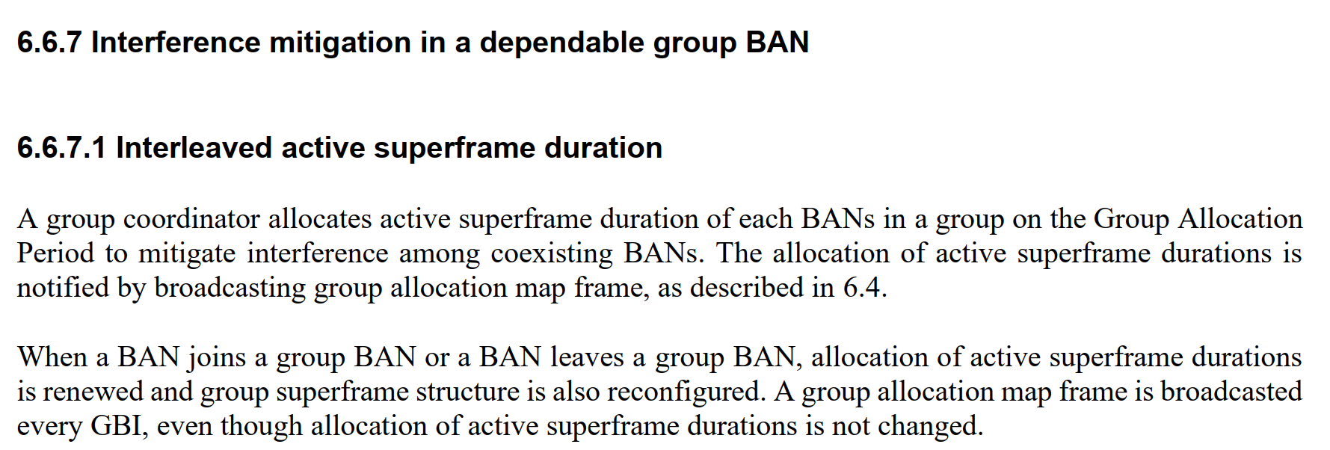

Slide 18
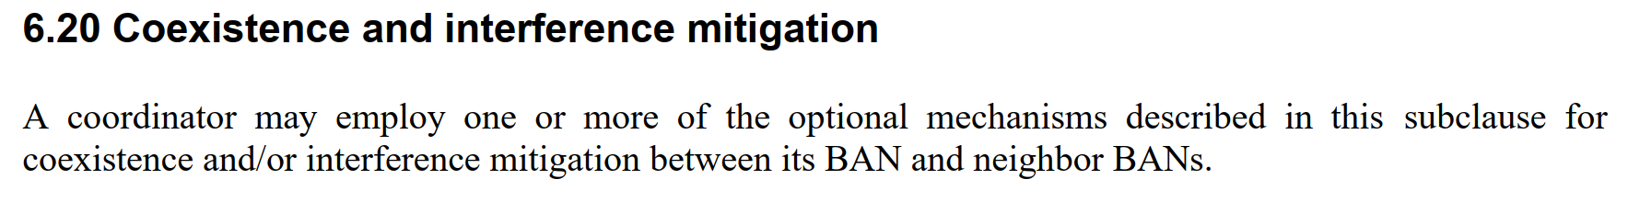
6.20.1 Beacon shifting
6.20.2 Channel hopping
6.20.3 Active superframe interleaving

Slide 19
Interference mitigation by
PHY

Slide 20
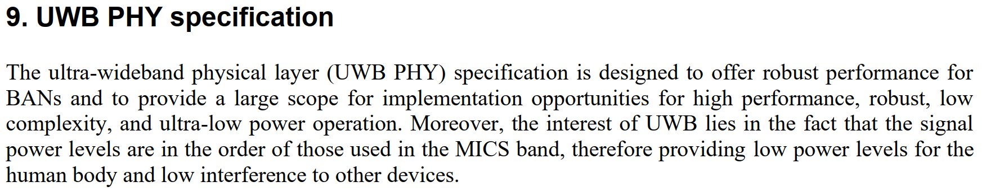
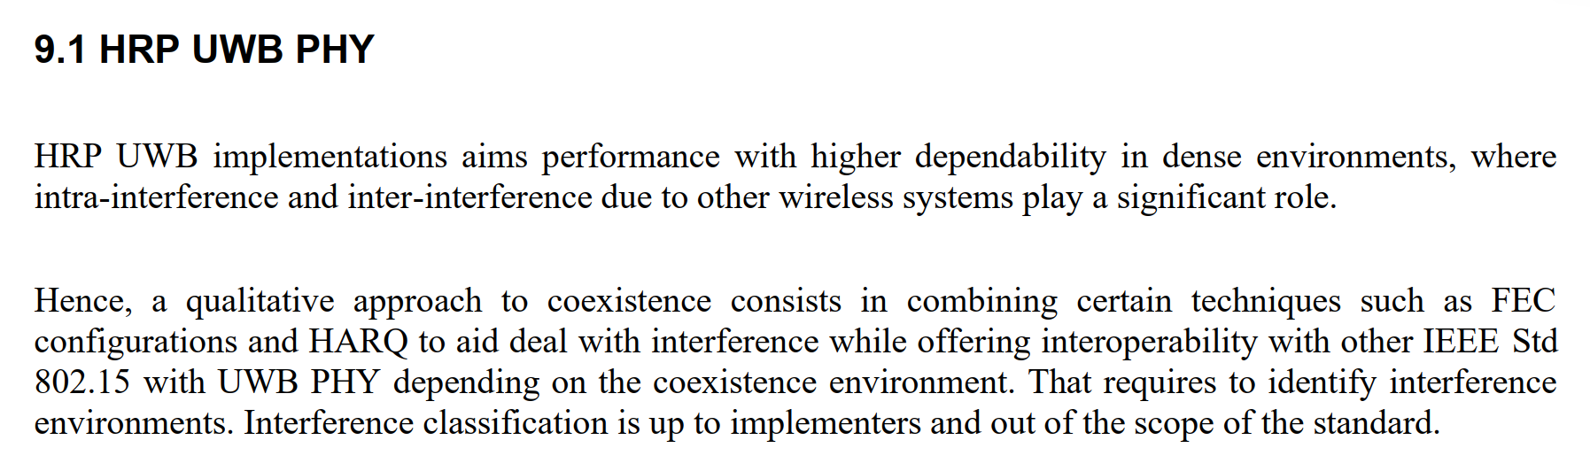

Slide 21
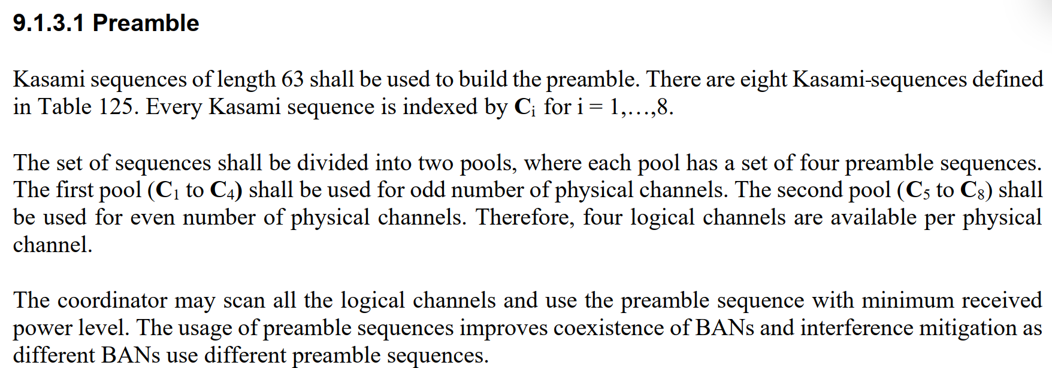

Slide 22
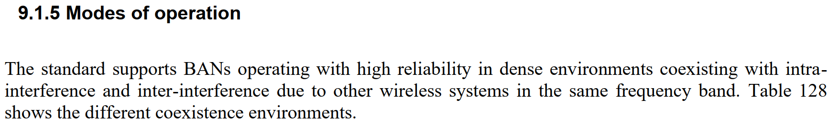
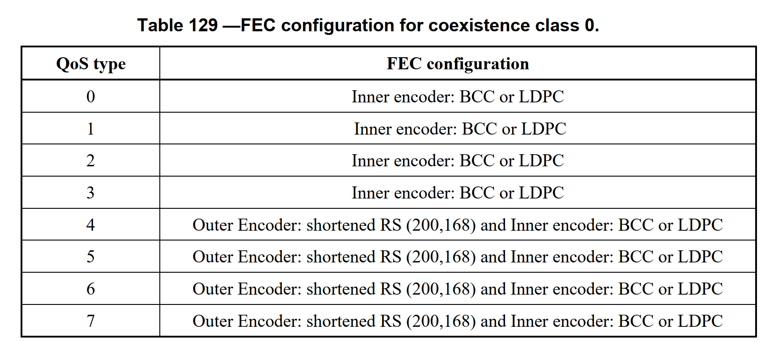
Table 130 —FEC configuration for coexistence class 1
Table 131 —FEC configuration for coexistence class 2
Table 136 —FEC configuration for coexistence class 7

Slide 23
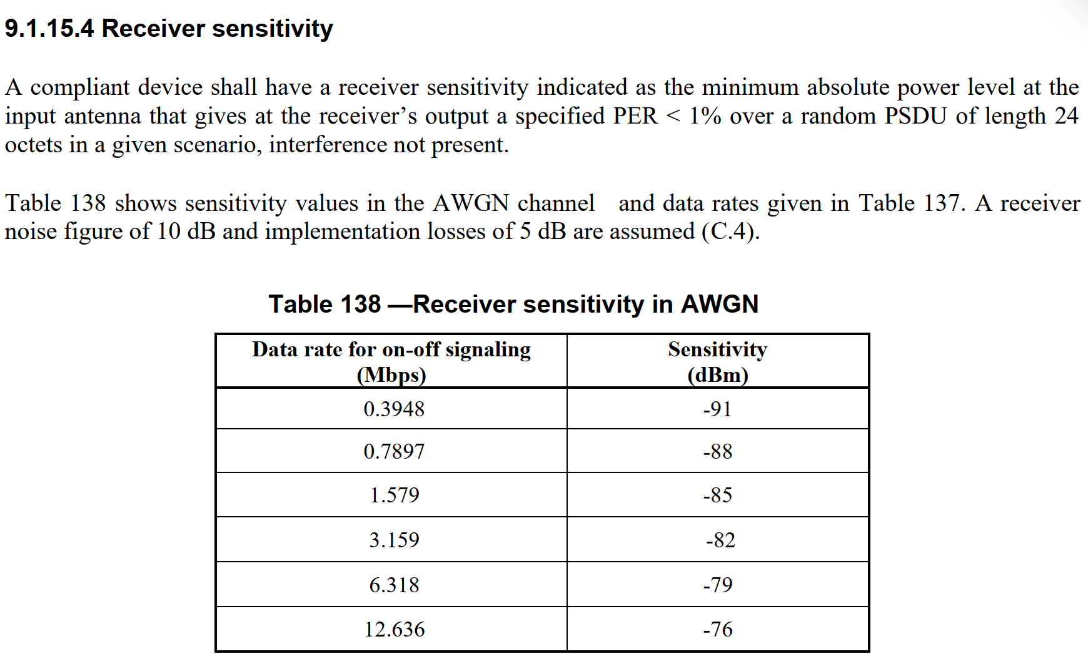

Slide 24
Interference mitigation by
Signal processing

Slide 25
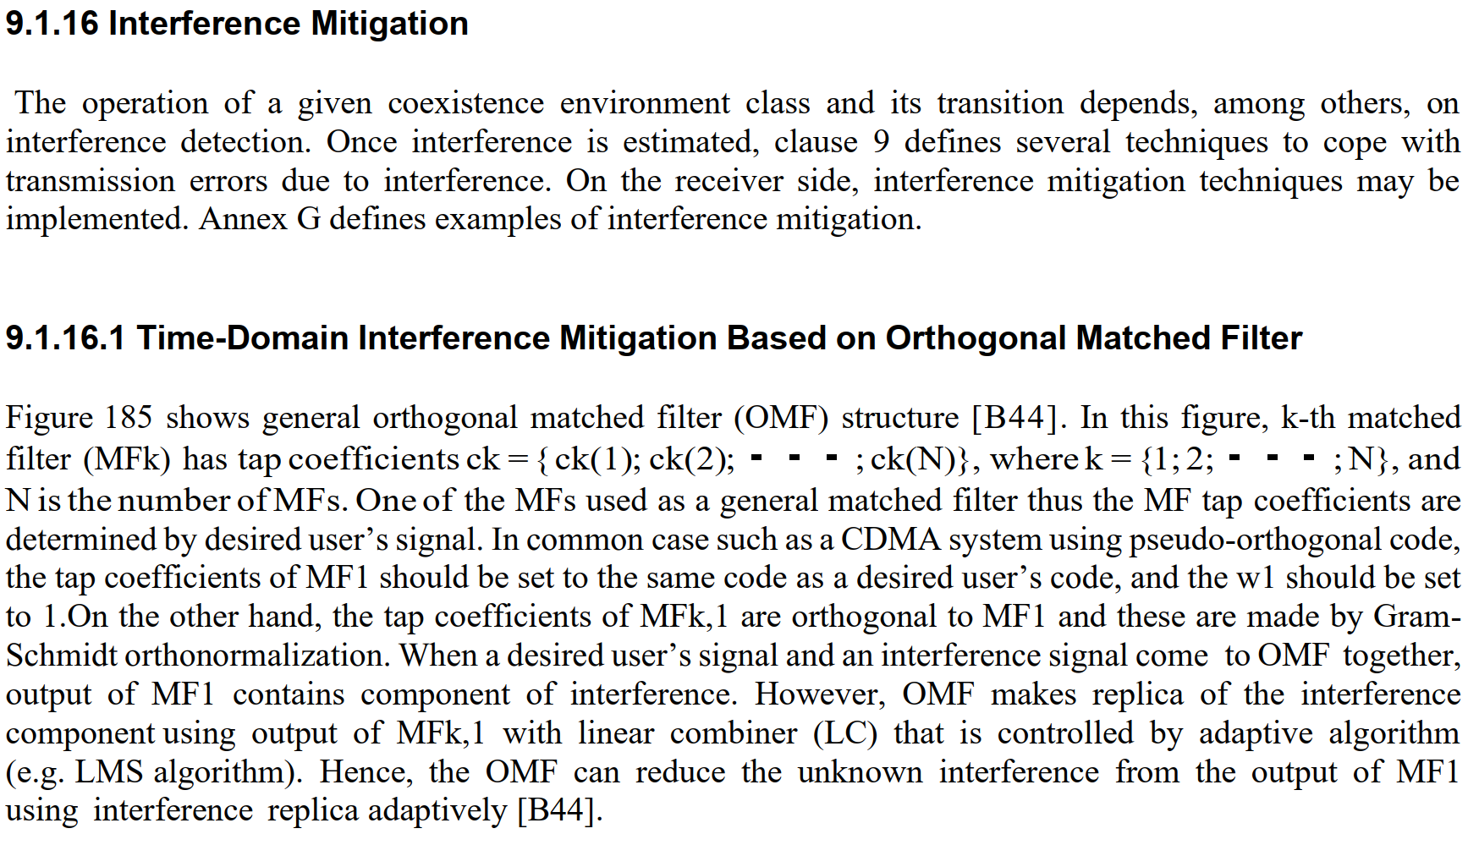

Slide 26
Antenna
Desired signal + interference
Desired signal + interference
+
Matched Filter (MF) 1
Replica of interferences
subtract
Orthogonal
Matched Filter (MF) 2
W1
Orthogonal
Matched Filter (MF) 3
W2
Orthogonal
Adaptive algorithm
e.g. LMS
Matched Filter (MF) 4
W3
Orthogonal
Matched Filter (MF) k
Wk
Linear combiner
Mixed signal EXCEPT desired signal.

Slide 27
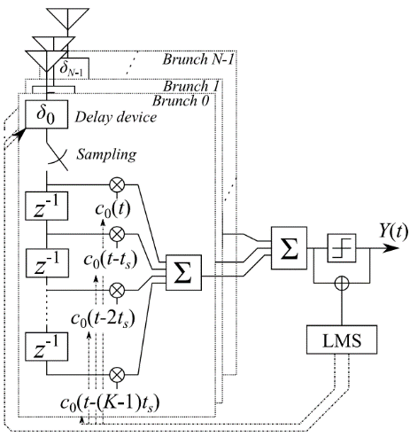
Apply pulse based OMF to spatial signal processing
  TDL array antenna
    Configured by multiple antennas and tapped delay line （TDL）
    TDL-AA can separate the signals which comes from the same direction by using time-domain signal processing.
  By applying OMF to TDL-AA
    Interference reduction is performed on both domains: time and space.
Space-temporal signal processing
Notes:
27
therefore

Slide 28
Conclusions
From the point of view of higher dependability, interference mitigation is important issue.
D03 has various approach to achieve interference mitigation with definition of coexistence classes.
Interference mitigation in MAC, PHY and lower layer technologies have been described in D03.

Slide 29
Thank you for your attention.

