Slide 1
IG NG-OWC
Submission Title: Low Complexity High Throughput Reed Solomon Channel Coding Architecture for FSO Communications
Date Submitted: September 10, 2024
Source: Zaini Irzal, Nguyen Ngoc Huy, Yeong Min Jang, Kookmin University
Address: Room #603 Mirae Building, Kookmin University, 77 Jeongneung-Ro, Seongbuk-Gu, Seoul, 136702, Republic of Korea
Voice: +82-2-910-5068 E-Mail: yjang@kookmin.ac.kr
Re:
Abstract: Present the RS coding hardware architecture for FSO communication
Purpose: Presentation for contribution on IG NG-OCC
Notice: This document has been prepared to assist the IG NG-OCC. It is offered as a basis for discussion and is not binding on the contributing individual(s) or organization(s). The material in this document is subject to change in form and content after further study. The contributor(s) reserve(s) the right to add, amend or withdraw material contained herein.
Release: The contributor acknowledges and accepts that this contribution becomes the property of IEEE and may be made publicly available by IG NG-OCC.

Slide 2
Low Complexity High Throughput Reed Solomon Channel Coding Architecture for FSO Communications
September 12, 2024

Slide 3
Contents
Background
Existing Solution
Proposed Solution
Conclusion

Slide 4
Background
Free-space optical (FSO) communication has great advantages over radio communication due to higher bandwidth and several benefits, which deliver a promising future.
However, FSO communication is very susceptible to fading due to atmospheric turbulence.
One possible solution is channel coding, such as Reed-Solomon (RS) codes.
To improve RS code efficacy in highspeed application such as in FSO it is needed to create a high-throughput low-complexity RS coding architecture.

Slide 5
Existing Solution
Reed-Solomon (RS) codes have been widely used in many communication systems.
However, current systems that are used in FSO require very demanding hardware specification and have very high complex architecture.
In order to maximize RS channel coding potential, it is required a modified hardware architecture.

Slide 6
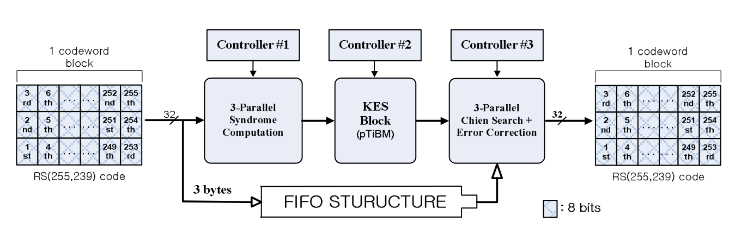
Proposed Solution
To create low complexity in RS coding hardware architecture is to separate the RS decoder the several parallel blocks.
This block structure is then multiplexed into 16-channel to increase throughput.
With this architecture [1], it can be achieved a throughput of 240 Gbps on a 640 MHz FPGA.

Slide 7
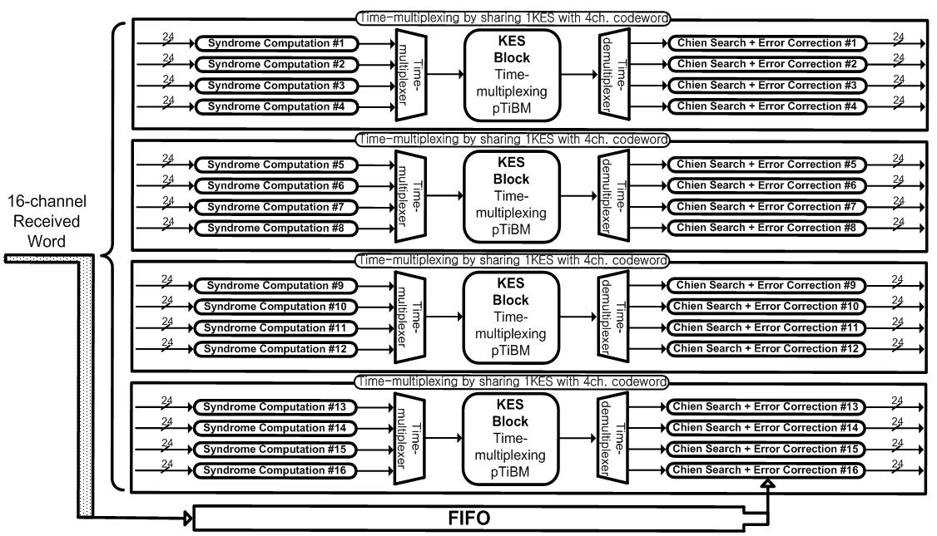
16-Channel RS Decoder

Slide 8
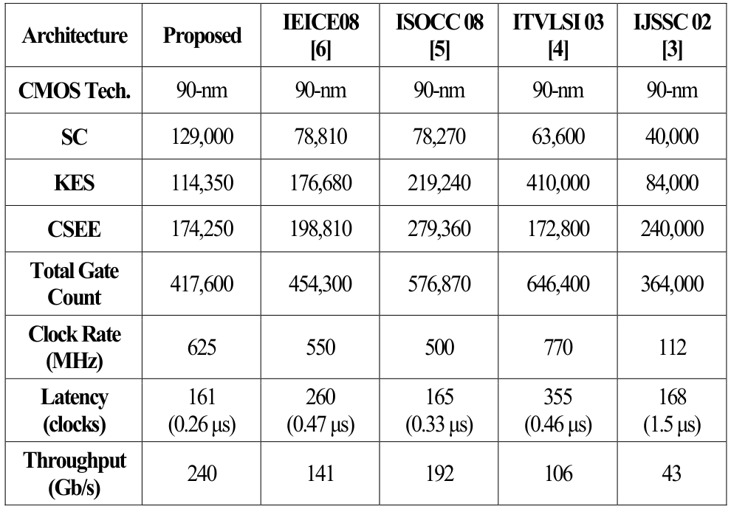
Result of 16-Ch RS Coding
The proposed RS coding architecture shows much better throughput compared with the conventional design
The complexity also lower with total gate counts lower than conventional design.

Slide 9
Conclusion
The proposed low complexity high throughput RS code architecture can be very useful in at FSO communication application.
Knowing the extremely noise channel in FSO communication, a good RS channel coding hardware architecture can improve the error correcting system that we have now.
The low complexity also means it can be implemented easier in any Field-programmable gate array (FPGA).

Slide 10
Reference
Park, J., Lee, H. (2012, December). A High-Speed Low-Complexity Time-Multiplexing Reed-Solomon-Based FEC Architecture for Optical Communications. IEICE Transactions on Fundamentals of Electronics, Communications, and Computer Sciences, Vol.E95-A, no. 12, pp. 2424-2429.
Choi, C., Ahn, H., Lee, H. (2011, May). High throughput four-parallel RS decoder architecture for 60GHz mmWAVE WPAN systems. IEICE Transactions on Communications, Vol.E94-B,No.05,pp.1332-1338, doi: 10.1109/ICCE.2010.5418839.
Zhao, Z. Liao, R. Lyke, S.D. (2010, April). Reed-Solomon coding for free-space optical communications through turbulent atmosphere. 2010 IEEE Aerospace Conference, doi: 10.1109/AERO.2010.5446896.

