Slide 1
IG NG-OWC
Submission Title: Vision Transformer (ViT) for Signal Denoising in OCC
Date Submitted: September, 2024
Source: Su Mon Ko, Nguyen Ngoc Huy, Yeong Min Jang, Kookmin University
Address: Room #603 Mirae Building, Kookmin University, 77 Jeongneung-Ro, Seongbuk-Gu, Seoul, 136702, Republic of Korea
Voice: +82-2-910-5068 E-Mail: yjang@kookmin.ac.kr
Re:
Abstract: Present the vision transformer (ViT) work for signal denoising in OCC
Purpose: Presentation for contribution on IG NG-OWC
Notice: This document has been prepared to assist the IG NG-OWC. It is offered as a basis for discussion and is not binding on the contributing individual(s) or organization(s). The material in this document is subject to change in form and content after further study. The contributor(s) reserve(s) the right to add, amend or withdraw material contained herein.
Release: The contributor acknowledges and accepts that this contribution becomes the property of IEEE and may be made publicly available by IG NG-OWC.

Slide 2
Vision Transformer (ViT) for Signal Denoising in OCC Contribution
September, 2024

Slide 3
Contents
Background
Overview of the Vision Transformer (ViT) in Signal Denoising
ViT Architecture
Vision Transformer Work for Denoising in OCC
Key Advantages of Vision Transformers for OCC Denoising
Conclusion

Slide 4
Background
In Optical Camera Communication (OCC), an LED is used as a transmitter that emits modulated light signals and a camera sensor capture these light signals as a receiver and decodes the transmitted data.
The signal can be affected by various forms of noise during the communication process like ambient light interference, camera sensor noise that leading to degraded communication quality.
Signal denoising is used to filter these unwanted noise to improve signal quality and enhance data recovery.
The goal of performing denoising is to recover the true modulated signal from the noisy observation.

Slide 5
Overview of the Vision Transformer (ViT) in Signal Denoising
The Vision Transformer (ViT) is a deep learning model that split an input image into small patches.
ViT uses a self-attention mechanisms to capture relationships between these patches that allow the model to handle long-range dependencies effectively and focus on the important parts of the image.
Signal denoising in OCC with ViT is to differentiate the data-encoding LED signal from the noisy background.
The ViT model can be trained to selectively focus on areas of the image that contain valid signal patterns by filtering noise.

Slide 6
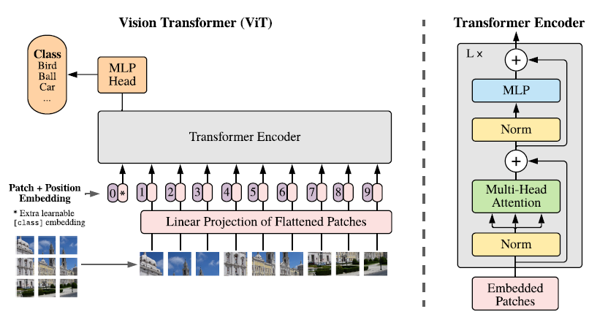
ViT Architecture
Patch Embedding: each image is split into patches, which are then flattened and linearly embedded into a vector. The result is a sequence of patch embeddings.
Positional Embedding: positional encodings are added to the patch embeddings to retain spatial information about the image structure.
Transformer Encoder Layers: each encoder layer consists of a self attention mechanism followed by a feed-forward network. Residual connections are applied between the layers to maintain the flow of information and help with deeper models.

Slide 7
Vision Transformer Work for Denoising in OCC
1. Input Representation and Patch Processing
Image Patching: the camera sensor in OCC captures the light signal emitted by LED transmitter as image or video frames.
The captured image is divided into small non-overlapping patches and each represents a segment of the image which include useful signal information or noise.
Each patch is flattened and passed through a linear projection layer to perform patch embeddings that are inputs to the transformer.
Positional encodings are added to these embeddings to help the model understand the spatial relationship between patches.
2. Self-Attention Mechanism for Denoising
The model computes attention scores between different patches to differentiate the regions that contain useful signal patterns and noise in the context of signal denoising.
ViT can selectively assign higher weights to signal patches and lower weights to noisy patches through this self-attention process.

Slide 8
Vision Transformer Work for Denoising in OCC
3. Feature Extraction
The ViT extracts high-level features from the transformed patches after completing the attention mechanism processes.
These features represent the denoised signal.
Each transformed patch is passed through a feed-forward network (FFN) to further process the signal and remove any residual noise.
4. Denoising Temporal Sequences (Optional)
The camera sensor captures frames continuously over time in UAV-based OCC communication process.
By processing sequences of frames, ViT can be extended to handle temporal information where each frame represents a point in time.
5. Reconstruction of the Denoised Signal
The final step is to reconstruct the denoised image after processing the patches through the ViT layers.
the output patches from the transformer are reshaped back into original image format resulting in a denoised version that has enhanced the LED signal and reduced noise.
the OCC decoder will interpret the modulated light signal to recover the transmitted data using that denoised frame.

Slide 9
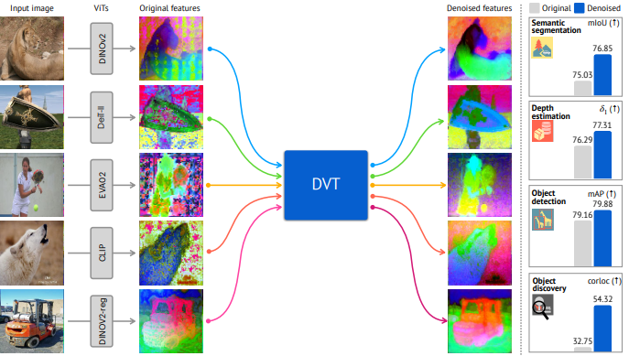
<Denoising Vision Transformers>

Slide 10
Key Advantages of Vision Transformers for OCC Denoising
Attention to Critical Signal Regions: ViT's self-attention processes can filter out noise-affected regions while selectively focusing on areas with strong signals.
Flexibility in Handling Noise: ViT can capture both local and global noise patterns, increasing its versatility in dealing with complex noise patterns.
Temporal Denoising Capability: ViT can handle noise across both spatial and temporal domains, improving the denoising process by leveraging information across multiple frames for OCC systems with dynamic environments like UAVs in motion.
Scalability: Depending on the amount of noise, size of input images and required real-time performance, ViTs can be scaled up and down that makes them adaptable to various OCC setups from small handheld devices to larger systems like UAVs.

Slide 11
Conclusion
Utilizing Vision Transformer (ViT) for noise reduction in Optical Camera Communication (OCC) shows great potential by utilizing self-attention to concentrate on crucial signal areas and eliminate interference.
ViT is highly effective for managing intricate noise patterns, such as spatial and temporal noise, making it ideal for dynamic OCC scenarios like UAV-based communication.
Training a ViT model on noisy and clean data pairings allows the model to successfully denoise signals in real time, hence boosting the quality and reliability of the OCC systems.
ViT provides a flexible and powerful denoising solution for OCC, increasing its potential for high-speed, secure communication in challenging environments.

Slide 12
Reference
Dosovitskiy, A. (2020). An image is worth 16x16 words: Transformers for image recognition at scale. arXiv preprint arXiv:2010.11929.
Yang, Jiawei, et al. "Denoising Vision Transformers." arXiv preprint arXiv:2401.02957 (2024).
Zhang, Dan, and Fangfang Zhou. "Self-supervised Image Denoising for Real-World Images with Context-Aware Transformer." IEEE Access 11 (2023): 14340-14349.

