Slide 1
IG NG-OWC
Submission Title: Machine Learning-Driven Optimization of Drone Battery Efficiency to Enhance OCC for NG-OWC
Date Submitted: -
Source: Zalza Karima, Nguyen Ngoc Huy, Yeong Min Jang, Kookmin University
Address: Room #603 Mirae Building, Kookmin University, 77 Jeongneung-Ro, Seongbuk-Gu, Seoul, 136702, Republic of Korea
Voice: +82-2-910-5068 E-Mail: yjang@kookmin.ac.kr
Re:
Abstract: Presenting the way to optimize battery for enhancing OCC in drone systems for NG-OWC
Purpose: Presentation for contribution on IG NG-OWC
Notice: This document has been prepared to assist the IG NG-OWC. It is offered as a basis for discussion and is not binding on the contributing individual(s) or organization(s). The material in this document is subject to change in form and content after further study. The contributor(s) reserve(s) the right to add, amend or withdraw material contained herein.
Release: The contributor acknowledges and accepts that this contribution becomes the property of IEEE and may be made publicly available by IG NG-OWC.

Slide 2
Machine Learning-Driven Optimization of Drone Battery Efficiency to Enhance OCC for NG-OWC , 2024
Notes:
Optimizing Drone Battery Efficiency to Enhance OCC in Drone Networks using an ML-based IoT System for Next-Generation OWC

Slide 3
Contents
Background
OCC in Drone System
How the ML- based IoT system for the BMS Algorithm Works
Conclusion

Slide 4
Background
Drones are now being utilized in various fields such as surveillance, monitoring, data collection, delivery services, and more. Drone networks can also provide on-demand communication for remote and hard-to-reach areas. Additionally, UAVs communicate and collaborate with each other to complete specific tasks.
Recently, drones have started using Optical Camera Communication (OCC) technology to communicate with each other, enabling fast, reliable, and efficient data transmission in drone networks.
Optical Wireless Communication (OWC), including Free Space Optics (FSO) and OCC, provides more secure communication, immunity to RF interference, low latency, license-free operation, and higher bandwidth in drone networks. [3]
Despite the advantages of OCC, several challenges remain. One critical issue is the limited battery performance of UAVs, which affects communication within drone networks.
The battery performance of UAVs limits network lifetime, making it difficult to provide optimal communication. Moreover, the short battery life is insufficient to support the rapidly growing number of emerging tasks.
A Machine Learning algorithm has been proposed to minimize energy consumption and maximize the overall energy efficiency of UAV communication, enhancing the performance of OCC. [1]

Slide 5
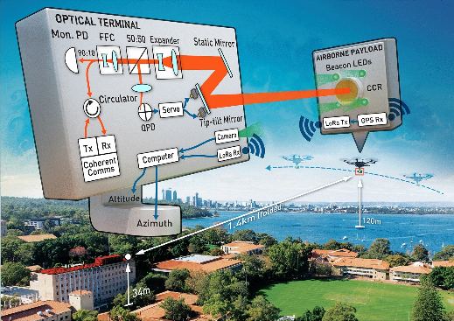
OCC in Drone System
< Schematic of the deployable optical terminal and experiment [2] >
Drone are widely projected to be a significant part of the development of integrative communication and computation in the near future due to advancements in artificial intelligence.
Currently most drones utilize the radio frequency (RF) spectrum to communicate with ground-based objects but it has several drawbacks that need to be addressed.
OCC is capable of addressing the challenges of RF technology.
To operate UAVs, OCC must be durable to enhance performance. However, if a drone’s battery is low, it can significantly affect the performance of optical camera communication (OCC). [3]

Slide 6
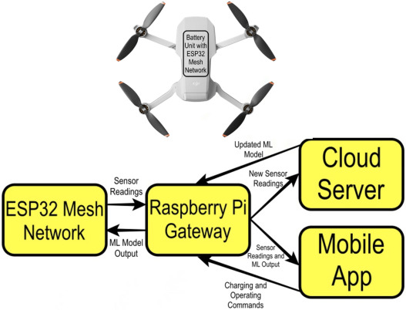
How the ML- based IoT system for the BMS Algorithm Works
< Framework of ML models > [1]
< Framework of IoT-based BMS for UAVs > [1]
Notes:
Maintaining sufficient battery levels is crucial for ensuring that OCC operates optimally in drone systems. So based on the paper that I read, Deep Neural Networks (DNN) and Random Forest (RF), This approach aims to increase the lifetime and efficiency of UAV batteries and enhance the reliability of UAV operations.
So how it works:
1. Sensor readings (voltage, current and temperature) are taken from the UAV battery by the mesh network and sent to the gateway. Next, the gateway uploads the data into the cloud server.
Additionally, the gateway analyzes the data using the trained ML models and sends the results to the mobile app and the mesh network.
2. The cloud server stores all the sensor readings and processes the data from the gateway. The processing done on the cloud is the re-training of the ML models with the new data so the performance of the ML model is being improved constantly and the new model can be deployed to the gateway.
3. the ML models would produce an output for SoC and SoH based on the sensor readings.
4. Following the accurate SoC and SoH predictions, the BMS can provide great insights to the user such as the expected flight time. In addition, the BMS can issue warnings of extensive battery degradation and time of replacement.
5. This results in enhanced energy efficiency and prolonged UAV operation by balancing the power needs of the OCC with the UAV's limited battery resources. [2]

Slide 7
Conclusion
A Battery Management System (BMS) was presented using two different machine learning algorithms: Deep Neural Networks (DNN) for State of Charge (SoC) regression and Random Forest (RF) for State of Health (SoH) classification. This approach aims to increase the lifetime and efficiency of UAV batteries and enhance the reliability of UAV operations.
Implementing the DNN and RF algorithms can optimize overall energy efficiency, allowing OCC to operate with minimal power consumption, thereby ensuring optimal performance in dynamic drone network environments.
By improving battery performance, it is also possible to increase the durability and reliability of OCC.
Future work involves exploring how AI for Energy can enable real-time adjustments in both communication and flight operations.

Slide 8
Reference
[1] Shibl, M. M., Ismail, L. S., & Massoud, A. M. (2023). A machine learning-based battery management system for state-of-charge prediction and state-of-health estimation for unmanned aerial vehicles. Journal of Energy Storage, 66. https://doi.org/10.1016/j.est.2023.107380
[2] Walsh, S. M., Karpathakis, S. F. E., McCann, A. S., Dix-Matthews, B. P., Frost, A. M., Gozzard, D. R., Gravestock, C. T., & Schediwy, S. W. (2022). Demonstration of 100 Gbps coherent free-space optical communications at LEO tracking rates. Scientific Reports, 12(1). https://doi.org/10.1038/s41598-022-22027-0
[3] Sitanggang, O. S., Herfandi, Faridh, M. M., & Jang, Y. M. (2024). Enhancing Drone Communication Utilizing 4QAM OFDM in OCC Systems. International Conference on Ubiquitous and Future Networks, ICUFN, 158–161. https://doi.org/10.1109/ICUFN61752.2024.10624837

