Slide 1
September 2024 Doc.: IEEE 802.15.4
A New Generation of Active RFID （LDSW）for IoT Application
Date: 2024-9-12
Authors:
subumission
Silde 1

Slide 2
September 2024 Doc. IEEE 802.15.4
Abstract
LDSW (low duty cycle smart wireless) will meet the chanllenges identified in the IEEE PAR document.
LDSW tag is for identification as well as for IoT applications. It can connect & control sensors, contollers, and location modules, while it is in a very low duty cycle working mode of periodical sleeping and waking up monitoring for identification purpose.
It can handle various IoT applications in a cost-effective way. This includes dealing with high volume end devices, no matter they are at fixed location or in fast moving state, with their IDs known or not.
Any LDSW device can initiate a communication at any time by continously and uninterruptedly transmitting wake-up signals to target devices in a period of time longer than the sleep & wake-up cycle of the target devices , to wake them up and set a communication just in 1 second.
Doing synchronization only at any needed time. This is different from periodical beacon synchronization. It cuts down power & increases flexibility
subumission
Silde 2

Slide 3
September 2024 Doc. IEEE 802.15.4
Background
The information revolution is moving from the Internet to the IoT.
However, there is a big gap between market needs and the reality
World Needs a Good IoT Standard
to Meet the Gap
subumission
Silde 3

Slide 4
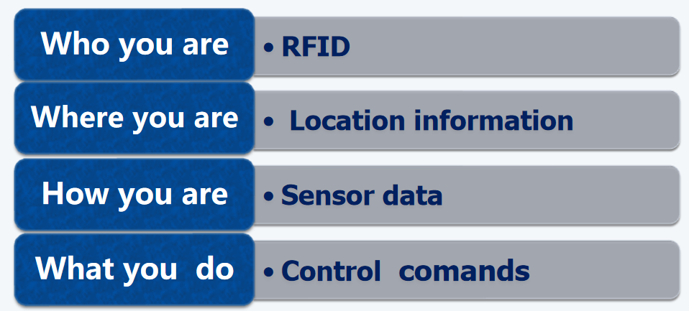
September 2024 Doc. IEEE 802.15.4
Basic IoT Data Information
They are characterized by “light data”, “Bursty”, “Asynchronous”and Transitive”,
comletely different from the one dealed by 3GPP
subumission
Silde 4

Slide 5
September 2024 Doc. IEEE 802.15.4
IoT technologies Current Available
IEEE 802.15.4 Series (including LoRaWAN and Bluetooth):
Primarily used for sensor data collection; limited improvements have been made in RFID functionalities. This standard is well-suited for low-data-rate applications such as sensor networks, but has limitations in high-density, dynamic RFID environments.
Active RFID: Mainly used for identification and location tracking. It excels in environments where active monitoring and real-time localization are required, such as tracking assets across large areas or within complex infrastructures.
RedCap：
Aims to streamline 3GPP protocols to better fit Internet of Things (IoT) requirements. However, because 3GPP was originally designed for high-bandwidth applications like audio and video transmission, it typically utilizes synchronous communication protocols. These protocols are not suitable for typical IoT application scenarios, which are characterized by light, bursty, asynchronous, and transient data. Therefore, it is challenging to directly apply these synchronous protocols to IoT data, which often requires minimal latency and overhead.
None of them can meet all the basic functionalities required by IoT
廖成都西谷数字技术有限公司

Slide 6
September 2024 Doc. IEEE 802.15.4
IEEE is Looking for the Solution --An unified IoT standard as defined in the following PAR document-- zengjiade
《802.15.4f Active RFID PAR Submittal from the RFID Study Group》
–Ultra-low energy consumption (low duty cycle)
–Low PHY transmitter power
–Both one-way and two-way communications (simplex and duplex transmission)
–High tag density (large tag population of many thousands)--
-( Reading & Writing in fast moving high desity tags)--added
–Reader to tag and tag to tag (meshing) communication (unicast)
–One to many communication (multicast)
-(On demands synchronization) --added
-（Multi-channel collaboration）--added
–Authentication
–Sensor integration
–Accurate location determination capability
–100m read range - (need even longer range >1000m)--added
–Global availability (with our without licensing)
–Narrow bandwidth PHY channels less than 3MHz wide
–Capable of avoiding, or operating in the presence of interference from other
devices operating within the Active RFID’s frequency band of operation
But not succeed yet. Please refer to: 《https://grouper.ieee.org/groups/802/15/pub/SGrfid.html》
subumission
Silde 6

Slide 7
September 2024 Doc. IEEE 802.15.4
Challenges for 802.15.4
It needs better working effeciency, faster data transimission、and capable of handling more devices and dealing with diferent scenarios at very low power,......
Test from Dash-7 organization
subumission
Silde 7

Slide 8
September 2024 Doc. IEEE 802.15.4
LDSW
LDSW is designed specially for IoT applications
with new topology、function & technology
Following are the explainations
subumission
Silde 8

Slide 9
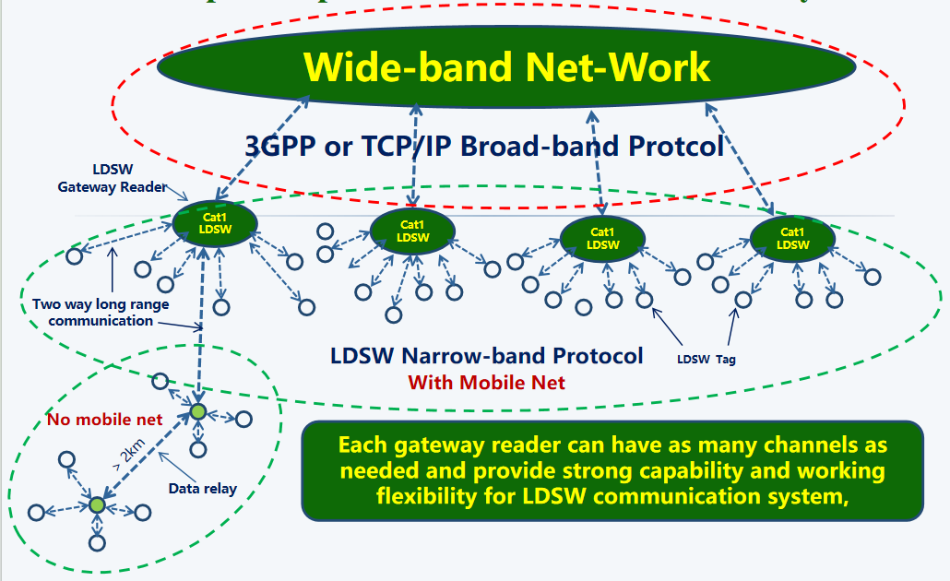
September 2024 Doc. IEEE 802.15.4
Star-Net - Connecting to Broadband Net
With peer to peer communication & data relay
Gateway reader can have as many channels as needed, and
connects both wideband and Narrow-band protocols together. Either one works effeciently
LDSW Net could be either a public narrow-band Net work serving the public or a pravite Net work
subumission
Silde 9

Slide 10
September 2024 Doc. IEEE 802.15.4
LDSW Topology Explaination
LDSW adopts a gateway reader that bridges two different communication protocols' , effectively bridging synchronous communication protocols (such as in 3GPP) with asynchronous communication protocols like LDSW. This solution addresses the needs of application scenarios that have two completely different data transmission requirements. This method allows each protocol to operate in its ideal environment rather than forcing a merger that would weaken their functionality. It is rational to maintain the independence of these protocols, allowing them to perform optimally on their own instead of attempting to merge them into a single solution.
Point-to-point data relay methods are only used in remote areas where broadband networks do not exist, forming a chain-like topology structure connected to broadband networks.
A public narrow band IoT network or a private one The LDSW system, rely on the existing broadband networks, can either be a public narrow band IoT network, providing a variety of IoT information services to governments, enterprises, and the public; or it can be a local IoT network connected to WIFI, serving enterprises and institutions themselves.
Identified by IPV6 in the network All LDSW terminals will be identified by their unique IPV6 identity numbers, and telecom operators will charge them a network usage fee based on their usage of their network.
廖成都西谷数字技术有限公司

Slide 11
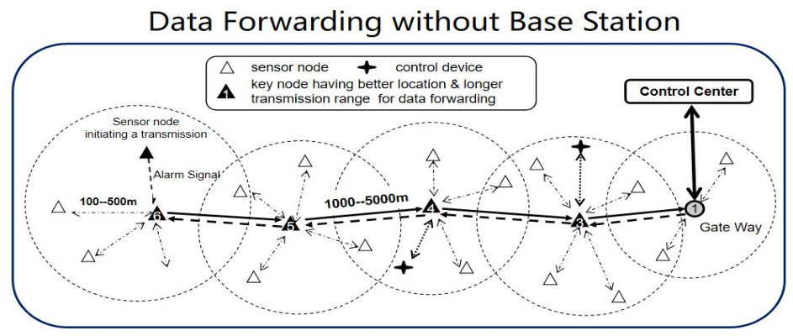
September 2024 Doc. IEEE 802.15.4
Peer to Peer Communication
LDSW devices can be in a very low duty cycle mode of periodical sleeping and monitoring. Anyone can initiate a communication by continously and uninterruptedly transmitting wake-up signals to the target devices, in a time period longer than the sleep & wake-up cycle of target devices waking them up and building a communication just in 1 second. See page 14
Data relay in the remote area without mobile net
subumission
Silde 10

Slide 12
September 2024 Doc. IEEE 802.15.4
New Concept of Active RFID
LDSW tag connects & controls sensors, contollers, and location modules.
It can handle various IoT applications at very low power and cost, no matter with high volume tags number or not, tags with fixed location or in fast moving, with knowing tags’ ID or not, ......
subumission
Silde 11

Slide 13
September 2024 Doc. IEEE 802.15.4
Wide Range of IoT Applications
..................
subumission
Silde 12

Slide 14
September 2024 Doc. IEEE 802.15.4
Key Technological Breakthroughs
“DNA Check” -- Similar to IEEE 802.15.4 CCA mode 2
“Multi-Channel Collaboration”
-More channels are available at the same time in the same system
“On demands synchronization”-- Dynamic timing
Tag Interfacing with sensors & controller,....
Micro code commands --Save power & get more flexibility
Explainations will follow
subumission
Silde 13

Slide 15
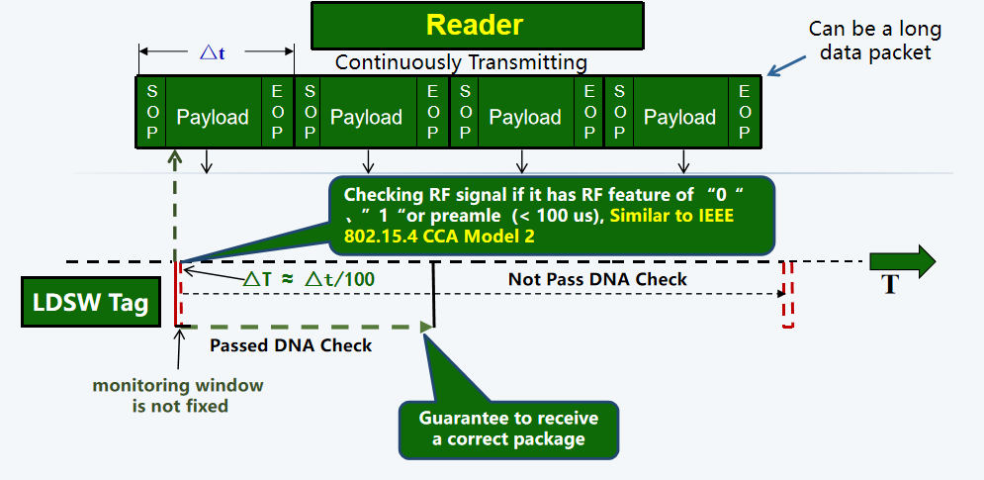
September 2024 Doc. IEEE 802.15.4
“DNA Check” Illustration
Reader initiates a communication with LDSW tag
subumission
Silde 14

Slide 16
September 2024 Doc. IEEE 802.15.4
Advantages of “DNA Check”
Cutting down power drastically
-- Average <10 uAs -Ultr-low power
Long rang tags consumes more power only in transmitting --Low power long range Star Net
Increasing work reliability
--Guaranteed to receive a correct package --Reliable
Very useful for wireless remote control
--Fast response in just 1 second
subumission
Silde 15

Slide 17
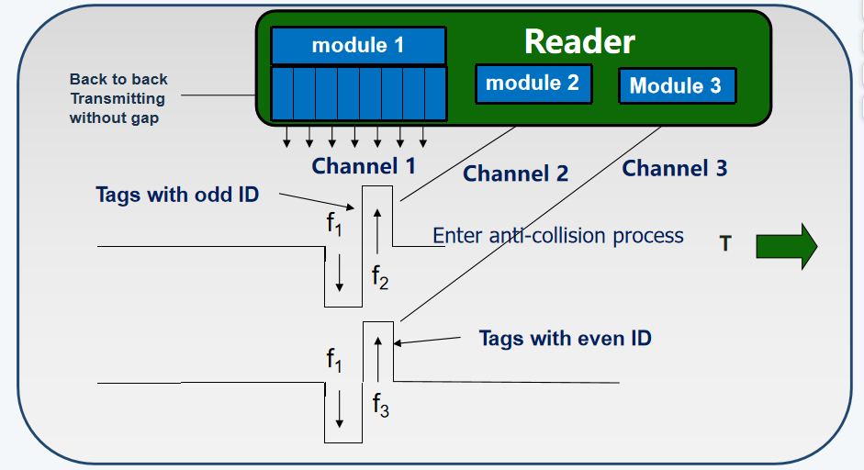
September 2024 Doc. IEEE 802.15.4
Multi-Channel Collaboration
Readers can have as many transceiver modules as needed
subumission
Silde 16

Slide 18
September 2024 Doc. IEEE 802.15.4
Advantages of “Multi-channel Collaboration”
Simplified LDSW system
All tags can communicate each other
Can handle fast moving high density tags
Speed up whole communication process
Siplex tags can be used as “dulplex even multi-plex”
subumission
Silde 17

Slide 19
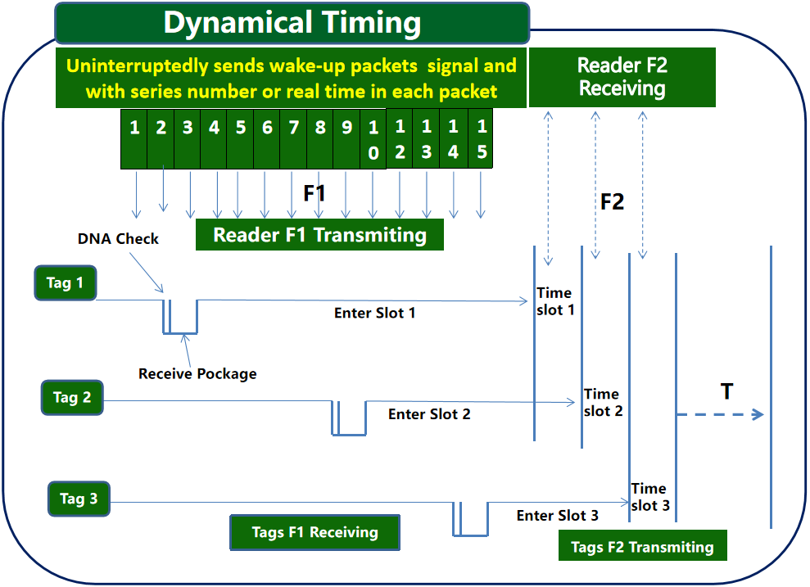
September 2024 Doc. IEEE 802.15.4
Synchronization only needed
Different from periodical beacon synchronization
It cuts down power & increases flexibility
subumission
Silde 18

Slide 20
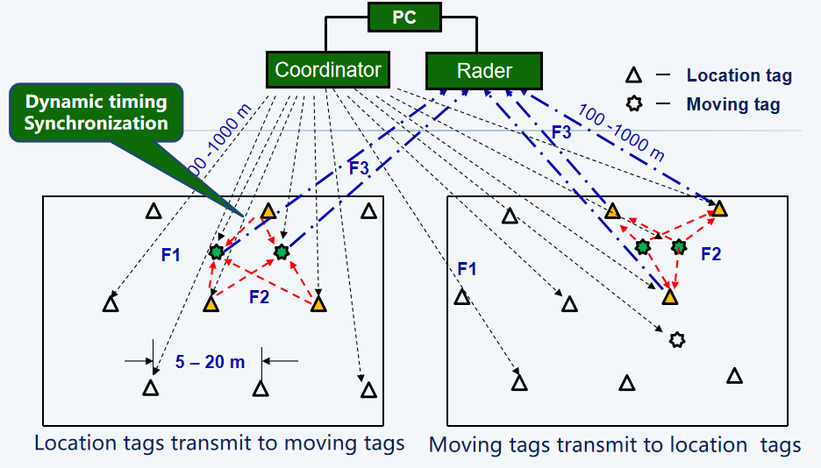
September 2024 Doc. IEEE 802.15.4
ApplicationA：accurate indoor location
Taking advantages of multi-channel collaboration & dynamic timing, simple low cost tags can be used for tag location
subumission
Silde 19

Slide 21
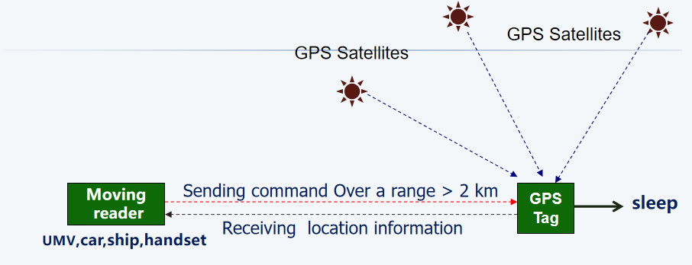
September 2024 Doc. IEEE 802.15.4
ApplicationB：accurate outdoor location
LDSW tag + GPS module = LDSW satellite location tag
Sending a command to turn on GPS to get location information, and turn GPS off right after received location information will save a lot of power
subumission
Silde 20

Slide 22
September 2024 Doc. IEEE 802.15.4
Summary
* LDSW is a new generation of active RFID, meeting all the requirements
identified in the PAR document:
“IEEE 802.15.4f Active RFID PAR Submittal from the RFID Study Group”.
* A Chinese national key IoT standard based on LDSW technology
《 Technical Requirements for Low duty cycle smart IoT tag communication system 》
will be published soon.
* LDSW has been accepted by ISO as the technical basis for a new
proposed active RFID international standard to replace ISO-18000-4
at the meeting : ISO/IEC JTC 1/SC 31/WG 4/SG 3 - Air Interface, Meeting Minutes
14 September 2010 Toulouse, FRANCE
subumission
Silde 21

Slide 23
September 2024 Doc. IEEE 802.15.4
Thank You !
subumission
Silde 22

Slide 24
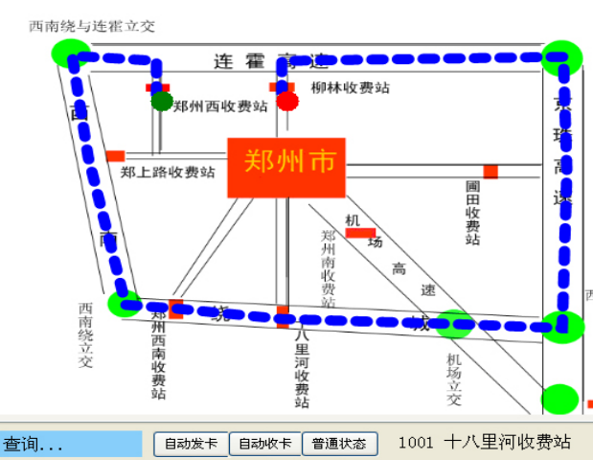
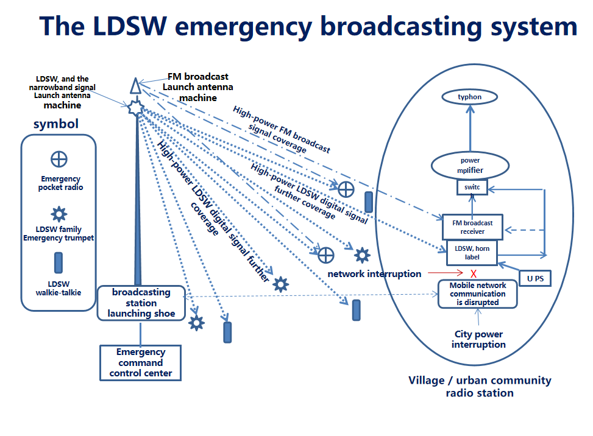
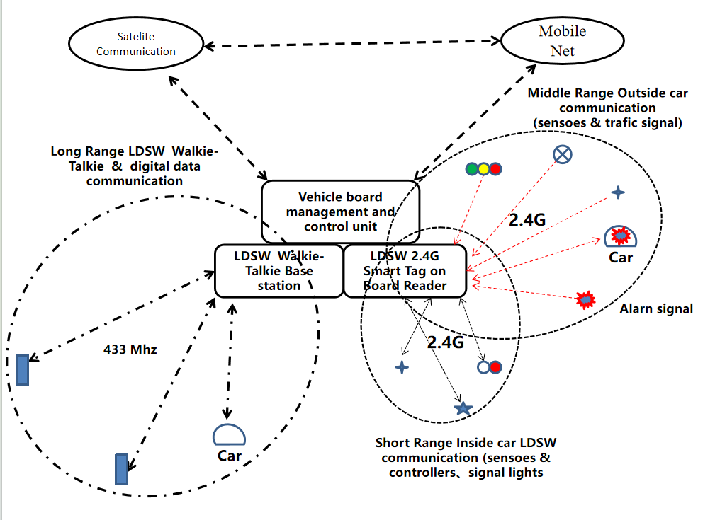
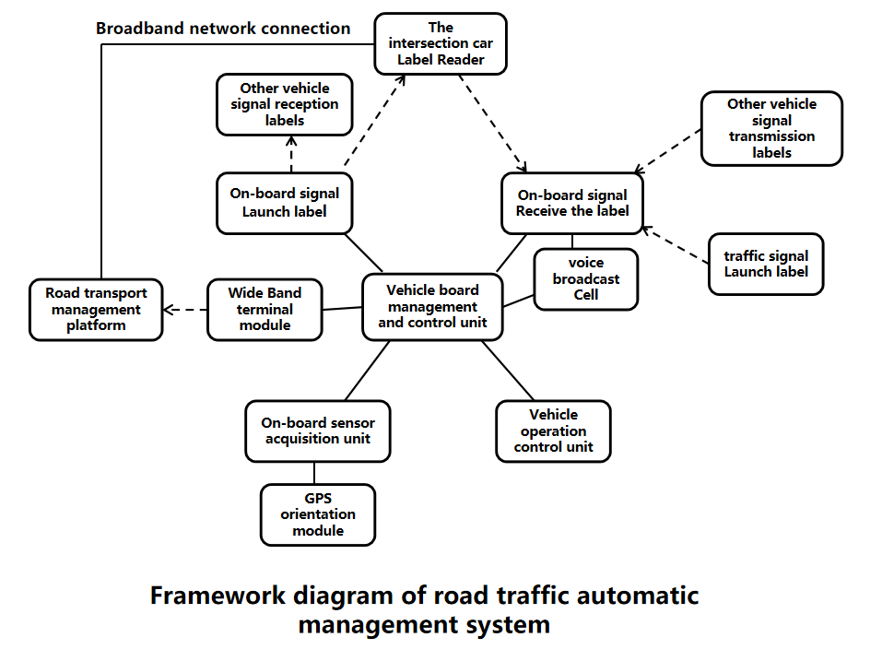
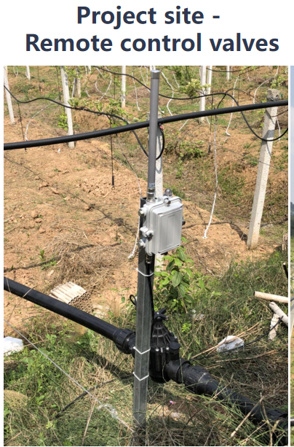
September 2024 Doc. IEEE 802.15.4
Some sample applycations
subumission
Silde 22

