Slide 1
Project: IEEE P802.15 Working Group for Wireless Personal Area Networks (WPANs)
Submission Title: IG Access Closing Report and Minutes
Date Submitted: 11 Sept 2024
Source: Benjamin A. Rolfe (Blind Creek Associates)
Contact:
Voice: +1 408 395 7207, E-Mail: ben.rolfe @ ieee.org
Re: Wireless Next Generation
Abstract: Closing report and minutes for the September Wireless Interim.
Purpose: Support the illusion of organization.
Notice: This document has been prepared to assist the IEEE P802.15. It is offered as a basis for discussion and is not binding on the contributing individual(s) or organization(s). The material in this document is subject to change in form and content after further study. The contributor(s) reserve(s) the right to add, amend or withdraw material contained herein.
Release: The contributor acknowledges and accepts that this contribution becomes the property of IEEE and may be made publicly available by P802.15.
Notes:
Jul 12, 2010
Page 1

Slide 2
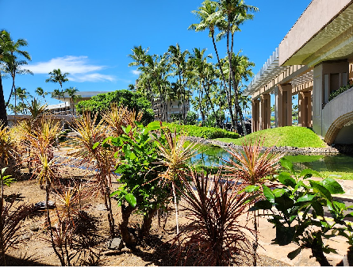
September 2024 802 Wireless Interim Session
Interest Group, Spectrum Access

Slide 3
Agenda
Opening and Meeting Reminders
Overview of Interest Group
Meeting objectives
Technical Presentation(s) and Discussion(s)
Next Steps
Any other business
Adjourn

Slide 4
Meeting Summary
Meeting opening
  Called to order at 10:30 HST
  Attendance requirements reminder
  Review IEEE Policy slides for pre-PAR activity
  Review agenda in 15-24-0492-01
    Following neither discussion nor objection, agenda approved by unanimous consent
Chair presents overview
Chair presents meeting objectives
Technical contribution: contained in 15-24-0492-01
  Presented by B. Rolfe
  Discussion follows
Next Steps:
  Chair conducts poll on interest: Yes/No: 22/0 [25 remote attendees; 12 in-room]
Any other business: non heard
Adjourn at 11:32 HST

Slide 5
Overview of Interest Group
July IG Results (outputs):
Short term focus: U-NII 6 GHz band
  Consider present occupants
  Consider future growth in occupation
    Consider that many current and future users will not be 802 compliant
  Expand consideration to NB+RLAN+UWB coexistence
  Support (Not pre-empt) efforts in other projects
Ground Rules for This IG
There are many 802 wireless technologies
  All are important
  None are more important (in the system view) than others
  Diversity of uses is an important metric for spectrum efficiency
  Diversity of technologies is a strength of 802
There are other technologies we have to expect (or some uses of our standard)
  Won’t abide by our protocols and limitations
  Must abide by regulations
802 is not a regulatory body
  Influence opportunity: if we present great ideas, people are likely to adopt
  People are often more influenced by the carrot than the stick

Slide 6
Meeting Objectives
Determine if there is interest in improving spectrum access techniques
Determine if there is sufficient interest to move forward with IG
Review and update prior contribution

Slide 7
Next Steps
Assess interest:
  Question: How many people are interested in continuing to explore better access methods and new ideas for effective sharing?
    Yes/No: 22/0
    [25 remote attendees; 12 in-room]
Next Meeting (contribution driven):
  Determine if SG is warranted
    Explore technical options available now (current standards)
    Explore new, promising approaches
    Define project options and discuss

Slide 8
Call for contributions and
Proposed Direction for IG
Consider spectrum access recommendations within the scope of 802
  Can be “above the MAC” (e.g. 802.15.5 and 802.15.10) and/or spanning use of multiple standards (e.g. 802.19.3)
    How to use features of the MAC to achieve a specific function
    How to use features of the MAC to address different optimization scenarios
  Can be recommendations for new features in 802 MACs
    Recommend a project in WG 15
    Recommend a project in WG 11
  Think beyond “one size fits all”
  Think beyond “what we already have done”

Slide 9
Recorded Attendance:
Local | Remote
Chitrakar, Rojan | Aldana, Carlos
Harada, Hiroshi | Almholt, Thomas
Huang, Lei | Amezawa, Yasuharu
Kohno, Ryuji | Chen, Run
Krebs, Alexander | Gruber, Josef
Kristem, Vinod | Guo, Jianlin
Lee, Jaegook | Hirata, Masayuki
Powell, Clinton | Ikegami, Tetsushi
Robert, Joerg | KOBAYASHI, Takumi
So, Youngwan | Li, Jialing
Sun, Li-Hsiang | Luo, Xiliang
Rolfe, Benjamin | Murali, Sriram
 | Murray, Carl
 | Nomura, Tetsuya
 | Patel, Tushar
 | Portier, Fabrice
 | Suzuki, Takafumi
 | Tang, Weidong
 | Xiao, Libra
 | Yoon, Kangjin
 | Zakaib, Larry

