Slide 1
Diversified Range IoT (DR-IoT) for Disaster Response Applications
Date: 2024-09-11
Authors:

Slide 2
Abstract
Land Mobile Radios (LMRs) are commonly used for voice-oriented operations and low rate data communications for disaster response, but applications for digitalized operations require higher data rates than LMRs can currently handle.
Diversified Range IoT (DR-IoT) that achieves 2^{m} speedup by increasing the (single carrier modulation) symbol rate by 2^{m} times has been proposed in order to support higher data rates.
A DR-IoT prototype has been implemented for field experiments using an off-the-shelf IEEE 802.15.4g chipset that can operate in the Japan VHF-High bands.
DR-IoT utilizes Spectrum Resource Measurement (SRM) frames to coordinate operating channels of PANs in close proximity.
We have performed a gap analysis between DR-IoT and existing IEEE 802.15.4 systems, and propose to form an Interest Group for further discussion.

Slide 3
Background
In disaster response operations, having a long range mobile communication means is essential for the last mile connectivity from the base to disaster damaged areas where cellular services are unlikely available.
Land Mobile Radios (LMRs) are commonly used for responders’ voice-oriented operations and low rate data communications.
  Depending on the operating frequency and the maximum transmit power, LMRs can provide a communication range of over 50 km without multi-hopping.
  In Japan, a variant of LMRs called Digital Convenience Radios (DCRs) have been widely used for voice-oriented disaster response operations.
However, applications for digitalized operations such as image sharing and video streaming (even in low resolution) require much higher rates than LMRs can currently handle.

Slide 4
Examples of Disaster Response Applications
Application | Required data rate | Use cases
Short text messaging | Less than 10 kbps | Safety confirmation, emergency alert, etc.
GPS tracking |  | Locating responders, vehicles, shelters, etc.
Intermittent monitoring |  | Monitoring temperature, precipitation, water level, etc.
Voice memo (low quality) | 10 - 50 kbps | Voicemail (when the voice call cannot be established)
Transceiver (simplex, low quality) |  | Communication among responders and the base
Remote system command & control |  | Remote control of vehicles (including UAVs)
Voice call (duplex, low quality) |  | Communication between the base and responders
Image sharing (low resolution) | 50 - 100 kbps | Area assessment at the base
DB sharing (small size) |  | Shelter management (conditions, supplies, etc.)
Voice conferencing (low quality) | Over 100 kbps (~300 kbps) | Conferencing among the base and responders
Image sharing (a few hundred kB) |  | Area assessment at the base
Video streaming (low resolution) |  | Drone control in a long distance or NLOS environment
: Range of applications that LMRs on the current market would be difficult to support.

Slide 5
Concept of DR-IoT
Diversified Range IoT (DR-IoT) achieves 2^{m} speedup by increasing the symbol rate by 2^{m} times (single carrier modulation).
While the idea of DR-IoT is not new, we extend the highest m for a broader range of data rates to support data-demanding disaster response applications.
Applying the concept of DR-IoT to RCC LMR GMSK and SUN Narrowband FSK
to achieve over 300 kbps (Base channel spacing: 6.25 kHz)
m | 0 | 1 | 2 | 3 | 4 | 5 | 6
Scale factor | 1 | 2 | 4 | 8 | 16 | 32 | 64
Channel bandwidth (kHz) | 6.25 | 12.5 | 25 | 50 | 100 | 200 | 400
RCC LMR GMSK Data rate (kbps) | 4.8 | 9.6 | 19.2 | 38.4 | 76.8 | 153.6 | 307.2
SUN Narrowband FSK* Data rate (kbps) | 5 | 10 | 20 | 40 | 80 | 160 | 320
Free space communication range (assuming 50 km when m = 0) | 50.0 | 35.4 | 25.0 | 17.7 | 12.5 | 8.8 | 6.3
* Channel bandwidth is adjusted for the VHF narrowbanding rules in the US.

Slide 6
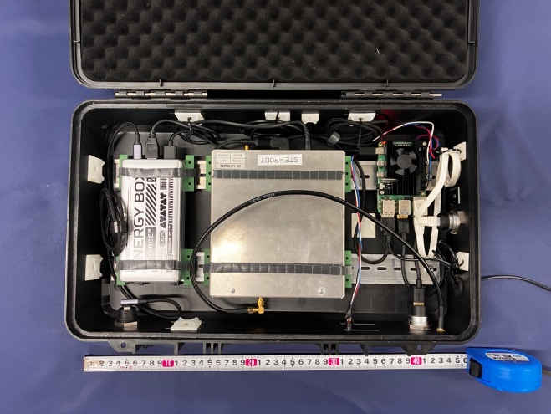
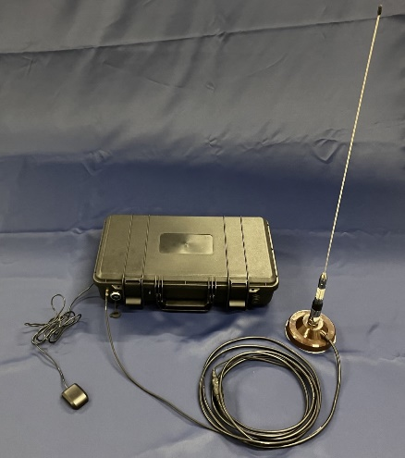
DR-IoT Prototyping
We implemented a DR-IoT prototype using a commercial off-the-shelf IEEE 802.15.4g chipset for experiments and user hearings.
A batch of measurements with the prototype has been performed in small cities and rural areas of Japan since 2021.
DR-IoT prototype specifications
Operating frequencies | 207.5 – 222 MHz (licensed for experimentation in Japan)
Channel bandwidth | 6.25 × 2^{m} kHz where m = 0, 2, 4, 6 (400 kHz for m = 6)
Data rates | 5 × 2^{m} kbps where m = 0, 2, 4, 6 (320 kbps for m = 6)
Maximum TX power | 19 dBm (1st generation) 37 dBm (2nd generation)
Modulation | 2GFSK Modulation Index: 0.5, BT: 0.5
Pictures of a 2nd generation DR-IoT prototype
(45 x 25 x 10 cm, 2 kg with battery)
and a whip antenna (λ/2, λ = 210 MHz)

Slide 7
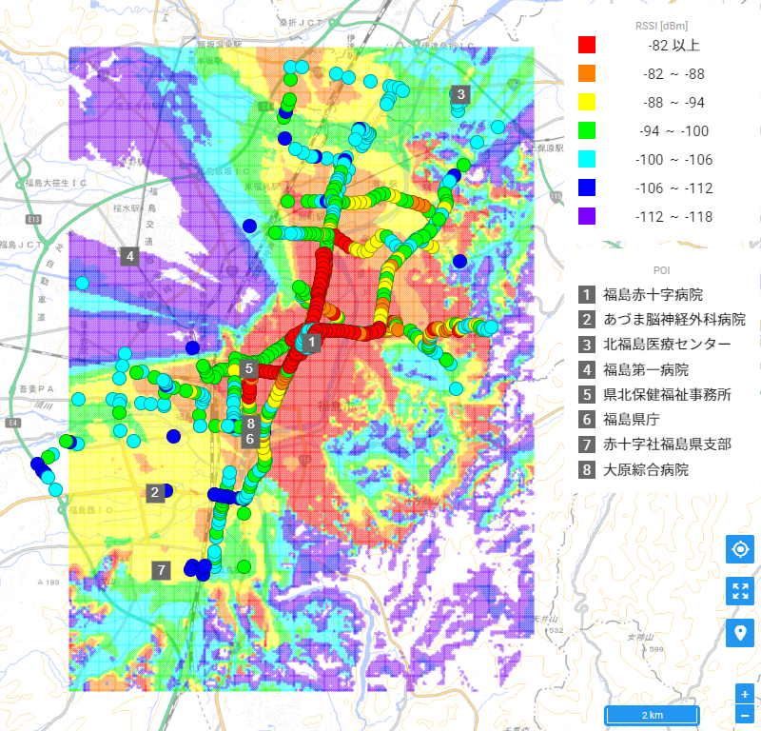
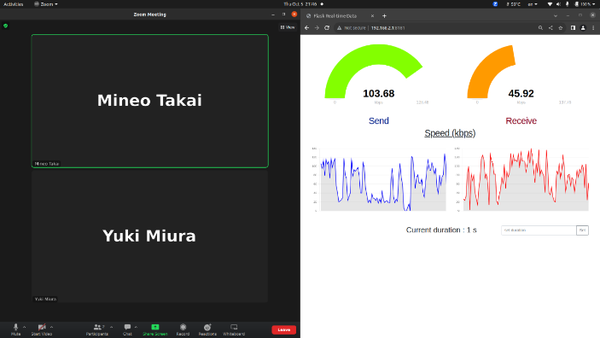
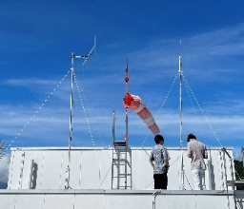
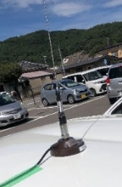

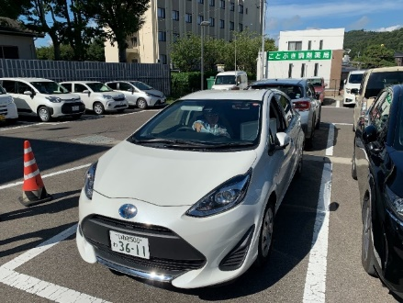
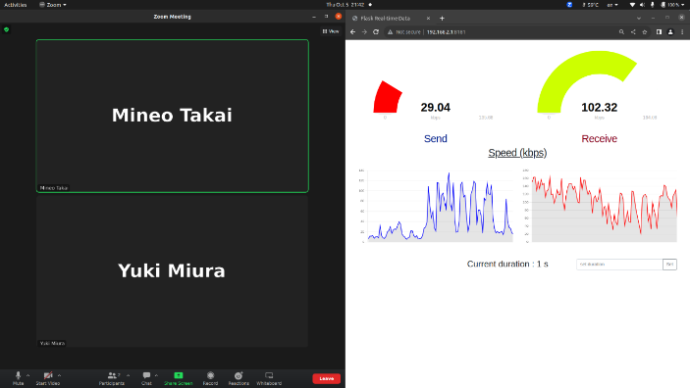
DR-IoT Experiments in the VHF High Bands
(In Fukushima, September 2023 [2])
DR-IoT successfully ran the GPS tracking application around downtown Fukushima at relatively low Tx power (19 dBm). Also, a voice conferencing was established (indoor environment) with the same set of devices.
Carrier frequency: 210 MHz
Tx power: 19 dBm
Antenna Gain (Tx/Rx): 2.15 dBi
Rooftop Antenna Height: 36 m
Vehicle Antenna Height: 1.6 m
6.4 km
6.0 km
Fukushima Red Cross Hospital (Left)
and a vehicle (Right) during the experiment
Measured RSSI (dots) over
ITM simulation result (heatmap)
Voice conferencing over a DR-IoT
channel (320 kbps, indoor)

Slide 8
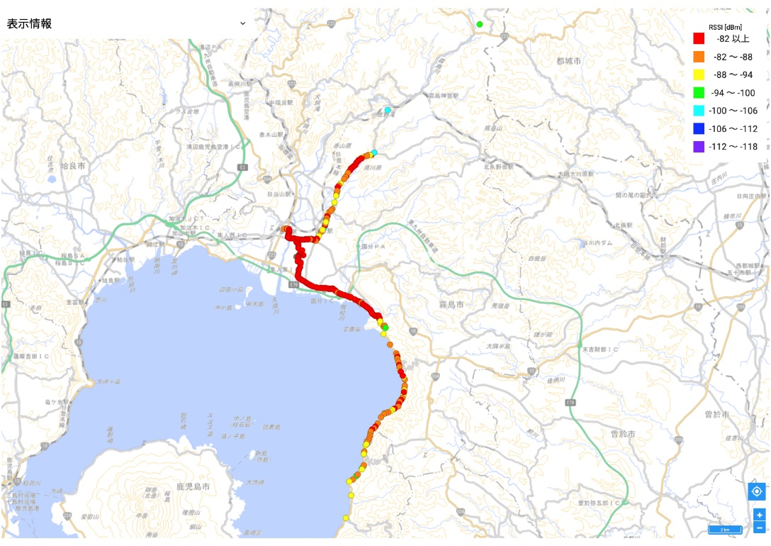
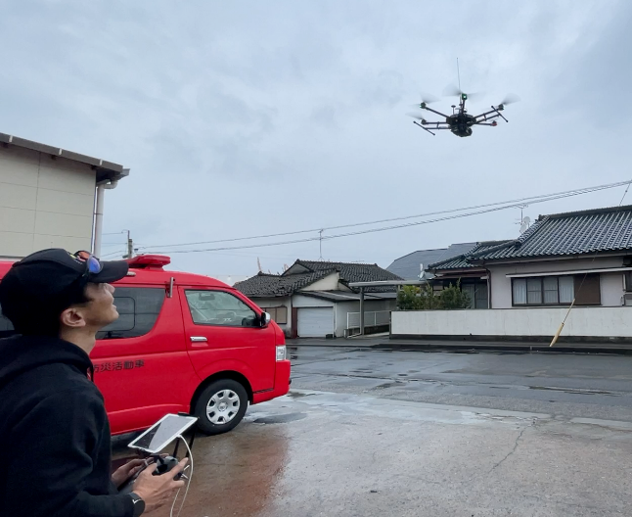
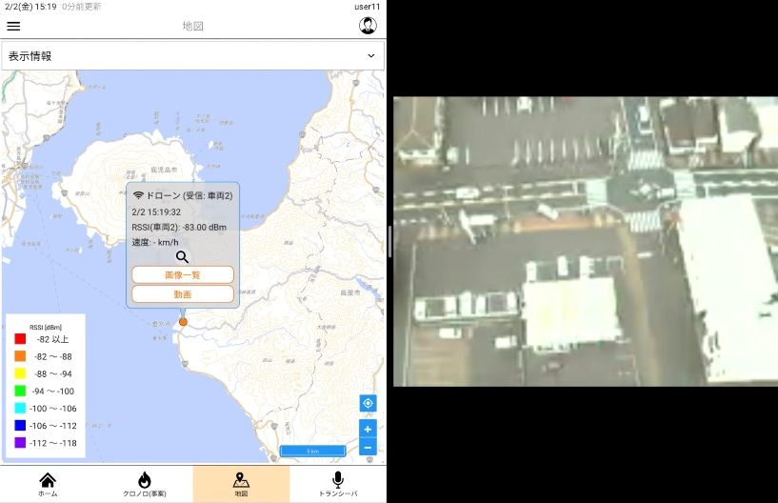
DR-IoT Experiments in the VHF High Bands
(In Kagoshima, February 2024 [3])
DR-IoT reached over 16 km for GPS tracking from a hospital in Kirishima City at 37 dBm. A video streaming from a UAV (120 m alt., 7 km away, 19 dBm) has also been demonstrated at the fire department in Tarumizu City, Kagoshima.
Carrier frequency: 210 MHz
Tx power: 19 dBm
Antenna Gain (Tx & Rx): 2.15 dBi
Data rate: 80 kbps
Streaming codec: H.264
Resolution: QVGA (320 x 240)
Frame rate: 5 fps
Tx
Carrier frequency: 210 MHz
Tx power: 37 dBm
Antenna Gain (Tx/Rx): 2.15 dBi
Rooftop Antenna Height: 28 m
Vehicle Antenna Height: 1.6 m
Data rate: 5 kbps
16 km
GPS tracking in Kirishima-Tarumizu city area
Video streaming demonstration at the Tarumizu fire department

Slide 9
Operation Frequencies for DR-IoT
We are currently looking into the operation of DR-IoT in the following VHF bands in Japan:
  VHF-High band: DR-IoT has been proposed as one of the VHF-High band systems, and its operations in the following sub-bands are under regulatory review by the Information and Communications Council [4].
    170.0 – 177.5 MHz (7.5 MHz total bandwidth)
    217.5 – 222 MHz (4.5 MHz total bandwidth)
  Unmanned Mobile Image Transmission System band: The regulation rules for image transmission (unattended vehicles) were made in 2016. It has been used for image transmission as well as command & control links for Unattended Aerial Vehicles (UAVs) [5].
    169.0500 – 169.3975 MHz (347.5 kHz total bandwidth)
    169.8075 – 170.0000 MHz (192.5 kHz total bandwidth)

Slide 10
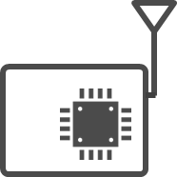
DR-IoT Spectrum Management
DR-IoT utilizes Spectrum Resource Measurement (SRM) frames and an advertising channel* for spectrum management of PANs in close proximity.
  Based on the SRM information via advertising channel, devices join one of the PANs in operation, or form a new PAN. If a new PAN is formed, it operates in a channel that would not overlap (interfere) with other PANs operating channels.
* Advertising channel is one of the in-band channels (possibly in another band or via the Internet) that is always accessible in the operating field.
Device #6
Form a new PAN (PAN #4)
Join PAN #3
Device #5
Coordinator #1
Coordinator #2
Device #5
Coordinator #4
(Device #6)
Operating channel and SRM information
Coordinator #3
ADV CH
PAN #1
PAN #2
PAN #3
PAN #4
DR-IoT spectrum management (operating channel discovery and selection) using SRM frames

Slide 11
DR-IoT Operation in the VHF-High Band (Japan)
The VHF-High band channels are expected to bear severe out-of-band-emission (OOBE) up to 19 dBm/MHz from the Public BB systems (177.5 – 217.5 MHz).
  Since Energy Detection (ED) of in-band signals may not function properly due to the severe OOBE, DR-IoT uses one of its narrower bandwidths (higher PSD) for the advertising channel in its spectrum management.
OOBE from Public BB Ch. 9:
19 dBm/MHz
(47 dBm EIRP, 5MHz BW)
A high propagation loss from Public BB is required for ED to function if the Japanese 920 MHz band rules (ARIB STD-T108 [6]) are applied for the VHF-High band.
Required propagation loss from Public BB: 99 dB
(12 km in free space
at 177.5MHz)
Device #5
Coordinator #1
Coordinator #2
Device #5
ED Threshold: -80 dBm/MHz
(ARIB STD-T108 for 1 MHz BW)
Operating channel and SRM information
Coordinator #3
217.5 MHz
ADV CH
PAN #1
PAN #2
PAN #3
217.5 MHz
DR-IoT spectrum management (operating channel discovery and selection) under severe OOBE from Public BB

Slide 12

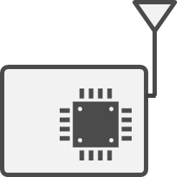
DR-IoT Operation in the Unmanned Mobile Image Transmission System Band (Japan)
As the available spectrum in the Unmanned Mobile Image Transmission System band is limited (540 kHz total), using narrowband channels efficiently with transmission power control (TPC) is crucial.
  DR-IoT figures an adequate transmission power for each link via its SRM based spectrum management, and achieves better frequency reuse for the band.
UAV
Tx Power
High
Medium
Low
Highest Power
Reduce Tx power for better frequency reuse
Highest Tx Power
Exchange SRM information periodically
UAV Ground controller
Distance
Illustration of DR-IoT transmission power control (SRM based) in the 169 MHz band

Slide 13
Overview of SRM
[SRM Request]
Timing: On demand
Request type:
- information get: PIB attributes
- information set: TPC
IEEE802.15.4s-2018 defines
  SRM: Spectrum Resource Measurement
  TPC: Transmit Power Control
[SRM Response/Report]
Timing:
- Response: in response to SRM request
- Report: periodical or event-driven
Information type:
- Response: PIB attributes
- Report: Status
[SRM Information/Extended Beacon]
Timing: On demand or periodical
- Extended Beacon: before MAC join
- SRM Information: after MAC join
Information type: information set (TPC)

Slide 14
DR-IoT Gap Analysis
DR-IoT is intended to apply to LMRs with the FSK modulation primarily in the VHF high bands. Applicable systems in the current IEEE 802.15.4 standards are RCC LMR (GMSK and 4-FSK) and SUN FSK (Narrowband FSK).
Gaps from RCC LMR (GMSK and 4-FSK):
  Application requirements of disaster response are almost identical to those of RCC, except that the former requires a wider range of data rates to be supported.
  The current technical specifications of RCC LMR are tailored for channels whose bandwidth is less than or equal to 50 kHz.
    Wider bandwidths need to be defined for higher rate communications. Also, the PHR protection can be omitted for data-demanding applications like video streaming, which can tolerate more frame losses for less per-packet overheads.
    To be able to use commercial off-the-shelf IEEE 802.15.4g chipsets, some of the currently mandated fields in RCC PPDU may be changed to optional for DR-IoT.

Slide 15
DR-IoT Gap Analysis
Gaps from SUN FSK (Narrowband FSK):
  Application requirements of disaster response are quite different from those of smart utility networks.
    Communication range without multi-hopping needs to be longer.
    Device mobility at a vehicular speed needs to be supported.
    Many disaster response applications, including system command & control and voice/video streaming, require higher duty cycle communications.
  Technical specifications of SUN FSK can accommodate a wider range of data rates than those of RCC LMR do, but the applicability to DR-IoT may be limited:
    The range of data rates offered by its Narrowband FSK (FSK-A) PHY mode is still the same as that by RCC LMR.
    The Multi-PHY Management (MPM) mechanism utilizing Common Signaling Mode (CSM) may be incompatible with the SRM based spectrum management of DR-IoT.

Slide 16
DR-IoT Gap Analysis
For the SRM based spectrum management, additional PIB attributes may be necessary to identify SRM related parameters and the advertising channel.
  Better efficiency may be achieved by defining an optional timing mechanism to switch between the advertising channel and other regular channels.
For the similarity of application requirements, DR-IoT should be based on the technical specifications of RCC LMR, and it needs to be discussed on how it would be able to support a broader range of data rates.
  For further discussion about the disaster response applications and potentially making DR-IoT part of the IEEE 802.15.4 standard, we propose to form an Interest Group.

Slide 17
Summary
Diversified Range IoT (DR-IoT) that achieves 2^{m} speedup by increasing the (single carrier modulation) symbol rate by 2^{m} times has been proposed in order to support higher data rates for narrowband radio systems.
A DR-IoT prototype has been implemented for field experiments using a commercial off-the-shelf IEEE 802.15.4 chipset that can operate in the VHF-High band in Japan.
DR-IoT utilizes Spectrum Resource Measurement (SRM) frames and an advertising channel for spectrum management for PANs in close proximity.
We have performed a gap analysis between DR-IoT and existing IEEE 802.15.4 systems, and propose to form an Interest Group for further discussion.

Slide 18
Straw Poll
Do you support to form an Interest Group for further discussion on the disaster response applications and potentially making DR-IoT part of the IEEE 802.15.4 standard?
  Yes
  No
  Abstain

Slide 19
References
[1] Ministry of Internal Affairs and Communications, “FY 2022 Spectrum Reorganization Action Plan,” (Abstract, Japanese).
[2] Y. Miura, M. Takai, T. Ikegami, etc., “Use of Diversified Range IoT (DR-IoT) in Disaster Medicine,” 29th Annual Meeting of Japanese Association for Disaster Medicine, February 2024.
[3] M. Takai, S. Ishihara, K. Uchiyama, etc., “A Phase-Free Use of Diversified Range IoT (DR-IoT) Data Communication Systems,” 29th Annual Meeting of Japanese Association for Disaster Medicine, February 2024.
[4] Ministry of Intrnal Affairs and Communications, “Consultation on the regulatory rules of the VHF-High Band,” (Japanese).
[5] Information and Communications Council, “Report on the regulatory rules of the 169 MHz band systems,” (Japanese).
[6] ARIB STD-T108, “920MHz-Band Telemeter, Telecontrol and Data Transmission Radio Equipment,” Association of Radio Industries and Businesses.

Slide 20
Format of SRM Metric ID
Attribute name SRM | Metric ID | Attribute name SRM | Metric ID
macED | 0 | macDuplicateFrameCount | 17
macTxFailTime | 1 | macRxSuccessCount | 18
macTxDeferredTime | 2 | macNackCount | 19
macRetryHistogram | 3 | macDeferredTxCount | 20
macChannelUtilization | 4 | macAverageBufferUtilization | 21
macRcp | 5 | macMaximumBufferUtilization | 22
macRsni | 6 | macTxFragmentCount | 23
macRssi | 7 | macRxFragmentCount | 24
macNoiseHistogram | 8 | macTxMulticastCount | 25
macFrameErrorCount | 9 | macRxMulticastCount | 26
macCounterOctets | 10 | macAverageAccessDelay | 27
macRetryCount | 11 | macChannelPage | 28
macMultipleRetryCount | 12 | macChannelNumber | 29
macTxFailCount | 13 | macRxAddrMode | 30
macTxSuccessCount | 14 | macRxDeviceAddress | 31
macFcsErrorCount | 15 | Reserved | 32–63
macSecurityFailure | 16

