Slide 1
Project: IEEE P802.15 Working Group for Wireless Personal Area Networks (WPANs)
Submission Title: MMS DS-TWR reporting and avoidance of clock attack
Date Submitted: Sept. 2024
Source: Li-Hsiang Sun, Li Ma, James Yee (MediaTek)
Address: 13480 Evening Creek Drive North, Suite 600, San Diego, CA 92128
E-Mail: li-hsiang.sun@mediatek.com
Abstract: Provide alternatives for discussion
Purpose: To facilitate comment resolution related to DS-TWR CIDs
Notice: This document has been prepared to assist the IEEE P802.15. It is offered as a basis for discussion and is not binding on the contributing individual(s) or organization(s). The material in this document is subject to change in form and content after further study. The contributor(s) reserve(s) the right to add, amend or withdraw material contained herein.
Release: The contributor acknowledges and accepts that this contribution becomes the property of IEEE and may be made publicly available by P802.15.

Slide 2
Background
[1] has proposed non-interleaved MMS for SS-TWR and DS-TWR
[2] has proposed interleaved MMS for DS-TWR
[3] pointed out SS-TWR can be subject to clock attack because the report from the other party is corrected by factor based on the CFO/SFO of the attacking ranging signal
DS-TWR can avoid the above attack
  Assume the report is protected
  Assume at measured time instance (RMARKER) a secure ranging signal is received
However, clock attack can still happen in DS-TWR for MMS ranging [3]
  In MMS ranging, the receiver may not be able to tell whether at the measured time instance (RMARKER) the received signal is noise, or actual signal fragment contributed to a positive correlation to the expected secure ranging signal

Slide 3
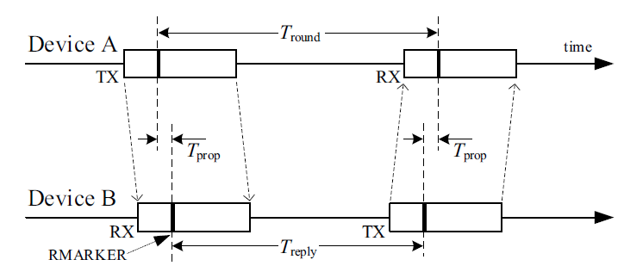

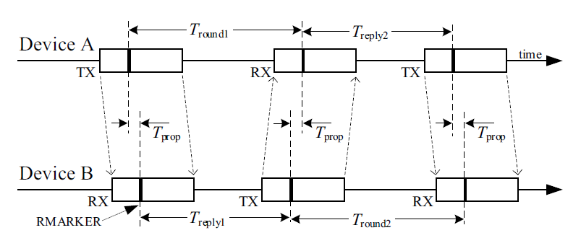
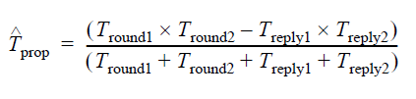
DS-TWR MMS reporting format
SS-TWR
DS-TWR report format needs to be changed comparted to that of SS-TWR currently defined for compact frame
SS-TWR (current MMS assumption)
  A reports T_round
  B reports T_reply
  A applies clock correction to T_reply before calculating T_prop
  B applies clock correction to T_round before calculating T_prop
DS-TWR
  B reports
    T_round2, T_reply1
  A reports
    T_round1, T_reply2
  A and B do not need to correct values reported by the peer
  2 ranging RMARKERS are sent by A, and because of fixed interval between RMARKERS from A (e.g. 1ms) for MMS, A only needs to report either T_round1 or T_reply2 but not both
DS-TWR

Slide 4
S&A attack [3] to DS-TWR
T_{round1}
T_{reply2}
Assume position of the arrows are RMARKERS
Green: correct derived RMARKER positions, e.g. attacker relays RIFs with 0 delay and does not change CFO between A & B, i.e. no attack
Red: derived RMARKER positions which are based on the altered clock frequency of replayed RIFs
  Receiver may not be able to tell it has received correct RIF pulses at/around the RMARKER position because of low link budget. RMARKER position is derived based on correlation and combination of all RIF pulses, and the CFO of peer’s clock. Some of the pulses contributed to the positive correlation may be several ms away from the RMARKER
  Proposal of Bit-wise verification [4] of RIF was rejected in 15.4ab
When A or B uses Green RMARKERS (x=y=0)
  Correct ranging result
When A or B uses Red RMARKERS (advanced)
  X>0, y=0
  X=0, y>0
  X>0, y>0
  T’_{prop} is shortened
Normally it is difficult to advance RMARKER because RIF is unpredictable
A
x
MITM
T_{reply1}
T_{round2}
B
y
y
$$T_{prop}^{′}=\frac{{(T}_{round1}−x)(T_{round2}−y)−(T_{reply1}+y)(T_{reply2}+x)}{T_{round1}+T_{round2}+T_{reply1}+T_{reply2}}$$

Slide 5
Advanced RMARKERs
Case 1
B
RMARKERS
Case 1 and case 2 are examples of MITM replays a partial sequence of RIFs with altered clock speed, which causes derived RMRKER positions to be earlier than they are supposed to be
Based on the previous page (red RMARKERs), the T’_{prop} is shortened
slower clock RIF-A (partial)
RMARKER
slower clock RIF-B (partial)
A
B
Case 2
RMARKERS
delayed and faster clock RIF-A (partial)
RMARKER
delayed and faster clock RIF-B (partial)
A

Slide 6
Remedy 1: use a conservative result
If the receiver cannot determine the position of RIF pulses contributed to positive correlation near the RMARKERs, then 2 sets of RMARKERs are used for T_{prop1} and T_{prop2}
The two sets of RMAKERs can be located at near the beginning and near the end of RIF sequence to ensure a conservative estimation.
For example, for application wishing to verify distance between A & B to be less than a threshold,
  T_{prop}=max(T_{prop1 ,} T_{prop2})
This has been proposed in [2]

Slide 7
Remedy 2: compare reports with CFO estimation
A compares T_{round2} +T_{reply1} in the report from B, and the interval D= (T_{round1} +T_{reply2}) corrected to B’s clock, to detect any discrepancies
For example,
A detects discrepancy larger than a margin between:
    (T_{round2} +T_{reply1}) in report
    (1+δ)D, δ is the estimated CFO used for coherently combining RSF/RIF from B
For case 1, δ<0 (i.e. MITM sends slowed RIF to A), but (T_{round2} +T_{reply1}) >D (i.e. MITM sends slowed RIF to B), then (T_{round2} +T_{reply1}) >(1 +δ)D + margin, is detected by A
  Based on received signal, A thinks B’s clock is slower, but the reported values from B indicate the B's clock is faster This discrepancy signals an attack.
For case 2, δ>0 (i.e. MITM sends faster RIF to A), (T_{round2} +T_{reply1}) <D (i.e. MITM sends faster RIF to B), then (T_{round2} +T_{reply1}) <(1 +δ)D – margin, is detected by A
  Based on received signal, A thinks B’s clock is faster, but the reported values from B indicate the B's clock is slower. This discrepancy signals an attack.
If discrepancy is detected by A, A indicates to B the ranging is unreliable, and/or does not report T_{round1} or T_{reply2} to B
  The unreliable indication could be in a protected message after the report message(s)

Slide 8
Cases not fixed by remedy 1&2
B
Case 3
RMARKERS
Attacker matches CFO of the replayed partial RIFs sequence (one faster than B’s clock, one slower than A’s clock, and replayed at different parts of sequence)
Case 3 is an example
  If y<x, distance reduction is still possible
delayed and faster clock RIF-A (partial)
RMARKER
slower clock RIF-B (partial)
T_{round1}
T_{reply2}
A
A
x
MITM
T_{reply1}
T_{round2}
B
y
y

Slide 9
Remedy 3
One device’s transmitted signal is pre-corrected based on another device’s clock
  e.g. responder pre-corrects its clock based on initiator’s clock before transmission
CFO -> 0, the imaginary advances of RMARKER do not happen
Even with clock pre-corrected, SS-TWR is still not advised

Slide 10
Summary
Check our understanding of possible attacks on DS-TWR described in [3] with 4ab experts.
Discuss/learn remedies if clock attack on DS-TWR is indeed an issue.

Slide 11
References
[1] https://mentor.ieee.org/802.15/dcn/24/15-24-0409-00-04ab-non-interleaved-mms.pptx
[2] https://mentor.ieee.org/802.15/dcn/24/15-24-0413-00-04ab-ds-twr-with-uwb-mms-packets.pptx
[3] https://mentor.ieee.org/802.15/dcn/23/15-23-0274-00-04ab-more-on-clock-related-attacks-against-uwb-ranging.pptx
[4] https://mentor.ieee.org/802.15/dcn/23/15-23-0403-00-04ab-optional-spreading-factor-l-16-for-ranging-integrity-fragments-rif.pptx

