Slide 1
Project: IEEE P802.15 Working Group for Wireless Personal Area Networks (WPANs)
Submission Title: [Proposal of Layers for the Interference Model]
Date Submitted: [10 September, 2024]
Source: [Joerg ROBERT] Company [TU Ilmenau/Fraunhofer IIS]
Address [Helmholtzplatz 2, Ilmenau, 98693, Germany]
E-Mail:[joerg.robert@ieee.org]
Abstract: []
Purpose: [Presentation in TG15.4ad]
Notice: This document has been prepared to assist the IEEE P802.15. It is offered as a basis for discussion and is not binding on the contributing individual(s) or organization(s). The material in this document is subject to change in form and content after further study. The contributor(s) reserve(s) the right to add, amend or withdraw material contained herein.
Release: The contributor acknowledges and accepts that this contribution becomes the property of IEEE and may be made publicly available by P802.15.

Slide 2
Motivation
Comparison of different proposals requires simulations of the physical layer performance
The proposed systems will operate in license-exempt frequency bands, resulting in interference from other systems
A suitable approach for the model has been presented in 15-24-0378-00
This document proposes layers for the interference model

Slide 3
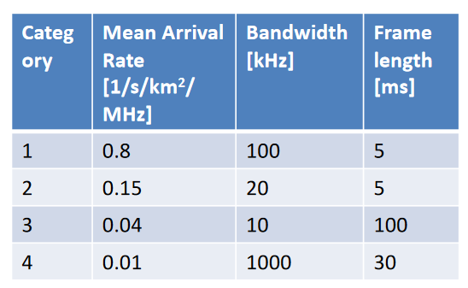
Current Parametrization of Layers
Currently defined layer reflect the situation in Germany in 2018
Interference models for the FCC region are currently not available
Channel measurements are already available, analyses are ongoing

Slide 4
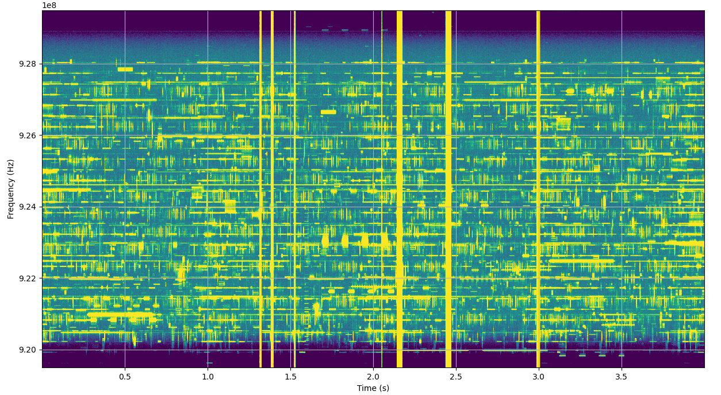
Example of Measured Spectrogram Measured in Hotel Room on 15th Floor, Montreal

Slide 5
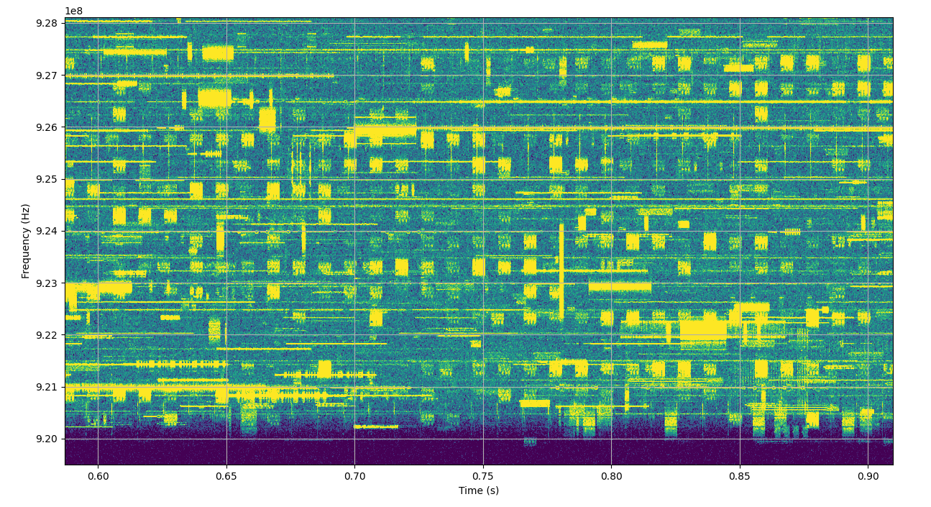
Zoom of Measured Spectrum
Wideband Short
Wideband Long
“15.4g-like”
RFID / Narrowband
LoRa (not visible here)

Slide 6
15.4g-like
Strictly follows channel structure
Duration ~ 5ms
Bandwidth 200kHz
Will follow CCA
Only relevant for weak Long-Range signals that cannot be detected by 15.4g like CCA as below CCA threshold

Slide 7
RFID / Narrowband
Very narrow bandwidth
On-air time typically much higher than the wanted signal, max. 400ms
Potentially strong signals if devices close by
Typical sources:
  RFID with CW to power passive tags
  LPWAN systems like sigfox
Systems typically do not (real) LBT
Should be modelled, e.g. by 1kHz wide white Gaussian noise signal

Slide 8
Wideband Short
Signals such as 802.11ah or other wideband signals
Bandwidth is much bigger than wanted signal bandwidth
Duration is very short, much smaller than 1ms
CCA threshold will be very high due to high bandwidth → interference is likely
Should be modelled, e.g. by 2MHz wide white Gaussian noise with duration 200µs

Slide 9
Wideband Long
Spreading signals
Bandwidth is much bigger than wanted signal bandwidth
Duration is approx. 2ms
Very likely that LBT is not used by these devices
Should be modelled, e.g. by 2MHz wide white Gaussian noise with duration 2ms

Slide 10
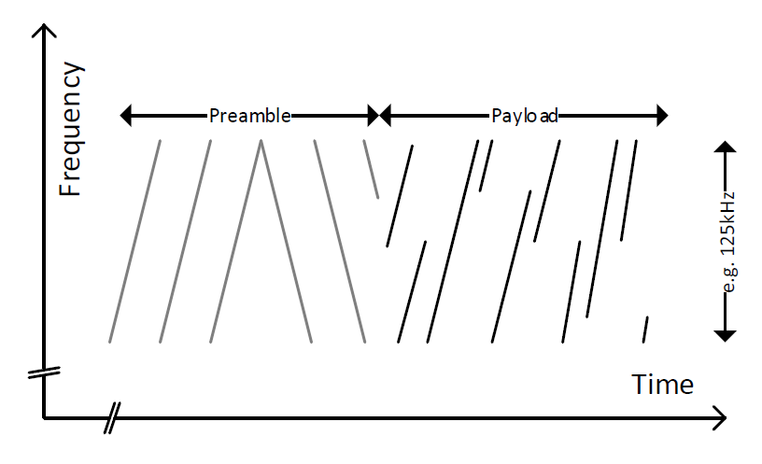
LoRa ( I / II )
Frequency chirps over 125kHz or 500kHz (US)
Total packet duration of 400ms (US)

Slide 11
LoRa ( II / II )
Does not use LBT
Different spreading factors used
Widely used in residential areas
Model using frequency chirps with 125kHz bandwidth and random phase offset of the chirps

Slide 12
Proposed Layers
Category | Mean Arrival Rate’ [1/s/km²/MHz] | Bandwidth | Length | Type
15.4g (only for Long Range Mode) | 20 | 200kHz | 5ms | White Gaussian Noise
RFID / Narrowband | 1 | 10kHz | 400ms | White Gaussian Noise
Wideband Short | 50 | 2MHz | 0.2ms | White Gaussian Noise
Wideband Long | 1 | 2MHz | 5ms | White Gaussian Noise
LoRa | 1 | 125kHz | 400ms | Chirps with random phase offset
Mean Arrival Rate‘ is multiplied with specific factor to model different scenarios (e.g. different antenna heights)

Slide 13
Thank You! Questions?

