Slide 1
Project: IEEE P802.15 Working Group for Wireless Personal Area Networks (WPANs)
Submission Title: IG Access Sept Agenda and Meeting Slides
Date Submitted: 10 Sept 2024
Source: Benjamin A. Rolfe (Blind Creek Associates)
Contact:
Voice: +1 408 395 7207, E-Mail: ben.rolfe @ ieee.org
Re: Wireless Next Generation
Abstract: Agenda and Meeting Slides for the September Wireless Interim.
Purpose: Support the illusion of organization.
Notice: This document has been prepared to assist the IEEE P802.15. It is offered as a basis for discussion and is not binding on the contributing individual(s) or organization(s). The material in this document is subject to change in form and content after further study. The contributor(s) reserve(s) the right to add, amend or withdraw material contained herein.
Release: The contributor acknowledges and accepts that this contribution becomes the property of IEEE and may be made publicly available by P802.15.
Notes:
Jul 12, 2010
Page 1

Slide 2
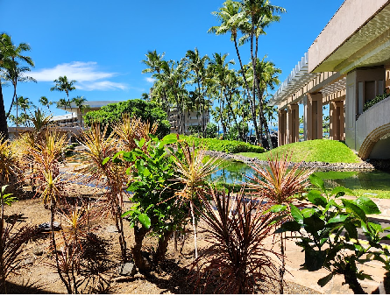
September 2024 802 Wireless Interim Session
Interest Group, Spectrum Access

Slide 3
Hybrid Meeting
Registration is required
Please remember to enter your attendance in IMAT
Reminder:
This is a non-PAR activity
All the rules of conduct apply https://grouper.ieee.org/groups/802/sapolicies.shtml

Slide 4
Meeting Conduct
Pre-PAR activity:
IEEE code of conduct, individual participation, and copyright rules apply as per WG opening:
  https://standards.ieee.org/wp-content/uploads/import/documents/other/Participant-Behavior-Individual-Method.pdf
  https://standards.ieee.org/wp-content/uploads/2022/02/ieee-sa-copyright-policy.pdf
Patent policy for pre-par (next slide)

Slide 5
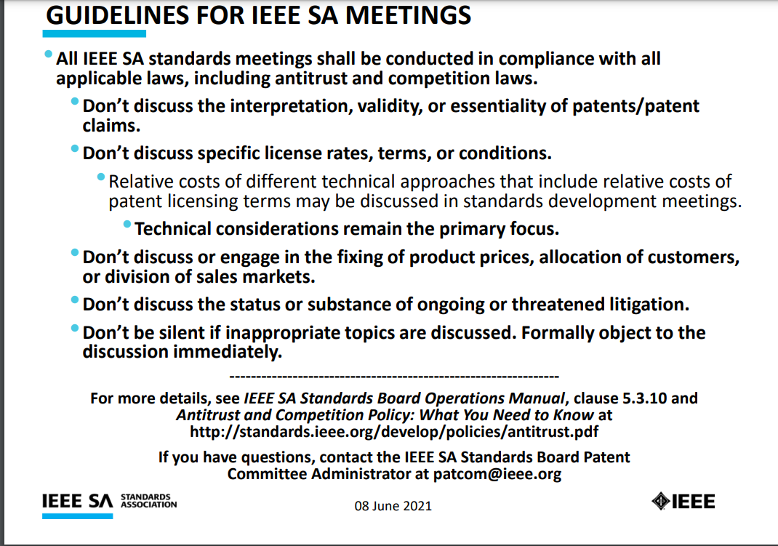

Slide 6
Agenda
Opening and Meeting Reminders
Overview of Interest Group
Meeting objectives
Technical Presentation(s) and Discussion(s)
Next Steps
Any other business
Adjourn

Slide 7
July IG Results (outputs)
Short term focus: U-NII 6 GHz band
  Consider present occupants
  Consider future growth in occupation
    Consider that many current and future users will not be 802 compliant
  Expand consideration to NB+RLAN+UWB coexistence
  Support (Not pre-empt) efforts in other projects

Slide 8
Ground Rules for This IG
There are many 802 wireless technologies
  All are important
  None are more important (in the system view) than others
  Diversity of uses is an important metric for spectrum efficiency
  Diversity of technologies is a strength of 802
There are other technologies we have to expect (or some uses of our standard)
  Won’t abide by our protocols and limitations
  Must abide by regulations
802 is not a regulatory body
  Influence opportunity: if we present great ideas, people are likely to adopt
  People are often more influenced by the carrot than the stick

Slide 9
Meeting Objectives
Determine if there is interest in improving spectrum access techniques
Determine if there is sufficient interest to move forward with IG
Review and update prior contribution

Slide 10
Opportunity Statement
Need to share spectrum
Need to share with many different things (some are radios)
Need to accommodate reality – RF environments, regulatory environments, myriad of uses and diversity of uses and sources of RF energy
Sharing through coexistence is essential
A systems view of coexistence is needed to advance beyond avoidance – more than one amendment to one standard

Slide 11
Opportunity Statement: Sharing need
Need to share with many different things
  Uncoordinated, random access systems of many flavors
  Some coordinated access systems (e.g. time-based scheduling)
  Systems using 802 standards
  Systems using other than 802 standards
  Systems using proprietary protocols
  Unintentional (non-radio) emissions
Need to share in multiple ways
  Separation methods are an approach
  Simultaneous use is another approach
  Different reality factors will require different approaches
  Any “one sizes fits all” won’t work (and so won’t be used)

Slide 12
Opportunity Statement: Reality Factors
Need to accommodate reality
RF environments can vary greatly and are complex
  The real world RF environment is widely varied and can be quite busy
  “Mandates” that don’t work are not going to be used
  Solutions that address real world conditions, that support real world applications, and provide performance advantages to adopters are more likely to be used
Regulatory constraints
  Regulations are not made by 802
  Regulations change over time
Scope of effect of 802 standards
  Standards can influence or support regulators (many standards)
  802 standards in practice are only a recommendation despite our desires (See 1c).

Slide 13
Opportunity Statement: Reality Factors
Need to accommodate reality
RF environments can vary greatly and are complex
  The real world RF environment is widely varied and can be quite busy
  “Mandates” that don’t work are not going to be used
  Solutions that address real world conditions, that support real world applications, and provide performance advantages to adopters are more likely to be used
Regulatory constraints
  Regulations are not made by 802
  Regulations change over time
Scope of effect of 802 standards
  Standards can influence or support regulators (many standards)
  802 standards in practice are only a recommendation despite our desires (See 1c).

Slide 14
RF environments Realities References:
Example studies of actual RF environments
Measurements of some (3) unintentional radiators: Sub 1-GHz band but typical of what we can expect in other bands:
https://mentor.ieee.org/802.19/dcn/24/19-24-0029-00-003a-measurement-result-of-radio-noise-over-920-mhz-band-emitted-from-mini-pc.pptx.
Some Measurements of real-world RF environment (Sub-1GHz):
https://mentor.ieee.org/802.19/dcn/24/19-24-0019-00-003a-update-of-920mhz-band-radio-environment-in-the-tokyo-area.pdf
https://mentor.ieee.org/802.19/dcn/24/19-24-0016-00-003a-interference-spectrum-measurements.pptx
https://mentor.ieee.org/802.19/dcn/24/19-24-0007-00-ES1G-900mhz-radio-environment-measurement-results-in-the-tokyo-area.pdf

Slide 15
About Sharing

Slide 16


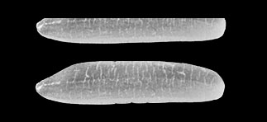
A tale of two methods of unlicensed access
+23 dBm/MHz
Mt Everest
8,849 meters
Standard Power U-NII
Power Represented as Height
Emitted Signal Power
-41 dBm/MHz
1.6 Rice Grains (2mm ea.)
UWB

Slide 17

Foundation: Sharing
Sharing means different things.
I told
you that spectrum is mine!
Toddler Rules of Sharing
1. If it’s mine, it’s mine!
Incumbents
2. If it’s yours, it’s mine!
New Entrants
3. If it’s broken, it’s yours!
Use the bands we don’t want

Slide 18
Foundation: Sharing
Or to put that another way…
Traditional non-sharing: It’s mine and you can’t play with it
Sharing by avoidance: in time, frequency, geography: you get a turn
Sharing by coexistence: We can play together
  Traditional unlicensed (LBT): avoidance at a finer time scale
  Co-use: ability for two radios to transmit and not annihilate each other

Slide 19
Foundation: Sharing
Sharing means different things to different users
Avoidance is one tool (part) that is familiar
  Separation in time, frequency or geography
  Unsustainable
Avoidance isn’t enough nor sustainable
Sharing by enabling mutual successful operation is better
  This is a working definition of sharing by coexistence
Coexistence is complicated – no one methods works always, everywhere, for everyone

Slide 20
A Systems View
There’s a lot of different things using the spectrum
  Not all are “family” but all will have access
There are a lot of different use cases RF environments, driving different (and often dynamic) requirements
There’s a lot of parts that are useful some of the time
  Some commonality among our standards
  Many, many choices (knobs to twiddle)
There are many trade-offs – what works best depends upon what you need to accomplish (and can be dynamic)
A systems view: do what works best for what you are optimizing (optimal assembly of parts – this is dynamic)
A common theme: dynamic

Slide 21
Coexistence isn’t one thing
Channel sensing can be useful
  Traditional LBT (listen, decide) can work sometimes
  Traditional LBT includes different methods of “listening”
Channel sensing can be misleading or disabling
  Traditional can lead to wasted opportunity and resulting inefficiency in spectrum usage
  “only letting me use it” is not coexistence nor a good spectrum efficiency
LBT is one (small) part of a solution, not a solution
Obvious examples of LBT:
  802.11 CSMA-CA (multiple variations)
  802.15.4 CSMA-CA (multiple variations)
  Each has multiple variations for important reasons
Need to look at the whole problem to make progress and provide something useful

Slide 22
Proposed Direction for IG
Consider spectrum access recommendations within the scope of 802
  Can be “above the MAC” (e.g. 802.15.5 and 802.15.10) and/or spanning use of multiple standards (e.g. 802.19.3)
    How to use features of the MAC to achieve a specific function
    How to use features of the MAC to address different optimization scenarios
  Can be recommendations for new features in 802 MACs
    Recommend a project in WG 15
    Recommend a project in WG 11
  Think beyond “one size fits all”
  Think beyond “what we already have done”

Slide 23
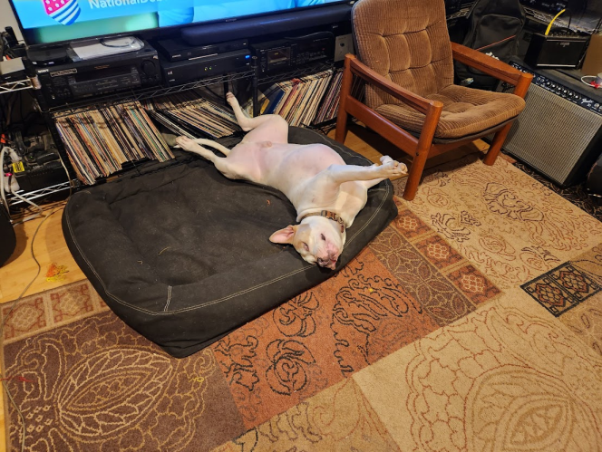
Discussion

Slide 24
Next Steps
Assess interest:
  Question: How many people are interested in continuing to explore better access methods and new ideas for effective sharing?
    Yes/No: 22/0
    [25 remote attendees; 12 in-room]
Next Meeting (contribution driven):
  Determine if SG is warranted
    Explore technical options available now (current standards)
    Explore new, promising approaches
    Define project options and discuss

Slide 25

Any Other Business

Slide 26
Adjourned

