Slide 1
Project: IEEE P802.15 Working Group for Wireless Personal Area Networks (WPANs)
Submission Title: Discussion on CID 15
Date Submitted: August 27, 2024
Source: Pooria Pakrooh, and Bin Tian (Qualcomm)
E-Mail: {ppakrooh, btian}@qti.qualcomm.com
Abstract: Discussion on CID 15 on the First Working Group Letter Ballot
Notice: This document has been prepared to assist the IEEE P802.15. It is offered as a basis for discussion and is not binding on the authoring individual(s) or organization(s). The material in this document is subject to change in form and content after further study. The authors(s) reserve(s) the right to add, amend or withdraw material contained herein.

Slide 2
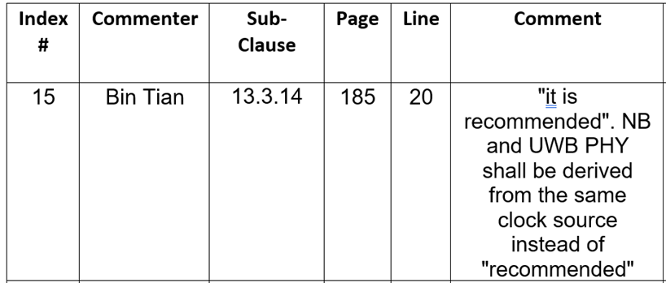
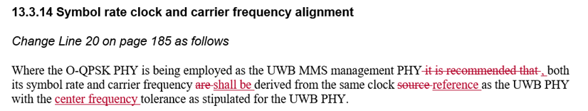
Introduction
Several rounds of discussions on CID 15 on the first working group letter ballot happened during the past few 4ab telecons.
The authors of DCN 438/r0 proposed the following resolution:
In this contribution, we share our thoughts on this topic.

Slide 3
Tx Frequency and Symbol Rate Error Tolerance
In the past few meetings, some of the TG members raised concerns on the following aspects of the proposed resolution, e.g.,
  Testability: “Is the proposed constraint testable?”
  “Imposes a constraint on the implementation, thus outside of the standard scope.”
  Several conflicting interpretations among the group about baseline technical concepts, such as the definition of CFO, what leads to CFO between two radios, etc.
It is quite common to specify the clock/frequency accuracy requirement by specifying mandatory sharing of reference oscillators.
This language has been used several times in 802.11 and 802.15 standards.
  Several examples from 802.15.4 are given in the next slides.
  It is understood that these examples are talking about one radio, not two coupled radios, but they show that there are many precedents of similar language in the standard we are amending to.

Slide 4
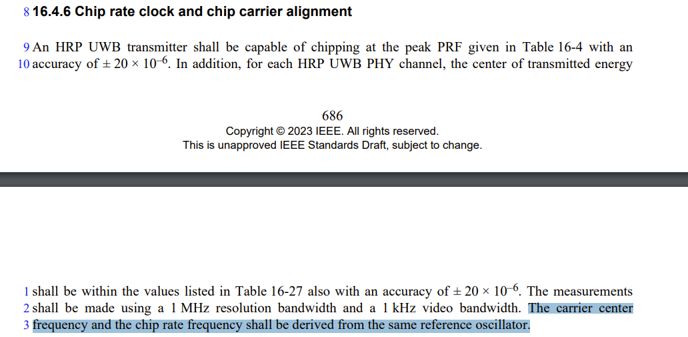
Examples (1/3)
Example 1: HRP UWB PHY (802.15.4z Amendment)

Slide 5
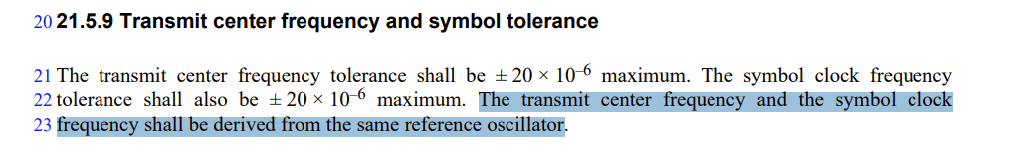
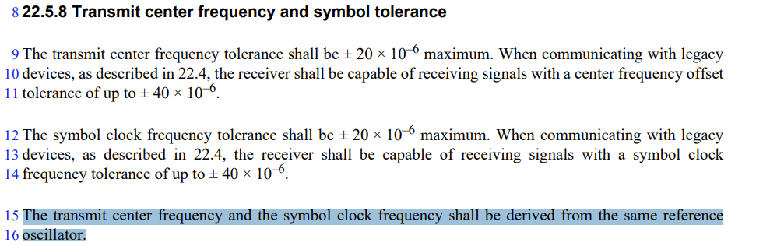
Examples (2/3)
Example 2: SUN OFDM PHY
Example 3: SUN O-QPSK PHY

Slide 6
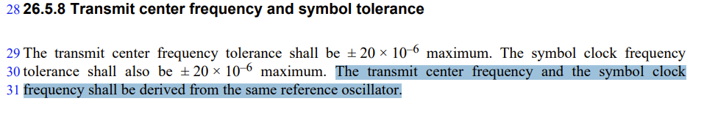
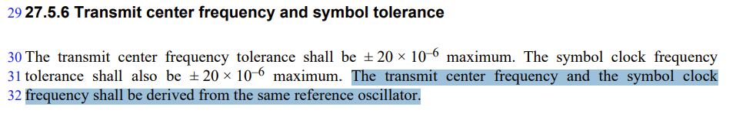
Examples (3/3)
Example 4: TVWS-OFDM PHY
Example 5: TVWS-NB-OFDM PHY

Slide 7
How to Specify “Tight Coupling” Between Two Radios
We think similar language can be used to specify the tight coupling between O-QPSK and UWB PHYs.
  This requirement is testable. But the details of testing is outside the scope of 15.4ab.
    If two radios have non-zero relative CFO, this leads to drift between their carrier waves over time. Theoretically, any non-zero CFO can be observed over long enough time period.
    Practically, this depends on the accuracy of measurement devices.
    Such requirements are typically not tested, mostly relying on vendor’s declaration.
What is the tolerable CFO between the two radios? Do we want to specify a threshold number?
  Requires justification on the proposed CFO number.
  This depends on assumptions like frequency estimation error for the O-QPSK.
  May require study on what the tolerable level of CFO is, before it impacts the receiver performance.

Slide 8
Summary
We think the group needs to decide about the following two issues
  The fist thing that needs to be specified is accuracy of O-QPSK symbol clock and carrier frequency.
    Our suggestion is to add the following text to the 4ab draft: “When O-QPSK is used as the management PHY, symbol rate and carrier frequency shall be derived from the same reference oscillator.”
  The second aspect is tight coupling between O-QPSK and UWB.
    We think the proposed resolution in slide 2 is a good way to specify the tight coupling between O-QPSK PHY and UWB PHY.
    If someone is interested in proposing a threshold on CFO error, the proposed threshold requires justification.
      The impact of OQPSK frequency estimation error should be considered as well.
      The impact of temperature on the accuracy number should be considered.

