Slide 1

151st Session of meetings of the
IEEE 802.15 Working Group for Wireless Specialty Networks (WSN)
Closing Report
July 14-19, 2024
Held in Montreal & Hybrid via Webex

Slide 2
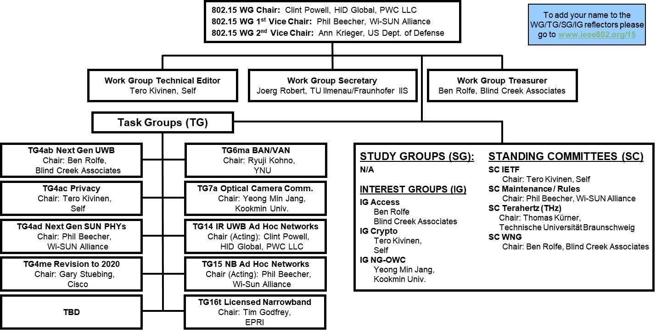
802.15 WG Org. Chart

Slide 3
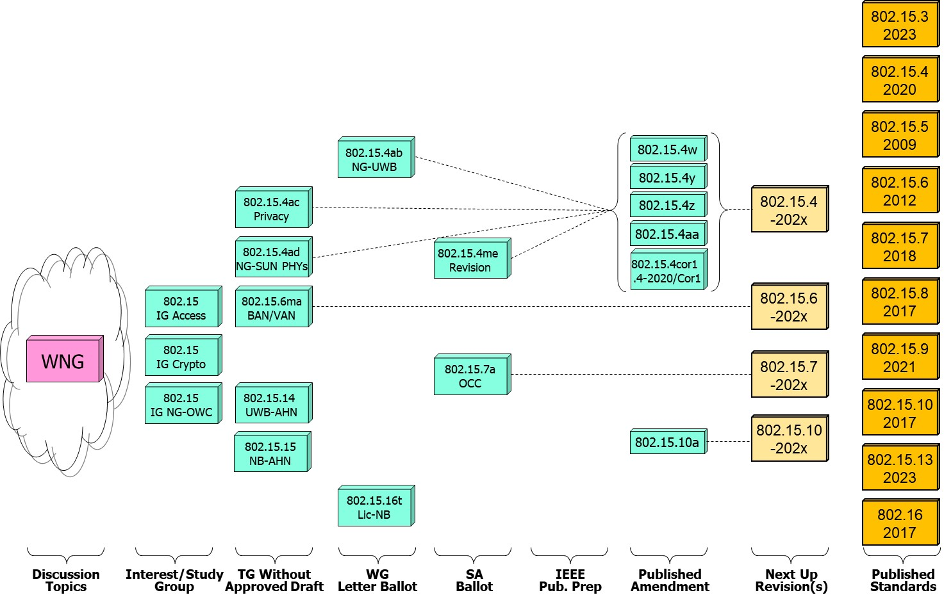
802.15 WG Standards Pipeline

Slide 4
802.15 WG Administrative
Voting members: 132
Nearly voting members: 3
Aspirant voting member: 20
Membership roster: 802.15 WG Membership Status
802.15 WG Officers - Elected March 2024
Clint Powell - Chair
Phil Beecher - 1st Vice-Chair
Ann Krieger - 2nd Vice-Chair
Joerg Robert - Secretary (appointed)
Tero Kivinen - Tech. Editor (appointed)
Ben Rolfe - Treasurer (appointed)

Slide 5
802.15 WG Operations
802.15 Operations Manual - covering Membership rules, Voting in the subgroup, Parliamentary procedures for approval to move any deliverables to the Standards Committee for action, officer scope of duties and much more…
WG15 Op's Manual
802 Operations Links
802 LMSC Op’s Manual
802 LMSC P&P
802 LMSC Chairs Guidelines
802 WCSC Op’s Manual

Slide 6
802 LMSC Annual Review of 802.15
Scope
  The 802.15 Working Group (WG) on Wireless Specialty Networks (WSN) focuses on the development of open consensus standards addressing wireless networking for the emerging Internet of Things (IoT), allowing these devices to communicate and interoperate with one another, mobile devices, wearables, etc.
    The goal of 802.15 is to publish standards, recommended practices, or guides that have broad market applicability and deal effectively with the issues of coexistence and interoperability with other wired and wireless networking solutions.
Duties
  Maintain and revise the 802.15 standards, amendments, and recommended practices
  Develop new standards when a PAR is approved by IEEE SASB and is assigned to the 802.15 WG by the IEEE 802 LMSC
  Maintain liaisons with other groups within IEEE 802 LMSC, and other relevant standards setting bodies and radio spectrum regulatory bodies
Membership
See: 802.15 WG Membership Status

Slide 7
Example 802.15 WG Session
(see specific mtg. agenda for actual graphic)

Slide 8
2.6a: 2024 January Designation of Individual experts
Individual experts who attend electronically for a specific purpose/presentation can be designated as such by the WG Chair and receive a registration fee waiver and limited attendance rights.
See section 5 in https://mentor.ieee.org/802-ec/dcn/17/ec-17-0090-25-0PNP-ieee-802-lmsc-operations-manual.pdf ,
  The Working Group Chair may designate specific individual experts who are allowed to participate in Working Group discussions via electronic means during an in-person meeting for the benefit of the group. These individuals are not considered to be attending the meeting and so they are not required to pay meeting fees and they do not get participation credit. The participation of these individuals should be limited to specific technical topics. Such participation shall be documented in the minutes of the Working Group meeting.
The individuals listed below are hereby designated as specific individual experts on their respective topics and subject to the restrictions and benefits described in the 802 OM.
  Example: Name, Affiliation, Specific mtg.
  n/a
  n/a
  n/a
  n/a
For WNG, attendance for each is limited to the WNG timeslot in which the respective presentation is scheduled.

Slide 9








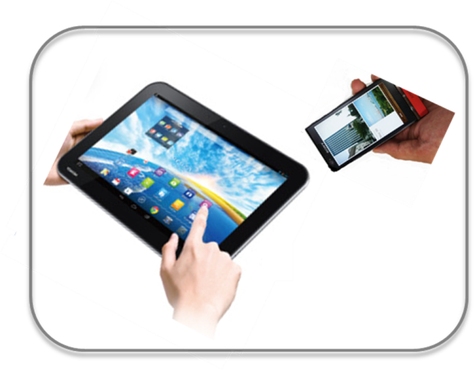








IEEE 802.15 Standards & their Applications
802.15.16
802.15.4
Locating and Tracking
Ultra-low Power Sensors
Automotive
FAN/MAN/RAN
802.15.4
Multi-media networks
&
High Speed
Interconnect
802.15.3
Industrial Networks
802.15.7
802.15.13
Medical
802.15.6
Critical Infrastructure Networks
Consumer Devices
Optical
Communications
Agricultural Sensing
Structural Monitoring
Slide 9

Slide 10
IEEE 802.15
Subgroups Objectives

Slide 11
TG4ab (NG-UWB) -
Next Gen. Ultra WideBand Amendment
Chair: Ben Rolfe
Objective:
Enhancements to 802.15.4 Ultra Wideband (UWB) physical layers (PHYs) media access control (MAC), and associated ranging techniques while retaining backward compatibility with enhanced ranging capable devices (ERDEVs).
TG4ab Webpage
Areas being worked on include:
Ranging
Link budget improvements
Improvements to accuracy, precision and reliability
Sensing
Pulse shape improvements
Channel impulse response reporting to support multistatic sensing
To better support presence detection, environment mapping and other uses
Data
Higher data rates for shorter transmission duration and power savings
Channel coding and packet format improvements for robustness
Additional options for even greater power savings
Protocol enhancements to support very low latency, low energy communications
Interference mitigation techniques to support:
Greater device density
Coexistence in the presence of other users
This amendment builds on top of the existing 802.15.4 standard and the 802.15.4z amendment.

Slide 12
TG4ac (Privacy) - Privacy Amendment
Chair: Tero Kivinen
Objective:
This amendment specifies modifications to the IEEE Std 802.15.4 MAC specification to specify mechanisms that address and improve user privacy. These mechanisms include randomized addresses, and exchanges that support session continuity. This amendment maintains backward compatibility with the base standard.
TG4ac Webpage
This amendment builds on top of the existing 802.15.4 standard.

Slide 13
TG4ad (NG-SUN PHY) -
Next Gen. SUN PHY
Chair: Phil Beecher
Objective:
The amendment specifies modifications for the development of a second-generation physical layer (PHY) for Smart Utility Networks (SUN). The primary focus is the improvement of the OFDM (Orthogonal Frequency Division Multiplexing) modes for higher data rates and longer-range communication, particularly in congested license-exempt frequency bands.
TG4ad Webpage
Areas being worked on include:
Definition of use-cases
Number of devices in given area
Max. payload bit-rate
Latency requirements
Definition of frequency bands
…
Channel Models
Channel models for indoor and outdoor use
Interference models for license-exempt band operation
…
This amendment builds on top of the existing 802.15.4 standard.

Slide 14
TG4me (Revision) - Revision to IEEE Std 802.15.4-2020
Chair: Gary Stuebing
Objective:
This project is needed to incorporate accumulated maintenance changes and corrigenda (editorial and technical corrections) into the standard and to include approved amendments.
TG4me Webpage
This is a roll up revision incorporating the following amendments:
IEEE Std 802.15.4w
IEEE Std 802.15.4y
IEEE Std 802.15.4z,
IEEE Std 802.15.4aa which are approved.
One additional amendment, P802.15.4ab, is currently under development.
This amendment builds on top of the existing 802.15.4-2020 standard.

Slide 15
TG6ma (BAN/VAN) - BAN with Enhanced Dependability Revision
Chair: Ryuji Kohno
Objective:
Enhancements to the Body Area Networks (BAN) Ultra Wideband (UWB) physical layer (PHY) and media access control (MAC) to support enhanced dependability to a human BAN (HBAN), adding support for vehicle BAN (VBAN.
TG6ma Webpage
Areas being worked on include:
Channel Modeling
Precise modeling of radio propagation of implant and wearable human BANs and around vehicle BANs for dependable data transmission
Classified modeling of multiple BANs and coexistence with other radios for resolution in PHY and MAC
Data transmission
Cognition of channel environment and coexistence
Initial acquisition and synchronization in coexisting BANs
FEC and hybrid ARQ according to QoS levels of data packets for various channel models and coexistence classes
Packet contention
Control and data channels, superframe formant, and MAC function to avoid packet contention in various classes of coexistence
Hybrid protocol of contention-free and contention access according to required QoS levels of data packets
Inter coordinators or hubs negotiation among coexisting BANs
Interference mitigation in coexistence
Interference surprising and canceling technologies for theoretical and feasible implementation in coexistence
Result in simpler classes of coexistence by mitigation of interference from non-BAN
Ranging
Optional ranging for cognition of dynamism of coexisting BANs
This revision builds on the existing standard 802.15.6-2012 with enhanced dependability for human BAN and additional vehicle BAN

Slide 16
TG7a (OCC) - Higher Rate, Longer Range Optical Camera Comms.
Chair: Yeong Min Jang
Objective:
This standard offers a global, secure, high-speed optical communication solution up to 100 Mbps and 200 m, with advantages like access to unlicensed spectrum, inherent security, and AI-enhanced features, promising for commercial and business markets.
TG7a Webpage
Areas being worked on include:
Wavelength range: 10000 nm to 190 nm in optically transparent media.
Data rate: Capable of delivering up to 100 Mbit/s.
Communication types: Designed for point-to-point and point-to-multipoint communication.
Adaptation features:
Adaptation to varying channel conditions.
Maintaining connectivity during high mobility (up to 350 km/h).
Flicker mitigation.
Radio Frequency (RF) co-existence.
Communication range: Up to 200 m.
Technology utilized:
Multiple-Input-Multiple-Output (MIMO).
MIMO-Orthogonal frequency-division multiplexing (MIMO-OFDM) for dealing with high levels of optical interference while maintaining high-rate data transmission.
Additional mechanisms:
Relaying mechanisms for enabling heterogeneous operation with existing RF wireless data communications standards.
Safety and regulation: Adheres to applicable eye safety regulations.
This amendment builds on the existing IEEE 802.15.7-2011 standard and the IEEE 802.15.7-2018 revision.

Slide 17
TG14 (UWB-AHN) - Impulse Radio UWB Wireless Ad Hoc Networks
Chair: Clint Powell
Objective:
Focused on impulse radio (IR) Ultra Wideband (UWB) PHY and MAC providing precision ranging capability that is accurate to the centimeter level by including (via. referencing) the 802.15.4 IR UWB functionality into a simple focused specification.
TG14 Webpage
Objective
This TG is currently in hibernation awaiting the outcome/conclusion of the TG4me revision, to see if has satisfied the objective of this project.
This project is for a new standards that references 802.15.4.

Slide 18
TG15 (NB-AHN) - Narrow Band Wireless Ad Hoc Networks
Chair: Phil Beecher
Objective:
Focused on narrow band ad hoc network PHY and MAC by including (via referencing) functionality and features of 802.15.4 into a simple focused specification.
TG15 Webpage
Objective
This TG is currently in hibernation awaiting the outcome/conclusion of the TG4me revision, to see if has satisfied the objective of this project.
This project is for a new standards that references 802.15.4.

Slide 19
TG16t (Lic-NB) - Licensed Narrowband Amendment
Chair: Tim Godfrey
Objective:
Enhancements to IEEE 802.16-2017 physical layer (PHYs) and media access control (MAC) to enable operation in licensed spectrum with channel bandwidths greater than or equal to 5 kHz and less than 100 kHz. The amendment is frequency independent but focuses on spectrum less than 2 GHz. The range and data rate supported by the narrower channels are commensurate with those of the base standard, as scaled by the reduced channel bandwidth. The project also amends IEEE Std 802.16 as required to support aggregated operation in adjacent and non-adjacent channels.
TG16t Webpage
Areas being worked on include:
Definition of the Wireless MAN-NB PHY to enable operation in narrow channels
Aggregation of non-contiguous narrow channels to provide higher capacity
Enhancements to MAC to improve efficiency and reduce control overhead
Definition of a Direct Peer-to-Peer (DPP) mode to support operation without fixed infrastructure
Updates to security protocols
This amendment is to the IEEE 802.16-2017 base standard.

Slide 20
IG Access -
WG15 Access Techniques
Chair: Ben Rolfe
Objective:
Determine interest in starting efforts for development of projects on 802.15 Access Techniques.

Slide 21
IG Crypt -
WG15 Crypto related activities
Chair: Tero Kivinen
Objective:
Determine interest in starting efforts for development of projects including use of ascon for 802.15.4 and amending 802.15.9 to add IETF EDHOC to it.

Slide 22
IG (NG-OWC) - Next Gen. Optical Wireless Communication
Chair: Yeong Min Jang
Objective:
Development of next-generation optical wireless communication (NG-OWC) characteristics and its future applications.
Areas being worked on include:
Artificial Intelligence (AI) for NG-OWC
Integration of various AI technologies into the OWC system
Lightweight AI utilization for each developed AI technology
Channel modelling for NG-OWC
Integration of machine-learning for channel estimation
Utilization of machine learning for channel estimation for dynamic and complex channel conditions
Future applications of NG-OWC
NG-OWC encompasses fields such as IoT, underwater communication, joint communication, sensing, and localization (V2V, M2M, Drone/UAV, etc.)
NG-OWC for OWC based drone Networks
NG-OWC for Indoor/Outdoor Positioning through OWC and LiDAR integration
Deep learning-based OWC to support high mobility vehicle
Preferred camera types for OWC
Resolution: Minimum 720x540 (single-link), maximum 3840 x 2160 (multi-link)
Frame rate: Minimum 30 FPS, preferred more than 120 FPS
Spectrum: Mono, color
Light sources: IR, VL, and UV
This group will evaluate the interest in developing Next Gen OWC capabilities

Slide 23
SC IETF -
Internet Engineering Task Force
Chair: Tero Kivinen
Objective:
This standing committee brings in the information from the Internet Engineering Task Force (IETF) to the 802.15 working group. It concentrates on the IETF working groups that might be of interest to the 802.15 working group members.
SC IETF Webpage
IETF working groups followed include:
6lo, lake, suit

Slide 24
SC MAINT -
802.15 Maintenance Activities
Chair: Phil Beecher
Objective:
The Standing Committee Maintenance (SCM) has the following roles:
Reviewing comments related to possible errata on 802.15 standards and making recommendations to 802.15 Working Group
Managing and maintaining the 802.15 Operations Manual
Managing and maintaining the 802.15 Motion templates and project checklist template
Reviewing 802 PARs and ICAIDs on behalf of 802.15 Working Group
SC MAINT Webpage
SCM meets at least once during every 802 plenary and 802 wireless interim session

Slide 25
SC THz -
THz Standing Committee
Chair: Thomas Kürner
Objective:
The IEEE 802.15 Standing Committee Terahertz is chartered to explore the feasibility of Terahertz for wireless communications. The Terahertz frequency band runs roughly from 300 GHz to 3 THz, a staggering 2700 GHz of bandwidth.
SC THz Webpage
Areas being worked on include:
The IEEE 802.15 Standing Committee Terahertz is soliciting, and hearing, contributions that address numerous THz issues.
There are no immediate plans to transition the group to a study group or a task group; rather, we want to fully understand the technology status in regards to a further amendment of IEEE Std. 805.15.3-2023 or a completely new standard.
Apart from the implementation aspects of THz Communications there are important regulatory aspects to be considered. For example the allocation and identification of THz spectrum especially in conjunction with the agenda items at WRC-27 and WRC-31 are topics of the THz standing committee.

Slide 26
SC WNG -
Wireless Next Generation
Chair: Ben Rolfe
Objective:
The IEEE 802.15 Standing Committee Wireless Next Generation is chartered to facilitate discussions on new Wireless related Technologies that may be of interest to the 802.15 community, and that may lead to new 802.15 standardization projects. The WNG also provides the opportunity to address the whole 802.15 work group with issues or concerns with current techniques or technologies.
SC WNG Webpage
Areas being worked on include:
WNG topics are not limited to only the PHY layer and/or the MAC sublayer since information on the layers above the MAC including the application is very important to making sure that the PHY and MAC are appropriate, especially in the WSN environment.
Presenters in WNG are usually asked to relate the material presented and/or discussed to the work of the WG via the “usual question”:
  What do you propose the Working Group do next?
The answer usually falls into one of these categories:
Information for the group
Form an interest group to pursue
Consider in the future a new project

Slide 27
Subgroups Objectives this Session
TG 4ab (NG-UWB)
  Conduct comment resolution for the Initial Letter Ballot
  Determine whether or not to start a Letter Ballot Recirc.
TG 4ac (Privacy)
  Continue hearing presentations on technical areas and preparing draft
TG 4ad (NG-SUN PHYs)
  Continue hearing presentations on technical areas and channel modeling
  Update preliminary timeline for TG
TG 4me (Revision)
  Conclude comment resolution for the 3rd SA Ballot Recirc.
  Complete package associated with requesting LMSC approval to move to RevCom

Slide 28
Subgroups Objectives this Session
TG 6ma (Revision + BAN/VAN)
  Conclude comment resolution on informal feedback of draft
  Determine whether or not to start Initial Letter Ballot
TG 7a (OCC)
  Conclude comment resolution for the 1st SA Ballot Recirc.
  Determine whether or not to start 2nd SA Ballot Recirc.
  Review and submit PAR extension to WG for approval
TG 14 (UWB-AHN) – in hibernation, no meetings
TG 15 (NB-AHN) – in hibernation, no meetings
TG 16t (Lic-NB)
  Conclude comment resolution for the 2nd Letter Ballot Recirc.
  Complete package associated with requesting LMSC approval to move to SA Ballot

Slide 29
Subgroups Objectives this Session
Joint 802.1/802.15
  Meeting w/802.1 on Tues. eve. (prep. in SC MAIN mtg. prior to this)
IG Access
  First meeting to discuss interest in potential projects
IG Crypto
  Respond to comments submitted on 2 PARs/CSDs sent out for review to all WG’s
  Prepare motion to approve PARs/CSDs during LMSC Closing
IG NG-OWC
  Hear additional presentations
  Continue to assess readiness to start Study Group

Slide 30
Subgroups Objectives this Session
SC MAINTENANCE
  Review draft of detailed development process steps checklist
  Review list of all templates for WG15 Subpage for completeness
  Review WG15 P&P for any updates
  Review and provide feedback on PARs submitted by other WG’s
SC IETF
  Discuss IETF activities related to 802/802.15 at WG15 mid-week
SC THz
  Not meeting this session
SC WNG
  Hearing presentations on WSN related topics

Slide 31
TG4ab (NG-UWB)
July 2024
Closing Report

Slide 32


Task Group 15.4ab
Next Generation UWB Amendment
July 2024 802 Wireless Plenary Session
Mixed Mode
Live Montreal, Quebec, Canada
Closing Report

Slide 33

Agenda
(check mentor for latest version)
https://mentor.ieee.org/802.15/dcn/24/15-24-0344-02-04ab-tg4ab-agenda-july-2024.xlsx

Slide 34
Session Objectives
Review and Resolve ballot comments
Update the Coexistence Assessment Document

Slide 35
5.2.b Scope of the project (As approved):
This amendment enhances the Ultra Wideband (UWB) physical layers (PHYs) medium access control (MAC), and associated ranging techniques while retaining backward compatibility with enhanced ranging capable devices (ERDEVs).
Areas of enhancement include:
  additional coding, preamble and modulation schemes to additional coding, preamble and modulation schemes to support improved link budget and/or reduced air-time relative to IEEE Std 802.15.4 UWB;
  additional channels and operating frequencies;
  interference mitigation techniques to support greater device density and higher traffic use cases relative to the IEEE Std 802.15.4 UWB;
  improvements to accuracy, precision and reliability and interoperability for high-integrity ranging; schemes to reduce complexity and power consumption;
  definitions for tightly coupled hybrid operation with narrowband signaling to assist UWB;
  enhanced native discovery and connection setup mechanisms;
  sensing capabilities to support presence detection and environment mapping;
  and mechanisms supporting low-power low-latency streaming as well as high data-rate streaming allowing at least 50 Mb/s of throughput.
Support for peer-to-peer, peer-to-multi-peer, and station-to-infrastructure protocols are in scope, as are infrastructure synchronization mechanisms. This amendment includes safeguards so that the high throughput data use cases do not cause significant disruption to low duty-cycle ranging use cases.
https://development.standards.ieee.org/myproject-web/app#viewpar/9081

Slide 36
Near Term Working Milestones
 | Original Schedule | Current Schedule
Call for proposals | November 2021
Cut-off for new features (high level feature set), PHY | May 2022
Cut-off for new features (high level feature set), MAC | July 2022
Draft 0 | Post-January 2023 | Post March July Sept 2023
TG draft review and revision complete | February - March 2023 | Mar-June 2023 Sept 2023 Oct 2023
Working group pre-ballot review commence | March – May 2023 (following March meeting) | July August Sept Start: Nov 2023 Close: 2 Jan 2024
Comment Resolution |  | Start: Jan 2024 Done: June 2024 (??)
First letter ballot | June 2023 (following meeting) | Oct Nov 2023 Jan 2024 June 2024
Initial LB comment resolution |  | Start: July 2024 Done: TBD
DONE
We are here
DONE

Slide 37

Comment Resolution

Slide 38
Overview of Comments
Total # Comments | # with Blank resolution
1470 | 1402
Technical | Editorial
854 | 611
General
5
Technical Category | Code | # CIDs
Ack changes | ACK | 2
Other channel access | CHA | 3
Dynamic Data Rate Mode | DDRN | 0
Device discovery | DISC | 36
Multi-node ranging / Hyper Block | HB | 66
LDPC | LCPC | 0
MAC General | MAC | 23
Not another category | MISC | 4
MMS general (both) | MMS | 246
MMS specific to Narrow Band | MMSNB | 4
MMS specific to UWN | MMSUWB | 9
Narrow Band specific function | NBF | 31
New frame format | NEWFR | 279
Technical Category | Code | # CIDs
UWB PHY HRP | PHYHRP | 13
UWB PHY LE | PHYLE | 8
Narrow Band PHY | PHYNB | 20
RSS | RSS | 5
Sensing | SENS | 86
SSBD | SSBD | 6
Assigned to the Technical Editor | TE | 617
UWB data offload | UWBDO | 10
Wake-up Radio | WUR | 1
Technical | Editorial
29 | 16
General | Total
2 | 47
Proposed Resolutions
47
Lots of fun to be had!

Slide 39
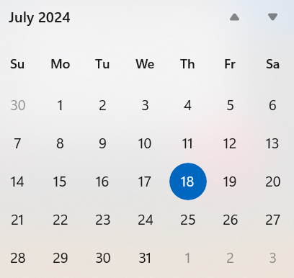
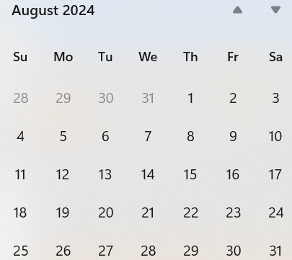
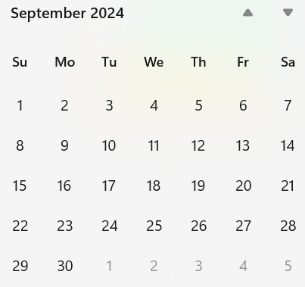
Call schedule, July thru Sept
Tuesdays, July 30, 06:00 PT (1 hour)
Weekly Tuesdays and Thursdays 06:00 (1 hour)
  August 6 through September 5.

Slide 40
TG4ac (Privacy)
July 2024
Closing Report

Slide 41
Agenda for July
Work on the actual draft text
Issue list: 15-23-0422-05
Privacy primitives: 15-24-0166-01
Privacy MLME-primatives 15-24-0315-02
Privacy frame formats 15-24-0314-02

Slide 42
Detailed Agenda for July
Monday 15th of July 13:30-15:30
  Opening slides
  Approve agenda (this document) 15-24-0372-00
  Approve minutes 15-24-0319-00
  Continue working on the primitives, frame formats and MLME-primitives
Thursday 18th of May 1330-1530
  Continue working on the primitives, frame formats and MLME-primitives
  Closing report

Slide 43
More information
List of issues can be found in the document 15-23-0422-05.
Project task list: 15-23-0397-01
Old WNG presentation 15-22-0477

Slide 44
Timeline
Finalize the list of issues to be solved | Jan 2024
First version of the draft for WG pre-ballot commenting | Sep 2024
Draft ready for letter ballot | Nov 2024
Draft ready for SA ballot | Jan 2025
SA ballot start | Mar 2025
SA ballot done | Jul 2025
Submit to RevCom | Sep 2025
Standard published | Jan 2026

Slide 45
Meeting achievements
Continued working on document describing the frame formats 15-24-0314.
Continued working on document for the MLME primitives 15-24-0315.
Continued working on the document for description of primitives 15-24-0166

Slide 46
Agenda for TG4ac for September
Two sessions
No overlap with IG Crypt, or TG4me.
  Finish the draft

Slide 47
TG4ad (NG-SUN PHY)
July 2024
Closing Report

Slide 48
TG4ad Leadership
Chair: Phil Beecher (Wi-SUN Alliance)
Vice Chair: Joerg Robert (TU Ilmenau/Fraunhofer IIS)
Vice Chair: Hiroshi Harada (Kyoto University)
Secretary: vacancy – let me know if you want to volunteer?

Slide 50
Draft Agenda
Monday PM2:
Policies and guidelines
Call for Patents
Approval of the agenda
Meeting Minutes
Presentations (Deferred to Tuesday)
Recess
Tuesday PM1:
Presentations and Contributions (continued)
  Sangsung Choi
  Henk De Ruijter
  Hiroshi Harada
  Joerg Robert
Channel Model and Interference Model discussions w.r.t. Technical Guidance Document
Recess
Wednesday PM2:
Technical Guidance Document
Call for Contributions
Recess
Thursday PM1:
Technical Guidance Document
Next Steps and Timeline
AoB
Adjourn

Slide 51
Achievements
Approval of May meeting minutes
Presentations:
  https://mentor.ieee.org/802.15/dcn/24/15-24-0408-00-04ad-next-steps-for-the-interference-model.pptx
  https://mentor.ieee.org/802.15/dcn/24/15-24-0398-00-04ad-o-qpsk-lr-phy-for-sun.pdf
  https://mentor.ieee.org/802.15/dcn/24/15-24-0378-00-04ad-evaluation-methods-for-transmission-characteristics-of-ieee-802-15-4ad-in-the-presence-of-interference.pdf
  https://mentor.ieee.org/802.15/dcn/24/15-24-0376-00-04ad-the-use-case-for-ng-sun-phys-in-ship-area-network.pptx
Consensus on Channel Model and Interference Model to use
Progress on Technical Guidance Document

Slide 52
Provisonal Conference call schedule
Between now and September session
Conference call - 29 August 2024 - 6am PDT, 8am CDT, 2pm BST, 3pm CET,10pm JST
Complete Technical Guidance Document
Issue Call for Intent

Slide 53
TG4me (Revision)
July 2024
Closing Report

Slide 54
15.4me Sessions this Week
 | Monday | Tuesday | Wednesday | Thursday
AM 1 | 9:00am 802.15 WG Opening Plenary |  | Tg4me Task Group Meeting | Tg4me Task Group Meeting
AM 2 |  | Tg4me Task Group Meeting | 802.15 Mid-Week Plenary
PM 1
PM 2 |  |  |  | 802.15 Closing Plenary
6:30p |  |  | SOCIAL

Slide 55
Agenda
Agenda
  - Call for Patents
  Approve Agenda
  Approve Minutes
    May Minutes – DCN 15-24-0264-00-04me
    CRG Jun 14 Minutes – DCN 15-24-0342-00-04me
    CRG Jun 28 Minutes – DCN 15-24-0351-00.04me
  3rd Recirc Results
  Next Steps
  EC Package for Revcom
  Update Checklist (DCN 15-0400 Latest Version)
  Next meetings

Slide 56
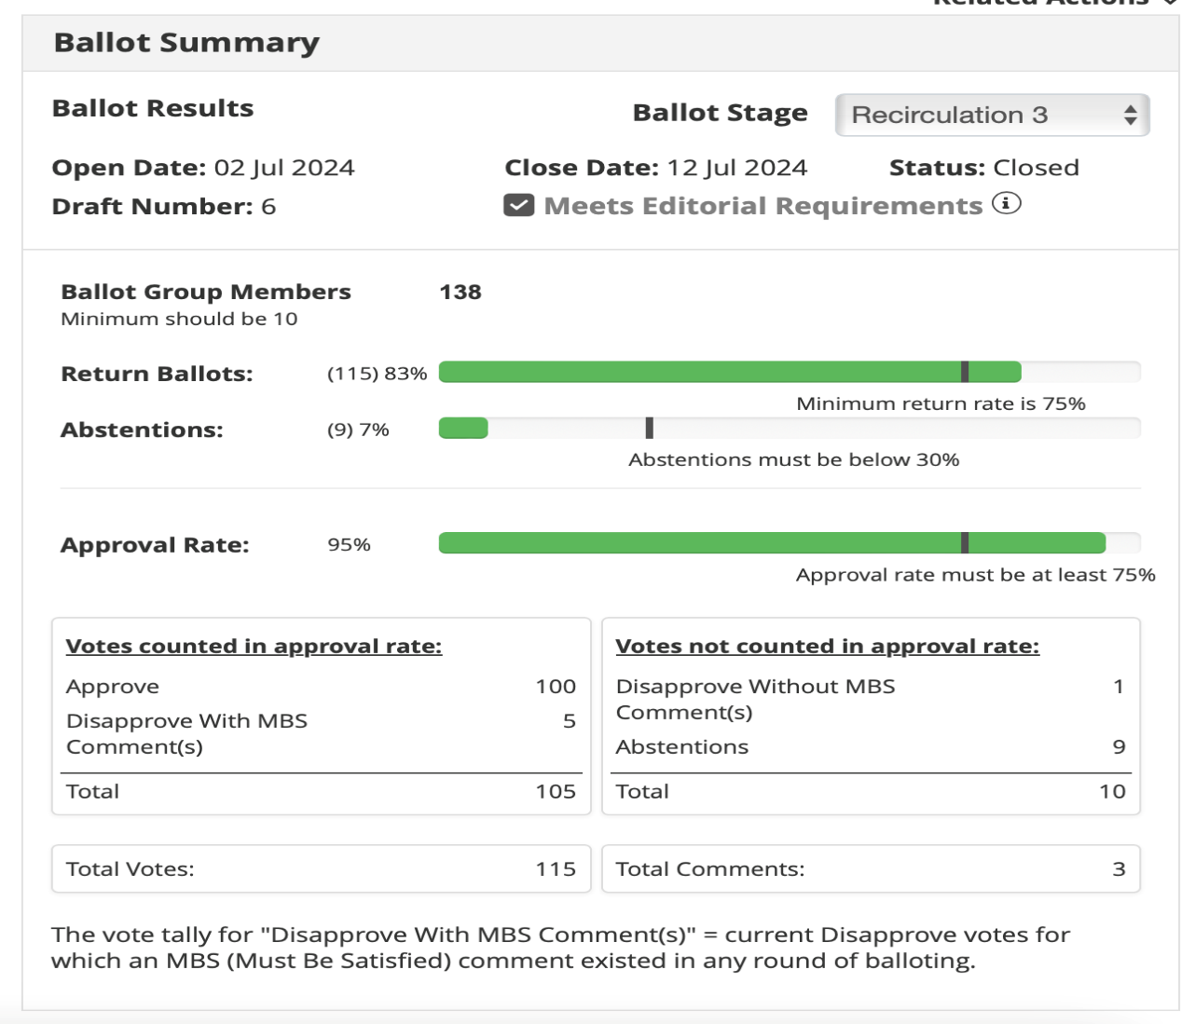
Results of 3rd Recirc Standards Ballot
THERE WERE
3 COMMENTS
2 TECHNICAL
1 EDITORIAL

Slide 57
TG motion:
Approval of comment resolutions
TG04me Approves comment resolutions in document 15-24-0341-08-04me.
Moved by: Tero Kivinen
Seconded by: Phil Beecher
Result: Approved Unanimously

Slide 58
TG motion:
Draft is ready for SB recirc
Motion: Move that TG04me formally requests that 802.15 WG start a Standards Association Recirculation Ballot of document P802.15.04me-D07.
Moved by: Tero Kivinen
Seconded by: Ann Krieger
Result: Approved Unanimously

Slide 59
TG motion:
CRG formation for SA ballot
Move that 802.15.4me approve the formation of a Comment Resolution Group (CRG) for the Standards Association balloting of the P802.15.4me-D07 with the following membership: Gary Stuebing(Chair), Phil Beecher, Ben Rolfe, Alex Krebs, Ann Krieger and Billy Verso. The 802.15.4me CRG is authorized to approve comment resolutions, edit the draft according to the comment resolutions, and to approve the start of recirculation ballots of the revised draft on behalf of the 802.15 WG. Comment resolution on recirculation ballots between sessions will be conducted via reflector email and via teleconferences announced to the reflector as per the LMSC 802 WG P&P.
Moved by: Phil Beecher
Seconded by: Ann Krieger
Result: Approved Unanimously

Slide 60
TG motion:
RevCom conditional submittal
Motion: that TG04me requests that 802.15 WG reviews, approves and requests conditional approval from the IEEE 802 LMSC to submit P802.15.4me-D07 (or current revision) to RevCom.
Moved by: Tero Kivinen
Seconded by: Phil Beecher
Result: Approved Unanimously

Slide 61
CLOSING REPORT
2 meetings
Resolved Comments from SA Ballot Recirculation 3
Generated LMSC Package for Conditional Submission to Revcom
Passed all Task Group Motions for Recirculation of Draft 07
Working Group motions completed for Recirc and CRG
Motion for Conditional Submission to LMSC of Draft 7 to Revcom

Slide 62
CLOSING REPORT
Updated All documents
  P802.15.4me – d07
  SA BALLOT COMMENTS – DCN 15-23-0341-08-04me
  LMSC Package DCN 15-24-0359-06-04me
  UNSATISFIED Comments DCN 15-24-0374-02-04me
  Minutes DCN 15-24-0390-00-04me

Slide 63
CLOSING REPORT
4th Recirc started July 17 – Closes July 27th
CRG Set for Aug 2, 2024
Conditional LMSC Approval to move to Revcom drafted
Timeline Updated
Checklist Updated DCN 15-23-0400-09-04me
Draft Agenda for September DCN 15-24-399-00-04me

Slide 64
WG motion:
Draft is ready for SB recirc
Motion: Move that 802.15 WG start a Standards Association Recirculation Ballot of document P802.15.04me-D07.
Moved by: Gary Stuebing
Seconded by: Phil Beecher
Result:

Slide 65
WG motion:
RevCom conditional submittal
Move that 802.15 WG requests conditional approval from the IEEE 802 LMSC to submit to submit P802.15.4me-D07 (or current revision) to RevCom.
Moved by: Gary Stuebing
Seconded by: Phil Beecher
Result:

Slide 66
WG motion:
CRG formation for SA ballot
Move that 802.15 WG approve the formation of a Comment Resolution Group (CRG) for the Standards Association balloting of the P802.15.4me_D03 with the following membership: Gary Stuebing(Chair), Alex Krebs, Ann Krieger, Ben Rolfe, Phil Beecher, Billy Verso. The 802.15.4me CRG is authorized to approve comment resolutions, edit the draft according to the comment resolutions, and to approve the start of recirculation ballots of the revised draft on behalf of the 802.15 WG. Comment resolution on recirculation ballots between sessions will be conducted via reflector email and via teleconferences announced to the reflector as per the LMSC 802 WG P&P.
Moved by: Gary Stuebing
Seconded by: Phil Beecher
Result:

Slide 67
Draft Timeline
Jul/24 – Conditional Submission to Revcom

Slide 68
TG6ma (BAN/VAN)
July 2024
Closing Report

Slide 69
Objectives of TG 6ma – Enhanced Dependability Body Area Network (ED-BAN)
Objective: Enhancements to the BAN Ultra Wideband (UWB) physical layer (PHY) and media access control (MAC) to support enhanced dependability to a human BAN (HBAN) and adds support for vehicle body area networks (VBAN), a coordinator in a vehicle with devices around the vehicular cabin.
Action:
•Update draft#2.3 of Draft Proposals for Pre-Ballot
•Comment resolution for draft#2.3
•Necessary documentation for Letter Ballot such as Coexistence Assurance Document, Progess Report, Project Task List
•Performance Evaluation of Technologies in PHY; Channel Coding According to 8 QoS Levels of Packets and Coexistence Levels, Interference Mitigation, etc.
•Performance Evaluation of Technologies in MAC; Channel Management, CCA, Hybrid Contention Free/Access Protocol According to 8 QoSs and Coexistences.
•Harmonization or Commonality with 4ab in Coexistence and Feasible Implementation of 6ma and 4ab
•Feasibility of TSN of 802.1 in MAC
Next Things to Do：
Finalize draft#2.3 for Letter Ballot

Slide 70
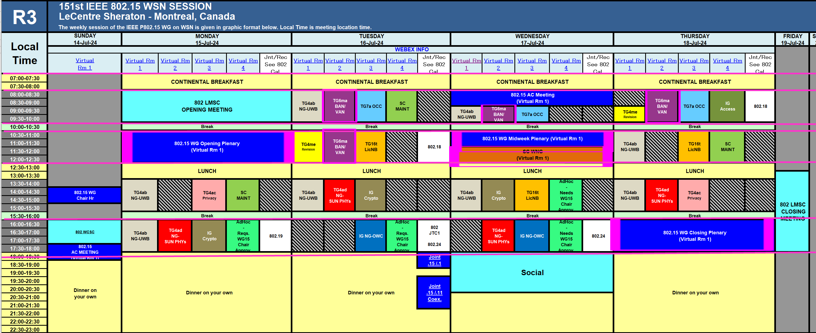
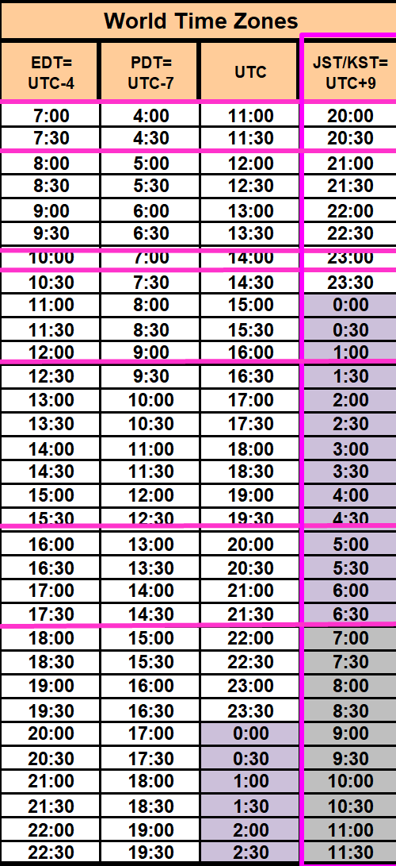
TG15.6ma Plenary Session Schedule for 14-19th, July 2024
TG15.6ma has three own sessions such as
Session1(Virtual RM#2) AM1 8:00-10:00 July 16(TUE) in Montreal time, 21:00 - 23:00 July 16(TUE) in JST/KST
Session2(Virtual RM#2) AM2 10:30-12:30 July 16(TUE) in Montreal time, 23:30 July 16 - 01:30 July 17 in JST/KST
Session3(Virtual RM#2) AM1 9:00-10:00 July 17(WED)in Montreal time, 22:00 - 23:00 July 17(WED) in JST/KST
Session4(Virtual RM#2) AM1 8:00-10:00 July 18(THU)in Montreal time, 21:00 - 23:00 July 18(THU) in JST/KST

Slide 71
Agenda items for the week
TG15.6ma meeting call to order
Call for essential patents and policies & procedures reminder doc.#15-24-0350-01-06ma
Approve last meeting minutes: TG 15.6ma Meeting Minutes for March 2024 doc.#15-24-0301-00-06ma
Agenda of TG15.6ma May Meeting doc.#15-24-0349-07-06ma
Review and Summary
  Overview of IG, SG, TG15.6ma doe Dependable BAN Revision of IEEE802.15.6-2012 doc.#15-23-0455-03-06ma
  Basic Consensus in MAC and PHY of Revision of IEEE802.15.6-2012(IEEE802.15.6ma) doc.#15-23-0557-04-06ma
  TG6ma Draft Action Items(Progress and Action Items for Draft#2.3 doc.#15-24-0xxx-00-06ma
  Review of draft#2.3 for Pre-Ballot WG doc.#15-23-0476-15-06ma
  Rescheduling Timeline doc.#15-23-0361-07-06ma
  Presentation
  1.. Performance Evaluation of Channel Coding with Interleaver Based on TG6ma Channel Model for Some Classes of Coexistence doc.#15-24-0247-01-06ma
  2. Ranging Accuracy Evaluation under TG6ma Communication Senarios doc.#15-24-0248-01-06ma
  3. Hybrid ARQ Scheme for High QoS Packets in High Class of Coexistence of IEEE 802.15.6ma #15-23-0576-04-06ma 4. Evaluation of IEEE 802.15.6 Ultra-wideband Physical Layer Utilizing Super Orthogonal Convolutional 22-0562-10-06ma
  5. Technical editor comments to the P802.15.6ma_D1.18 doc.#15-24-0333-00-06ma
  6. MAC features to be specified doc.#15-24-0352-00-06ma
  7 .MAC Performance Evaluation of Multiple BAN Coexistence Under TG6ma Channel doc.#15-24-0246-01-06ma
  8 Group MAC service features doc.#15-24-0353-00-06ma
  9. 15.6ma MAC compared to 15.4-2020 MAC and 15.6-2012 MAC doc.#15-24-0354-00-06ma
  10. Proposed text for 6ma - MAC Service Features doc.#15-24-0356-00-06ma
  11. TG15.6ma MAC Frame and Function doc.#15-24-0yyy-00-06ma
  12. Theoretical Analysis of System Performance in a Multi-BAN Coexistence Environment (Class 1) 24-0357-00-06ma
  13. TG15.6ma Coexistence Assessment Document doc.#15-24-0348-00-06ma
  14. Joint work with 802.1; Draft PAR and CSD 802.1ACea: Amendment to IEEE Standard 802.1AC-2016 15-24-0396-00
  15..TG6ma Channel Model Document for Enhanced Dependability doc.#15-22-0519-08-06ma
  16. Comments to channel-model-document doc.#15-24-0073-03-06ma
  17. Interference Mittigation Schemes in Class 3, 5, 6, and 7 of Coexisitence in TG6ma doc.#15-24--0073-02-06ma
  18. Progress Report of TG6ma doc.#15-23-0056-07-06ma
  19. Timeline of TG6ma doc.#15.23-0361-07-06ma
  20. TG15.6ma Closing Report for July 2024 doc.#15-24-0404-00-06ma
  21. TG15.6ma Meeting Minutes for July 2024 doc.#15-24-0405-00-06ma

Slide 72
Definition of Coexistence Environment Classes
Coexistence Class | Coexisting system(s) |  |  |  |  | Category
Level | 802.15.6ma | 802.15.6-2012 | Non-UWB (ex. Wi-Fi / Unlicensed / 3GPP) | 802.15 UWB (ex. 802.15.4) | Non-802.15 UWB (ex. ETSI SmartBAN) | Category
0 | - | - | - | - | - | Single BAN
1 (1a) | ✓ | - | - | - | - | Multiple 15.6 BANs
2 (1b) | ✓ | ✓ | - | - | -
3 | ✓ | - | ✓ | - | - | Non-UWB
4 (2a) | ✓ | - | - | ✓ | - | Multiple UWB systems
5 (2b) | ✓ | - | - | - | ✓
6 (2c) | ✓ | - | - | ✓ | ✓
7 | ✓ | ✓ | ✓ | ✓ | ✓ | Final Boss
The coexistence class has been redefied to 8 levels, which can be represented by 3 bits and would be suitable to include in PHY or MAC headers.

Slide 73
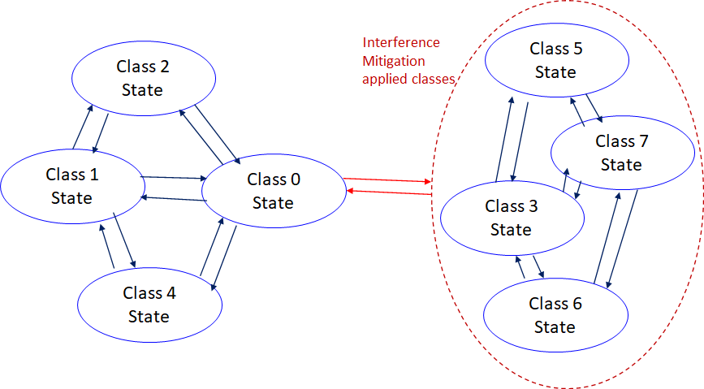
    Coexistence Class States Transition(1/2)
The standard's revision supports BANs operating with high reliability (coexistence class 0) and coexisting in dense environments with intra-interference and inter-interference (coexistence class 1 to 7). Figure 6 shows the state transition between several classes of coexistence environments defined in above –mentioned table.
Class 0: 6ma BAN alone
Class 1: Multiple 6ms BANs
Class 2: 6ma BAN with old 6 BAN
Class 4: 6ma BAN with other
802.15 UWB WSNs e.x. 4z, 4ab
Class 3: 6ma BAN with other
narrowband Nets WSNs
Class 5: 6ma BAN with other
UWB Nets e.x. ESTI SmartBAN
Class 6: 6ma with 802.15 other WSN
Class 7: 6ma with any frequency
shared networks
Figure 6 Diagram of state transitions for coexistence class environments.

Slide 74
    Coexistence Class States Transition(2/2)
The standard's revision focuses on the dependability mechanisms for a single HBAN or VBAN (Class 0) and the scenario with multiple HBANs or VBANS (Class 1).
Class 2 supports compatibility with legacy BANs (IEEE 802.15.6-2012 Std).
Class 4 supports coexistence with other IEEE 802.15 UWB Stds, and amendments such as 15.4, 15.8, 15.4z, and 4ab, via the PHY and MAC specification.
Classes 3, 5, 6, and 7 support coexistence with other wireless systems can result in Class 0, 1, and 2 by mitigation technology to cancel interference from other radios except regacy 15.6 at the receiver side (see clause 4.7.2 of draft#1.11.
During CCA, a BAN coordinator may analyze the type of synchronization preamble detected from a 15.6ma, 15.6, or 15.4 system.
In Figure 6, the state transition probabilities are approximated in consecutive superframes. Furthermore, the duration of the CAP and CFP are determined by statistics of various QoS level of packets in previous consecutive superframes for every coming superframe.
The draft revision #1.11 supports BANs operating with high reliability in dense environments coexisting with intra-interference and inter-interference due to other wireless systems in the same frequency band. Figure 6 shows state transition among several classes of coexistence environment defined in Table 1.

Slide 75
QoS Levels of Packets corresponding to User Priority
In Std.15.6 WBAN systems, a various data such as vital signs, skin temperature, blood pressure, ECG, EEG, ECoG, and vehicle controlling commons have different QoS levels corresponding to user priority.
In 15.6ma for dependable WBAN for human and vehicles, data packet transmission should be dependable according to QoS levels even in various classes of coexistence environment.
Therefore, appropriate sets of error controlling scheme with FEC and hybrid ARQ corresponding to QoS levels have been standardized in 15.6ma,
User priority | Traffic designation | Frame type
0 | Background (BK) | Data
1 | Best effort (BE) | Data
2 | Excellent effort (EE) | Data
3 | Video (VI) | Data
4 | Voice (VO) | Data
5 | Medical data or network control | Data or management
6 | High-priority medical data or network control | Data or management
7 | Emergency or medical implant event report | Data

Slide 76
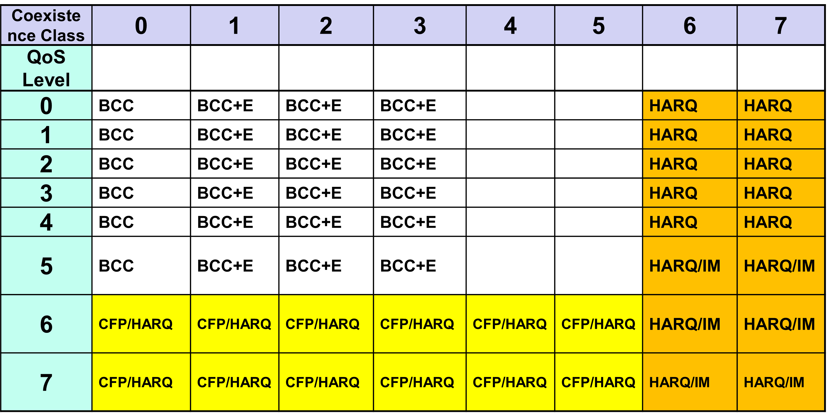
FEC/HARQ for 64 Combinations of 8 Coexistence Classes
× 8 QoS Packet Levels
FEC codes and Hybrid ARQ have been designed for 8 × 8 = 64 combinations for QoS levels and Coexistence classes under various standard of channel models.

Slide 78
FEC in TG6ma
Common with IEEE802.15.4ab
Error-correcting codes corresponding to QoS levels
User priority | Inner code | Outer code | HARQ
0 | 15.4ab LDPC or BCC (R=1/2) |  | -
1 | 15.4ab LDPC or BCC (R=1/2) |  | -
2 | 15.4ab LDPC or BCC (R=1/2) |  | -
3 | 15.4ab LDPC or BCC (R=1/2) |  | -
4 | 15.4ab LDPC or BCC (R=1/2) | (54, 46) shortened RS code | -
5 | 15.4ab LDPC or BCC (R=1/2) | (54, 38) shortened RS code | -
6 | 15.4ab LDPC or BCC (R=1/2) | (54, 28) shortened RS code | -
7 | 15.4ab LDPC or BCC (R=1/2) | (54, 14) shortened RS code | -
As an outer code, shortened Reed-Solomon (RS) codes with N=54 (original code length N=63) will be selected to correct burst errors due to interference from other WBANs and the coding rates are changed according to each QoS and channel condition
As an inner code, 15.4ab LDPC (K=324, 648, 972, R=1/2) in mandatory or BCC in optional will be selected for the coexistence of 15.6ma and 15.4ab
This updated concept table is considered as the first priority

Slide 79
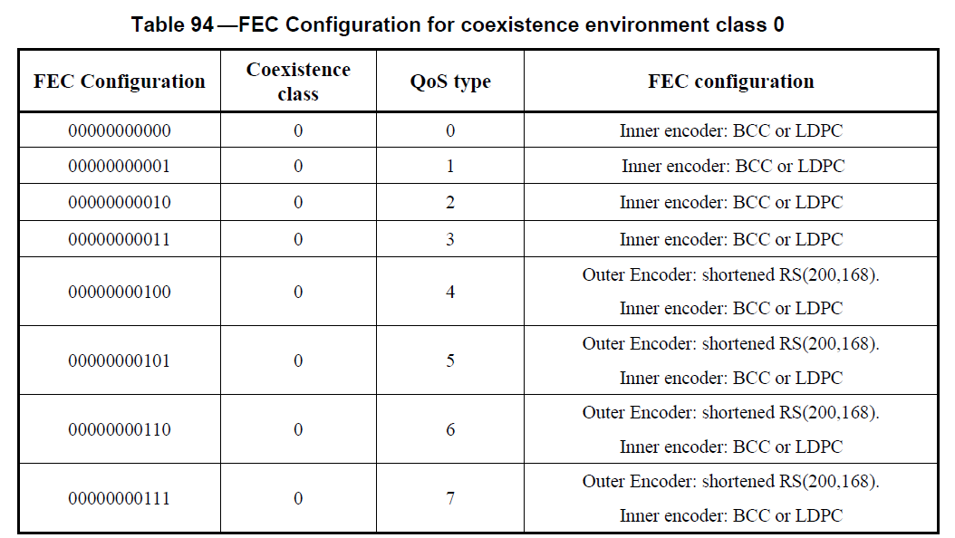
FEC in TG6ma

Slide 80
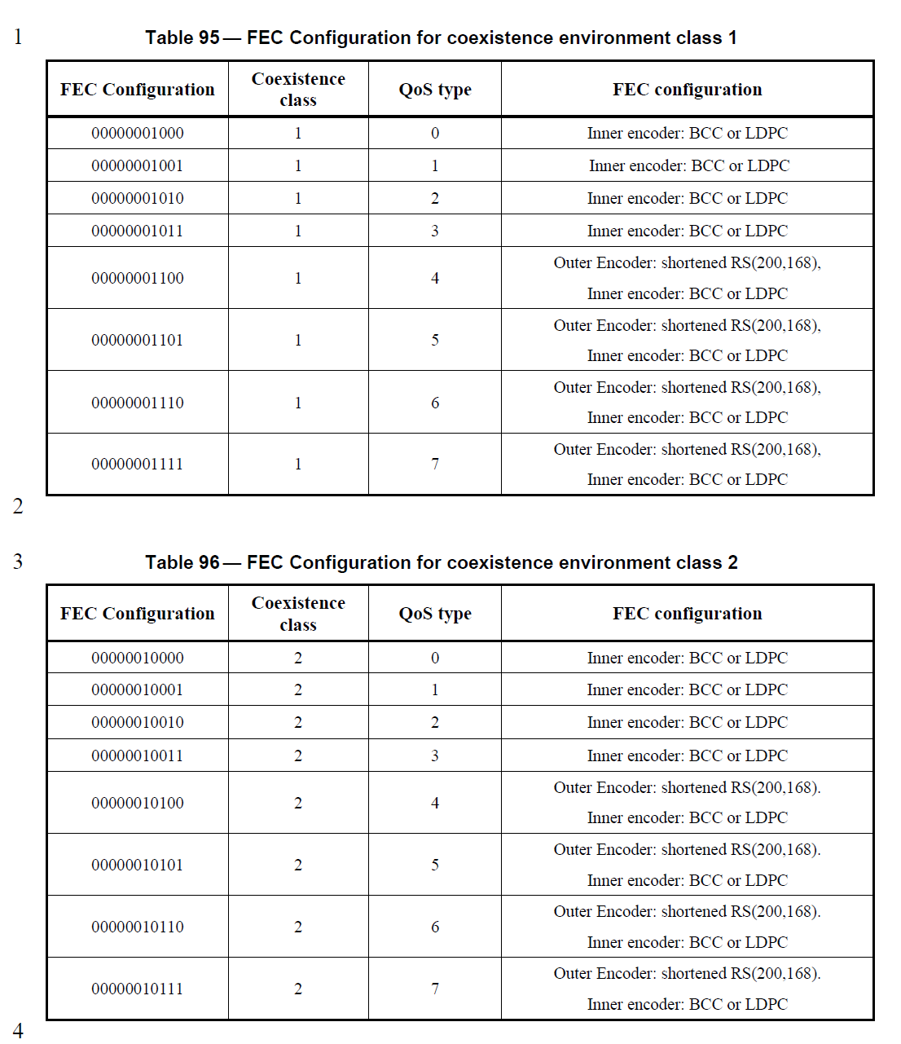
FEC in TG6ma

Slide 81
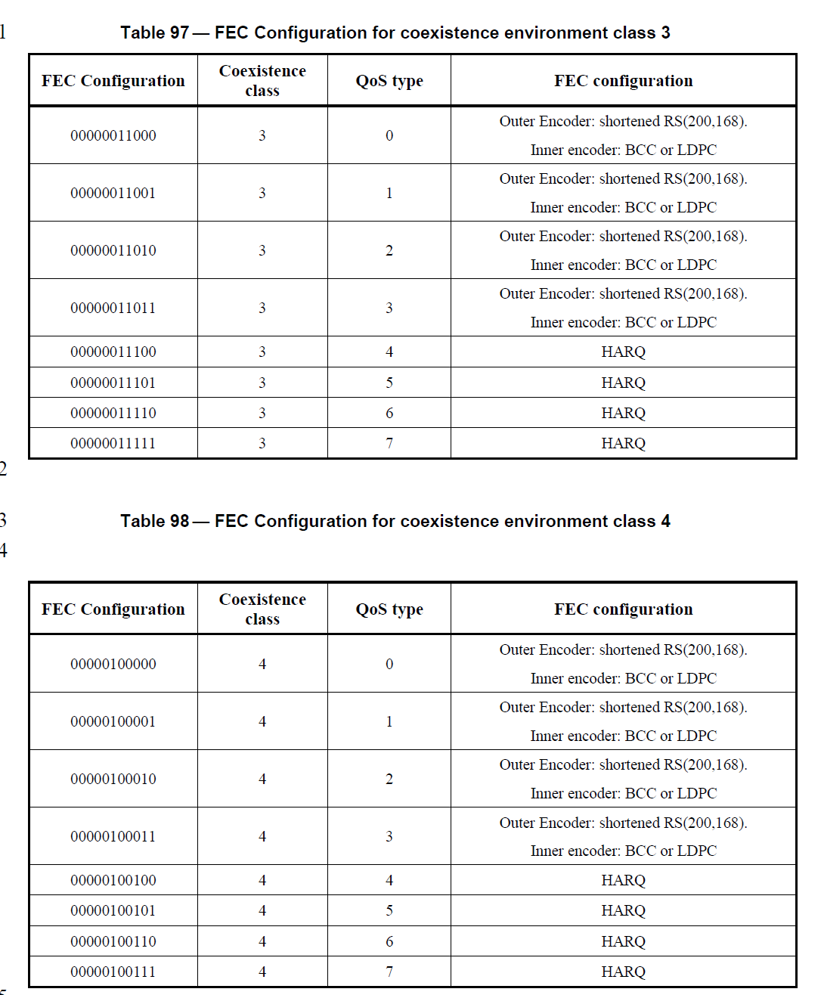
FEC in TG6ma

Slide 82
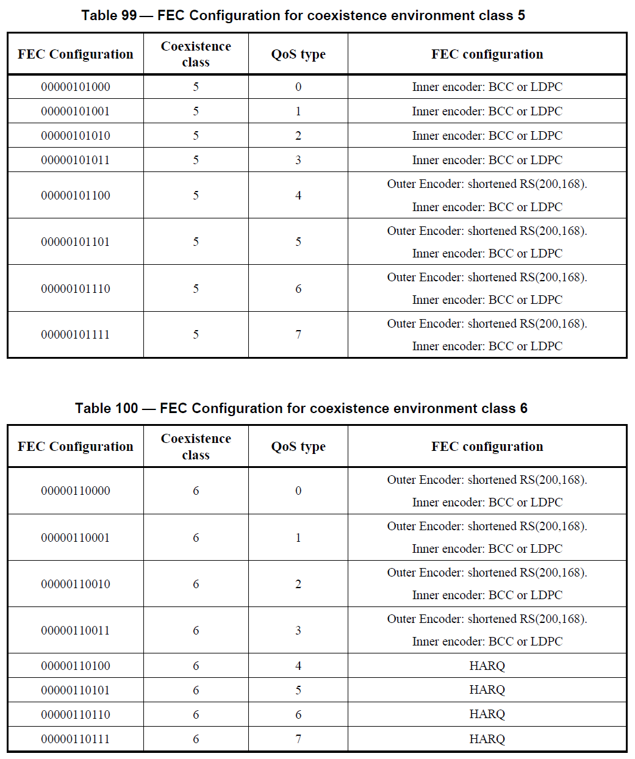
FEC in TG6ma

Slide 83
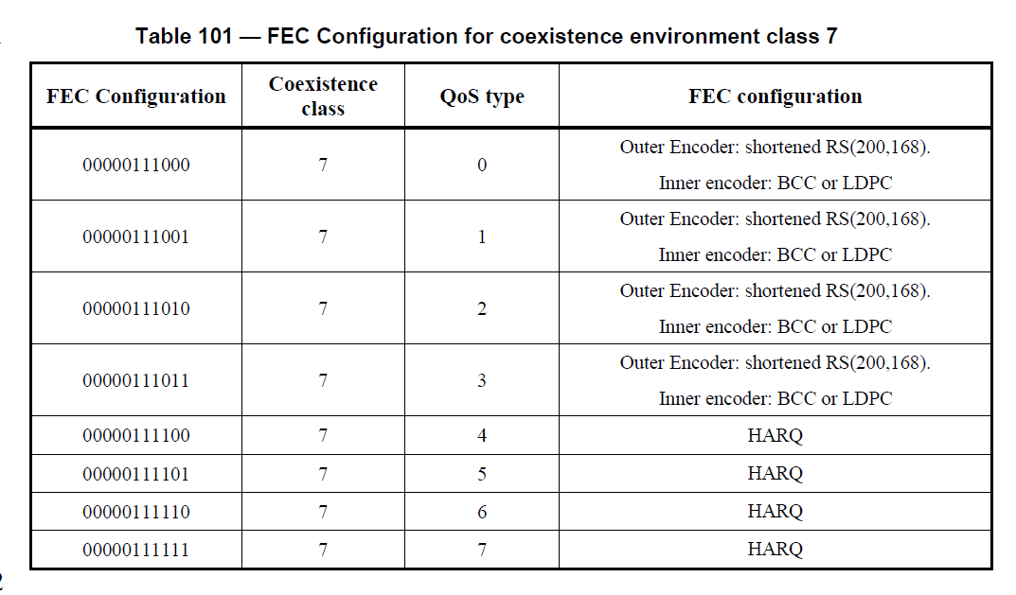
FEC in TG6ma

Slide 84
TG 6ma Timeline(expected)
Tech Req Doc July 2022
Presentation of proposals
May 2023
Comment Resolutionfor LB
Sept. 2024
EC approval to SB, SB submission
January 2025
WG PreBallot submission for Draft1.18May2024
SB recirculation
March 2025
SB recirculation if required
May 2025
Revcom Approve
July 2025
^{Draft V1,11 Com}
Jan. 2024
RevcomSubmission
June 2025
Comment Resolution fo Draft v1.14 on WG for PreBallot March 2024
1st Letter Ballot(LB)
July 2024
Conditional approval for Sponsor Ballot (SB)
Nov. 2024
TRD,CMD
Call Proposals Sept 2022
Std. Draf V1.9 Proposals
Nov. 2023
Notes: SASB/RevCom scheduled for 2024 a guess

Slide 85
Expecting Timeline detail
Topic item | Deadline | Action items | Notes
Std Draft D2_3 WG pre-ballot recirculation. | July/2024 |  | Editorial comments from 802.15 technical editor were addressed. Still missing cross-references.
Towards the July 2024 meeting | July/2024 | Adding MAC text. Revise PHY text. Editorial revisions.
Target WG letter ballot (LB) submission: submit draft to TEG | August/2024 | Disposition of comments. | 1. Based on pre-ballot resolutions, prepare Draft D2_4 2. Request LB submission before the September meeting. Consequently, the July meeting is used to resolve comments.
1st LB recirculation | Sep/2024 |  | Comment-resolutions to LB recirculation.
2nd LB recirculation | Nov/2024 |  | Comment-resolutions to LB recirculation.
Conditional approval for Sponsor Ballot (SB) | Nov/2024 |  | Seek conditional approval for SB by the Executive Committee.
Final LB recirculation. | Jan/2025 |  | WG approval to request SB submission.
Request EC approval for SB | Jan/2025 |  | Request SB approval by the EC (conditional or not)
IEEE SA Sponsor Ballot submission | March/2025 |  | One month for IEEE SA editorial review.
1st SB recirculation | May/2025 |  | Comment-resolutions to SB and recirculation.
2nd SB recirculation | Jun/2025 |  | Comment-resolutions to SB and recirculation.
Request conditional/unconditional approval to RevCom | Jun/2025 |  | Submission to SASB agenda
Final SB recirculation, if required. Submission to RevCom | July/2025 |  | Submission to SASB
RevCom submission | July/2025 |  | RevCom approval
Note: the deadlines are subject to change.
Reference: doc.#15-23-0361-07-06ma

Slide 86
Contributions
・TG15.6ma opening report for July 2024 meeting 15-24-0350-01-06ma
・TG15.6ma Agenda of July Meeting in 2024 15-24-0349-07-06ma
・Progress reort of 802.15.6ma 15-23-0056-07-06ma
・Rescheduling Timeline 15-23-0361-07-06ma
・Overview of IG-DEP, SG6a, TG6a ＆ TG15.6ma BAN with Enhanced Dependability15-23-0455-03-06ma
・Basic Consensus in MAC and PHY of Revision of IEEE802.15.6-2012 15-23-0557-01-06ma
・Technical-editor-comments-to-the-p802-15-6ma-d1-18 15-24-0333-01-006a
・Propagation Channel Parameters of UWB for Human BAN (HBAN) Use Cases 15-24-0145-03-06ma
・MAC Performance Evaluation of Multiple BAN Coexistence Under TG6ma Channel Model 24-246-01
・Performance Evaluation of Channel Coding with Interleaver for Some Classes of Coexistence 24-247-00
・Ranging Accuracy Evaluation under TG6ma Communication Senarios 15-24-0248-00-06ma
・Hybrid ARQ Scheme for High QoS Packets in High Class of Coexistence of IEEE 802.15.6ma 23-0576-03
・Evaluation of IEEE 802.15.6 UWB PHY Utilizing Super Orthogonal Convolutional Code 15-22-0562-09
・Overview and convergence of MAC proposals for 15.6ma 15-23-0408-02-06ma
・MAC features to be specified 15-24-0352-00-06ma
・Group MAC service features 15-24-0353-00-06ma
・15.6ma MAC compared to 15.4-2020 MAC and 15.6-2012 MAC 15-24-0354-00-06ma ・
・Proposed text for 6ma - MAC Service Features 15-24-0356-00-06ma
・Theoretical Analysis of System Performance in a Multi-BAN Coexistence Environment (Class 1)24-0357-0
・TG15.6ma Coexistence Assessment Document 15-24-0348-00-06ma
・Joint work with 802.1; Draft PAR and CSD 802.1ACea: Amendment to IEEE Standard 802.1AC-2016 396-00
・TG6ma Channel Model Document for Enhanced Dependability 15-22-0519-08-06ma
・Comments to channel-model-document 15-24-0073-03-06ma
・Interference Mittigation Schemes in Class 3, 5, 6, and 7 of Coexisitence in TG6ma 15-24--0073-02-06ma
・Progress Report of TG6ma 15-23-0056-07-06ma
・Timeline of TG6ma 15.23-0361-07-06ma
・TG15.6ma Closing Report for July 2024 15-24-0404-00-06ma
・TG15.6ma Meeting Minutes for July 2024 15-24-0405-00-06ma

Slide 87
Contacts and Conference call
Chair; Ryuji Kohno, YNU/YRP-IAI
kohno@ynu.ac.jp, kohno@yrp-iai.jp
1st Vice-Chair; Marco Hernandez, YRP-IAI/CWC
marco.hernandez@ieee.org
2nd Vice-Chair; Daisuke Anzai, NIT
anzai@nitech.ac.jp
3. Secretary; Takumi Kobayashi, YNU/TCU
kobayashi-takumi@yrp-iai.jp, kobayashi@nitech.ac.jp
Technical Editors;
Minsoo Kim, YRP-IAI minsoo@minsookim.com
Seong-Soon Joo, KPST wowbk@kpst.co.kr
Kento Takabayashi, Toyo U. takabayashi.kento.xp@gmail.com
Marco Hernandez, YRP-IAI/CWC marco.hernandez@ieee.org

Slide 88
TG7 (OCC)
July 2024
Closing Report

Slide 89
Accomplishment for the meeting
3 Slots (on AM1 Tue., AM1 Wed., and AM1 Thur.)
1st Slot:
  Meeting Objectives and Agenda Approval (368-00)
  Review and approval for TG7a May 2024 Wireless Interim Meeting Minutes (323-00)
  Review and approval for TG7a CRG Telco minutes from May to June 2024 (360-00)
  Comment Resolution for the 1st recirculation SA ballot (361-00)
  Recess

Slide 90
Accomplishment for the meeting
3 Slots (on AM1 Tue., AM1 Wed., and AM1 Thur.)
2nd Slot:
  Meeting Objectives and Agenda Approval (368-01)
  Discussion of TG and WG Motion
  Plan for Teleconference schedule
  Plan for September meeting
  Recess
  3rd Slot:
  Meeting Objectives and Agenda Approval (368-02)
  Discussion on PAR extension
  Plan for Teleconference schedule
  Plan for September meeting
  Adjourn

Slide 91
TG Motion #1
TG7a Motion to approve TG7a May 2024 Wireless Interim Meeting Minutes
Motion to approve the TG7a May 2024 Wireless Interim Meeting Minutes in IEEE P802.15-24-323-00-007a
Moved By: Yeong Min Jang
Seconded By: Sangsung Choi
Approved by unanimous consent

Slide 92
TG Motion #2
TG7a Motion to approve TG7a CRG Telco minutes from May to June 2024
Motion to approve the TG7a CRG Telco minutes from May to June 2024 in IEEE P802.15-24-360-00-007a
Moved By: Yeong Min Jang
Seconded By: Sangsung Choi
Approved by unanimous consent

Slide 93
TG Motion #3
TG7a Motion to approve the 1st recirculation SA ballot
Move that the TG7a approve the comment resolutions for the 1st recirculation SA ballot as described in document IEEE P802.15-24-0361-00-007a
Moved By: Yeong Min Jang
Seconded By: Sangsung Choi
Approved by unanimous consent

Slide 94
TG Motion #4
    TG Motion to approve the formation of CRG for the SA recirculation ballot
Move that 802.15.7a TG approve the formation of a Comment Resolution Group (CRG) for the SA balloting of the P802.15.7a with the following membership: Yeong Min Jang(Chair), Sangsung Choi, Sang-Kyu Lim, Ryuji Kohno, and Seongsoon Joo. The 802.15.7a CRG is authorized to approve comment resolutions, edit the draft according to the comment resolutions, and to approve the start of recirculation ballots of the revised draft on behalf of the 802.15 WG. Comment resolution on recirculation ballots between sessions will be conducted via reflector email and via teleconferences announced to the reflector as per the LMSC 802 WG P&P.
Moved By: Yeong Min Jang
Seconded By: Sangsung Choi
Approved by unanimous consent

Slide 95
TG Motion #5
      TG Motion to start the SA ballot 2nd recirculation
Motion: Move that TG7a formally requests that 802.15 WG start a Standards Association Recirculation Ballot of CA document [15-22-0292-r3] and document P802-15-7a_D8 (as edited in accordance with the instructions in document 15-24-0361-00-007a) pending the completion and inclusion of the edits in the draft.
Moved By: Yeong Min Jang
Seconded By: Sangsung Choi
Approved by unanimous consent

Slide 96
WG Motion #1
    CRG formation for the SA Ballot
Move that 802.15 WG approve the formation of a Comment Resolution Group (CRG) for the SA balloting of the P802.15.7a with the following membership: Yeong Min Jang (Chair), Sangsung Choi, Sang-Kyu Lim, Ryuji Kohno, and Seongsoon Joo. The 802.15.7a CRG is authorized to approve comment resolutions, edit the draft according to the comment resolutions, and to approve the start of recirculation ballots of the revised draft on behalf of the 802.15 WG. Comment resolution on recirculation ballots between sessions will be conducted via reflector email and via teleconferences announced to the reflector as per the LMSC 802 WG P&P.
Moved By:
Seconded By:
Approved by

Slide 97
WG Motion #2
Motion: Move that 802.15 WG start a Standards Association Recirculation Ballot of CA document [15-22-0292-r3] and document P802.15.7a_D8.
Moved By:
Seconded By:
Approved by

Slide 98
Plan for Teleconference Meeting
4 slots (6AM (EST) Aug. 7, Aug. 21, Aug. 28, and Sep. 4 )
Complete comment resolution for SA Ballot 2nd recirculation
Prepare the D9 document for SA Ballot 3rd recirculation
Complete comment resolution for SA Ballot 3rd recirculation
Prepare the D10 document for SA Ballot 4th recirculation

Slide 99
Plan for September Meeting
3 slots (PM2 on Tue., Wed., and PM1 on Thur.)
Complete comment resolution for SA Ballot 2nd recirculation
Prepare the D9 document for SA Ballot 3rd recirculation
Complete comment resolution for SA Ballot 3rd recirculation
Prepare the D10 document for SA Ballot 4th recirculation

Slide 100
TG16t (LIC-NB)
July 2024
Closing Report

Slide 101
Plan for week
Tuesday AM2 10:30am CEST
Wednesday PM1 1:30pm CEST
Thursday AM2 10:30am CEST

Slide 102
July Meeting Start Status
LB205 Third Letter Ballot (2nd Recirculation)
  Comments received discussed on CRG Teleconference 2024-06-11
  CRG Teleconference minutes 15-24-0339-00-016t-minutes-of-tg16t-LB205-crg-teleconference-2024-06-11.docx
Comment Resolution Spreadsheet:
  15-24-0340-00-016t-tg16t-lb205-comments-and-resolutions.xlsx
  Comments withdrawn to forward unchanged draft to SA Ballot.
  Final Spreadsheet: 15-24-0340-01-016t-tg16t-lb205-comments-and-resolutions.xlsx

Slide 103
High Level Plan
Accept comments in LB205
Walk through comments and D4.0 to verify resolutions.
TG Motion for Recirculation on D4.0
WG motion for recirc on D4.0
CRG Motion or WG
WG motion for Conditional SA Ballot on D4.0
  Put Agenda for August LMSC Call for SA Ballot.

Slide 104
Motions
TG Motion to start WG recirculation on D4.0
  Move that TG16t formally request that the 802.15 WG start a WG Letter Ballot requesting approval of document P802.16t_D4.0 and to forward document P802.16t_D4.0, to Standards Association ballot
    Moved: Joerg Robert
    Second: Ann Krieger
    Vote: 4 : 0 : 0
TG Motion for conditional SA Ballot
  Motion: Move that TG16t formally request that 802.15 requests conditional approval from the LMSC to submit P802.16t_D4.0 (or current revision) to Standards Association ballot.
    Moved: Ann Krieger
    Second: Joerg Robert
    Vote: 4 : 0 : 0
WG Motion text for recirculation LB:
  Move that 802.15 WG start a WG recirculation requesting approval of document P802.16t_D4.0 and to forward document P802.16t_D4.0, to Standards Association ballot
WG Motion text for Conditional SA Ballot:
  Motion: 802.15 requests conditional approval from the LMSC to submit P802.16t_D4.0 (or current revision) to Standards Association ballot.

Slide 105
Formation of Comment Resolution Group
Move that 802.15 WG approve the formation of a Comment Resolution Group (CRG) for the WG balloting of P802.16t_D4.0 with the following membership: Tim Godfrey (Chair), Vishal Kalkundrikar, Harry Bims, Tero Kivinen, and Joerg Robert. The 802.15.16 CRG is authorized to approve comment resolutions, edit the draft according to the comment resolutions, and to approve the start of recirculation ballots of the revised draft on behalf of the 802.15 WG. Comment resolution on recirculation ballots between sessions will be conducted via reflector email and via teleconferences announced to the reflector as per the LMSC 802 WG P&P.
TG Vote
  Moved : Vishal Kalkundrikar
  Second: Joerg Robert
  Vote - unanimous Consent

Slide 106
Teleconference / CRG Meeting
Schedule CRG meeting August 6, 8am PT, 11am ET

Slide 107
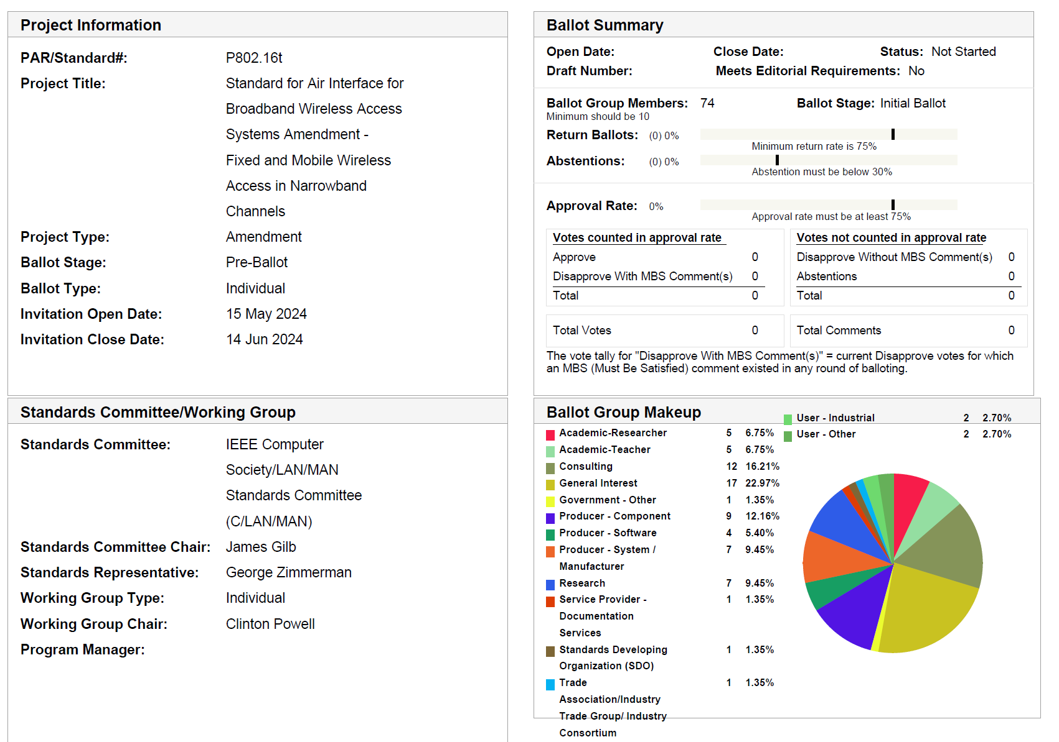

Slide 108
MEC
Initiate MEC – started July 17, 2024.

Slide 109
Revision Plans
After approval of TG16t amendment, plan to initiate a revision PAR to develop a revision to 802.16. (possibly to be 802.16-2025)
Revision PAR to be submitted in November. 48-hour rule, no CSD.

Slide 110
Project Timeline
Milestone | Date
Task Group Start | Jan 2020
SRD Approval | April 2021
SDD Approval | Jan 2022
Draft Development
Informal TG review of draft | Mar 2023
Working Group Letter Ballot | Nov 2023
Working Group Recirculation Letter Ballot | March 2024
SA Ballot | July 2024
Forward to RevCom | Nov 2024

Slide 111
Future Meetings
Sept 2024 Interim
  Sept 9-12 – Waikoloa, Hawaii, USA
    Request 4 meeting slots for comment resolution.
November 2024 Plenary
  November 11-14, Vancouver, BC, CA

Slide 112
Closing
Any Other Business
Actions
Adjourn

Slide 113
IG Access
July 2024
Closing Report

Slide 114
Agenda
Opening and Meeting Reminders
Overview of Interest Group
Technical Discussion
Any other business
Adjourn

Slide 115
Opportunity Statement
Need to share spectrum
Need to share with uncoordinated, random access
Sharing through coexistence is essential
Need to accommodate reality
We need a systems view of coexistence to advance beyond avoidance
  Greater than a single amendment to a single standard

Slide 116
Basis Realities for this IG
(ground rules)
There are many 802 wireless technologies
  All are important
  None are more important (in the system view) than others
  Diversity of uses is an important metric for spectrum efficiency
  Diversity of technologies is a strength of 802
There are other technologies we have to expect
  Won’t abide by our rules
  Must abide by regulations
802 is not a regulatory body

Slide 117



A tale of two methods of unlicensed access
+23 dBm/MHz
Mt Everest
8,849 meters
Standard Power U-NII
Power Represented as Height
Emitted Signal Power
-41 dBm/MHz
UWB

Slide 118

Foundation: Sharing
Sharing means different things.
I told
you that spectrum is mine!
Toddler Rules of Sharing
1. If it’s mine, it’s mine!
Incumbents
2. If it’s yours, it’s mine!
New Entrants
3. If it’s broken, it’s yours!
Use the bands we don’t want

Slide 119
Foundation: Sharing
Or to put that another way…
Traditional non-sharing: It’s mine and you can’t play with it
Sharing by avoidance: in time, frequency, geography: you get a turn
Sharing by coexistence: We can play together
  Traditional unlicensed (LBT): avoidance at a finer time scale
  Co-use: ability for two radios to transmit and not annihilate each other

Slide 120
Foundation: Sharing
Sharing means different things
Avoidance is one tool (part) that is familiar
  Separation in time, frequency or geography
  Unsustainable
Avoidance isn’t enough nor sustainable
Sharing by enabling mutual successful operation is better
  This is a working definition of sharing by coexistence
Coexistence is complicated – no one methods works always, everywhere, for everyone

Slide 121
A Systems View
There’s a lot of different things using the spectrum
  Not all are “family”
There are a lot of different use cases RF environments, driving different (and often dynamic) requirements
There’s a lot of parts that are useful
  Some commonality among our standards
  Many, many choices (knobs to twiddle)
There are many trade-offs – what works best depends upon what you need to accomplish
A systems view: do what works best for what you are optimizing (optimal assembly of parts – this is dynamic)

Slide 122
Coexistence isn’t one thing
Channel sensing can be useful
  Traditional LBT (listen, decide) can work sometimes
  Traditional LBT doesn’t work sometimes
  LBT is part of a solution, not a solution
Obvious examples of LBT:
  802.11 CSMA-CA (multiple variations)
  802.15.4 CSMA-CA (multiple variations)
Need to look at the whole problem

Slide 123
IG Crypt
July 2024
Closing Report

Slide 124
Agenda for July
Process comments received for the PARs.

Slide 125
Detailed Agenda for July
Monday 15th of May 1600-1800
    Opening slides
    Approve agenda (this document) 15-24-0373-00
    Approve minutes 15-24-0269-01
    Review comments received for the PARs
    Generate responses to the comments
Tuesday 16th of May 1330-1530
    Continue working on comments
Wednesday 16th of May 1330-1530
    Finish on working on comment responses
    Closing report

Slide 126
PARs
There is two PARs of interest
  Ascon cipher algorithms for 802.15.4
    TG4ae
  EDHOC KMP for 802.15.9
    TG9a

Slide 127
Ascon
Ascon is lightweight crypto algorithm and would be quite suitable for 802.15.4 use.
  It is AEAD algorithm, uses 128-bit nonce etc, thus can be quite easily added to the 802.15.4 which uses same construct.
  Two versions Ascon-128 and Ascon-128a, most likely we want to pick one (more efficient Ascon-128a?)
  Does not currently support 32-bit tags in standard, that needs to be added.
  Also supports hashing, PRF etc, but those are not yet used in 802.15.4.

Slide 128
TG4ae Ascon
IEEE Std 802.15.4 amendment that adds Ascon to the 802.15.4.
Changes needed:
  Add Ascon to secAeadAlgorithm assignment table.
  Create annex to describe how Ascon is used, most likely very short just refer to the external references.
  Create annex to provide test vectors similar to Annex C.

Slide 129
EDHOC
EDHOC is lightweight key management protocol.
Provides mutual authentication, forward secrecy and identity protection.
Intended for usage in constrained scenarios.
Three messages, small message sizes.

Slide 130
TG9a EDHOC
IEEE Std 802.15.9 amendment that adds EDHOC to 802.15.9.
Allocate new KMP ID value for 802.15.9.
Add new Annex that defines how EDHOC is used inside 802.15.4 frames. Needs to define how keys are derived, and how the keys are identified.
Not sure if there is a way to transport broadcast and/or multicast keys.

Slide 131
PAR and CSD
Finished creating PAR and CSD for TG9a.
  PAR: 15-24-0284-01
  CSD: 15-24-0286-03
Finished creating PAR and CSD for TG4ae.
  PAR: 15-24-0267-02
  CSD: 15-24-0268-02

Slide 132
WG motion: WG approval of comment responses for PAR and CSD
Request that the responses to received PAR and CSD review comments contained in document 15-24-0382-02 be approved for submission to the LMSC. The 802.15 working group chair and technical editor are authorized to make additional modifications to the responses as needed.
Moved by: Tero Kivinen
Seconded by: Phil Beecher
Result:

Slide 133
Comment responses
Comment responses are in document 15-24-0382-02.
The slide responses are in document 15-24-0406-00.

Slide 134
Agenda for TG4ae and TG9a
September:
    One session for each
    Start working on the document

Slide 135
IG NG-OWC
July 2024
Closing Report

Slide 136
Session Objectives
Present eight contributions related to the future of next generation OWC technology

Slide 137
Session Schedule
The Group scheduled 2 time slots in this meeting
- Tues. PM2 and Wed. PM2

Slide 138
Accomplishment for the meeting
1st Slot: Tues. PM2
  Meeting Objectives and Agenda Approval (369-02)
  Present and accept the presentation from Kookmin University titled "Leveraging NG-OWC and Deep Learning in Smart Factory Environment to Enhance Efficiency" (387-01)
  Present and accept the presentation from Kookmin University titled "Routing using GNN for FSO Communication Network " (384-00)
  Present and accept the presentation from Kookmin University titled " Integrating Optical Camera Communication and Deep Learning into Intelligent Internet of Vehicles for NG-OWC" (389-00)
  Present and accept the presentation from Kookmin University titled "Turbulence Compensation and Symbol Detection of Orbital Angular Momentum FSO/OCC System Using Deep CBDNet" (395-00)
  Present and accept the presentation from Kookmin University titled "Adaptive modulation and coding(AMC) technique for OCC/FSO link for NG-OWC " (388-00)
  Recess

Slide 139
Accomplishment for the meeting
2nd Slot: Wed. PM2
  Meeting Objectives and Agenda Approval (369-02)
  Present and accept the presentation from Kookmin University titled "Utilization of OCC for Localization in a Constrained Environment" (392-00)
  Present and accept the presentation from Kookmin University titled "Integrating OCC with Few-shot Learning for NG-OWC" (393-00)
  Present and accept the presentation from Kookmin University titled "Acquisition, Tracking, and Pointing (ATP) for NG-OWC system in Drone Networks" (394-00)
  Plan for September meeting
  Plan for IG NG-OWC
  Adjourn

Slide 140
Plan for September Meeting
2 Time Slots (PM1 on Mon. and Thur.)
Need contributions for NG-OWC
Invite some companies for presentations.

Slide 141
  Plan for IG NG-OWC
Invite contributors from research institute and companies

Slide 142
SC IETF
July 2024
Closing Report

Slide 143
Agenda for July
Discuss what will be happening in IETF 120 Vancouver (July 20 – 26, 2024)

Slide 144
IETF 119
IETF 119 was held in Brisbane between 16th of March and 22th of March, 2024.
The proceedings are being collected:
  https://datatracker.ietf.org/meeting/119/proceedings

Slide 145
IETF 120
IETF 120 will be held in Vancouver, between 20th of July and 26th of July, 2024.
Registration is open:
  Registration

Slide 146
Working groups to cover
6lo – IPv6 over Networks of Resource-constrained Nodes
Lake – Lightweight Authenticated Key Exchange
Suit – Software Updates for Internet of Things

Slide 147
6lo – IPv6 over Networks of Resource-constrained Nodes
Will meet in 120
  Agenda
    The “Transmission of SCHC-compressed Packets over IEEE 802.15.4” document is on the agenda, but slides have not yet been posted.

Slide 148
6lo Work in progress
  RFC Editor queue
    IPv6 ND Multicast Address Listener Registration
      https://datatracker.ietf.org/doc/draft‐ietf‐6lo‐multicast‐registration/
  Work in progress
    Transmission of SCHC-compressed Packets over IEEE 802.15.4
      https://datatracker.ietf.org/doc//draft-gomez-6lo-schc-15dot4/
    Path-Aware Semantic Addressing (PASA) for Low power and Lossy Networks
      https://datatracker.ietf.org/doc/draft-ietf-6lo-path-aware-semantic-addressing/
    IPv6 Neighbor Discovery Prefix Registration
      https://datatracker.ietf.org/doc/draft-ietf-6lo-prefix-registration/
    Transmission of IPv6 Packets over Short-Range OWC (expired)
      https://datatracker.ietf.org/doc/html/draft-choi-6lo-owc-01

Slide 149
Lake – Lightweight Authenticated Key Exchange
Will meet in 120
  Agenda

Slide 150
Lake – Work in progress
Document status
  Working documents
    Lightweight Authorization using EDHOC
    draft-ietf-lake-authz
    Implementation Considerations for EDHOC
    draft-ietf-lake-edhoc-impl-cons

Slide 151
Suit – Software Updates for Internet of Things
Will meet in 120
  No agenda posted yet

Slide 152
Suit – Work in progress
Document status
  Publication requested
        https://datatracker.ietf.org/doc/draft-ietf-suit-manifest/
        https://datatracker.ietf.org/doc/draft-ietf-suit-mud/
Work in Progress (most of then almost done in WG)
  https://datatracker.ietf.org/doc/draft-ietf-suit-firmware-encryption/
  https://datatracker.ietf.org/doc/draft-ietf-suit-report/
  https://datatracker.ietf.org/doc/draft-ietf-suit-trust-domains/
  https://datatracker.ietf.org/doc/draft-ietf-suit-update-management/
  https://datatracker.ietf.org/doc/draft-moran-suit-mti/

Slide 153
BoFs in IETF 120
List of requested BoFs can be found from https://datatracker.ietf.org/doc/bof-requests
List of approved BoFs can be found from https://datatracker.ietf.org/wg/bofs/
alldispatch - IETF-Wide "Dispatch" Session BOF
diem - Digital Emblems BOF
green - Getting Ready for Energy-Efficient Networking BOF
nasr - Network Attestation for Secure Routing BOF
sconepro - Secure Communication of Network Properties BOF

Slide 154
IETF-Wide "Dispatch" Session (alldispatch)
Combination of the different dispatch groups in the IETF.
Experiment to see whether we can combine all of them.
This is meant to solve five problems:
  Proponents often have trouble figuring out where to dispatch something that spans multiple areas.
  Each Dispatch session aggravates scheduling because they have large target audiences, and consolidating them in a single time slot will simplify that problem.
  Participants with cross-area expertise, who provide valuable input for dispatching, find it difficult to attend multiple Dispatch sessions.
  Currently, Dispatch meetings sometimes result in routing to a different Dispatch, which wastes months.
  There is a common practice of "Dispatch Shopping" in which proponents attempt to discover the least rigorous venue. This consumes agenda time and can result in lower-quality work being admitted into the IETF.

Slide 155
Digital Emblems (diem)
International law defines a number of emblems, such as the blue helmets of United Nations peacekeeping forces , as indicative of special protections.
Such physical emblems do not translate to the digital realm and also suffer from a number of weaknesses in the physical world.
This BoF is to explore the problem space, discuss technical requirements raised by a variety of stakeholders, and help determine if there is useful work to be done in the IETF around digital emblems.
Not working group forming.

Slide 156
Getting Ready for Energy-Efficient Networking (green)
As the desire to improve energy efficiency gains momentum, network operators increasingly focus on understanding energy consumption by different links, nodes, and devices/components within their networks. Network Energy-efficiency management involves deploying and managing network infrastructures with the goals of optimizing energy use on network devices while improving network utilization. This will involve technologies to monitor energy consumption, evaluate the effectiveness of energy saving polices, use control strategies to improve energy efficiency in network operations.
This BoF is intended to discuss these objectives and determine whether there is a community of interest to work on these topics within the IETF through a new working group (provisionally called GREEN).
Working grouping forming.

Slide 157
Network Attestation for Secure Routing (nasr)
Traffic signing and encryption has been insofar the primary method to ensure data confidentiality, integrity and authenticity. However, an increasing amount of attacks, vulnerabilities, and new emerging requirements are deeming the data security provided by such methods insufficient.
Clients with high security and privacy requirements are not anymore satisfied with pure encryption-based data security measures in the application or transport layer that do not allow any control over the underlay networks. Clients now require their data to exclusively traverse the network through trusted devices, trusted operating environments, trusted links and trusted services, avoiding any exposure to insecure or untrusted devices.
Non-working group forming.

Slide 158
Secure Communication of Network Properties (sconepro)
Video traffic is 70% of the overall traffic volume on the Internet and is expected to grow to 80% by 2028.
Local mobile radio conditions may constrain the maximum throughput for a given client, or be so volatile as to rapidly change the maximum throughput throughout the course of a session.
Network operators have found it faster and less expensive to invest in shaping (also called throttling) of video traffic on a per-flow basis, which negatively affects video stream quality.
It would be beneficial, for both the application provider and network operator, to signal network attributes to the application to self-adapt its video traffic to conform to the specified characteristics.
Working group forming.

Slide 159
SC MAINT
July 2024
Closing Report

Slide 161
SC Meeting Objectives – Agenda
    Meetings 1&2 (Monday and Tuesday)
    Policy and Procedure
    Approve Agenda
    PAR reviews
    Recess
    Meeting 2 Thursday
    Review any change requests for Operations Manual – none
    Review Motion Templates 15-23-0506-03-0mag
    Review Project Checklist
    AoB
    Adjourn

Slide 162
802 PARs for Review
802.1DD -Standard - Resource Allocation Protocol, PAR and CSD
802.1ASed - Amendment - Fault-Tolerant Timing with Time Integrity PAR and CSD
802.1DP - Standard - Time-Sensitive Networking for Aerospace Onboard Ethernet Communications, PAR Extension
802.1AB-2016-rev - Standard - Station and MAC Connectivity Discovery, PAR
802.1AC-2016-rev - Standard - MAC Service Definition, PAR
802.11-2024 - Standard - Wireless LANs, PAR Revision
802.11bf - Amendment - Enhancements for Wireless Local Area Network (WLAN) Sensing, PAR Extension
802.16t - Amendment - Fixed and Mobile Wireless Access in Narrowband Channels, PAR Extension
802.15.4ae - Amendment - Ascon cryptographic algorithms, PAR and CSD
802.15.9a - Amendment - Ephemeral Diffie-Hellman Over COSE (EDHOC) KMP, PAR and CSD

Slide 163
Achievements
    Reviewed PARs / CSDs – no comments
    Reviewed and Updated Example Motions
    Reviewed and Updated Project Task list template

Slide 164
SC WNG
July 2024
Closing Report

Slide 165
Hybrid Meeting
Registration is required
Please remember to enter your attendance in IMAT
Reminder:
This is a non-PAR activity
All the rules of conduct apply https://grouper.ieee.org/groups/802/sapolicies.shtml

Slide 166
Agenda 15 November 2023
Opening and Meeting Reminders
Presentations and discussion
  New Things for 802.15.4 (Kitazawa, Takai)
  ETSI TR 103 970 (Pre-standardization study on UWB in ITS)
Any other business
Adjourn

Slide 167
References
https://mentor.ieee.org/802.15/dcn/24/15-24-0402-00-wng0-diversified-range-communication-for-disaster-response-operations.pptx
https://mentor.ieee.org/802.15/dcn/24/15-24-0375-00-wng0-etsi-tr-103-970-feasibility-study-on-the-use-of-uwb.pptx

