Slide 1
        DOC: 15-24-0436-00-04ab
Project: IEEE P802.15 Working Group for Wireless Personal Area Networks (WPANs)
Submission Title: Ranging Report for DS-TWR with UWB MMS Packets
Date Submitted: August 2024
Source: Xiliang Luo, Vinod Kristem, Moche Cohen (Apple)
Address: One Apple Park Way, Cupertino, CA 95104, USA
E-Mails: xiliang_luo@apple.com
Abstract: Provide a description of the ranging reports for secure DS-TWR in the context of UWB MMS.
Purpose: Clarify the ranging reports in the context of UWB MMS ranging.
Notice: This document has been prepared to assist the IEEE P802.15. It is offered as a basis for discussion and is not binding on the contributing individual(s) or organization(s). The material in this document is subject to change in form and content after further study. The contributor(s) reserve(s) the right to add, amend or withdraw material contained herein.
Release: The contributor acknowledges and accepts that this contribution becomes the property of IEEE and may be made publicly available by P802.15.

Slide 2
Mixed MMS & RMARKERs for Ranging Integrity
        DOC: 15-24-0436-00-04ab

Slide 3
Part-1:
Measurements for UWB MMS Ranging Integrity
        DOC: 15-24-0436-00-04ab

Slide 4
DS-TWR with 3 Pkts: Multiple Sets of RMARKERs
        DOC: 15-24-0436-00-04ab
Ping1-Set1
Ping1-Set2
Ping2-Set1
Ping2-Set2
1
2
1
2
Device-A
Initiator
2 Ping1-RMARKERs
from Initiator’s Packet 1
2 Ping2-RMARKERs
from Initiator’s Packet 2
Each set of RIF-RMARKERs include: Ping1, Pong, Ping2
Ping1-RMARKER from Initiator’s 1st MMS packet
Pong-RMARKER from Responder’s MMS packet
Ping2-RMARKER from Initiator’s 2nd MMS packet
Pong-Set1
Pong-Set2
1
2
Device-B
Responder

Slide 5
Ranging Measurement Report: Type-1, Set#1
        DOC: 15-24-0436-00-04ab
Ping1-Set1
Ping2-Set1
1
1
Device-A
Initiator
RoundTrip1
Reply2
Reply1
Pong-Set1
RoundTrip2
1
Device-B
Responder

Slide 6
Ranging Measurement Report: Type-2, Set#2
        DOC: 15-24-0436-00-04ab
Ping1-Set2
Ping2-Set2
2
2
Device-A
Initiator
RoundTrip1
Reply2
Reply1
Pong-Set2
RoundTrip2
2
Device-B
Responder

Slide 7
Ranging Measurement Report: Type-3, Mixed Sets
        DOC: 15-24-0436-00-04ab
Ping1-Set1
Ping2-Set2
1
2
Device-A
Initiator
RoundTrip1
Reply2
Reply1
Pong-Set1
RoundTrip2
1
Device-B
Responder

Slide 8
We Have All Timing after 3 Ranging Reports
        DOC: 15-24-0436-00-04ab
Ping1-Set1
Ping1-Set2
Ping2-Set1
Ping2-Set2
1
2
1
2
Device-A
Initiator
All relative timing is known wrt Ping1-Set1
Pong-Set1
Pong-Set2
1
2
Device-B
Responder

Slide 9
DS-TWR with 2 Pkts: Multiple Sets of RMARKERs
        DOC: 15-24-0436-00-04ab
Ping1-Set1
Ping2-Set1
Ping1-Set2
Ping2-Set2
1
1
2
2
Device-A
Initiator
2 Ping1-RMARKERs
from RIF Region 1
2 Ping2-RMARKERs
from RIF Region 2
Each set of RIF-RMARKERs include: Ping1, Pong, Ping2
Ping1-RMARKER from Initiator’s 1st RIF Region: RIF-1,…,7
Pong-RMARKER from Responder’s MMS packet
Ping2-RMARKER from Initiator’s 2nd RIF Region: RIF-2,…,8
Pong-Set1
Pong-Set2
1
2
Device-B
Responder

Slide 10
Ranging Measurement Report: Type-1, Set#1
        DOC: 15-24-0436-00-04ab
Ping1-Set1
Ping2-Set1
1
1
Device-A
Initiator
RoundTrip1
Reply2
Reply1
RoundTrip2
1
Pong-Set1
Device-B
Responder

Slide 11
Ranging Measurement Report: Type-2, Set#2
        DOC: 15-24-0436-00-04ab
Ping1-Set2
Ping2-Set2
2
2
Device-A
Initiator
RoundTrip1
Reply2 (negative)
RoundTrip2
(negative)
Reply1
2
Pong-Set2
Device-B
Responder

Slide 12
Ranging Measurement Report: Type-3, Mixed Sets
        DOC: 15-24-0436-00-04ab
Ping1-Set1
Ping2-Set2
1
2
Device-A
Initiator
RoundTrip1
Reply2
Reply1
RoundTrip2
1
Pong-Set1
Device-B
Responder

Slide 13
We Have All Timing after 3 Ranging Reports
        DOC: 15-24-0436-00-04ab
Ping1-Set1
Ping2-Set1
Ping1-Set2
Ping2-Set2
1
1
2
2
Device-A
Initiator
All relative timing is known wrt Ping1-Set1
Pong-Set1
Pong-Set2
1
2
Device-B
Responder

Slide 14

2 Sets of RMARKERs Give 8 ToF Values
        DOC: 15-24-0436-00-04ab
Initiator Ping1 | Responder Pong | Initiator Ping2 | ToF Value | Comments
Set1 | Set1 | Set1 | ToF_111 | Computed with Type-1 report
Set1 | Set1 | Set2 | ToF_112 | Computed with Type-3 report
Set1 | Set2 | Set1 | ToF_121 | Computed with timing values derived from Type-1,2,3 reports
Set1 | Set2 | Set2 | ToF_122 | Computed with timing values derived from Type-1,2,3 reports
Set2 | Set1 | Set1 | ToF_211 | Computed with timing values derived from Type-1,2,3 reports
Set2 | Set1 | Set2 | ToF_212 | Computed with timing values derived from Type-1,2,3 reports
Set2 | Set2 | Set1 | ToF_221 | Computed with timing values derived from Type-1,2,3 reports
Set2 | Set2 | Set2 | ToF_222 | Computed with Type-2 report
RIF validation ensures attacker cannot reduce all these 8 ToF values!
Distance-Bounding is ensured by $max_{i,j,k∈\left\{1,2\right\}}\{\text{ToF}\text{_}ijk\}$

Slide 15
Summary of Ranging Reports -1-
        DOC: 15-24-0436-00-04ab
Each set of RIF-RMARKERs include: Ping1, Pong, Ping2
  Ping1-RMARKER from Initiator
    From 1st MMS packet for 3 packet DS-TWR
    From the1st RIF Region, e.g., RIFs: 1, 2, …, A, for 2 packet DS-TWR
  Pong-RMARKER from Responder’s MMS packet
  Ping2-RMARKER from Initiator
    From 2nd MMS packet for 3 packet DS-TWR
    From the 2nd RIF Region, e.g., RIFs: 2, 3, …, B, for 2 packet DS-TWR
Two important sets for 3 packet DS-TWR
  Set-Early: set of early RIF-RMARKERs
    Ping1: Earliest RIF-RMARKER in 1st MMS packet from Initiator
    Pong: Earliest RIF-RMARKER in the MMS packet from Responder
    Ping2: Earliest RIF-RMARKER in 2nd MMS packet from Initiator
  Set-Late: set of late RIF-RMARKERs
    Ping1: Latest RIF-RMARKER in 1st MMS packet from Initiator
    Pong: Latest RIF-RMARKER in the MMS packet from Responder
    Ping2: Latest RIF-RMARKER in 2nd MMS packet from Initiator

Slide 16
Summary of Ranging Reports -2-
        DOC: 15-24-0436-00-04ab
Each set of RIF-RMARKERs include: Ping1, Pong, Ping2
  Ping1-RMARKER from Initiator
    From 1st MMS packet for 3 packet DS-TWR
    From the1st RIF Region, e.g., RIFs: 1, 2, …, A, for 2 packet DS-TWR
  Pong-RMARKER from Responder’s MMS packet
  Ping2-RMARKER from Initiator
    From 2nd MMS packet for 3 packet DS-TWR
    From the 2nd RIF Region, e.g., RIFs: 2, 3, …, B, for 2 packet DS-TWR
Two important sets for 2 packet DS-TWR
  Set-Early: set of early RIF-RMARKERs
    Ping1: Earliest RIF-RMARKER in 1st RIF region of the MMS packet from Initiator
    Pong: Earliest RIF-RMARKER in the MMS packet from Responder
    Ping2: Earliest RIF-RMARKER in 2nd RIF region of the MMS packet from Initiator
  Set-Late: set of late RIF-RMARKERs
    Ping1: Latest RIF-RMARKER in 1st RIF region of the MMS packet from Initiator
    Pong: Latest RIF-RMARKER in the MMS packet from Responder
    Ping2: Latest RIF-RMARKER in 2nd RIF region of the MMS packet from Initiator

Slide 17
Summary of Ranging Reports -3-
        DOC: 15-24-0436-00-04ab
Type-1 ranging report
  Reply time & Round-trip time are wrt the Set-Early of RIF-RMARKERs
Type-2 ranging report
  Reply time & Round-trip time are wrt the Set-Late of RIF-RMARKERs
Type-3 ranging report
  Reply time & Round-trip time are wrt the RIF-RMARKERs mixed from Set-Early & Set-Late
    Ping1 & Pong from Set-Early
    Ping2 from Set-Late
Next, we discuss how to report these time values …

Slide 18
Part-2:
Ranging Reports with RMI IE in 4me
        DOC: 15-24-0436-00-04ab

Slide 19
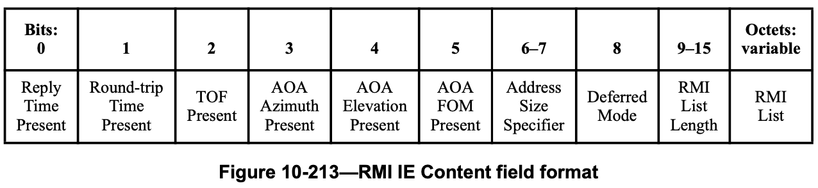
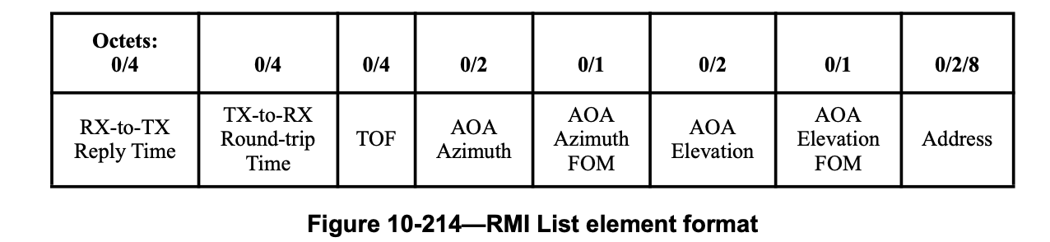
Use 4me RMI IE for MMS DS-TWR
        DOC: 15-24-0436-00-04ab
RMI IE
  Ranging Measurement Information IE (RMI IE)
    Used to send ranging-related measurements to one or more devices
    RMI List Length: specifies the # elements in RMI List
  RMI List
    Reply Time and Round-trip Time fields: unsigned integer with time unit: Tc/128 = 15.65 ps with Tc=1/499.2 us
    4 bytes allow a maximum value of (2^32-1)*15.65/10^9 = 67 ms

Slide 20
Use 4me RMI IE for MMS DS-TWR
        DOC: 15-24-0436-00-04ab
RMI IE configuration for DS-TWR in the case of UWB MMS
  RMI List Length = 3
  RMI List
    #1 element
      Type 1 ranging report
    #2 element
      Type 2 ranging report
    #3 element
      Type 3 ranging report

Slide 21
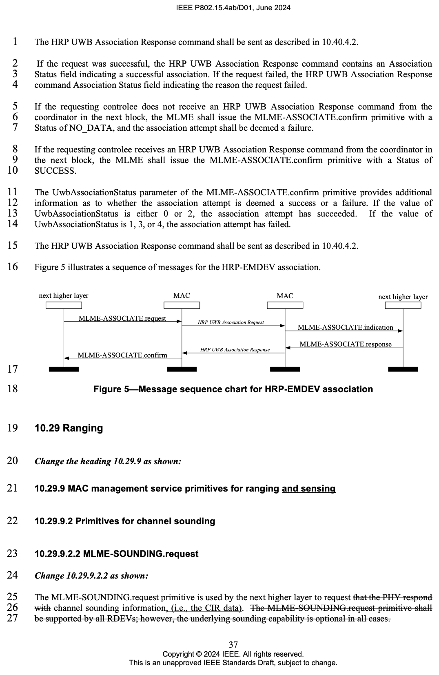
Suggested Changes in 4ab
        DOC: 15-24-0436-00-04ab
10.29 Ranging: Page 37, after line 19, add the following
10.29.8.4 Ranging Measurement Information IE (RMI IE)
Add the following texts at the end of clause 10.29.8.4:
When performing DS-TWR with UWB MMS as described in 10.38, to ensure ranging integrity, multiple RMI List elements will be carried in one RMI IE. Meanwhile, both the RX-to-TX Reply Time field and the TX-to-RX Round-trip Time field shall be interpreted as signed integers that can convey either positive or negative relative timing differences.

Slide 22
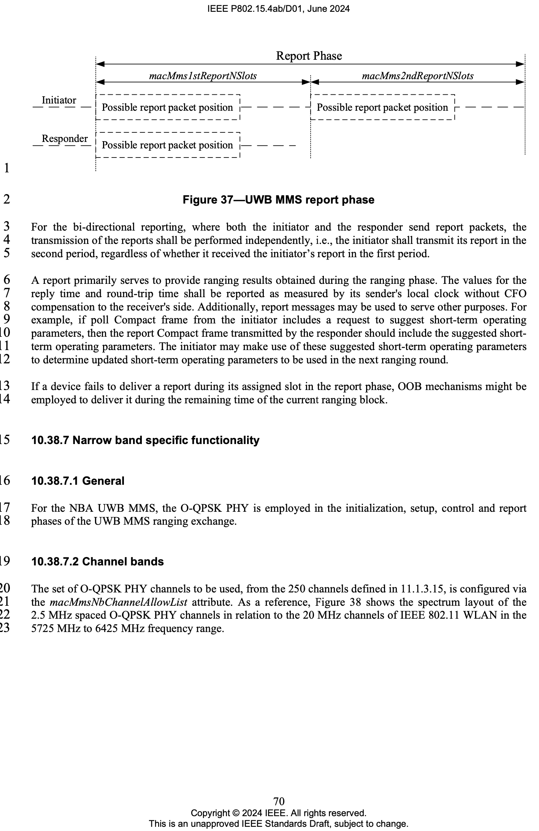
Suggested Changes in 4ab
        DOC: 15-24-0436-00-04ab
10.38.6 UWB MMS report phase: Page 70, after line 14, add the following
When performing DS-TWR with UWB MMS, multiple sets of RIF-RMARKERs could be defined to ensure ranging integrity. Each RIF-RMARKER set includes Ping1-RMARKER from Initiator, Pong-RMARKER from Responder, and Ping2-RMARKER from Initiator.
For DS-TWR with 3 UWB MMS packets, the Ping1-RMARKER is from Initiator’s 1st MMS packet and the Ping2-RMARKER is from Initiator’s 2nd MMS packet.
For DS-TWR with 2 UWB MMS packets, the Ping1-RMARKER is from the 1st RIF Region within Initiator’s MMS packet and the Ping2-RMARKER from the 2nd RIF Region within Initiator’s MMS packet.
RIF-RMARKER Set-Early refers to the set consisting of earliest RIF-RMARKERs. RIF-RMARKER Set-Late refers to the set consisting of latest RIF-RMARKERs.
When reporting measurements with RMI IE in 10.29.8.4, RMI List element #1 reports RX-to-TX reply time and TX-to-RX Round-trip time with respect to RMARKERs in Set-Early. RMI List element #2 reports RX-to-TX reply time and TX-to-RX Round-trip time with respect to RMARKERs in Set-Late. RMI List element #3 reports RX-to-TX reply time and TX-to-RX Round-trip time with respect to Ping1-RMARKER and Pong-RMARKER from Set-Early and Ping2-RMARKER from Set-Late. In this case, both the RX-to-TX Reply Time field and the TX-to-RX Round-trip Time field in Figure 10-214 of 10.29.8.4 shall be interpreted as signed integers.

Slide 23
Part-3:
Ranging Reports with Compact Frames in 4ab
        DOC: 15-24-0436-00-04ab

Slide 24
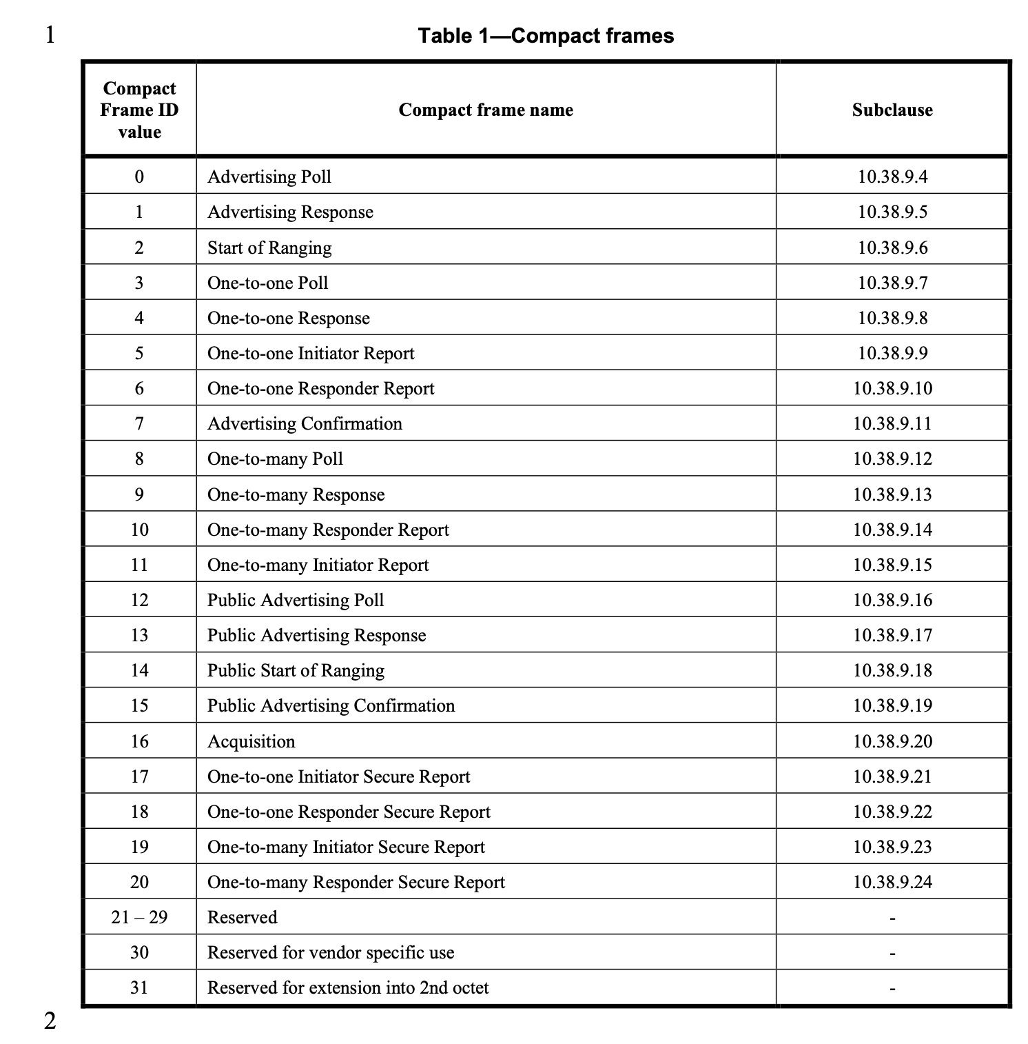
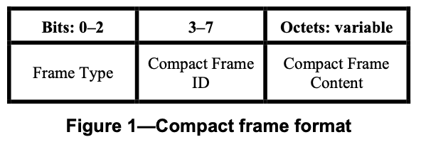
Use Compact Frames for MMS DS-TWR
        DOC: 15-24-0436-00-04ab
4ab Draft1
  7.3.7 Compact frame format
    Compact Frame ID
      Identifies what is carried by the compact frame
    Relevant ones defined in Draft1
      ID=5: One-to-one Initiator Report
        Clause 10.38.9.9
      ID=6: One-to-one Responder Report
        Clause 10.38.9.10

Slide 25
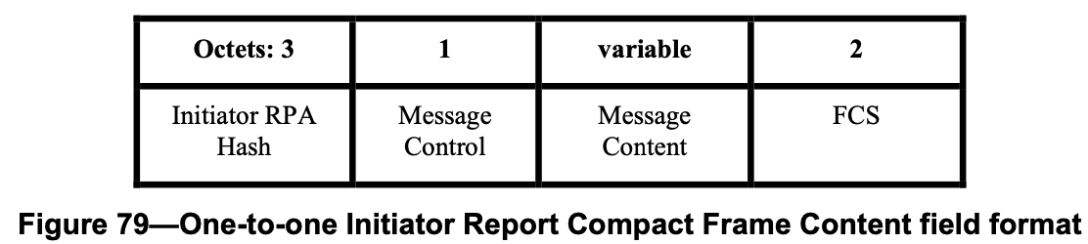
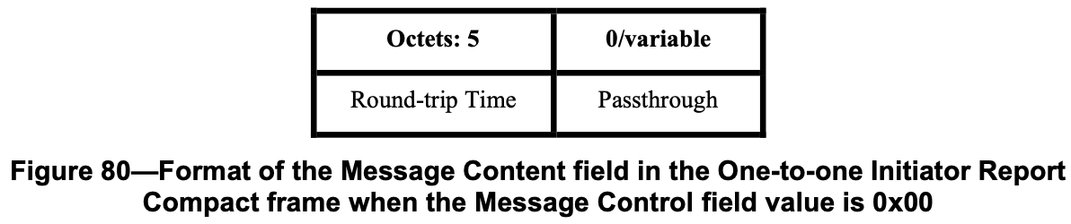
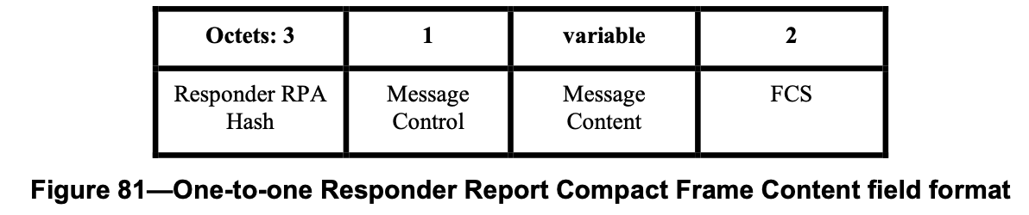
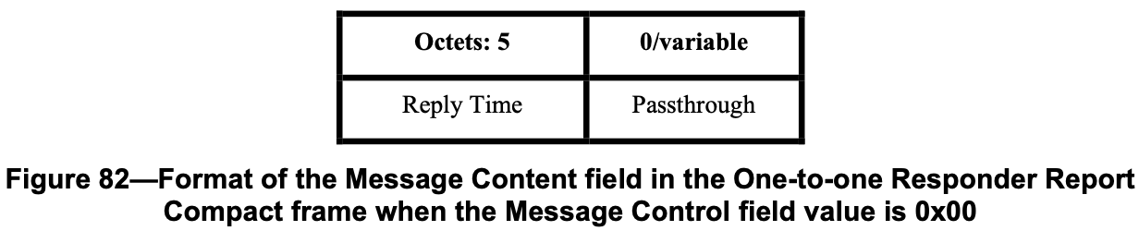
Use Compact Frames for MMS DS-TWR
        DOC: 15-24-0436-00-04ab
4ab Draft1
  10.38.9.9 One-to-one Initiator Report Compact frame
  10.38.9.10 One-to-one Responder Report Compact frame

Slide 26
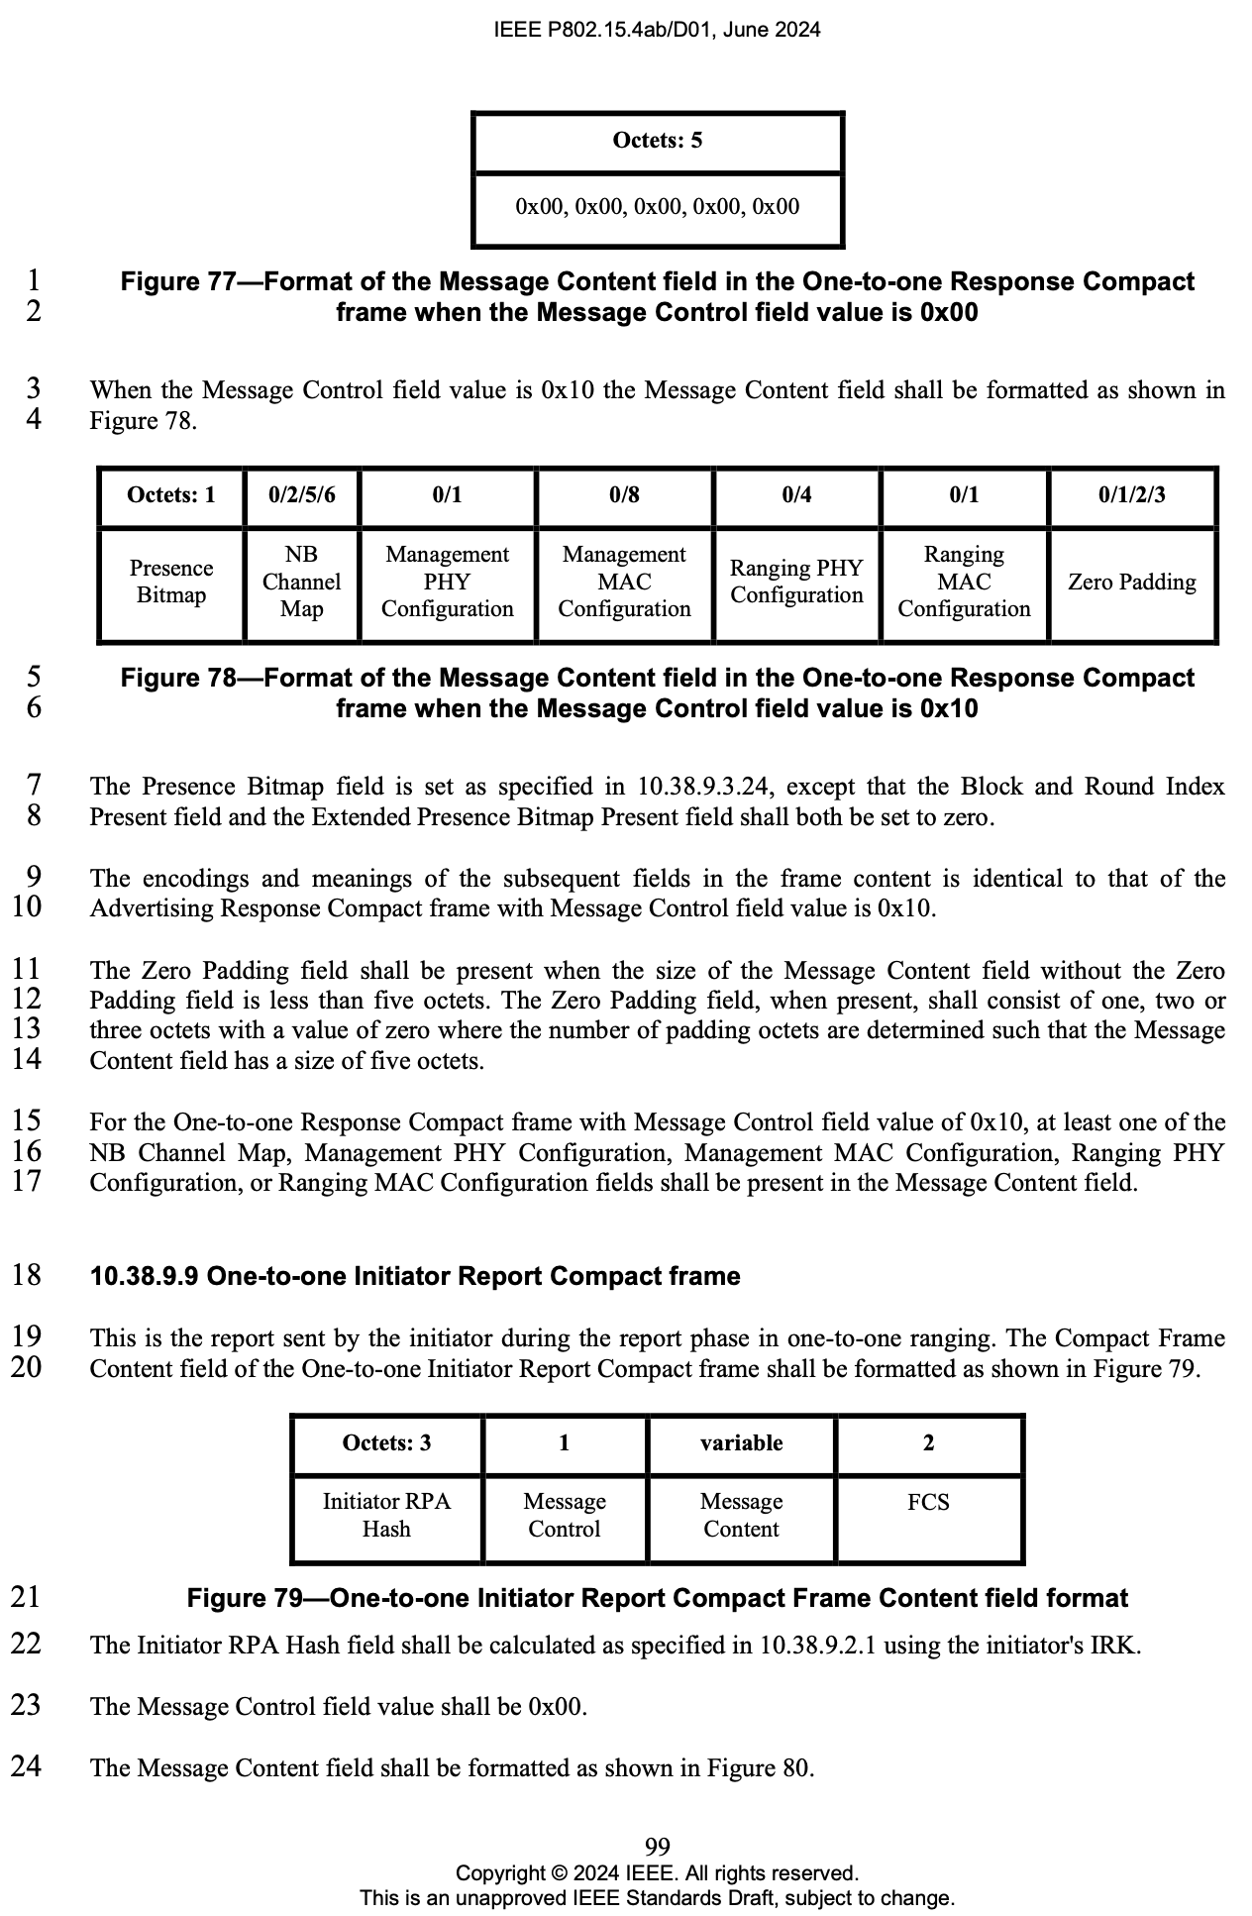
Suggested Changes in 4ab
        DOC: 15-24-0436-00-04ab
10.38.9.9 One-to-one Initiator Report Compact frame
  Page 99, line 23, line 24, update the texts as follows
The Message Control field value is set to 0x00 for SS-TWR. When performing DS-TWR, this field is set to 0xAB for DS-TWR with 2 UWB MMS packets and set to 0xCD for DS-TWR with 3 UWB MMS packets.
The Message Content field shall be formatted as shown in Figure 80 for SS-TWR. When performing DS-TWR, this field shall be formatted as shown in Figure 80.1.

Slide 27
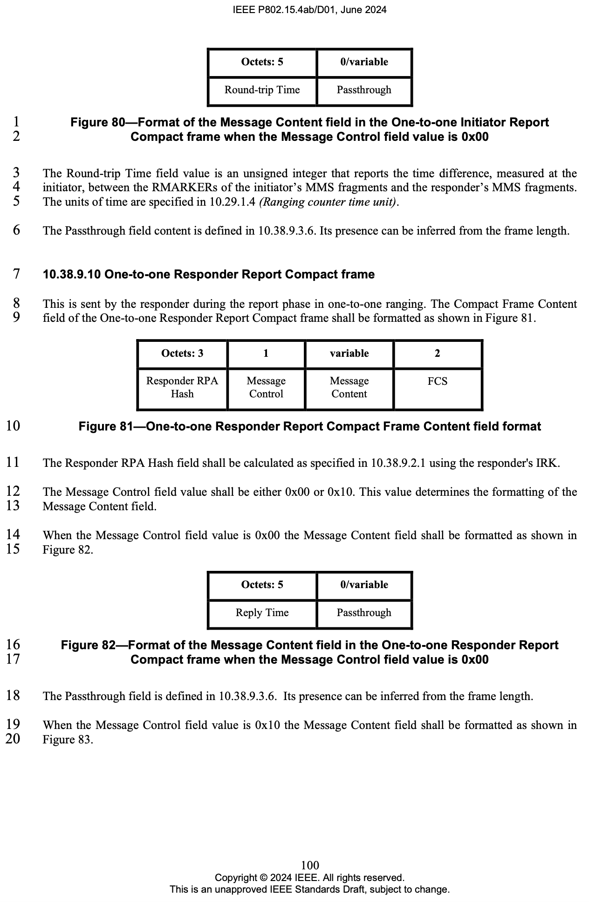
Suggested Changes in 4ab
        DOC: 15-24-0436-00-04ab
10.38.9.9 One-to-one Initiator Report Compact frame
  Page 100, after line 2, add the following figure
Figure 80.1 Format of the Message Content field in the One-to-one Initiator Report Compact frame when Message Control field value is 0xAB or 0xCD
Octets: 5 | Octets: 5 | Octets: 5 | Octets: 5 | Octets: 5 | Octets: 5 | 0/variable
RX-to-TX Reply Time 1 | TX-to-RX Round-trip Time 1 | RX-to-TX Reply Time 2 | TX-to-RX Round-trip Time 2 | RX-to-TX Reply Time 3 | TX-to-RX Round-trip Time 3 | Passthrough

Slide 28
Suggested Changes in 4ab
        DOC: 15-24-0436-00-04ab
10.38.9.9 One-to-one Initiator Report Compact frame
  Page 100, line 3,4,5, update the texts as follows
The Round-trip Time field value in Figure 80 is an unsigned integer that reports the time difference for SS-TWR, measured at the initiator, between the RMARKERs of the initiator’s MMS fragments and the responder’s MMS fragments. The units of time are specified in 10.29.1.4 (Ranging counter time unit).
The values of the RX-to-TX Reply Time field and the TX-to-RX Round-trip Time field in Figure 80.1 are signed integers that report the time differences for DS-TWR with the units of time specified in 10.29.1.4.
When performing DS-TWR with UWB MMS, multiple sets of RIF-RMARKERs are defined to ensure ranging integrity. Each RIF-RMARKER set includes Ping1-RMARKER from Initiator, Pong-RMARKER from Responder, and Ping2-RMARKER from Initiator. For DS-TWR with 3 UWB MMS packets, the Ping1-RMARKER is from Initiator’s 1st MMS packet and the Ping2-RMARKER is from Initiator’s 2nd MMS packet. For DS-TWR with 2 UWB MMS packets, the Ping1-RMARKER is from the 1st RIF Region within Initiator’s MMS packet and the Ping2-RMARKER from the 2nd RIF Region within Initiator’s MMS packet. RIF-RMARKER Set-Early refers to the set consisting of earliest RIF-RMARKERs. RIF-RMARKER Set-Late refers to the set consisting of latest RIF-RMARKERs.
When reporting measurements with the Message Content field in Figure 80.1 for DS-TWR, RX-to-TX reply time 1 and TX-to-RX Round-trip time 1 are with respect to RMARKERs in Set-Early. RX-to-TX reply time 2 and TX-to-RX Round-trip time 2 are with respect to RMARKERs in Set-Late. RX-to-TX reply time 3 and TX-to-RX Round-trip time 3 are with respect to Ping1-RMARKER and Pong-RMARKER from Set-Early and Ping2-RMARKER from Set-Late.

Slide 29
Suggested Changes in 4ab
        DOC: 15-24-0436-00-04ab
10.38.9.10 One-to-one Responder Report Compact frame
  Page 100, line 12, update the texts as follows
The Message Control field value shall be either 0x00, 0x10, 0xAB, or 0xCD.

Slide 30
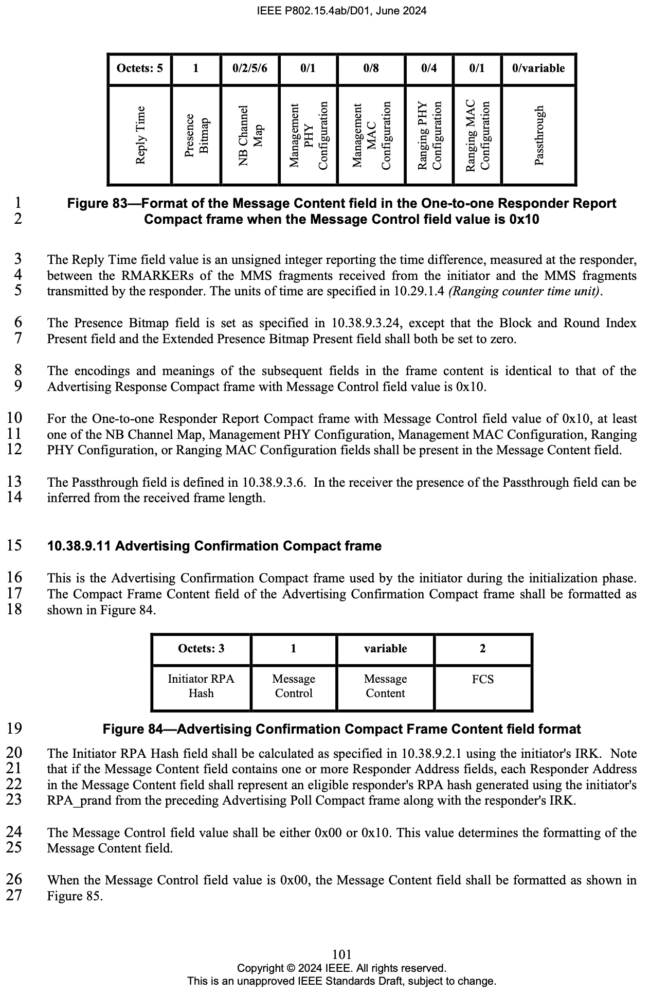
Suggested Changes in 4ab
        DOC: 15-24-0436-00-04ab
10.38.9.10 One-to-one Responder Report Compact frame
  Page 101, after line 2, add the following figure
Figure 83.1 Format of the Message Content field in the One-to-one Responder Report Compact frame when Message Control field value is 0xAB or 0xCD
Octets: 5 | Octets: 5 | Octets: 5 | Octets: 5 | Octets: 5 | Octets: 5 | 0/variable
RX-to-TX Reply Time 1 | TX-to-RX Round-trip Time 1 | RX-to-TX Reply Time 2 | TX-to-RX Round-trip Time 2 | RX-to-TX Reply Time 3 | TX-to-RX Round-trip Time 3 | Passthrough
10.38.9.10 One-to-one Responder Report Compact frame
  Page 101, after line 2, add the following texts
When the Message Control field value is 0xAB or 0xCD, the Message Content field shall be formatted as shown in Figure 83.1. The field value of 0xAB indicates DS-TWR with 2 UWB MMS packets and the field value of 0xCD indicates DS-TWR with 3 UWB MMS packets.

Slide 31
Suggested Changes in 4ab
        DOC: 15-24-0436-00-04ab
10.38.9.10 One-to-one Responder Report Compact frame
  Page 101, line 3,4,5, update the texts as follows
The Reply Time field value in Figure 82 is an unsigned integer reporting the time difference for SS-TWR, measured at the responder, between the RMARKERs of the MMS fragments received from the initiator and the MMS fragments transmitted by the responder. The units of time are specified in 10.29.1.4 (Ranging counter time unit).
The values of the RX-to-TX Reply Time field and the TX-to-RX Round-trip Time field in Figure 83.1 are signed integers that report the time differences for DS-TWR with the units of time specified in 10.29.1.4.
When performing DS-TWR with UWB MMS, multiple sets of RIF-RMARKERs are defined to ensure ranging integrity as described in 10.38.9.9. When reporting measurements with the Message Content field in Figure 83.1 for DS-TWR, RX-to-TX reply time 1 and TX-to-RX Round-trip time 1 are with respect to RMARKERs in Set-Early. RX-to-TX reply time 2 and TX-to-RX Round-trip time 2 are with respect to RMARKERs in Set-Late. RX-to-TX reply time 3 and TX-to-RX Round-trip time 3 are with respect to Ping1-RMARKER and Pong-RMARKER from Set-Early and Ping2-RMARKER from Set-Late.

Slide 32
Part-4:
Backup Slides
        DOC: 15-24-0436-00-04ab

Slide 33
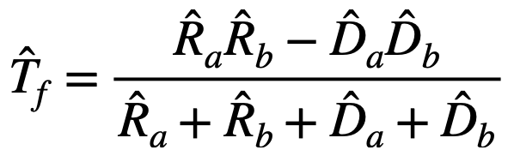
DS-TWR Recap 1: Ping Pong Ping
        DOC: 15-24-0436-00-04ab

Slide 34
DS-TWR Recap 2: Ping Ping Pong
        DOC: 15-24-0436-00-04ab
Ping-Ping-Pong is equivalent to Ping-Pong-Ping when treating timing values as negative numbers!

Slide 35
DS-TWR Recap 3: Pong Ping Ping
        DOC: 15-24-0436-00-04ab
Ping-Ping-Pong is equivalent to Pong-Ping-Ping when treating timing values as negative numbers!

Slide 36
DS-TWR with 3 Pkts: Multiple Sets of RMARKERs
        DOC: 15-24-0436-00-04ab
Ping1-Set1
Ping1-Set2
Ping2-Set1
Ping2-Set2
1
2
1
2
Device-A
Initiator
Each set of RIF-RMARKERs include: Ping1, Pong, Ping2
Ping1-RMARKER from Initiator’s 1st MMS packet
Pong-RMARKER from Responder’s MMS packet
Ping2-RMARKER from Initiator’s 2nd MMS packet
Pong-Set1
Pong-Set2
1
2
Device-B
Responder

Slide 37
DS-TWR with 3 Pkts: Multiple Sets of RMARKERs
        DOC: 15-24-0436-00-04ab
Ping1-Set1
Ping1-Set2
Ping2-Set1
Ping2-Set2
1
2
1
2
Device-A
Initiator
Pong-Set1
Pong-Set2
1
2
Device-B
Responder

Slide 38
DS-TWR with 2 Pkts: Multiple Sets of RMARKERs
        DOC: 15-24-0436-00-04ab
Ping1-Set1
Ping2-Set1
Ping1-Set2
Ping2-Set2
1
1
2
2
Device-A
Initiator
RIF Region 1
RIF Region 2
Each set of RIF-RMARKERs include: Ping1, Pong, Ping2
Ping1-RMARKER from Initiator’s 1st RIF Region: RIF-1,…,7
Pong-RMARKER from Responder’s MMS packet
Ping2-RMARKER from Initiator’s 2nd RIF Region: RIF-2,…,8
Pong-Set1
Pong-Set2
1
2
Device-B
Responder

Slide 39
DS-TWR with 2 Pkts: Multiple Sets of RMARKERs
        DOC: 15-24-0436-00-04ab
Ping1-Set1
1
1
Ping2-Set1
Ping1-Set2
2
2
Ping2-Set2
Device-A
Initiator
RIF Region 1
RIF Region 2
Pong-Set1
Pong-Set2
1
2
Device-B
Responder

