Slide 1
Project: IEEE P802.15 Working Group for Wireless Personal Area Networks (WPANs)
Submission Title: [Next Steps for the Interference Model]
Date Submitted: [17 July, 2024]
Source: [Joerg ROBERT] Company [TU Ilmenau/Fraunhofer IIS]
Address [Helmholtzplatz 2, Ilmenau, 98693, Germany]
E-Mail:[joerg.robert@ieee.org]
Abstract: []
Purpose: [Presentation in TG15.4ad]
Notice: This document has been prepared to assist the IEEE P802.15. It is offered as a basis for discussion and is not binding on the contributing individual(s) or organization(s). The material in this document is subject to change in form and content after further study. The contributor(s) reserve(s) the right to add, amend or withdraw material contained herein.
Release: The contributor acknowledges and accepts that this contribution becomes the property of IEEE and may be made publicly available by P802.15.

Slide 2
Motivation
Comparison of different proposals requires simulations of the physical layer performance
The proposed systems will operate in license-exempt frequency bands, resulting in interference from other systems
A suitable approach for the model has been presented in 15-24-0378-00
The layer have to be updated to reflect lasted changes in the frequency use

Slide 3
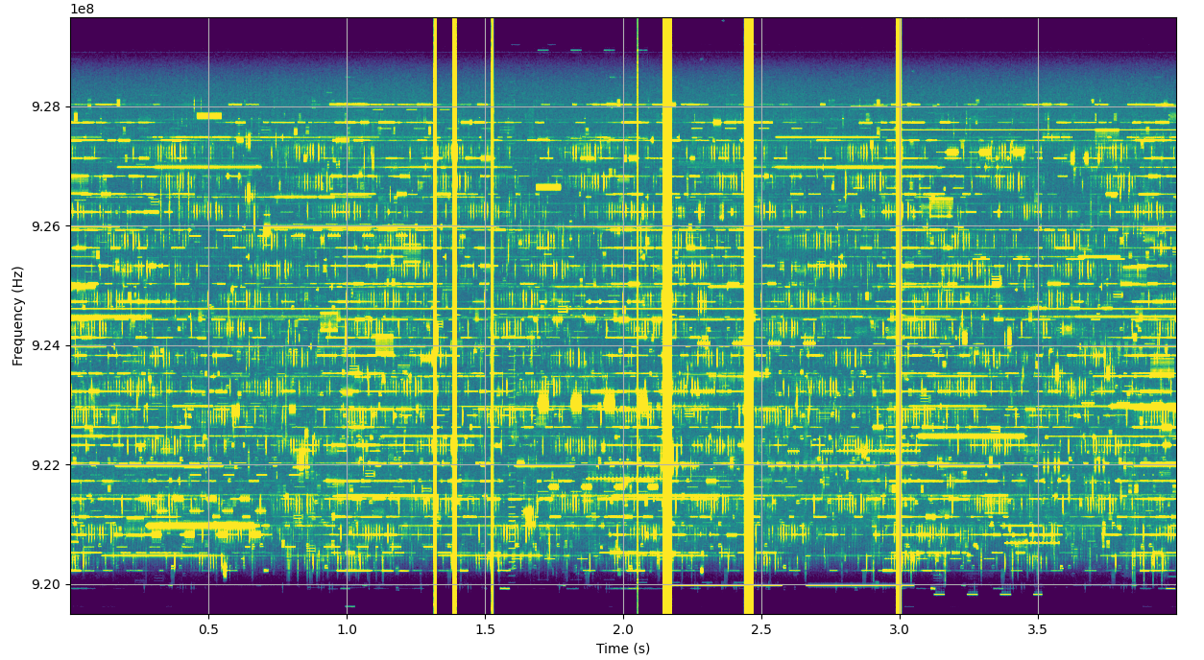
Example of Measured Spectrogram Measured in Hotel Room on 15th Floor

Slide 4
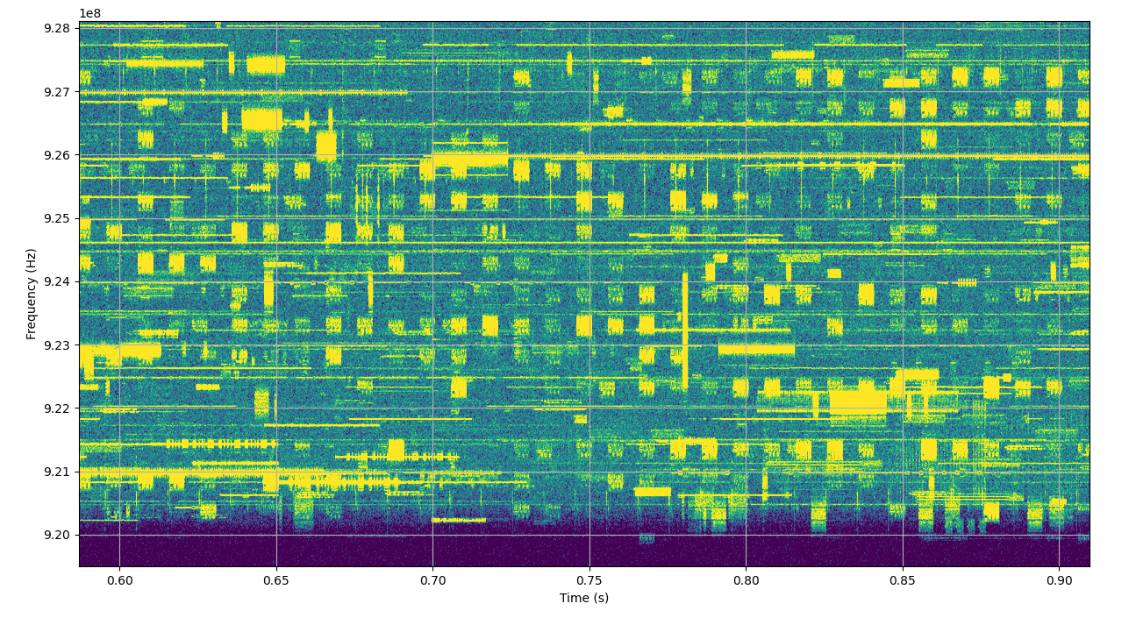
Zoom of Measured Spectrum

Slide 5
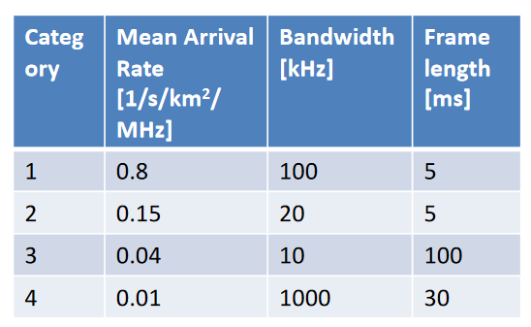
Parametrization of Layers
Currently defined layer reflect the situation in Germany in 2018
Interference models for the FCC region are currently not available
Channel measurements are already available, analyses are ongoing

Slide 6
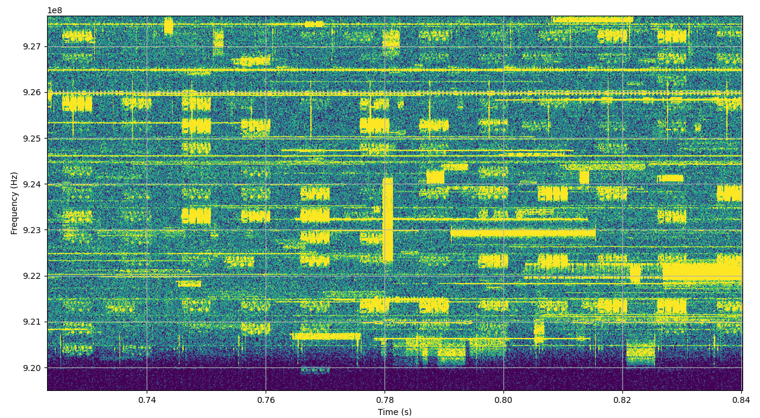
Examples of Defining Different Layers

Slide 7
Automatic Definition of Layers
Image processing tools will be used to identify the channel use
Data for different locations are already available
Data for Japan is still missing
Proposal for layers will be available for the September meeting
Any kind of help is welcome!

Slide 8
Thank You! Questions?

