Slide 1
Diversified Range Communication for Disaster Response Operations
Date: 2024-07-17
Authors:

Slide 2
Abstract
For the disaster response operations, a low-cost long range mobile communication system is needed as a backup system for the cellular service, or as a last mile connectivity for NTNs.
Diversified Range IoT (DR-IoT) that exponentially changes the bandwidth and the power spectral density is proposed as one such system. It has been considered one of the Narrowband IoT systems in the VHF-High band in Japan.
However, DR-IoT may bear severe interference from adjacent systems, and there needs to be a mechanism to mitigate its impact on the performance.
Such a mechanism can make use of SRM, but some extensions to the current set of SRM frames may be necessary.

Slide 3
Background
Japan has been experiencing numerous natural disasters (storm, flood, earthquake etc.) over the years.
First responders to the disastrous area need alternative data communication means to the cellular service, as the cellular infrastructure hit by a natural disaster may become inoperable for days or even weeks.
Non-terrestrial networks (NTNs) with LEO satellites or HAPS may be good alternatives, while it is not yet affordable enough for all responders to carry NTN capable mobile devices for their operation.
A new, low-cost mobile communication system is in need as a backup system for the cellular service, or as a last mile connectivity for NTNs.

Slide 4
System Requirements
The new system must be capable of long range communication, as the multi-hopping technology for extending the range is considered unrealistic particularly in a vast disastrous area.
  As the responders use Digital Convenience Radio (DCR) for their voice-oriented operations in Japan, the communication range of the new system is expected to be comparable to that of DCR.
  However, a mobile DCR with typical specifications (fc: 351 MHz, BW: 6.25 kHz, Tx power: 5 W) can reach over 30 kilometers, which is very challenging to achieve at a high data speed.
On the other hand, since the operation uses many non bandwidth demanding applications, the device data rate can be compromised in lieu of the power consumption level, or the device’s portability (weight).

Slide 5
Examples of Low Rate Disaster Response Applications
Among this diverse set of applications, ones running at a lower rate or at a low duty cycle require longer communication ranges.
Application | Required data rate | Use cases
Short text messaging | Less than a few kbps | Safety confirmation, emergency alert, etc.
GPS tracking |  | Locating responders, vehicles, shelters, etc.
Intermittent monitoring |  | Monitoring temperature, precipitation, water level, etc.
Voice memo (low quality) | 10 - 50 kbps | Voicemail (when the voice call cannot be established)
Transceiver (simplex, low quality) |  | Walkie-talkie
Image sharing (low resolution) |  | Area assessment at the base (when data rate is limited)
Voice call (duplex, low quality) | 50 - 100 kbps | Real time communication between the base and responders
DB sharing (small size) |  | Shelter management (conditions, supplies, etc.)
Voice conferencing (low quality) | More than 100 kbps (up to a few hundred kbps) | Conferencing among the base and responders
Image sharing (a few hundred kB) |  | Area assessment at the base
Video streaming (low resolution) |  | Drone control in a long distance or NLOS environment

Slide 6
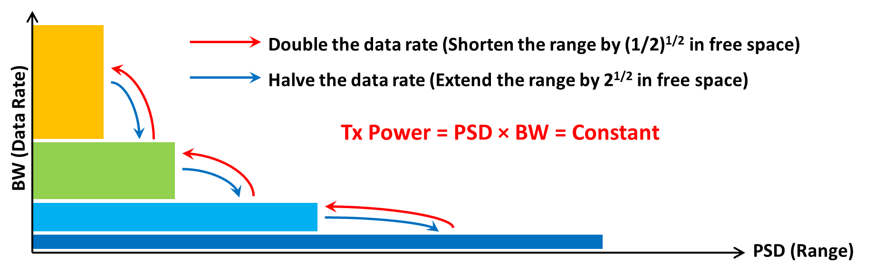
Concept of Diversified Range IoT (DR-IoT)
To support a diverse set of low-rate application requirements, there needs to be a trade-off between the communication range and the data rate.
DR-IoT exponentially (2^{n}) changes the bandwidth (BW) and the power spectral density (PSD) while keeping the Tx power the same.
  This realizes adaptation of the communication range and the data rate without having to increase the power consumption.

Slide 7
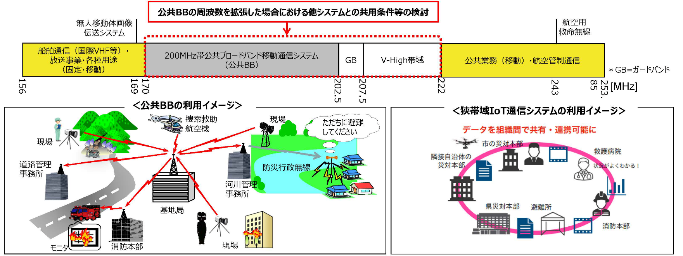
Narrowband IoT Systems in the VHF-High Band (Japan)
DR-IoT was proposed as one of the Narrowband IoT systems in the VHF-High band (170 – 222 MHz) in Japan, and it has been currently under regulatory review by the Information and Communications Council.
Public Broadband
Mobile Communication Systems (Public BB)
VHF-High Band IoT (VHF IoT) system
Ministry of Internal Affairs and Communications (MIC)
FY 2022 spectrum reorganization action plan [1]

Slide 8
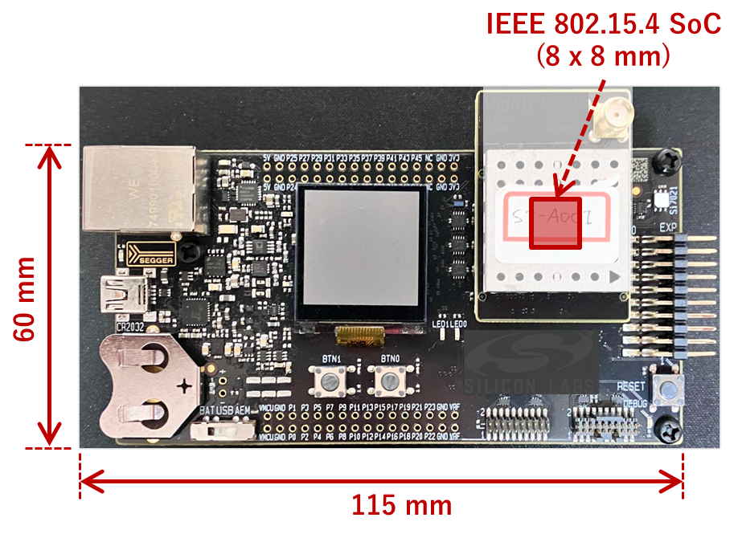
A Proof-of-Concept DR-IoT System
A DR-IoT system prototype has been implemented using an IEEE 802.15.4 chipset that supports the FSK modulation.
A batch of measurements with the prototype together with user hearings has been performed in small cities and rural areas of Japan since 2021.
DR-IoT system prototype specification
Parameter | Values
Operating frequencies [MHz] | 207.5 – 222 [MHz]
Maximum TX power [dBm] | 19 [dBm] (1st generation), 37 [dBm] (2nd generation)
Modulation scheme | GMSK (2GFSK with modulation index = 0.5)
Channel bandwidth [kHz] | 6.25 × 2^{n} [kHz] where n = 0, 2, 4, 6 (400 when n = 6)
Data rate [kbps] | 5 × 2^{n} [kbps] where n = 0, 2, 4, 6 (320 when n = 6)
Media access | CSMA/CA (IEEE 802.15.4)
First generation prototype of DR-IoT device

Slide 9
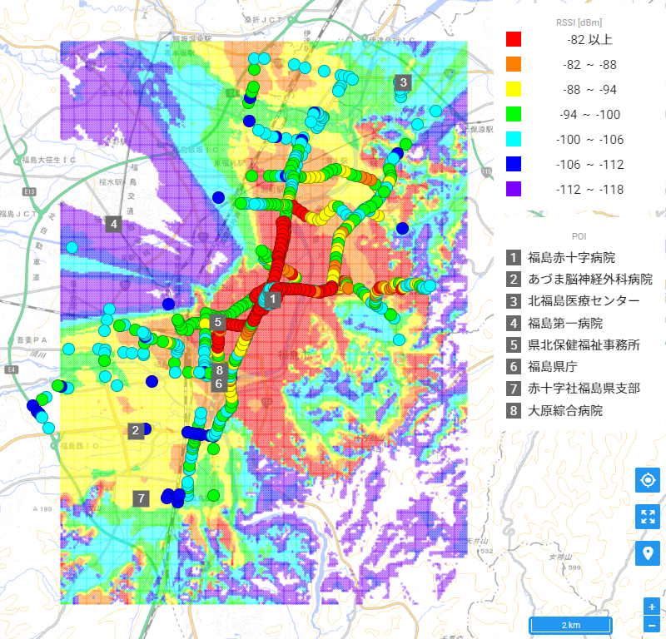
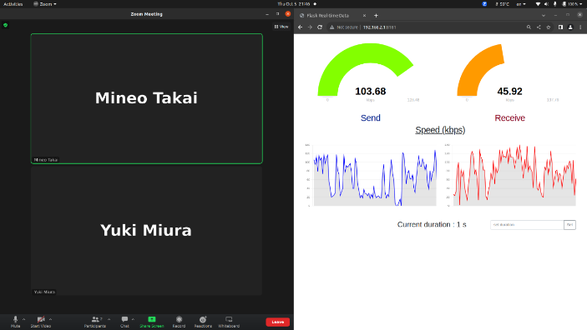
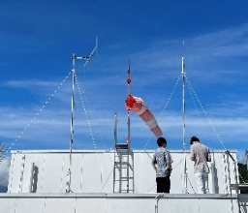
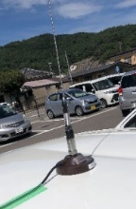
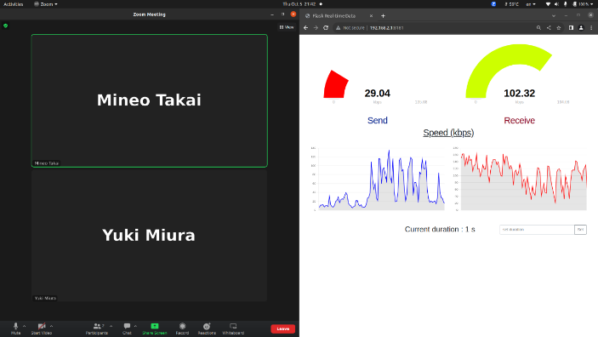
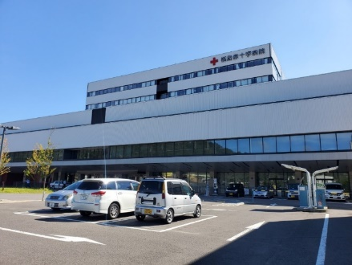
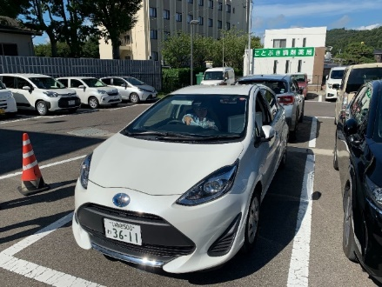
DR-IoT Experiment in Fukushima
At 19 dBm, vehicles reached up to 6 km at 5 kbps from a hospital near downtown, while 2-party voice conferencing (indoor) ran successfully at 320 kbps (September 2023) [2].
Carrier frequency: 210 MHz
Tx power: 19 dBm
Antenna Gain (both sides): 2.15 dBi
Rooftop Antenna Height: 36 m
Vehicle Antenna Height: 1.6 m
6.4 km
6.0 km
Fukushima Red Cross Hospital (Left)
and a vehicle (Right) in the experiment
Measured RSSI (5 kbps) and
simulation result (Longley-Rice)
Voice conferencing over a DR-IoT
channel (320 kbps, indoor)

Slide 10
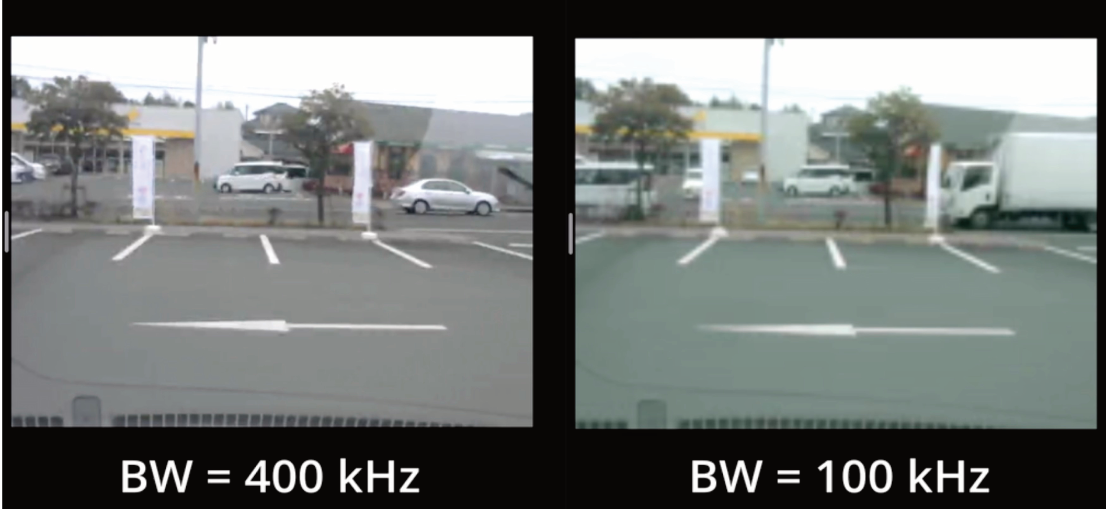
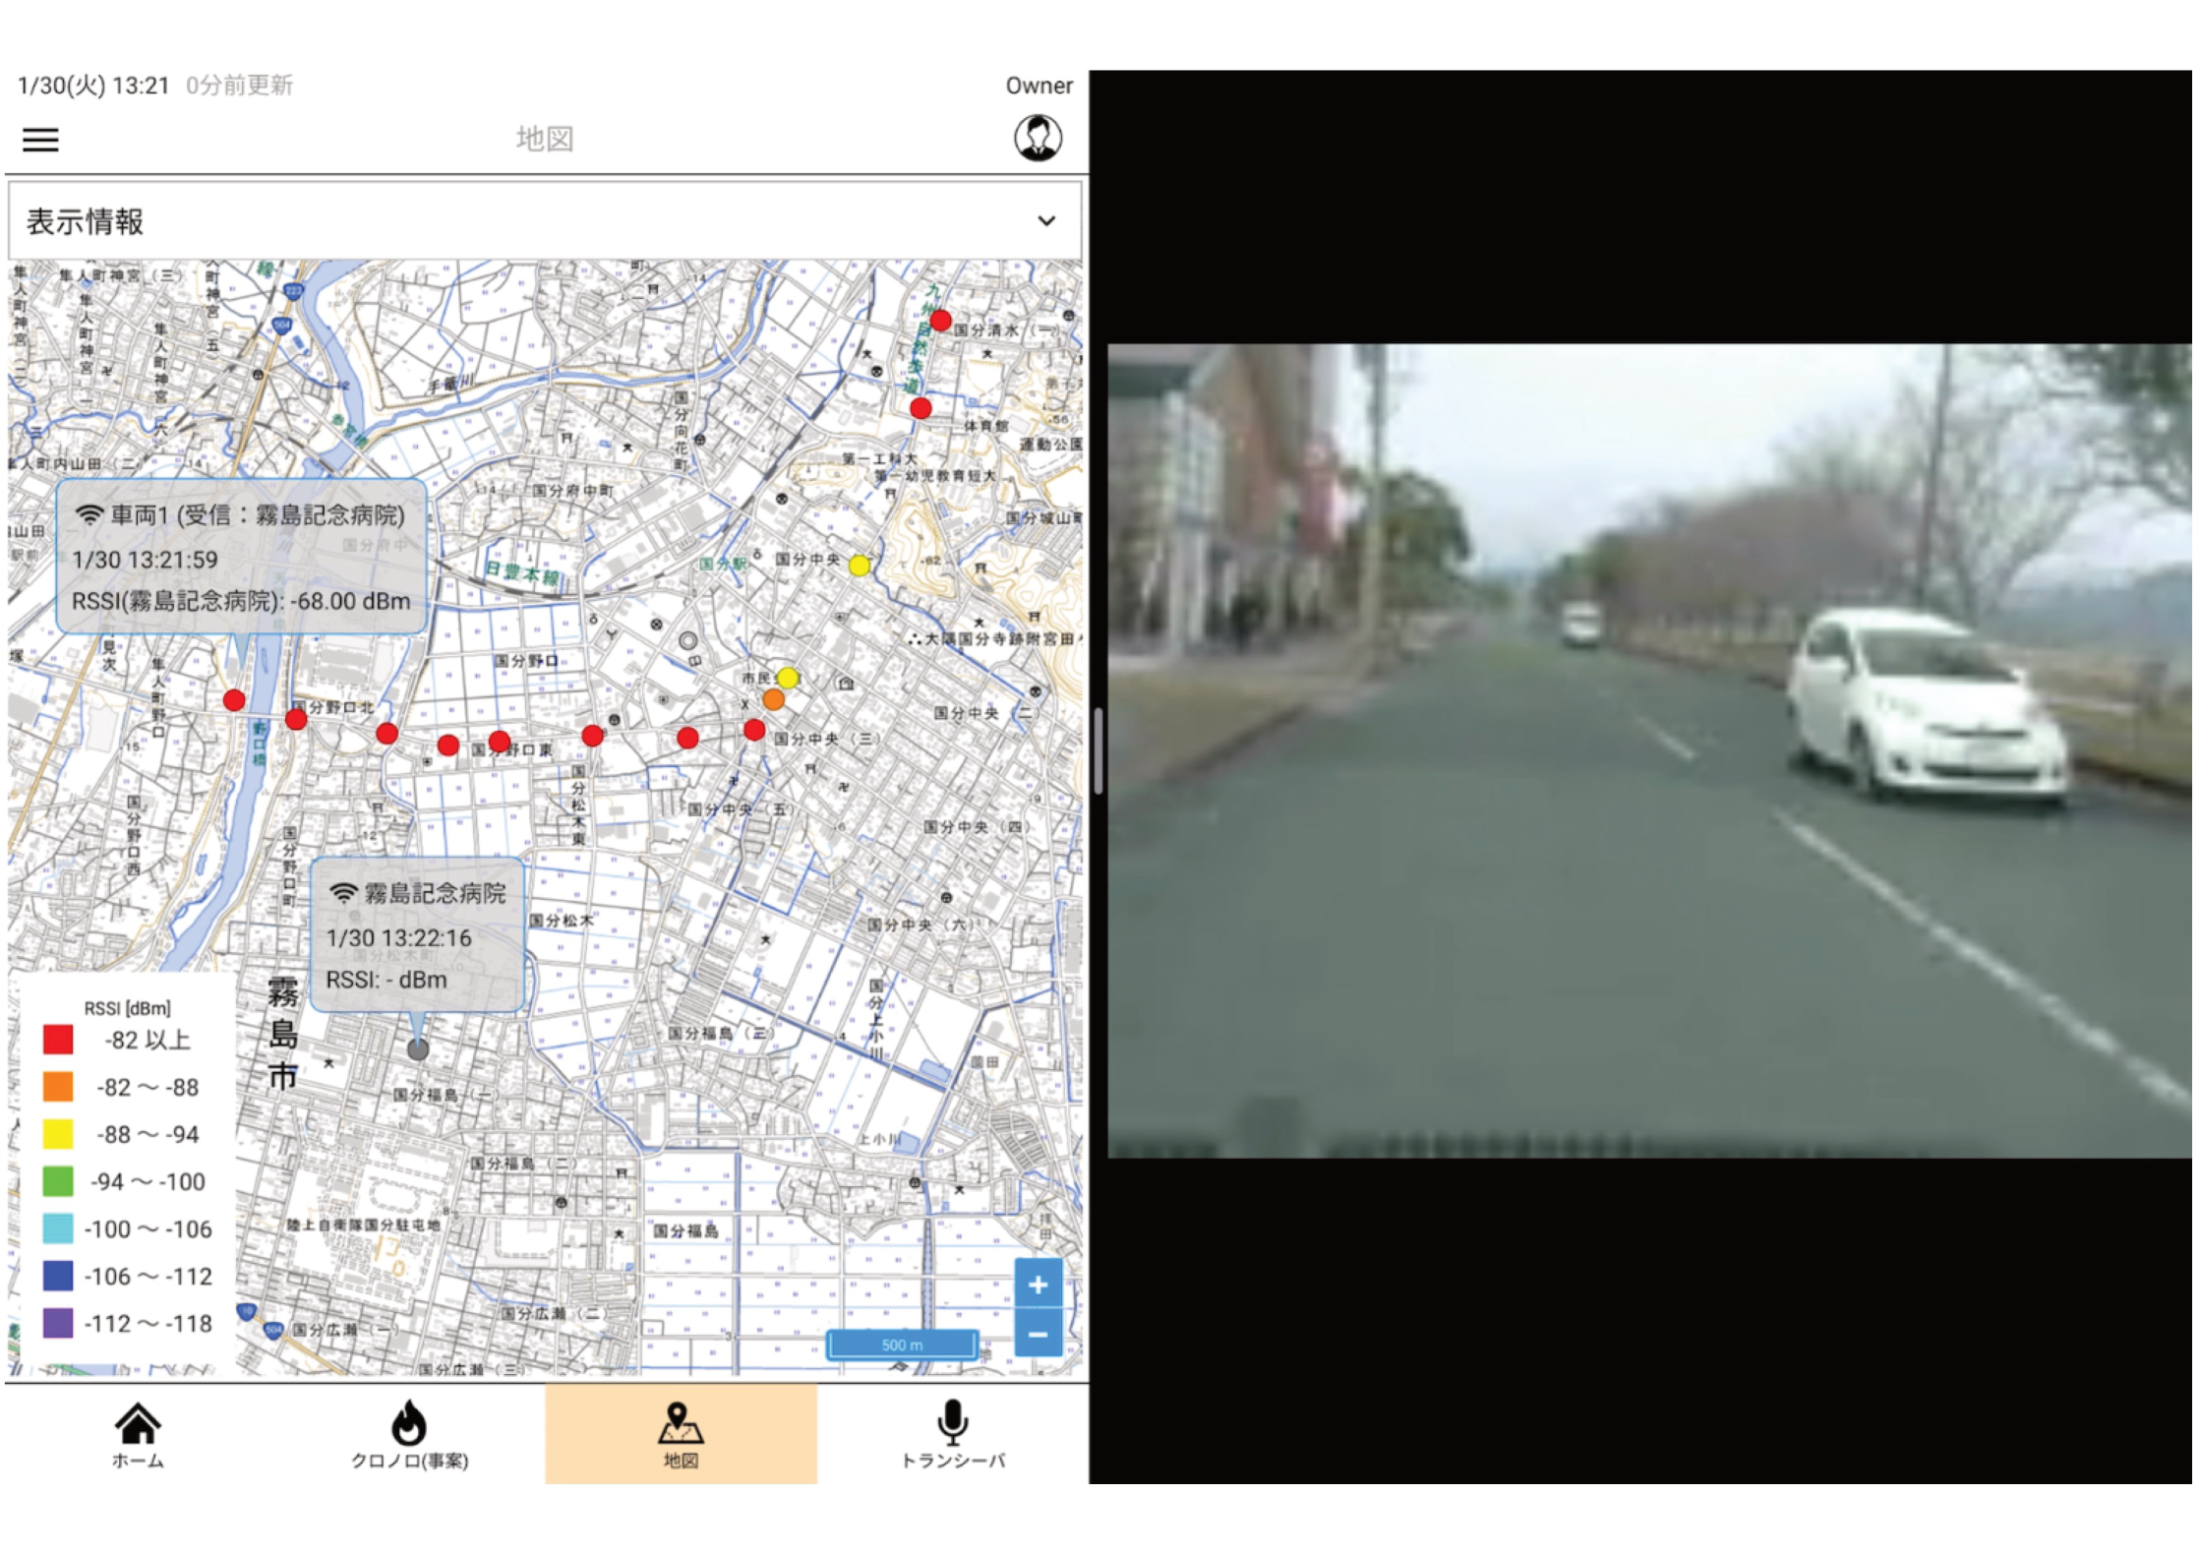
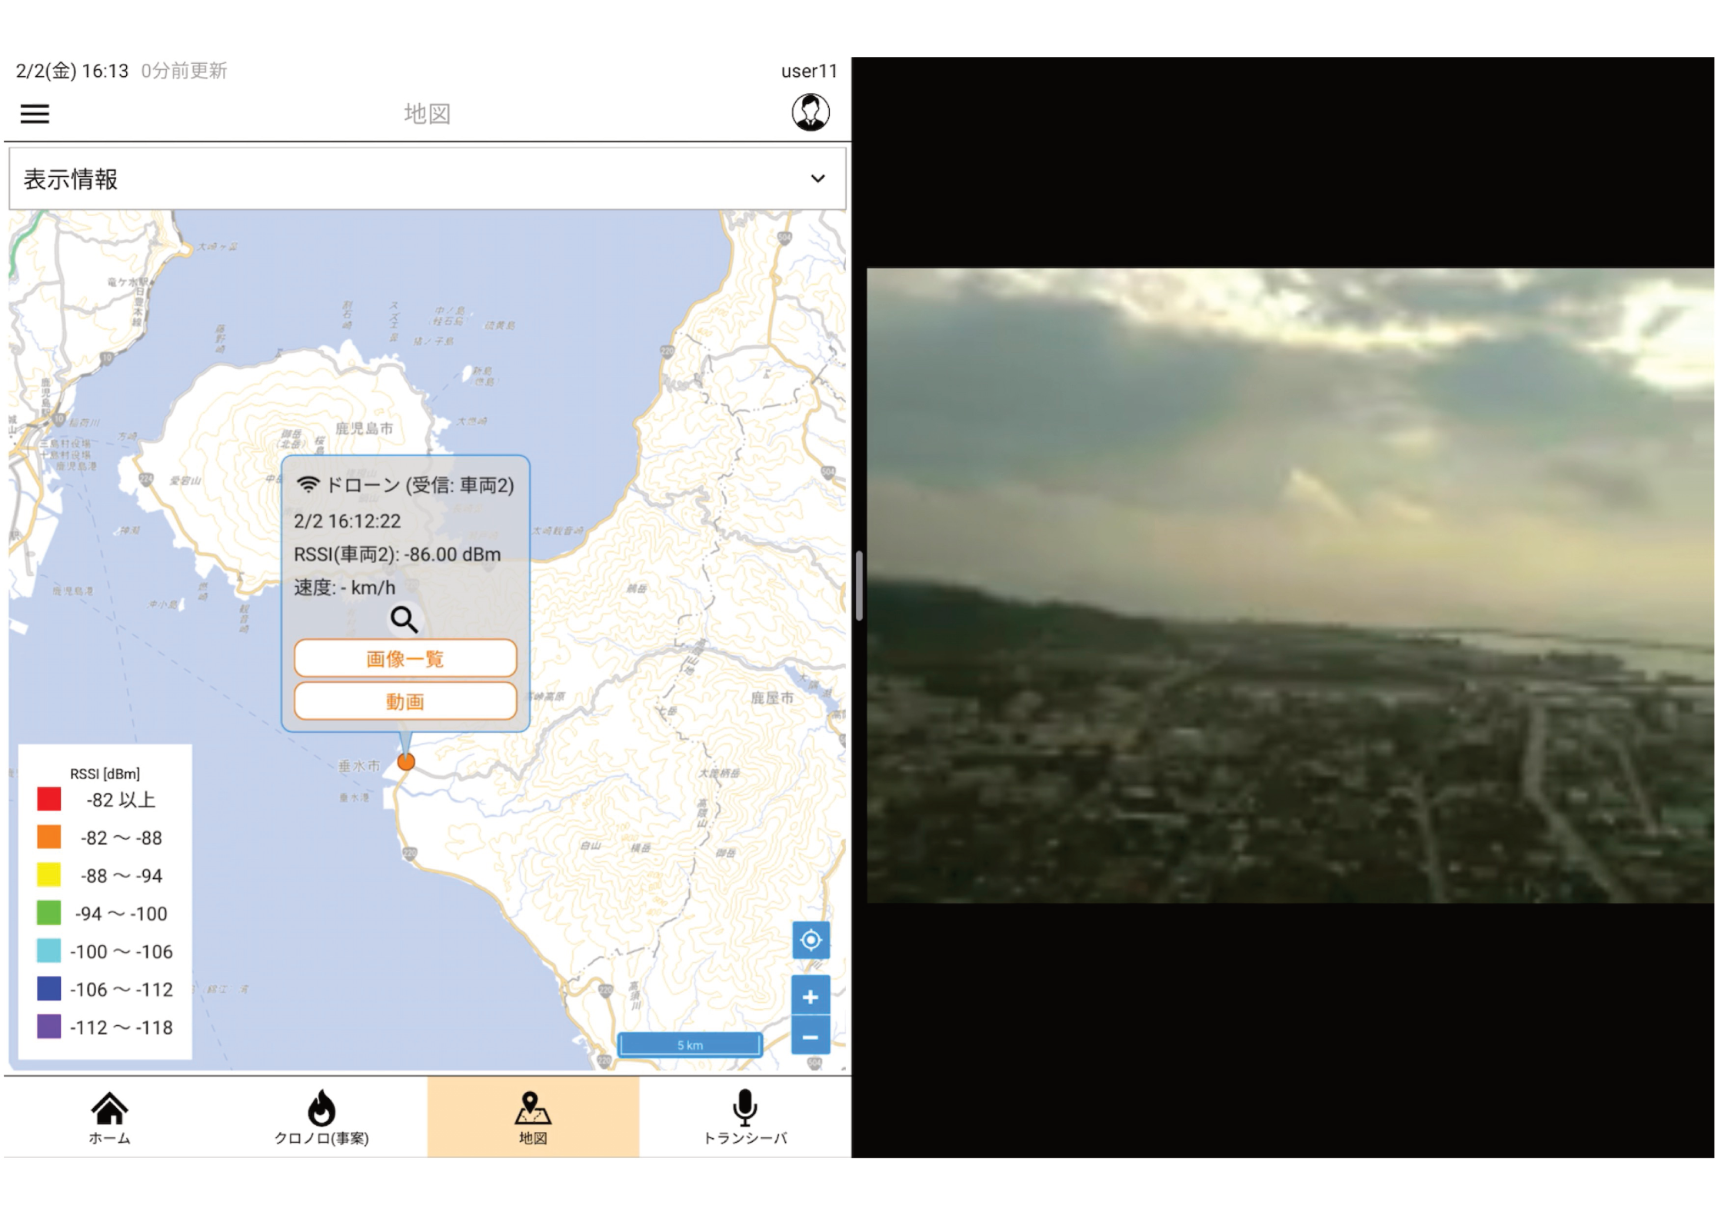
User Hearings on the DR-IoT Use Cases
Many user hearings at local governments, fire departments and hospitals reveal that the DR-IoT’s capability would be useful not only on the emergency situations but also on their regular business activities [3].
H.264 encoding H.264 encoding
VGA (640x480) at 10 fps QVGA (320x240) at 5 fps
Location information every 5 s
QVGA (320x240) at 5 fps
Altitude: 120 m from the ground
Ground control 7 km away
Comparison of video streaming resolutions
at user hearings in Kagoshima Prefecture
Vehicle GPS tracking with
on-board camera streaming
Drone mounted camera streaming
for NLOS control

Slide 11
Major issue with DR-IoT operations
DR-IoT may bear severe interference from adjacent systems including Public Broadband Mobile Communication Systems (Public BB).
  Public BB’s adjacent channel emission is up to 19 dBm/MHz.
  This would make a DR-IoT device about 10 km away* from Public BB report a busy medium if the ED threshold is set to -80 dBm/MHz for instance.
* Free space pathloss of 99 dB
DR-IoT operation considered
DR-IoT operation considered
Public BB Maximum EIRP:
40 dBm/MHz
-21 dBc
Public BB Emission:
19 dBm/MHz
Lower Frequency adjacent systems
Public Broadband Mobile
Communication Systems (Public BB)
99 dB
Air Traffic Control Systems
ED threshold:
-80 dBm/MHz
170
177.75
217.5
222.0

Slide 12
Utilization of Spectrum Resource Measurement Frames
DR-IoT systems can still operate under the severe interference by using a narrower bandwidth channel, but there needs to be a feedback mechanism for the PAN coordinator to collect the reception conditions of associated devices.
DR-IoT can utilize Spectrum Resource Measurement (SRM) frames defined in the IEEE 802.15.4 for the PAN coordinator to collect feedback from the devices.
However, extensions to the current set of SRM frames may be necessary in order to perform the following functions:
  Determining the required application bandwidth
  Scanning receiving conditions of channels other than the operating channel
  Controlling the TX power to mitigate the unnecessary interference to other PANs

Slide 13
Overview of SRM
[SRM Request]
Timing: On demand
Request type:
- information get: PIB attributes
- information set: TPC
IEEE802.15.4s-2018 defines
  SRM: Spectrum Resource Measurement
  TPC: Transmit Power Control
[SRM Response/Report]
Timing:
- Response: in response to SRM request
- Report: periodical or event-driven
Information type:
- Response: PIB attributes
- Report: Status
[SRM Information/Extended Beacon]
Timing: On demand or periodical
- Extended Beacon: before MAC join
- SRM Information: after MAC join
Information type: information set (TPC)

Slide 14
Summary
Diversified Range IoT (DR-IoT) that exponentially changes the bandwidth and the power spectral density is proposed for the disaster response operations.
Hearings from local governments, fire departments, and hospitals reveal that its capability would be useful for both emergency and regular uses.
However, its operating frequencies under consideration by the regulators in Japan may bear severe interference from adjacent systems, and there needs to be a mechanism to mitigate its impact on the performance.
Such a mechanism can make use of SRM frames, but some extensions to the current set of SRM frames may be necessary.
As a next step, a gap analysis between the proposed DR-IoT specifications and the current IEEE 802.15.4 standard should be done.

Slide 15
References
[1] Ministry of Internal Affairs and Communications, “FY 2022 Spectrum Reorganization Action Plan,” https://www.soumu.go.jp/main_content/000846640.pdf (Abstract)
[2] Y. Miura, M. Takai, T. Ikegami, etc., “Use of Diversified Range IoT (DR-IoT) in Disaster Medicine,” 29th Annual Meeting of Japanese Association for Disaster Medicine, February 2024.
[3] M. Takai, S. Ishihara, K. Uchiyama, etc., “A Phase-Free Use of Diversified Range IoT (DR-IoT) Data Communication Systems,” 29th Annual Meeting of Japanese Association for Disaster Medicine, February 2024.

Slide 16
Format of SRM Metric ID
Attribute name SRM | Metric ID | Attribute name SRM | Metric ID
macED | 0 | macDuplicateFrameCount | 17
macTxFailTime | 1 | macRxSuccessCount | 18
macTxDeferredTime | 2 | macNackCount | 19
macRetryHistogram | 3 | macDeferredTxCount | 20
macChannelUtilization | 4 | macAverageBufferUtilization | 21
macRcp | 5 | macMaximumBufferUtilization | 22
macRsni | 6 | macTxFragmentCount | 23
macRssi | 7 | macRxFragmentCount | 24
macNoiseHistogram | 8 | macTxMulticastCount | 25
macFrameErrorCount | 9 | macRxMulticastCount | 26
macCounterOctets | 10 | macAverageAccessDelay | 27
macRetryCount | 11 | macChannelPage | 28
macMultipleRetryCount | 12 | macChannelNumber | 29
macTxFailCount | 13 | macRxAddrMode | 30
macTxSuccessCount | 14 | macRxDeviceAddress | 31
macFcsErrorCount | 15 | Reserved | 32–63
macSecurityFailure | 16

