Slide 1
IG NG-OWC
Submission Title: Utilization of OCC for Localization in a Constrained Environment
Date Submitted: July 16, 2024
Source: Ida Bagus Krishna Yoga Utama, Nguyen Ngoc Huy, Yeong Min Jang (Kookmin University)
Address: Room #603 Mirae Building, Kookmin University, 77 Jeongneung-Ro, Seongbuk-Gu, Seoul, 136702, Republic of Korea
Voice: +82-2-910-5068 E-Mail: yjang@kookmin.ac.kr
Re:
Abstract: Present the use case of OCC for indoor positioning in a constrained environment
Purpose: Presentation for contribution on IG NG-OWC
Notice: This document has been prepared to assist the IG NG-OWC. It is offered as a basis for discussion and is not binding on the contributing individual(s) or organization(s). The material in this document is subject to change in form and content after further study. The contributor(s) reserve(s) the right to add, amend or withdraw material contained herein.
Release: The contributor acknowledges and accepts that this contribution becomes the property of IEEE and may be made publicly available by IG NG-OWC.

Slide 2
Utilization of OCC for Localization in a Constrained Environment Contribution July 16, 2024

Slide 3
Contents
Introduction
Existing Solutions
Proposed Solutions
Conclusion

Slide 4
Introduction
In a constrained environment, limited options are available to perform localization.
In most cases, localization in a constrained environment requires a complex setup or heavy computation.
One potential applications of localization in a constrained environment is underground mine.
Nowadays, mine industry tries to apply a smart mining to improve the safety and health of the mine workers.
Based on Xu, et al. [1], main issues for localization in underground mine are as follows:
Lack of effective high-precision absolute positioning
Long working time and high position accuracy requirements
Complex working conditions, harsh underground environment, and the sensor contains large errors

Slide 5
Existing Solution
Currently, several methods emerges as solution to perform localization in a constrained environment:
Inertial navigation system
Wireless sensor networks
Camera-based sensing
LiDAR-based sensing

Slide 6
Existing Solution
Inertial navigation system (INS)
INS is an instrument that estimate the current position and attitude based on the accelerometers and gyroscopes data.
Researchers has been utilizing the INS for localization in an underground mine [2].
Advantages | Disadvantages
Provide high-precision position and attitude information | Accumulative error
Provide a continuous position information | The measurement should be performed continuously
Less interference
Easy to compute

Slide 7
Existing Solution
Wireless sensor networks (WSN)
Localization using WSN is performed by deploying a large number of sensor nodes across the environment.
The equipment estimate its position by utilizing the position of the anchor nodes.
The position can be recovered from the RSSI or CSI of the retrieved signal.
Advantages | Disadvantages
Reliable and robust | Complex sensor setup and deployment
Provide instant position information, no accumulative errors | Accuracy may decrease due to the environment structure, causing more NLOS signal

Slide 8
Existing Solution
Camera-based sensing
Camera-based sensing can be performed using two techniques, the visual odometry and visual landmark matching [3].
These methods utilize only image data to estimate the movement of the equipment and thus provide the position information.
Advantages | Disadvantages
Low cost | Accumulative error
Simple to setup | The camera lens may be obstructed by the dust or low-light environment
Provide a continuous measurement | Need a complex algorithm to generate a precise position and attitude estimation
 | Requires a higher computation power

Slide 9
Existing Solution
LiDAR-based sensing
Localization using LiDAR-based sensing can be performed by using SLAM and odometry technique.
The retrieved 3D point cloud data is processed to estimate the changes in position and attitude of the equipment while also allows for 3D map generation.
Advantages | Disadvantages
Reliable | Accumulative error
Provide a continuous measurement | Expensive to setup
 | Need a complex algorithm to generate a precise position and attitude estimation
 | Requires a high-power computation

Slide 10
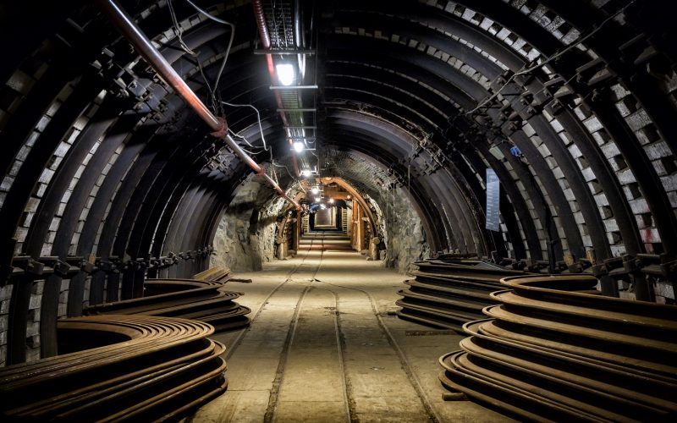
Proposed Solution
The Optical Camera Communication (OCC) can be leveraged to establish the localization in a constrained environment.
By integrating with OCC, the equipment only need to installed with a camera.
Additional modification is also required on the underground mine by converting each lamp into an OCC transmitter.
OCC TX
< Underground mine >
Source: https://www.ggled.net/wp-content/uploads/2020/07/iStock-1174789834-800x500.jpg

Slide 11
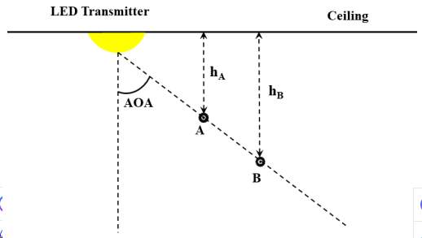
Proposed Solution
Each OCC TX continuously broadcast its position which the broadcasted rays are received by the camera of the equipment.
Then, the equipment compute its relative position to the OCC TX position to estimate its current position.
To estimate the current position based on OCC, an angle-of-arrival (AOA) calculation should be performed [4].
The AOA measures the distance between the current position of the equipment with the center position of the OCC TX.
Estimating position based on AOA and ceiling height information

Slide 12
Proposed Solution
By using OCC for localization in a constrained environment, a better localization system can be obtained.
Advantages | Disadvantages
Reliable and robust | Requires to modify the lamp into an OCC TX
Provide an instant measurement
No accumulative error
Low cost
Easy to setup
No need for complex algorithm, only OCC RX and AOA calculation
Low computation
Immune to interference

Slide 13
Conclusion
For constrained environment localization, several methods has been proposed.
Among the existing methods, they have pros and cons that cause challenges when implementing it on the real environment.
OCC emerges as a solution to perform the localization in a constrained environment.
Unlike existing methods, OCC use less requirements and computations.
The OCC also better when comparing the pros and cons with the existing methods.

Slide 14
Reference
X. Xu, L. Li, W. Jiao and Q. Zhang, "Challenges of Autonomous Navigation and Perception Technology for Unmanned Special Vehicles in Underground Mine," 2023 6th International Symposium on Autonomous Systems (ISAS), Nanjing, China, 2023, pp. 1-6, doi: 10.1109/ISAS59543.2023.10164322.
M. T. Dunn, J. P. Thompson, P. B. Reid and D. C. Reid, "High accuracy inertial navigation for underground mining machinery," 2012 IEEE International Conference on Automation Science and Engineering (CASE), Seoul, Korea (South), 2012, pp. 1179-1183, doi: 10.1109/CoASE.2012.6386402.
A. Jacobson, F. Zeng, D. Smith, N. Boswell, T. Peynot and M. Milford, "Semi-Supervised SLAM: Leveraging Low-Cost Sensors on Underground Autonomous Vehicles for Position Tracking," 2018 IEEE/RSJ International Conference on Intelligent Robots and Systems (IROS), Madrid, Spain, 2018, pp. 3970-3977, doi: 10.1109/IROS.2018.8593750.
K. Bera, R. Parthiban, and N. Karmakar, “A Truly 3D Visible Light Positioning System Using Low Resolution High Speed Camera, LIDAR, and IMU Sensors,” IEEE Access, vol. 11, pp. 98578–98585, 2023, doi: 10.1109/access.2023.3312293.

