Slide 1
IG NG-OWC
Submission Title: Leveraging NG-OWC and Deep Learning in Smart Factory Environment to Enhance Efficiency
Date Submitted: July xx, 2024
Source: Khairi Hindriyandhito, Nguyen Ngoc Huy, Yeong Min Jang, Kookmin University
Address: Room #603 Mirae Building, Kookmin University, 77 Jeongneung-Ro, Seongbuk-Gu, Seoul, 136702, Republic of Korea
Voice: +82-2-910-5068 E-Mail: yjang@kookmin.ac.kr
Re:
Abstract: Present the utilization of NG-OCC in a smart factory environment
Purpose: Presentation for contribution on IG NG-OCC
Notice: This document has been prepared to assist the IG NG-OCC. It is offered as a basis for discussion and is not binding on the contributing individual(s) or organization(s). The material in this document is subject to change in form and content after further study. The contributor(s) reserve(s) the right to add, amend or withdraw material contained herein.
Release: The contributor acknowledges and accepts that this contribution becomes the property of IEEE and may be made publicly available by IG NG-OCC.

Slide 2
Leveraging NG-OWC and Deep Learning in Smart Factory Environment to Enhance Efficiency
July xx, 2024

Slide 3
Contents
Background
NG-OWC for Smart Factory
NG-OWC and Deep Learning for Smart Factory
Conclusion

Slide 4
Background
Optical Camera Communication (OCC) is a cutting-edge technology that enables data transmission through light signals captured by camera sensors. Recent advancements have significantly improved the data rate, reliability, and integration capabilities of OCC, making it a viable communication protocol for smart factory environments.
By leveraging existing CCTV infrastructure, OCC can transform surveillance cameras into multi-purpose devices, simultaneously supporting security monitoring and data communication without the need for additional hardware.
Implementing a unified system that combines OCC and deep learning transforms CCTV cameras into multifunctional devices. This system can simultaneously perform data reception and advanced surveillance tasks, streamlining the communication infrastructure within a smart factory.

Slide 5
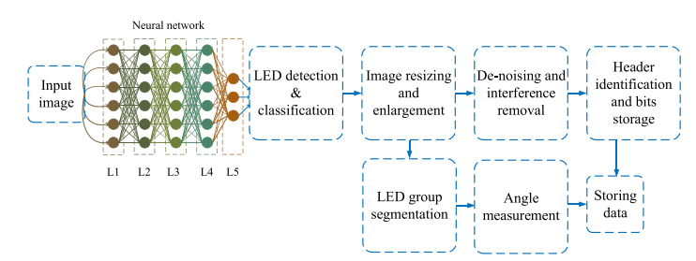
NG-OWC for Smart Factory​
From the sensor employed in an industrial room, there would be an OCC transmitter using LED array.
The receiver is the existing CCTV that being used for room monitoring.
Eliminating the needs for another communication protocol and hardware between sensors and system.

Slide 6
NG-OWC and Deep Learning for Smart Factory
<OCC and Deep Learning Integration for Smart Factory Environment>
The sensors would be integrated with an OCC transmitter (LED array)
The LED array would then be captured by CCTV alongside with the surrounding image
From the image received then it would be processed with multi-object tracking to detect multiple object
The system then could detect early fire sign, intruder, or anomalies in the image by leveraging deep learning

Slide 7
Conclusion
Leveraging next-generation Optical Camera Communication (OCC) and deep learning in smart factories utilizes existing CCTV infrastructure for dual-purpose communication and surveillance, reducing additional hardware needs
Integrating deep learning algorithms with CCTV systems enhances safety and operational efficiency through robust, automated fire and intruder detection.
This unified system simplifies communication protocols and device maintenance, leading to cost savings and enhanced efficiency in smart factory.

Slide 8
Reference
Van Hoa, N., Nguyen, H., Nguyen, C. H., & Jang, Y. M. (2020, October). Occ technology-based developing iot network. In 2020 International Conference on Information and Communication Technology Convergence (ICTC) (pp. 670-673). IEEE.
Ahmed, M. F., Hasan, M. K., Chowdhury, M. Z., Hoan, N. C., & Jang, Y. M. (2021). Continuous status monitoring of industrial valve using OCC-enabled wireless sensor network. IEEE Transactions on Instrumentation and Measurement, 71, 1-10.
Herfandi, H., Sitanggang, O. S., Nasution, M. R. A., Nguyen, H., & Jang, Y. M. (2024). Real-Time Patient Indoor Health Monitoring and Location Tracking with Optical Camera Communications on the Internet of Medical Things. Applied Sciences, 14(3), 1153.

