Slide 1
Project: IEEE P802.15 Working Group for Wireless Personal Area Networks (WPANs)
Submission Title : The Use-Case for NG-SUN PHYs in Ship Area Network
Date Submitted : July 15, 2024
Source : Sangsunng Choi, Seonghyeon Chung (A2UICT), Tae-Joon Park(ETRI)
Re : TG4ad Next Generation SUN PHYs
Abstract : This contribution describes an use-case of NG-SUN PHYs in Ship Area Network(SAN) and discusses requirements of NG-SUN PHYs for SAN applications
Purpose: Discussion
Notice: This document has been prepared to assist the IEEE P802.15.4ad It is offered as a basis for discussion and is not binding on the contributing individual(s) or organization(s). The material in this document is subject to change in form and content after further study. The contributor(s) reserve(s) the right to add, amend or withdraw material contained herein.
Release: The contributor acknowledges and accepts that this contribution becomes the property of IEEE and may be made publicly available by P802.15.
Notes:
Jul 12, 2010
Page 1

Slide 2
Introduction(1)
Modern ships are equipped with automation systems that automate the control and management of ship operations, reducing the need for human intervention.
This includes systems for propulsion, navigation, power management, and cargo handling.
Maintaining robust communication systems is vital for ship automation system.
The Ship Area Network (SAN) is one of the important parts of the ship automation system because the network deals with condition and control information of devices in the ship.
SAN is a convergence network that provides unified interface to local control networks in a ship while enabling remote services.
IMO and IEC tend to configure the current isolated network type of SAN as a single network with a backbone architecture.

Slide 3
Introduction(2)
The latest SAN is comprised of the Control Area Network (CAN) and the Ethernet-based physical communications network.
Sea-going vessels are required to establish the CAN Bus system to be connected with a backbone network referred as the SAN.
Both of which support the National Marine Electronic Association (NMEA) 2000 standard protocol.
Numerous onboard Wireless Sensor/Actuator Network(WSN) tests based on IEEE 802.15.4 compliant devices have demonstrated the feasibility of wirelessly installing ship automation systems in SAN.
The development of NG-SUN, which offers improved performance over existing IEEE 802.15.4 compliant devices, allows ship automation systems to be more reliably connected to the SAN.
In this contribution, we've considered a NMEA2000-based SAN that has been converged with NG-SUNPHYs technology

Slide 4
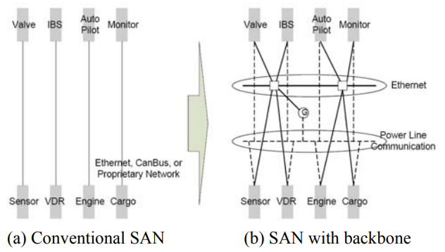
Ship Area Network(SAN)
The SAN is a communication network in a ship
provides connection and control information for ship automation system
replace the conventional isolated network with a modern backbone network recently
Source: ETRI

Slide 5
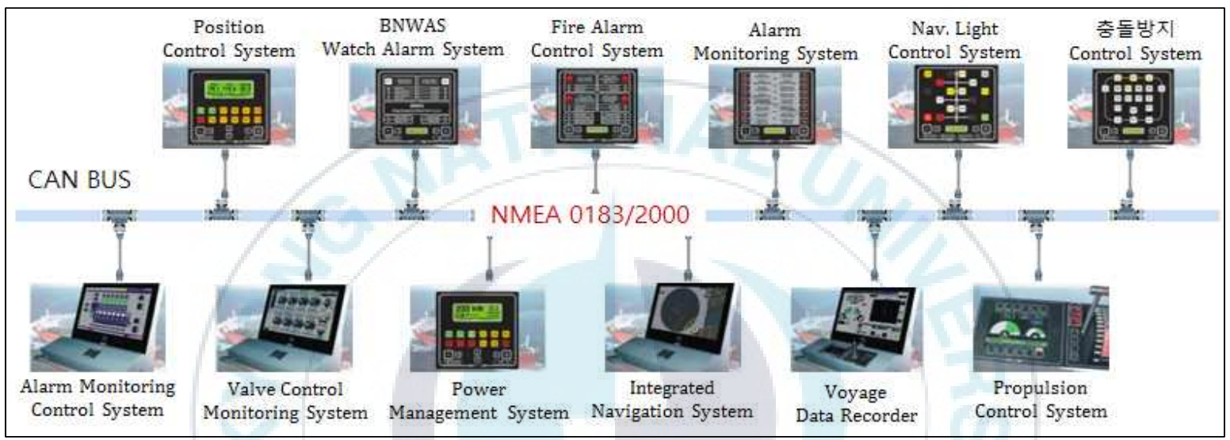
SAN with Backbone
The latest SAN is comprised of the Control Area Network (CAN) and the Ethernet-based physical communications network
Both of which support the National Marine Electronic Association (NMEA) 2000 standard protocol.
SAN is being deployed onboard with connecting ship automation systems such as alarm monitoring system, bridge maneuvering system, and voyage data recorder
Source: BUKYONG National University

Slide 6
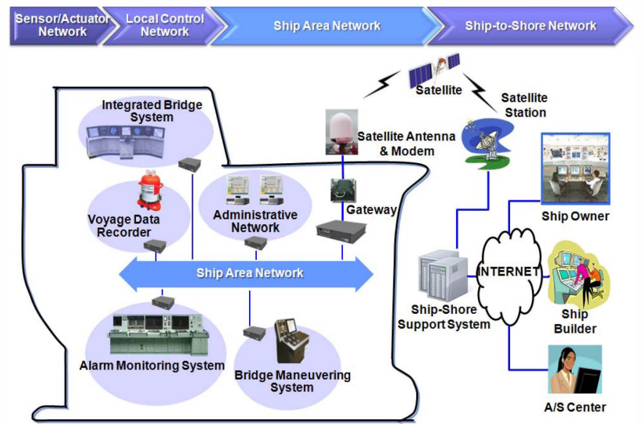
Example of SAN Model
The whole network infrastructure including the ship area network has hierarchical architecture from small field networks to world-wide network.
SAN is a convergence network which provides unified interface that complied with IEC 61162-450,
SAN constructs the backbone of local control networks, while enabling data transfer from/to clients in the shore side.
Source: ETRI

Slide 7
SAN Architecture(1)
SAN consists of 4-layered architecture:
Ship-to-Shore Network
Ship Area Network
Local Control Network
Sensor/Actuator Network:
Source: ETRI

Slide 8
SAN Architecture(2)
Ship-to-Shore Network
A top-level network which contains the ship area network, satellite modem and antenna, satellite space and user segments, and the internet that connects remote maintenance servers and clients.
Ship owners and suppliers can access to unified data collected by the ship area network via satellite communication.
This facilitates remote maintenance services.
Ship Area Network
A convergence network of gateways and local control networks based on Ethernet.
The communication in the ship area network is complied with IEC 61162-450 standard protocol
utilizes UDP(User Datagram Protocol) multicast
provides reliable/unreliable transfer mode.
Source: ETRI

Slide 9
SAN Architecture(3)
Local Control Network
A local network of controller, I/O modules, and devices that achieves a sole purpose like alarm monitoring system, bridge maneuvering system, voyage data recorder, integrated bridge system, etc.
The communication inside the network can be Ethernet or fieldbus technologies such as profibus or CANopen.
Especially, the local control network of ship automation system can act as a gateway system for other systems or local networks which do not support IEC 61162-450 interface.
Sensor/Actuator Network
A field level network which integrates sensors and actuators.
The network connects to unit controller or local control networks.
This can also utilize hard-wiring or simpler fieldbus technologies compared to local control networks.
Source: ETRI

Slide 10
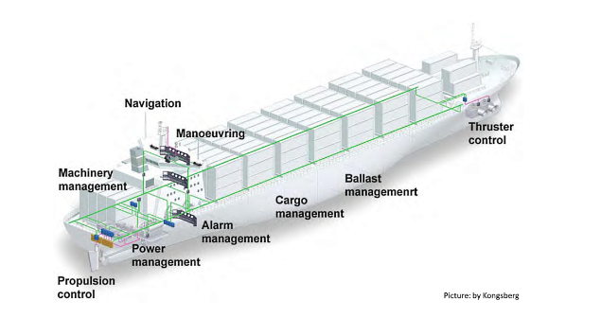
Ship Automation Systems in SAN
Automation system in modern ships is a fully integrated systems covering many aspects of the ship operation
propulsion plant operation,
power management operation on the auxiliary engines,
auxiliary machinery operation,
cargo on-and-off-loading operation,
monitoring and control of cargo during voyage

Slide 11
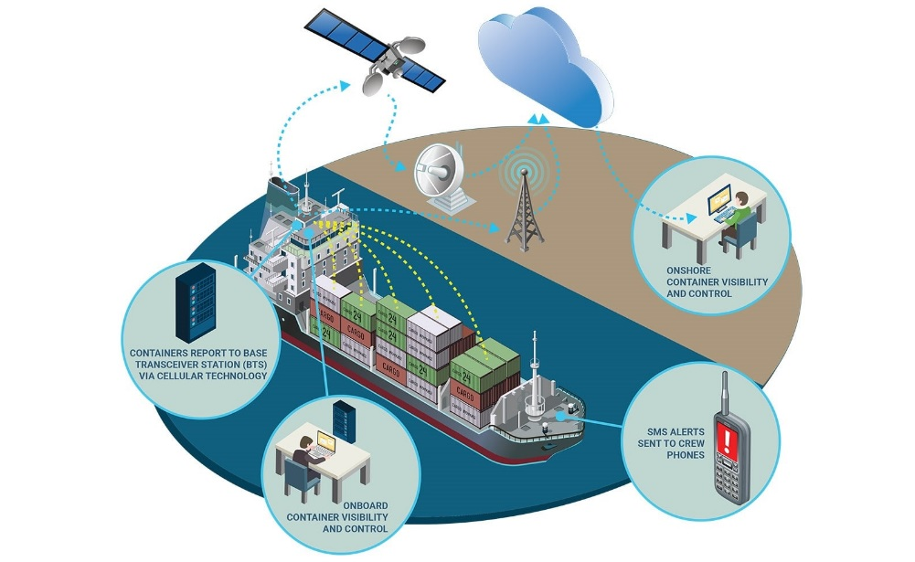
Example of SAN Application(1)
Wireless Ship Cargo Monitoring and Control System during voyage
Create a local data transmission network within the ship using on board WSN infrastructure based on NG-SUN.
Reefer containers or other containers equipped with NG-SUN devices can continuously report real-time container condition even while the vessel is at sea.
Source: Naver

Slide 12
Example of SAN Application(2)
If an alarm occurs, first, check whether there is a false alarm using video/audio based information.
Then, it will be automatically displayed on the cargo monitoring console and directed via SMS to crew phones.
Then, an engineer can be promptly sent to check and resolve any issues.
Source: Naver

Slide 13
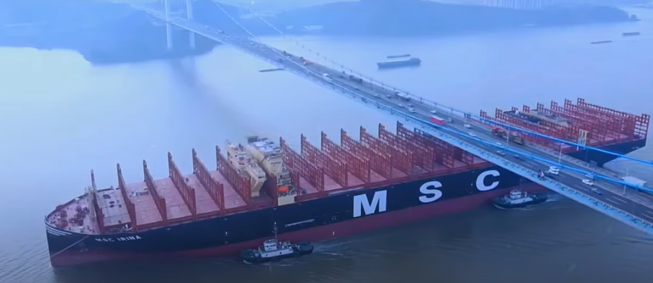
NG-SUN PHY Requirements for SAN Application (1)
The communication range of NG-SUN should be over 400m.
The world's largest container ship, MSC Irina, is about 400m in length from stem to stern and 61m wide reaching about 4 times of a football field.
Source: Naver

Slide 14
NG-SUN PHY Requirements for SAN Application (2)
An OFDM-based NG-SUN that is robust to multipath effects should be adopted.
the confined spaces below decks, with their numerous reflecting surfaces and bulkheads, severely attenuate and distort wireless signals and greatly complicate wireless system planning.
moreover, the propagation environment is highly variable and greatly affected by the opening and closing of watertight doors and loading or unloading of cargo and stores.
Source: Naver

Slide 15
NG-SUN PHY Requirements for SAN Application (3)
For NG-SUN-based onboard WSN applications, a global common frequency band needs to be developed.
Sub-Giga frequency band(433.05~433.79 MHz(zone 1), 902~928 MHz(zone 2)
The 433MHz and 902MHz band are not ISM band in zone 3.
Low-power wireless devices that do not require permission
2.4GHz ISM band(2.4~2.48 GHz)
5~6GHz frequency(5.725~5.875 GHz)
The U.S. FCC has decided to supply unlicensed frequencies with a total bandwidth of 1,200 MHz from 5.925 GHz to 7.125 GHz(2020. 4.23)
In Korea, the 5150-5350 MHz, 5470-5850 MHz, and 5925-6445 MHz bands were allocated to the wireless access system(WAS).

Slide 16
NG-SUN PHY Requirements for SAN Application (4)
NG-SUN-based on board ship WSN should be capable of connecting more than 2,500 devices.
The number of devices in the SAN of a general container ship is almost 460 and these devices are connected by isolated networks.
The vessel, MSC Irina, can carry more than 24,300 standard 20-foot shipping containers stacked up to 26 deep.
Source: Naver

Slide 17
NG-SUN PHY Requirements for SAN Application (5)
NG-SUN PHY should achieves a data rate greater than 2.4 Mb/s for collecting video/audio data from onboard monitoring devices
A minimum of 10 Mbps is required to transmit video/audio data
Use wider bandwidth than that of existing SUN or develop a new modulation scheme
IEEE 802.15.4ad PAR specifies that OFDdata Grater M-based NG-SUN must exceed a sensitivity of -120dBm at 1% packet error rate (PER) for 64B payload.
Apply channel models for onboard ship and at sea environment
Develop channel coding techniques for enhanced efficiency and reliability.
etc.
is required.

Slide 18
Conclusions(1)
On a ship there are many parameters that needs to be controlled or monitored including:
temperatures, pressure, level, viscosity, flow control, position of vessel, speed, torque control, voltage, current, machinery status (on/ off), and equipment status (open/ closed).
video/audio data linked to control or monitoring parameters
However, the ship's bulkhead structure and extreme sea conditions required better performance and higher reliability of wireless communication for SAN
Numerous onboard Wireless Sensor/Actuator Network(WSN) tests based on IEEE 802.15.4 compliant devices have demonstrated the feasibility of wirelessly installing ship automation systems in SAN.
The development of NG-SUN with better performance and higher reliability than existing IEEE 802.15.4 compliant devices can be applied to the ship automation system to connect the SAN

Slide 19
Conclusions(2)
One of ship automation system to connect the SAN is wireless ship cargo monitoring and control system during voyage
NG-SUN PHY, which has a structure that allows data of various characteristics to coexist, can be applied to a wireless ship cargo monitoring and control system during voyage.
It matches the communication requirements of smart cities where data of various characteristics coexist.
Urban environment with obstacles of varying density
Suburban environment with high path loss
Shaded area environment such as the basement of a building
Therefore, NG-SUN PHYs that meet SAN application requirements are expected to be expandable to various application fields in the future.

Slide 20
Conclusions(3)
NG-SUN PHY Specification for wireless cargo monitoring and control system during voyage required as follow
Propose to add this SAN applications to the document DCN15-23-0625-010-04ad (Next-Generation SUN PHY Use Case Collection) as a Next-Generation SUN PHY Use Case.
Use-Case | Application | Data-rate | Transmit Range | Link Budget | Connecting devices
Ship Area Network | Ship cargo monitoring & control system | > 10Mbps | > 500m | >120dB | >2500

Slide 21
Thanks for Listening !
Q&A

