Slide 1
Project: IEEE P802.15 Working Group for Wireless Specialty Networks
Submission Title: Theoretical Analysis of System Performance in a Multi-BAN Coexistence Environment (Class 1)
Date Submitted: 17 July 2024
Source: Kento Takabayashi¹, Ryuji Kohno^{2,3}
Company: (1) Toyo University (2)Yokohama National University (3) YRP International Alliance Institute
Address: (1) 2100 Kujirai, Kawagoe, Saitama, Japan 351-8585, (3)79-5 Tokiwadai, Hodogaya-ku, Yokohama, 240-8501 Japan,
(4) YRP1 Blg., 3-4 Hikarinooka, Yokosuka-City, Kanagawa, 239-0847 Japan
Voice:[(1) +81-866-94-2104 , (3) +81-90-5408-0611] E-Mail:[takabayashi.kento.xp@gmail.com, kohno@ynu.ac.jp, kohno@yrp-iai.jp]
Re: In response to call for technical contributions
Abstract:
Purpose: Material for discussion in P802.15.6ma TG corresponding to comments in EC Meeting
Notice: This document has been prepared to assist the IEEE P802.15. It is offered as a basis for discussion and is not binding on the contributing individual(s) or organization(s). The material in this document is subject to change in form and content after further study. The contributor(s) reserve(s) the right to add, amend or withdraw material contained herein.
Release: The contributor acknowledges and accepts that this contribution becomes the property of IEEE and may be made publicly available by P802.15.

Slide 2
Theoretical Analysis of System Performance in a Multi-BAN Coexistence Environment (Class 1)
July 2024,
Hybrid Session,
Sheraton Le Centre Montreal, Montreal, Quebec, Canada
Kento Takabayashi ⁽¹⁾, Ryuji Kohno^{(2,3)}
(1) Toyo University (2)Yokohama National University (3) YRP International Alliance Institute

Slide 3
Coexistence environment level
Coexistence environment class | Environment
0 | 6ma BAN only
1 [1a] | Multiple 6ma BANs 1a
2 [1b] | Multiple 15.6 & 6ma BANs
3 | Multiple 6ma BANs & non-UWB systems (Wi-Fi & Unlicensed 3GPP)
4 [2a] | Multiple 6ma BANs & 802.15 UWB systems
5 [2b] | Multiple 6ma BANs, non-802.15 UWB systems (ETSI UWB systems)
6 [2c] | Multiple 6ma BANs & 802.15 UWB & non-802.15 UWB systems (ETSI UWB)
7 | Multiple 6ma BANs & non-UWB systems (Wi-Fi & Unlicensed 3GPP) & 802.15 UWB & non-802.15 UWB systems (ETSI UWB)
  Coexistence environment class is divided into 8 categories
  This presentation introduces a simple PER performance analysis in class 1
    These results can be useful for cross-layer evaluation of physical and MAC layers in multiple WBANs environment

Slide 4
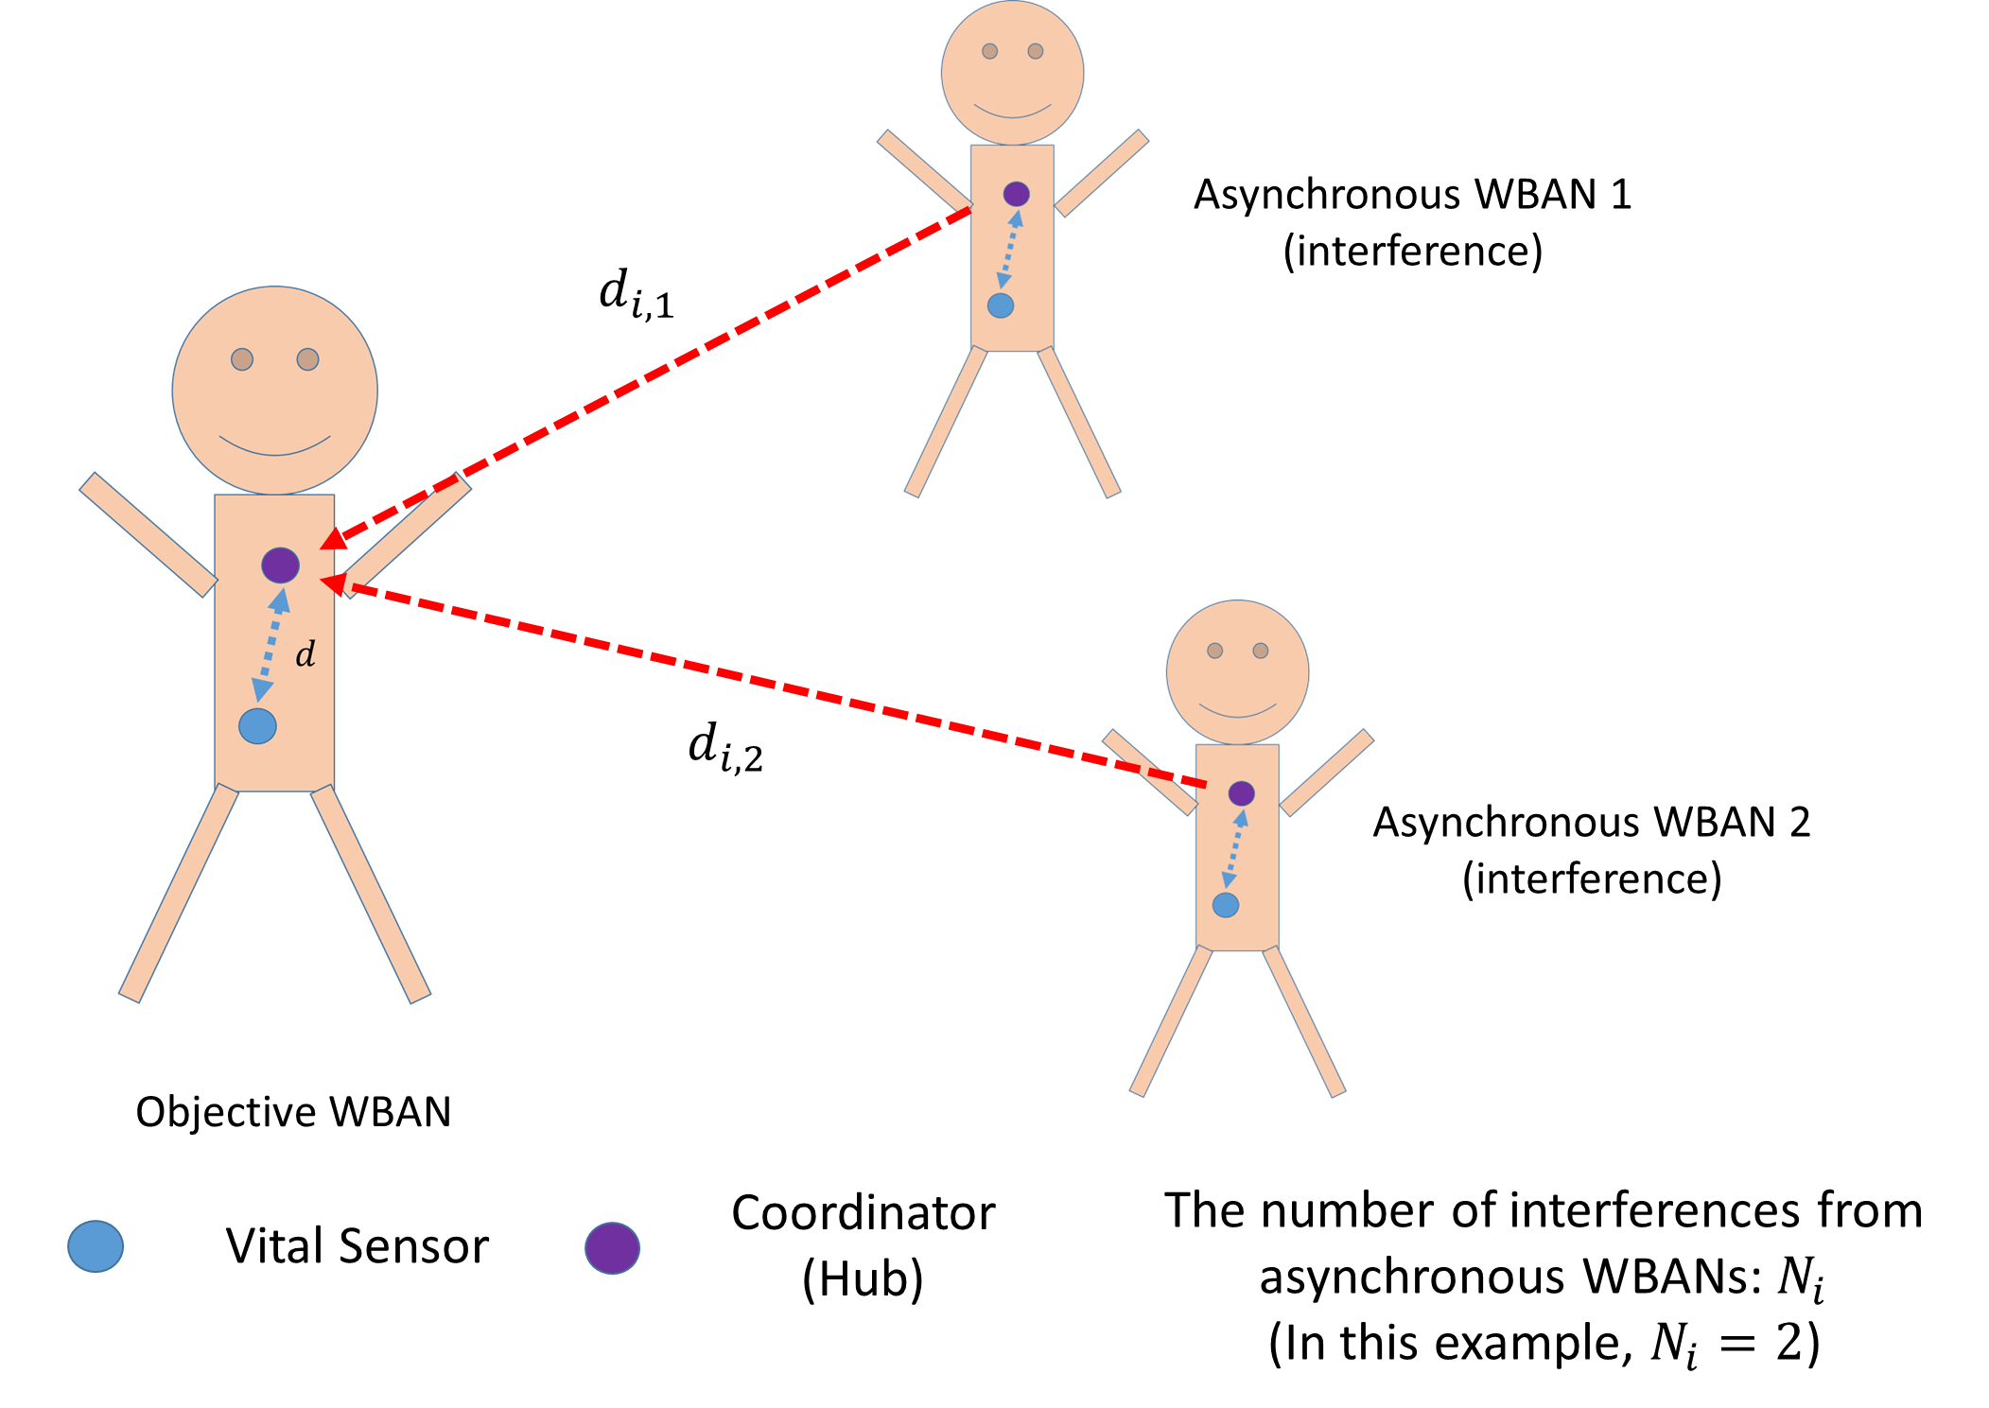
Assumed environment
The right figure shows the assumed environment
Several asynchronous WBANs interfere an objective WBAN
It is assumed that the entire transmitted packet is affected by interference

Slide 5
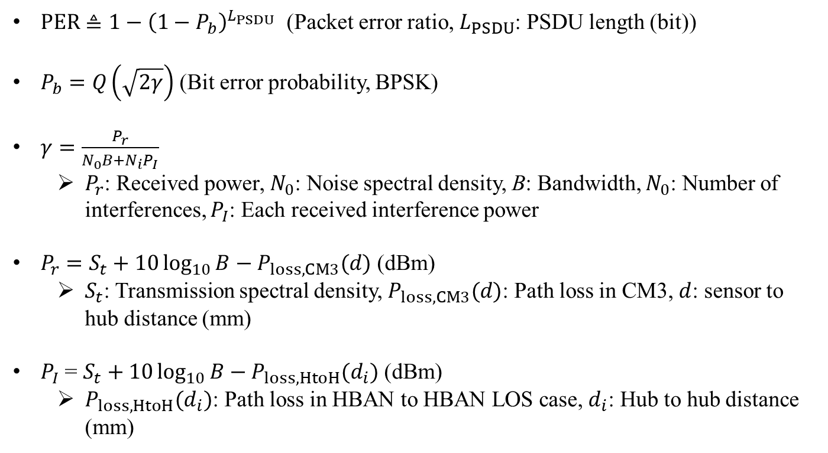
Mathematical expression
$PER≜1−{\left(1−P_{b}\right)}^{L_{PSDU}}$ (Packet error ratio, $L_{PSDU}$: PSDU length (bit))
$P_{b}=Q\left(\sqrt{2γ}\right)$ (Bit error probability, BPSK)
$γ=\frac{P_{r}}{N_{0}B+N_{i}P_{I}}$
  $P_{r}$: Received power, $N_{0}$: Noise spectral density, B: Bandwidth, $N_{0}$: Number of interferences, $P_{I}$: Each received interference power
$P_{r}=S_{t}+10\log_{10}{B}−P_{loss,CM3}(d)$ (dBm)
  $S_{t}$: Transmission spectral density, $P_{loss,CM3}(d)$: Path loss in CM3, $d$: sensor to hub distance (mm)
$P_{I}$ = $S_{t}+10\log_{10}{B}−P_{loss,HtoH}(d_{i})$ (dBm)
  $P_{loss,HtoH}(d_{i})$: Path loss in HBAN to HBAN LOS case, $d_{i}$: Hub to hub distance (mm)

Slide 6
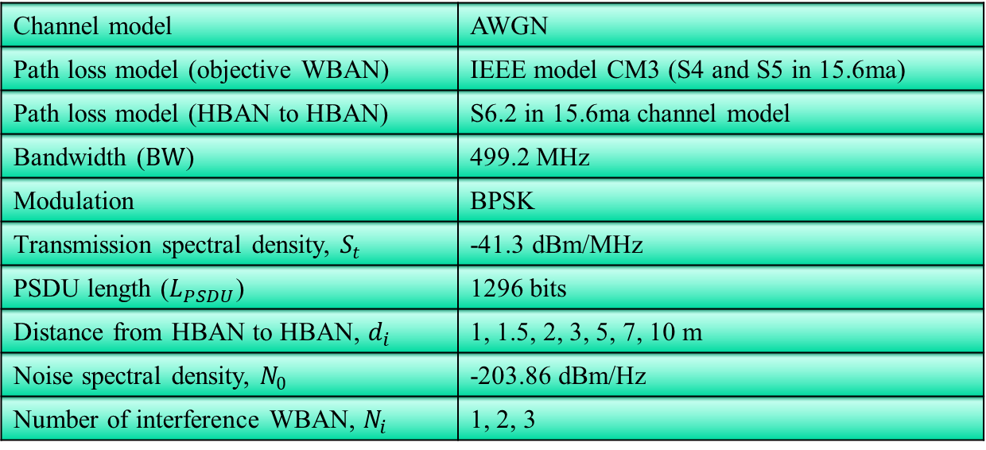
Evaluation
Channel model | AWGN
Path loss model (objective WBAN) | IEEE model CM3 (S4 and S5 in 15.6ma)
Path loss model (HBAN to HBAN) | S6.2 in 15.6ma channel model
Bandwidth ($BW$) | 499.2 MHz
Modulation | BPSK
Transmission spectral density, $S_{t}$ | -41.3 dBm/MHz
PSDU length ($L_{PSDU}$) | 1296 bits
Distance from HBAN to HBAN, $d_{i}$ | 1, 1.5, 2, 3, 5, 7, 10 m
Noise spectral density, $N_{0}$ | -203.86 dBm/Hz
Number of interference WBAN, $N_{i}$ | 1, 2, 3
For simple analysis, error correcting and retransmission is not considered
Packet collision within an objective WBAN and from other synchronous WBAN is also not considered

Slide 7
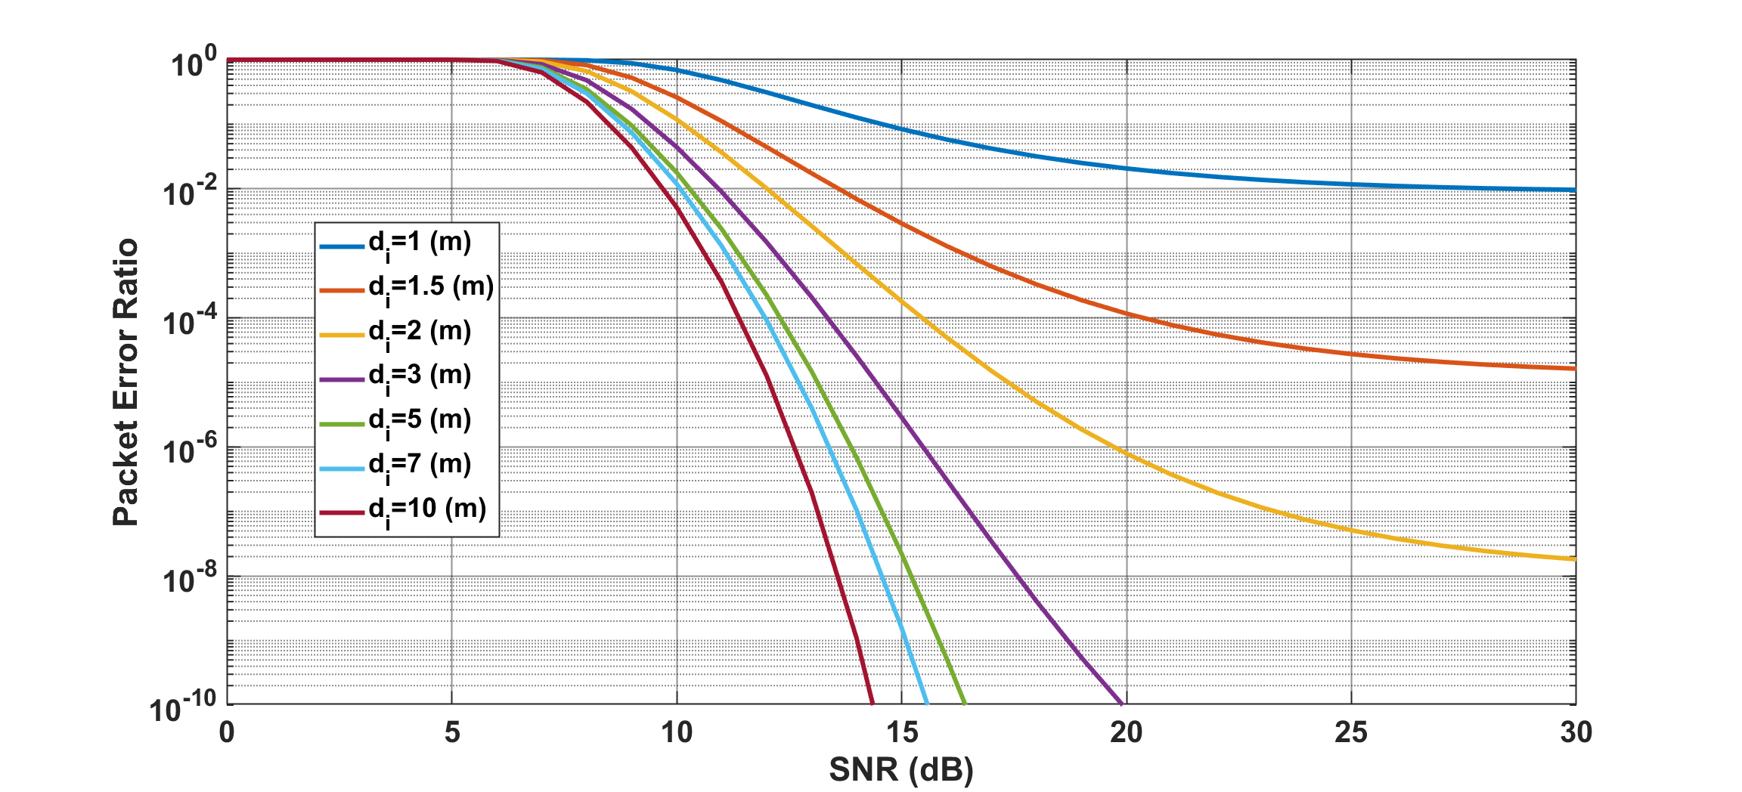
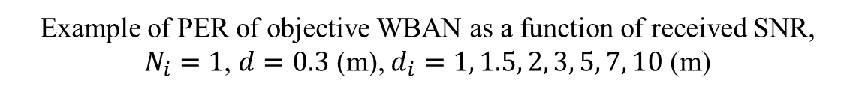
Results
Example of PER of objective WBAN as a function of received SNR, $N_{i}=1$, $d=0.3$ (m), $d_{i}=1, 1.5, 2, 3, 5, 7, 10$ (m)

Slide 8
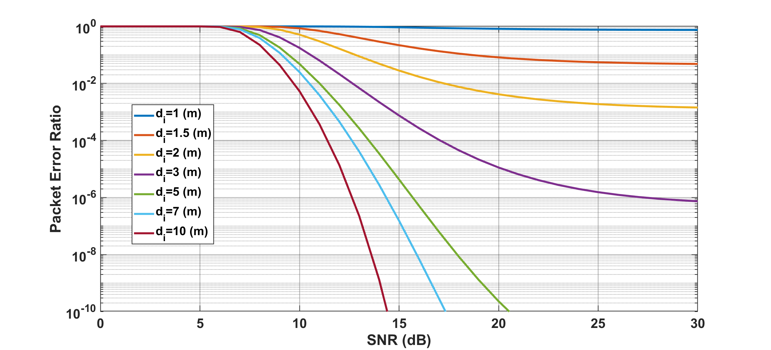
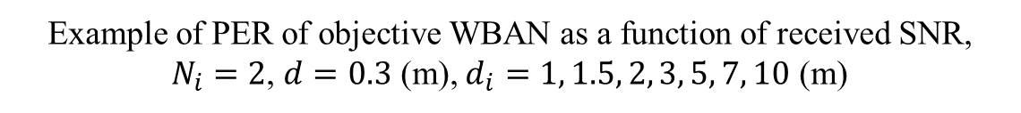
Results
Example of PER of objective WBAN as a function of received SNR, $N_{i}=2$, $d=0.3$ (m), $d_{i}=1, 1.5, 2, 3, 5, 7, 10$ (m)

Slide 9
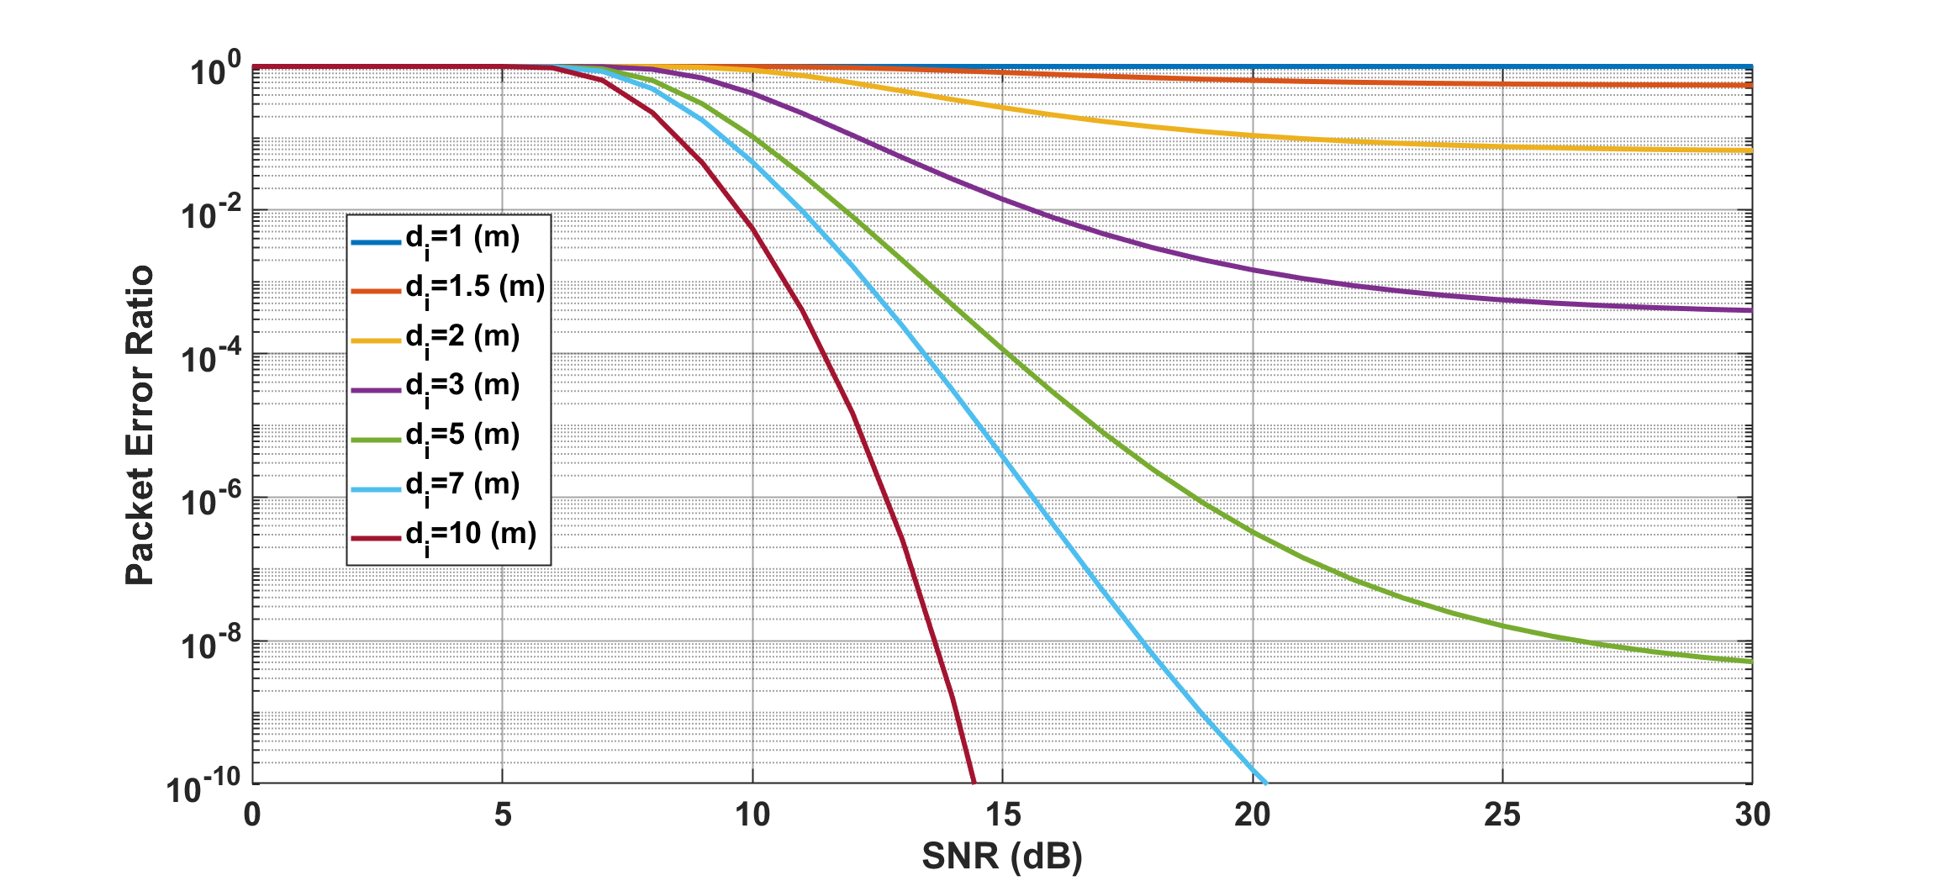
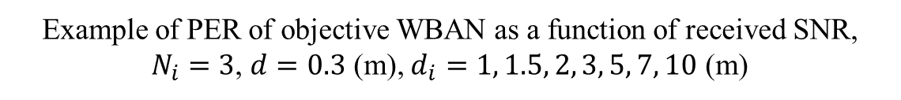
Results
Example of PER of objective WBAN as a function of received SNR, $N_{i}=3$, $d=0.3$ (m), $d_{i}=1, 1.5, 2, 3, 5, 7, 10$ (m)

Slide 10
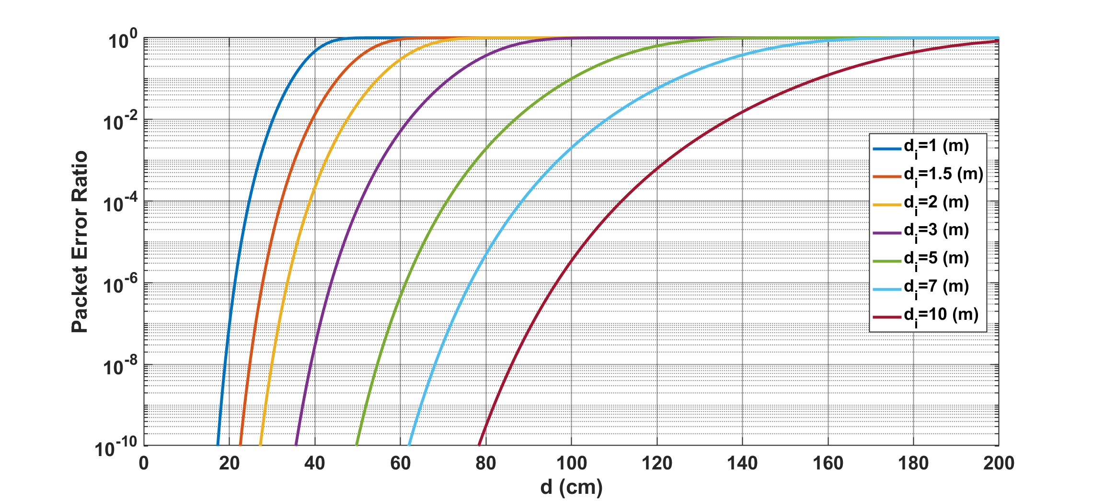
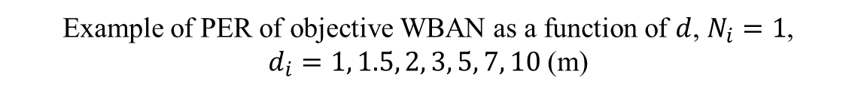
Results
Example of PER of objective WBAN as a function of $d$, $N_{i}=1$,
$d_{i}=1, 1.5, 2, 3, 5, 7, 10$ (m)

Slide 11
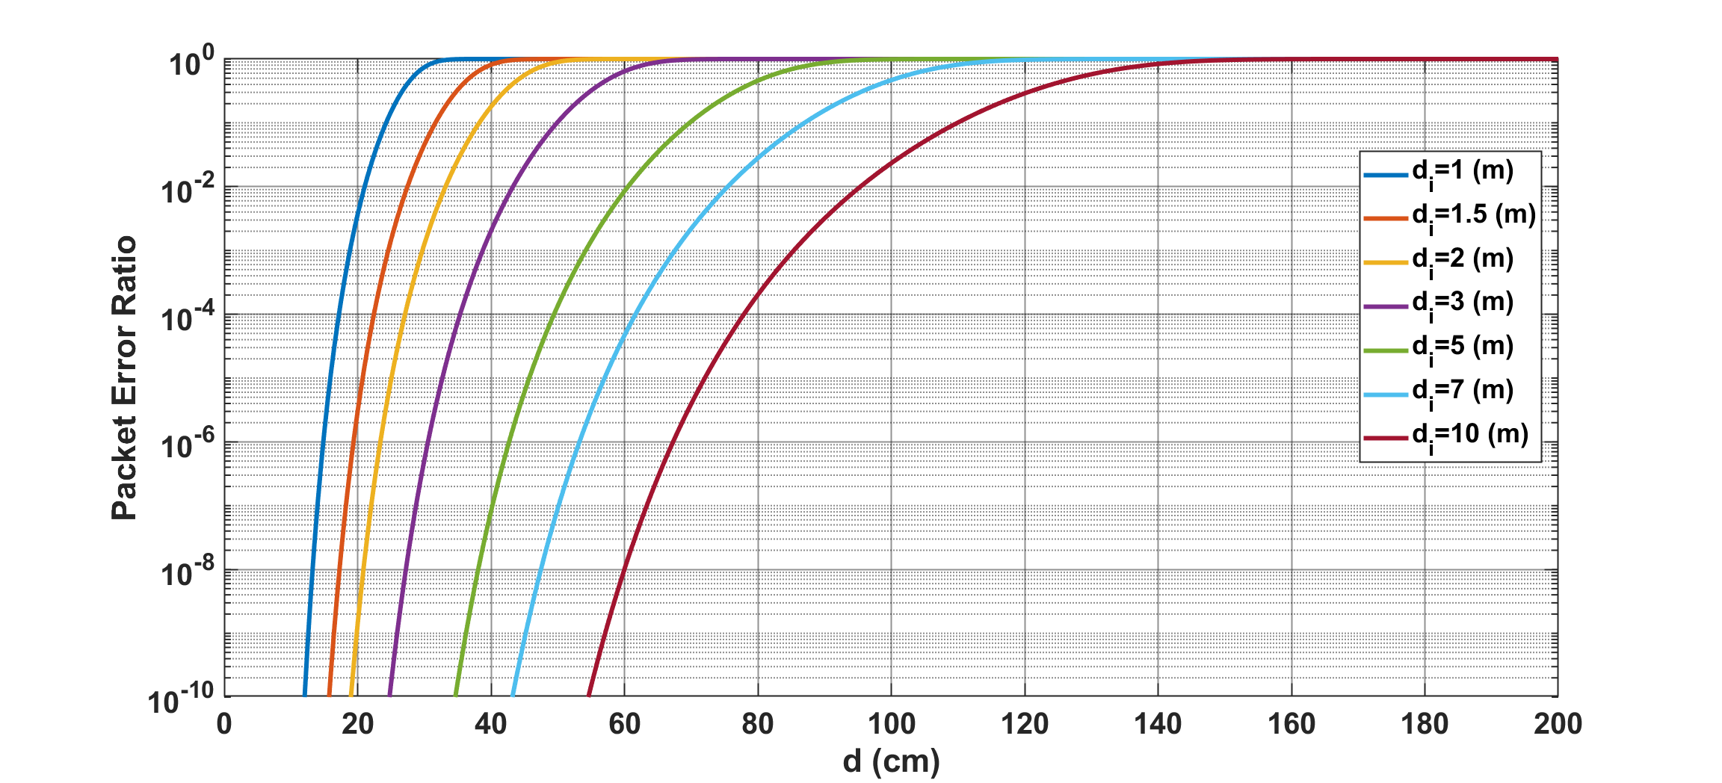
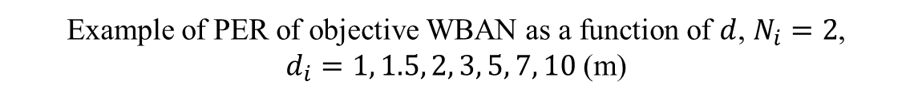
Results
Example of PER of objective WBAN as a function of $d$, $N_{i}=2$,
$d_{i}=1, 1.5, 2, 3, 5, 7, 10$ (m)

Slide 12
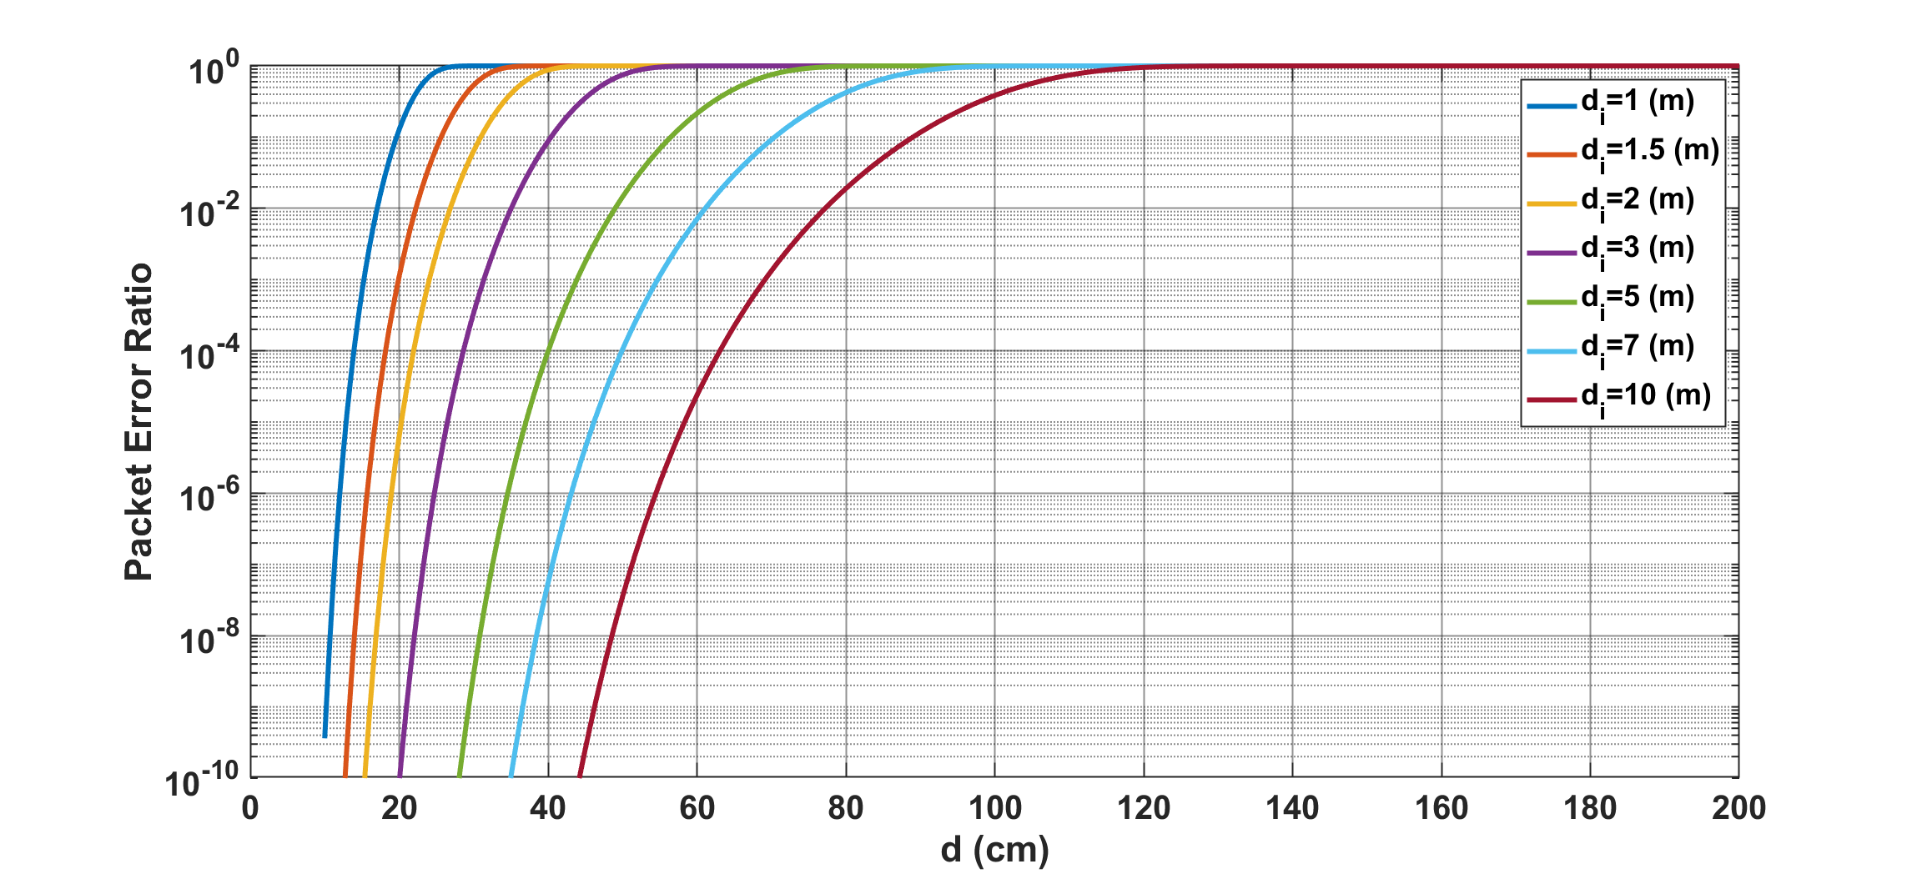
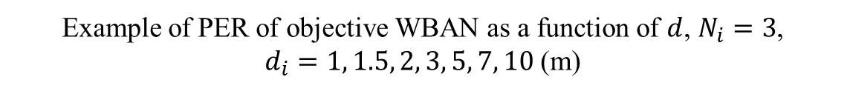
Results
Example of PER of objective WBAN as a function of $d$, $N_{i}=3$,
$d_{i}=1, 1.5, 2, 3, 5, 7, 10$ (m)

Slide 13
Conclusion
Sufficient PER performance could be obtained without error correction by ensuring a certain level of SNR if the number of interference was small
Even with interference from close range, sufficient PER performance was obtained if the number of interferences was small
  In normal use cases, interference from a distance of 5m or more can be almost ignored
  Since error correction, retransmission, and transmission timing deviations are normally considered, it is thought that the PER performance will be better than that of this analysis.

Slide 14
Thank you for your attention ! ! !

