Slide 1
Project: IEEE P802.15 Working Group for Wireless Personal Area Networks (WPANs)
Submission Title: [Interference Model Usage and Details]
Date Submitted: [19 June, 2024]
Source: [Joerg ROBERT] Company [TU Ilmenau/Fraunhofer IIS]
Address [Helmholtzplatz 2, Ilmenau, 98693, Germany]
E-Mail:[joerg.robert@ieee.org]
Re: []
Abstract: [This document shows how to use the proposed interference model]
Purpose: [Presentation to TG 802.15.4ad]
Notice: This document has been prepared to assist the IEEE P802.15. It is offered as a basis for discussion and is not binding on the contributing individual(s) or organization(s). The material in this document is subject to change in form and content after further study. The contributor(s) reserve(s) the right to add, amend or withdraw material contained herein.
Release: The contributor acknowledges and accepts that this contribution becomes the property of IEEE and may be made publicly available by P802.15.

Slide 2
Interference Model Usage and Details
Joerg Robert
TU Ilmenau / Fraunhofer IIS

Slide 3
Abstract
The typical use-case of IEEE 802.15.4ad will be communication in license-exempt frequency bands
Interference of other systems is unavoidable as other systems do not care about coexistence
  No Listen Before Talk used by many Low Power Wide Area Network Systems
  Hidden node problem
  Very low reception levels (others are technically not able to detect 4ad signals)
IEEE 802.15.4ad should be robust against typical interference in license-exempt bands
Usage of the IEEE 802.15.4w interference model would be a suitable approach

Slide 4
IEEE 802.15.4w Interference Model
The IEEE 802.15.4w interference model tries to simulate the typical interference in license exempt frequency bands
The model has been published some years ago: [1]
Robert, Joerg, et al. "IEEE 802.15 low power wide area network (LPWAN) PHY interference model." 2018 IEEE International Conference on Communications (ICC). IEEE, 2018.
The configuration itself may be updated to meet recent interference conditions
The model purely focuses on the unpredictable interference in larger areas

Slide 5
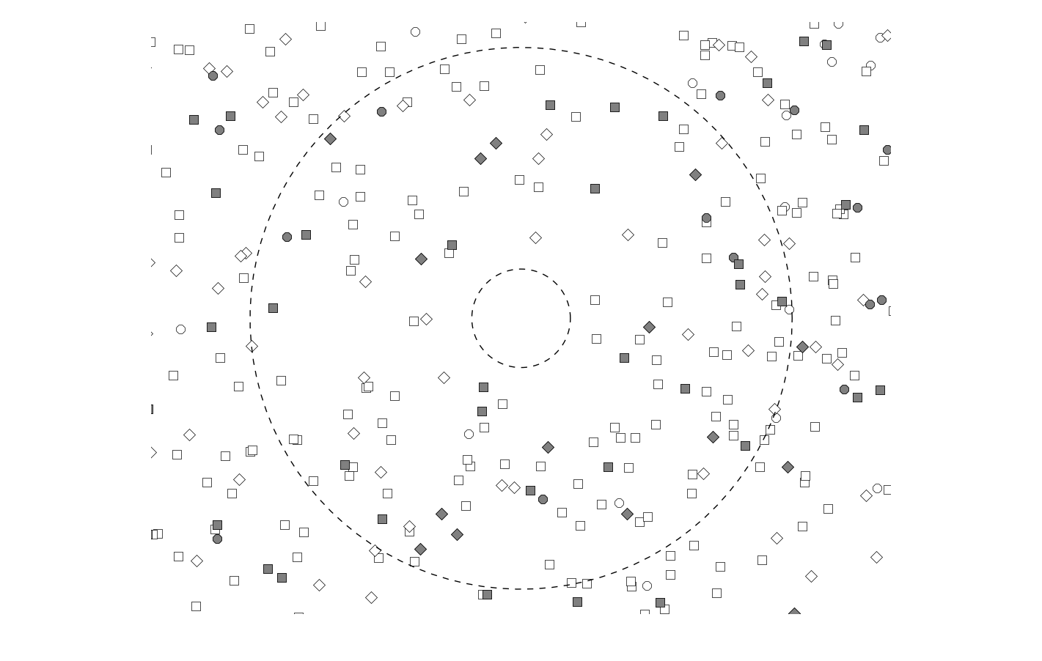


Assumption of the Interferer Distribution
The model has an infinite number of transmitters, with a given transmitter density per area
All transmitters act independently with a given transmit probability
The transmitters have a minim distance r_{min} to the receiver
The received signal level of transmitters with a distance of more than r_{max} is negligble
$$r_{max}$$
$$r_{min}$$

Slide 6
Received Signal Level
The received signal level of each transmitter depends on different factors
  The transmit power (given as part of the “layer”, i.e. the signal type)
  The distance
  The used propagation model
The interference model currently supports some pre-defined propagation models based on the well-known Okumura Hata models

Slide 7
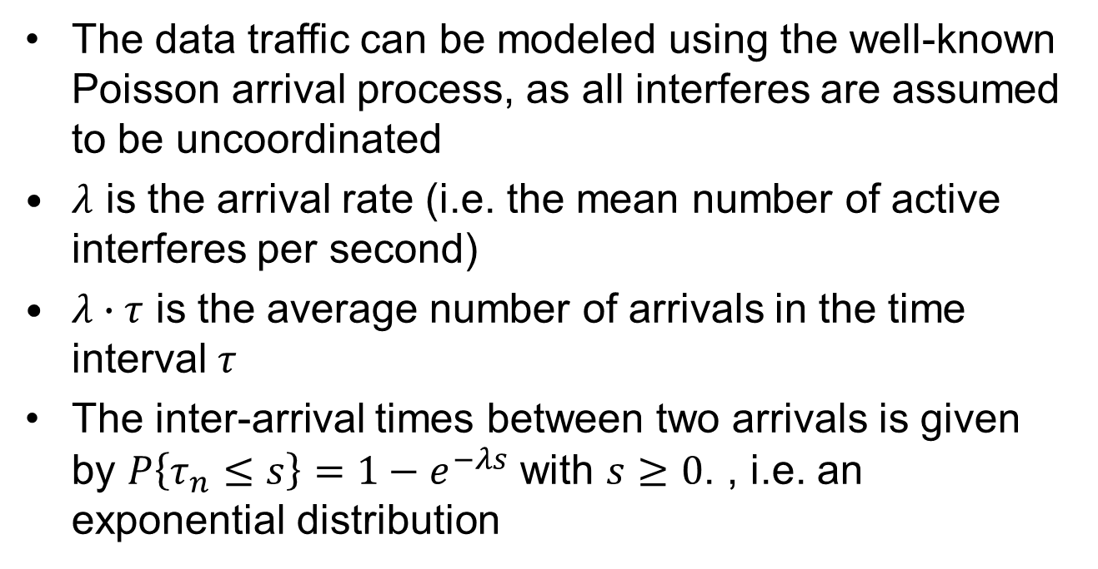
Arrival Rate of Interferers
The data traffic can be modeled using the well-known Poisson arrival process, as all interferes are assumed to be uncoordinated
$λ$ is the arrival rate (i.e. the mean number of active interferes per second)
$λ∙τ$ is the average number of arrivals in the time interval $τ$
The inter-arrival times between two arrivals is given by $P\left\{τ_{n}≤s\right\}=1−e^{−λs}$ with $s≥0$. , i.e. an exponential distribution

Slide 8



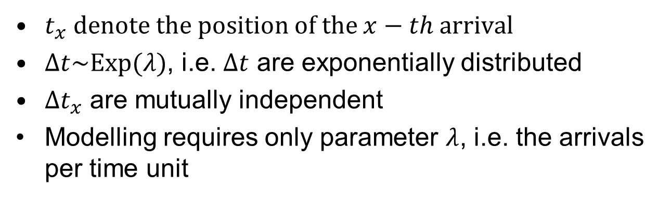




Properties of the Arrival Process
$$Δt_{0}$$
$$Δt_{1}$$
$$Δt_{2}$$
$$t_{0}$$
$$t_{1}$$
$$t_{2}$$
$$t_{3}$$
$t_{x}$ denote the position of the $x−th$ arrival
$Δt\sim Exp(λ)$, i.e. $Δt$ are exponentially distributed
$Δt_{x}$ are mutually independent
Modelling requires only parameter $λ$, i.e. the arrivals per time unit

Slide 9
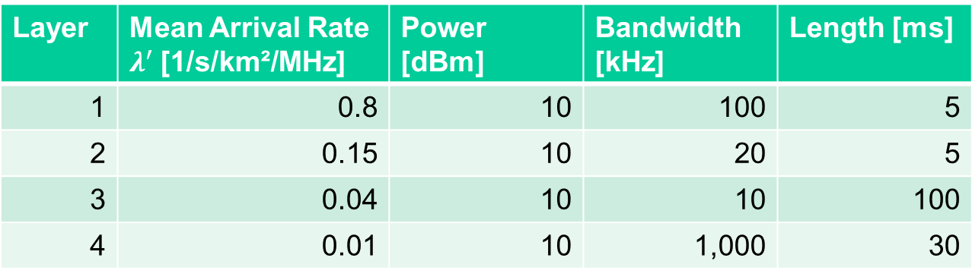
Currently Defined Layers
Definition of multiple layers to cover different interferer types
Required layer parameters are transmit power, bandwidth, and the signal length
Example layer configuration:
Layer | Mean Arrival Rate $λ^{′}$[1/s/km²/MHz] | Power [dBm] | Bandwidth [kHz] | Length [ms]
1 | 0.8 | 10 | 100 | 5
2 | 0.15 | 10 | 20 | 5
3 | 0.04 | 10 | 10 | 100
4 | 0.01 | 10 | 1,000 | 30

Slide 10
Generation of the Transmit Signal
The transmit signal of the of the different interferes could be FSK, OFDM, or other types of modulation
To abstract different modulation schemes, the interference is assumed by filtered Gaussian noise
  Bandwidth of the noise is given by the layer
  Power of the noise if given by the layer
  Duration is given by the layer
Gaussian noise is generally a good model for OFDM signals
Constant envelope signals (e.g. FSK, MSK) do not follow a Gaussian distribution, but the impact on the simulation results is most likely negligible

Slide 11
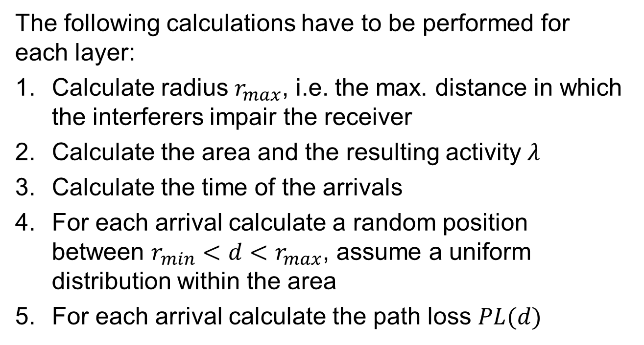
Calculation of Channel Realization (I/II)
The following calculations have to be performed for each layer:
Calculate radius $r_{max}$, i.e. the max. distance in which the interferers impair the receiver
Calculate the area and the resulting activity $λ$
Calculate the time of the arrivals
For each arrival calculate a random position between $r_{min}<d<r_{max}$, assume a uniform distribution within the area
For each arrival calculate the path loss $PL(d)$

Slide 12
Calculation of Channel Realization (II/II)
For each arrival generate white Gaussian noise of the desired interferer length and filter the signal to limit the signal bandwidth to the desired layer bandwidth
For each arrival correct the signal power to the defined layer power
For each arrival apply the path-loss and add the signal to the play-ground

Slide 13
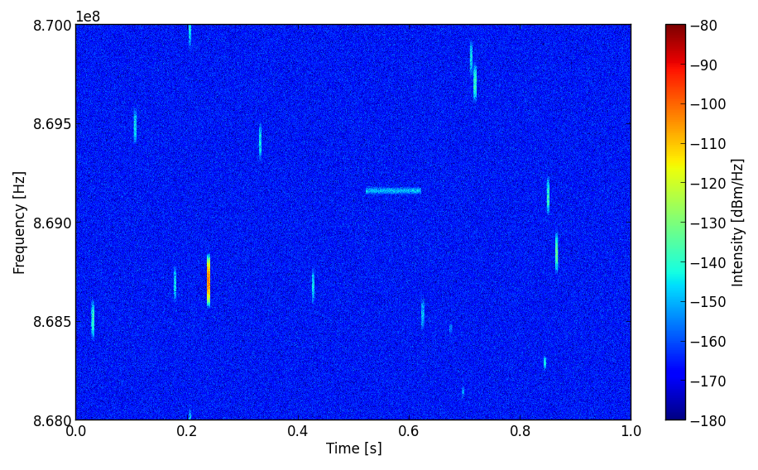
Device-to-Device Path-Loss Model
Based on parameters used given in the example layer configuration

Slide 14
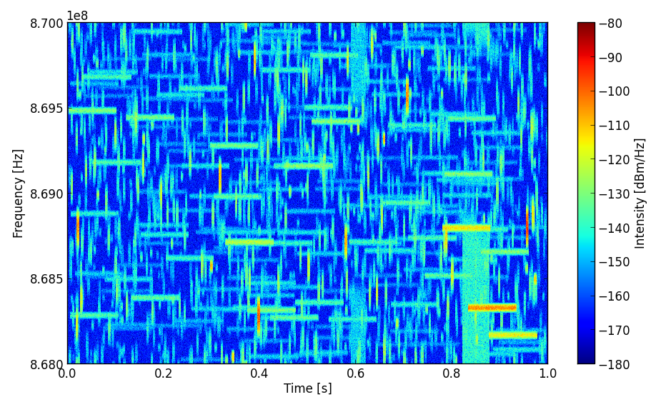
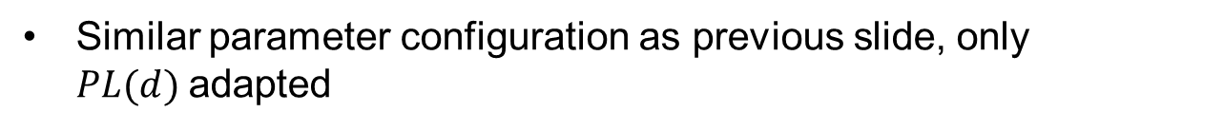
Outdoor Urban Path-Loss Model
Similar parameter configuration as previous slide, only $PL(d)$adapted

Slide 15
Using the Model in Simulations
The open source code mentioned in [1] creates the Additive White Gaussian Noise and the interference
The IQ samples generated by the model and stored in a file have to be added to the signal in the simulation:
Compared to the “normal” simulation
File Reader
Source
Add
Sink
Source
AWGN
Sink

Slide 16
File Content
The file format is binary float or double with interleaved complex data (always Re, Im, Re, Im, …)
All levels inside the generated file are normalized to dBm, i.e. an absolute value of “1” corresponds to a signal level of 0dBm → all values are typically quite small
The bandwidth of the generated interference / noise file can be adapted to the simulation bandwidth

Slide 17
Normalization of the Model
Relevant for most applications is the Signal to Noise Ratio (SNR)
In most simulations, the Noise is changed to meet the required SNR
But: This is not true in real systems, as the noise is normally constant but the signal level changes (thermal noise + noise figure is given)
Further, the same interference file is typically used for modelling different SNR
Requirement to change the Signal Level (normalized to 0dBm)
  A transmit power of 0dBm would result in a signal amplitude of “1”

Slide 18
Summary
This document gives some additional insight to the interference model proposed in [1]
The models is intended to model unpredictable interference that is independent of the desired signals that are dominant in sub-GHz systems
Details on the calculations are presented
For more details ask or try the model yourself

Slide 19
Literature
[1] Robert, Joerg, et al. "IEEE 802.15 low power wide area network (LPWAN) PHY interference model." 2018 IEEE International Conference on Communications (ICC). IEEE, 2018.

