Slide 1
Project: IEEE P802.15 Working Group for Wireless Personal Area Networks (WPANs)
Submission Title: [Important 4ab MMS options.]
Date Submitted: [27th May 2024]
Source: [Micheal McLaughlin] Company [Qorvo, Inc.]
Address [ ]
E-Mail:[micheal.mclaughlin (at) qorvo.com]
Re: [Proposals for TG4ab next generation UWB project]
Abstract: [Proposed UWB MMS packet options.]
Purpose: [To promote further discussion and convergence on the content for the IEEE 802.15.4ab amendment.]
Notice: This document has been prepared to assist the IEEE P802.15. It is offered as a basis for discussion and is not binding on the contributing individual(s) or organization(s). The material in this document is subject to change in form and content after further study. The contributor(s) reserve(s) the right to add, amend or withdraw material contained herein.
Release: The contributor acknowledges and accepts that this contribution becomes the property of IEEE and may be made publicly available by P802.15.

Slide 2
My Credentials
Founded the world’s most successful UWB startup, Decawave
Started 15.4a task group in 2003 with like-minded individuals
  Fed up with the politics involved in the UWB wars
Have worked on UWB ever since (21 years)
The fledgling study group decided that 15.4a’s mission would be to select best technical solution, and to leave politics out of our considerations
Am getting on in years, so this, 4ab, will probably be my last IEEE standard

Slide 3
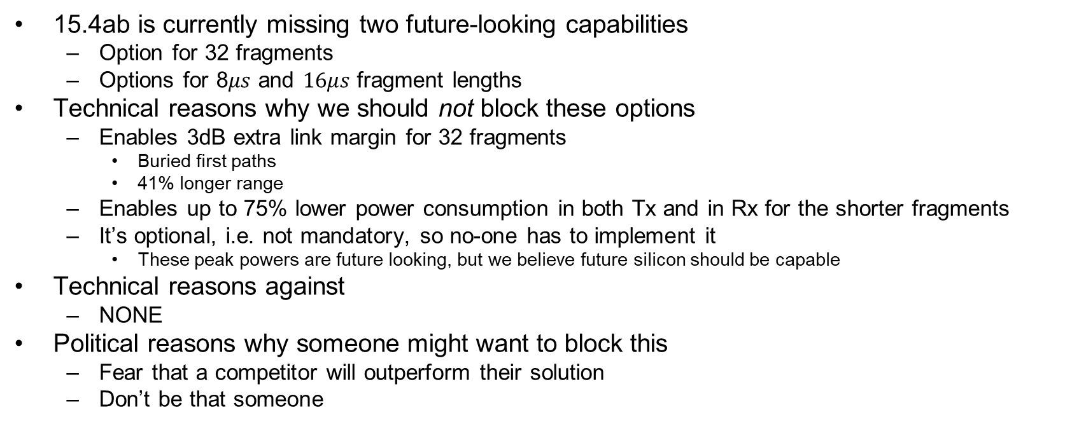
Missing MMS options for future proofing 4ab
15.4ab is currently missing two future-looking capabilities
  Option for 32 fragments
  Options for 8$μs$ and $16μs$ fragment lengths
Technical reasons why we should not block these options
  Enables 3dB extra link margin for 32 fragments
    Buried first paths
    41% longer range
  Enables up to 75% lower power consumption in both Tx and in Rx for the shorter fragments
  It’s optional, i.e. not mandatory, so no-one has to implement it
    These peak powers are future looking, but we believe future silicon should be capable
Technical reasons against
  NONE
Political reasons why someone might want to block this
  Fear that a competitor will outperform their solution
  Don’t be that someone

Slide 4
THE END.

