Slide 1
IG NG-OCC
Submission Title: Detection Transformer based RoI extraction for NG-OCC
Date Submitted: May 14, 2024
Source: Md Minhazur Rahman, Nguyen Ngoc Huy, Yeong Min Jang, Kookmin University
Address: Room #603 Mirae Building, Kookmin University, 77 Jeongneung-Ro, Seongbuk-Gu, Seoul, 136702, Republic of Korea
Voice: +82-2-910-5068 E-Mail: yjang@kookmin.ac.kr
Re:
Abstract: Present the use case DETR for NG-OCC
Purpose: Presentation for contribution on IG NG-OCC
Notice: This document has been prepared to assist the IG NG-OCC. It is offered as a basis for discussion and is not binding on the contributing individual(s) or organization(s). The material in this document is subject to change in form and content after further study. The contributor(s) reserve(s) the right to add, amend or withdraw material contained herein.
Release: The contributor acknowledges and accepts that this contribution becomes the property of IEEE and may be made publicly available by IG NG-OCC.

Slide 2
Detection Transformer based RoI extraction for NG-OCC
Contribution
May 16, 2024

Slide 3
Contents
Background
Detection Transformer based RoI extraction for NG-OCC
Conclusion

Slide 4
Background
Region of Interest (RoI) extraction in OCC, where need to identify the relevant portions of the captured image that contain the transmitted data.
DETR models use attention mechanisms to capture global context information, enabling to localize the relevant regions within the image and classification of objects.
Detection Transformer-based RoI extraction for NG-OCC addresses limitations of conventional methods, can efficiently extract relevant RoIs from images or video frames.
End-to-end nature of DETR-based approaches allows joint optimization of RoI extraction and processing steps, predict object classes and bounding box coordinates for each RoI.
Detection transformers can learn intricate patterns and structures within optical signals, allowing for robust and adaptive RoI extraction across diverse NG-OCC scenarios..

Slide 5
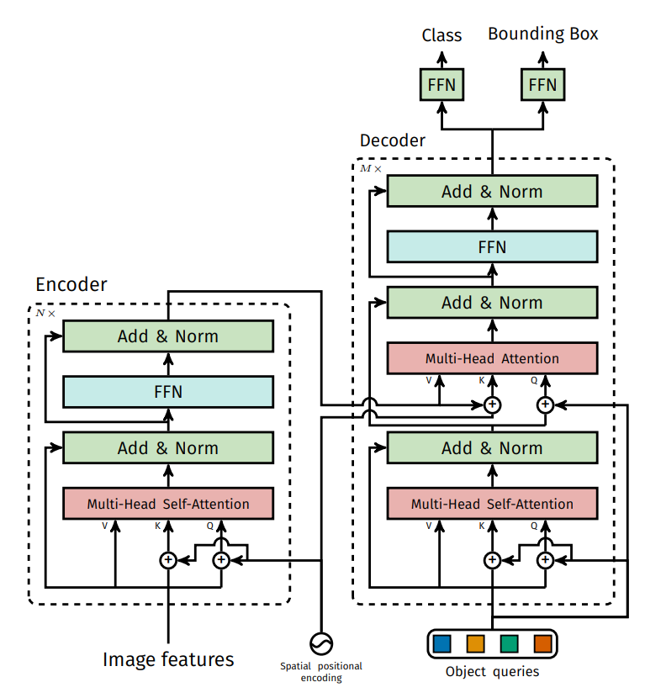
Detection Transformer based RoI extraction for NG-OCC ​
Detection Transformer (DETR) is a neural network architecture designed for object detection tasks. Unlike traditional object detection models that rely on region proposal networks (RPNs) and anchor boxes, DETR utilizes transformer-based architectures. Object detection involves identifying and localizing objects within an image or video. It predicts object classes and bounding boxes simultaneously.
Detection Transformer-based RoI extraction is to accurately detect and decode symbols, patterns, or information encoded within the identified regions of interest. .
Detection Transformer block diagram

Slide 6
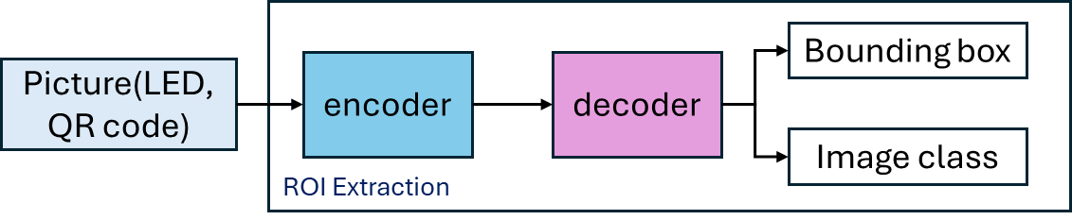
Detection Transformer based RoI extraction for NG-OCC
Detection Transformer based RoI extraction for OCC enhence the capabilities of detection transformer models to identify, localize and accurately extract the regions of interest (RoIs) of relevant objects such as LED transmitters or QR codes within captured images or video frames.
The DETR based RoI extraction system operates in real-time, enabling rapid response and adaptability to dynamic OCC environments. This is particularly important for applications requiring high-speed data transmission and communication.

Slide 7
Conclusion
The Detection Transformer is a promising approach for RoI extraction in OCC systems, capturing complex spatial dependencies and contextual information within input images.
It uses attention mechanisms and end-to-end learning to efficiently identify regions containing LED transmitters or QR codes, even in challenging environments.
This end-to-end optimization allows for joint optimization of feature extraction and object detection, leading to improved performance and reduced computational complexity.
The DETR is versatile and adaptable to different OCC scenarios and applications, training on diverse datasets containing various optical signals like LED transmitters or QR codes. It is also suitable for real-world deployment in various OCC systems.

Slide 8
Reference
Carion, N., Massa, F., Synnaeve, G., Usunier, N., Kirillov, A., & Zagoruyko, S. (2020). End-to-End Object Detection with Transformers. In Lecture notes in computer science (pp. 213–229).
Hu, X., Zhang, P., Sun, Y., Deng, X., Yang, Y., & Chen, L. (2022). High-Speed extraction of regions of interest in optical camera communication enabled by Grid Virtual Division. Sensors, 22(21), 8375.
A. Sturniolo et al., "ROI Assisted Digital Signal Processing for Rolling Shutter Optical Camera Communications," 2018 11th International Symposium on Communication Systems, Networks & Digital Signal Processing (CSNDSP), Budapest, Hungary, 2018, pp. 1-6.
C. H. Nguyen, V. H. Nguyen and Y. M. Jang, "Optical Camera Communication Application using Display Modulation," 2020 International Conference on Artificial Intelligence in Information and Communication (ICAIIC), Fukuoka, Japan, 2020, pp. 729-731.

