Slide 1
IG NG-OCC
Submission Title: Speech-to-Text AI Model for NG-OCC (May 2024)
Date Submitted: May 15, 2024
Source: Le Duy Tuan Anh, Nguyen Ngoc Huy, Yeong Min Jang, Kookmin University
Address: Room #603 Mirae Building, Kookmin University, 77 Jeongneung-Ro, Seongbuk-Gu, Seoul, 136702, Republic of Korea
Voice: +82-2-910-5068 E-Mail: yjang@kookmin.ac.kr
Re:
Abstract: Present the use case Speech-to-Text AI Model for NG-OCC
Purpose: Presentation for contribution on IG NG-OCC
Notice: This document has been prepared to assist the IG NG-OCC. It is offered as a basis for discussion and is not binding on the contributing individual(s) or organization(s). The material in this document is subject to change in form and content after further study. The contributor(s) reserve(s) the right to add, amend or withdraw material contained herein.
Release: The contributor acknowledges and accepts that this contribution becomes the property of IEEE and may be made publicly available by IG NG-OCC.

Slide 2
Speech-to-Text AI Model for
NG-OCC
Contribution
May 15, 2024

Slide 3
Contents
Background
Speech-to-Text (STT) AI model for NG-OCC​
Use case of STT AI model in OCC domain
Conclusion

Slide 4
Background
Speech-to-Text (STT) AI Model: also known as automatic speech recognition (ASR), is the process of converting spoken language into written text. By applying machine learning and natural language processing techniques, the model can analyze and transcribe the audio inputs into text data [1].
The ASR models can process and recognize multi-languages and offer many beneficial applications in the real world such as virtual assistants, transcription services,…
OCC has emerged as a beneficial and safe technology aiming to replace the RF technique in particular applications [2].
In the context of NG-OCC, combining these two technologies can make the OCC system more applicable and commercial in practice.

Slide 5
Speech-to-Text (STT) AI model for NG-OCC
The function of STT AI model is to convert spoken language into written text accurately and efficiently, enabling a wide range of applications and services [3].
The text data can be encoded by modulation techniques and then transmitted through optical channel by light source.
On the receiver side, the camera will capture the images of light source and extract the data by using decoder algorithms. The data from the transmitter side can be received and served for specific applications.

Slide 6
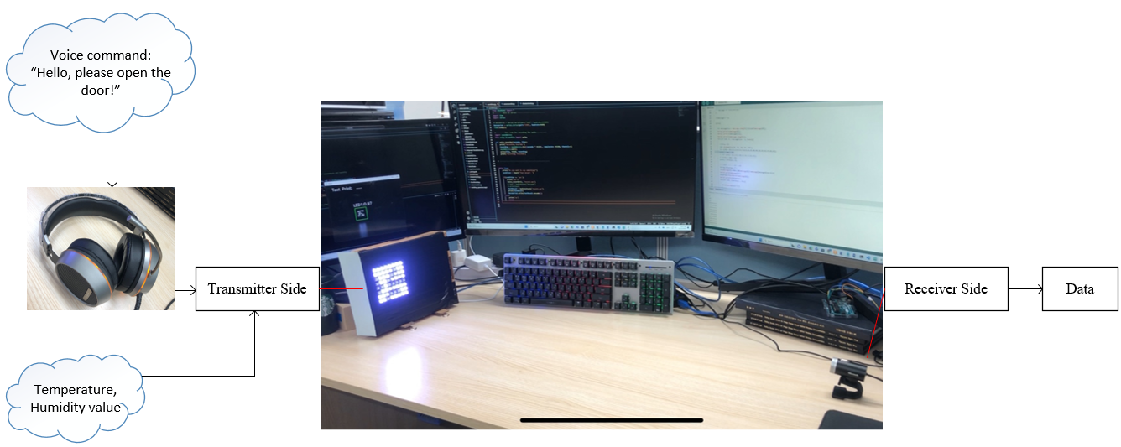
Use case of STT AI Model in OCC domain
In the domain of robotics, STT AI model and OCC technologies can enable advanced functionalities and improve human-robot interaction in non-facing communication.
In some specific applications such as chemical environment, hospital... The voice commands from humans (nurses, chemical engineers…) can be transmitted through the LED and the camera inside the robot can receive these commands from the people.

Slide 7
Conclusion
Speech-to-Text AI models for NG-OCC hold significant potential for advancing human-robot interaction, enabling efficient information exchange, and facilitating real-time interaction and response capabilities.
Applying ASR models in the OCC domain can increase the ability to commercialize OCC technology.
In some particular cases, OCC systems integrated STT AI models offer more safety and beneficial than deploying RF systems.

Slide 8
Reference
Bhardwaj, V.; Ben Othman, M.T.; Kukreja, V.; Belkhier, Y.; Bajaj, M.; Goud, B.S.; Rehman, A.U.; Shafiq, M.; Hamam, H. Automatic Speech Recognition (ASR) Systems for Children: A Systematic Literature Review. Appl. Sci. 2022, 12, 4419. https://doi.org/10.3390/app12094419
Le, Duy Tuan Anh, Huy Nguyen, and Yeong Min Jang. 2024. "An Experimental Demonstration of 2D-Multiple-Input-Multiple-Output-Based Deep Learning for Optical Camera Communication" Applied Sciences 14, no. 3: 1003. https://doi.org/10.3390/app14031003
Karpagavalli, S.; Evania Haris Chandra. “A Review on Automatic Speech Recognition Architecture and Approaches” April 2016, 9(4):393-404. DOI: 10.14257/ijsip.2016.9.4.34

